Slide 1

Hands-on Privacy Tools
Hysun Chung (hysun@hysun.com)
LinkedIn: https://linkedin.com/in/hysun-c
X/Twitter: @azmaveth
Blog: https://azmaveth.com

Slide 2
Today’s Topics
Introduction
  Importance of smartphone privacy and security
  Overview of potential risks
Commonly used tools
  Private Web Browsers
  Private Email
  Private Instant Messaging
  Password Manager
  Virtual Private Networks (VPNs)
Where to find good tools
  Privacy Tools Website
    https://privacytools.io
Installation and use
  Brave Browser
  Proton Mail
  Signal Messenger
  Bitwarden / Proton Pass
  Proton VPN

Slide 3

Importance of Smartphone Privacy and Security
Your smartphone: A treasure trove of personal information
Privacy and security: Key to protecting your digital life
Notes:
Emphasize how central smartphones have become in our daily lives:
We use them for communication, banking, shopping, health tracking, and more.
They contain our photos, messages, emails, and other personal data.
Explain that this wealth of information makes smartphones attractive targets for cybercriminals and other malicious actors.
Highlight that understanding privacy and security is not just for tech experts:
It's crucial for everyone who uses a smartphone.
Even basic knowledge can significantly improve protection.
Reassure the audience that while the topic might seem complex, you'll be breaking it down into simple, actionable steps.
Briefly mention that over the course of this presentation, they'll learn practical ways to enhance their smartphone's privacy and security.
Encourage questions throughout the presentation, reminding them of the Q&A session at the end.

Slide 4
Potential Risks
Identity theft
Financial fraud
Data breaches
Unauthorized access to personal information
Location tracking
Everyone is a target (Yes, even you!)
Notes:
Explain that understanding potential risks is the first step in protecting oneself.
Briefly describe each risk:
Use relatable examples for each risk, if possible. For instance:
"Imagine someone using your name to apply for a credit card."
"Picture someone being able to read all your private messages to your family."
Address the misconception of "Why would anyone want to hack me?":
Explain that cybercriminals often cast a wide net, targeting many people at once.
Emphasize that they're not typically targeting specific individuals, but rather looking for any vulnerable device or account.
Use an analogy: "It's like a thief checking car doors in a parking lot. They're not after your car specifically, but any car that's unlocked."
Point out that personal information, even if it seems mundane, can be valuable:
Emails and passwords can be used to access other accounts.
Personal details can be used for identity theft or sophisticated phishing attempts.
Devices can be hijacked for use in larger attacks or to mine cryptocurrency.
Stress that everyone's data has value to cybercriminals, regardless of perceived importance or wealth.
Emphasize that while these risks sound scary, the goal isn't to cause alarm but to motivate protection:
"We're not discussing these to frighten you, but to show why the steps we'll learn today are so important."
Reassure the audience that simple precautions can significantly reduce these risks:
"The good news is, with some basic knowledge and practices, you can greatly reduce your vulnerability to these risks."
Preview that the rest of the presentation will cover practical steps to address these risks:
"Throughout this presentation, we'll learn how to protect ourselves from each of these potential threats."
Encourage the audience to think about which of these risks concern them the most, as it can help them focus on the most relevant parts of the presentation for their needs.

Slide 5
Commonly Used Privacy Tools
Private Web Browsers
Private Email
Private Instant Messaging
Password Manager
Virtual Private Networks (VPNs)

Slide 6
Private Web Browser – Brave Browser
Prevents invisible trackers from building a portfolio of your behavior
Notes:
Many web pages include code that sends data in the background without your knowledge or consent. Some of this is required for the page to function, but some is simply tracking data that tells the website owner how long you spent on a page, where your mouse hovered and for how long, etc. They often use invisible images on the page that have code attached to those images. The code is run when you click or move your mouse over the invisible image.

Slide 7
Private Email – Proton Mail
Prevents invisible trackers from building a portfolio of your behavior
End-to-end encryption
Doesn’t use email content for marketing
Cannot or does not provide account access to third parties (both commercial and government)
Referral link: https://pr.tn/ref/YJS1HGKJNYD0
Notes:
Email that is rendered as HTML (has images and clickable links in the email) has the same vulnerabilities as web pages. Invisible trackers can tell if you opened an email, hovered over images, clicked on links, or simply deleted it.
End-to-end encryption means the message is encrypted before it leaves your device and can only be decrypted by the recipient. This means that even the hosting provider cannot access the contents of your messages, only the metadata (time sent, destination account, etc).
Gmail’s terms of use allow them to snoop into your private emails for “marketing” purposes.
Depending on the location of the application servers, there may be differing laws regarding account access by regulators and law enforcement.
Advanced usage – register your own domain name & have unlimited email aliases for life! This will also let you keep the same email address forever, even if you change services later.

Slide 8
Private Instant Messaging – Signal
End-to-end encryption
Cannot or does not provide account access to third parties (both commercial and government)
Preferably has a unique identifier that is not tied to other personal information (such as phone number, email address, etc)
Notes:
It is best for privacy to disassociate all of your accounts from the others. This is the opposite agenda of advertisers and government agencies. They want to build portfolios on you instead, which requires them to associate all of your accounts together.

Slide 9
Password Manager – Bitwarden or Proton Pass
Helps you create unique passwords for each app/website
Only need to remember a single password even though you may use hundreds of sites
Strong encryption and key management to prevent third party access
Referral link: https://pr.tn/ref/YJS1HGKJNYD0

Slide 10
Virtual Private Network (VPN) – Proton VPN
Often considered the #1 priority for internet privacy and safety, but marketing has encouraged a lot of misunderstanding about what VPNs actually do
Referral link: https://pr.tn/ref/YJS1HGKJNYD0
Notes:
VPNs are often misunderstood. They protect the privacy your IP address, which is generally a temporarily assigned number anyway. Tracking by IP address is useful, but outdated. There are many better identifiers to use instead, and they are not subverted by the use of a VPN.
VPNs that say they block trackers are using a filter to block things like the invisible trackers mentioned before. But that is not the primary function of a VPN, as you can prevent those trackers using other tools like a privacy enhanced browser.

Slide 11
Where to Find Other Good Tools
Privacy Tools Website – https://privacytools.io
Many other good options
My picks are based on personal preference
Proton Suite provides a good all-in-one platform
  Free version includes email, calendar, cloud storage, VPN, and password manager

Slide 12
Questions?

Slide 13
Q&A
Introduction
  Importance of smartphone privacy and security
  Overview of potential risks
Commonly used tools
  Private Web Browsers
  Private Email
  Private Instant Messaging
  Password Manager
  Virtual Private Networks (VPNs)
Where to find good tools
  Privacy Tools Website
    https://privacytools.io
Installation and use
  Brave Browser
  Proton Mail
  Signal Messenger
  Bitwarden / Proton Pass
  Proton VPN

Slide 14
Resources
Youtube
  https://www.youtube.com/@NaomiBrockwellTV
  https://www.youtube.com/@AllThingsSecured
Blogs/News
  https://www.privacytools.io/guides/category/smartphones
  NSA's Mobile Device Best Practices

Slide 15
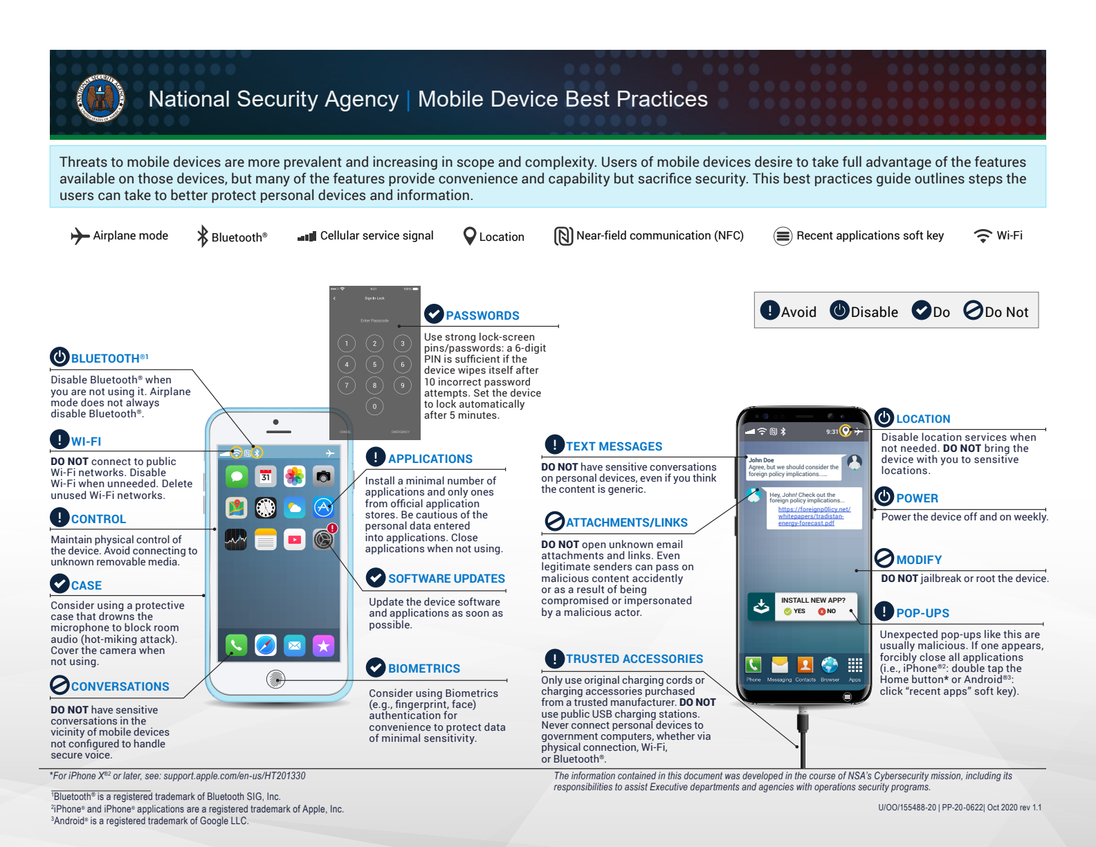
Mobile Device Best Practices from the NSA

Slide 16
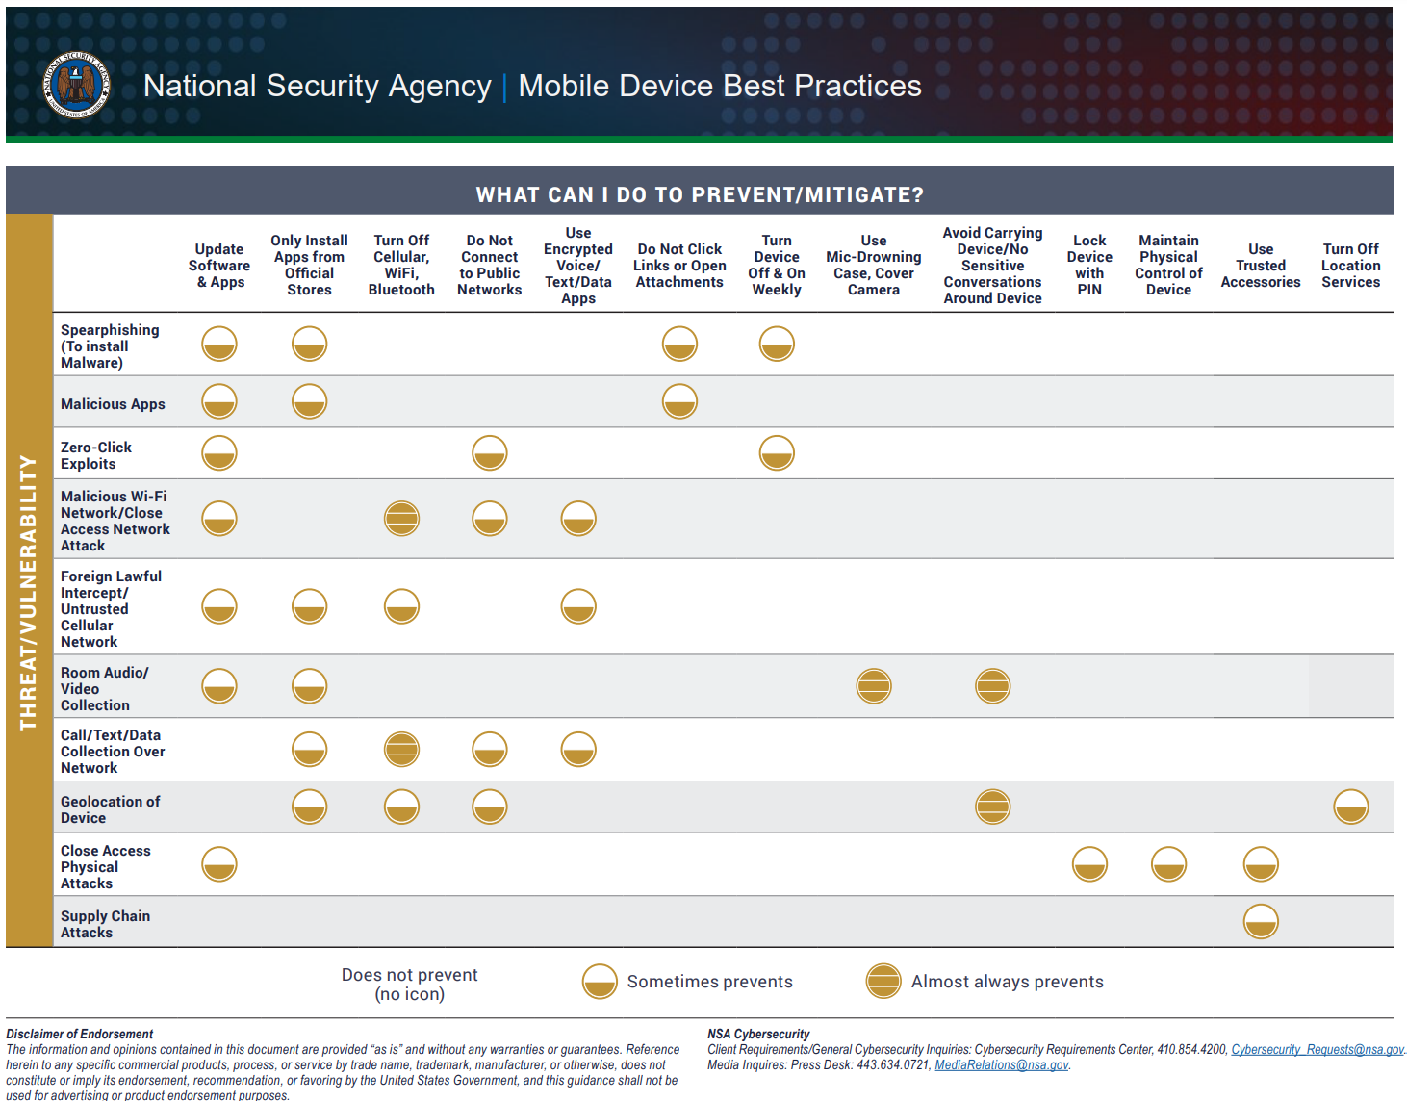
Mobile Device Best Practices from the NSA

