Slide 1

Everyday Cybersecurity
Hysun Chung (hysun@hysun.com)
LinkedIn: https://linkedin.com/in/hysun-c
X/Twitter: @azmaveth
Blog: https://azmaveth.com

Slide 2
Today’s Topics
Introduction
  Importance of smartphone privacy and security
  Overview of potential risks
Basic Security Measures
  Strong passwords and PINs
  Biometric security
  Keeping software and apps updated
  Device encryption
  Physical device security
Data Privacy
  Understanding app permissions
  Managing location services
  Controlling ad tracking
  Privacy settings on social media apps
  Safe browsing practices

Slide 3

Importance of Smartphone Privacy and Security
Your smartphone: A treasure trove of personal information
Privacy and security: Key to protecting your digital life
Notes:
Emphasize how central smartphones have become in our daily lives:
We use them for communication, banking, shopping, health tracking, and more.
They contain our photos, messages, emails, and other personal data.
Explain that this wealth of information makes smartphones attractive targets for cybercriminals and other malicious actors.
Highlight that understanding privacy and security is not just for tech experts:
It's crucial for everyone who uses a smartphone.
Even basic knowledge can significantly improve protection.
Reassure the audience that while the topic might seem complex, you'll be breaking it down into simple, actionable steps.
Briefly mention that over the course of this presentation, they'll learn practical ways to enhance their smartphone's privacy and security.
Encourage questions throughout the presentation, reminding them of the Q&A session at the end.

Slide 4
Potential Risks
Identity theft
Financial fraud
Data breaches
Unauthorized access to personal information
Location tracking
Malware and viruses
Everyone is a target (Yes, even you!)
Notes:
Explain that understanding potential risks is the first step in protecting oneself.
Briefly describe each risk:
Use relatable examples for each risk, if possible. For instance:
"Imagine someone using your name to apply for a credit card."
"Picture someone being able to read all your private messages to your family."
Address the misconception of "Why would anyone want to hack me?":
Explain that cybercriminals often cast a wide net, targeting many people at once.
Emphasize that they're not typically targeting specific individuals, but rather looking for any vulnerable device or account.
Use an analogy: "It's like a thief checking car doors in a parking lot. They're not after your car specifically, but any car that's unlocked."
Point out that personal information, even if it seems mundane, can be valuable:
Emails and passwords can be used to access other accounts.
Personal details can be used for identity theft or sophisticated phishing attempts.
Devices can be hijacked for use in larger attacks or to mine cryptocurrency.
Stress that everyone's data has value to cybercriminals, regardless of perceived importance or wealth.
Emphasize that while these risks sound scary, the goal isn't to cause alarm but to motivate protection:
"We're not discussing these to frighten you, but to show why the steps we'll learn today are so important."
Reassure the audience that simple precautions can significantly reduce these risks:
"The good news is, with some basic knowledge and practices, you can greatly reduce your vulnerability to these risks."
Preview that the rest of the presentation will cover practical steps to address these risks:
"Throughout this presentation, we'll learn how to protect ourselves from each of these potential threats."
Encourage the audience to think about which of these risks concern them the most, as it can help them focus on the most relevant parts of the presentation for their needs.

Slide 5

Basic Security Measures
Strong passwords and PINs
Biometric security (fingerprint, face recognition)
Keeping software and apps updated
Device encryption
Physical device security
Notes:
Introduce this section as the foundation of smartphone security:
"These are the building blocks that will help protect your device from many common threats."
Briefly explain each point: a) Strong passwords and PINs:
First line of defense against unauthorized access
Will demonstrate how to create and set a strong PIN
b) Biometric security:
Convenient and secure way to unlock your device
Options typically include fingerprint or face recognition
c) Software and app updates:
Critical for patching security vulnerabilities
Also improve performance and add new features
d) Device encryption:
Protects data if your device is lost or stolen
Makes it extremely difficult for others to access your information
e) Physical device security:
Simple yet crucial aspect often overlooked
Includes being aware of your device's location and using "Find My Device" features
Emphasize the importance of implementing all these measures:
"Think of these as layers of security. Each one adds protection, making it harder for anyone to access your personal information."
Preview that you'll go through each of these in more detail:
"We'll now look at each of these measures one by one, and I'll show you exactly how to implement them on your own devices."
Encourage questions as you go through each measure:
"Please feel free to ask questions at any point. It's important that you understand how to use these security features."

Slide 6

Strong Passwords & PINs
Use at least 6 digits for PINs (more is better)
Avoid obvious numbers (birthdays, address, etc.)
For passwords, use a mix of:
  Upper and lowercase letters
  Numbers
  Special characters
Avoid using the same password across multiple accounts
Consider using a password manager
Demonstration: Setting up a strong password
Notes:
Explain the importance of strong passwords and PINs:
"This is your first line of defense against unauthorized access to your device."
"A weak password or PIN is like leaving your front door unlocked."
Discuss PINs:
Recommend using at least 6 digits, explaining that more digits make it harder to guess.
Warn against using obvious numbers: "Avoid using your birthday, address, or simple patterns like 123456."
Suggest using a random number if possible: "Think of a number that's meaningful to you but not obvious to others."
Talk about passwords:
Explain the benefit of mixing different types of characters.
Give an example of a strong password (but advise not to use this exact one).
Tip: "Think of a phrase and use the first letter of each word, adding numbers and symbols."
Address password reuse:
"Using the same password everywhere is like using the same key for your house, car, and office. If one gets compromised, they all do."
Introduce the concept of password managers:
"These are tools that can generate and store strong, unique passwords for all your accounts."
"You only need to remember one master password."
Mention that you'll provide some recommendations for password managers later.
Demonstration:
Show how to change the PIN on a smartphone (consider demonstrating on both Android and iPhone if possible).
Walk through the steps slowly, encouraging audience members to follow along on their own devices.
Practical tip:
"If you're worried about forgetting your new PIN, write it down initially but keep it in a secure place at home, separate from your phone. Once you've memorized it, destroy the written copy."
Encourage questions:
"Are there any questions about creating strong PINs or passwords? Remember, this is a crucial step in protecting your device."

Slide 7

Biometric Security
What is biometric security?
  Fingerprint recognition
  Face recognition
Benefits:
  Convenient and quick
  Generally more secure than short PINs
  Difficult to replicate or guess
Considerations:
  Not foolproof - can sometimes be tricked
  May still need a backup PIN or password
Demonstration: Setting up fingerprint or face recognition
Notes:
Introduce the concept of biometric security:
"Biometric security uses unique physical characteristics, like your fingerprint or face, to unlock your device."
Explain the two main types:
Fingerprint recognition: "This scans the unique patterns of your fingerprint."
Face recognition: "This analyzes the unique features of your face."
Discuss the benefits:
Convenience: "No need to remember a PIN or password - it's always with you."
Security: "Generally more secure than a 4-digit PIN as it's much harder to guess or replicate."
Speed: "Usually faster than typing in a password or PIN."
Address potential concerns:
"While very secure, no system is perfect. In rare cases, these can be tricked by high-quality photos or fingerprint replicas."
"That's why it's still important to have a strong backup PIN or password."
Provide reassurance about privacy:
"Your biometric data is stored securely on your device, not on the internet or in the cloud."
"Apps can't access your full fingerprint or face data, only whether the unlock was successful or not."
Demonstration:
Show how to set up fingerprint or face recognition (consider demonstrating on both Android and iPhone if possible).
Walk through the process slowly, encouraging audience members to follow along if they're comfortable.
Practical tips:
"For fingerprint recognition, it's good to register multiple fingers in case you injure one."
"For face recognition, you might need to set it up again if you significantly change your appearance, like growing a beard or starting to wear glasses."
Addressing comfort levels:
"If you're not comfortable with biometric security, that's okay. A strong PIN or password is still a good security measure."
Encourage questions:
"What are your thoughts on biometric security? Do you have any concerns or questions about using it?"

Slide 8

Keeping Software and Apps Updated
Why updates are important:
  Fix security vulnerabilities
  Improve performance
  Add new features
What to keep updated:
  Operating system (iOS/Android)
  Individual apps
How to update:
  Enable automatic updates
  Check for updates manually
Demonstration: Checking for and installing updates
Notes:
Introduce the importance of updates:
"Keeping your software up-to-date is like maintaining the locks on your house. It helps keep the bad guys out."
Explain why updates are crucial:
Security: "Updates often fix security holes that hackers could exploit."
Performance: "They can make your device run faster and more smoothly."
Features: "You might get new useful features or improvements to existing ones."
Discuss what needs updating:
Operating system: "This is the main software that runs your phone. For iPhones, it's iOS, and for many other smartphones, it's Android."
Apps: "These are the individual programs you use, like your web browser, email, or games."
Explain how to update:
Automatic updates: "You can set your phone to update automatically. This is the easiest way to stay protected."
Manual updates: "You can also check for updates yourself and choose when to install them."
Address common concerns:
Storage space: "Updates might take up space, but they're crucial for security. If space is an issue, we can discuss managing your storage later."
Data usage: "Set your phone to only download updates over Wi-Fi if you're worried about data costs."
Demonstration:
Show how to check for system updates on both Android and iPhone.
Demonstrate how to update an app from the app store.
Show how to enable automatic updates.
Best practices:
"Try to install updates soon after they're available."
"It's best to update when you're connected to Wi-Fi and your phone is charging."
"Don't interrupt an update once it's started - let it complete."
Practical tip:
"If you're not sure about an update, it's okay to wait a day or two and see if others report any issues. But don't wait too long, as updates often contain important security fixes."
Encourage questions:
"Do you have any questions about updates? Have you had any experiences, good or bad, with updating your phone or apps?"

Slide 9

Device Encryption
What is device encryption?
  Scrambles data to make it unreadable without the key
Why is it important?
  Protects your data if your phone is lost or stolen
  Prevents unauthorized access to your information
How it works:
  Encrypts all data on your device
  Decrypts data when you unlock your phone
Enabling encryption:
  Often on by default in newer phones
  Can be turned on in settings for older devices
Demonstration: Checking encryption status and enabling it if necessary
Notes:
Introduce the concept of device encryption:
"Device encryption is like having a secret code that scrambles all the information on your phone."
Explain encryption in simple terms:
"Imagine your phone's data is a book. Encryption turns all the words into a secret code. Without the key (your password or PIN), the book is just gibberish."
Emphasize its importance:
"If your phone is lost or stolen, encryption makes it extremely difficult for someone else to read your personal information, photos, or messages."
Describe how it works:
"When you turn on your phone and enter your password, it decrypts (or decodes) your data so you can use it normally."
"When your phone is off or locked, all the data remains encrypted and protected."
Discuss availability:
"Many newer smartphones are encrypted by default. But it's good to check and make sure."
"On some older phones, you might need to turn it on yourself."
Address potential concerns:
Performance: "Modern phones handle encryption well, so you likely won't notice any slowdown."
Battery life: "The impact on battery life is minimal on most devices."
Demonstration:
Show how to check if a device is already encrypted (demonstrate on both Android and iPhone if possible).
If not encrypted, show how to enable encryption.
Warn about the time it might take to encrypt a device and the importance of having the device plugged in during the process.
Important notes:
"Once you encrypt your device, you'll need to use a PIN, password, or biometric method to unlock it. This is for your protection."
"If you forget your PIN or password after encrypting, it can be very difficult or impossible to recover your data. So make sure you remember it!"
Practical tip:
"Write down your PIN or password and keep it in a secure place at home, separate from your phone, at least until you're comfortable you won't forget it."
Encourage questions:
"What are your thoughts on device encryption? Do you have any concerns or questions about using it?"

Slide 10

Physical Device Security
Keep your device with you or in a secure location
Be aware of your surroundings when using your phone in public
Don't leave your phone unattended, even briefly
Use "Find My Device" features
Back up your data regularly
Demonstration: Setting up "Find My Device"
Notes:
Introduce the concept of physical security:
"While we've talked a lot about digital security, physical security of your device is equally important."
"The best software security can't protect your phone if someone can physically access it."
Discuss keeping the device secure:
"Always know where your phone is. It's easy to set it down and forget about it."
"Be especially careful in public places like cafes, libraries, or on public transport."
Talk about awareness in public:
"When using your phone in public, be aware of your surroundings."
"Be cautious of 'shoulder surfing' - people looking over your shoulder to see your screen."
Emphasize the risks of leaving the phone unattended:
"Even if you're just stepping away for a moment, take your phone with you or leave it with someone you trust."
"It only takes seconds for someone to access your device or install malicious software."
Introduce "Find My Device" features:
"Both iPhones and Android phones have features to help you find your device if it's lost."
"These features can also let you remotely lock or erase your phone if it's stolen."
Stress the importance of regular backups:
"Regularly backing up your data means you won't lose everything if your phone is lost or stolen."
"Many phones can be set to back up automatically to the cloud."
Demonstration:
Show how to set up "Find My Device" on both Android and iPhone.
Briefly demonstrate how to use it to locate a device.
Practical tips:
"Consider using a secure phone case or grip to prevent accidental drops."
"Add emergency contact information to your lock screen. This can help if someone finds your lost phone."
What to do if your phone is lost or stolen:
"Use another device to activate 'Find My Device' features immediately."
"Change passwords for any accounts you access on your phone, especially email and banking."
"Report the theft to local authorities and your mobile carrier."
Encourage questions and sharing:
"Have any of you ever lost a phone or had one stolen? What did you do?"
"Do you have any other tips for keeping your phone physically secure?"

Slide 11

Data Privacy
Key topics we'll cover:
  Understanding app permissions
  Managing location services
  Controlling ad tracking
  Privacy settings on social media apps
  Safe browsing practices
Why it matters:
  Protect your personal information
  Control who sees your data
  Prevent unwanted tracking
Notes:
Introduce the concept of data privacy:
"Data privacy is about controlling who has access to your personal information and how it's used."
"In the digital age, our smartphones contain a wealth of personal data. It's important to understand how to protect it."
Briefly explain why data privacy matters:
"Your personal information is valuable, not just to you, but to companies and potentially to cybercriminals."
"By managing your data privacy, you can reduce the risk of identity theft, unwanted advertising, and other privacy intrusions."
Overview of the topics:
App permissions: "We'll look at how to control what information apps can access on your phone."
Location services: "You'll learn how to manage when and which apps can track your location."
Ad tracking: "We'll discuss how to limit the data advertisers collect about you."
Social media privacy: "We'll cover some key privacy settings for social media apps."
Safe browsing: "You'll learn some practices to protect your privacy while using the internet."
Emphasize the balance between convenience and privacy:
"Often, sharing some data can make apps more useful. But it's important to make informed decisions about what you share."
"We'll help you understand how to strike a balance that you're comfortable with."
Encourage a proactive approach:
"Taking control of your data privacy might seem daunting, but we'll break it down into simple, manageable steps."
"Remember, it's your data. You have the right to decide how it's used and shared."
Preview the hands-on nature of this section:
"We'll be looking at specific settings on your phones, so feel free to follow along as we go through each topic."
Encourage questions:
"As we go through this section, please don't hesitate to ask questions. Understanding your data privacy is crucial in today's digital world."

Slide 12

Understanding App Permissions
What are app permissions?
  Requests to access specific features or data on your phone
Common types of permissions:
  Camera
  Microphone
  Location
  Contacts
  Storage
Why permissions matter:
  Control what information apps can access
  Protect your privacy and security
Demonstration: Reviewing and adjusting app permissions
Notes:
Introduce the concept of app permissions:
"App permissions are like keys that allow apps to access different parts of your phone or different types of information."
"When you install or use an app, it might ask for permission to use certain features of your phone or access certain data."
Explain common types of permissions:
Camera: "An app might need this to take photos or scan QR codes."
Microphone: "Needed for voice calls or voice commands."
Location: "For maps, weather apps, or location-based services."
Contacts: "Social media or messaging apps might request this."
Storage: "To save files or access photos you've taken."
Discuss why permissions matter:
"Permissions help you control what information apps can access. This protects your privacy and security."
"Some apps might request more permissions than they really need. It's okay to say no if you're not comfortable."
Explain how permissions work:
"On newer phones, you're usually asked for permission when the app first tries to use a feature."
"You can choose to allow it once, allow it while using the app, or deny it."
"You can also change these settings later in your phone's settings."
Demonstration:
Show how to review app permissions in settings (demonstrate on both Android and iPhone if possible).
Show how to change permissions for a specific app.
Best practices:
"Only grant permissions that make sense for the app's function."
"Periodically review your app permissions and revoke any that are no longer needed."
"If an app you don't use often has lots of permissions, consider uninstalling it."
Address common concerns:
"If you deny a permission, the app might not work properly. But you can always grant the permission later if you need to."
"Reputable apps from official app stores are generally safe, but it's still good to be cautious with permissions."
Practical tip:
"When installing a new app, take a moment to think about what permissions it's requesting and why it might need them."
Encourage questions:
"Are there any apps you're unsure about in terms of what permissions they should have?"
"Have you ever been surprised by the permissions an app requested?"

Slide 13
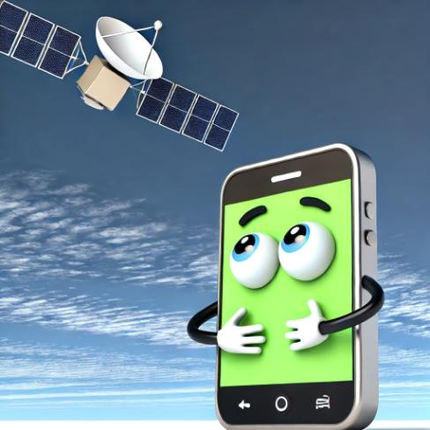
Managing Location Services
What are location services?
  Features that use your phone's location
Benefits of location services:
  Navigation and maps
  Finding nearby businesses
  Weather updates
Privacy concerns:
  Apps tracking your movements
  Location history being stored
How to manage:
  Control which apps can access your location
  Choose when apps can access location (always, while in use, never)
Demonstration: Adjusting location settings
Notes:
Introduce location services:
"Location services allow your phone and apps to know where you are."
"They use technologies like GPS, Wi-Fi, and cellular networks to determine your location."
Explain the benefits:
"Location services can be very useful. They help with navigation, finding nearby restaurants, or getting local weather updates."
"Some safety features, like emergency services, also rely on location."
Discuss privacy concerns:
"While useful, location services can also raise privacy concerns."
"Some apps might track your location more than necessary, or even when you're not using them."
"Your location history could potentially be used to infer personal information about your habits and routines."
Explain how to manage location services:
"You have control over which apps can access your location and when."
"Options usually include 'Always', 'While Using the App', or 'Never'."
"You can also turn off location services entirely, but this will limit functionality of many apps."
Demonstration:
Show how to access location settings (demonstrate on both Android and iPhone if possible).
Show how to change location permissions for specific apps.
Demonstrate how to view and delete location history (if available on the device).
Best practices:
"Only allow 'Always' access for apps that truly need it, like navigation apps."
"For most apps, 'While Using the App' is a good balance between functionality and privacy."
"Regularly review your location settings and adjust as needed."
Address common questions:
"Turning off location for an app doesn't mean the app stops working entirely. It just can't access your location."
"Even with location services off, your cellular provider can still approximate your location. This is necessary for things like emergency services."
Practical tips:
"If you're concerned about privacy but still want to use location-based apps, consider turning location on only when you need it."
"Be cautious about apps that request location access without an obvious need for it."
Encourage questions and discussion:
"What are your thoughts on location tracking? Are there any apps you're particularly concerned about?"
"Has anyone had an experience where location services were particularly helpful or concerning?"

Slide 14

Controlling Ad Tracking
What is ad tracking?
  Collection of your online activity to show personalized ads
How it works:
  Apps and websites track your behavior
  This data is used to create a profile of your interests
Privacy concerns:
  Extensive data collection about your habits
  Potential for data breaches or misuse
How to limit ad tracking:
  Use built-in phone settings
  Opt out of personalized ads
  Use privacy-focused browsers and search engines
Demonstration: Adjusting ad tracking settings
Notes:
Introduce ad tracking:
"Ad tracking is how companies collect information about your online activities to show you personalized advertisements."
"It's why you might see ads for products you've recently searched for or websites you've visited."
Explain how it works:
"Apps and websites use various methods to track what you do online."
"This information is used to create a profile of your interests and behaviors."
"Advertisers use this profile to show ads they think you're more likely to be interested in."
Discuss privacy concerns:
"While personalized ads can sometimes be helpful, they involve extensive data collection about your habits and preferences."
"There are concerns about how this data might be used or shared, and the potential for breaches or misuse."
Explain how to limit ad tracking:
"Most smartphones have built-in settings to limit ad tracking."
"You can often opt out of personalized ads in your device settings or in individual apps."
"Using privacy-focused browsers and search engines can also help reduce tracking."
Demonstration:
Show how to access ad tracking settings (demonstrate on both Android and iPhone if possible).
Demonstrate how to opt out of personalized ads.
Show how to reset your advertising identifier (if available on the device).
Best practices:
"Regularly review and adjust your ad tracking settings."
"Be cautious about which apps you install, as some may be more aggressive with data collection."
"Consider using ad-blocking apps or browsers with built-in tracking protection."
Address common questions:
"Limiting ad tracking doesn't mean you won't see ads, but they won't be as personalized."
"Some websites or apps might not work properly if you block all tracking, so you may need to find a balance."
Practical tips:
"Pay attention to app permissions related to ad tracking when installing new apps."
"Use 'Incognito' or 'Private' browsing mode when you want to avoid tracking for a particular session."
Encourage questions and discussion:
"Have you noticed personalized ads? How do you feel about them?"
"Are there any particular types of ad tracking that concern you?"

Slide 15
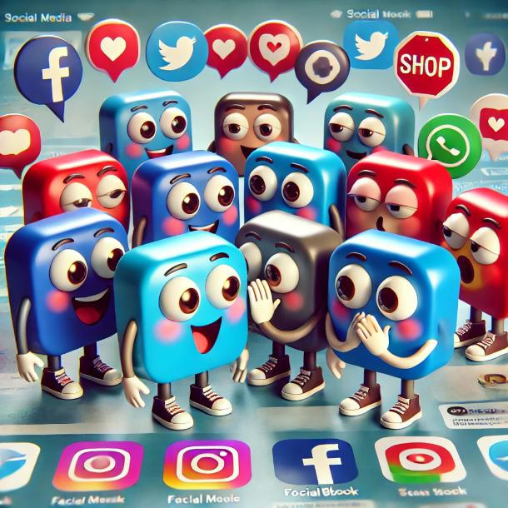
Privacy Settings on Social Media Apps
Why social media privacy matters:
  Control who sees your posts and information
  Protect personal data from misuse
Key privacy settings to review:
  Profile visibility
  Post audience
  Friend/follower approvals
  Data sharing with third-party apps
Common social media platforms:
  Facebook
  Instagram
  Twitter
Demonstration: Adjusting privacy settings on a popular platform
Notes:
Introduce the importance of social media privacy:
"Social media helps us stay connected, but it's important to control who can see our information."
"Good privacy settings help protect your personal data and control your online presence."
Explain key privacy settings:
Profile visibility: "This controls who can see your profile information."
Post audience: "You can choose who sees each post - public, friends only, or custom groups."
Friend/follower approvals: "You can control who can friend or follow you."
Data sharing: "Some apps might share your data. You can often control this in settings."
Discuss common platforms (focus on those most relevant to your audience):
Facebook: "Known for detailed privacy settings. You can control post visibility, friend requests, and more."
Instagram: "You can make your account private, control story visibility, and manage tagged photos."
Twitter: "You can make your tweets private, control who can tag you, and manage direct message settings."
Demonstration:
Choose one platform (e.g., Facebook) and show how to access privacy settings.
Demonstrate how to change key settings like profile visibility and post audience.
Show how to review and adjust third-party app permissions.
Best practices:
"Regularly review your privacy settings, as platforms often update their options."
"Be cautious about what personal information you share, even with privacy settings in place."
"Remember that even with strict settings, information can be screenshot or shared by others."
Address common concerns:
"Using stricter privacy settings doesn't mean you can't enjoy social media. It just gives you more control."
"If you're unsure about a setting, it's usually safer to choose the more private option."
Practical tips:
"Before posting, always check who can see it. Most platforms let you set this for each post."
"Be careful about using social media logins for other websites, as this can share more of your data."
Encourage questions and discussion:
"Which social media platforms do you use most often?"
"Have you ever had concerns about your privacy on social media?"
"Are there any specific settings you'd like help with?"
Reminder:
"Remember, it's okay to take your time with these settings. You can always come back to them later if you're not sure."

Slide 16

Safe Browsing Practices
Use secure websites (look for "https" and padlock icon)
Be cautious with public Wi-Fi
Use private browsing mode when appropriate
Clear browsing data regularly
Be wary of phishing attempts
Keep your browser updated
Demonstration:
  Identifying secure websites
  Enabling private browsing
  Clearing browsing data
Notes:
Introduce safe browsing:
"Safe browsing practices help protect your privacy and security while using the internet on your smartphone."
"These habits can help guard against various online threats, from data theft to malware."
Explain key practices:
Secure websites: "Look for 'https' at the start of the web address and a padlock icon. This means the connection is encrypted."
Public Wi-Fi: "Be cautious when using public Wi-Fi. Avoid accessing sensitive information like bank accounts on these networks."
Private browsing: "This mode, also called 'Incognito', doesn't save your browsing history or cookies."
Clearing data: "Regularly clearing your browsing data can help protect your privacy, especially on shared devices."
Phishing awareness: "Be cautious of emails or messages asking for personal information or urging you to click suspicious links."
Browser updates: "Keep your browser app updated to ensure you have the latest security features."
Demonstration:
Show how to identify a secure website (look for https and padlock icon).
Demonstrate how to enable private browsing mode.
Show how to clear browsing data.
Best practices:
"Use strong, unique passwords for online accounts, especially those accessed through your browser."
"Consider using a password manager to help manage multiple complex passwords."
"Be mindful of what you download. Only get apps from official app stores and be cautious of downloading files from the web."
Address common questions:
"Private browsing doesn't make you completely anonymous online. Your internet service provider can still see your activity."
"Clearing browsing data might sign you out of some websites, so be prepared to log in again."
Practical tips:
"If a website looks suspicious or asks for unnecessary personal information, trust your instincts and leave."
"Consider using privacy-focused search engines like DuckDuckGo for more private searches."
Encourage questions and discussion:
"What concerns do you have about browsing safely on your smartphone?"
"Have you ever encountered a situation where you felt your online safety was at risk?"
Recap the importance:
"Safe browsing is a crucial part of overall smartphone privacy and security."
"These practices might take a little extra time, but they can greatly reduce your risk of privacy breaches or security issues."

Slide 17
Questions?

Slide 18
Q&A
Introduction
  Importance of smartphone privacy and security
  Overview of potential risks
Basic Security Measures
  Strong passwords and PINs
  Biometric security
  Keeping software and apps updated
  Device encryption
  Physical device security
Data Privacy
  Understanding app permissions
  Managing location services
  Controlling ad tracking
  Privacy settings on social media apps
  Safe browsing practices

Slide 19
Resources
Youtube
  https://www.youtube.com/@NaomiBrockwellTV
  https://www.youtube.com/@AllThingsSecured
Blogs/News
  https://www.privacytools.io/guides/category/smartphones
  NSA's Mobile Device Best Practices

Slide 20
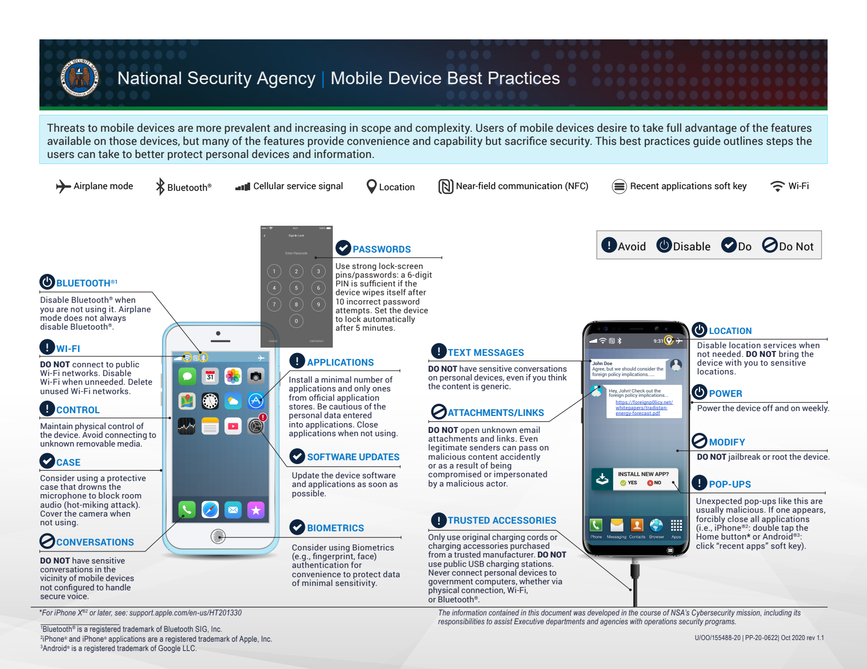
Mobile Device Best Practices from the NSA

Slide 21
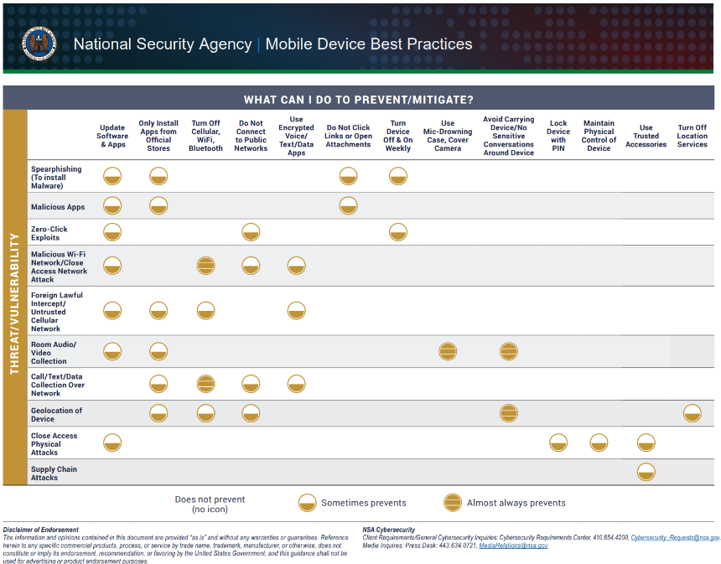
Mobile Device Best Practices from the NSA

