Slide 1


Methods of multivariate analysis for imbalance data problem
Selecting Optimal Sets of Variables
Nikolai Gagunashvili (UNAK and MPIK)
N. Gagunashvili (UNAK & MPIK)

Slide 2
The importance of features (attributes) selection
Reduce the cost of learning by reducing the number of attributes.
Provide better learning performance compared to using full attribute set.
N. Gagunashvili (UNAK & MPIK)

Slide 3
There are two approach for attribute selection.
Filter approach attempt to assess the merits of attributes from the data, ignoring learning algorithm.
Wrapper approach the attributes subset selection is done using the learning algorithm as a black box.
Ron Kohavi, George H. John (1997). Wrappers for feature subset selection. Artificial Intelligence. 97(1-2):273-324.
N. Gagunashvili (UNAK & MPIK)

Slide 4
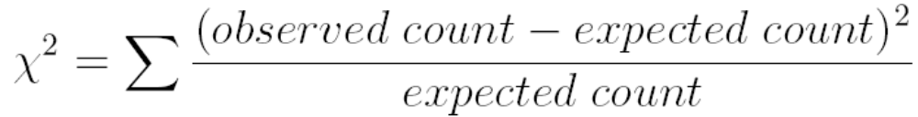
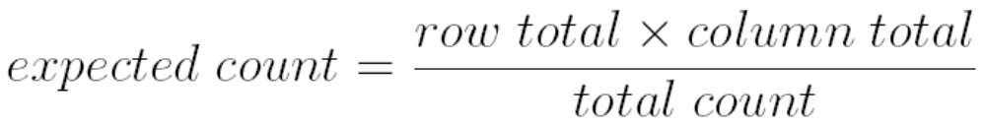

Most simple filter approach is ranking of attributes according value chi-square for two way tables. Two way table for this case is confusion matrix.
the expected count in any cell a two-way table is
Large value better attribute
N. Gagunashvili (UNAK & MPIK)

Slide 5
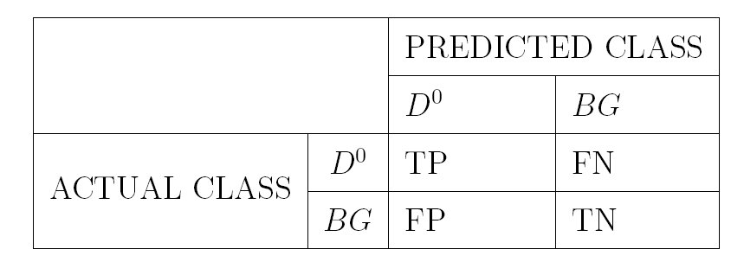
N. Gagunashvili (UNAK & MPIK)

Slide 6

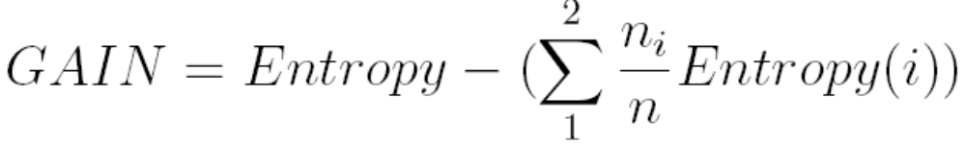
Second example is ranking according entropy gain of attributes. Entropy for given set of data with 2 class can be defined as
After classification that use one attribute we can calculate gain
Larger value of gain better attribute.
Ross Quinlan (1993). C4.5: Programs for Machine Learning. Morgan Kaufmann Publishers, San Mateo, CA
N. Gagunashvili (UNAK & MPIK)

Slide 7
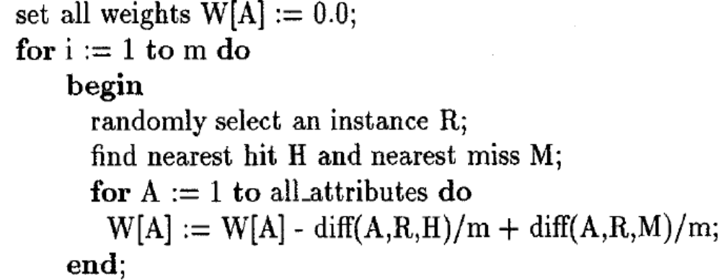
RELIEF algorithm:
nearist hit H is the nearist neighbour the same class as instance R nearist miss M is the nearist neibour different class as instance R
diff (A,R,H) = atrr_value(R) - attr_value(H) diff (A,R,M) = atrr_value(R) - attr_value(M)
Differencis normalized to the interval [0,1], then all weights are in the interval [-1,1].
Kenji Kira, Larry A. Rendell: A Practical Approach to Feature Selection. In: Ninth International Workshop on Machine Learning, 249-256, 1992.
N. Gagunashvili (UNAK & MPIK)

Slide 8
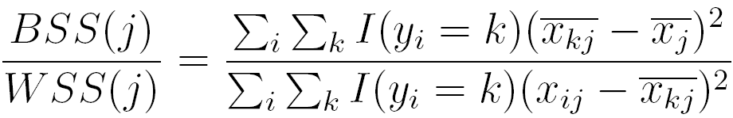
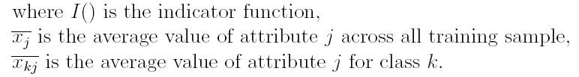
BW-ratio algorithm.
Algoritm used for attribute j heuristic
S. Dudoit, J. Fridlyand and T. P. Speed, Comparison of Discrimination Methods for the Classification of Tumors Using Gene Expression Data, Journal of the American
Statistical Association, 2002, Vol. 97, No. 457, pp. 77-87
N. Gagunashvili (UNAK & MPIK)

Slide 9
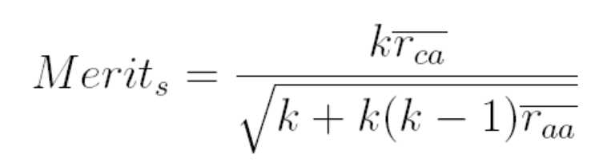
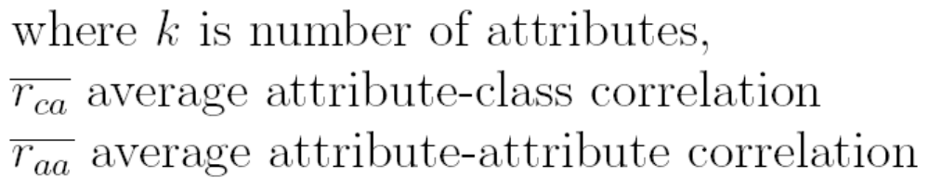
Correlation Based Feature(attribute) Selection
Main idea of CFS algoritm
Good feature subsets contain attributes highly correlated with the class, yet uncorrelated with each other
Heuristic “merit” for subset S formalised this approach
M. A. Hall (1998). Correlation-based Feature Subset Selection for Machine Learning. Hamilton, New Zealand.
N. Gagunashvili (UNAK & MPIK)

Slide 10
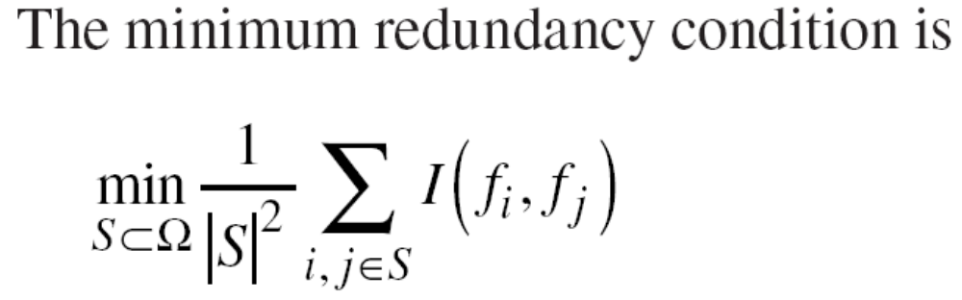
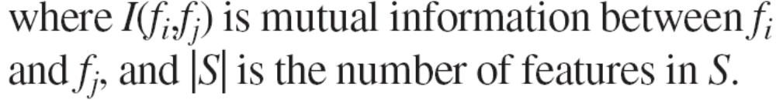
(mRMR) Minimum Redundancy-Maximum Relevance Feature (attribute) Selection
S is the features (attributes) subset that we are seeking and Ω the pool of all candidate features
N. Gagunashvili (UNAK & MPIK)

Slide 11
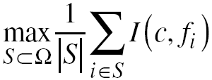
For classes c=(c_{i},....c_{k}) the maximum relevance condition is to maximize the total relevance of all features in S
N. Gagunashvili (UNAK & MPIK)

Slide 12
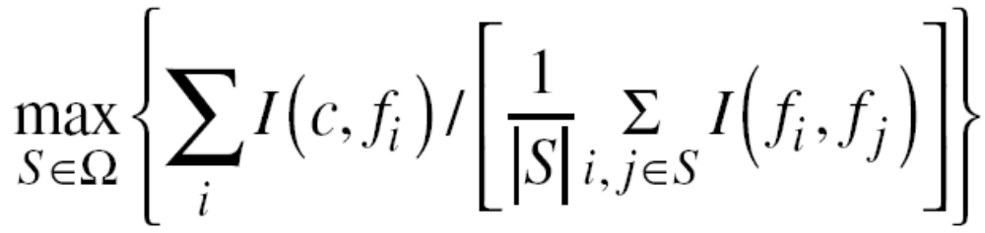
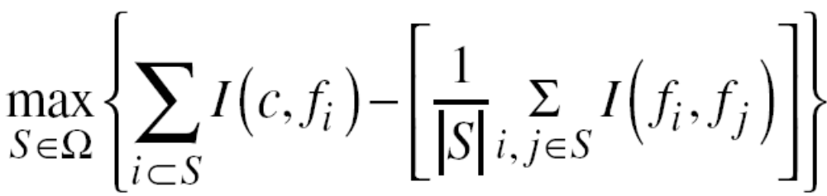
We can obtain the mRMR feature set by optimizing these two conditions simultaneously, either in quatient form
or in difference form
N. Gagunashvili (UNAK & MPIK)

Slide 13
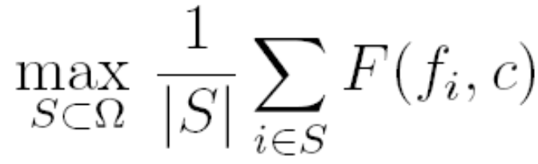
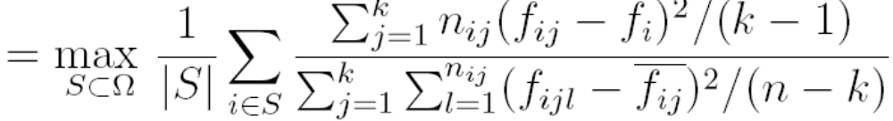
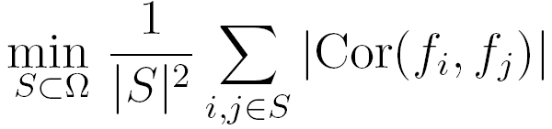
For first part of equation we can calculate
And the second part
H.C. Peng, F.H. Long, and C. Ding, Feature Selection Based on Mutual Information: Criteria of Max-Dependency, Max-Relevance, and Min-Redundancy, IEEE Trans. Pattern Analysis and Machine Intelligence, vol. 27, no. 8, 2005, pp. 1226–1238.
N. Gagunashvili (UNAK & MPIK)

Slide 14
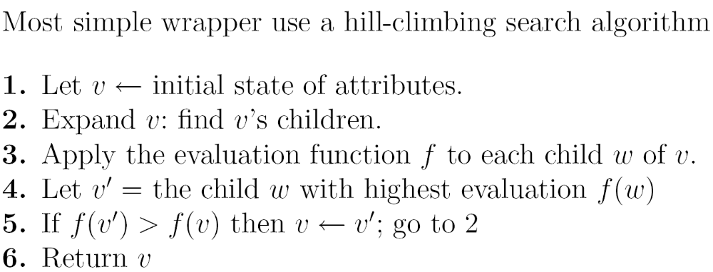
Ron Kohavi, George H. John (1997). Wrappers for feature subset selection. Artificial Intelligence. 97(1-2):273-324.
N. Gagunashvili (UNAK & MPIK)

Slide 15
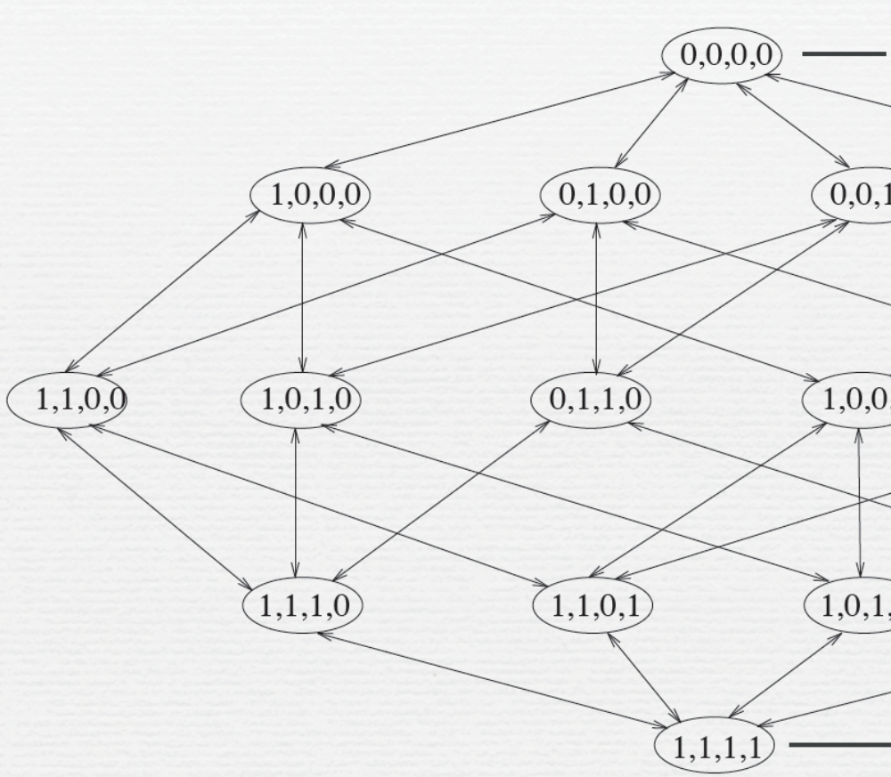
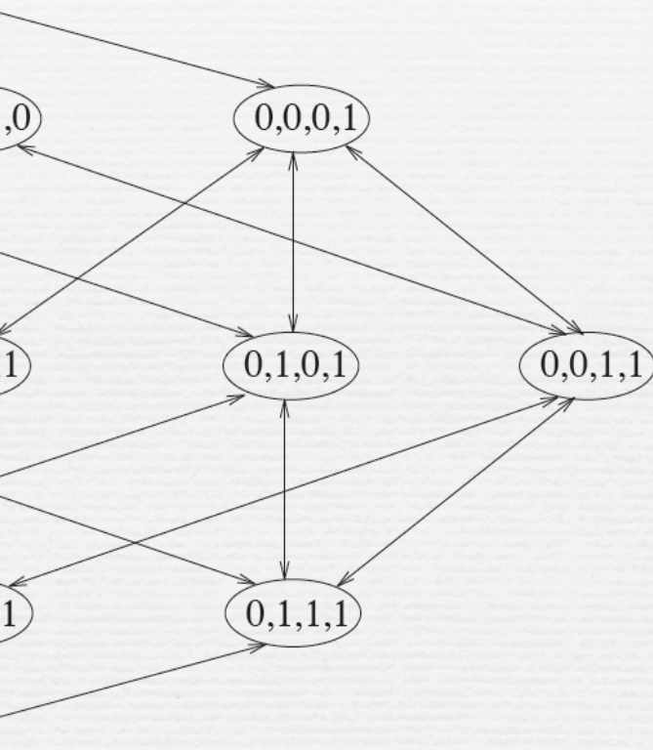
Empty subset of attributes
Full set of attributes
N. Gagunashvili (UNAK & MPIK)

Slide 16
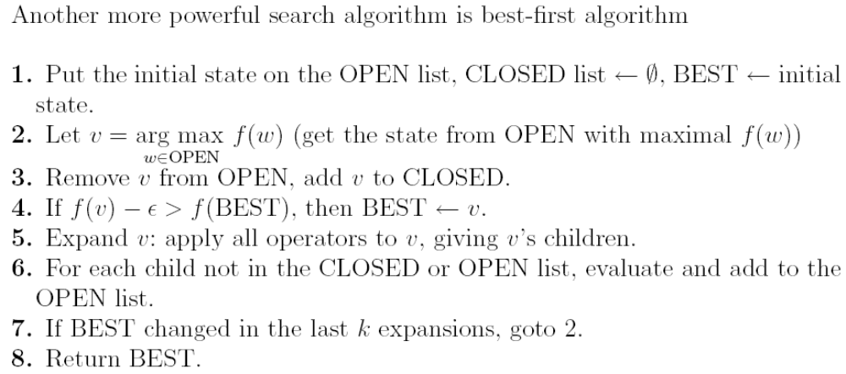
Ron Kohavi, George H. John (1997). Wrappers for feature subset selection. Artificial Intelligence. 97(1-2):273-324.
N. Gagunashvili (UNAK & MPIK)

Slide 17
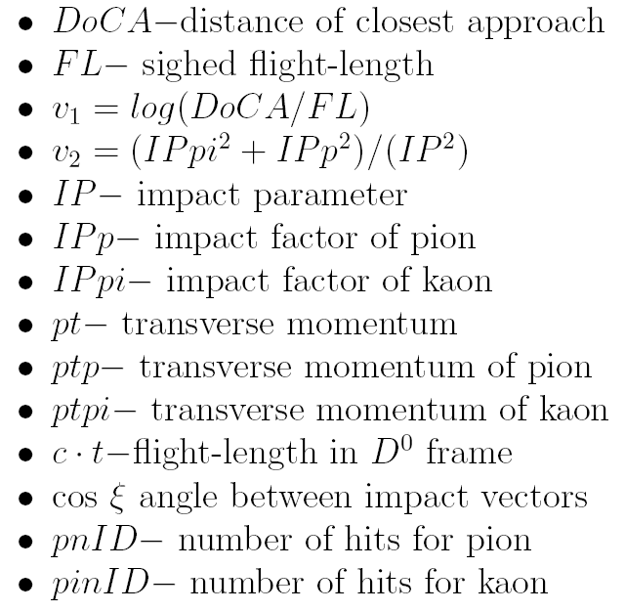
N. Gagunashvili (UNAK & MPIK)

Slide 18
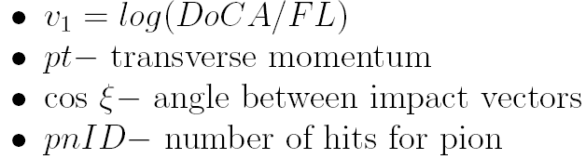
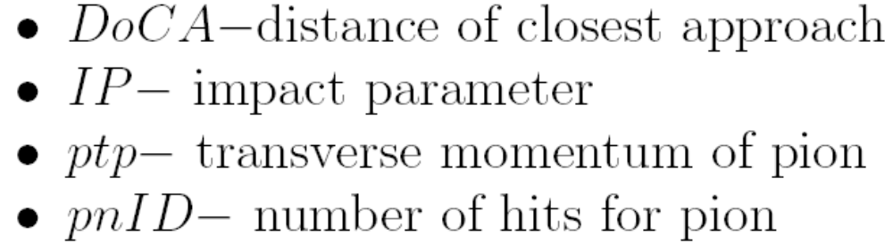
Excluded attributes after wrapper:
Excluded attributes after chi-square and gain ranking approach:
N. Gagunashvili (UNAK & MPIK)

Slide 19
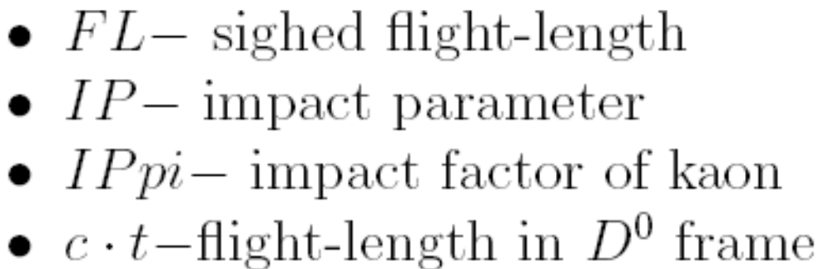
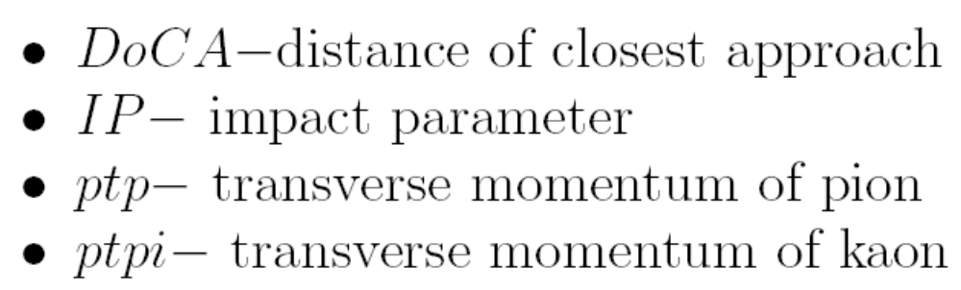
Excluded attributes after RELIEF ranking approach:
Excluded attributes after CFS subset evaluation approach:
N. Gagunashvili (UNAK & MPIK)

Slide 20
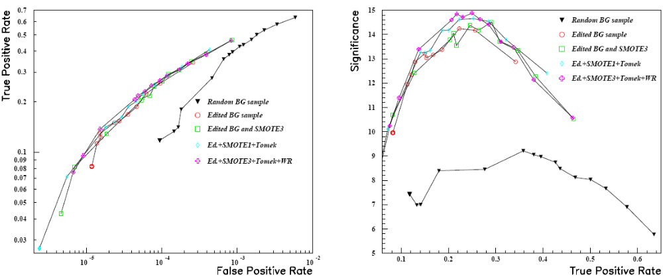
N. Gagunashvili (UNAK & MPIK)

Slide 21
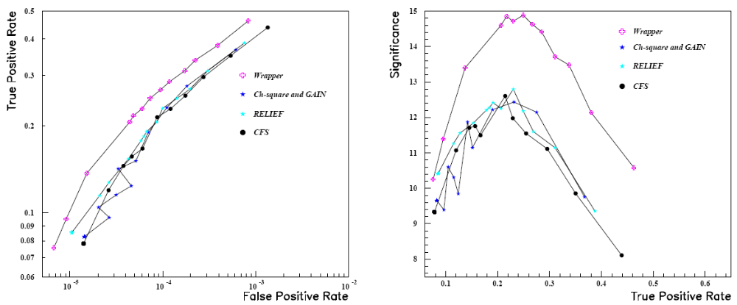
N. Gagunashvili (UNAK & MPIK)

Slide 22
Conclusions
Filter approach very fast and can be used if number of attributes is large.
Wrapper algorithm require extensive computation, but better result can be achived.
N. Gagunashvili (UNAK & MPIK)

Slide 23
Backup slides
N. Gagunashvili (UNAK & MPIK)

Slide 24
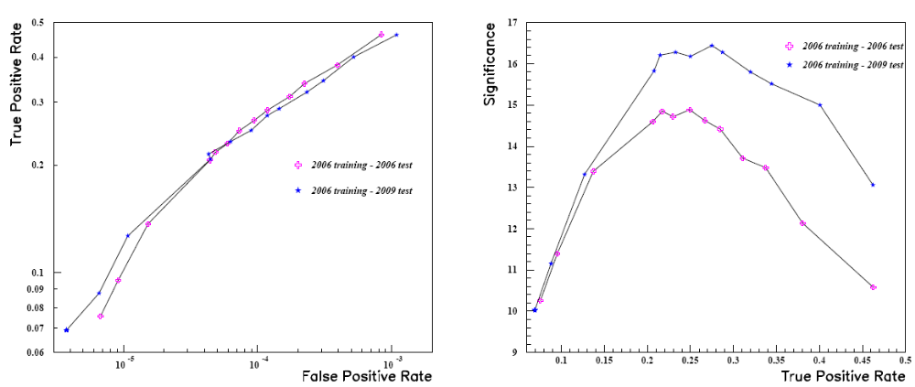
Generalization of algoritm for M-C 2009
N. Gagunashvili (UNAK & MPIK)

