Slide 1
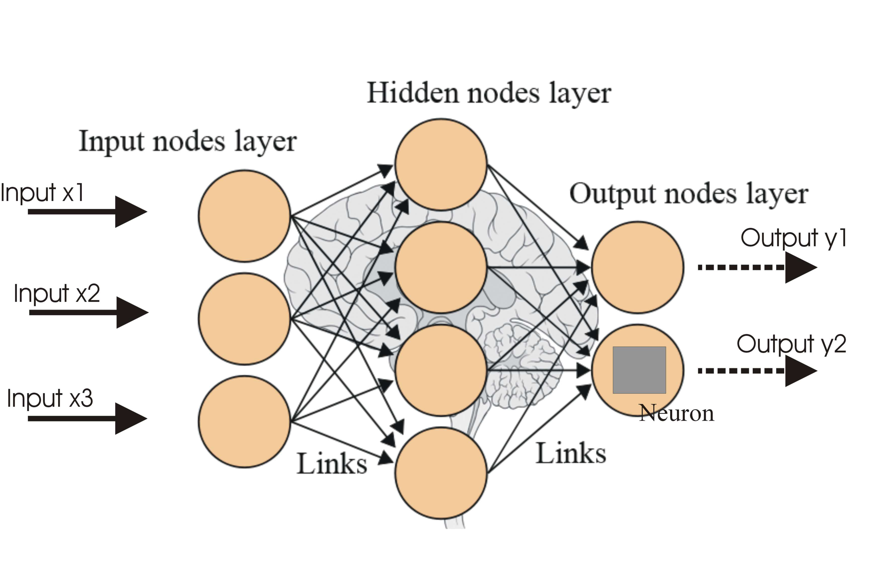
Artificial neural networks (ANNs) are learning models inspired by biological neural networks and used to estimate unknown functions that can depend on a large number of inputs.
What is artificial neural networks?
Multilayer Perceptron (MLP)

Slide 2
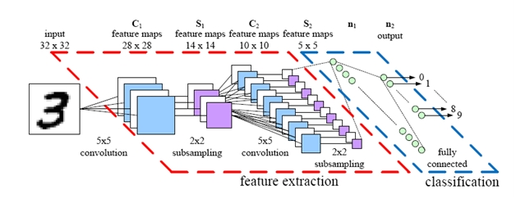
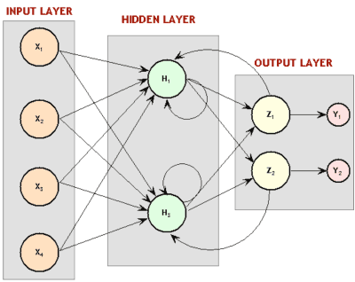
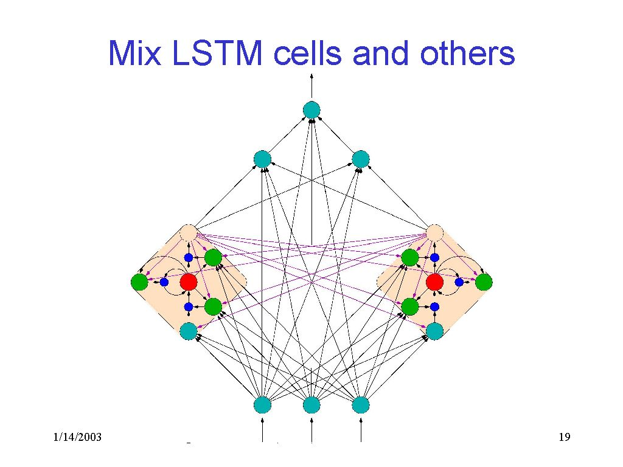
Some Neural Network Types
Convolutional Neural Network (CNN)
Recurrent Neural Network (RNN)
Long-Short Term Memory

Slide 3
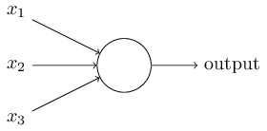

Perceptron
Basic mathematical model
- A way you can think about the perceptron is that it's a device that makes decisions by weighing up evidence.
- You can think of the bias as a measure of how easy it is to get the perceptron to output a 1. Or to put it in more biological terms, the bias is a measure of how easy it is to get the perceptron to fire.

Slide 4
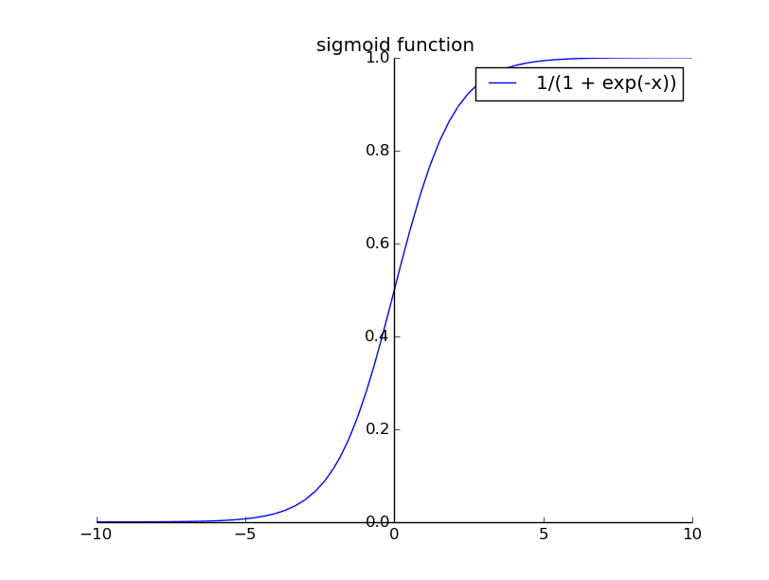

Sigmoid Neuron
Basic mathematical model
- Sigmoid neurons are similar to perceptrons, but modified
so that small changes in their weights and bias cause only a small change in their output.
- So, for instance, 0.735 is a valid input for a sigmoid neuron. Also just like a perceptron, the sigmoid neuron has weights for each input, w1 , w2, . . . and an overall bias, b. But the output is not 0 or 1. Instead, it’s σ(w · x + b), where σ is called the sigmoid function.

Slide 5
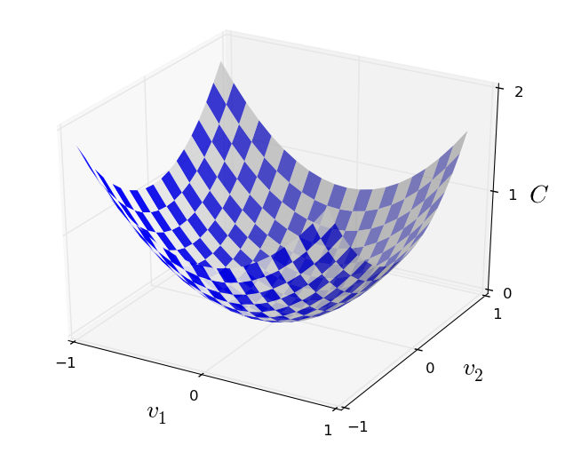



Cost Function
Quadratic Cost Function
Cross Entropy Cost Function
- What we’d like is an algorithm which lets us find weights and biases so that the output from the network approximates y(x) for all training inputs x. To quantify how well we’re achieving this goal we define a cost function.
Log-likelihood Cost Function

Slide 6
Gradient Descent
- The way the gradient descent algorithm works is to repeatedly
compute the gradient ∇C, and then to move in the opposite direction, “falling
down” the slope of the valley.

Slide 7




Gradient Descent
We’re going to find a way of choosing ∆v1 and ∆v2 so as to make ∆C negative.
We denote the gradient vector by ∇C.
With these ∆C can be rewritten as
In particular, suppose we choose,
where η is a small, positive parameter (known as the learning rate). Then

Slide 8



Gradient Descent
This guarantees that ∆C ≤ 0, i.e., C will always decrease.
Then move the ball’s position v by that amount:
If we keep doing this, over and over, we’ll keep decreasing C until - we hope - we reach a global minimum. Therefore update rule for weights and biases is

Slide 9
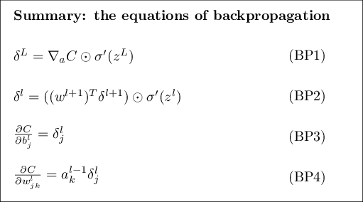
Backpropagation

Slide 10
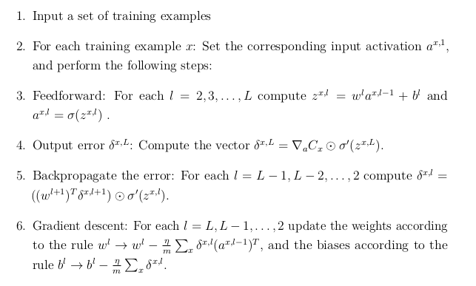
Backpropagation algorithm

Slide 11
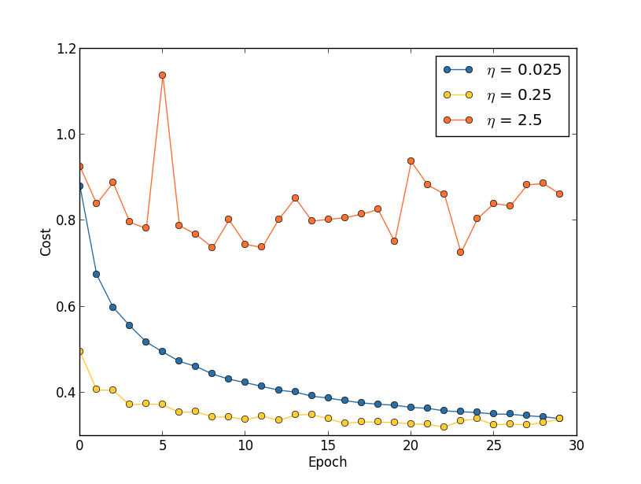
Hyper-parameters and some important techniques
- Different cost functions
- Learning rate
- Epoch
- Regularization
- Mini-batch
- Dropout
- Dataset expanding
- Weight initialization
- Broad strategy
- Momentum
- Hessian technique
Different Learning Rates

Slide 12
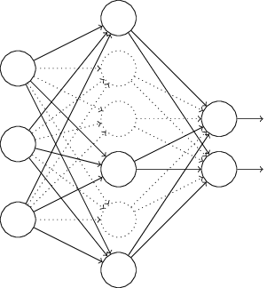
Dropout
With dropout, we start by randomly (and temporarily) deleting the hidden neurons in the network.
After doing this over a mini-batch of examples, we update the appropriate weights and biases. We then repeat the process, first restoring the dropout neurons, then
choosing a new random subset of hidden neurons to delete, estimating the gradient for a different mini-batch, and updating the weights and biases in the network.

Slide 13
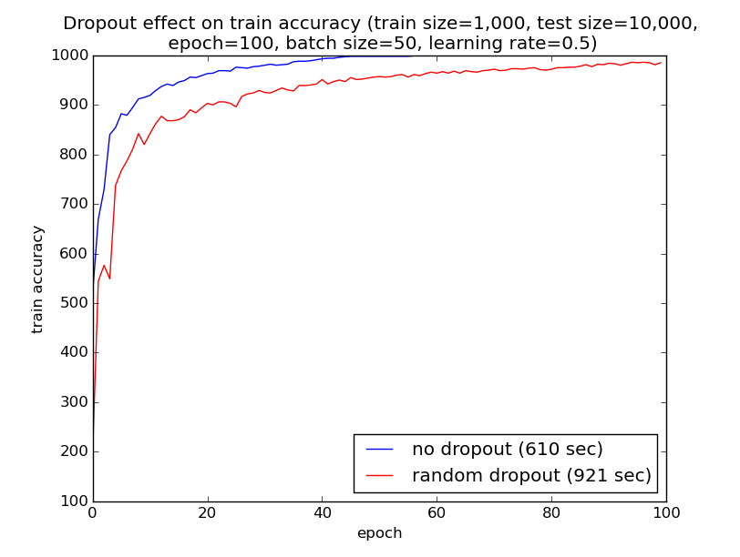
Dropout

Slide 14
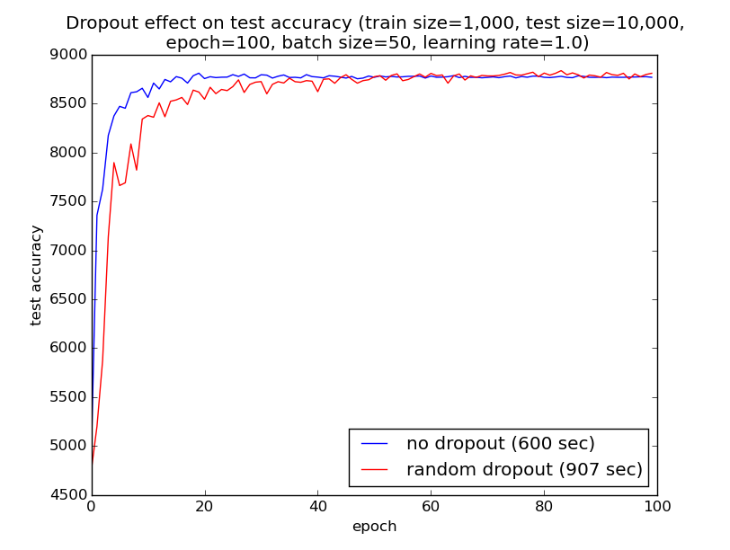
Dropout

Slide 15
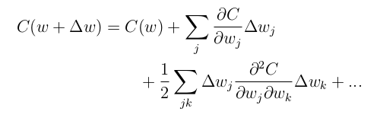

Hessian technique
The cost function can be approximated near a point w by
We can rewrite this more compactly as
There are theoretical and empirical results showing that Hessian methods converge on a minimum in fewer steps than standard gradient descent.

