Slide 1
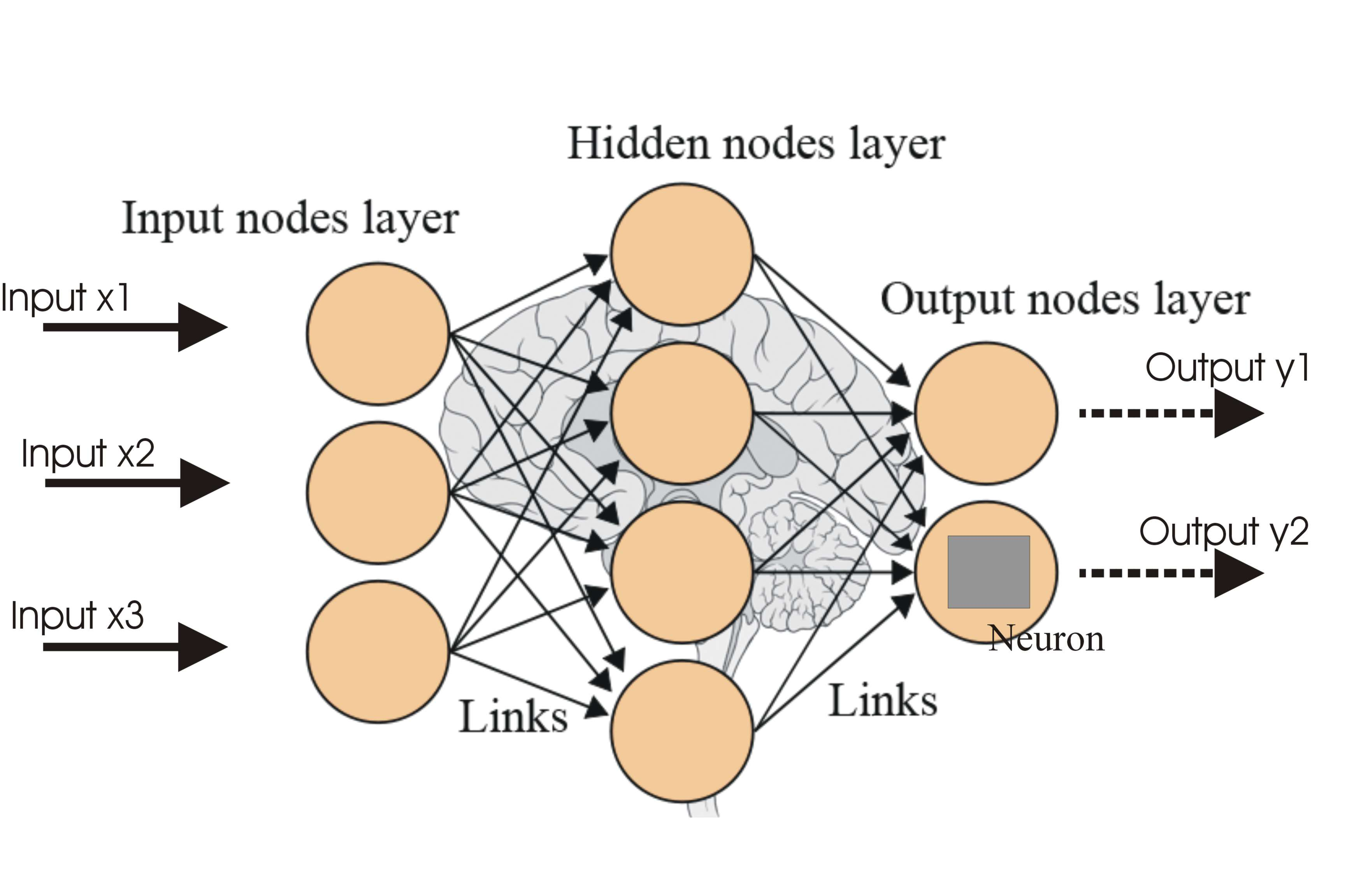
Artificial neural networks (ANNs) are learning models inspired by biological neural networks and used to estimate unknown functions that can depend on a large number of inputs.
What is artificial
neural networks?
Figure 1. Multilayer Perceptron (MLP)

Slide 2
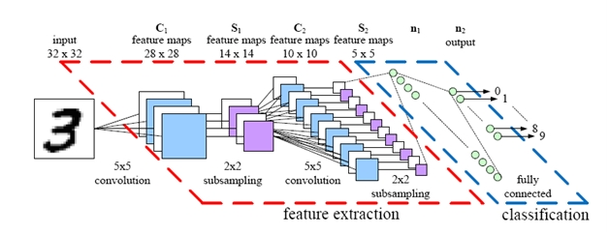
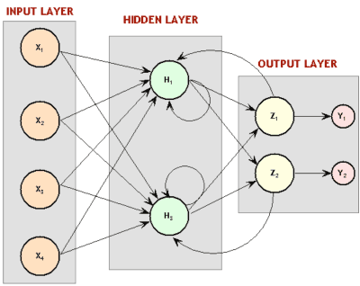
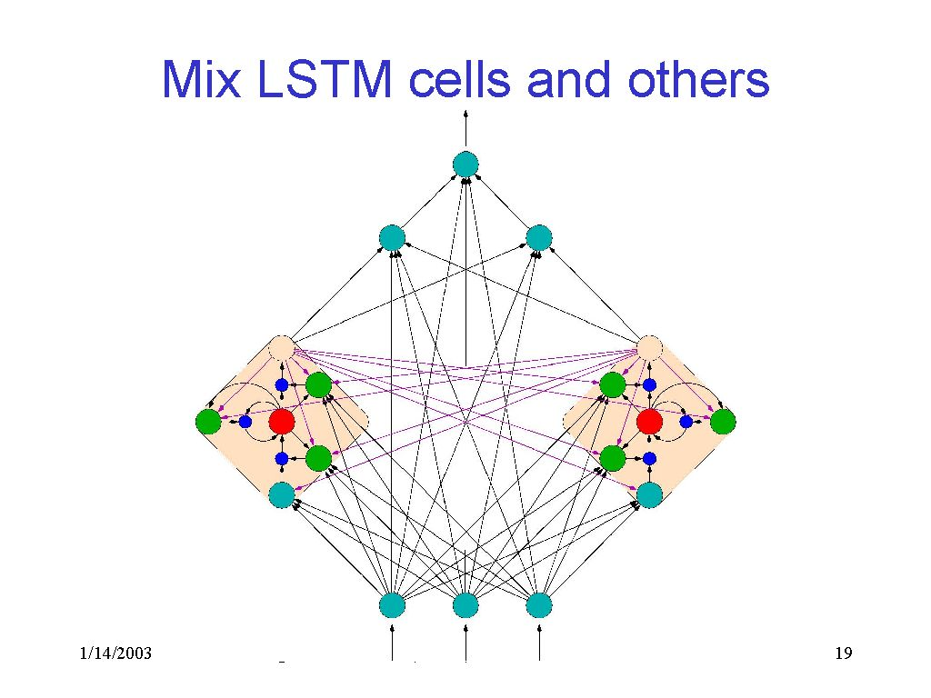
Some Neural Network Types
Figure 2. Convolutional Neural Network (CNN)
Figure 3. Recurrent Neural Network (RNN)
Figure 4. Long-Short Term Memory

Slide 3
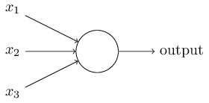

Neuron Types
Figure 5. Perceptron
- Sigmoid
- Tanh
- Rectified unit
- Softmax*

Slide 4
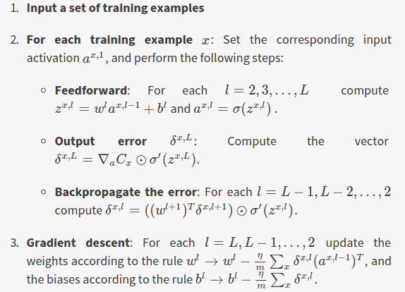
How it learns?
- Cost function
- Gradient descent
- Backpropagation
- Feature extraction
- Training set
- Test set
Figure 6. Backpropagation algorithm

Slide 5
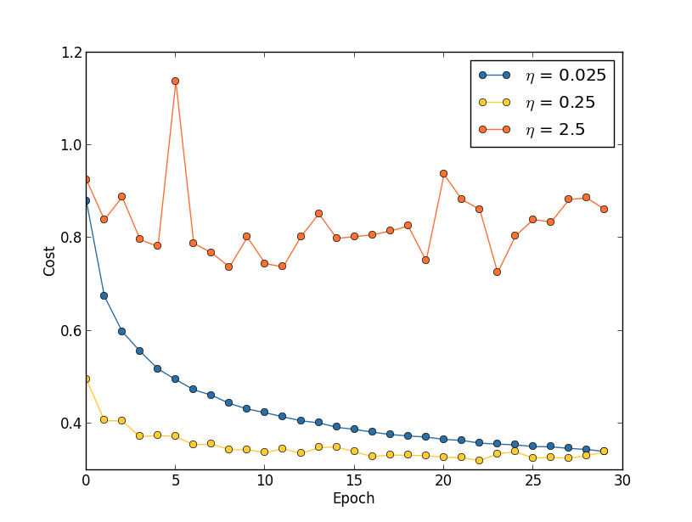
Hyper-parameters and some important techniques
- Cross entropy cost
- Learning rate
- Epoch
- Overfitting
- Regularization
- Mini-batch
- Dropout
- Dataset expanding
- Weight initialization
- Broad strategy
- Momentum
- Hessian technique
Figure 7. Learning rates

