Slide 1
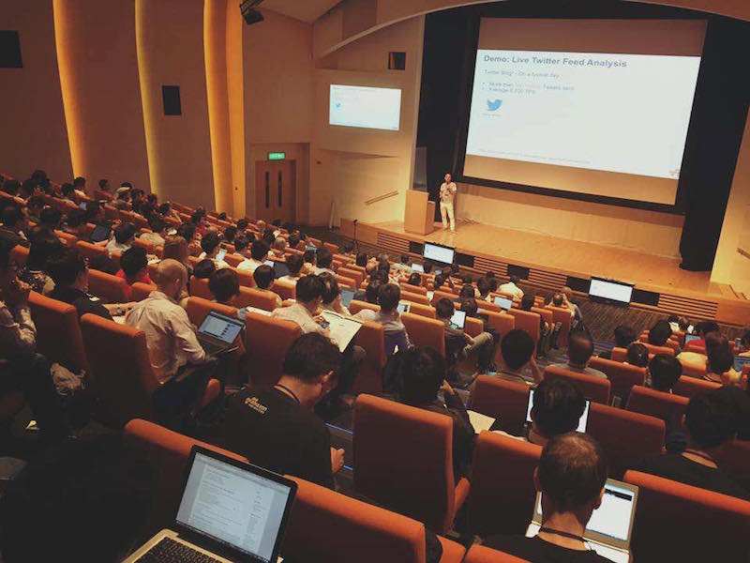
EVENT MANAGEMENT SYSTEM Project Proposal
This Photo by Unknown Author is licensed under CC BY-SA

Slide 2
CONSULTANT. Md. Moshaidul Islam wdpf.idb-bisew it scholarship Email: moshaidul@gmail.com
DEVELOPED BY.
Name: Azmira Khatun
Trainee ID:1288399
Batch: WDPF/NCLC-M/65/01
Email:azmiragrn@gmail.com
FARHANA AKTER LUCKY
Instructor:
wdpf idb-bisew it scholarship
Email: farhanawdpf@gmail.com

Slide 3
Proposal Application | 4
Project Overview | 5
Project Objectives | 6
SOFTWARE Key Features(For usars) | 7
SOFTWARE Key Features(For Administrators) | 8
System Flow Chart | 9
Project ERD Daigram | 10
Project Demo | 11
Invoice | 12
Project Milestone & Duration | 13
Technical Requirements | 14
Conclusion and Future Plan | 15

Slide 4
PROJECT OBJECTIVES
Streamlined Event Creation and Listing
Provide an intuitive interface for administrators to create, edit, and list events.
Include essential event details like title, date, time, venue, description, and pricing.
User-Friendly Registration and Booking
Enable users to register and book tickets seamlessly through a responsive and interactive UI.
Include real-time ticket availability updates to prevent overbooking.
Secure User Authentication
Implement a robust authentication system for users and administrators, ensuring secure access to functionalities.
Protect sensitive user data with encryption and secure session management.
Comprehensive Admin Panel
Provide admins with tools to monitor registrations, manage bookings, and generate reports.
Include event performance analytics and ticket sales data for insights.
Payment Gateway Integration
Support secure online payments with integration of trusted payment gateways.
Offer multiple payment options for user convenience.

Slide 5
APPLICATION
9 August, 2025
The Consultant
IDB Bhaban,
Sher e Bangla, Nagar, Dhaka
Subject: Project proposal letter for the Event Management system.
Dear sir,
Thank you for offering us a great opportunity to make a Real-life project based on our core course that is Professional Web Development with PHP and MySQL. In this project, I would like to inform you that I have decided to make a project on Event Management System, which is most importance for every business communities.. I have studied about the various aspects of the system and make a proposal accordingly which is enclosed here with for your kind perusal. So, We think you will finally Approved the project and help to utilize my creativity.
Sincerely,
NameAzmira Khatun
Batch: PWAD/NCLC-M/65/01
Round - 65

Slide 6
SOFTWARE KEY FEATURES FOR USARS
Streamlined Event Creation and Listing
Provide an intuitive interface for administrators to create, edit, and list events.
Include essential event details like title, date, time, venue, description, and pricing.
User-Friendly Registration and Booking
Enable users to register and book tickets seamlessly through a responsive and interactive UI.
Include real-time ticket availability updates to prevent overbooking.
Secure User Authentication
Implement a robust authentication system for users and administrators, ensuring secure access to functionalities.
Protect sensitive user data with encryption and secure session management.
Comprehensive Admin Panel
Provide admins with tools to monitor registrations, manage bookings, and generate reports.
Include event performance analytics and ticket sales data for insights.
Payment Gateway Integration
Offer multiple payment options for user convenience.

Slide 7
SOFTWARE KEY FEATURES FOR ADMINISTRATORS
Dashboard Overview: A comprehensive dashboard showing event performance, bookings, usars data, and financial statistics.
User Management: Admins can manage events, delete events.
System Configuration: Configuration options for events.

Slide 8
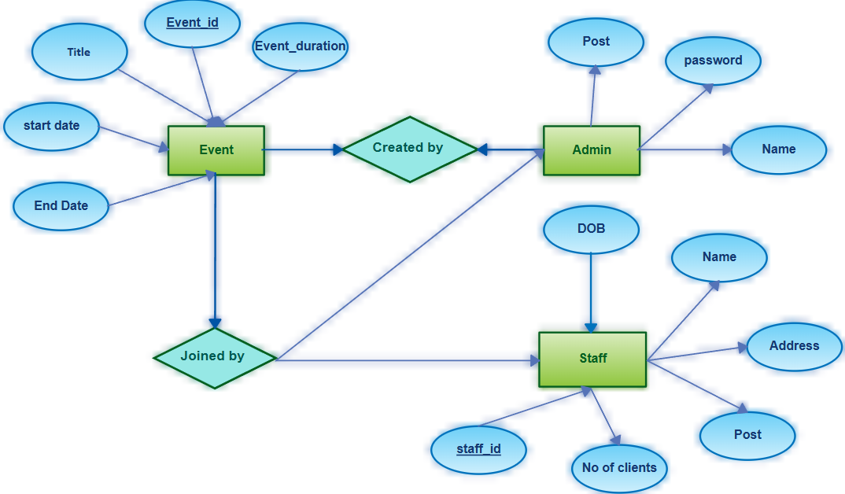
FLOWCHART

Slide 9
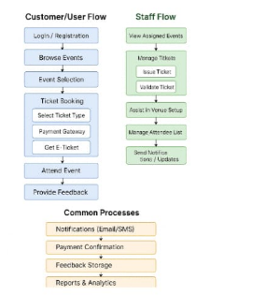

Slide 10
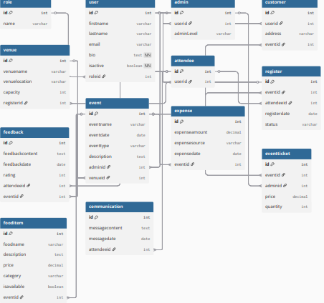
ERD Diagram

Slide 11

RelationShip
One User can book multiple Tickets.
One Ticket is linked to one Event.
One Event belongs to one Event Type (e.g., Movie, Music Festival, Convention).
Multiple Events can be managed by multiple Admins.
One Payment is associated with one Ticket.

Slide 12
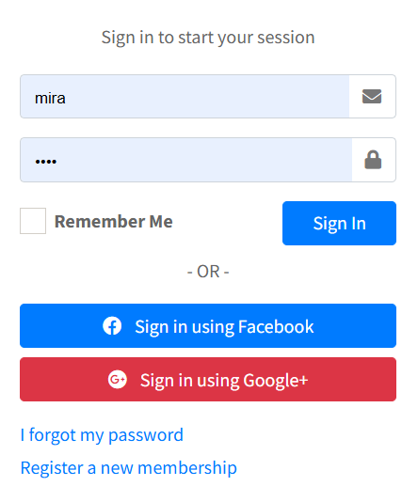
Login

Slide 13
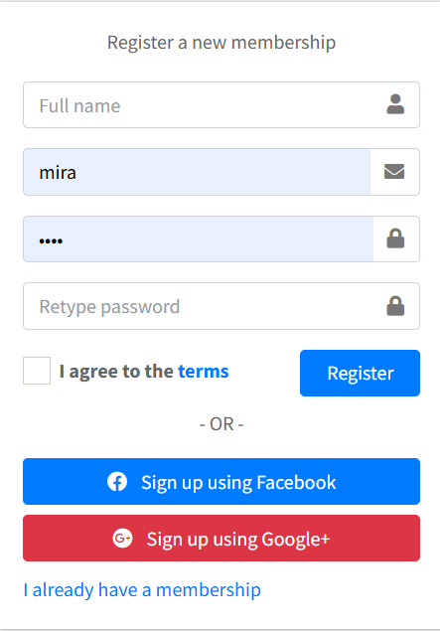
Registration

Slide 14
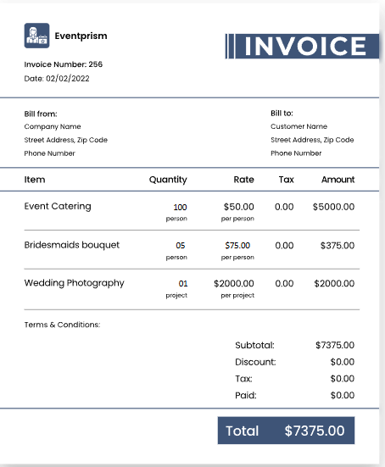
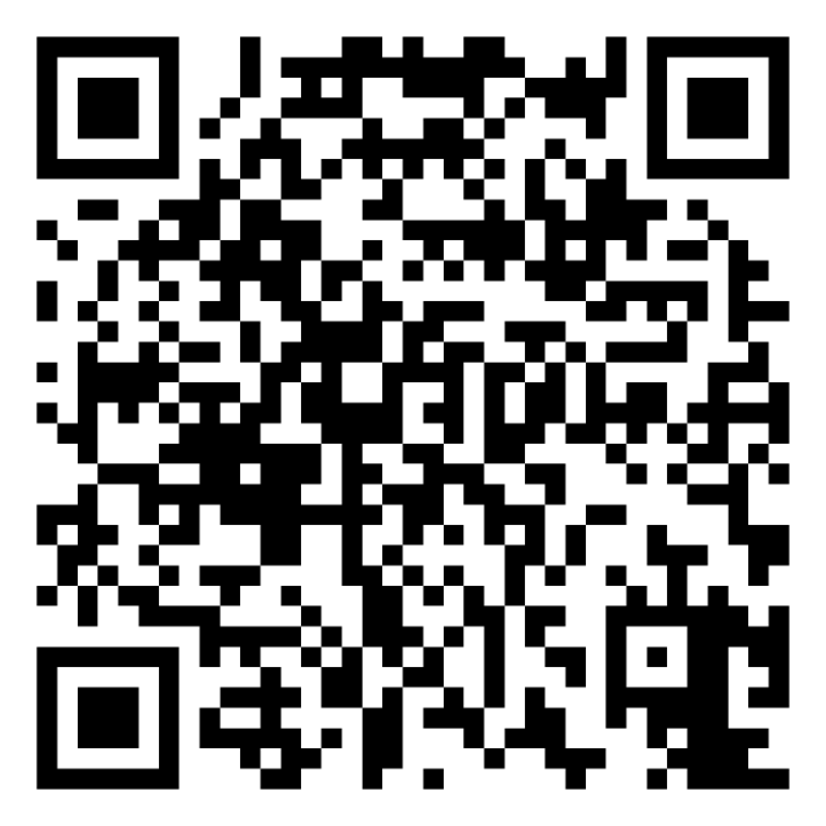
INVOICE
This Photo by Unknown Author is licensed under CC BY-ND

Slide 15
PROJECT MILESTONE & DURATION
MILESTONE | DURATION (DAYS)
Requirements Gathering | 10
Design and User Interface | 10
Implementation and Coding | 20
Testing | 7
Deployment and Launch | 7
Project Completion and Handover | 6
Total Duration | 60

Slide 16
TECHNICAL REQUIREMENTS
FRONTEND:HTML5, CSS3, JavaScript, Jquery: For responsive and interactive UI.
Bootstrap CSS: For a responsive layout.
Backend:
PHP : For server-side operations.
Database : MySQL for storing data.

Slide 17

Thanks for watching
This Photo by Unknown Author is licensed under CC BY-NC

