Slide 1
Title : Lab Tracker Automating Lab Management using GitHub
Presented by : Mohd Saud
Department of Computer Science, AMU
Date : 05/09/2024

Slide 2
Introduction
Background
Traditional lab tracking methods are manual and inefficient.
Challenges on coding assignments and submission verification.
Integration with GitHub can streamline processes.
Objective
Lab Tracker aims to automate submission tracking and documentation generation.
Enhance educator efficiency and student experience.

Slide 3
Problem Statement
Description
Lack of integration with modern coding platforms.
Manual Processes lead to inefficiencies and errors.
Importance
Automating lab tracking improves feedback delivery and academic standards.
Lab Tracker streamlines the process through GitHub Integration

Slide 4
Study of Existing System
Overview
Current lab management systems do not integrate with GitHub, limiting their functionality
Limitations
Lack of real-time tracking and updates on GitHub
Manual documentation generation requires significant effort.
Absence of automated progress tracking
Comparative Analysis
Lab Tracker focuses on automation and efficiency via GitHub API integration.
Minimizes inaccuracies by generating required files.

Slide 5
Proposed Solution
Overview
Lab Tracker automates the management of weekly lab exercises using GitHub
Key Features
GitHub Integration : Repository structure verification and tracking.
Progress Tracking : Monitors commits and submissions.
Automated Documentation : Generate files with problem description and solutions.
Teacher Dashboard : Manage problems, generate reports and monitor progress.

Slide 6
Scope of the Project
Inclusions
GitHub integration for real-time tracking and submission verification.
Secure user authentication and verification.
Automated generation of lab documentations.
Exclusions
No in-depth code verification.
No AI-driven analysis of code.
No offline functionality.

Slide 7
System Design
High Level Architecture
Client-server architecture with Django backend and frontend using HTML, CSS and JavaScript.
Major Components
Student Module : Signup, progress tracking, file generation.
Teacher Module : Add/edit problems, generate reports, view recent activities.
Data Flow
User inputs to Backend processes data via GitHub API to Real-time updates on frontend.

Slide 8
Feasibility Analysis
Technical Feasibility
Uses reliable, widely-adopted technologies like Django and GitHub API.
Economic Feasibility
Open-source tools reduce costs.
Suitable for institutions with limited budgets.
Operational Feasibility
User-friendly interface with minimal learning curve.
Easy adoption due to familiarity with GitHub

Slide 9
Expected Outcomes
Deliverables
Lab Tracker automates the management of weekly lab exercises using GitHub
Automated documentation generation.
User guides and system documentation.
Success Criteria
Effective automation of lab tracking.
Improved management of lab exercises.
High user satisfaction rates.

Slide 10
Risks and Challenges
Potential Risks
Dependence on GitHub API.
Scalability challenges with increased usage.
No code verification might lead to inaccuracies.
Mitigation Strategies
Regular updates for GitHub API.
Scalable architecture.
Clear communication to users about system limitations.

Slide 11
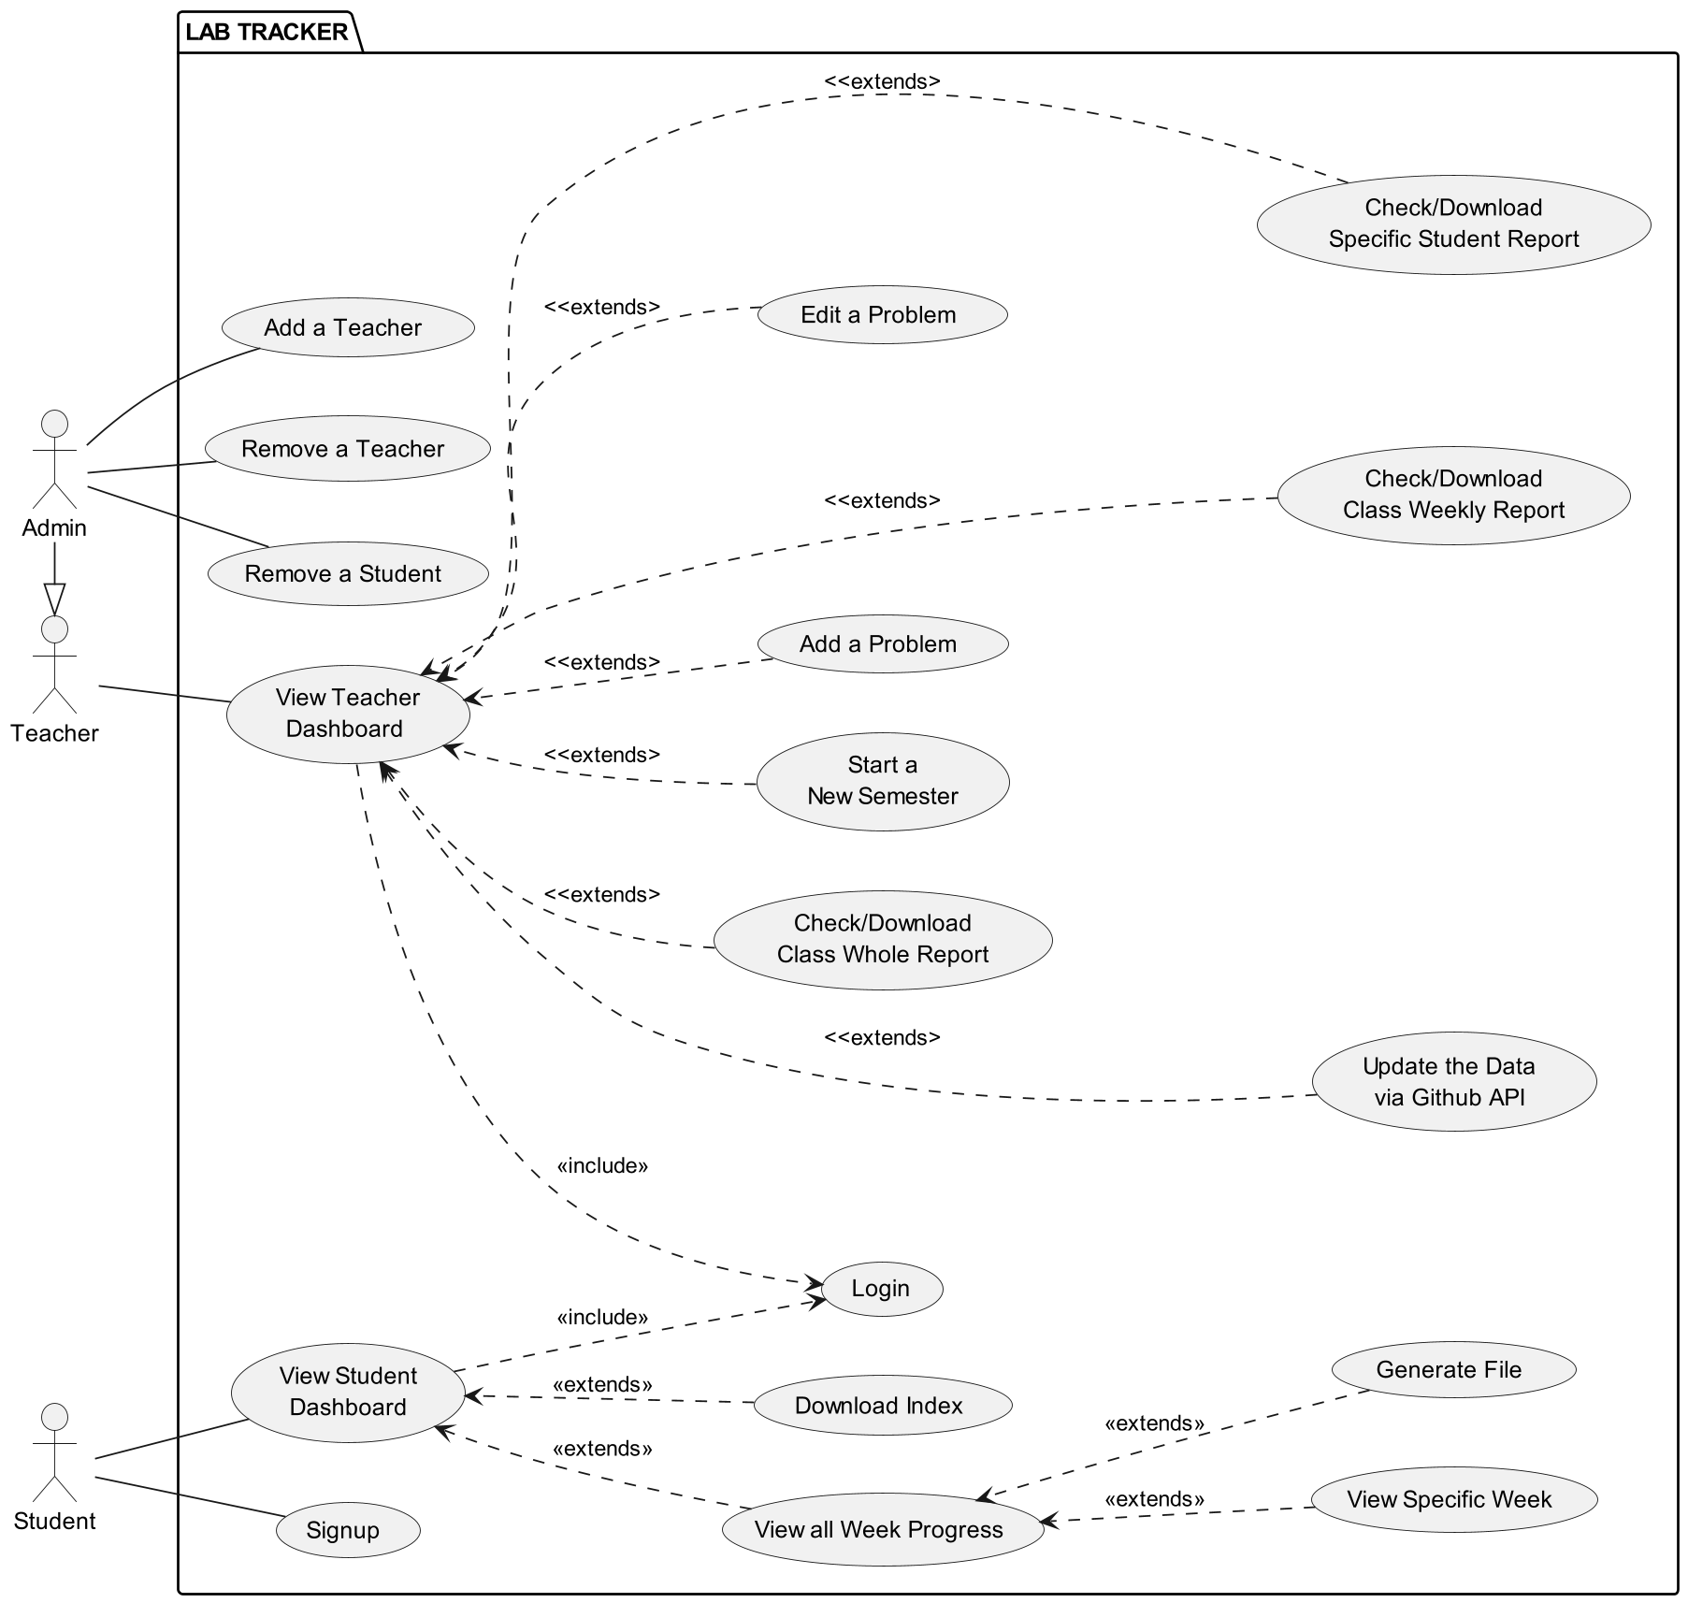
Use Case Diagram
Signup & Login : Students and teachers access their dashboard.
Student Dashboard : View progress, specific week problems, generate files, and download the index.
Teacher Dashboard : Manage problems, view student/class reports.
Class Management : Teachers update student data via GitHub API, start new semesters.
Admin Features : Admins add/remove teachers and students.
Automation : Lab Tracker automates file generation and data updates via GitHub integration.

Slide 12
THANK YOU
…

