Slide 1
HELLO EVERYONE
WELCOME TO MY PRESENTATION

Slide 2
Documentation of Software
ID:161-35-1574

Slide 3

MY PRESENTATION TOPIC IS
BIKROY.COM

Slide 4
What is Bikroy.com?
Bikroy.com is a website where you can buy and sell almost everything. The best deals are often done with people who live in your own city or on your own street, so on Bikroy.com it's easy to buy and sell locally. All you have to do is select your region.
It takes you less than 2 minutes to post an ad on Bikroy.com. You can sign up for a free account and post ads easily every time.

Slide 5

What is Bikroy.com?
Bikroy.com has the widest selection of popular second hand items all over Bangladesh, which makes it easy to find exactly what you are looking for. So if you're looking for a car, mobile phone, house, computer or maybe a pet, you will find the best deal on Bikroy.com.

Slide 6
What is Bikroy.com?
Bikroy.com does not specialize in any specific category - here you can buy and sell items in more than 50 different categories. We also carefully review all ads that are being published, to make sure the quality is up to our standards.

Slide 7
Stay safe on Bikroy.com
At Bikroy.com we are 100% committed to making sure that your experience on our site is as safe as possible.
Here you can find advice on how to stay safe while trading on Bikroy.com.
General safety advice
Scams and frauds to watch out for
Bikroy.com's safety measures
Reporting a safety issue

Slide 8

FAQ
1. How do I post an ad?
2. How do I delete my ad?
3. How do I edit my ad?
4. How do I set a new password on Bikroy.com?
5. How long do ads stay on Bikroy.com?
6. I posted an ad but can't find it. What's wrong?
7. Why has my ad been rejected?
8. I'm getting contacted about an ad I didn't post. Can you help me?
9. I haven't received any responses to my ad. What's wrong?
10. How does Bikroy.com make money?
11. What are the rules for posting on Bikroy.com?
12. How do I sign up for a user account on Bikroy.com?
13. How do I log in and log out of my account?
14. How do I change my account details?
15. Why can't I log in to my account?
16. What is my free posting allowance?
17. What is Buy Now?

Slide 9
Paid products and services Q&A
1. What is "Top Ad"?
2. Why is my ad not showing as a Top Ad?
3. What is “Daily Bump Up for 7 days”?
4. How do I get a Shop / page for my business?
5. What is a Membership?
6. What is "Buy Now" and how does it work?
7. How do I buy a voucher?
8. How do vouchers work?

Slide 10

Sitemap
The Bikroy.com site is organised into several sections, as shown below. The sections are broken down by category and there is also a general section where you will find pages with useful information.
Electronics
Education
Services
Clothing, Health & Beauty
Cars & Vehicles
Pets & Animals
Hobby, Sport & Kids
Food & Agriculture
Property
Jobs in Bangladesh.
Home & Garden.
Business & Industry.
Overseas Jobs.
Other

Slide 11
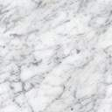
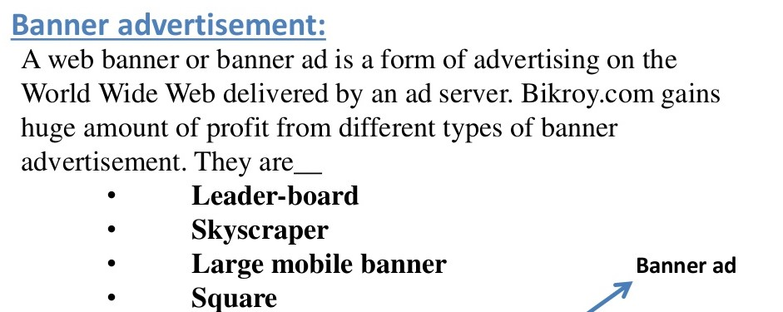

Slide 12
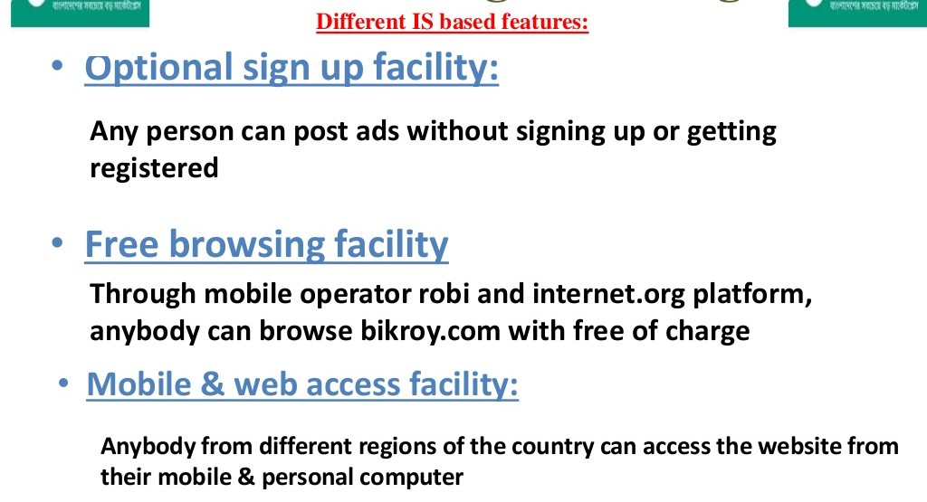

Slide 13
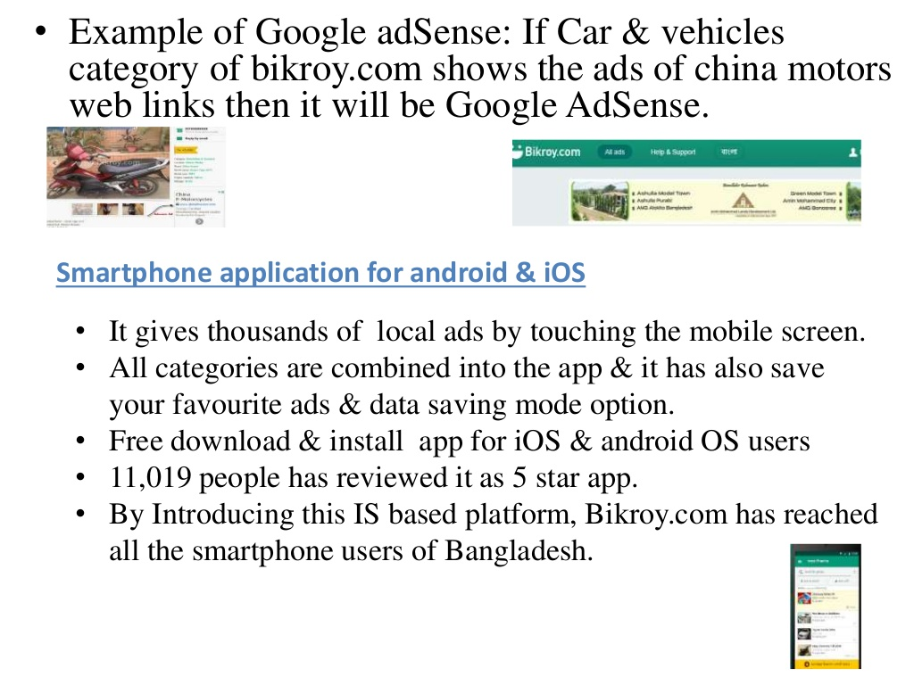

Slide 14
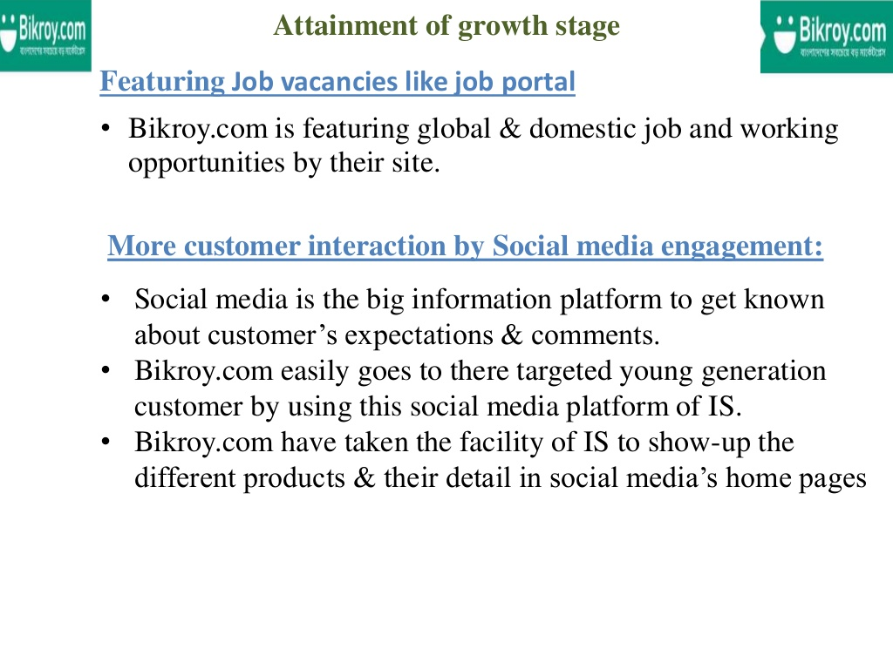

Slide 15
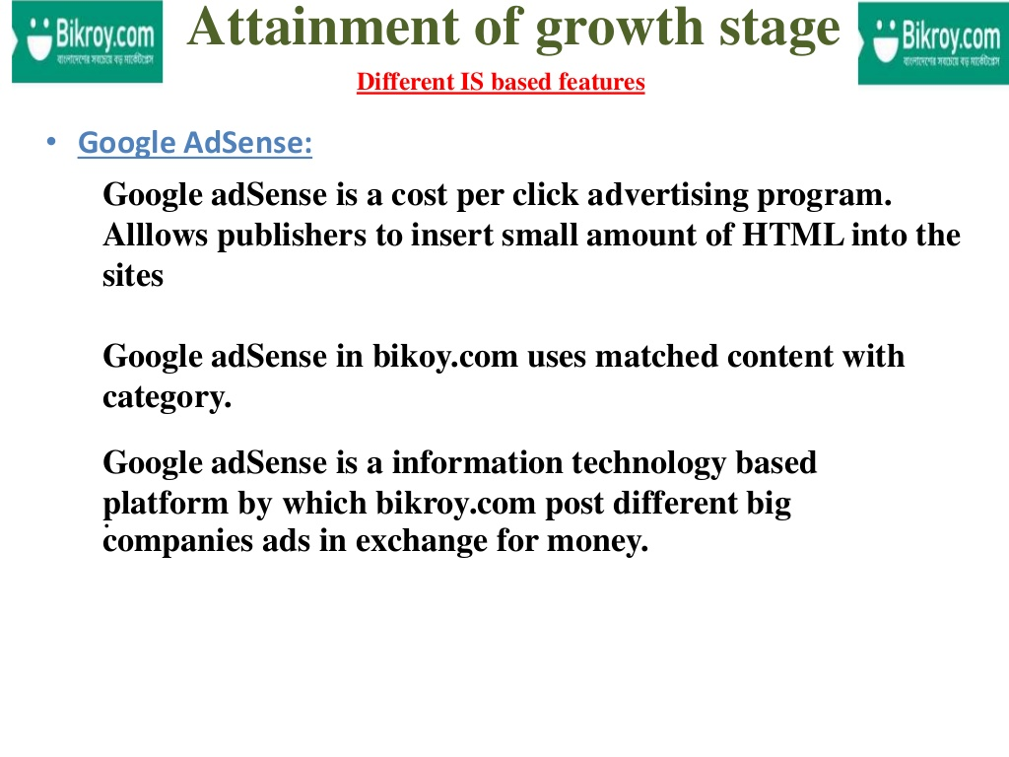

Slide 16
History
2013
The year 2013 saw Bikroy become one the top 10 most popular Bangladeshi websites.^{[11]} "Bikroy.com" was the 4th most searched keyword in Bangladesh that year on Google.^{[12]} The company gained over 500,000 fans on Facebook.
2014
Through a collaboration with Robi, a Zero Rating campaign was also released that year thus enabling free browsing of Bikroy through the operator.^{[13]} During this year, the company opened a total of five offices in Bangladesh and the their Facebook page reached 2,000,000 fans.

Slide 17

History
2015
The launch of Bikroy application on iOS and Android was one of the major milestones that year.^{[14]} Bikroy also partnered with Facebook and Internet.org to enable free browsing of Bikroy.com on the internet through the Free Basics service.^{[15]} Another major milestone for the company was the offer of a pre-order and delivery service for sacrificial animals on the occasion of Eid-ul-Adha. This was the first time live Qurbani animals were ever sold online in Bangladesh.^{[16]}
2016
This year the company launched a Membership service for small businesses, allowing them to advertise their products under their own page on Bikroy.^{[17]} Bikroy was ranked in the top three, right after Facebook and Google, by a Millward Brown survey on top of mind preference conducted on over a thousand Bangladeshi internet users, marking the second time the company ranked in the top 3 in the last 2 years.^{[1}

Slide 18

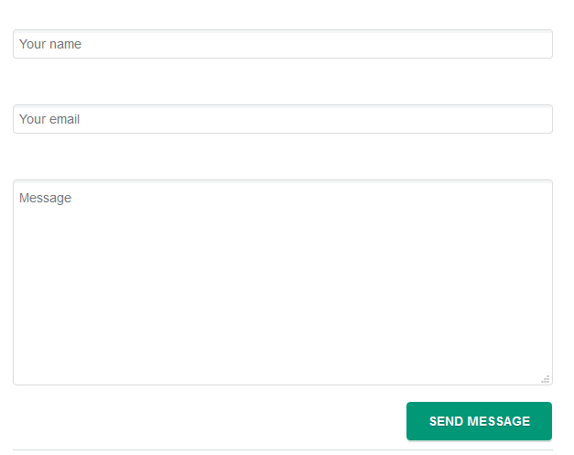
Contact us
If you did not find the answer to your question or problem, please get in touch with us using the form below and we will respond to your message as soon as possible.

Slide 19
Bikroy.com Helpline
Our helpline is open Saturday - Thursday from 9:00 AM to 5:00 PM. The helpline is closed on Fridays and all government holidays.
Call us-09613 555444

Slide 20

THANK YOU!

