Slide 1


Steemit.com
Md. Nakeeb Bin Ali
ID : 161-35-1412
A blogging and virtual currency website

Slide 2
What is it about ?
Steemit is a blogging and social networking website on top of the Steem blockchain database. The Steem blockchain produces STEEM and Steem Dollars

Slide 3
Establishment
Established by
Ned Scott and Dan Larimer, creator of BitShares^{[2][3]} .
Established on
July, 4th, 2016, Steemit.Inc officially launched Steemit.

Slide 4
Development
Programming language : Python
Also used HTML, CSS and Javascript for UI, SQL for Database. And the maintainance team always work on updating the website. Here is the Github link of this site : https://github.com/steemit/devportal

Slide 5
What is Steem and Steem Dollar ?
Steem : Steem is a blockchain-based rewards platform.
Steem Dollar : Steem Dollars are tradable tokens users obtain for posting, discovering, and commenting on interesting content.

Slide 6
Procedure
Create account.
Exploring.
Activities (Posting, Upvoting, Commenting, Resteeming etc.).
Currency market.

Slide 7
Let’s see the procedures with the practical images.

Slide 8
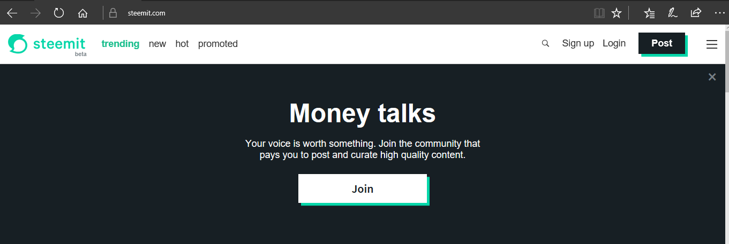
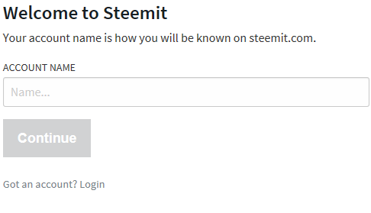
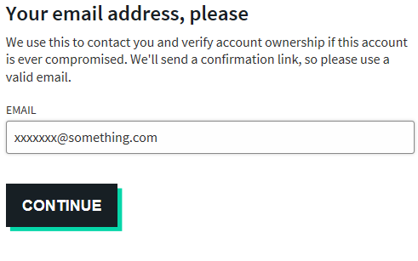
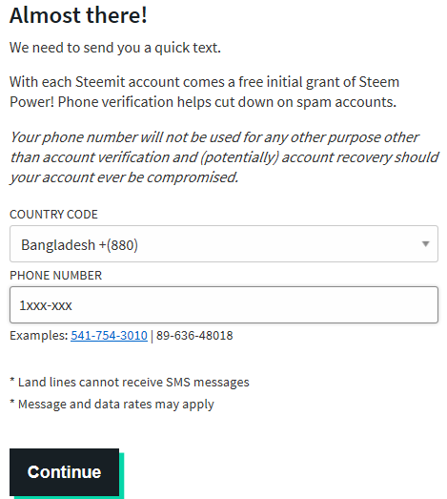
Create Account

Slide 9
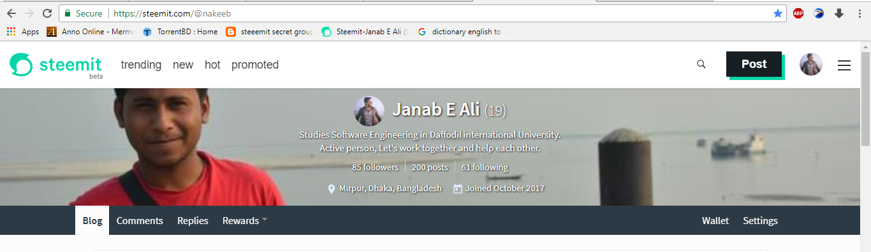

Own Blog page

Slide 10
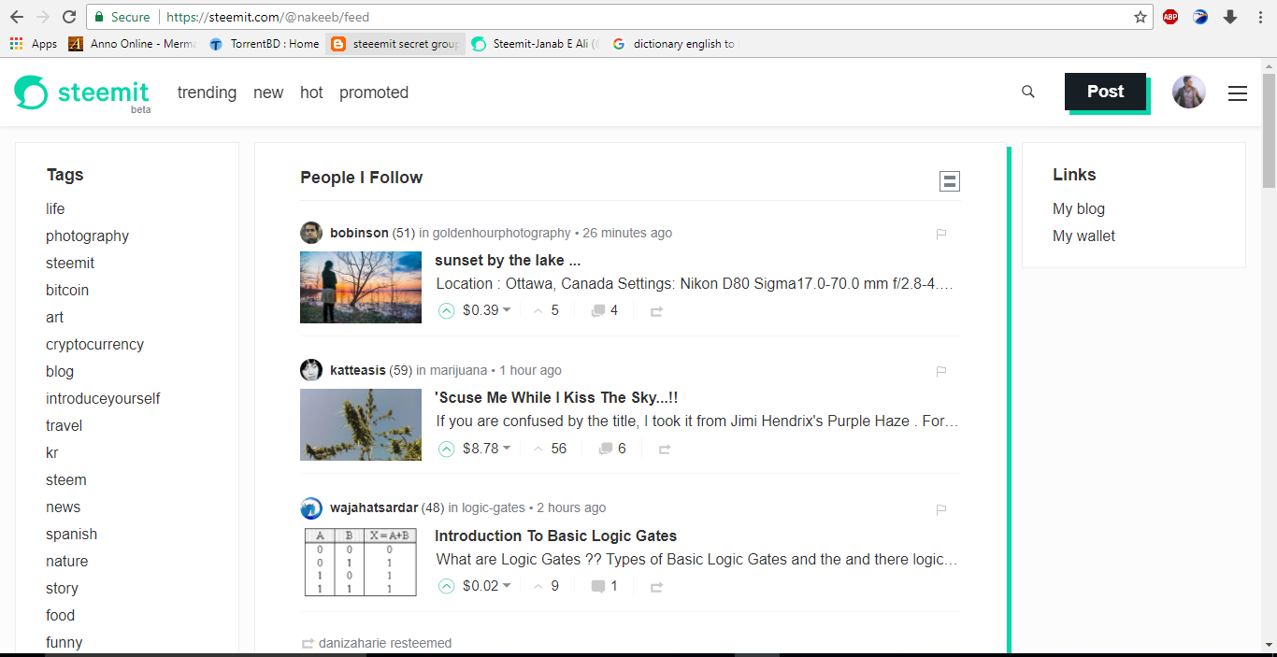
Exploring

Slide 11
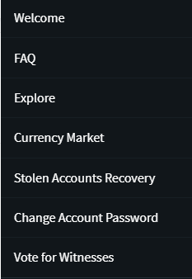
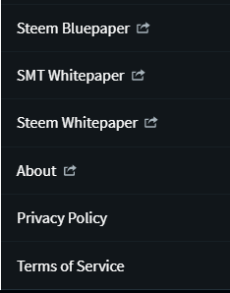
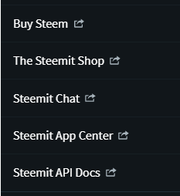

Slide 12

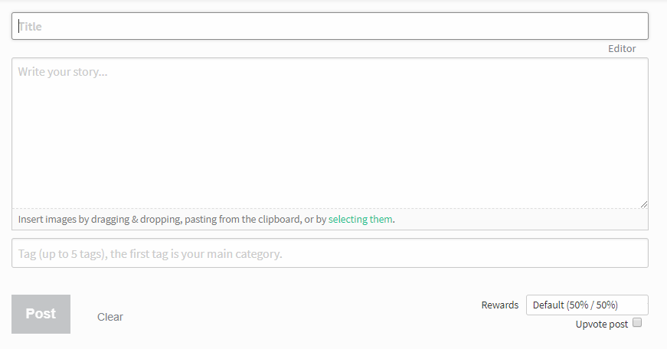
Activities
Posting :

Slide 13
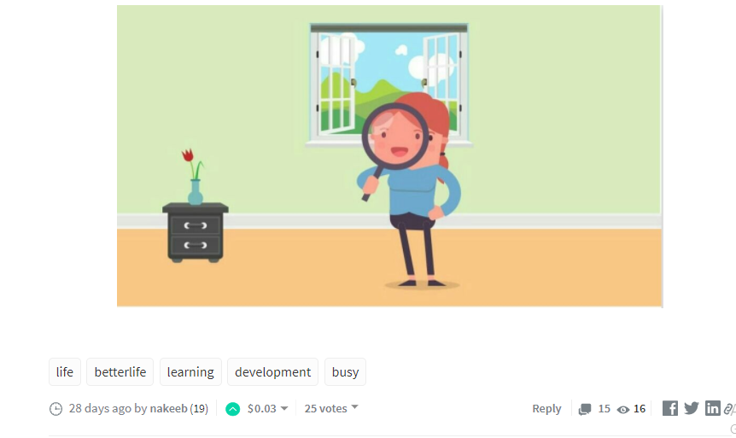
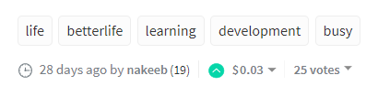
Upvoting :
It’s kind of similar to giving Like on facebook.
If someone gives an upvote to a post, then the value of the post increases and if the content is unique and interesting then the person who has given upvote gets curisity point which later helps to gain more Steem dollars and so on.

Slide 14
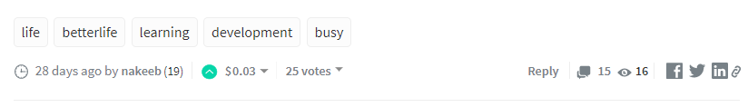
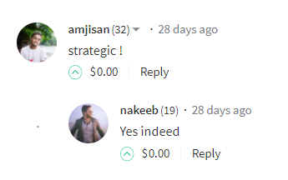
Comments :
It’s also like commenting on a post on facebook.
If someone comments on anyone’s post, it adds a steem value on the post. If the post is good enough and valuable then the person who has commented gets rewards after these kinds of continuous activitis.

Slide 15
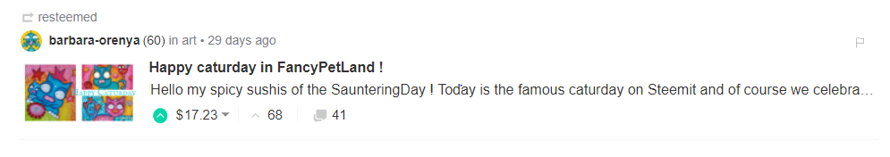
Resteeming :
It’s like the share option on a post on facebook.
If there is a post which trending in a high speed, and anyone thinks that it will gain a lot of steem points/dollars then he/she can resteem it, it’ll increase his/her steem power and chances of gaining more steem points.

Slide 16
Currency market
Here a user can
See account value
See earning progress graph
Convert Steem dollar into real money.
Buy or sell steem dollar.
See the transactions going on

Slide 17
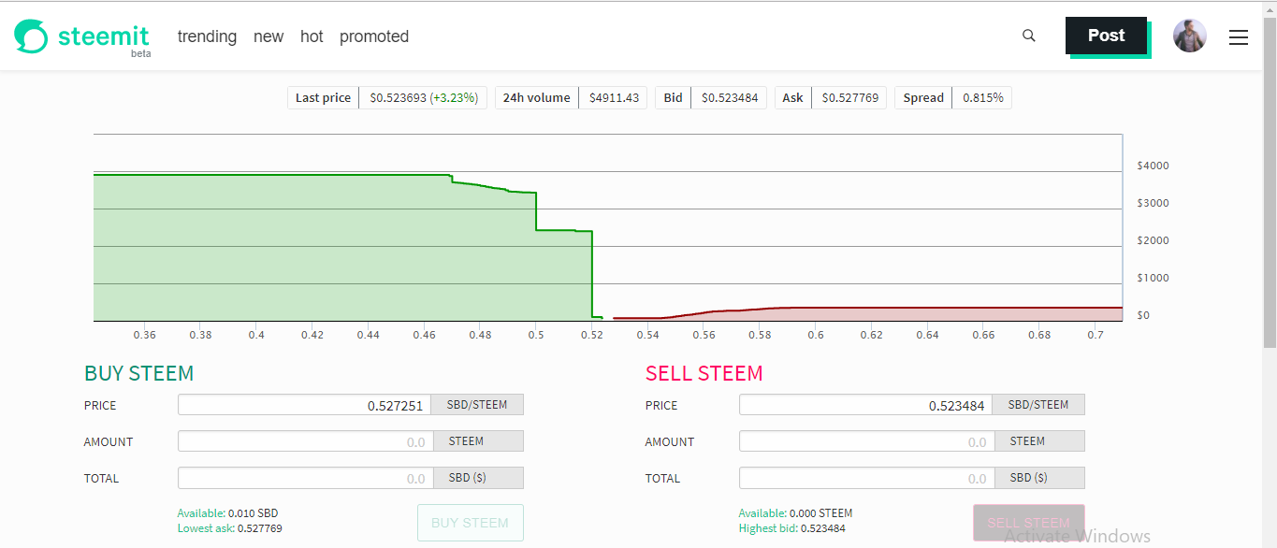
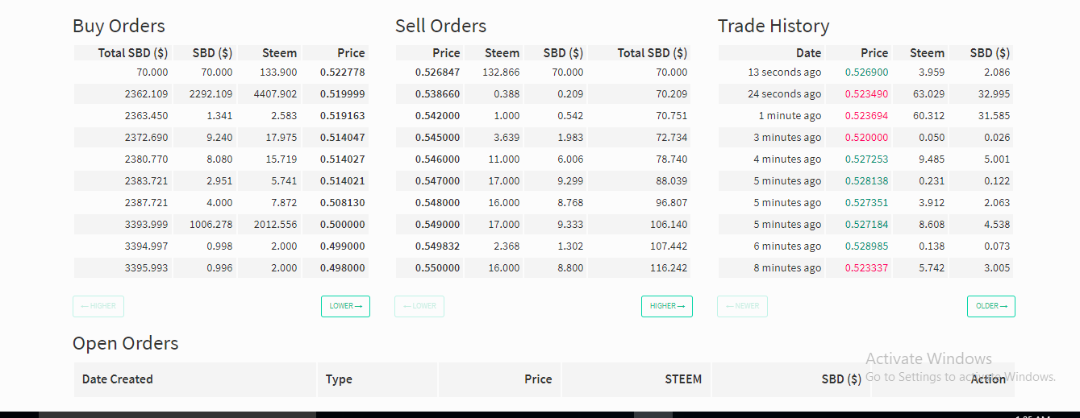

Slide 18
Why Steemit
Our generation spends a lot of time on social medias for nothing. But, Steemit gives us value for doing social activities and sharing our thinking. The biggest thing is, it pays us for these activities.
It’s a way for easy money and of course change making concept.

Slide 19
Thanks Everyone
You can ask any kind questions if you’ve queries.

