Slide 1
CSE 30341 Operating System Principles
Protection

Slide 2
Overview
Goals of Protection
Principles of Protection
Domain of Protection
Access Matrix
Implementation of Access Matrix
Access Control
Revocation of Access Rights
Capability-Based Systems
Language-Based Protection

Slide 3
Objectives
Discuss the goals and principles of protection in a modern computer system
Explain how protection domains combined with an access matrix are used to specify the resources a process may access
Examine capability-based protection systems

Slide 4
Goals of Protection
In one common protection model, a computer consists of a collection of objects, hardware or software
Each object has a unique name and can be accessed through a well-defined set of operations
Protection problem - ensure that each object is accessed correctly and only by those processes that are allowed to do so

Slide 5
Principles of Protection
Guiding principle – principle of least privilege
Static
Dynamic - domain switching, privilege escalation
“Need to know” a similar concept regarding access to data
“Containment of failure”
Must consider “grain” aspect
Rough-grained
Fine-grained
Domain can be user, process, procedure

Slide 6
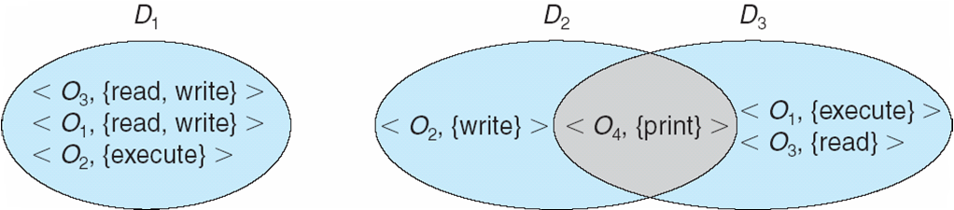
Domain Structure
Access-right = <object-name, rights-set> where rights-set is a subset of all valid operations that can be performed on the object
Domain = set of access-rights

Slide 7
Domain Implementation (UNIX)
Domain = user-id
Domain switch accomplished via file system
Each file has associated with it a domain bit (setuid bit)
When file is executed and setuid = on, then user-id is set to owner of the file being executed (similary “setgid”)
When execution completes user-id is reset
Domain switch accomplished via passwords
su command temporarily switches to another user’s domain when other domain’s password provided
Domain switching via commands
sudo command prefix executes specified command in another domain (if original domain has privilege or password given)

Slide 8
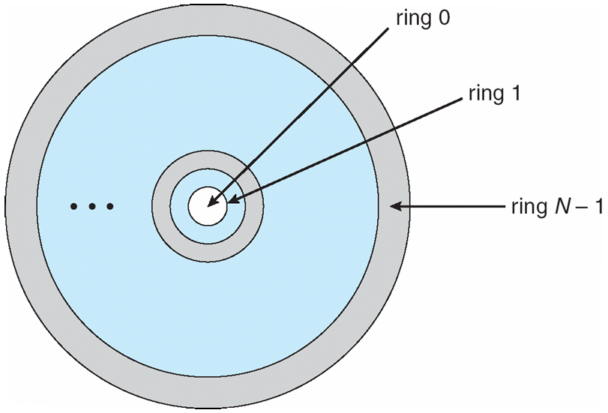
Domain Implementation (MULTICS)
Let D_{i} and D_{j} be any two domain rings
If j < i ⇒ D_{i} ⊆ D_{j}

Slide 9
Multics Benefits and Limits
Ring / hierarchical structure provided more than the basic kernel / user or root / normal user design
Fairly complex -> more overhead
But does not allow strict need-to-know
Object accessible in D_{j} but not in D_{i}, then j must be < i
But then every segment accessible in D_{i} also accessible in D_{j}

Slide 10
Access Matrix
View protection as a matrix (access matrix)
Rows represent domains
Columns represent objects
Access(i, j) is the set of operations that a process executing in Domain_{i} can invoke on Object_{j}

Slide 11
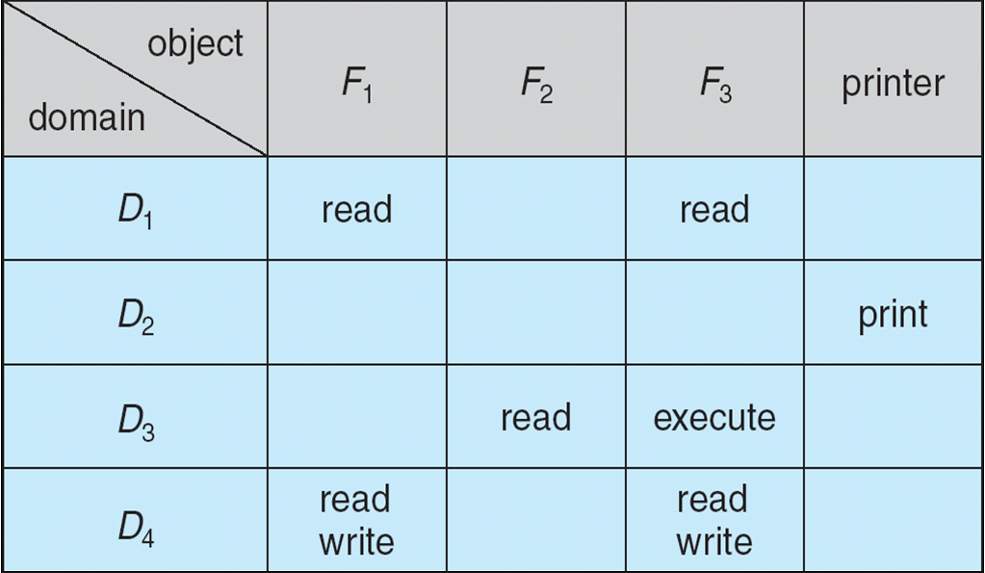
Access Matrix

Slide 12
Use of Access Matrix
If a process in Domain D_{i} tries to do “op” on object O_{j}, then “op” must be in the access matrix
User who creates object can define access column for that object
Can be expanded to dynamic protection
Operations to add, delete access rights
Special access rights:
owner of O_{i}
copy op from D_{i} to D_{j} (denoted by “*”)
control – D_{i} can modify D_{j} access rights
transfer (switch) – switch from domain D_{i} to D_{j}
Copy and Owner applicable to an object
Control applicable to domain

Slide 13
Use of Access Matrix (Cont.)
Access matrix design separates mechanism from policy
Mechanism
Operating system provides access-matrix + rules
It ensures that the matrix is only manipulated by authorized agents and that rules are strictly enforced
Policy
User dictates policy
Who can access what object and in what mode
Good policy supported by good default values

Slide 14
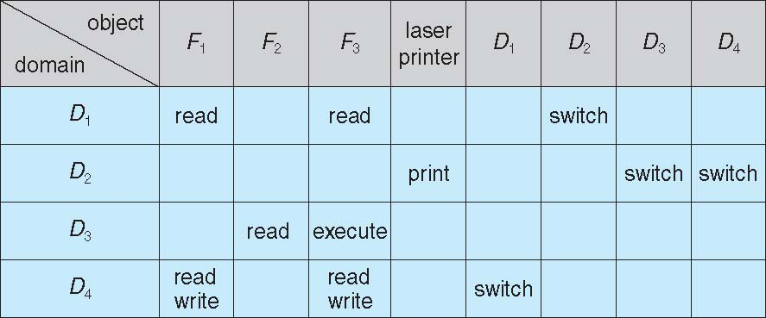
Access Matrix Example

Slide 15
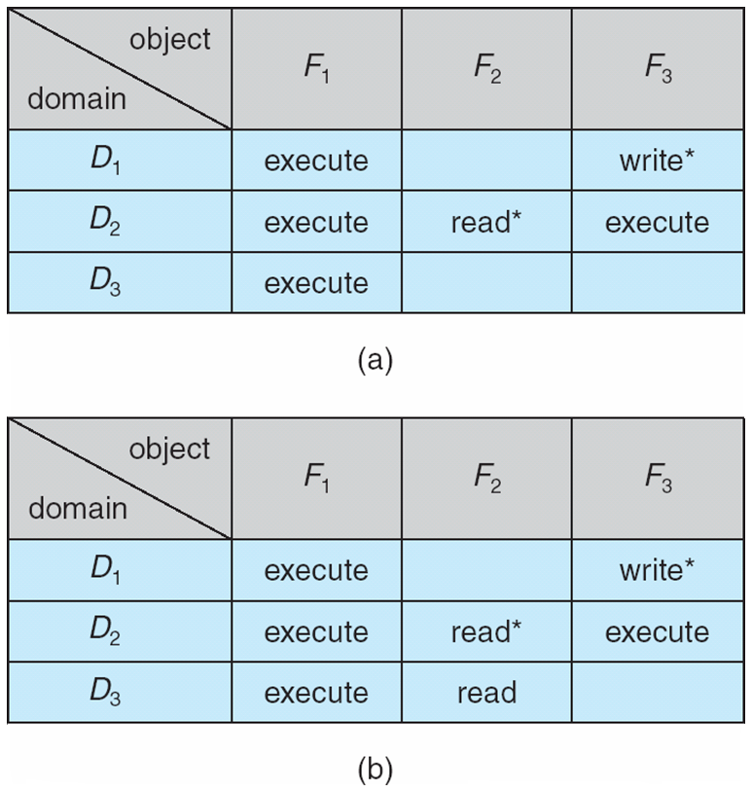
Access Matrix Example

Slide 16
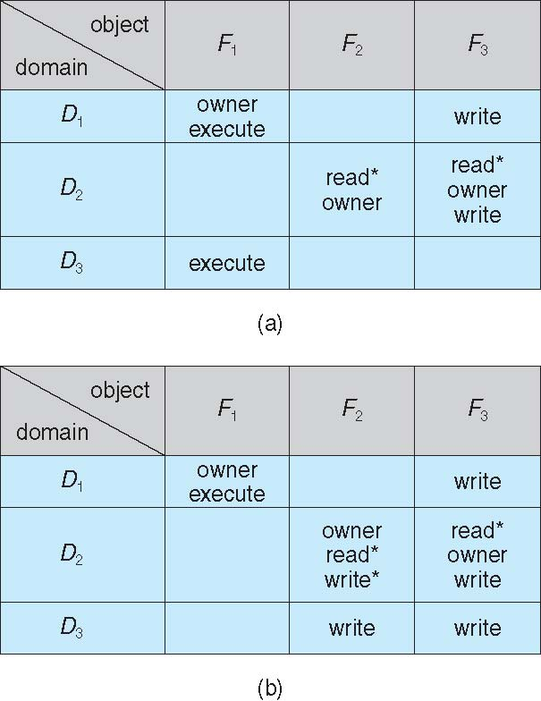
Access Matrix Example

Slide 17
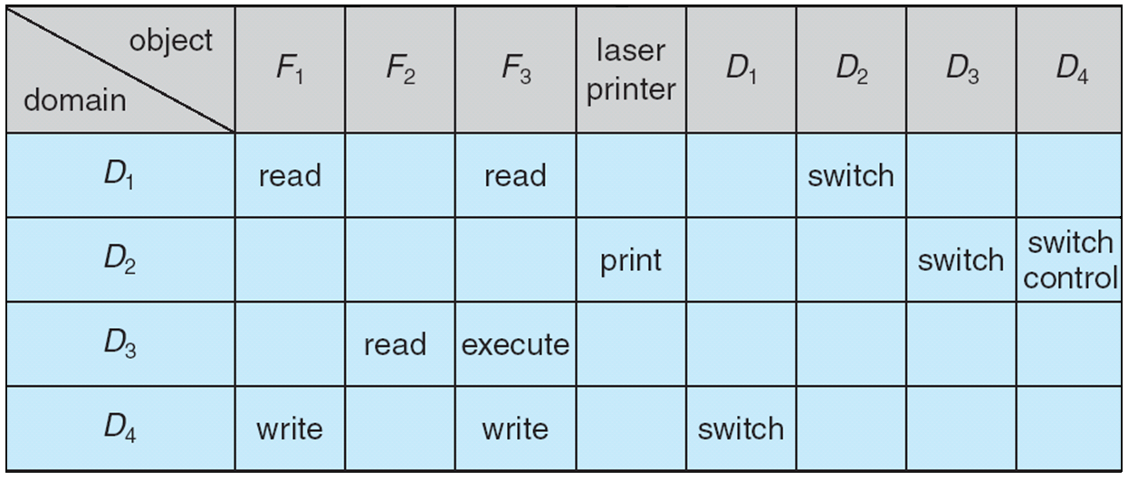
Access Matrix Example

Slide 18
Implementation of Access Matrix
Generally, a sparse matrix
Option 1 – Global table
Store ordered triples < domain, object, rights-set > in table
A requested operation M on object O_{j} within domain D_{i} -> search table for < D_{i}, O_{j}, R_{k} >
with M ∈ R_{k}
But table could be large -> won’t fit in main memory
Difficult to group objects (consider an object that all domains can read)
Option 2 – Access lists for objects
Each column implemented as an access list for one object
Resulting per-object list consists of ordered pairs < domain, rights-set > defining all domains with non-empty set of access rights for the object
Easily extended to contain default set -> If M ∈ default set, also allow access

Slide 19
Implementation of Access Matrix
Option 3 - Capability list for domains
Instead of object-based, list is domain based
Capability list for domain is list of objects together with operations allows on them
Object represented by its name or address, called a capability
Execute operation M on object O_{j}, process requests operation and specifies capability as parameter
Possession of capability means access is allowed

Slide 20
Comparison of Implementations
Many trade-offs to consider
Global table is simple, but can be large
Access lists correspond to needs of users
Determining set of access rights for domain non-localized difficult
Every access to an object must be checked
Many objects and access rights -> slow
Capability lists useful for localizing information for a given process
But revocation capabilities can be inefficient
Lock-key effective and flexible, keys can be passed freely from domain to domain, easy revocation
Most systems use combination of access lists and capabilities
First access to an object -> access list searched
If allowed, capability created and attached to process
Additional accesses need not be checked
After last access, capability destroyed

Slide 21
Revocation of Access Rights
Various options to remove the access right of a domain to an object
Immediate vs. delayed
Selective vs. general
Partial vs. total
Temporary vs. permanent

