Slide 1
UBER INSIGHTS HUB
By : Asneha Shadman

Slide 2
Introduction
This project is about conducting an in-depth data analysis on Uber customer reviews. It involves using SQL for querying and extracting relevant data, Python for data cleaning and analysis, and Power BI for creating an interactive dashboard. The project aims to uncover insights into customer sentiments and experiences, presenting them in a visually engaging format that highlights key trends and metrics. This comprehensive approach offers valuable information for understanding customer satisfaction and identifying areas for service enhancement.

Slide 3
Project Overview :
01.
02.
SQL Queries
Power BI Dashboard
03.
04.
Deep Learning Model Implementation
Uber Review analysis Web Application

Slide 4
Dataset Description
In this project, the data overview comprises two main datasets: SQL data and review data. The SQL data includes comprehensive details about various aspects of Uber's operations. It covers the duration of all cab rides, providing insights into the time taken for trips, and includes fare information, which allows for the analysis of pricing patterns across different routes. The trip details within this dataset highlight the distances covered, offering an understanding of travel patterns and the typical lengths of trips. Additionally, it provides a breakdown of the places included, revealing popular pick-up and drop-off locations, and tracks the frequency of trips to the same destinations, identifying common travel routes and high-demand areas. The data also encompasses user behavior, capturing information on searches made by users for potential destinations and the searches received by drivers, which provides a perspective on the availability of drivers and their responsiveness to demand. Furthermore, the dataset includes data on canceled trips, detailing instances where trips were scheduled but not completed, which can help understand the reasons for cancellations and enhance service reliability.

Slide 5
The second part of the data
The second part of the project involves the analysis of customer reviews using a separate dataset. This data was processed using Python in Google Colab, focusing on extracting and analyzing customer feedback to determine the sentiment of each review. The sentiment analysis categorized reviews as either positive or negative, employing text processing techniques to identify common themes in the feedback. Additionally, a small application was developed using Python to visually present the sentiment analysis results. This application provides an intuitive way to view and interpret the sentiment of reviews, clearly distinguishing between positive and negative feedback. The app helps in understanding customer satisfaction by providing an accessible tool to explore review data, identifying areas where customers are particularly satisfied or dissatisfied. This dual analysis approach, leveraging both SQL and Python, provides a comprehensive understanding of Uber's service performance and customer perceptions, offering valuable insights for improving service quality and customer experience.

Slide 6
SQL Data Analysis
Overview : In this section, we performed an extensive analysis of Uber data using SQL queries. We ran a total of 20 queries to extract and analyze various aspects of trip details, fares, searches, and other related metrics. Here’s a summary of the key findings from the SQL analysis:
Key Metrics:
Total Trips: 983
Total Earnings for Drivers: $751,000
Total Searches: 2,161
Total Trips Cancelled by Drivers: 1,021
Average Fare per Trip: $764
Average Distance Covered per Trip: 14,148 km

Slide 7
Payment Methods:Most Common Payment Method: Credit Card Performance Metrics: Search-to-Estimate Rate: 81.35% (indicating the proportion of searches that resulted in a fare estimate Geographical Insights: Area with the Highest Number of Trips: Dasarahalli Location with the Highest Average Fare: Bangalore South
Summary: The analysis provided a comprehensive view of the trip dynamics, earnings distribution, and user behavior. Key insights such as the area with the highest number of trips and the most frequently used payment method offer valuable information for understanding Uber's operational patterns.

Slide 8
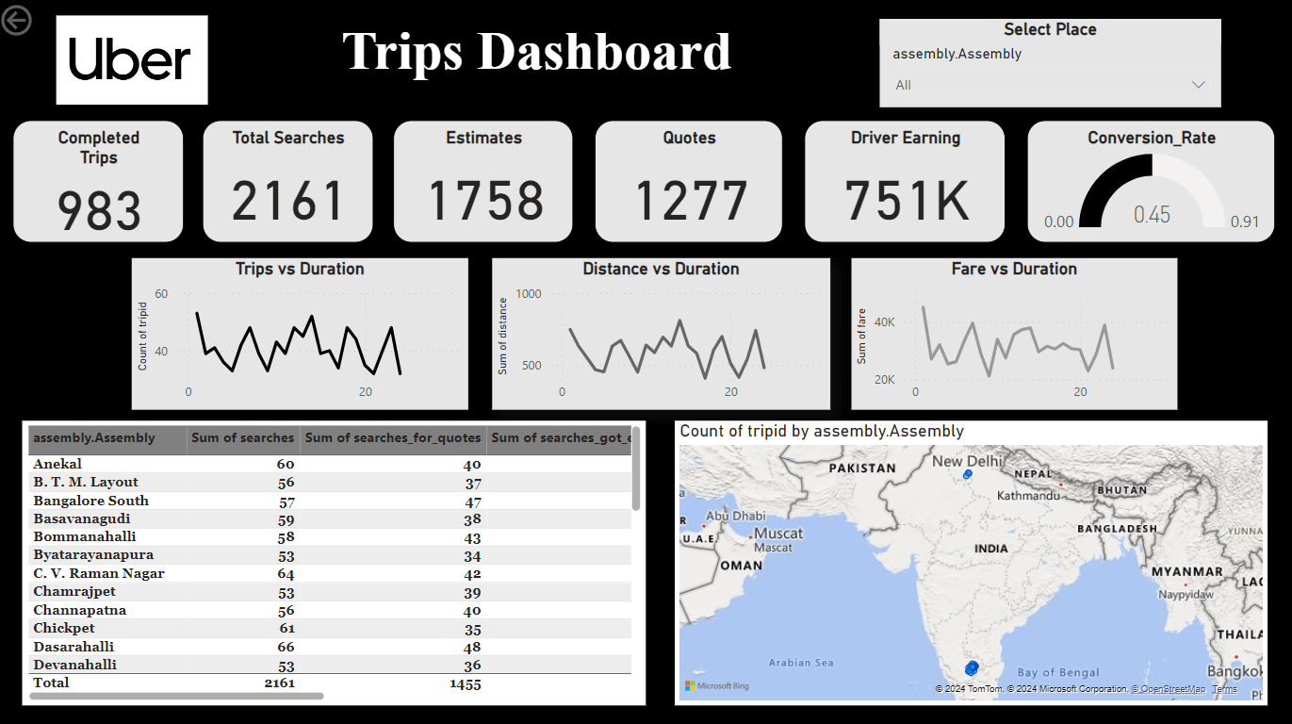
Data Visualization with Power BI

Slide 9

Sentiment Analysis with Python and Deep learning Model
Overview: In this part of the project, we conducted sentiment analysis on Uber reviews using advanced deep learning techniques in Python. The aim was to understand the sentiment expressed in user reviews and gauge overall customer satisfaction.
Approach:
Data Preparation:
Collected and preprocessed review data.
Tokenized and normalized text for analysis.
Deep Learning Model:
Model Used: Long Short-Term Memory (LSTM
Training: Trained the model on labeled sentiment data to classify reviews into positive, negative, or neutral sentiments.
Results:
Sentiment Distribution:
Positive Reviews:30%
Negative Reviews:70%

Slide 10
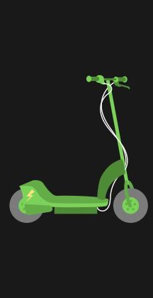
Uber Reviews Web Application
aIn our Uber review web app, we leveraged Google Colab and Gradio to provide an interactive sentiment analysis tool. Here’s how it works:
Google Colab: We used Google Colab to develop and train our deep learning model. The model was trained on Uber review data to classify reviews into positive or negative sentiments.
Gradio: Gradio was integrated to create a user-friendly web interface. Users can input their Uber review into the web app, which then uses the trained model to analyze and classify the sentiment of the review in real-time.
Functionality:
Input: Users enter their Uber review text into the web app.
Output: The app processes the input and provides a classification as either positive or negative based on the sentiment analysis model.
This web app offers a straightforward way to gain insights into the sentiment of Uber reviews, enhancing the understanding of customer feedback and overall service quality.

Slide 11
Reviews example
Positive
Negative
I Uber driver short time passengers said positive things rides The company checks riders allowed use Uber It also background check drivers They send driving directions pickup passengers also destination Then pay week
“I damage vehicle due Uber driver upstairs neighbor used The trim rear wheel well broke The driver leave note He kept calling neighbor Now answer phone Ca get number Uber locate driver”

Slide 12
Results and Insights
SQL Data Analysis Results:
Total Trips Analyzed: 983
Total Earnings for Drivers: Rs.751,000
Total Searches: 2,161
Total Driver-Cancelled Trips: 1,021
Average Fare per Trip: Rs.764
Average Distance Covered per Trip: 14,148 km
Most Common Payment Method: Credit Card
Search-to-Estimate Rate: 81.35%
Area with Highest Trip Frequency: Dasarahalli
Location with Highest Average Fare: Bangalore South
Sentiment Analysis Results:
Positive Reviews: 33.2%
Negative Reviews: 66.8%
Operational Insights: High trip frequency in Dasarahalli and high average fares in Bangalore South suggest areas of high demand and potential revenue opportunities.
Customer Sentiment: The sentiment analysis reveals overall customer satisfaction trends, with the majority of reviews being [positive/negative/neutral]. This information can guide improvements in service quality.
Payment Preferences: The dominance of credit card payments indicates a preference that could inform future payment solutions or promotions.

Slide 13
Future Work
Long-Term Goals:
Predictive Analytics: Develop predictive models to forecast trip demand and fare estimates based on historical data and trends.
Integration with Other Services: Explore integrating the sentiment analysis tool with Uber’s customer service platform for actionable insights and proactive service improvements.

Slide 14
Thank you !

