Slide 1


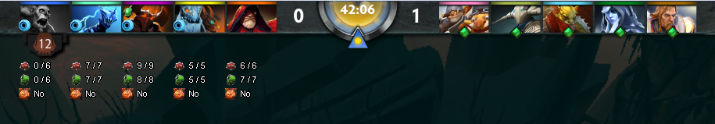



Panel Information
*Gem and Sentry Display can be turned off under Script-Config by setting the value to false and Reloading the script.
Display if enemy carries Gem
Display if enemy carries Sentry
Script will activate if you play Techies
Display “Current Bomb Needed (Current HP) / Max Bomb Needed (Full HP)”
Suicide will calculate based off Current HP if Alive and Max HP if Dead
Calculation done based off Physical Resistance.
Calculation done based off Magical Resistance.
Calculation done based off Physical Resistance.
*Only Full Damage (No partial)
*Take Scepter into account
*Only Full Damage (No partial)

Slide 2
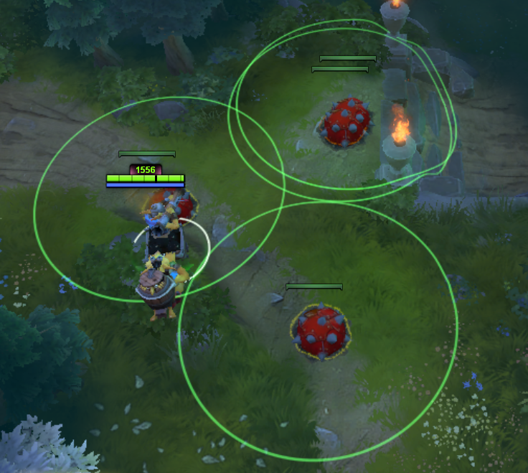
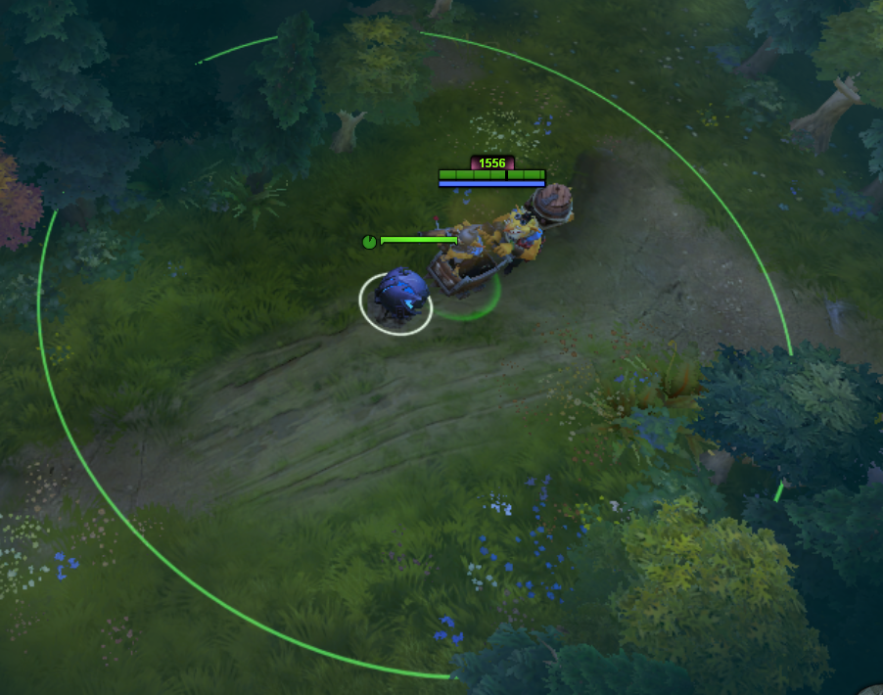
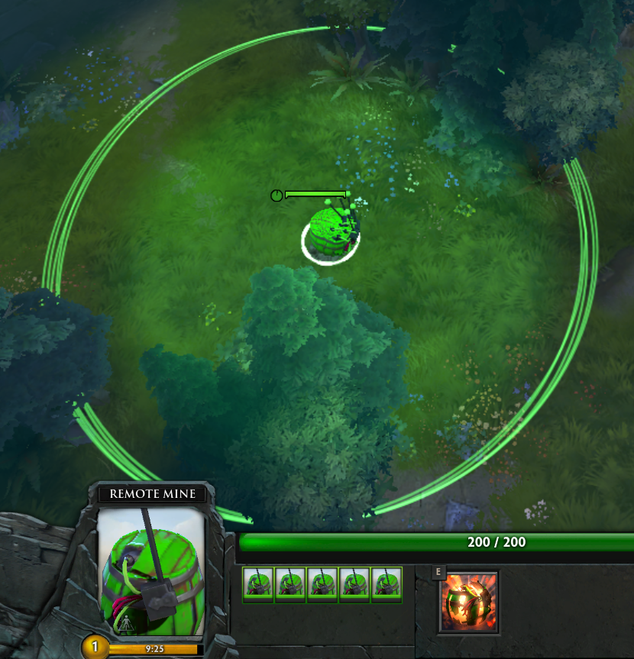
Range Display
*Each Range Display can be turned off under Script-Config by setting the value to false and Reloading the script.
Try to avoid planting in creep path!
Can prepare yourself if it triggers!
Know exact AOE to blow them up!

Slide 3
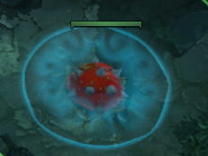
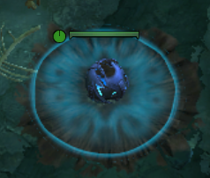
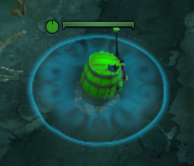
Visibility Display
*Each Visibility Display can be turned off under Script-Config by setting the value to false and Reloading the script.
Generally useful to check if
Sentry is in the area (Stop planting if it is)
Fade time is being seen (Change planting location)

