Slide 1
CS441 – TeamHK FTP APPLICATION 11/28/2016
Developers: Omid Azodi, Evan Causey, Jorge Chavez, Michael le, Jason Martin, Graham Thomas

Slide 2
Environment/tools used
Everyone had:
SLACK for comunication
JIRA tickets assigned
Git for version control
Developed on same virtual machine instance (windows 7)
We didn’t want any “It worked on mine”.

Slide 3
Project management
Iterative development (SCRUM)
Ended up with about 6 sprints (each lasting Approx. 2-3 weeks)
Product backlog/Ticketing system was: JIRA
3 times a week of communication via slack
Once a week meeting
Consisted of:
Testing, learning new concepts as a team.
Fixing problems.
updating code.
Retrospective after every sprint.

Slide 4
Requirements analysis
Actors: FTP User(s), Anyone wanting to connect to an FTP server and manage their files.
FTP User(s): Connect to an ftp server with correct information (host, id, password, port). Able to manipulate files on server side such as renaming, creating, and removing. Able to traverse forward and back on the hierarchy of directories on both server and local side. Upload and download files from server to local or vice versa.
System Requirements Specification
PYTHON (2.7.3 or higher)
KIVY (1.9.1)
Cross platform (MAC OSX, Windows, LINUX)

Slide 5
Requirements analysis
Use cases accomplished:
User makes connection to server ---→ transition to transfer screen
Use adding a new file to server by typing name of file in text box and pressing create button --→ show file added via current directory
User able to traverse to previous directories using “..” button ---→display content from previous directory
SRS for complete list.

Slide 6
Requirements analysis
USE CASES Prioritized:
Based on what would make the ftp an ftp:
For instance: listing the files and directories on both local and server side, then upload and download functionalities
Rather than working on removing a file, before even having the listing of directories/files.
Prioritizing helped our testing process, because if we created the removing a file functionality first we couldn’t test it if we didn’t have the listing files down first. Switching these tasks would allow for proper testing.

Slide 7
DESIGN
Design patterns used:
Iterator
Observer
Singleton

Slide 8
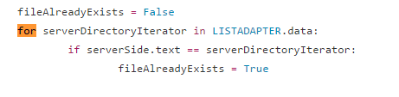

DESIGN
Iterator example code:
1) Traversing LIST ----→
2) Traversing STRING ----→

Slide 9
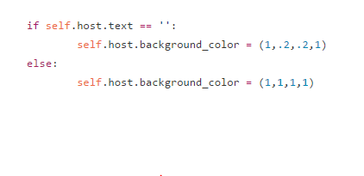
DESIGN
Observer:
Button is binded to a function call that updates the background colors of text inputs on login screen depending if it is empty when the connect button is pressed.
This functionality is built in kivy

Slide 10
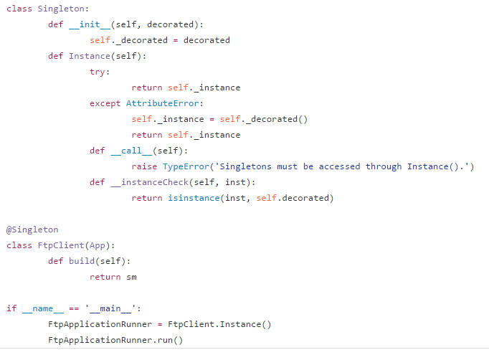
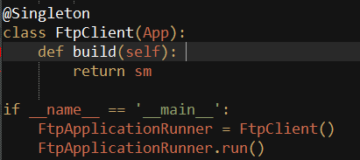

DESIGN
Singleton
(Must access through instance)
←--- ERROR:

Slide 11
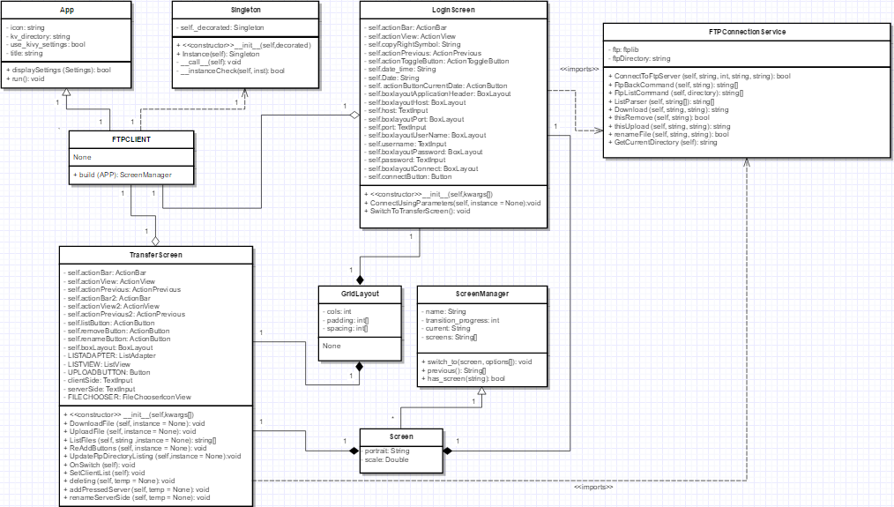
Design UML Class Diagram OVERview

Slide 12
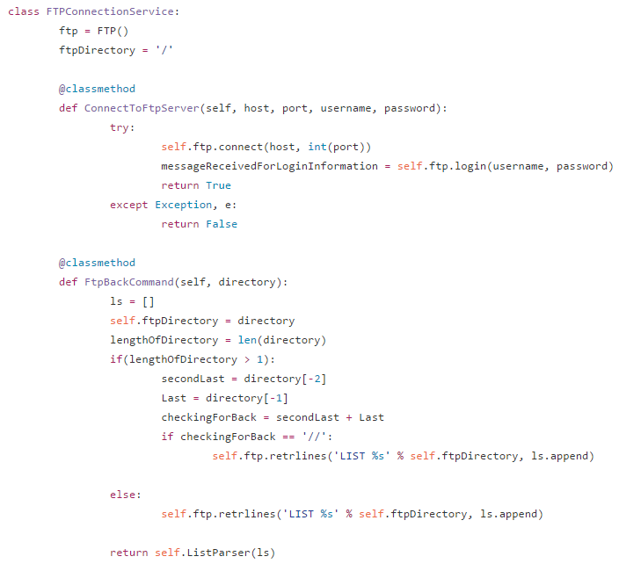
Implementation
This class:
Allowed FTP
functionality to be
compact, and reused
In other files/code.

Slide 13
Testing/test plan
Test plan:
Test based off our “use cases”.
We tested our functionality on both local ftp server and other ftp servers we had access to such as (test.rebex.net, and ftp.debian.org).
Lots of manual testing
Making sure outputs/functionality works when user does something expected/unexpected on gui
Testing one functionality at a time on multiple ftp servers, before proceeding to next functionality.
Example: Trying to connect to a non-ftp server would crash program (make sure its handled)
Testing led to defensive programming:
Had to handle errors accordingly and properly notify the user via (popup, or color changes, etc.)

Slide 14
What we would accomplish with more time
Removing directories
Login history (being able to connect with previous information)
Adding content to file when creating
Example: creating a test.txt with content of “I love software” rather than creating a blank test.txt file.

Slide 15
CS441 - Complete
That’s it!
THANK YOU!

