Slide 1


Chapter 2—Programming by Example
Java
The Art and Science of
An Introduction
C H A P T E R 2
ERIC S. ROBERTS
to Computer Science
Programming by Example
Example is always more efficacious than precept.
—Samuel Johnson, Rasselas, 1759
2.1 The “Hello world” program
2.2 Perspectives on the programming process
2.3 A program to add two numbers
2.4 Programming idioms and patterns
2.5 Classes and objects
2.6 Graphical programs

Slide 2
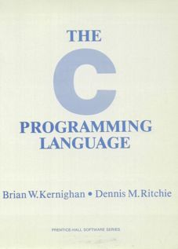
The “Hello World” Program
One of the important influences on the design of Java was the C programming language, which was developed at Bell Labs in the early 1970s. The primary reference manual for C was written by Brian Kernighan and Dennis Ritchie.
1.1 Getting Started
The only way to learn a new programming language is to write programs in it. The first program to write is the same for all languages:
Print the words
hello, world
This is the big hurdle; to leap over it you have to be able to create the program text somewhere, compile it, load it, run it, and find out where your output went. With these mechanical details mastered, everything else is comparatively easy.
In C, the program to print “hello, world” is
#include <stdio.h>
main() {
printf("hello, world");
}
On the first page of their book, the authors suggest that the first step in learning any language is to write a simple program that prints the message “hello, world” on the display. That advice remains sound today.

Slide 3
The “Hello World” Program in Java
The simple “Hello World” example illustrates several features that are common to the programs you will see in this book.
This first few lines (everything between /* and */) are an example of a comment, which is intended for human readers.
The next two lines are the imports, which indicate what library packages the program uses.
The last few lines in the file define the HelloProgram class, which the extends keyword identifies as a GraphicsProgram.
A class definition in Java typically contains a series of entries. This example has one entry, which is a method called run.
A Java method consists of a series of statements. Here, the only statement is a call to add, which adds an object to the display.
The object to be added is indicated by supplying an argument to the add method. Here, the argument is a new GLabel object.
In Java, objects are created by using a constructor, which consists of the keyword new followed by the class name and arguments.
The arguments supply information that the constructor needs to make the object, such as the string to display and the coordinates.
The next slide simulates the operation of HelloProgram so that you can get a sense of what appears on the display.
/*
* File: HelloProgram.java
* -----------------------
* This program displays "hello, world" on the screen.
* It is inspired by the first program in Brian
* Kernighan and Dennis Ritchie's classic book,
* The C Programming Language.
*/
import acm.graphics.*;
import acm.program.*;
public class HelloProgram extends GraphicsProgram {
public void run() {
add( new GLabel( "hello, world", 100, 75 ) );
}
}
/*
* File: HelloProgram.java
* -----------------------
* This program displays "hello, world" on the screen.
* It is inspired by the first program in Brian
* Kernighan and Dennis Ritchie's classic book,
* The C Programming Language.
*/
import acm.graphics.*;
import acm.program.*;
public class HelloProgram extends GraphicsProgram {
public void run() {
add( new GLabel( "hello, world", 100, 75 ) );
}
}
/*
* File: HelloProgram.java
* -----------------------
* This program displays "hello, world" on the screen.
* It is inspired by the first program in Brian
* Kernighan and Dennis Ritchie's classic book,
* The C Programming Language.
*/
import acm.graphics.*;
import acm.program.*;
public class HelloProgram extends GraphicsProgram {
public void run() {
add( new GLabel( "hello, world", 100, 75 ) );
}
}

Slide 4
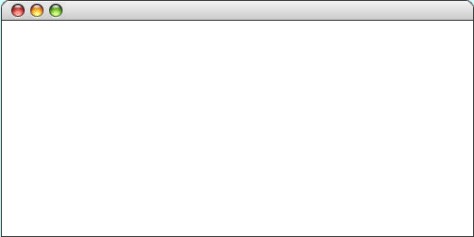
The “Hello World” Program in Java
import acm.graphics.*;
import acm.program.*;
public class HelloProgram extends GraphicsProgram {
public void run() {
add( new GLabel("hello, world", 100, 75) );
}
}
import acm.graphics.*;
import acm.program.*;
public class HelloProgram extends GraphicsProgram {
public void run() {
add( new GLabel("hello, world", 100, 75) );
}
}
HelloProgram
hello, world

Slide 5

Perspectives on the Programming Process
In his Pulitzer-prizewinning book, computer scientist Douglas Hofstadter identifies two concepts—holism and reductionism—that turn out to be important as you begin to learn about programming.
Hofstadter explains these concepts in the form of a dialogue in the style of Lewis Carroll:
Achilles:
I will be glad to indulge both of you, if you will first oblige me, by telling me the meaning of these strange expressions, “holism” and “reductionism”.
Crab:
Holism is the most natural thing in the world to grasp. It’s simply the belief that “the whole is greater than the sum of its parts”. No one in his right mind could reject holism.
Anteater:
Reductionism is the most natural thing in the world to grasp. It’s simply the belief that “a whole can be understood completely if you understand its parts, and the nature of their ‘sum’”. No one in her left brain could reject reductionism.

Slide 6
A Program to Add Two Numbers
The holistic perspective is particularly useful when you are first learning to program. When you look at a program, you should concentrate on understanding its operation in a general way rather than focusing on the details. Consider, for example, the following program, which adds two integers and prints their sum:
This program is an example of a ConsoleProgram, which reads input from the keyboard and displays characters on the screen. Such programs are not as exciting as graphical applications but are useful for illustrating programming concepts.
As you saw in the case of the HelloProgram example, Java programs written using the acm.program package begin by executing the statements in the run method.
The first statement in the program prints a message to the user describing what the program does.
The next two statements read the input values from the user, each of which is a whole number, which is more formally called an integer. The input values are stored in memory cells called variables that serve as placeholders for those values.
The next statement computes the sum by adding the values stored in the variables n1 and n2. In this statement, the + operator represents addition, as in standard mathematics.
The final statement in the run method displays the result. In this statement, the + operator signifies concatenation, which consists of combining the operands together as strings.
The next slide animates the operation of this program to illustrate the assignment of values to variables.
import acm.program.*;
public class Add2Integers extends ConsoleProgram {
public void run() {
println("This program adds two numbers.");
int n1 = readInt("Enter n1: ");
int n2 = readInt("Enter n2: ");
int total = n1 + n2;
println("The total is " + total + ".");
}
}
import acm.program.*;
public class Add2Integers extends ConsoleProgram {
public void run() {
println("This program adds two numbers.");
int n1 = readInt("Enter n1: ");
int n2 = readInt("Enter n2: ");
int total = n1 + n2;
println("The total is " + total + ".");
}
}

Slide 7
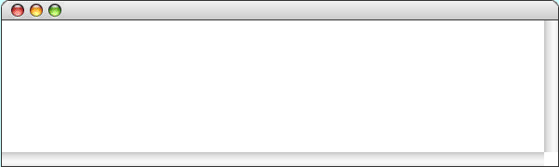
The Add2Integers Program
class Add2Integers extends ConsoleProgram {
public void run() {
println("This program adds two numbers.");
int n1 = readInt("Enter n1: ");
int n2 = readInt("Enter n2: ");
int total = n1 + n2;
println("The total is " + total + ".");
}
}
class Add2Integers extends ConsoleProgram {
public void run() {
println("This program adds two numbers.");
int n1 = readInt("Enter n1: ");
int n2 = readInt("Enter n2: ");
int total = n1 + n2;
println("The total is " + total + ".");
}
}
n1
n2
total
n1
n2
total
17
17
25
25
42
42
Add2Integers
This program adds two numbers.
Enter n1:
17
Enter n2:
25
The total is 42.

Slide 8
Programming Idioms and Patterns
Experienced programmers also often take a holistic approach to programming. Effective programmers can recognize a variety of common operations and have learned a standard solution strategy for each one. The code that implements such a solution strategy is called a programming idiom or programming pattern. Learning to use these patterns saves you from having to think about the nitty-gritty details.
As an example, it is important to think of a statement like
int n1 = readInt("Enter n1: ");
not in terms of what each part of the statement means, but rather as a holistic pattern to read an integer from the user:
int variable = readInt("prompt");

Slide 9
Classes and Objects
As described in the slides for Chapter 1, Java programs are written as collections of classes, which serve as templates for individual objects. Each object is an instance of a particular class, which can serve as a pattern for many different objects.
Classes in Java form hierarchies. Except for the class named Object that stands at the top of the hierarchy, every class in Java is a subclass of some other class, which is called its superclass. A class can have many subclasses, but each class has only one superclass.
A class represents a specialization of its superclass. If you create an object that is an instance of a class, that object is also an instance of all other classes in the hierarchy above it in the superclass chain.
When you define a new class in Java, that class automatically inherits the behavior of its superclass.

Slide 10
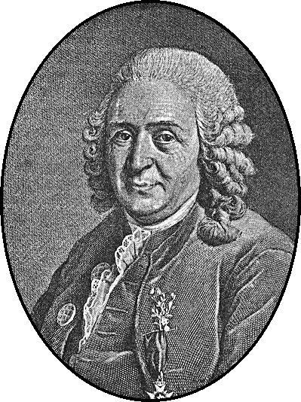
Biological Models of Class Structure
The structure of Java’s class hierarchy resembles the biological classification scheme introduced by Scandinavian botanist Carl Linnaeus in the 18th century. Linnaeus’s contribution was to recognize that organisms fit into a hierarchical classification scheme in which the placement of individual species reflects anatomical similarities.
Carl Linnaeus (1707–1778)

Slide 11
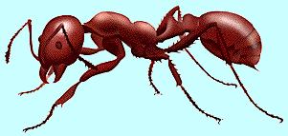

Biological Class Hierarchy
Living Things
Kingdom
Plants
Animals
Fungi
Phylum
Annelida
Brachiopoda
Arthropoda
Mollusca
Chordata
Order
Crustacea
Insecta
Arachnida
Class
Hymenoptera
Formicidae
Every red ant is also an animal, an arthropod, and an insect, as well as the other superclasses in the chain.
Family
Classification of the red ant Iridomyrmex purpureus
Note that there can be many individual red ants, each of which is an instance of the same basic class.
Genus
Iridomyrmex
Species
purpureus

Slide 12
The Program Hierarchy
Java class hierarchies are similar to the biological class hierarchy from the previous slide. This diagram, for example, shows the hierarchy formed by the classes in the acm.program package.
Applet
Every ConsoleProgram is also a Program, a JApplet, and an Applet. That means that every ConsoleProgram can run as an applet on the web. The same is true for any DialogProgram or GraphicsProgram.
JApplet
Program
ConsoleProgram
DialogProgram
GraphicsProgram

Slide 13
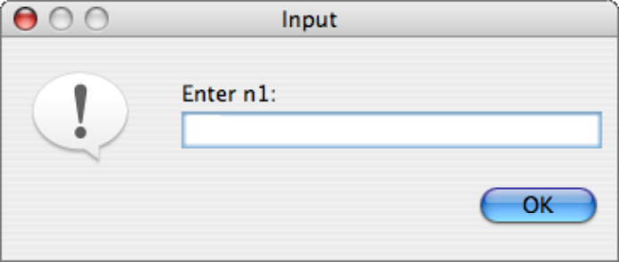
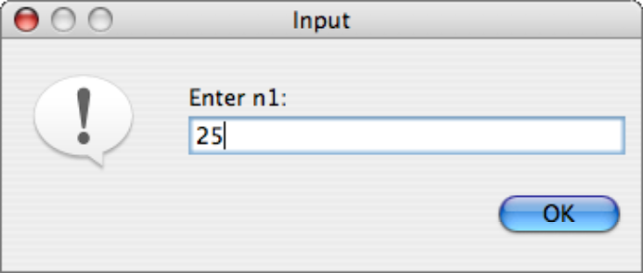
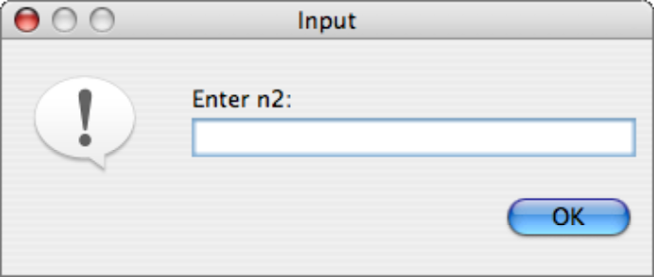
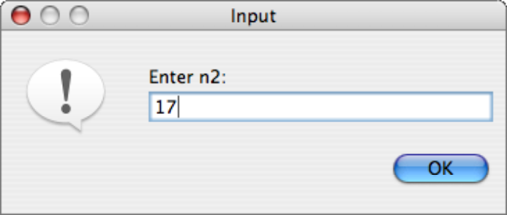
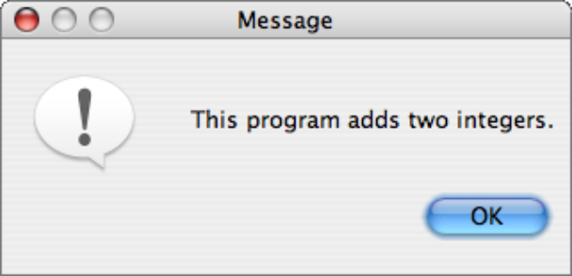
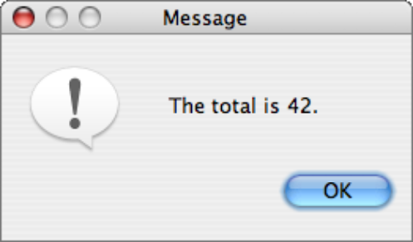
The DialogProgram Class
In object-oriented languages like Java, a class definition specifies the behavior of objects of that class. The DialogProgram class has exactly the same operations as the ConsoleProgram class; the only difference is that the input and output operations use popup dialogs instead of a console, as illustrated by the following implementation of AddTwoIntegers:
public class Add2Integers extends DialogProgram {
public void run() {
println("This program adds two numbers.");
int n1 = readInt("Enter n1: ");
int n2 = readInt("Enter n2: ");
int total = n1 + n2;
println("The total is " + total + ".");
}
}
public class Add2Integers extends DialogProgram {
public void run() {
println("This program adds two numbers.");
int n1 = readInt("Enter n1: ");
int n2 = readInt("Enter n2: ");
int total = n1 + n2;
println("The total is " + total + ".");
}
}

Slide 14
Graphical Programs
The GraphicsProgram class makes it possible to create simple pictures on the screen. The conceptual model is that of a collage composed of objects on a canvas.
Running a GraphicsProgram creates a window that serves as the background canvas for the collage. You create pictures by creating graphical objects of various kinds and then adding those objects to the canvas.
In this chapter, you will learn how to work with labels, rectangles, ovals, and lines using the classes GLabel, GRect, GOval, and GLine. The complete set of graphics classes is introduced in Chapter 9.

Slide 15
Sending Messages to Objects
In many applications, you will need to change the appearance of a graphical object after you have created it. For example, you might want to have the object change its color or move to a new position on the canvas.
In object-oriented languages like Java, such changes are the responsibility of the object. To change the color of an object you send a message to the object asking it to change color.
Java uses the following syntax to send a message to an object:
receiver.name(arguments);
where receiver is the object to which the message is directed, name identifies the type of message, and arguments is a list of values used to specify any other information associated with the message.

Slide 16
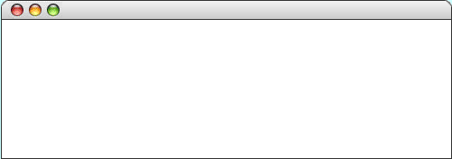
Sending Messages to a GLabel
The following program illustrates sending a message to an object. Note that the label doesn’t appear until it is added to the canvas.
public class HelloProgram extends GraphicsProgram {
public void run() {
GLabel label = new GLabel("hello, world", 100, 75);
label.setFont("SansSerif-36");
label.setColor(Color.RED);
add(label);
}
}
public class HelloProgram extends GraphicsProgram {
public void run() {
GLabel label = new GLabel("hello, world", 100, 75);
label.setFont("SansSerif-36");
label.setColor(Color.RED);
add(label);
}
}
label
label
hello, world
hello, world
hello, world
hello, world
HelloProgram
hello, world
skip simulation

Slide 17
The Java Coordinate System
Positions and distances in a graphics program are measured in terms of pixels, which are the individual dots that cover the screen.
Unlike traditional mathematics, Java defines the origin of the coordinate system to be in the upper left corner. Values for the x coordinate increase as you move rightward across the screen; y coordinate values increase as you move downward.
Creating a JLabel at a particular x and y position means that the baseline of the first character in the label appears at that point, as follows:
HelloProgram
Hello
(100, 75)

Slide 18
The GObject Hierarchy
The classes that represent graphical objects form a hierarchy, part of which looks like this:
GObject
GLabel
GRect
GOval
GLine
The GObject class represents the collection of all graphical objects. The four subclasses shown in this diagram correspond to particular types of objects: labels, rectangles, ovals, and lines. The class diagram makes it clear that any GLabel, GRect, GOval, or GLine is also a GObject.
Operations on graphical objects are defined at each level of the hierarchy. Operations that apply to all graphical objects are specified at the GObject level, where they are inherited by each subclass. Operations that apply to a particular subclass are specified as part of the definition of that class.

Slide 19
Operations on the GObject Class
The following operations apply to all GObjects:
object.setColor(color)
Sets the color of the object to the specified color constant.
object.setLocation(x, y)
Changes the location of the object to the point (x, y).
object.move(dx, dy)
Moves the object on the screen by adding dx and dy to its current coordinates.
The standard color names are defined in the java.awt package:
Color.BLACK
Color.DARK_GRAY
Color.GRAY
Color.LIGHT_GRAY
Color.WHITE
Color.RED
Color.YELLOW
Color.GREEN
Color.CYAN
Color.BLUE
Color.MAGENTA
Color.ORANGE
Color.PINK

Slide 20
Operations on the GLabel Class
Constructor
new GLabel(text, x, y)
Creates a label containing the specified text that begins at the point (x, y).
Methods specific to the GLabel class
label.setFont( font)
Sets the font used to display the label as specified by the font string.
The font is typically specified as a string in the form
"family-style-size"
where
family is the name of a font family
style is either PLAIN, BOLD, ITALIC, or BOLDITALIC
size is an integer indicating the point size

Slide 21
Drawing Geometrical Objects
Constructors
new GRect( x, y, width, height)
Creates a rectangle whose upper left corner is at (x, y) of the specified size.
new GOval( x, y, width, height)
Creates an oval that fits inside the rectangle with the same dimensions.
new GLine( x₀, y₀, x₁, y₁)
Creates a line extending from (x₀, y₀) to (x₁, y₁).
Methods shared by the GRect and GOval classes
object.setFilled( fill)
If fill is true, fills in the interior of the object; if false, shows only the outline.
object.setFillColor( color)
Sets the color used to fill the interior, which can be different from the border.

Slide 22
The GRectPlusGOval Program
public class GRectPlusGOval extends GraphicsProgram {
public void run() {
GRect rect = new GRect(100, 50, 125, 60);
rect.setFilled(true);
rect.setColor(Color.RED);
add(rect);
GOval oval = new GOval(100, 50, 125, 60);
oval.setFilled(true);
oval.setFillColor(Color.GREEN);
add(oval);
}
}
public class GRectPlusGOval extends GraphicsProgram {
public void run() {
GRect rect = new GRect(100, 50, 125, 60);
rect.setFilled(true);
rect.setColor(Color.RED);
add(rect);
GOval oval = new GOval(100, 50, 125, 60);
oval.setFilled(true);
oval.setFillColor(Color.GREEN);
add(oval);
}
}
rect
rect
oval
oval
GRectPlusGOval
skip simulation

Slide 23
The End

