Slide 1


Chapter 14—Looking Ahead
Java
The Art and Science of
An Introduction
C H A P T E R 1 4
ERIC S. ROBERTS
to Computer Science
Looking Ahead
The best way to predict the future is to invent it.
—Alan Kay, Xerox Palo Alto Research Center, 1972
14.1 Recursion
14.2 Concurrency
14.3 Using the network
14.4 Programming patterns

Slide 2
Recursion
This chapter offers a brief introduction to four topics that are sometimes included an introductory computer science course.
The first of these topics is recursion, which is the process of solving a problem by dividing it into smaller subproblems of the same form. The italicized phrase is the essential characteristic of recursion; without it, all you have is a description of stepwise refinement as discussed in Chapter 5.
The fact that recursive decomposition generates subproblems that have the same form as the original problem means that recursive programs will use the same method to solve subproblems at different levels of the solution. In terms of the structure of the code, the defining characteristic of recursion is having methods that call themselves, directly or indirectly, as the decomposition process proceeds.

Slide 3
A Simple Illustration of Recursion
Suppose that you are the national fundraising director for a charitable organization and need to raise $1,000,000.
One possible approach is to find a wealthy donor and ask for a single $1,000,000 contribution. The problem with that strategy is that individuals with the necessary combination of means and generosity are difficult to find. Donors are much more likely to make contributions in the $10 range.
Another strategy would be to ask 100,000 friends for $10 each. Unfortunately, most of us don’t have 100,000 friends.
There are, however, more promising strategies. You could, for example, find ten regional coordinators and charge each one with raising $100,000. Those regional coordinators could in turn delegate the task to local coordinators, each with a goal of $10,000, continuing the process reached a manageable contribution level.

Slide 4
A Simple Illustration of Recursion
The following diagram illustrates the recursive strategy for raising $1,000,000 described on the previous slide:
Goal:
$1,000,000
Goal:
$100,000
Goal:
$100,000
Goal:
$100,000
Goal:
$100,000
Goal:
$100,000
Goal:
$100,000
Goal:
$100,000
Goal:
$100,000
Goal:
$100,000
Goal:
$100,000
Goal:
$10,000
Goal:
$10,000
Goal:
$10,000
Goal:
$10,000
Goal:
$10,000
Goal:
$10,000
Goal:
$10,000
Goal:
$10,000
Goal:
$10,000
Goal:
$10,000
Goal:
$1000
Goal:
$1000
Goal:
$1000
Goal:
$1000
Goal:
$1000
Goal:
$1000
Goal:
$1000
Goal:
$1000
Goal:
$1000
Goal:
$1000
Goal:
$100
Goal:
$100
Goal:
$100
Goal:
$100
Goal:
$100
Goal:
$100
Goal:
$100
Goal:
$100
Goal:
$100
Goal:
$100

Slide 5
A Pseudocode Fundraising Strategy
If you were to implement the fundraising strategy in the form of a Java method, it would look something like this:
private void collectContributions(int n) {
if (n <= 100) {
Collect the money from a single donor.
} else {
Find 10 volunteers.
Get each volunteer to collect n/10 dollars.
Combine the money raised by the volunteers.
}
}
What makes this strategy recursive is that the line
Get each volunteer to collect n/10 dollars.
will be implemented using the following recursive call:
collectContributions(n / 10);

Slide 6
Recursive Functions
The easiest examples of recursion to understand are functions in which the recursion is clear from the definition. As an example, consider the factorial function from Chapter 5, which can be defined in either of the following ways:
n! = n ^{x} (n - 1) ^{x} (n - 2) ^{x} . . . ^{x} 3 ^{x} 2 ^{x} 1
1
if n is 0
n! =
n ^{x} (n - 1)!
otherwise
The second definition leads directly to the following code, which is shown in simulated execution on the next slide:
private int factorial(int n) {
if (n == 0) {
return 1;
} else {
return n * factorial(n - 1);
}
}

Slide 7
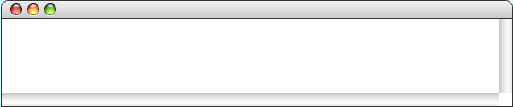
Simulating the factorial Method
public void run() {
int n = readInt("Enter n: ");
println(n + "! = " + factorial(n) );
}
private int factorial(int n) {
if (n == 0) {
return 1;
} else {
return n * factorial(n - 1);
}
}
private int factorial(int n) {
if (n == 0) {
return 1;
} else {
return n * factorial(n - 1);
}
}
120
n
private int factorial(int n) {
if (n == 0) {
return 1;
} else {
return n * factorial(n - 1);
}
}
5
private int factorial(int n) {
if (n == 0) {
return 1;
} else {
return n * factorial(n - 1);
}
}
n
5
private int factorial(int n) {
if (n == 0) {
return 1;
} else {
return n * factorial(n - 1);
}
}
24
n
4
private int factorial(int n) {
if (n == 0) {
return 1;
} else {
return n * factorial(n - 1);
}
}
private int factorial(int n) {
if (n == 0) {
return 1;
} else {
return n * factorial(n - 1);
}
}
6
n
3
2
n
2
1
n
1
n
1
n
0
0
Factorial
Enter n:
5
5! = 120
skip simulation

Slide 8
The Recursive “Leap of Faith”
The purpose of going through the complete decomposition of the calculation of factorial(5) is to convince you that the process works and that recursive calls are in fact no different from other method calls, at least in their internal operation.
The danger with going through these details is that it might encourage you to do the same when you write your own recursive programs. As it happens, tracing through the details of a recursive program almost always makes such programs harder to write. Writing recursive programs becomes natural only after you have enough confidence in the process that you don’t need to trace them fully.
As you write a recursive program, it is important to believe that any recursive call will return the correct answer as long as the arguments define a simpler subproblem. Believing that to be true—even before you have completed the code—is called the recursive leap of faith.

Slide 9
The Recursive Paradigm
Most recursive methods you encounter in an introductory course have bodies that fit the following general pattern:
if (test for a simple case) {
Compute and return the simple solution without using recursion.
} else {
Divide the problem into one or more subproblems that have the same form.
Solve each of the problems by calling this method recursively.
Return the solution from the results of the various subproblems.
}
Finding a recursive solution is mostly a matter of figuring out how to break it down so that it fits the paradigm. When you do so, you must do two things:
1.
Identify simple cases that can be solved without recursion.
2.
Find a recursive decomposition that breaks each instance of the problem into simpler subproblems of the same type, which you can then solve by applying the method recursively.

Slide 10
Exercise: A Recursive gcd Function
Solution: A Recursive gcd Function
In the discussion of algorithmic methods in Chapter 5, one of the primary examples was Euclid’s algorithm for computing the greatest common divisor of two integers, x and y. Euclid’s algorithm can be implemented using the following code:
public int gcd(int x, int y) {
if (y == 0) {
return x;
} else {
return gcd(y, x % y);
}
}
public int gcd(int x, int y) {
int r = x % y;
while (r != 0) {
x = y;
y = r;
r = x % y;
}
return y;
}
As always, the key to solving this problem lies in identifying the recursive decomposition and defining appropriate simple cases.
Rewrite this method so that it uses recursion instead of iteration, taking advantage of Euclid’s insight that the greatest common divisor of x and y is also the greatest common divisor of the y and the remainder of x divided by y.

Slide 11
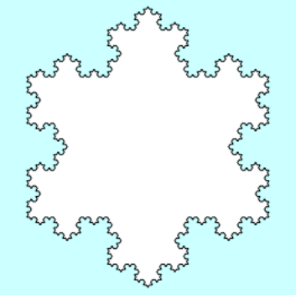
Graphical Recursion
Recursion comes up in certain graphical applications, most notably in the creation of fractals, which are mathematical structures that consist of similar figures repeated at various different scales. Fractals were popularized in a 1982 book by Benoit Mandelbrot entitled The Fractal Geometry of Nature.
One of the simplest fractal patterns to draw is the Koch fractal, named after its inventor, the Swedish mathematician Helge von Koch (1870-1924). The Koch fractal is sometimes called a snowflake fractal because of the beautiful, six-sided symmetries it displays as the figure becomes more detailed. as illustrated in the following diagram:

Slide 12
Drawing Koch Fractals
The process of drawing a Koch fractal begins with an equilateral triangle, as shown in the diagram on the lower left.
From the initial position (which is called a fractal of order 0), each higher fractal order is created by replacing each line segment in the figure by four segments that connect the same endpoints but include an equilateral wedge in the middle.
order 0
order 1
order 2
The figure on the previous slide is the Koch fractal of order 4.

Slide 13
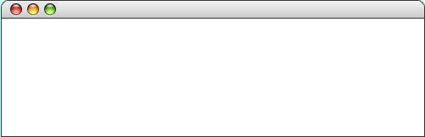
Simulating the Snowflake Program
public void run() {
SnowflakeFractal fractal = new SnowflakeFractal(100, 2) ;
fractal.setFilled(true);
fractal.setFillColor(Color.MAGENTA);
add(fractal, getWidth() / 2, getHeight() / 2);
}
public void run() {
SnowflakeFractal fractal = new SnowflakeFractal(100, 2) ;
fractal.setFilled(true);
fractal.setFillColor(Color.MAGENTA);
add(fractal, getWidth() / 2, getHeight() / 2);
}
public SnowflakeFractal(double edge, int order) {
addVertex(-edge / 2, -edge / (2 * Math.sqrt(3)));
addFractalLine(edge, 0, order);
addFractalLine(edge, -120, order);
addFractalLine(edge, +120, order);
}
public SnowflakeFractal(double edge, int order) {
addVertex(-edge / 2, -edge / (2 * Math.sqrt(3)));
addFractalLine(edge, 0, order);
addFractalLine(edge, -120, order);
addFractalLine(edge, +120, order);
}
private void addFractalLine(double r, int theta, int order) {
if (order == 0) {
addPolarEdge(r, theta);
} else {
addFractalLine(r / 3, theta, order - 1);
addFractalLine(r / 3, theta + 60, order - 1);
addFractalLine(r / 3, theta - 60, order - 1);
addFractalLine(r / 3, theta, order - 1);
}
}
private void addFractalLine(double r, int theta, int order) {
if (order == 0) {
addPolarEdge(r, theta);
} else {
addFractalLine(r / 3, theta, order - 1);
addFractalLine(r / 3, theta + 60, order - 1);
addFractalLine(r / 3, theta - 60, order - 1);
addFractalLine(r / 3, theta, order - 1);
}
}
fractal
private void addFractalLine(double r, int theta, int order) {
if (order == 0) {
addPolarEdge(r, theta);
} else {
addFractalLine(r / 3, theta, order - 1);
addFractalLine(r / 3, theta + 60, order - 1);
addFractalLine(r / 3, theta - 60, order - 1);
addFractalLine(r / 3, theta, order - 1);
}
}
this
this
private void addFractalLine(double r, int theta, int order) {
if (order == 0) {
addPolarEdge(r, theta);
} else {
addFractalLine(r / 3, theta, order - 1);
addFractalLine(r / 3, theta + 60, order - 1);
addFractalLine(r / 3, theta - 60, order - 1);
addFractalLine(r / 3, theta, order - 1);
}
}
private void addFractalLine(double r, int theta, int order) {
if (order == 0) {
addPolarEdge(r, theta);
} else {
addFractalLine(r / 3, theta, order - 1);
addFractalLine(r / 3, theta + 60, order - 1);
addFractalLine(r / 3, theta - 60, order - 1);
addFractalLine(r / 3, theta, order - 1);
}
}
private void addFractalLine(double r, int theta, int order) {
if (order == 0) {
addPolarEdge(r, theta);
} else {
addFractalLine(r / 3, theta, order - 1);
addFractalLine(r / 3, theta + 60, order - 1);
addFractalLine(r / 3, theta - 60, order - 1);
addFractalLine(r / 3, theta, order - 1);
}
}
private void addFractalLine(double r, int theta, int order) {
if (order == 0) {
addPolarEdge(r, theta);
} else {
addFractalLine(r / 3, theta, order - 1);
addFractalLine(r / 3, theta + 60, order - 1);
addFractalLine(r / 3, theta - 60, order - 1);
addFractalLine(r / 3, theta, order - 1);
}
}
this
edge
order
edge
order
this
100.0
2
100.0
2
this
this
this
this
r
theta
order
100.0
0
2
r
theta
order
33.33
0
1
r
r
r
r
theta
theta
theta
theta
order
order
order
order
11.11
11.11
11.11
11.11
60
0
–60
0
0
0
0
0
Snowflake
skip simulation

Slide 14
Concurrency
One of the initial design criteria for Java was that it be able to support concurrency, which is simply the ability to carry on several activities in parallel, even on computers that have only one processor.
The classical approach to supporting concurrency is called multiprogramming, in which a computer with a single processor runs multiple programs by sharing that processor among each of the individual processes. The computer runs one process for a short period and then switches over to one of the other processes, cycling around the different tasks to ensure that they all get a fair share of processor time.
Java supports concurrency at a lower level by allowing users to create new threads, which are independent activities that coexist when the same program and share access to the same memory space. As in multiprogramming, a multithreaded system shares the processor among the active threads.

Slide 15
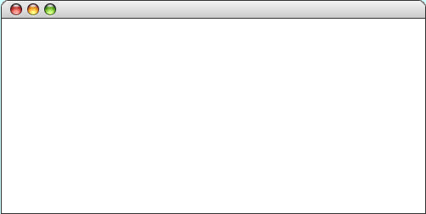
A Simple Concurrent Application
The TestAnimatedSquare program on the next slide offers a simple illustration of multithreaded programming.
Each of the squares shown in the sample run below is an instance of the AnimatedSquare class, which implements the Runnable interface which allows it to support a thread.
The run method for each square causes it to move in a random direction, which changes every 50 steps.
TestAnimatedSquare

Slide 16
The TestAnimatedSquare Program
/**
* This program tests the AnimatedSquare class by putting two squares
* on the screen and having them move independently.
*/
public class TestAnimatedSquare extends GraphicsProgram {
public void run() {
double x1 = getWidth() / 3 - SQUARE_SIZE / 2;
double x2 = 2 * getWidth() / 3 - SQUARE_SIZE / 2;
double y = (getHeight() - SQUARE_SIZE) / 2;
AnimatedSquare redSquare = new AnimatedSquare(SQUARE_SIZE);
redSquare.setFilled(true);
redSquare.setColor(Color.RED);
add(redSquare, x1, y);
AnimatedSquare greenSquare = new AnimatedSquare(SQUARE_SIZE);
greenSquare.setFilled(true);
greenSquare.setColor(Color.GREEN);
add(greenSquare, x2, y);
Thread redSquareThread = new Thread(redSquare);
Thread greenSquareThread = new Thread(greenSquare);
waitForClick();
redSquareThread.start();
greenSquareThread.start();
}
/* Private constants */
private static final double SQUARE_SIZE = 75;
}

Slide 17
The AnimatedSquare Class
/**
* This class creates an animated square that has its own thread of control.
* Once started, the square moves in a random direction every time step.
* After CHANGE_TIME time steps, the square picks a new random direction.
*/
public class AnimatedSquare extends GRect implements Runnable {
/* Creates a new AnimatedSquare of the specified size */
public AnimatedSquare(double size) {
super(size, size);
}
/* Runs when this object is started to animate the square */
public void run() {
for (int t = 0; true; t++) {
if (t % CHANGE_TIME == 0) {
direction = rgen.nextDouble(0, 360);
}
movePolar(DELTA, direction);
pause(PAUSE_TIME);
}
}
/* Private constants */
private static final double DELTA = 2; /* Pixels to move each cycle */
private static final int PAUSE_TIME = 20; /* Length of time step */
private static final int CHANGE_TIME = 50; /* Steps before changing direction */
/* Private instance variables */
private RandomGenerator rgen = RandomGenerator.getInstance();
private double direction;
}

Slide 18
Using the Network
Because Java got its start during the early days of the World Wide Web, it is not at all surprising to find that its libraries have good support for networking, most of which is available through the classes in the java.net package.
Although detailed coverage of the facilities in java.net is beyond the scope of this text, the following example shows how it is possible to open a reader on a web resource:
public BufferedReader openNetworkReader(String prompt) {
BufferedReader rd = null;
while (rd == null) {
try {
URL url = new URL(readLine(prompt));
InputStream in = url.openStream();
rd = new BufferedReader(new InputStreamReader(in));
} catch (IOException ex) {
println("Can't open that URL.");
}
}
return rd;
}

Slide 19
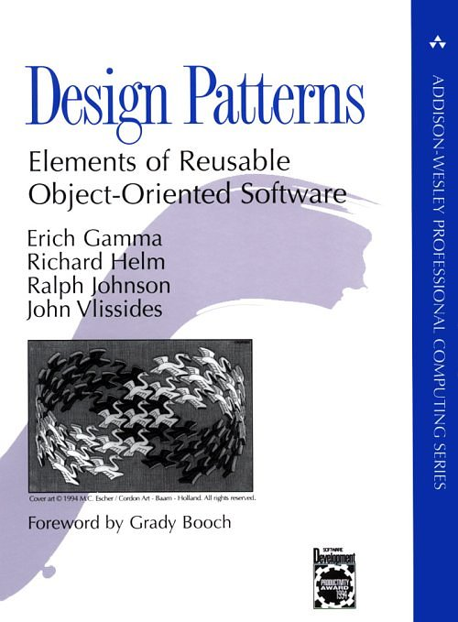
Programming Patterns
In 1994, Addison-Wesley published Design Patterns, a groundbreaking book that called attention to the fact that many programming problems are most easily solved by applying certain common software patterns.
Although the patterns described in the book are typically implemented using classes and methods, each pattern tends to represent more of a general solution strategy for some class of problems and not a ready-made solution.

Slide 20

The Model/View/Controller Pattern
The user interacts with a MVC-based user interface through the controller, which is the part of the system capable of accepting user commands. It is typically a collection of Swing interactors.
The controller never updates the displayed data directly. It instead sends requests to the model, which keeps track of the state of the system but is separate from the user interface.
When changes occur in the model, it sends messages to one or more views, which are responsible for updating the information that the user sees on the display.
One of the most important patterns in terms of its applicability to user-interface design is the model/view/controller pattern, which is often abbreviated as MVC.
Controller
Model
View

Slide 21
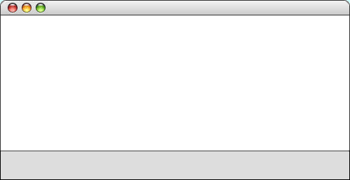



The HousePoints Program
The HousePoints program described in section 14.4 uses the model/view/controller pattern to present two views of the house points assigned to the Hogwarts houses at the end of J. K. Rowling’s Harry Potter and the Philosopher’s Stone. The first appears as a bar graph, the second as a pie chart.
In this example, the role of the controller is taken by the interactors at the bottom of the window. The controller sends messages to the model, which in turn updates both views.
HousePoints
Points
312, 352, 426, 472
Graph
312, 352, 426, 472
4, 352, 426, 472
48, 352, 426, 472
482, 352, 426, 472

Slide 22
The End

