Slide 1
Let's start with AI/ML

Slide 2
AI/ML

Slide 3
Introduction to AI/ML
AI/ML

Slide 4
What is AI?

Slide 5
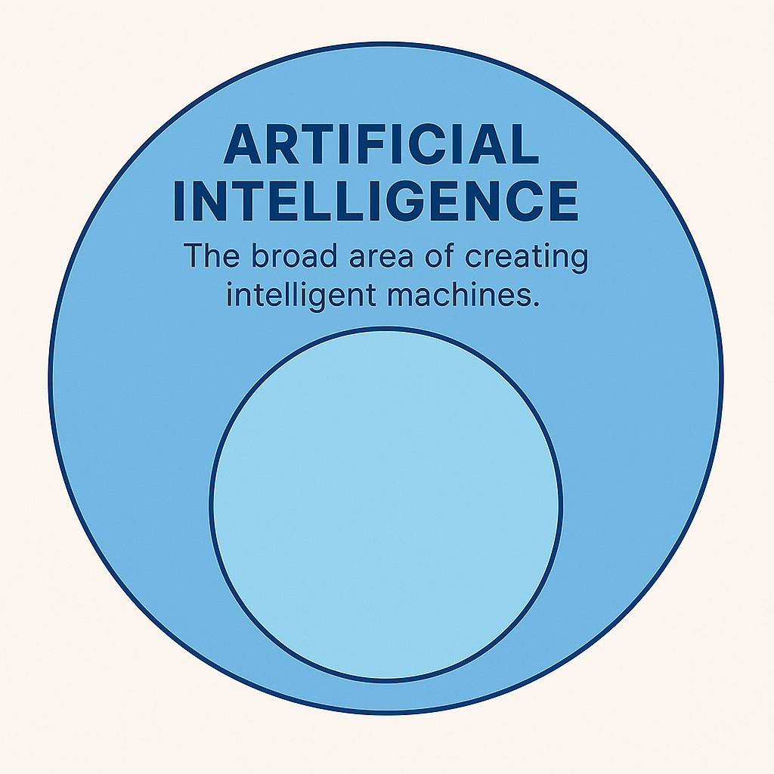
What is AI ?
AI refers to systems or machines that mimic human intelligence to perform tasks and can iteratively improve themselves based on the information they collect

Slide 6
How to do you teach machines to take actions?

Slide 7
Machine Learning

Slide 8
What is Machine Learning ?
0 & 1

Slide 9
What is Machine Learning ?
0 & 1
ML is an art or science making anything to turn into numbers
[0s and 1s],and finding the pattern in those numbers

Slide 10
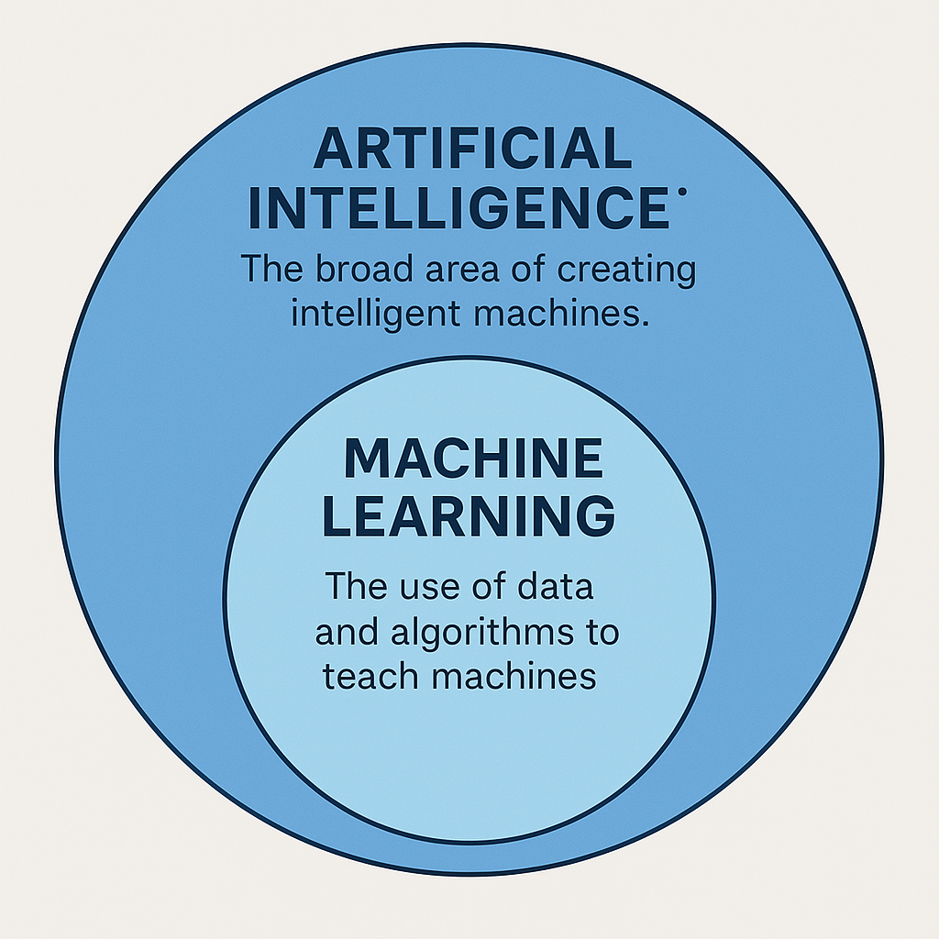
What is Machine Learning ?
ML is an art or science making anything to turn into numbers
[0s and 1s],and finding the pattern in those numbers

Slide 11
To teach a machine, what will you show it?

Slide 12
Data

Slide 13
Types of Data

Slide 14
STRUCTURED DATA
SEMI STRUCTURE DATA
UNSTRUCTURED DATA

Slide 15
STRUCTURED DATA
SEMI STRUCTURE DATA
UNSTRUCTURED DATA
Dates
Phone Numbers
Customer Names
Transactions
Data in Excel
Data in Relational Database
JSON (JavaScript Object Notation)
XML (Extensible Markup Language)
NoSQL Databases
Text Documents: Free-form text documents like articles, books, emails, and chat logs
Images: Digital images in formats like JPEG, PNG, or GIF Image files contain pixel data and are unstructured in terms of text-based content
Audio and Video
Social Media Feeds: Posts, comments, and tweets on platforms like Twitter and Facebook These data types contain unstructured text, emojis, and multimedia content
Sensor Data

Slide 16
Complex data needs deeper thinking—enters “Deep Learning”

Slide 17
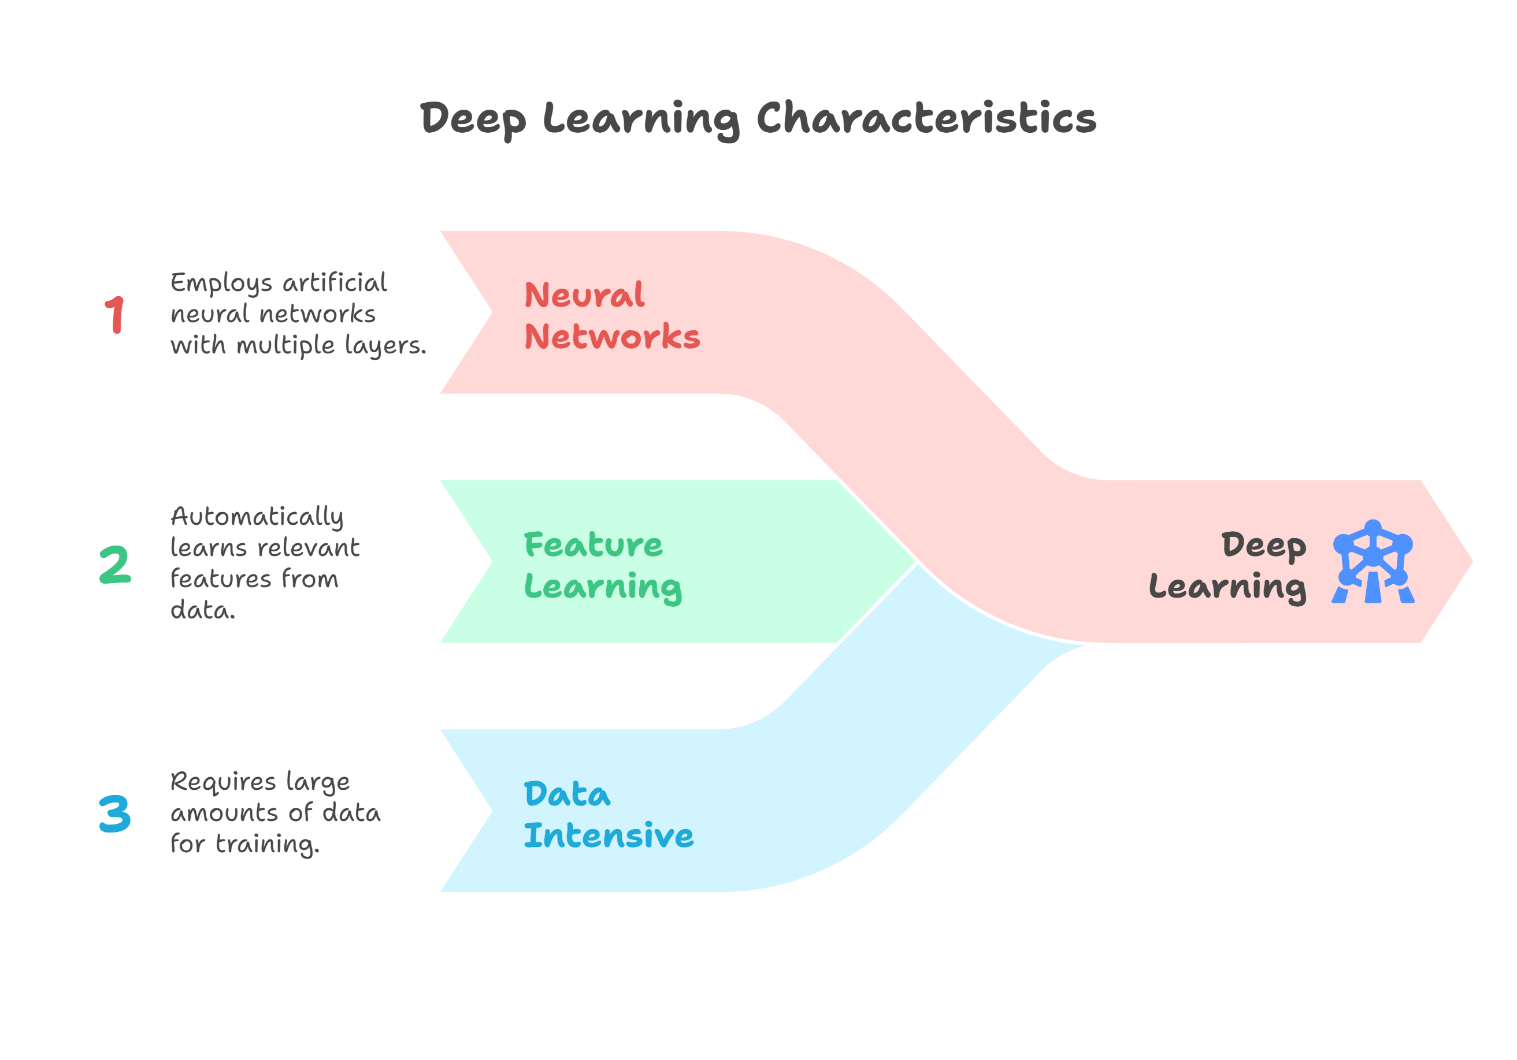
What is Deep Learning ?
Deep Learning (DL) is a subfield of Machine Learning that uses artificial neural networks with multiple layers (hence "deep") to analyze data

Slide 18
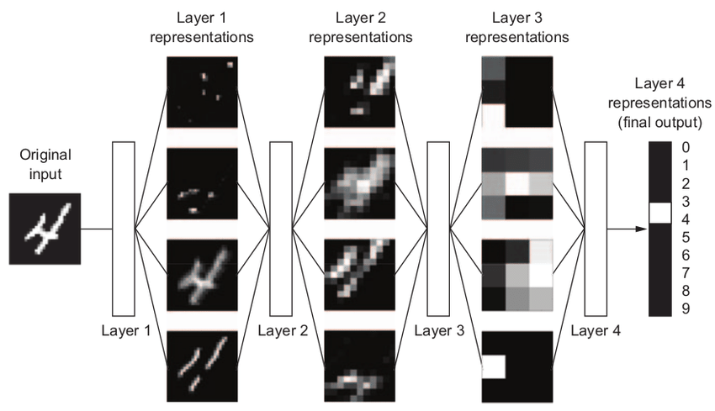

Slide 19
After training, are models capable of generating content?

Slide 20
Generative AI

Slide 21
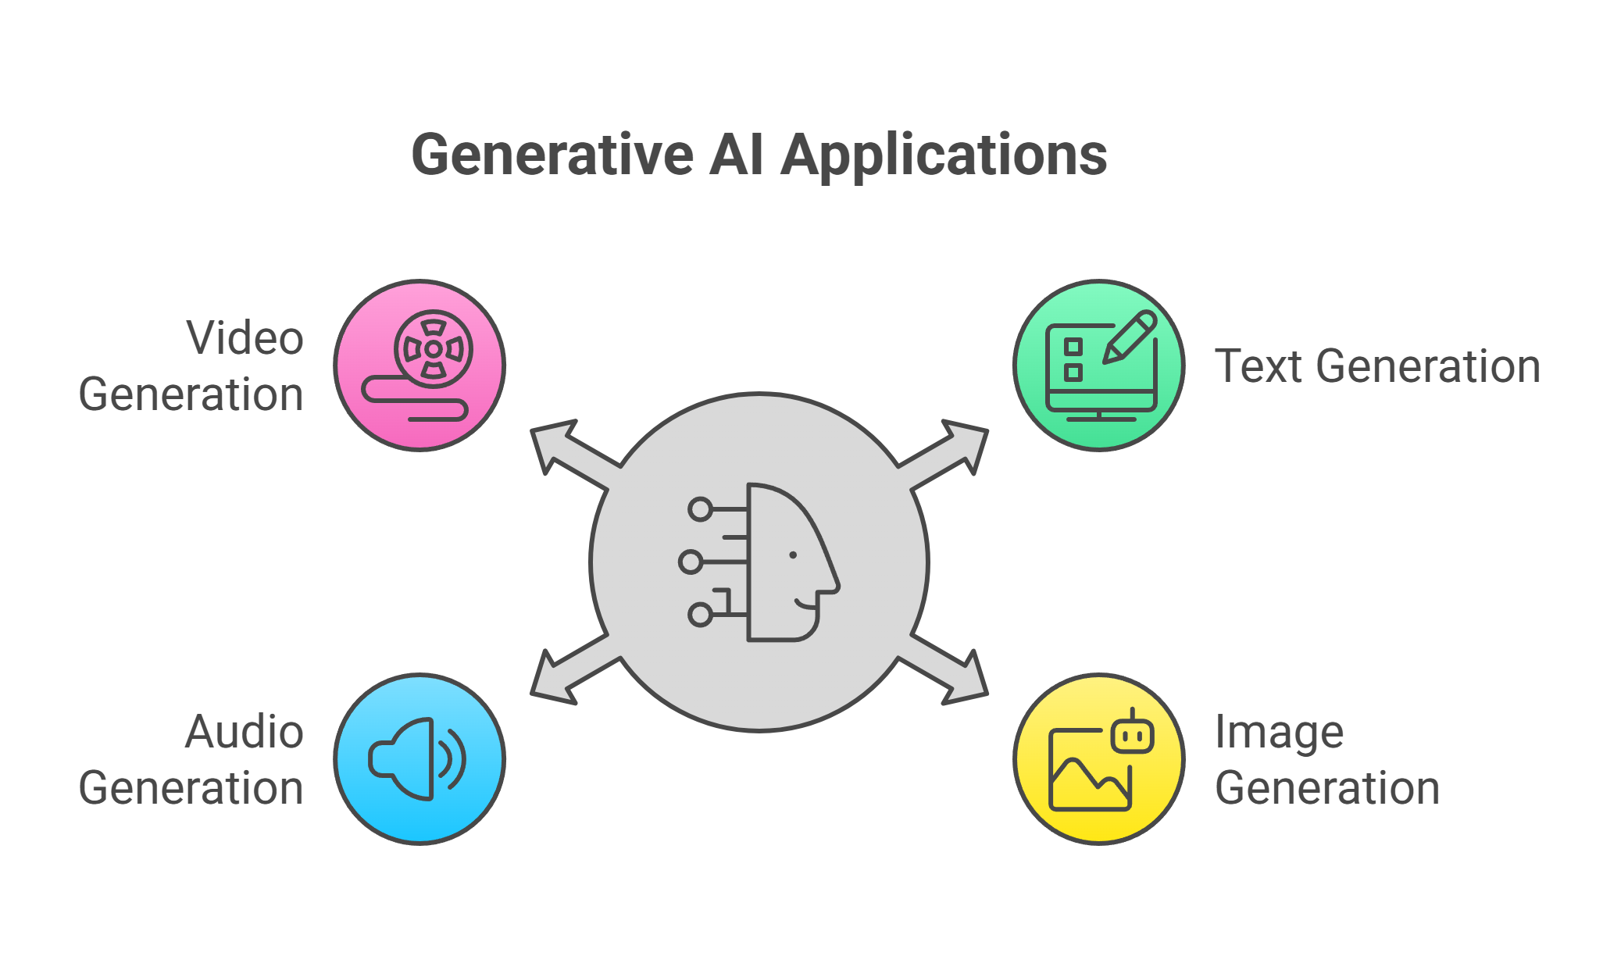
What is Generative AI?
Generative AI is a type of artificial intelligence that can create new content—like text, images, music, or code—by learning patterns from existing data

Slide 22
🧩 So, how are they all connected?

Slide 23
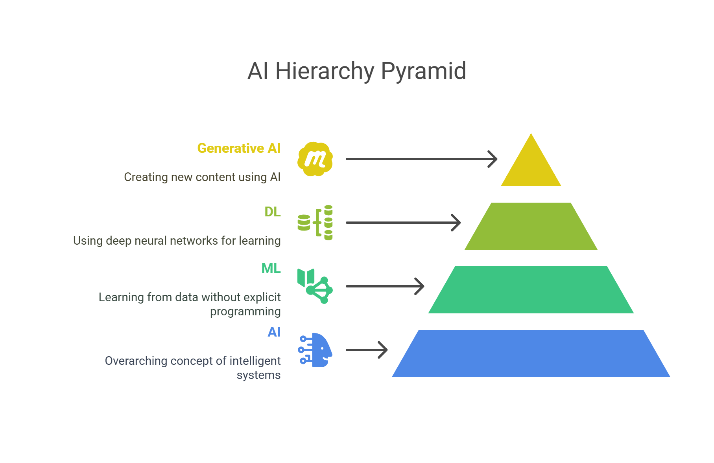
So, how are they all connected?
Generative AI is the car that drives creativity using an engine.
Deep Learning is the engine.
No deep learning = no generative AI.
They’re part of the same machine.
Machine Learning is the whole vehicle system—it’s the broader field that teaches machines to learn from data

Slide 24
How do we teach machines to learn from data?

Slide 25
Types of Machine Learning(ML) Systems
  Supervised learning
  Unsupervised learning
  Reinforcement learning
  Generative AI

Slide 26
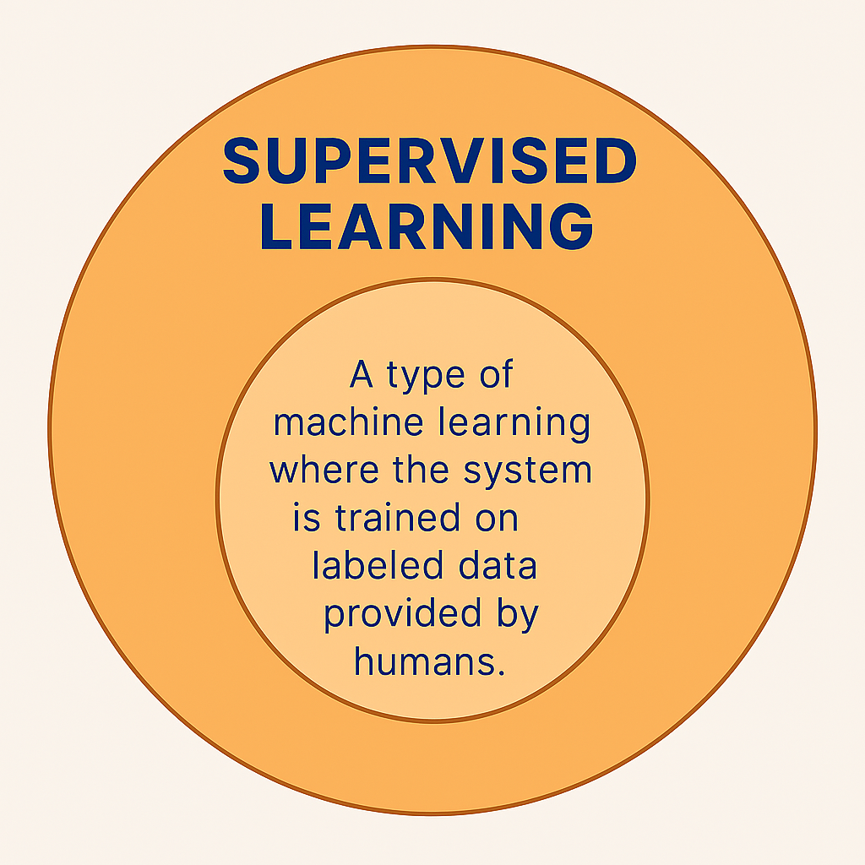
In Supervised Learning
Supervised learning
Training with labeled data
Improving prediction accuracy
Learning from correct answers
Discovering patterns in data

Slide 27
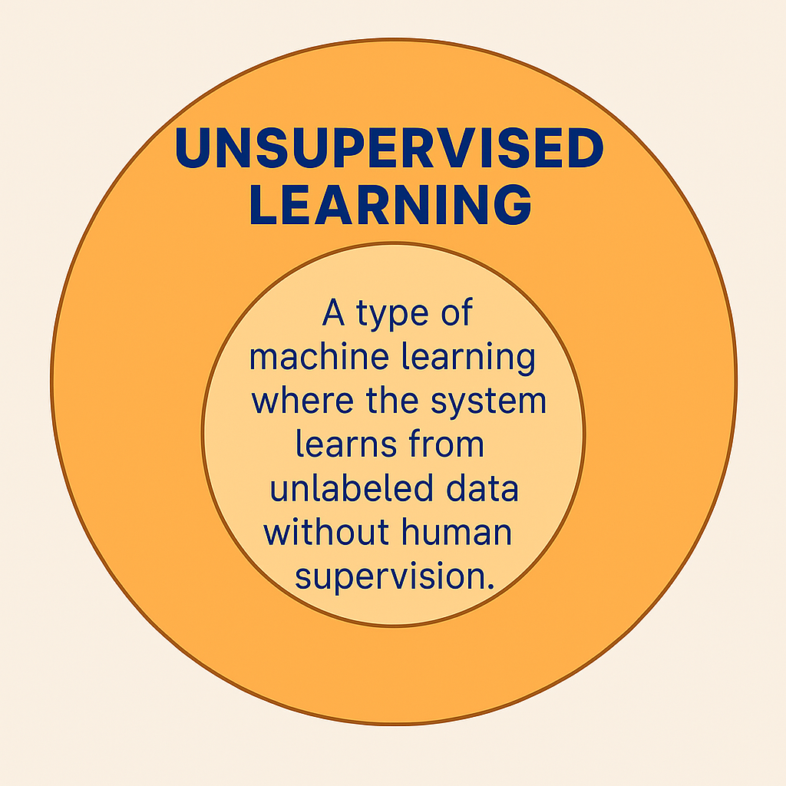
Un Supervised Learning
Un-Supervised learning
No labeled data
No correct answers provided
Model finds patterns on its own
Learns to group similar data
Uses clustering to identify structure

Slide 28
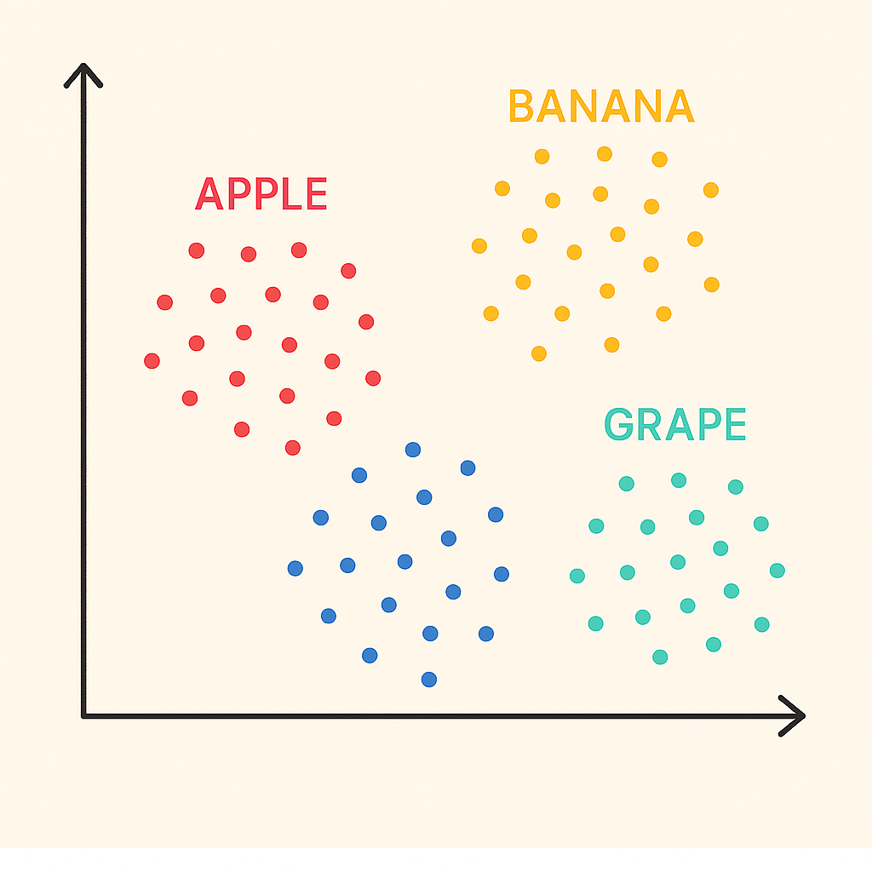
Un Supervised Learning
Un-Supervised learning
No labeled data
No correct answers provided
Model finds patterns on its own
Learns to group similar data
Uses clustering to identify structure

Slide 29
Reinforcement Learning
Reinforcement Learning
Learns through rewards and penalties
Interacts with an environment
Improves by trial and error
Develops a strategy (policy)
Aims to maximize total rewards

Slide 30
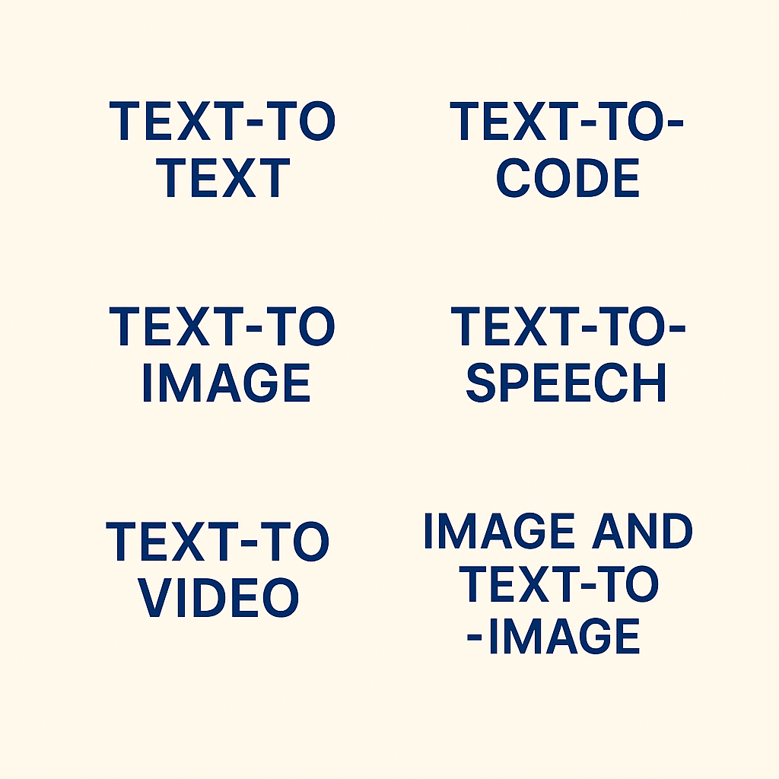
Generative AI
Generative AI
Creates content from user input
Generates text, images, audio, video
Supports multi-modal inputs and outputs
Combines input types (e.g., image + text)
Common types: text-to-text, text-to-image, text-to-video, etc

Slide 31
Thank You

