Slide 1
Foundational supervised learning concepts

Slide 2
Foundational supervised learning concepts
Data
Feature
Label
Labeled example
Unlabeled example
Model
Training
Prediction
Evaluating
Inference
Loss

Slide 3
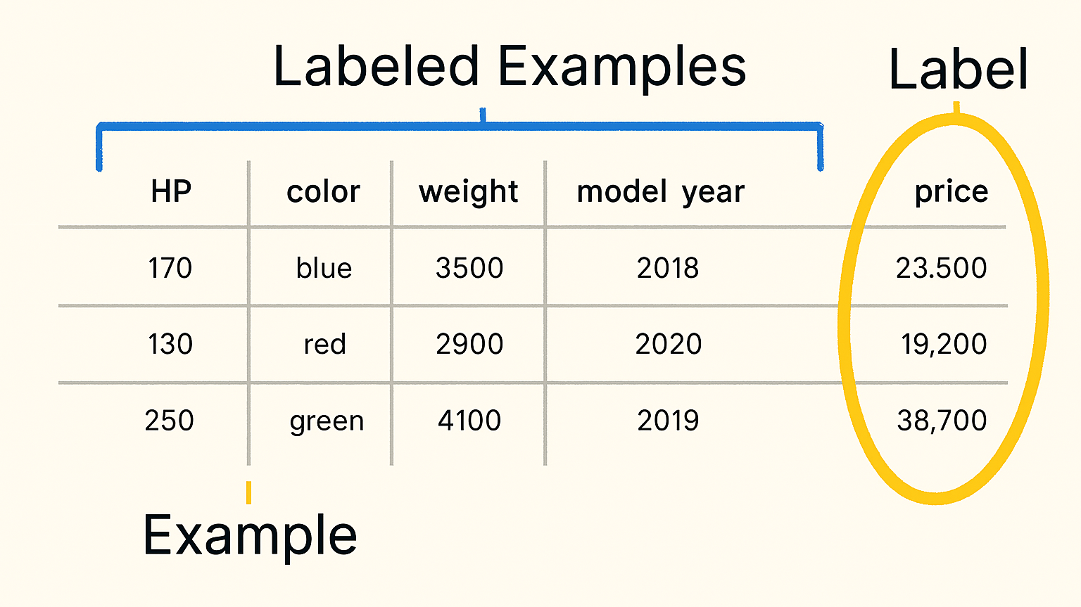

Slide 4
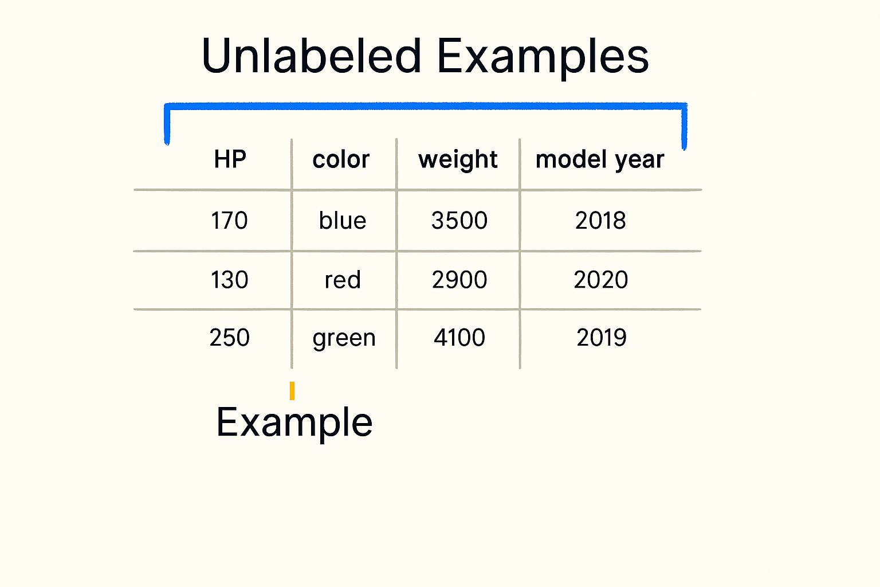

Slide 5
features(x)
One which helps to define an example
  Ex: HP, Color,Weight ,Model Year
label(y)
You will use feature(x) and predict or find the value of Label (y)
  Ex: Price of the Car Model
model
In supervised learning, we use features and labels in training a piece of software, called a model, to make useful predictions from data

Slide 6
Common Use cases for supervised learning

Slide 7
Common Use cases for Supervised learning
Regression
  A regression model making a numeric prediction
    Linear Regression – Predicts a continuous value using a linear relationship
    Ridge Regression – Linear regression with L2 regularization to prevent overfitting
    Lasso Regression – Linear regression with L1 regularization for feature selection
    Elastic Net Regression – Combines L1 and L2 regularization
Classification
  A classification model making predictions
    Logistic Regression – Despite the name, it's used for binary classification (e.g., spam vs. not spam)
    Decision Trees – Classify data by learning decision rules from features
    Random Forest – An ensemble of decision trees for more robust classification
    Naive Bayes – Based on Bayes’ theorem, good for text classification
    K-Nearest Neighbors (KNN) – Classifies based on the majority class among nearest neighbors

Slide 8
Linear Regression

Slide 9
Advertising Spend ($1000s) | Sales Revenue ($1000s)
5.2 | 12.1
6.8 | 13.5
7.5 | 15.3
8.0 | 15.9
9.1 | 17.2
10.3 | 18.5
11.2 | 20.1
12.0 | 21.3
13.5 | 23.0
14.8 | 24.5
16.1 | 26.3
17.4 | 28.1
18.7 | 29.8
20.0 | 31.5
Advertising Spend (feature)
and Sales Revenue (label)

Slide 10
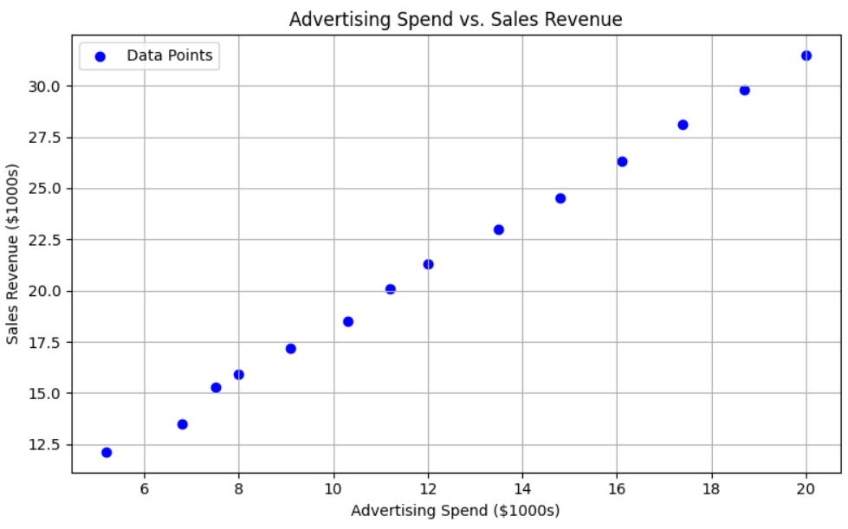

Slide 11
How to make the best fit ?

Slide 12
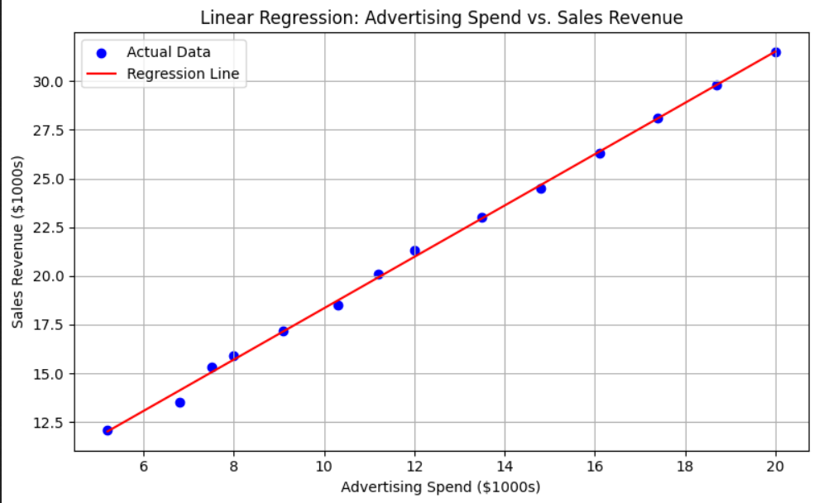

Slide 13
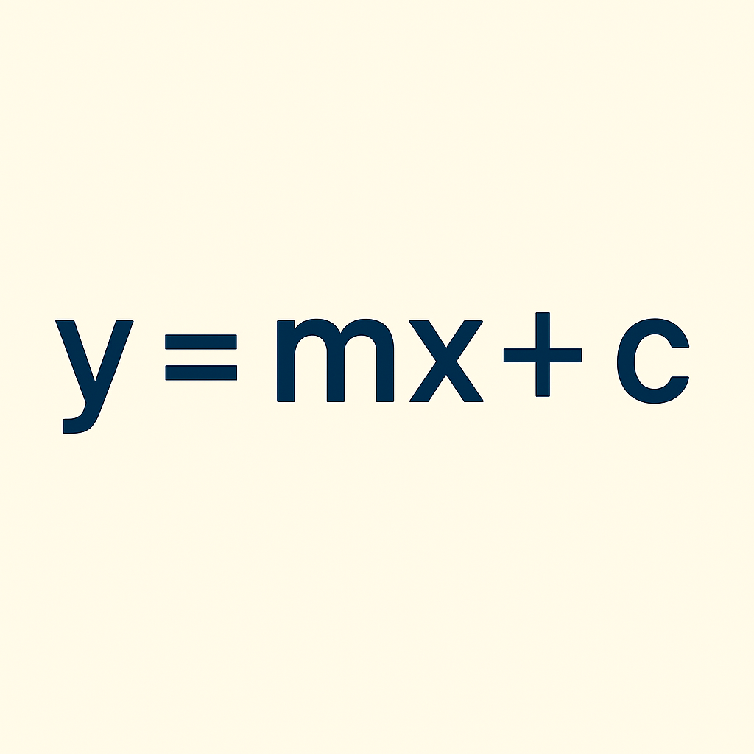
Linear Equation

Slide 14
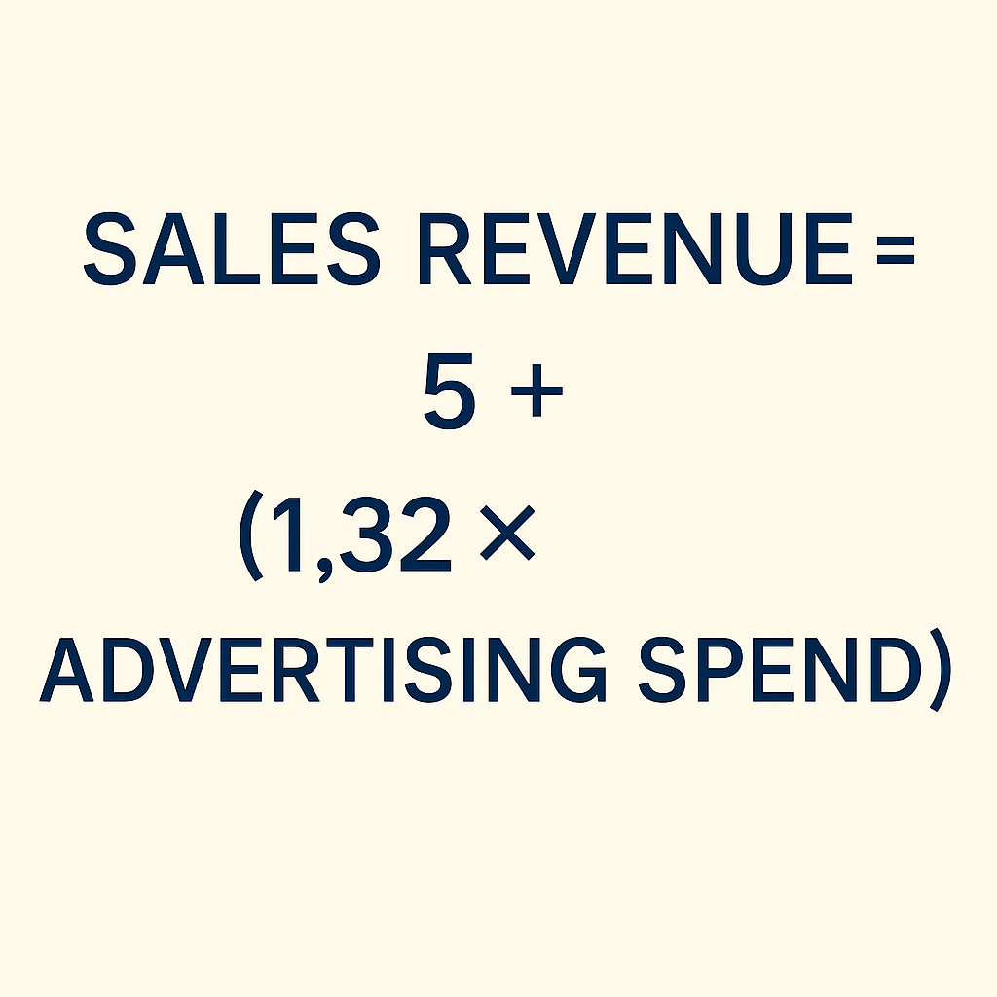
Sales Revenue =
5 + (1.32 × Advertising Spend)

Slide 15
Logistic Regression

Slide 16
exam_score | results
30 | 0
35 | 0
40 | 0
45 | 0
50 | 0
55 | 1
60 | 1
65 | 1
70 | 1
75 | 1
80 | 1
85 | 1
90 | 1
95 | 1
Exam Score (feature)
and Results (label)

Slide 17
How to make the best fit ?

Slide 18
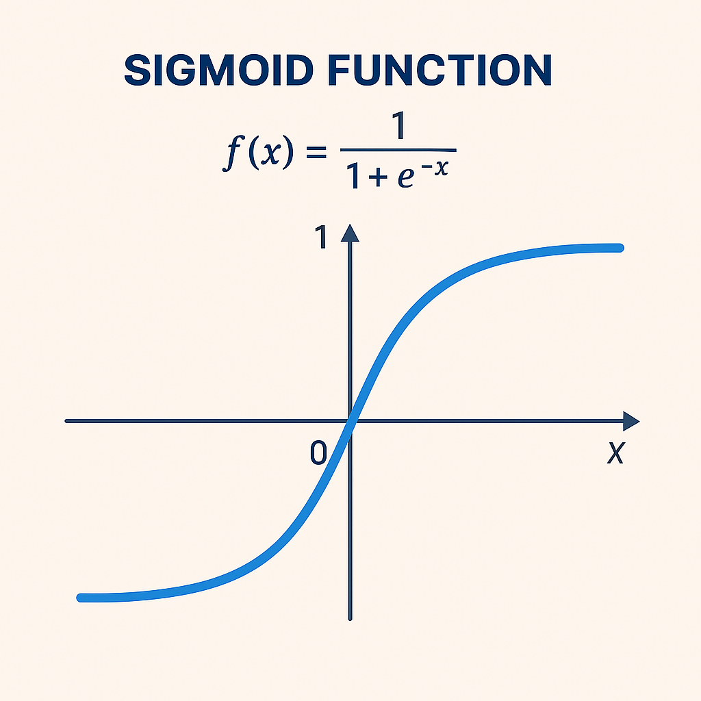
Sigmoid Function

Slide 19
Exam Score | Results
30 | 0
35 | 0
40 | 0
45 | 0
50 | 0
55 | 1
60 | 1
65 | 1
70 | 1
75 | 1
80 | 1
85 | 1
90 | 1
95 | 1
Exam Score (feature)
and Results (label)

Slide 20
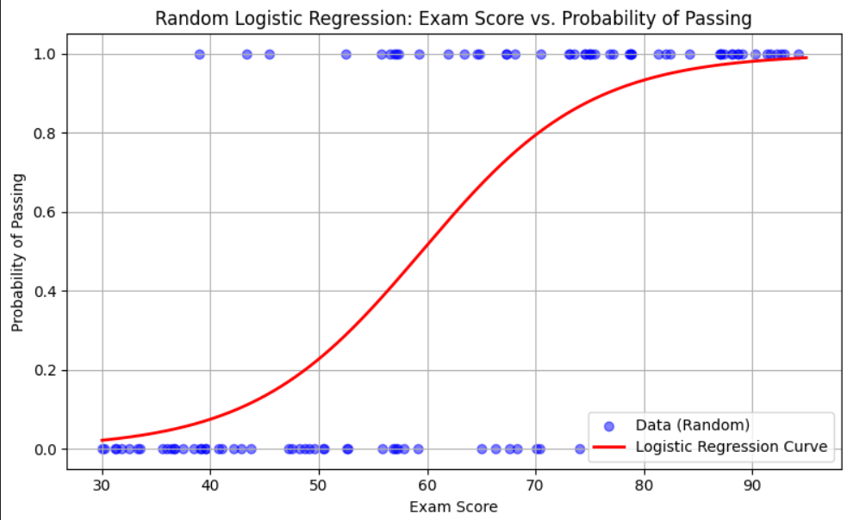

Slide 21
Training and Loss Functions

Slide 22
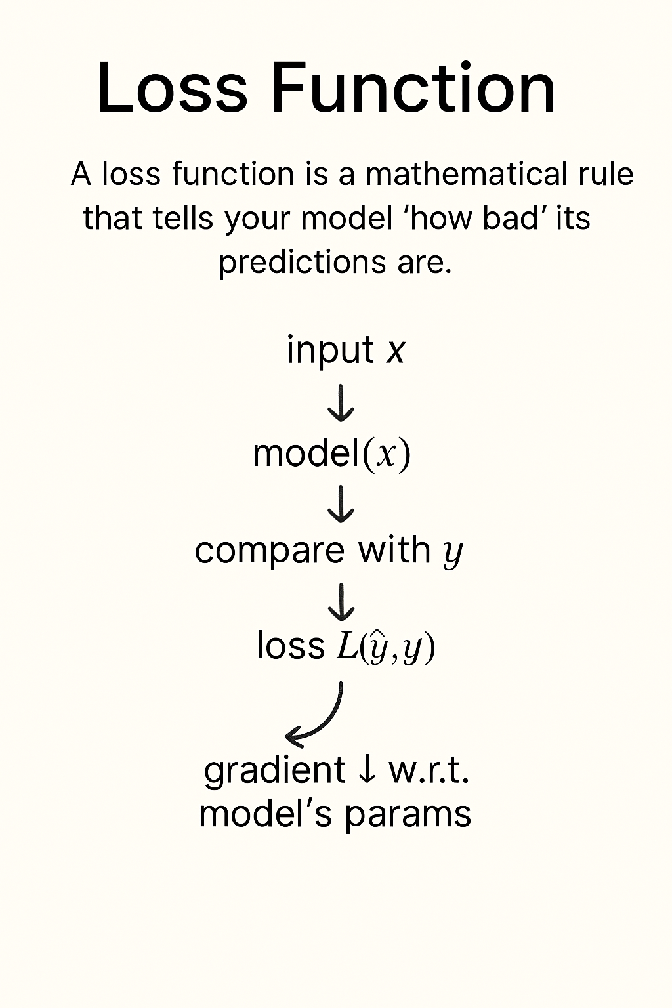
Training and Loss Functions
Loss function = (y- ŷ)

Slide 23
Thank You

