Slide 1
Foundational Generative AI concepts

Slide 2
Generative AI

Slide 3
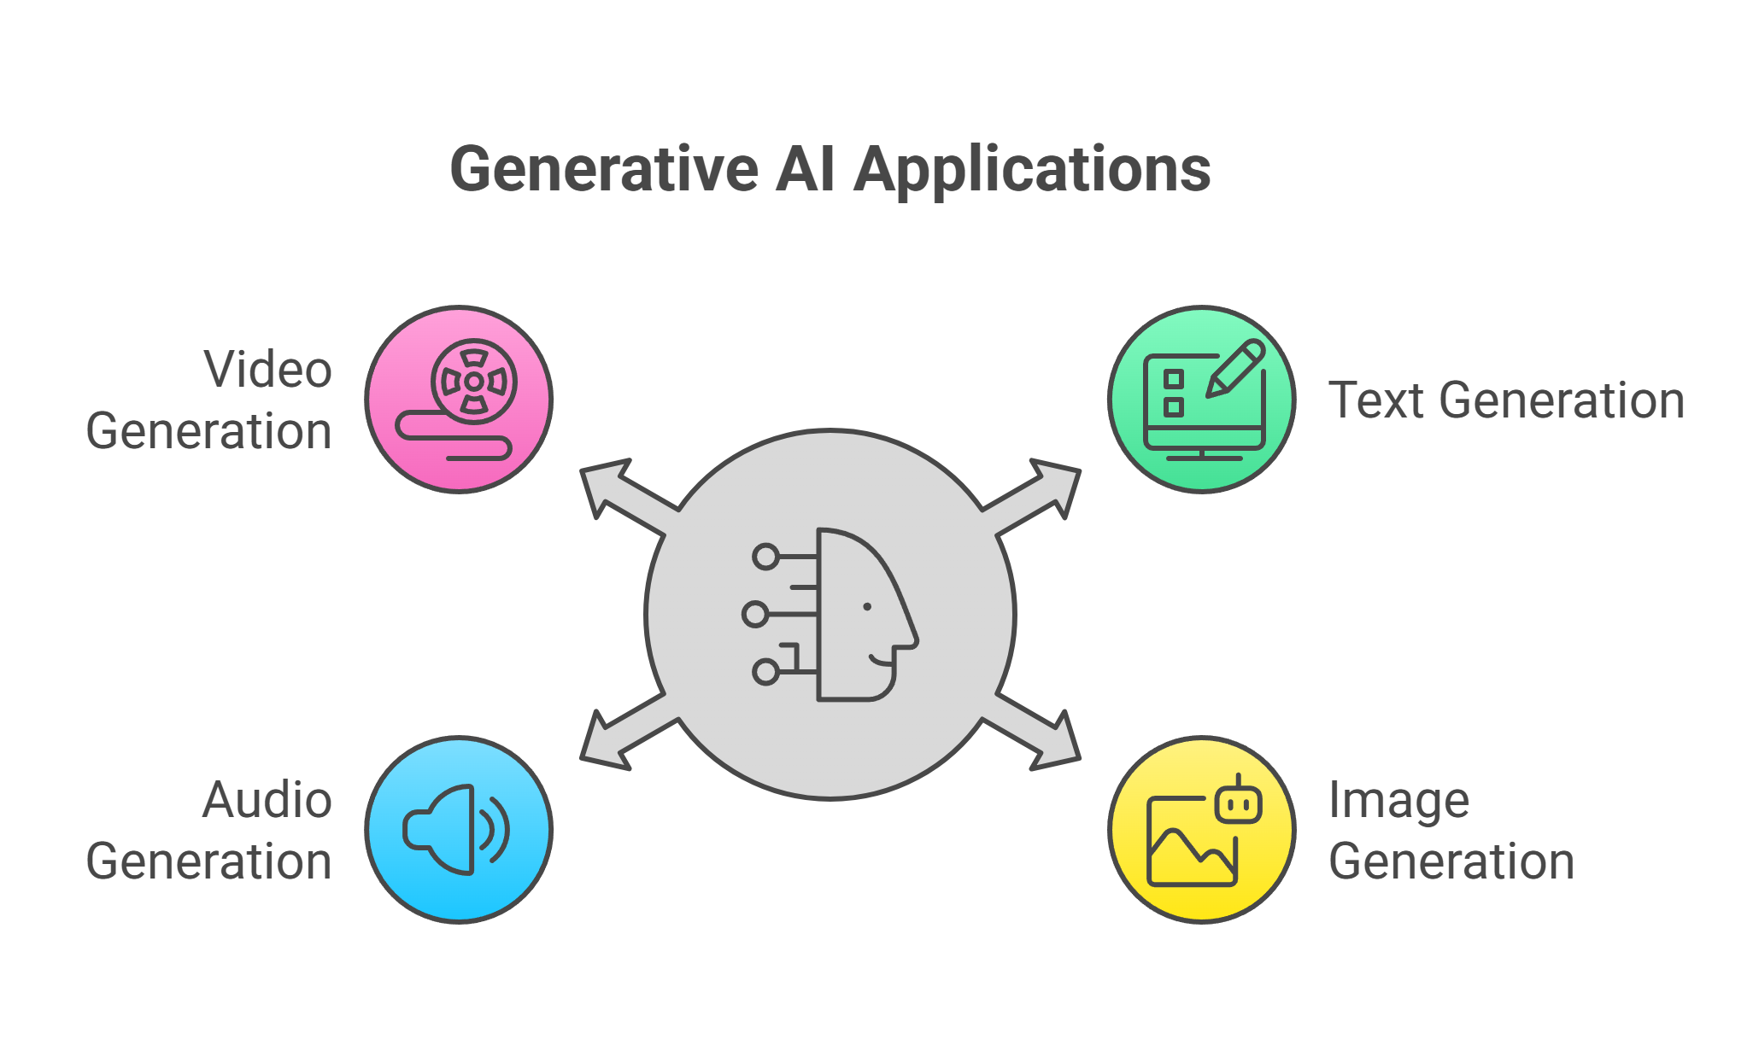
What is GenAI ?
Generative AI is a type of artificial intelligence that can create new content—like text, images, music, or code—by learning patterns from existing data

Slide 4
What is LLM?
LLM (Large Language Model) is a deep learning model trained on massive text datasets to understand and generate human-like language.
Characteristics:
- Based on Transformer architecture
- Examples: GPT-4, BERT, LLaMA
- Trained using self-supervised learning
- Can perform translation, summarization, Q&A, and more

Slide 5
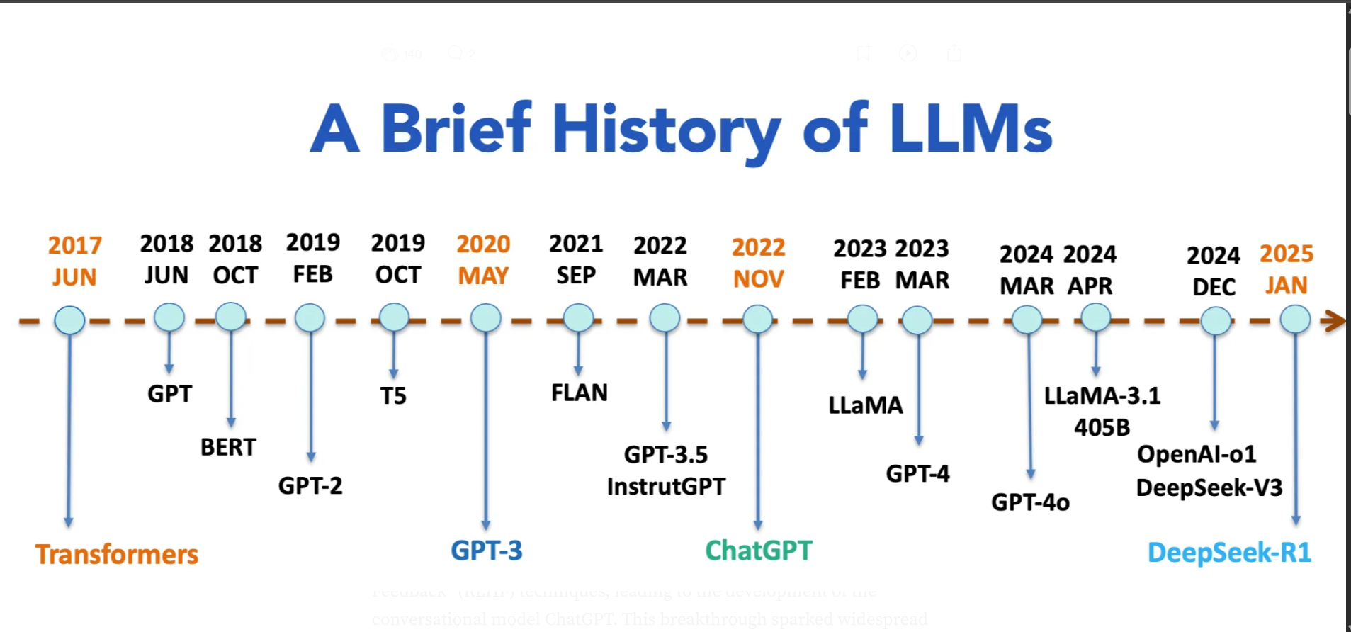

Slide 6
What is Embeddings ?
Converts data into numerical vectors capturing semantic meaning
Example Tools:
Word2Vec
BERT embeddings

Slide 7
What are Vector Databases ?
Stores and retrieves embeddings using similarity search
Example Tools:
Pinecone
FAISS
Chroma

Slide 8
What is RAG (Retrieval-Augmented Generation) ?
Enhances LLMs by retrieving relevant documents before generating responses
Example Tools:
LangChain + Vector DB + LLM

Slide 9
Concept | Definition | Examples/Tools
LangChain | Framework for chaining LLM components like prompts, tools, and memory | Chains, Agents, Memory, Tools
LangChain in RAG | Manages document loading, embedding, retrieval, and LLM integration | LangChain + Chroma + OpenAI
Prompt Engineering | Designing effective prompts to guide LLM behavior | Few-shot prompts, zero-shot prompts
Fine-Tuning | Retraining LLMs on domain-specific data for specialized tasks | Custom GPT models, domain-specific LLaMA

Slide 10
Foundational Generative AI concepts
Chat
Few-shot prompting
Fine-tuning
Gemini
Golden Response
Ground Truth
LLM
Model cascading
MMIT
No One Right answer (NORA)
Noise
One-shot prompting
Pre-trained model
Prompt engineering
Role prompting
Temperature
Zero-shot prompting

Slide 11
Foundational Generative AI concepts
Chat: A back-and-forth dialogue with an ML system, typically an LLM
Few-shot prompting : Prompting with more than one example to guide the model's response
Fine-tuning: Task-specific retraining of a pre-trained model to improve performance
Golden Response: A reference answer known to be correct, used for evaluation
LLM : Abbreviation for large language model

Slide 12
Foundational Generative AI concepts
Model cascading : Selecting the best model for a query to balance quality and resource use
MMIT : Abbreviation for multimodal instruction-tuned
No One Right answer (NORA) : A prompt with multiple valid responses, making evaluation challenging
Noise : Irrelevant or random data that can affect model training or output

Slide 13
Foundational Generative AI concepts
One-shot prompting : Prompting with a single example to demonstrate the desired response
Pre-trained model : A model already trained on large data, ready for further tuning or use
Prompt engineering : Crafting prompts to extract desired responses from an LLM
Role prompting : Including a target audience or persona in a prompt to guide model behavior
Temperature : A parameter controlling the randomness of model output
Zero-shot prompting : Prompting with no examples, relying on the model’s generalization ability

