Slide 1
Active Power Rail Probes

Slide 2
Challenges of Power Rail Measurement
Looking for weak ripple on large offset
DC coupled measurements are hard
  Most active probes can’t work with 5 / 12 / 24V rails
  Even at lower voltages, often limited offset at low V/div
AC coupled measurements lose LF content

Slide 3
Challenges of Power Rail Measurement
We want low attenuation to see weak signal
But also need low loading
  Heavy DC load will alter DUT PSU behavior

Slide 4
Power Rail Probe: Architecture
Split the signal into two paths
High(ish) impedance DC path
  Around 50KΩ is common
  Active amplifier with large offset range (± 24-60V)
Capacitively coupled 50Ω AC path
  Minimal attenuation, close to 1:1
  Entirely passive, no additive noise

Slide 5
Power Measurement Scenario
Zynq-7000 series SoC (Digilent Zybo)
Looking at 1.0V core power rail
Time domain and spectral analysis in ngscopeclient
Compare two 4 GHz probes on same 4 GHz scope
Teledyne LeCroy WaveRunner 8404M-MS
  D400-AT: 4 GHz /2.5 differential
  RP4030: 4 GHz /1.2 power rail

Slide 6
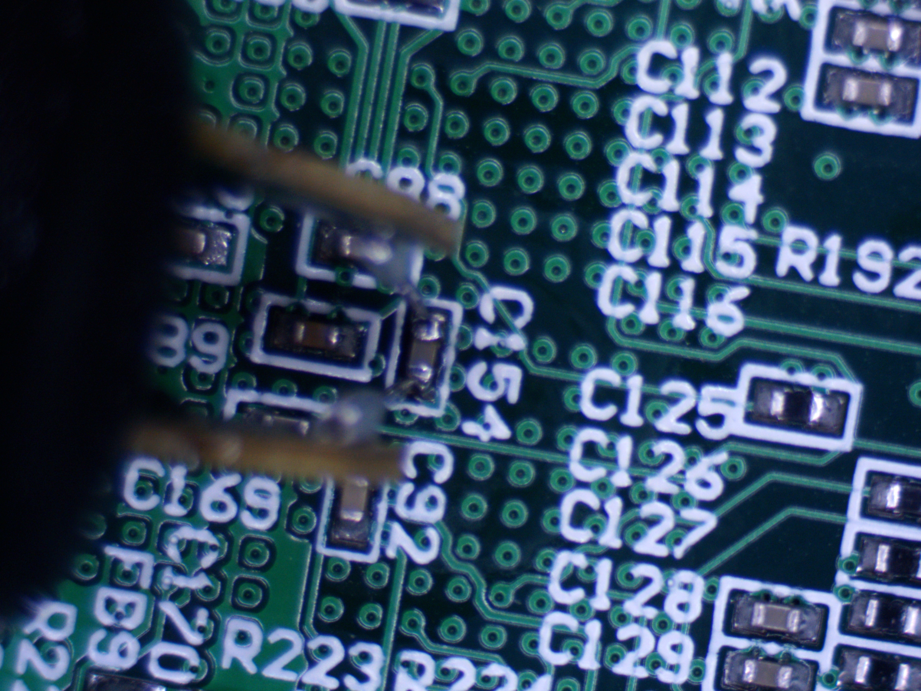
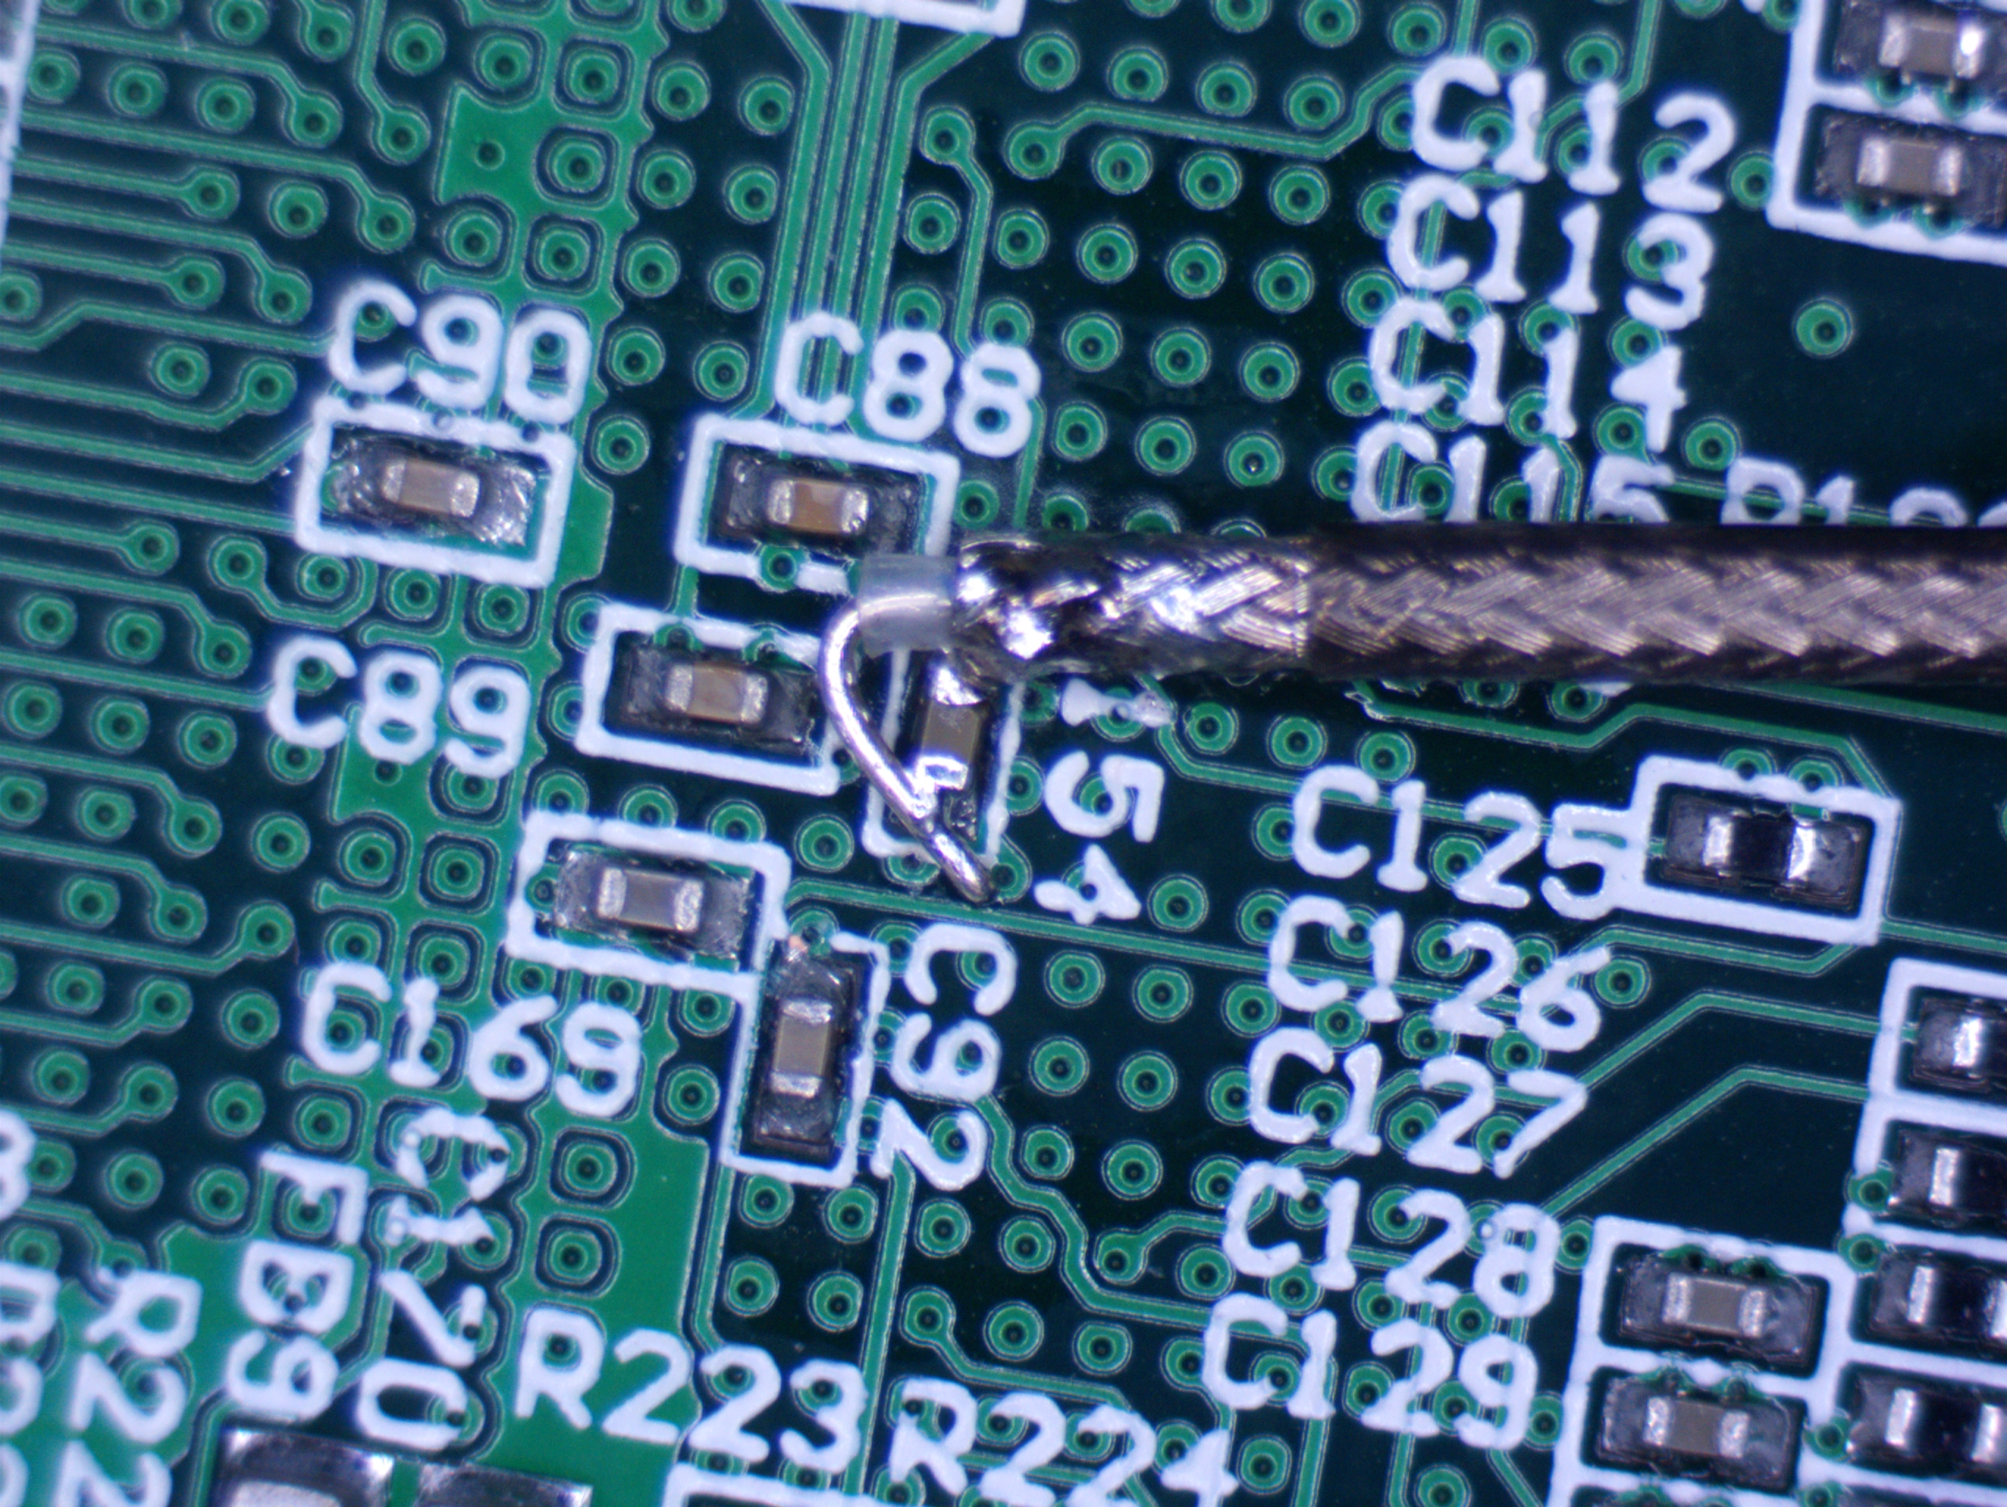
Power Measurement Scenario
D400A-AT
RP4030

Slide 7
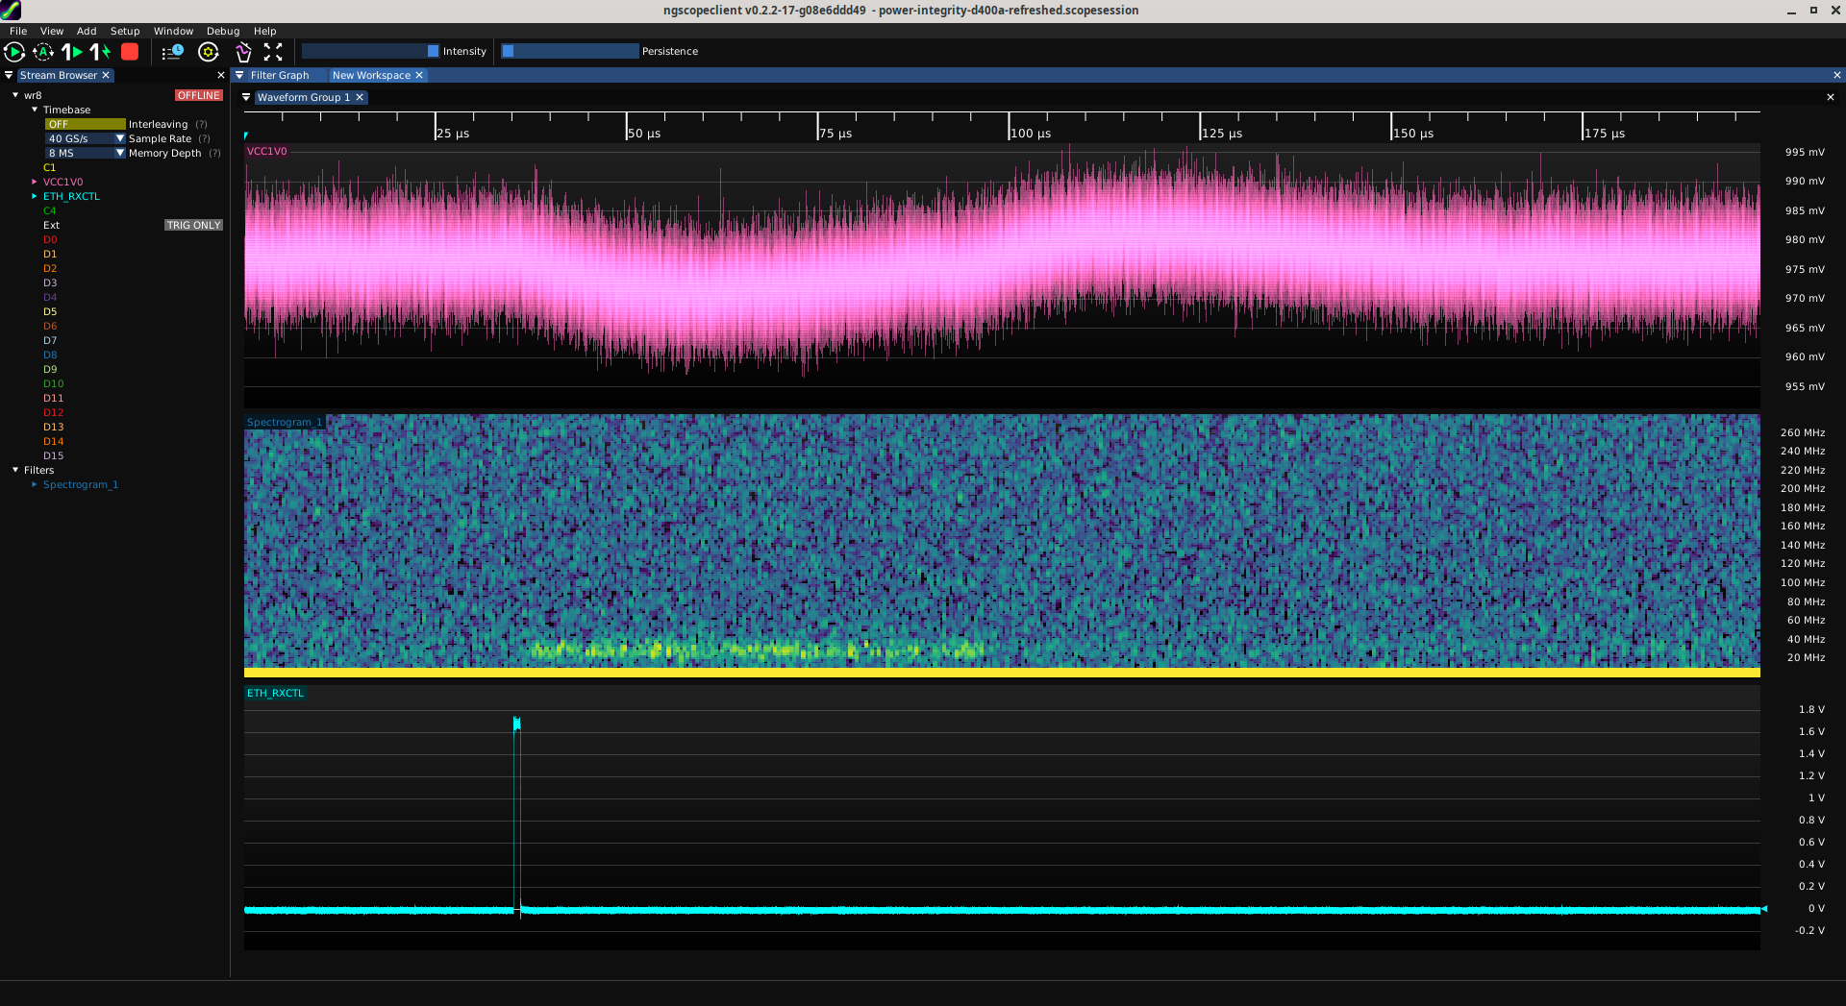
Results using D400A-AT
Activity spike
Voltage dips
On-die activity
Ethernet frame
arrives
SMPS ripple + harmonics

Slide 8
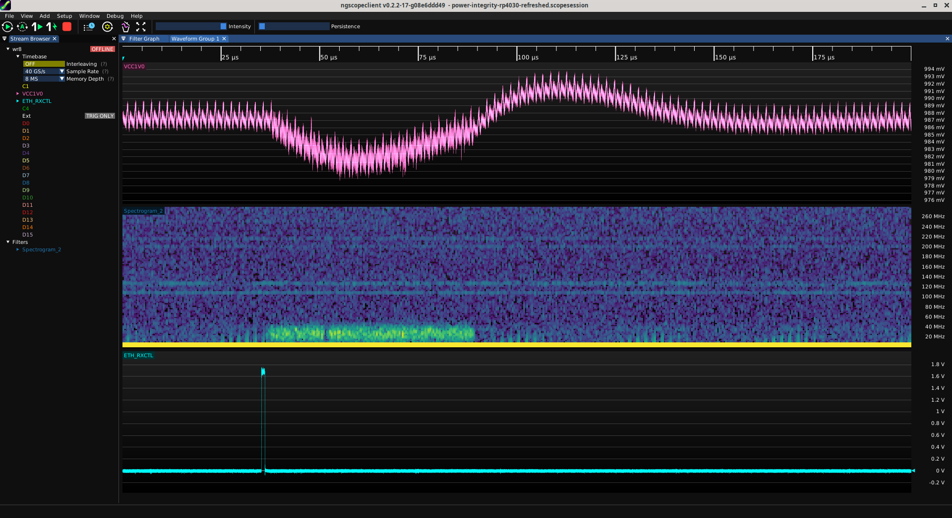
Results using RP4030
Overshoot as control
loop recovers from transient
SMPS ripple
On-die clocks
108, 125 MHz
2nd harmonics of clocks
Additional switching
activity visible
Much lower
noise floor

Slide 9
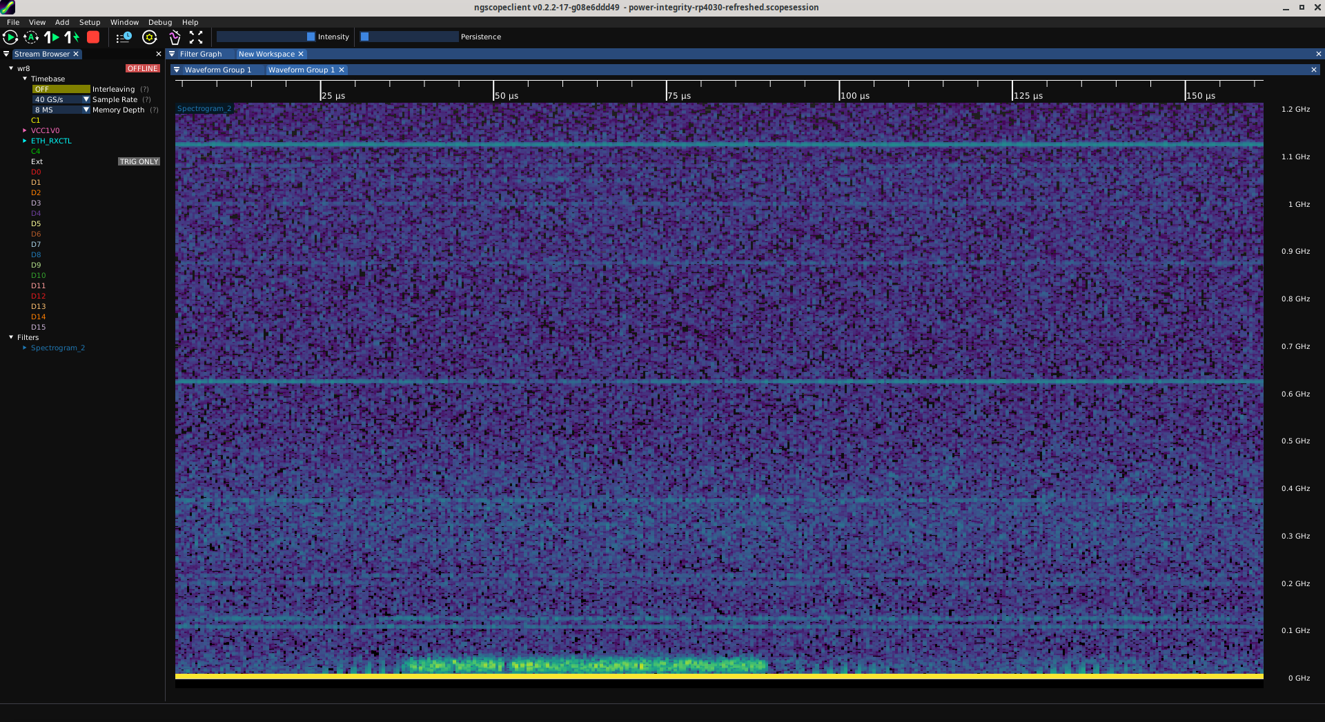
Better view of spectrogram

Slide 10
Power Rail Probe: Strengths
Extremely low noise
Very low attenuation (close to 1:1)
  Can detect extremely weak signals

Slide 11
Power Rail Probe: Weaknesses
Expensive (RP4030 $3016, TPR4000 $7380)
Limited dynamic range (± 1V or less)
Not much good for anything but power rails

Slide 12
Power Rail Probe: When to use
Power integrity measurements
Millivolt signals on large DC bias

Slide 13
Improvised power rail probe
Want good low-noise power rail measurements?
Don’t have a $$$ power rail probe handy?
Two-pass measurement flow
  Single solder-in or connectorized test lead
  SMA to 4mm banana, DMM measurement for DC path
  SMA to 50 ohm scope input w/ inner DC block for AC path
Can maybe do DSP crossover in ngscopeclient?

Slide 14
Questions?

Slide 15
Lab 5: Power Rail Probes
Measure power rail values on the demo board
Pre-instrumented w/ U.FL test points
  Use provided extractor tool and power down DUT
  when moving cable between test points
Look at a few of the rails
  3V3 (MCU Vdd), MCU Vcore, and 1V0 (FPGA) should be fun
  Just to be safe, do not probe Vbus

