Slide 1
Resistive Probes

Slide 2
Resistive Probe
The other passive probe design
  Aka Transmission line probe, Low-Z probe, Z0 probe
Conceptually super simple
  Resistor and a piece of coax
Doesn’t get as much love as it deserves

Slide 3
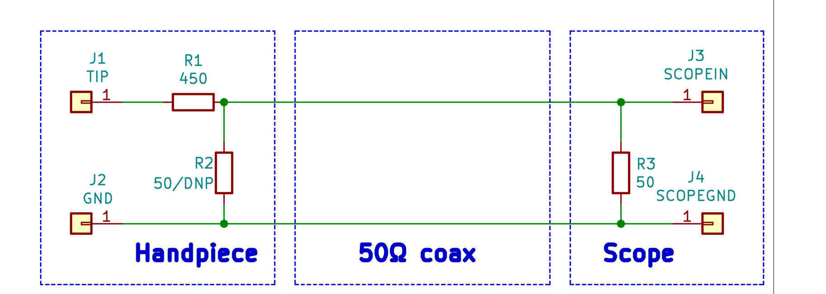
Resistive Probe
Linear tradeoff between insertion
loss and loading on DUT.
450Ω for 10x, 950Ω for 20x
Optional terminator
Doubles probe attenuation
but damps out reflections
if scope input is mismatched

Slide 4
Resistive Probe
Much higher DC loading than an R-C divider
But response can be much flatter!
  Ideal resistive probe has C=0 and constant S21 / S11
  Of course, parasitics ruin our fun like always...

Slide 5
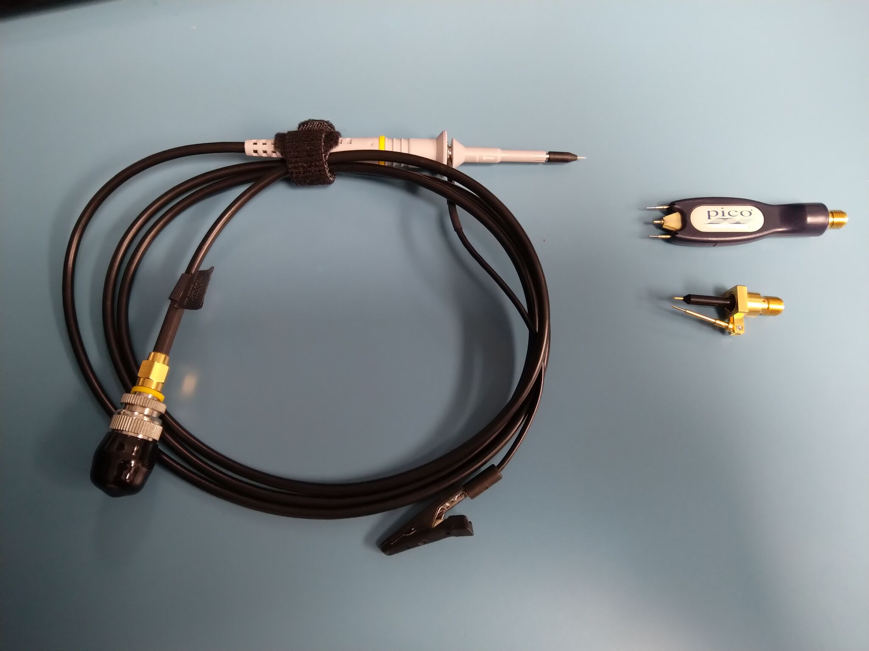
Typical Resistive Probes
PicoConnect 921
20:1, AC coupled
Source terminated
$1055, 6 GHz
Pico TA061
10:1
$419, 1.5 GHz
Teledyne LeCroy
PP066
1:1 / 10:1 / 20:1
$1860, 7.5 GHz

Slide 6
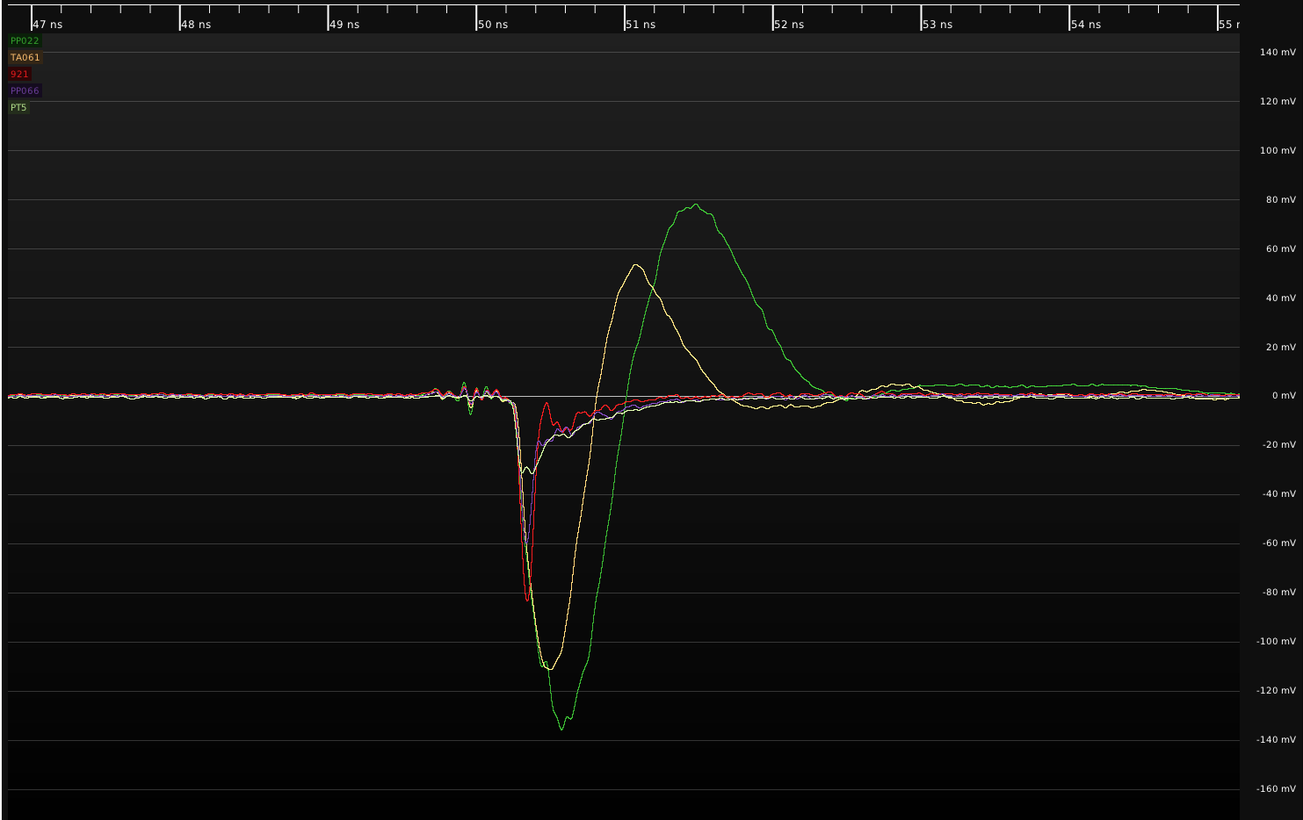
Resistive Probe: TDR vs R-C Divider
Pico TA061
Entry level
Resistive
LeCroy
PP022
R-C divider

Slide 7
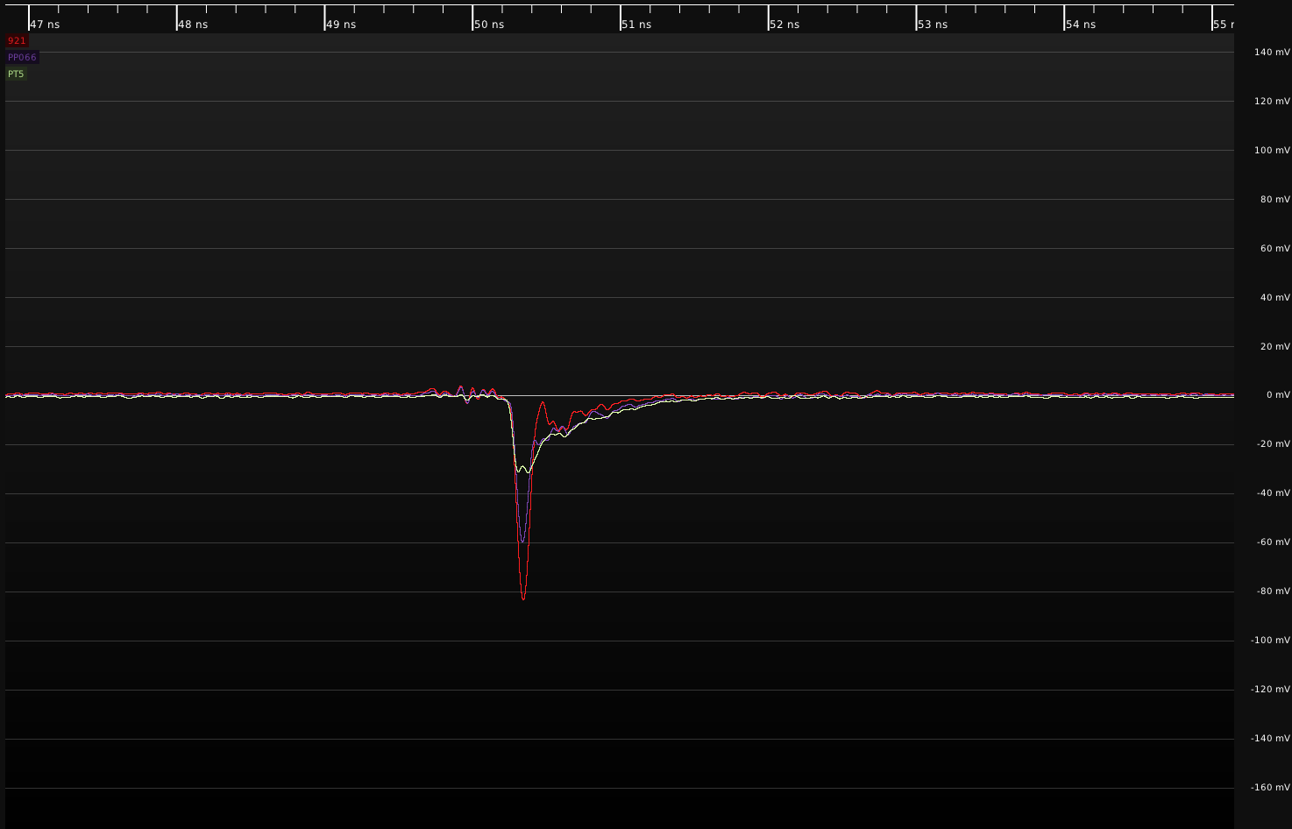
Resistive Probe: TDR response
Prototype
LeCroy
PP066
Pico 921

Slide 8
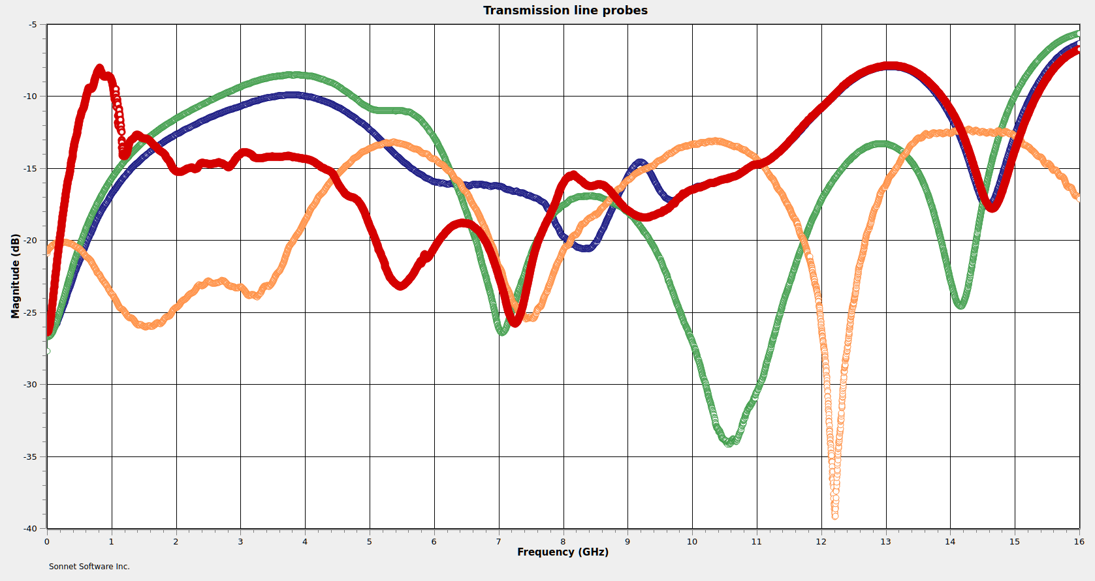
Resistive Probe: S11 comparison (across 50Ω)
Pico TA061
-8 dB @ 810 MHz
LeCroy PP066
-10 dB @ 3.79 GHz
Prototype
< -13 dB to 16 GHz
PicoConnect 921
-8.5 dB @ 3.86 GHz

Slide 9
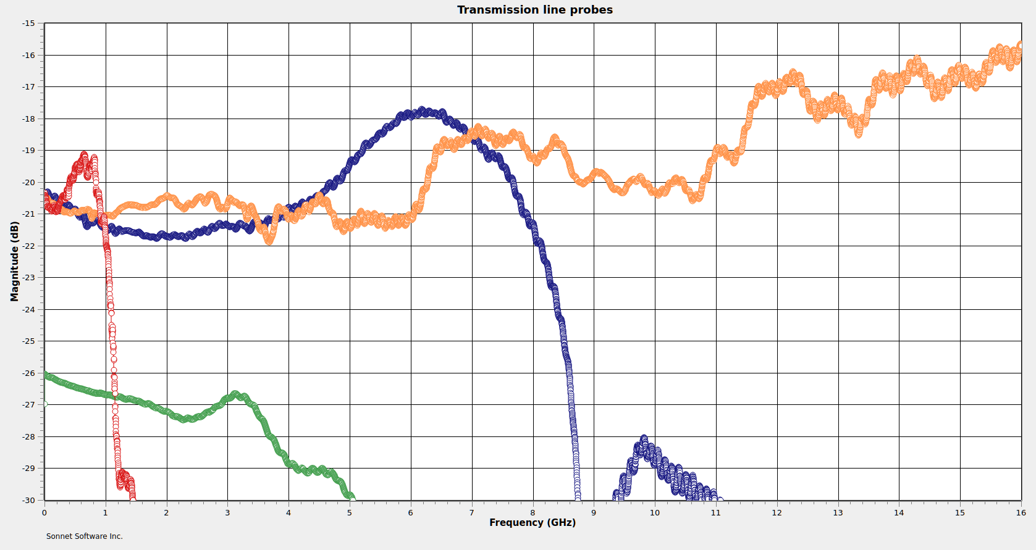
Resistive Probe: S21 Flatness
Pico TA061
10:1, $419
Prototype
10:1
LeCroy PP066
10:1, $2115
PicoConnect 921
20:1, $1055

Slide 10
Resistive Probe: Comparison
Lower end probes perform worse
  Worse S21 flatness
  More loading
But why?
Let’s look at some of the effects in play

Slide 11
Chip Resistor Cross Section
NiCr film
Al2O3 brick
Solder terminals

Slide 12
But from a different perspective...
Leakage path
Dielectric
Parallel plates of conductor

Slide 13
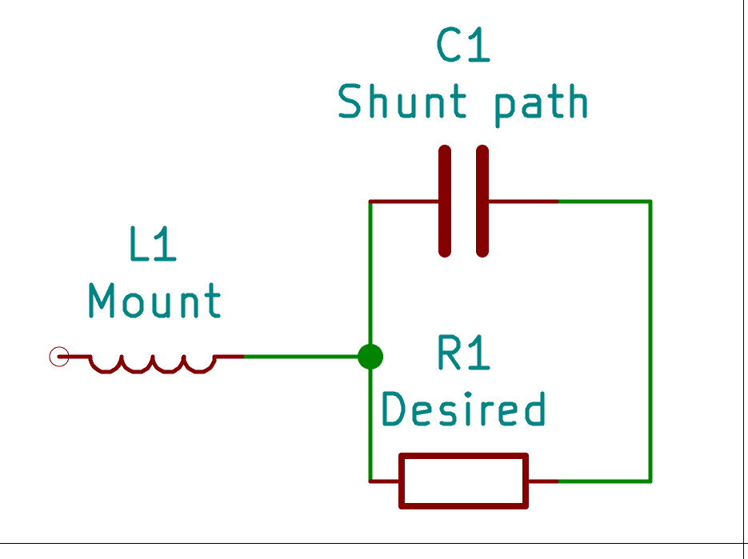
Yep, it’s a capacitor!
Here’s a better model of a real resistor

Slide 14
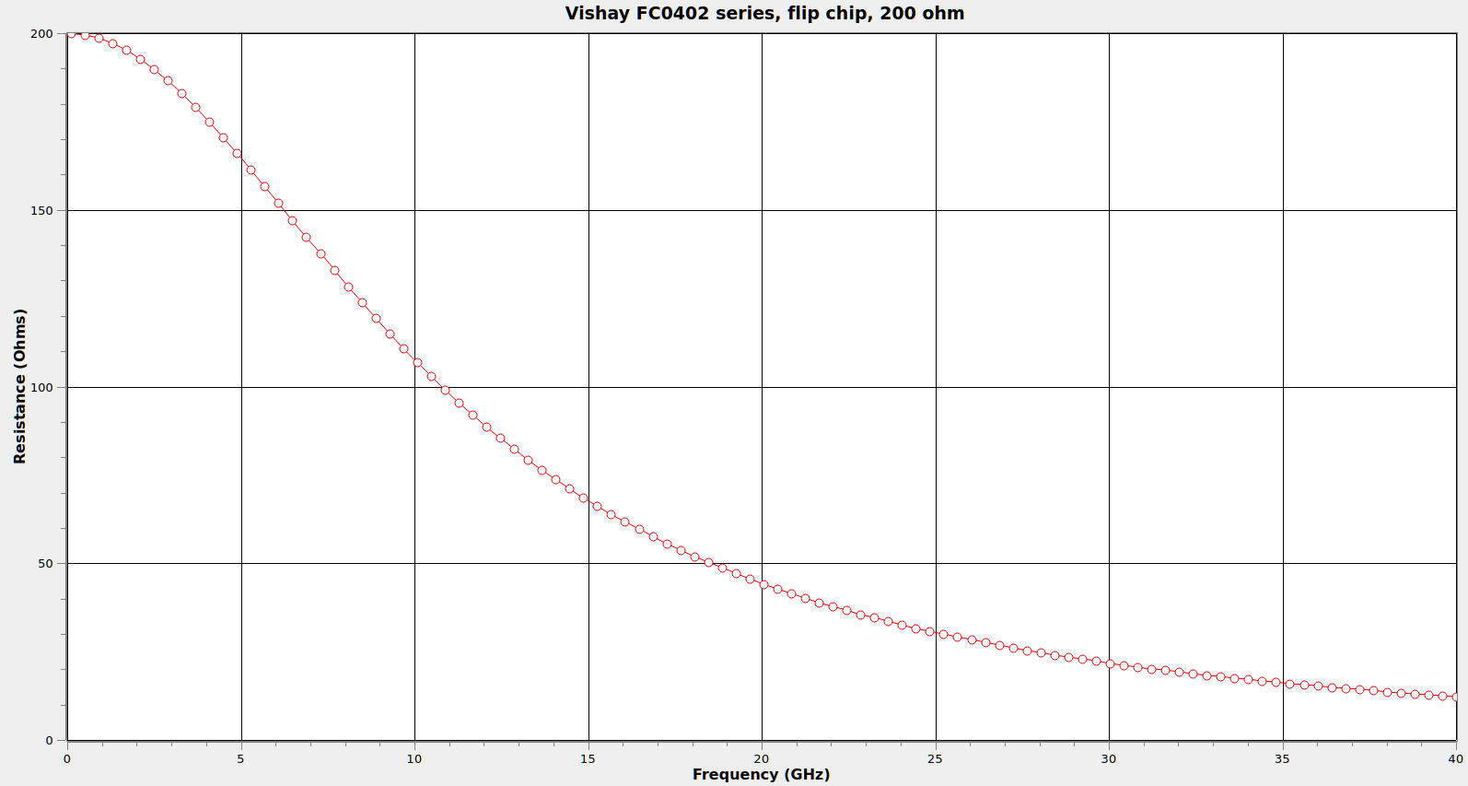
Real Resistor Behavior

Slide 15
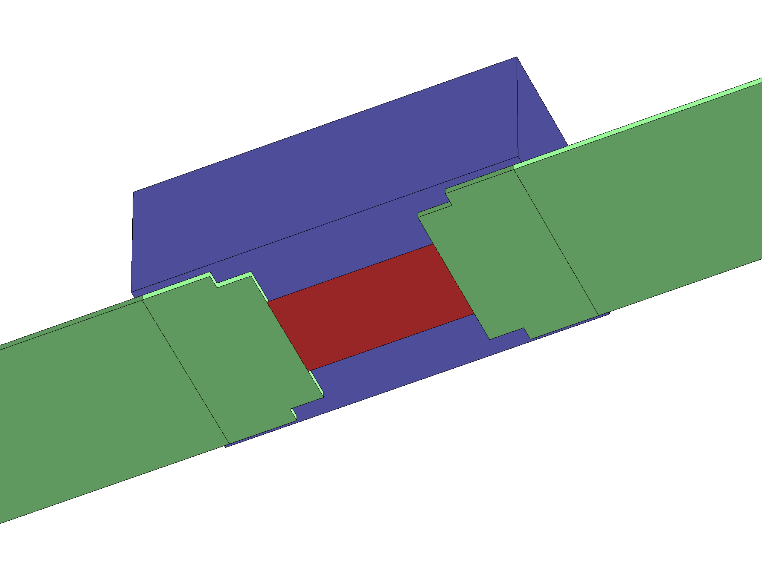
Flip-Chip Resistors

Slide 16
Resistive Probe: Ground L Sensitivity
Much less input C than an R-C divider
  Low end ones (TA061) can be as high as 2 pF
  More expensive ones (921, PP066) are hundreds of fF
Less C means less ringing for same L
  You can often get away with worse grounding vs R-C divider

Slide 17
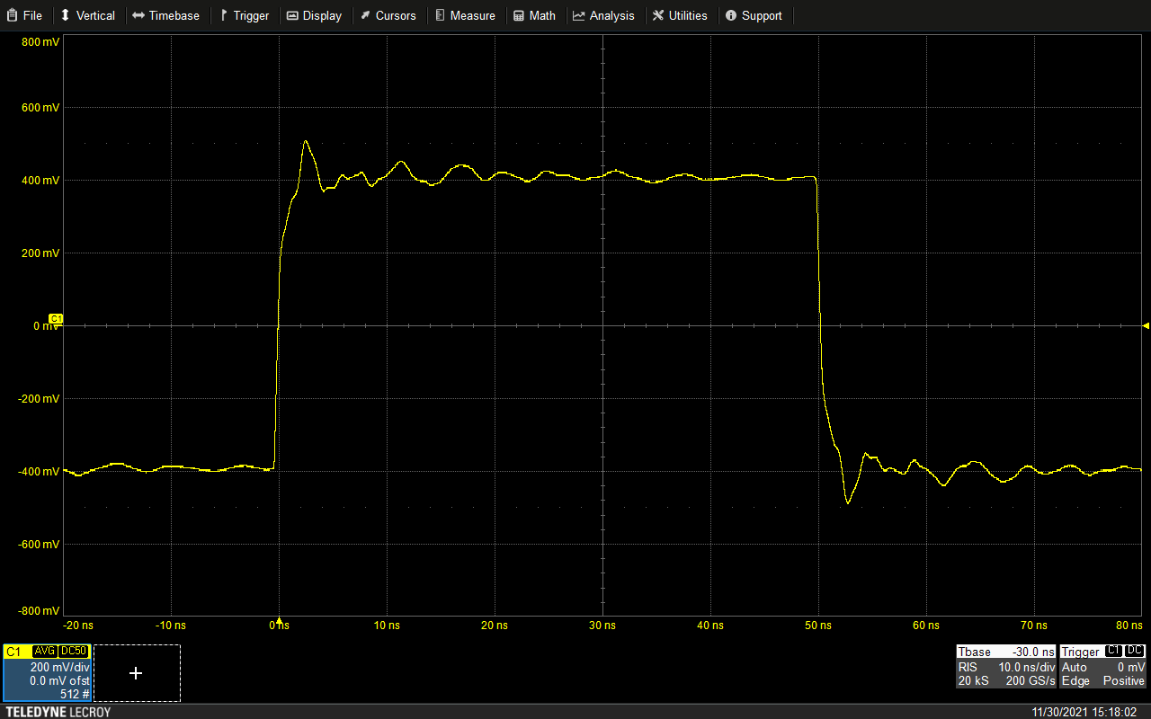
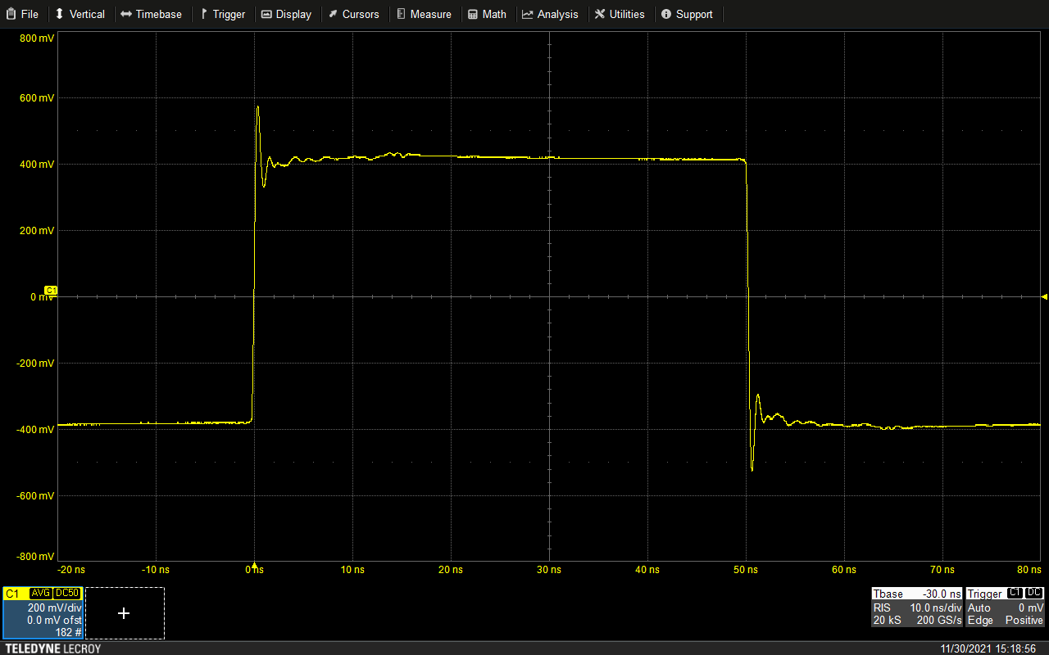
Resistive Probe: Ground L Sensitivity
Pico TA061
Alligator ground
Pico TA061
Spring ground

Slide 18
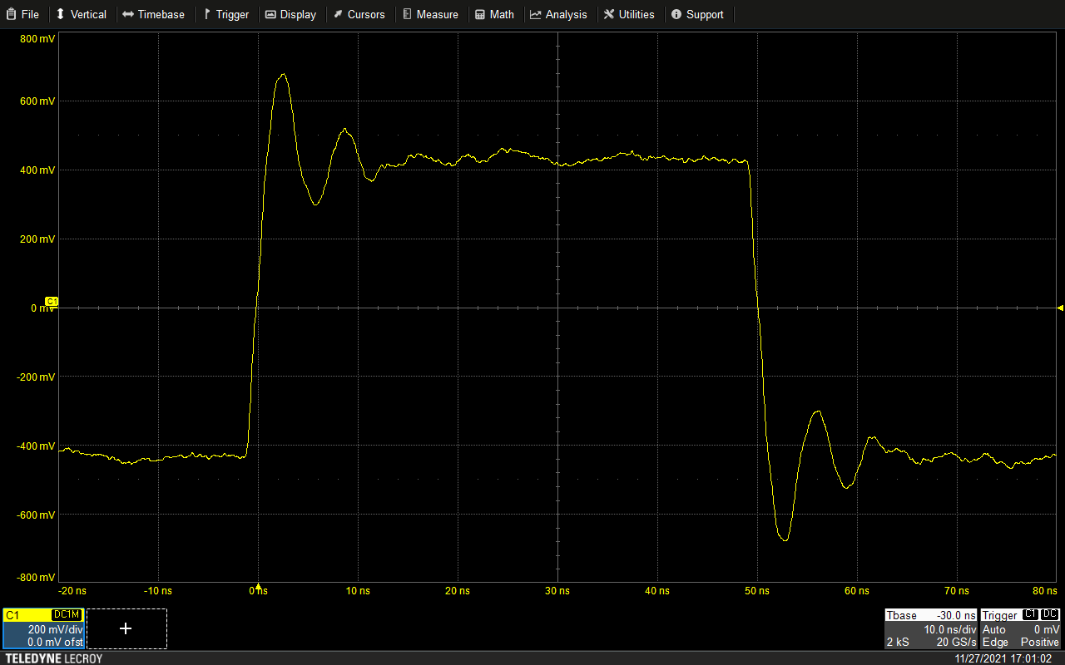
Resistive Probe: Ground L Sensitivity vs R-C
Pico TA061
Alligator ground
Teledyne LeCroy PP023
Alligator ground

Slide 19
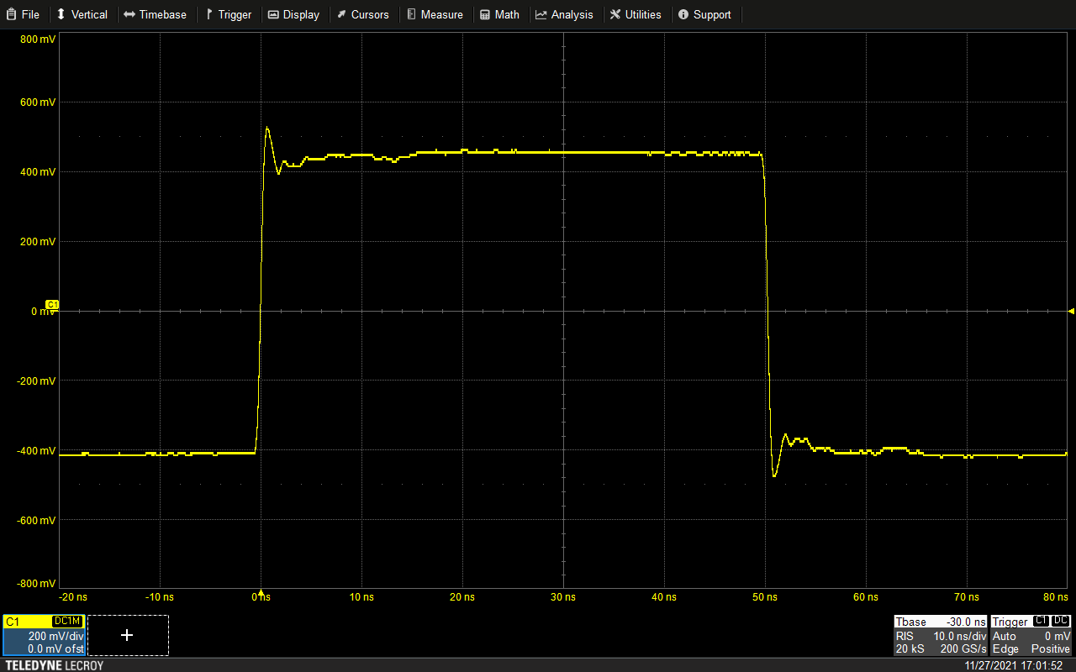
Resistive Probe: Ground L Sensitivity vs R-C
Pico TA061
Spring ground
Teledyne LeCroy PP023
Spring ground

Slide 20
Resistive Probe: Ground L Sensitivity vs R-C
Pico TA061
Alligator ground
Teledyne LeCroy PP023
Spring ground

Slide 21
Resistive Probe: Input Stub
Distance from probe tip to resistor is critical
  This is an unterminated low-Z stub!
  Reflection off resistor causes ¼ wave null in response
Longer tip needle makes this effect worse

Slide 22
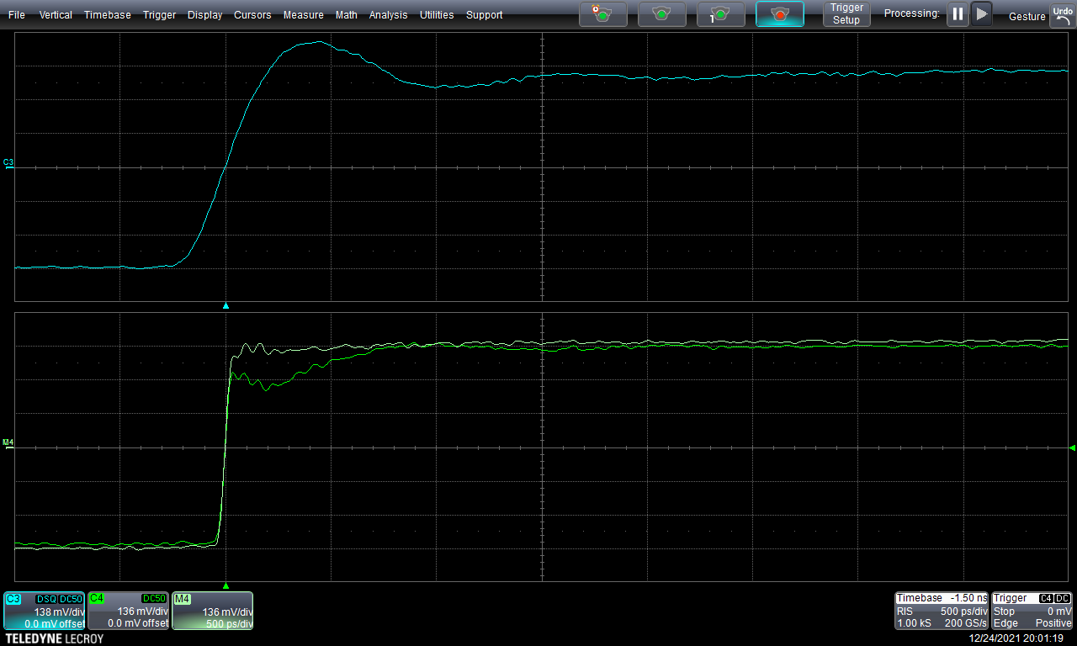
Resistive Probe – Time Domain Loading (TA061)
Capacitive / stub loading from probe tip
Long needle = long reflection period
DC loading from
500Ω input resistance

Slide 23
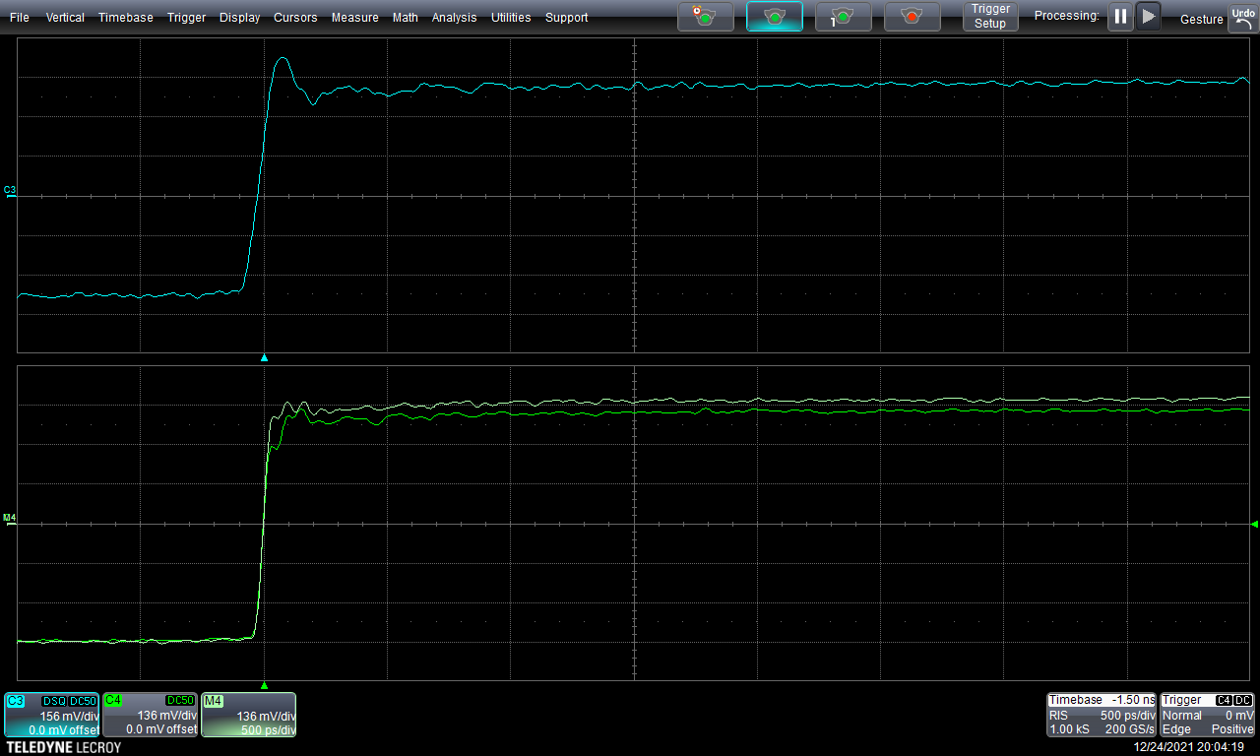
Resistive Probe – Time Domain Loading (921)
Much smaller capacitive load!
Can still see tiny ~50ps reflection
from probe tip to resistor
DC loading comparable
to TA061

Slide 24
Resistive Probe – Input Stub
Ideally we want no reflection at all!
  But how can we get that?
  Need to eliminate the mismatched stub somehow...

Slide 25
Resistive Probe – Reducing Reflections
What if we match tip Z0 to probe resistance?
  For example, 500Ω Z0 for a 500Ω 10:1 probe
This eliminates mismatch at tip-to-R junction
  All power we don’t sample is instantly reflected back to DUT

Slide 26
Resistive Probe – Reducing Reflections
There’s just one problem…
  The impedance of free space is ~377Ω
  Matched tip is impossible with a 10:1 or 20:1 probe
  Doable (maybe) with a 5:1, but mechanically tricky

Slide 27
Resistive Probe – Reducing Reflections
Alternative: Make the stub really short
  Move the null past the band of interest
Lots of fun ways to do this
  Castellated probe tips
  Solder-in damping resistors
  Carbon fiber tip needles
Any of these sound familiar?
  We’ll return to this in a later section...

Slide 28
Resistive Probe: Strengths
Excellent price / performance ratio
  Nothing else gives you GHz of BW for $1K!
  Prices typically mid 3 to low 4 digits USD
No active components – fairly ESD resistant
Generic design – no vendor lock-in
More tolerant of bad grounding than R-C probe

Slide 29
Resistive Probe: Weaknesses
Relatively high DC loading
  Not suitable for use on lines with pullups
May disturb DC bias on DUT
  Can mitigate this w/ coaxial DC block
  Some probes include AC coupling cap
High attenuation (typically 10:1 or 20:1)
  Can reduce attenuation at the cost of worse DC loading
Still needs reasonably decent grounding

Slide 30
Resistive Probe: When to Use
Fast digital signals with push-pull drivers
  Excellent general purpose embedded debug probe
  Easily usable out to several Gbps
Low impedance analog
  Great for 50Ω RF
RF / high speed test points
  Design resistive couplers into your DUT
  Add coaxial test points

Slide 31
Questions?

Slide 32
LAB OPTION A: Demo board + scope
Same setup as previous lab
Each lab group shares a TA061
One PP066 and one 921 total, pass them around

Slide 33
Lab 2: Resistive Probes
Compare loading and rise time vs R-C probes
  Pay attention to both edge shape and the DC shift
Try different ground options on TA061
Compare sensitivity to ground L vs the R-C probe

Slide 34
Lab 2: Resistive Probes
Try higher frequency signals
PRBS up to 5 Gbps on left side SMAs

Slide 35
LAB OPTION B: Antikernel Labs facility
Oscilloscope
  Teledyne LeCroy
  SDA 816Zi-A
Probes
  Teledyne LeCroy PP066
  Pico TA061
  Pico 921
  AKL-PT5 prototype
Signal sources
  Siglent SSG5060X-V
  Leo Bodnar fast edge generator
  1.25 – 10 Gbps PRBS board
  MultiLane ML4039-BTP

Slide 36
Lab 2A: Step response
10 MHz sharp rising edge
Compare all probes
  Note shape, speed, and artifacts on edge

Slide 37
Lab 2B: Loading
10 MHz sharp rising edge
Look at thru path on fixture
Compare each probe to the no-probe case

Slide 38
Lab 2C: PRBS measurements
Connect signal source to fixture
  DS125DF111 board for 1.25, 2.5, 5 Gbps
  ML4039-BTP for 10.3125 and up
Compare waveform shape and eye patterns

