Slide 1
Active Differential Probes

Slide 2
Differential Probe
Differential amplifier fed by probe tip
Typically used for low swing, high BW signals
  HV diff probes exist, but out of scope for this section

Slide 3
Differential Probe: Input Considerations
Loading
Common mode range
Differential dynamic range
Damage levels
Overload recovery

Slide 4
Differential Probe: Grounding
Input signal isn’t measured WRT ground, but...
Very limited common mode range
  ± 5V for Teledyne LeCroy DH series
  ± 2.4V for Teledyne LeCroy D400A-AT
Board needs to share same DC ground as probe
  No need for a low-L RF ground path!

Slide 5
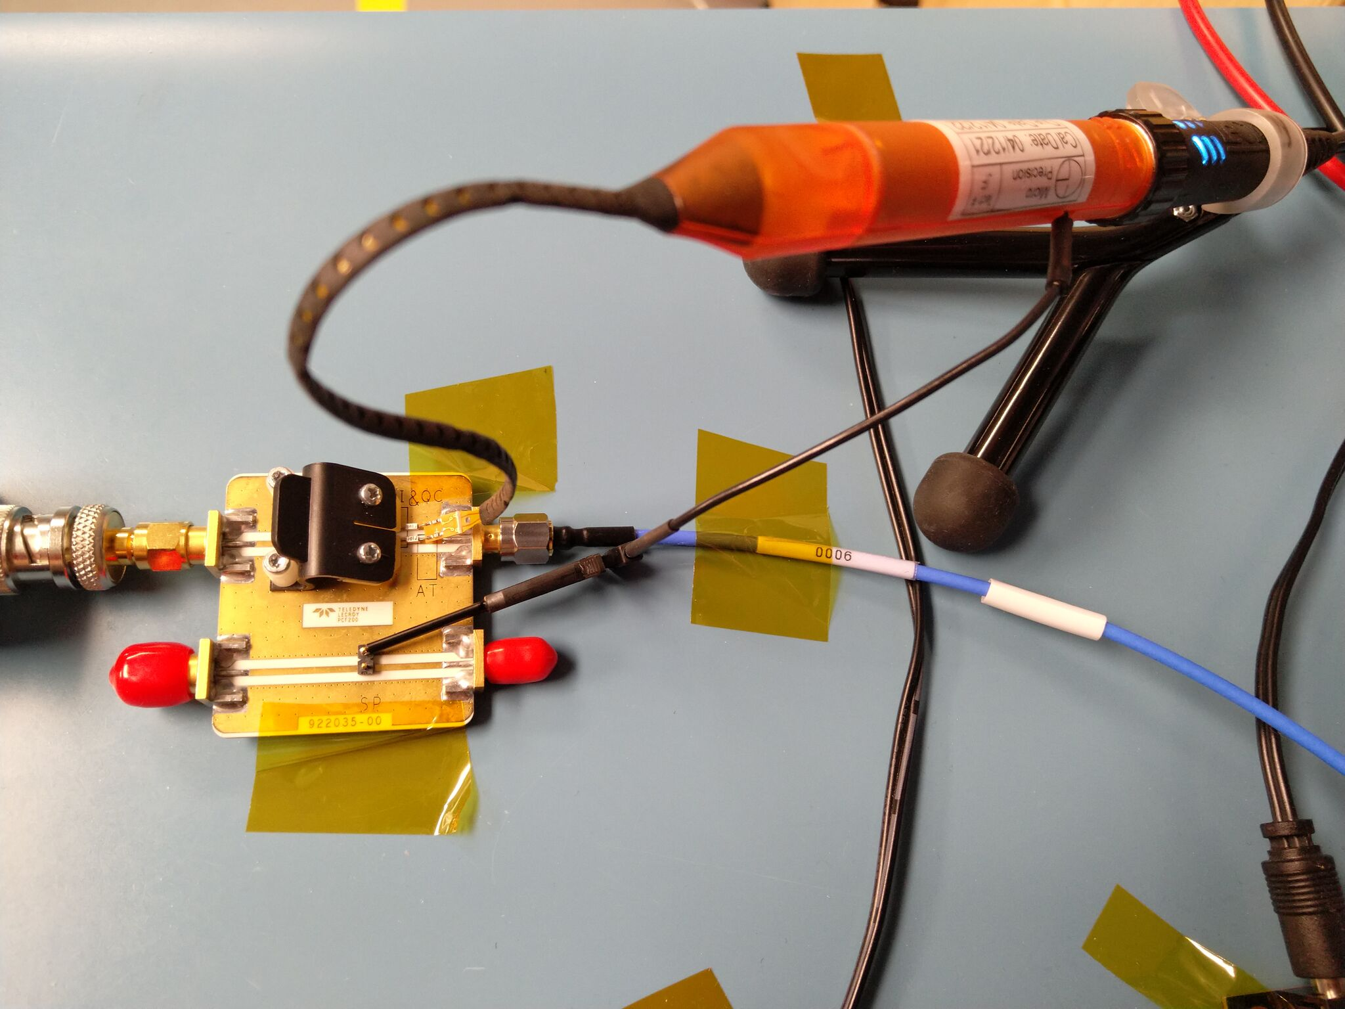
Differential Probe: Grounding Methods
Ground from another probe
Grounded power supply
Ground input on amplifier
  Only need to use one per DUT
USB / UART / JTAG cable
Coax shield

Slide 6
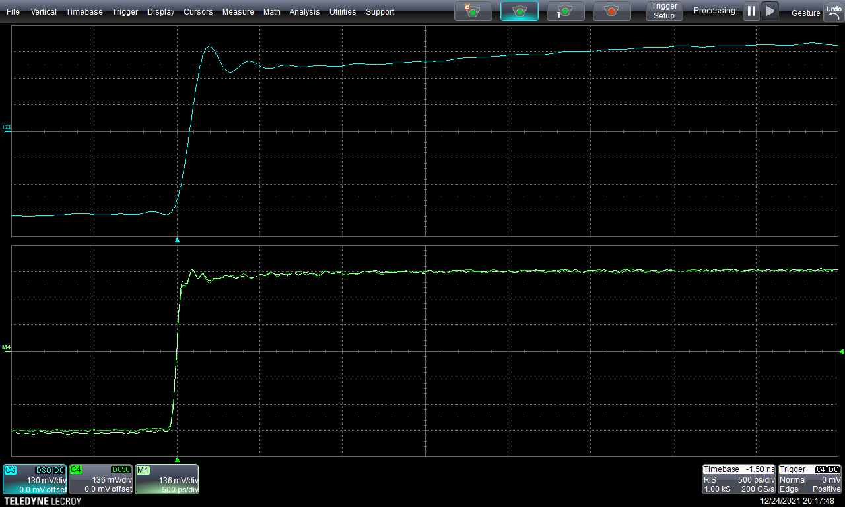
Loading (Teledyne LeCroy D420-A, SI tip)
Shift is almost invisible!
Good diff probes have
extremely low loading

Slide 7
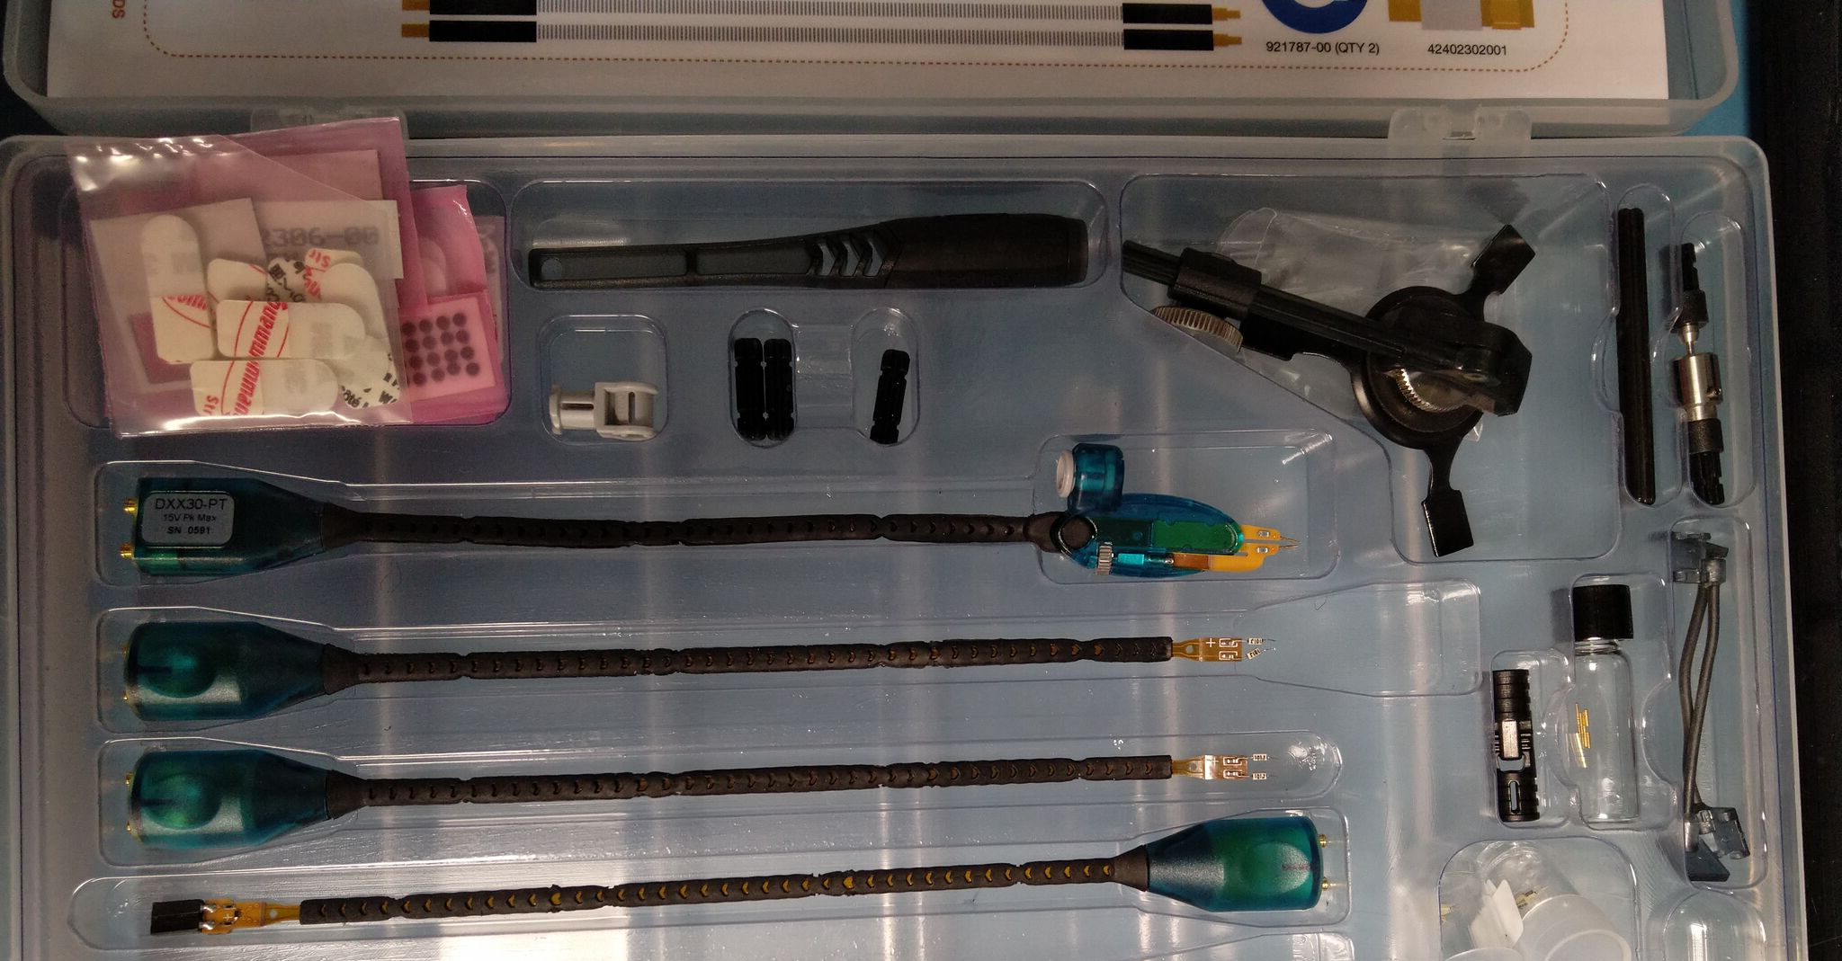
Differential Probe: Tips/Accessories (D1330)
Mounting jigs, tape,
tip clips, etc.
Yes, they’re Legos!
Handheld browser
Solder-in
Pin header

Slide 8
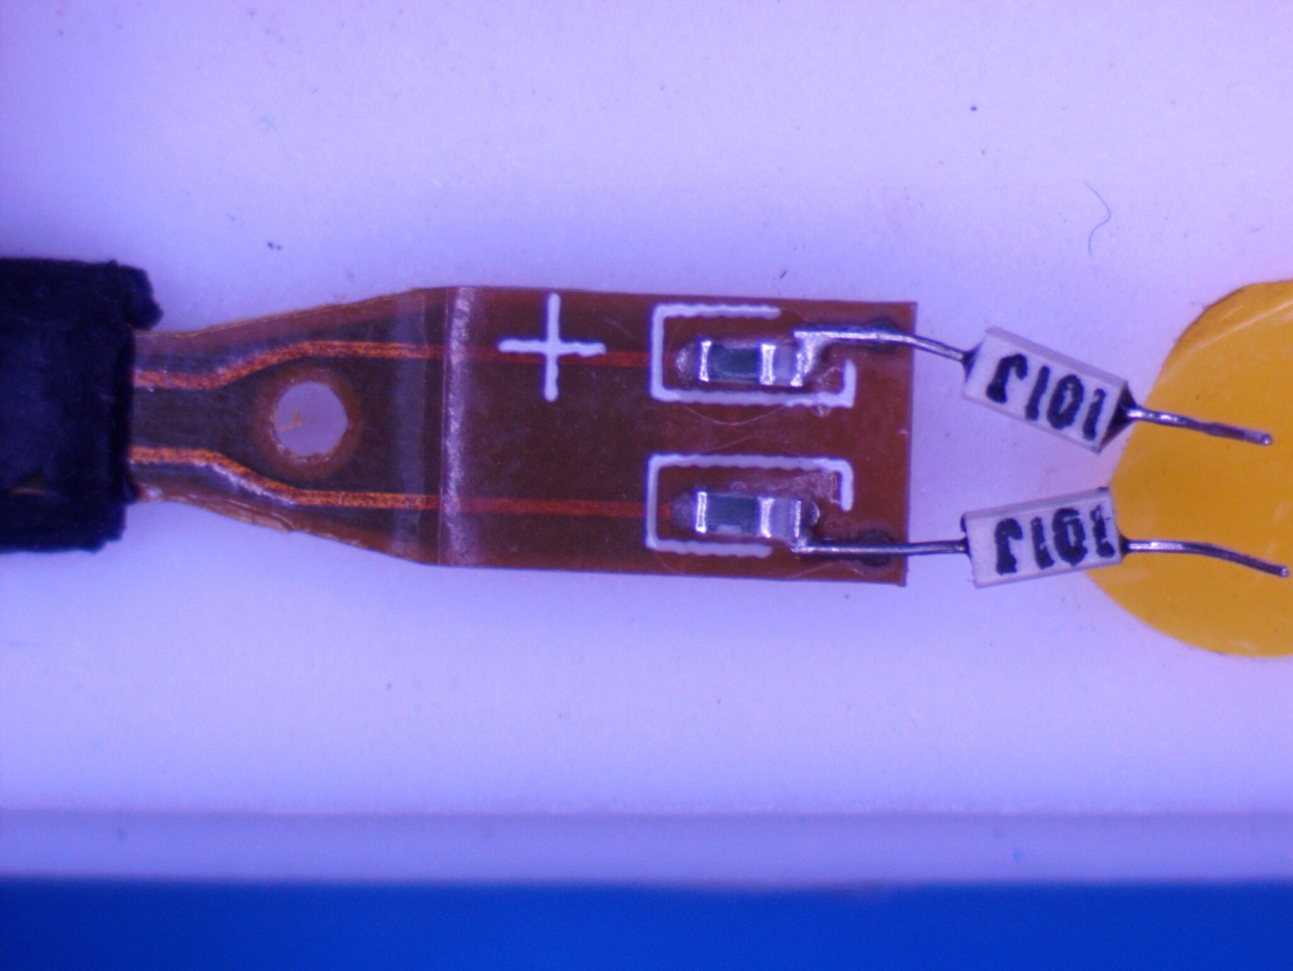
Solder-In Tip (D1330-SI)
950Ω
100Ω
Tip is just two
resistive probes!

Slide 9
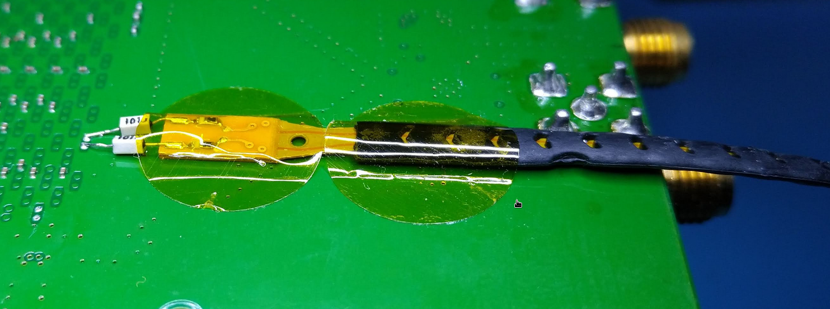
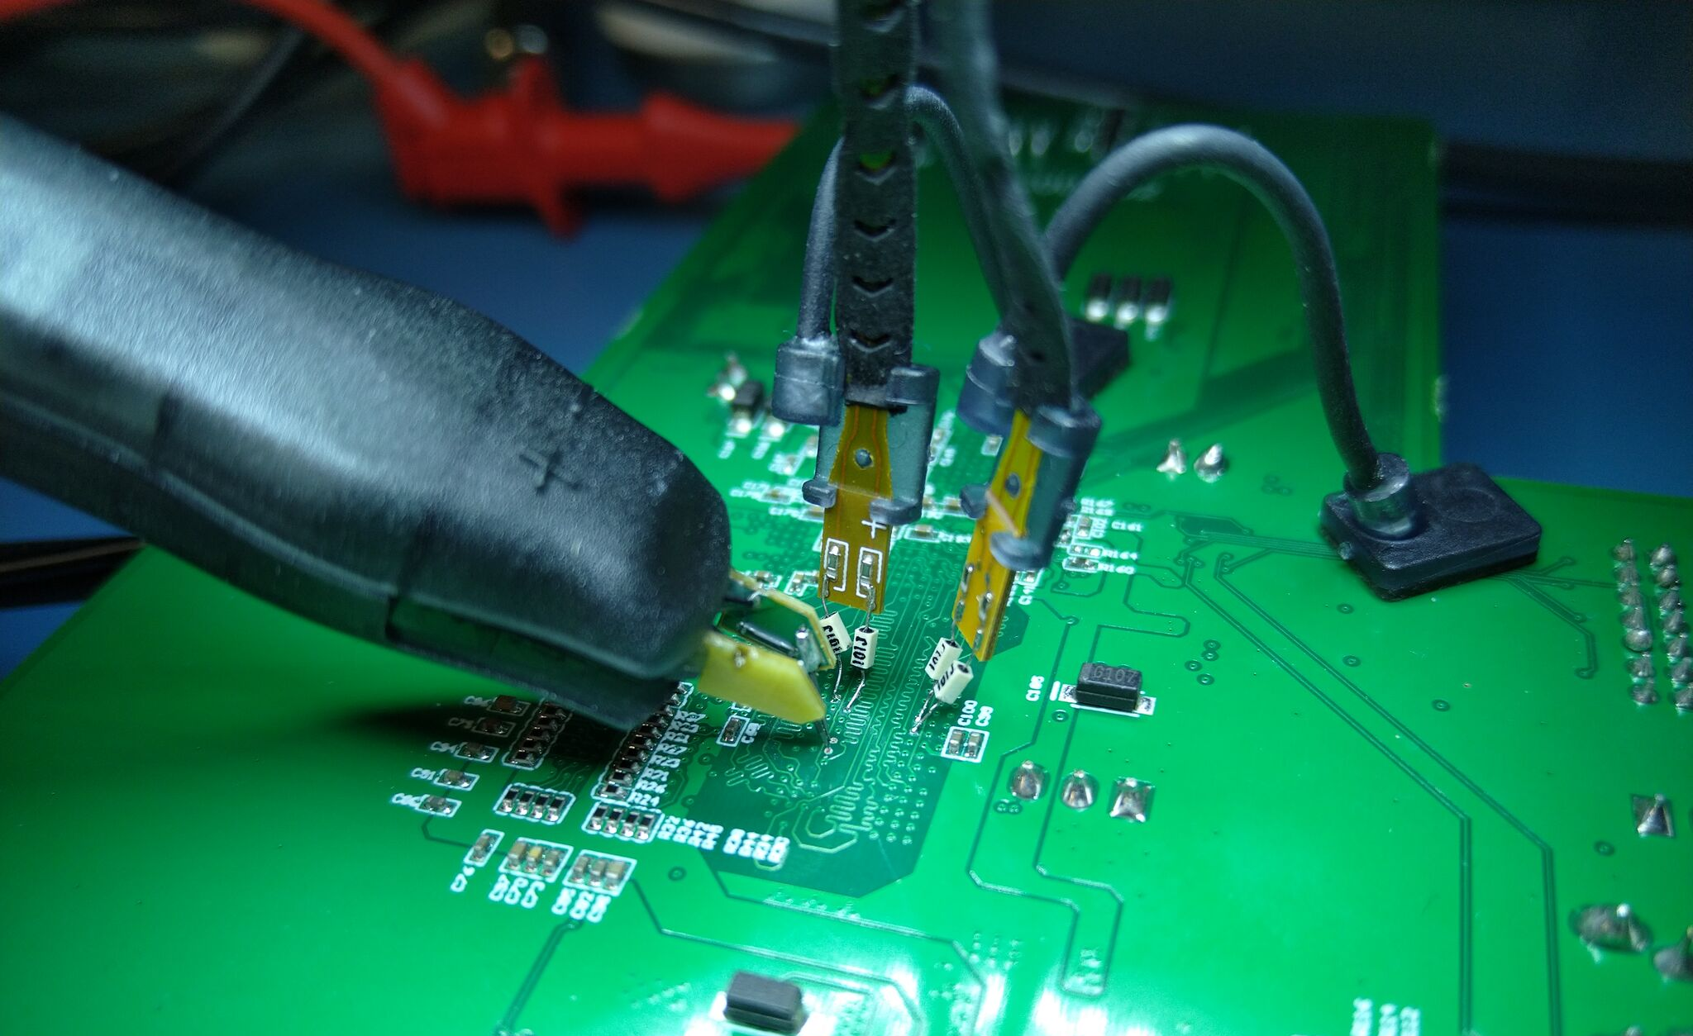
Differential Probe: Securing Tips
Solder-in probe tips are fragile!
  Cannot handle significant shear forces
Secure them with tape or dedicated probe clips

Slide 10
Differential Probe: Tip Coupling
Input is fairly high impedance
Avoid routing tips over strong EMI sources

Slide 11
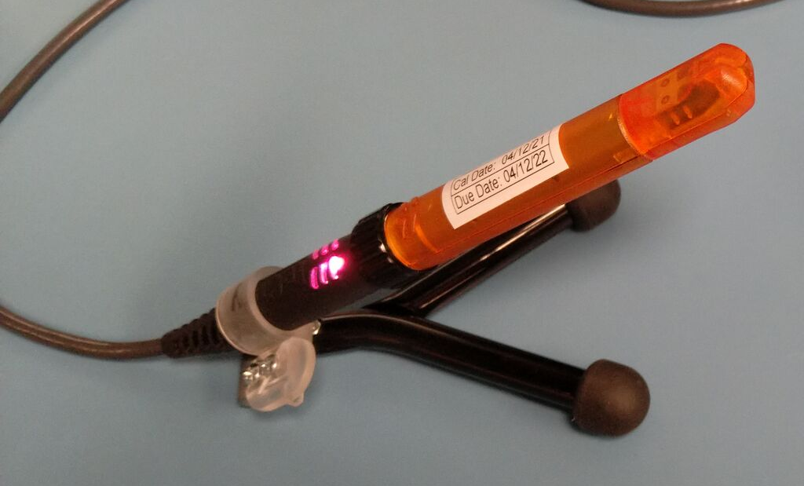
Differential Probe: Securing Probe Body
Amplifier is large and heavy compared to tip
If it moves, it will damage the tip
Use provided holders
Taping wires down helps too

Slide 12
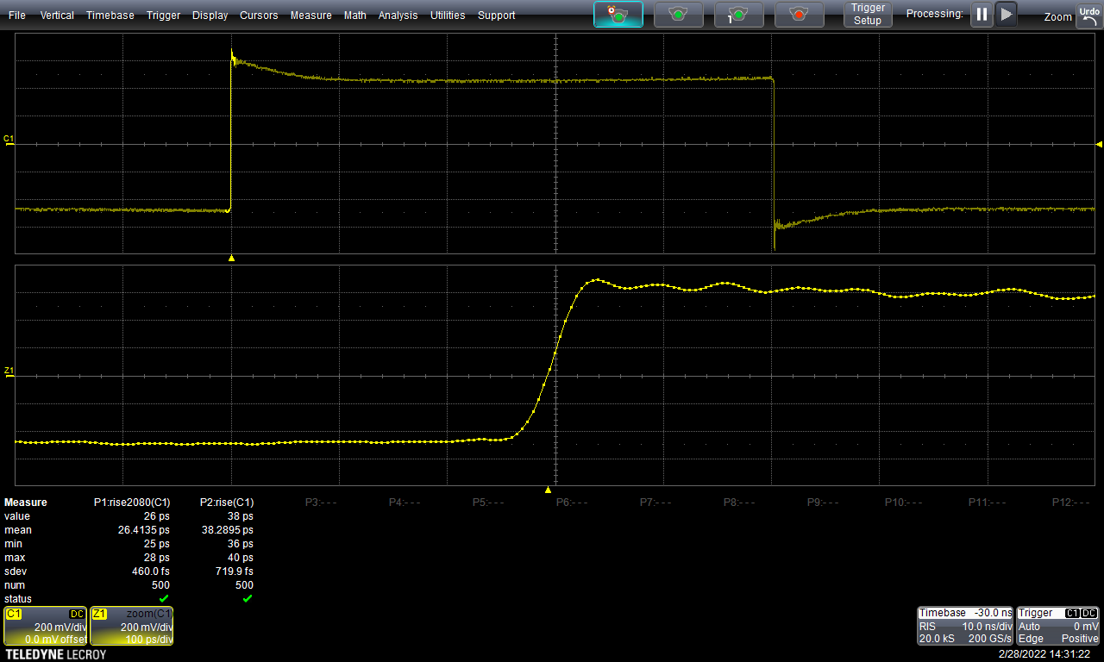
Overload Recovery (LeCroy D1605)
Overshoot and slow recovery
in response to sharp edge

Slide 13
Flatness correction
Most scopes do FIR / DSP flatness corrections
EEPROM in amplifier and/or probe tip
Sometimes automatic, sometimes manual config

Slide 14
Differential Probe: Strengths
Relatively low DC loading
  Often not as low as high-Z active probe
Very low capacitance
Very tolerant of poor grounding
  Ground is only used to keep common mode in range

Slide 15
Differential Probe: Strengths
Rejection of common mode noise
Saves scope channels when probing a diff pair
  Psuedo-differential input uses 2 channels + math function
Low net attenuation (typ range /1 to /5)
  Probe head has significant attenuation = low loading
  Amplifier means scope sees strong signal anyway

Slide 16
Differential Probe: Weaknesses
Very ESD sensitive
Extremely expensive (4-5 digits USD)
Limited range
Overload recovery issues

Slide 17
Differential Probe: When to use
High speed low-swing differential signals
High speed low-swing single-ended signals (DDRx)
  Need to make it differential somehow
  Most common is to measure WRT ground
  Can also measure WRT SSTL Vref etc
Do you really need one?
  Resistive probe on every test point of every DUT?
  One active diff probe? Probably same price

Slide 18
Questions?

Slide 19
Lab 4: Active Differential Probes
Use FPGA GTP outputs (left side) for sharper edge
Observe loading and pulse response w/ slow clock
Compare thru vs probe’s view of eye w/ PRBS

