Slide 1
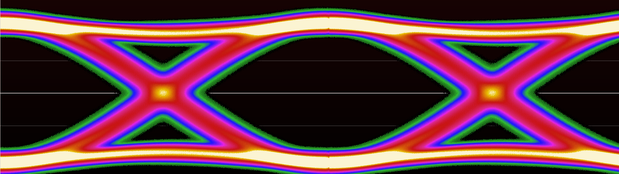
Oscilloscope Probing
Andrew D. Zonenberg, Ph. D

Slide 2
Introduction

Slide 3
Today’s Class
Lecture mixed with hands-on lab
Stop me at any time with questions
Bathroom / emergency procedures
Slides are on my GitHub (CC BY-SA 4.0)
  https://github.com/azonenberg/electronics-training/tree/master/oscilloscope-probing

Slide 4
Learning Goals
Pros and cons of various probe designs
How to select the best probe for a measurement
  Not always the most expensive!
How to get the most out of each probe
Understand non-idealities of real world probes

Slide 5
Lecture Outline
Introduction
What is a probe?
Types of probes
  R-C divider probes
  Resistive probes
  Active voltage probes
  Active differential probes
  Power rail probes
  Nearfield loop probes
  Current probes
  High voltage probes

Slide 6

About Me
Ph.D Computer Science (RPI 2015)
Embedded systems security by day
High speed digital and F/OSS T&M by night
Author and lead developer of ngscopeclient

Slide 7
Disclaimer re Example Hardware
Not an endorsement
  I’m mostly a Teledyne LeCroy and Pico shop
  Most probes we’ll discuss or use are made by them
  This just means I have their products handy
  Discussion of a probe doesn’t imply being particularly good / bad
Product / model names are trademarks of their respective owners

Slide 8
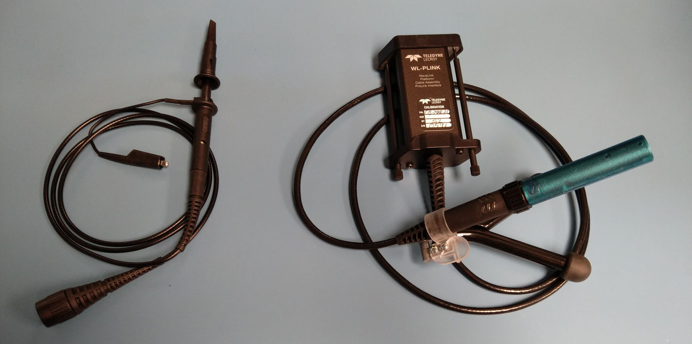
Why Use One Probe Over Another?
Matrix IP1120
200 MHz
$10 on Amazon
Teledyne LeCroy D1330
13 GHz
Over $10000

Slide 9
What is a Probe?
Both electrical and mechanical components
Takes signal from board and puts into instrument

Slide 10
The Ideal Probe
No influence on DUT behavior
No noise
No loss
Low cost
Unlimited frequency / voltage range
Doesn’t exist!
  All real probes are compromises

Slide 11
Attributes of a Probe
What distinguishes one probe from another?
Let’s think of as many as we can

Slide 12
Attributes of a Probe
Bandwidth
Attenuation
Noise
Flatness
Loading
Voltage range
Linearity
Cost
Durability
Ergonomics

Slide 13
Crash Course in S-Parameters
We have a circuit with N ports
  Typical probes are 2-port networks
RF energy is applied to one port
Some signal comes out each port
  Outputs / reflections have amplitude and phase shift
Model this as a NxN “scattering matrix”

Slide 14
Crash Course in S-Parameters
Notation: Sxy is path to X from Y
S21
Port 1
DUT
Port 2
S11
S22
S12

Slide 15
Crash Course in S-Parameters
Each S-matrix element is a complex number
  Real and imaginary
  Or (often easier to think about) magnitude and phase angle
Value is frequency dependent
Nonlinear effects can create harmonics
  S-parameters only model linear behavior
  Keysight developed X-Parameters for modeling nonlinearities.
  This is beyond the scope of today’s discussion.

Slide 16
Crash Course in S-Parameters
Typically measured with a VNA
  Can also simulate, etc
Port numbering is arbitrary
  For examples in today’s class, convention is:
  1 = DUT end
  2 = scope end
  S11 = power reflected to DUT
  S21 = power seen by scope

Slide 17
Direct Coaxial Connection

Slide 18
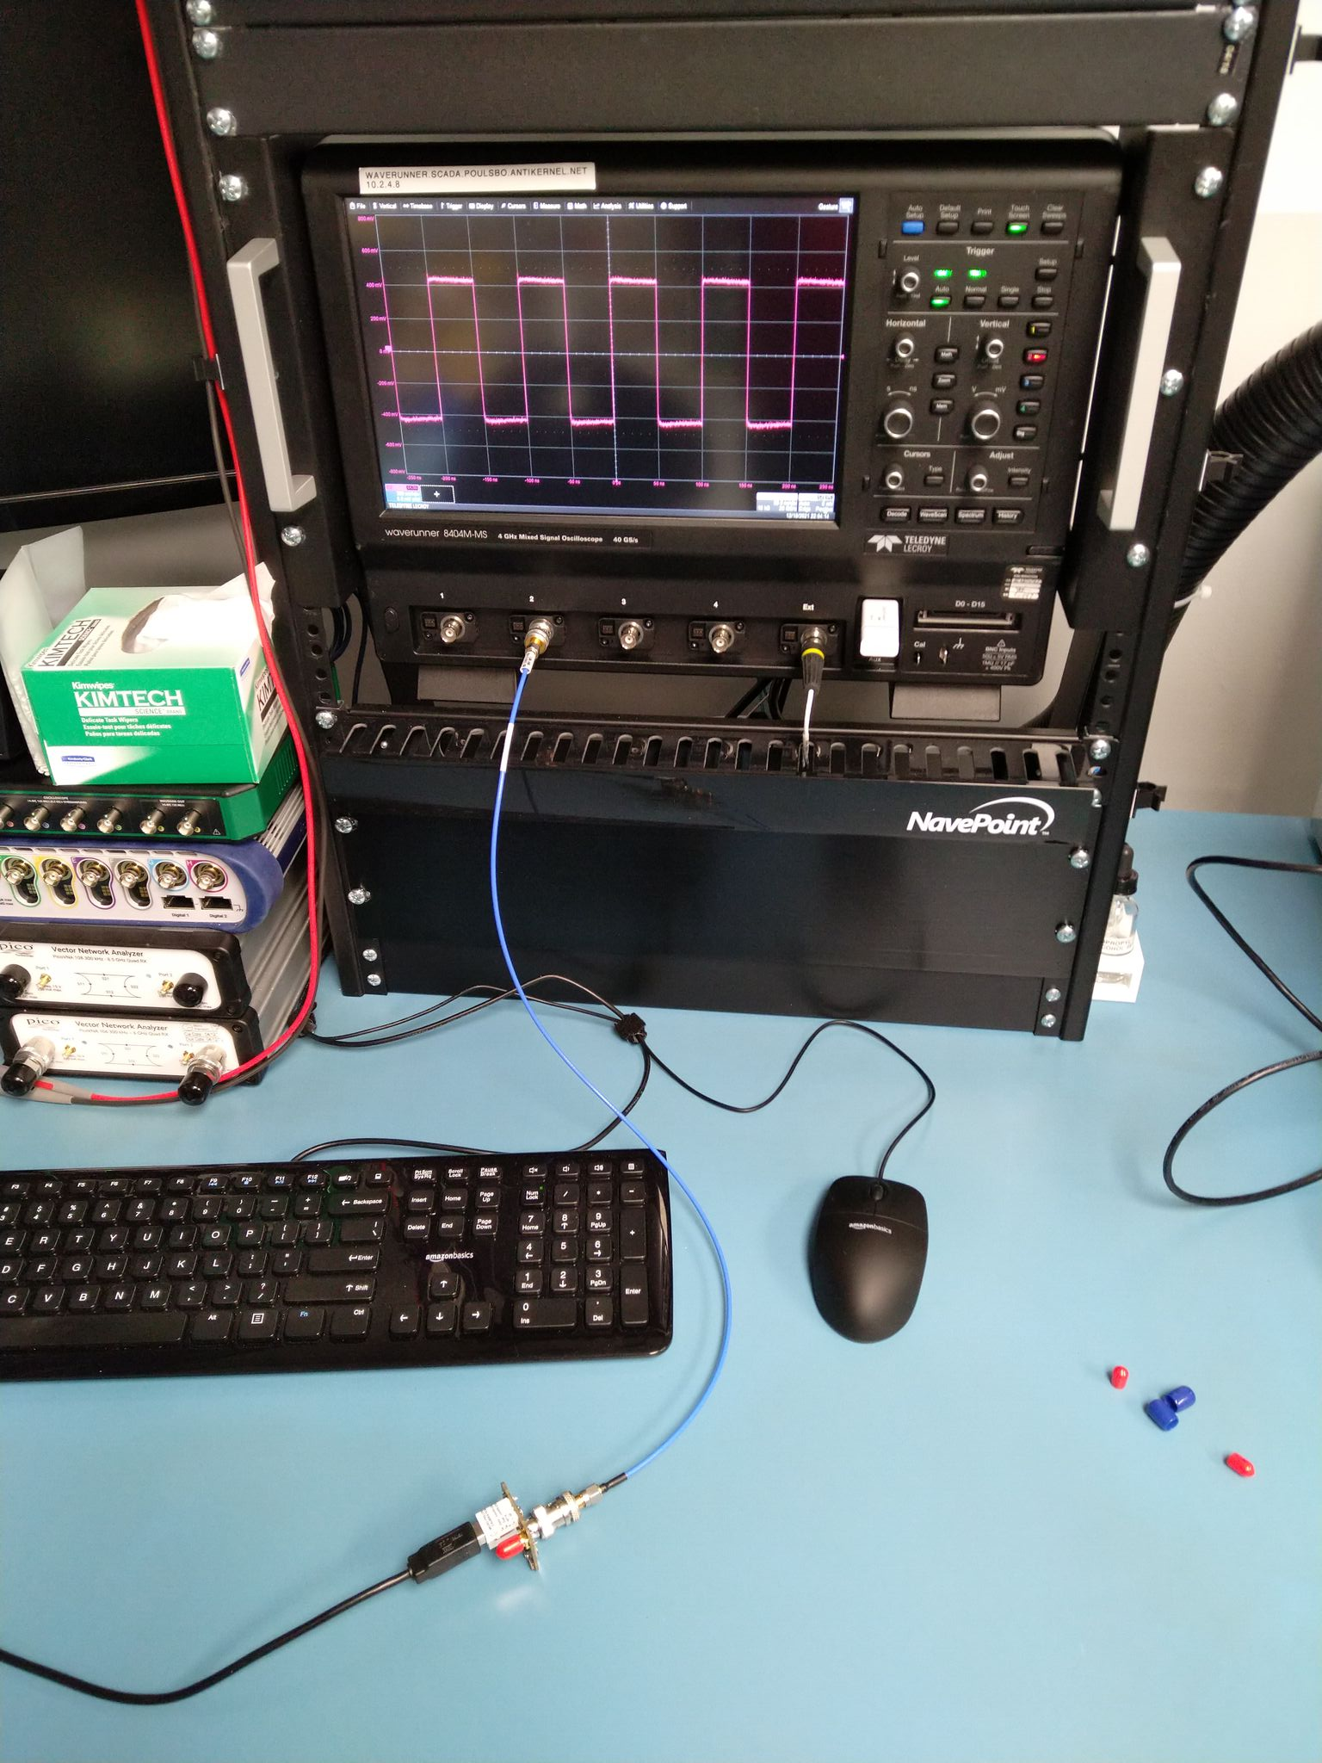
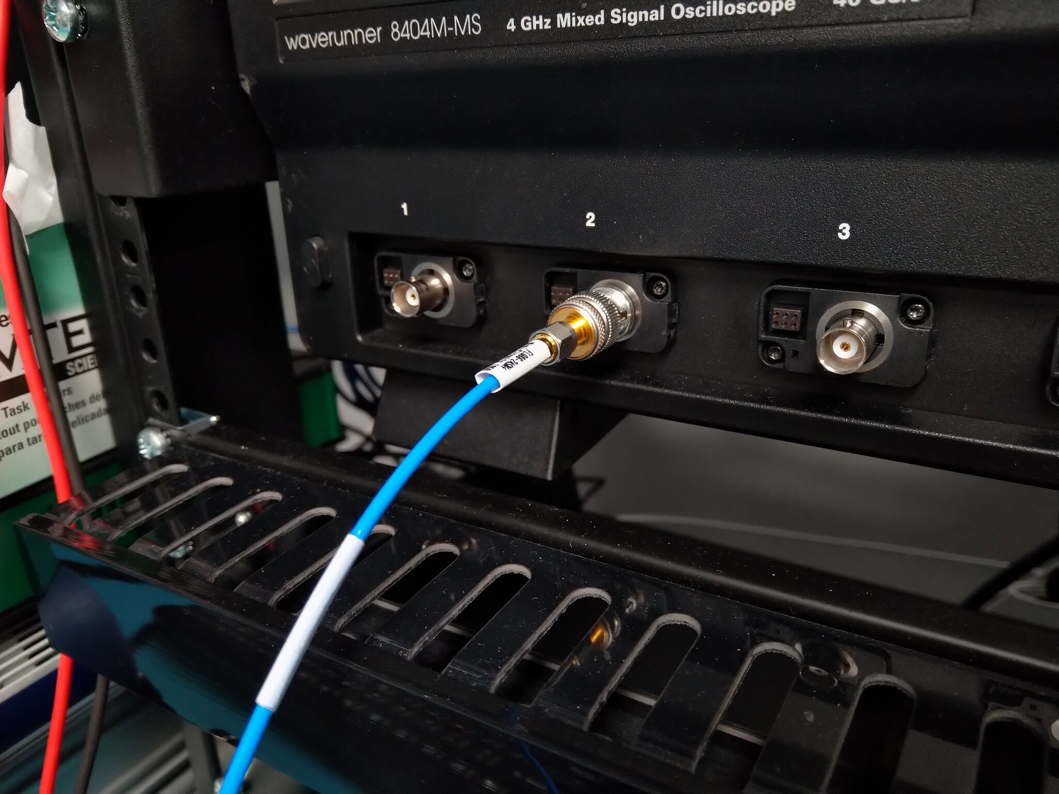
When Is A Probe Not A Probe?
When it’s just a cable!

Slide 19
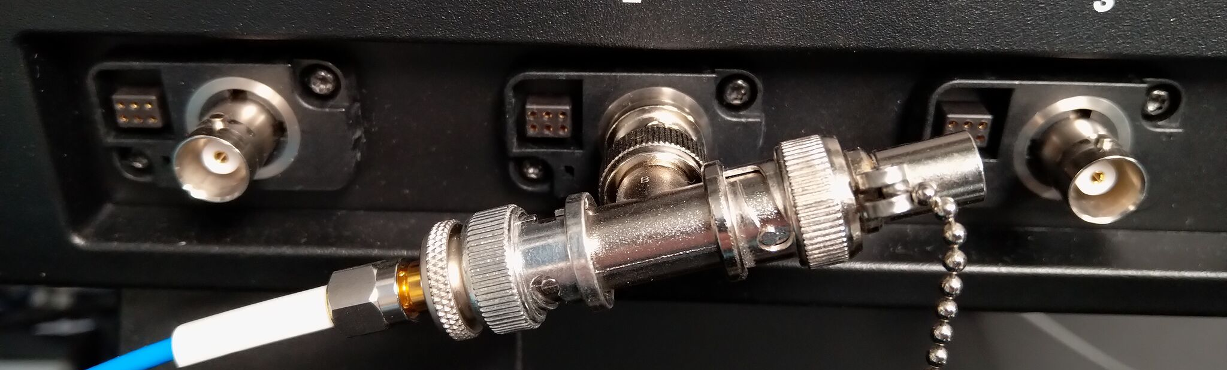
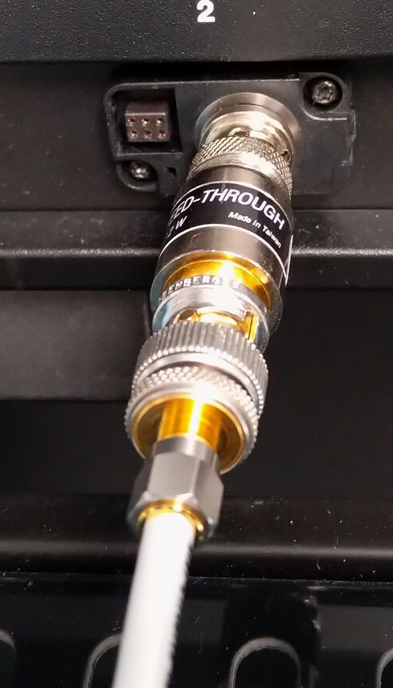
External 50Ω Termination
Lower end scopes lack native 50Ω terminations
Can use in-line or T terminations at lower freqs

Slide 20
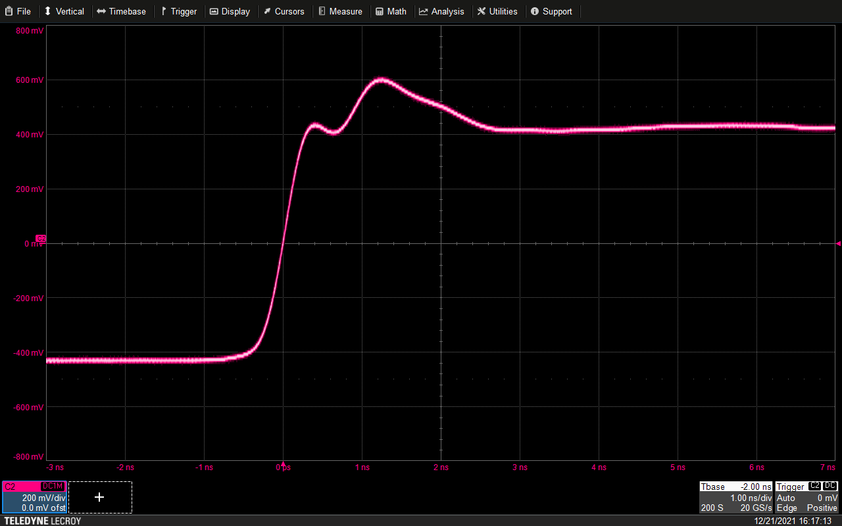
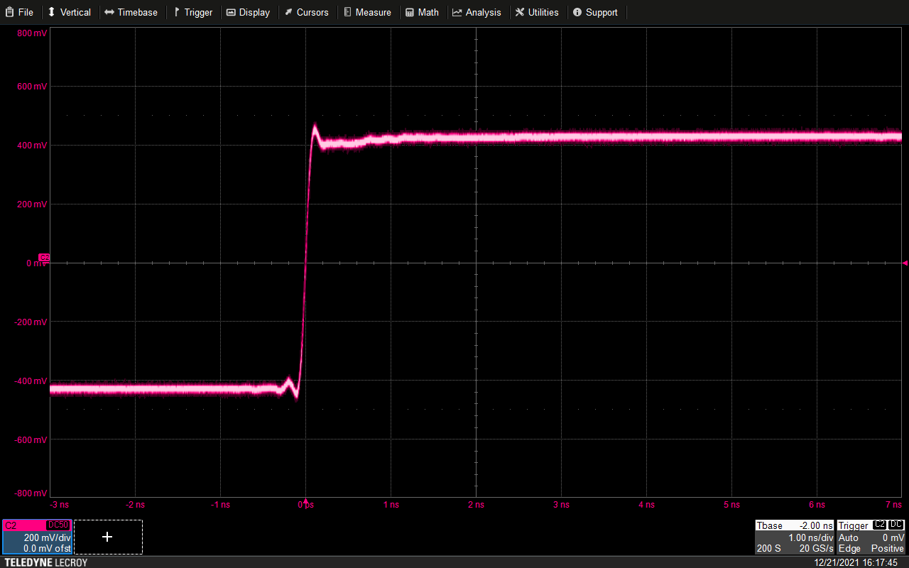
In-Line Terminator vs Native 50Ω Input
Reflection off stub between
terminator and scope frontend
Matched input
No reflection
Note rise time difference:
This scope is 4 GHz BW in 50Ω mode, 500 MHz in 1MΩ mode

Slide 21
Direct Coaxial Connection: Advantages
Lowest possible noise
  No external amplifiers
  No attenuation so need less frontend gain
Low cost – no expensive probe needed
Flattest possible response
  Only source of error is cable loss
  Can de-embed this if cable is characterized

Slide 22
Direct Coaxial Connection: Disadvantages
Requires 50Ω scope input
  Inline termination works OK at lower freqs
  Reflection issues at higher speeds
High loading on DUT
  Probe presents a 50Ω load
Limited range
  Most 50Ω scope inputs are ±5V max range
  Many higher BW inputs are even less (±2V is common)

Slide 23
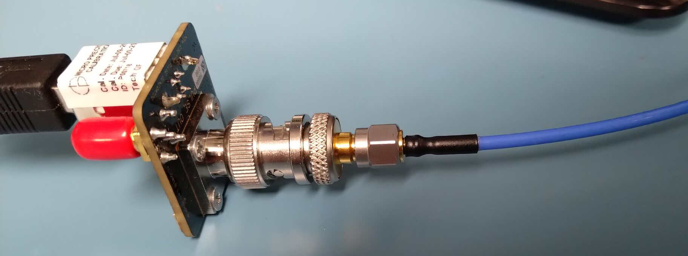
Direct Coaxial Connection: When to Use
If your DUT already has coaxial test points
Measuring end of unterminated 50Ω line
  Empty DIMM or PCIe socket*
  Card edge connector
  Unpopulated footprint
Ideal reference signal to compare probe against
  It’s hard to get flatter response than a short cable

Slide 24
R-C Divider Probe

Slide 25
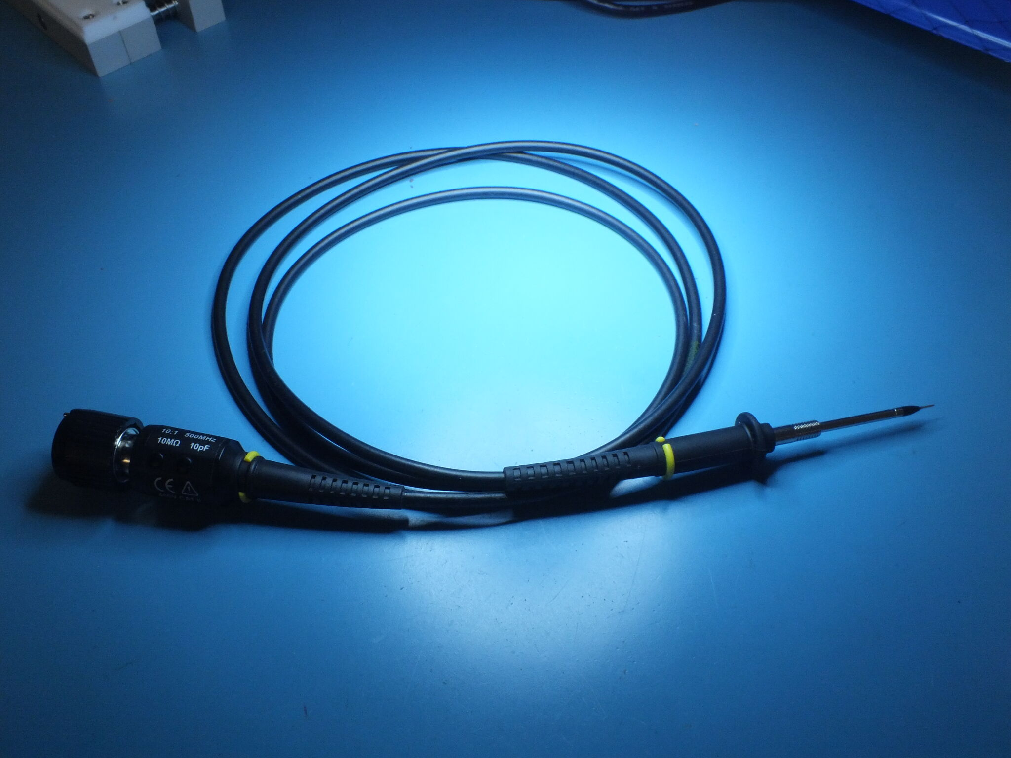
R-C Divider Probe
You’ve all used this one
Dates to the vacuum tube era!

Slide 26
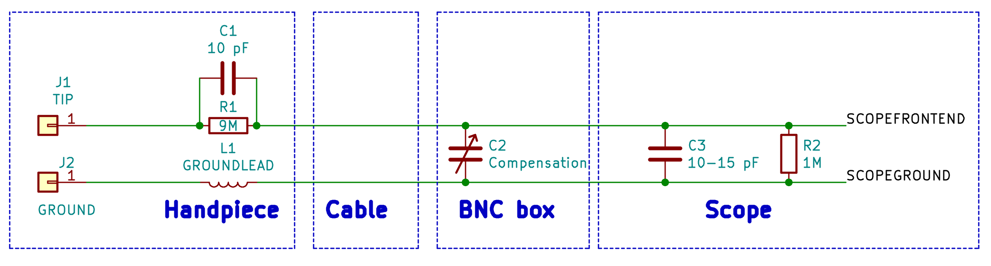
R-C Divider Probe
Lossy cable (often thin Ni-Cr core)
to damp out reflections
Ground wire has
nontrivial inductance

Slide 27
R-C Divider Probe: Compensation
Trimpots / caps near BNC
  Simple design is a single C
  Higher end probes may have multiple trimmers for fine tuning
Adjust for desired frequency response
  Usually target is broadband flatness
  For narrowband measurements, optimize for that region
Generally not portable across scope models
  If moving probe to another instrument, re-compensate

Slide 28
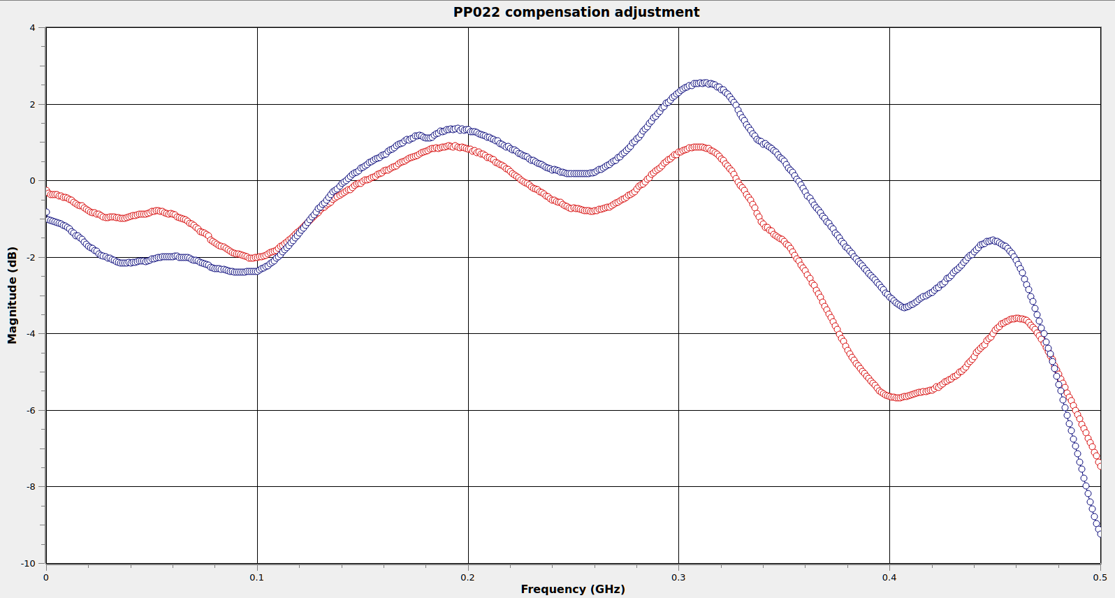
R-C Divider Probe: Compensation
Compensated for
this scope
1.5 dB less
peaking
0.3 dB
less dip
Compensated for
another scope
But 30 MHz
less B/W

Slide 29
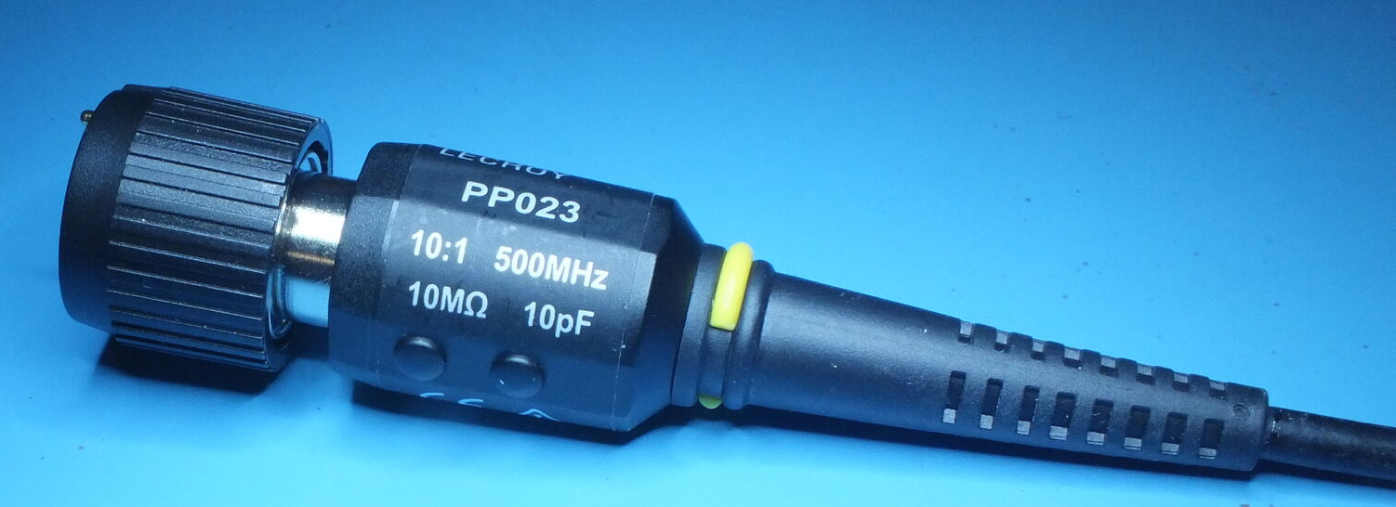
R-C Divider Probe: Loading
10MΩ input impedance is great!
  ...right?
We might have forgot something :(

Slide 30
Probe Loading
Placing probe on a circuit changes its behavior
This can manifest as a “heisenbug”
  DUT stops working when you probe it, or (worse)...
  DUT only works when you probe it!
  New, unrelated failure introduced by probing

Slide 31
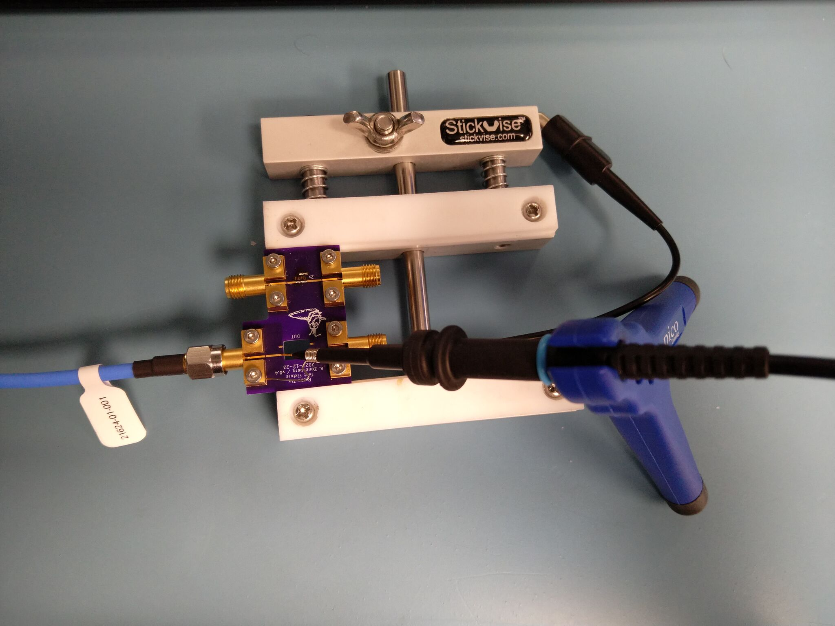
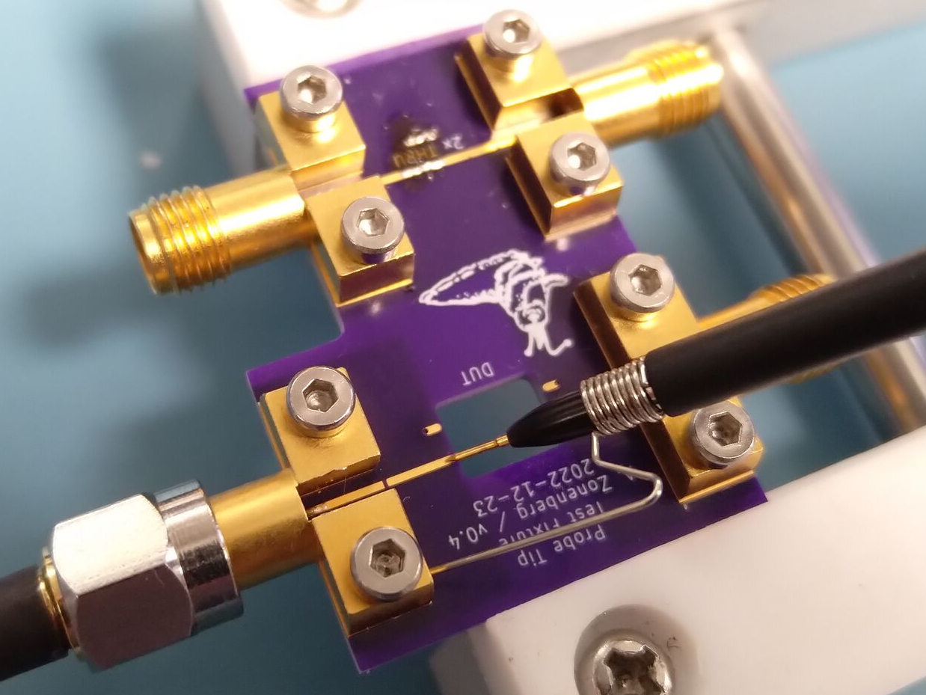
S11 Measurement Setup

Slide 32
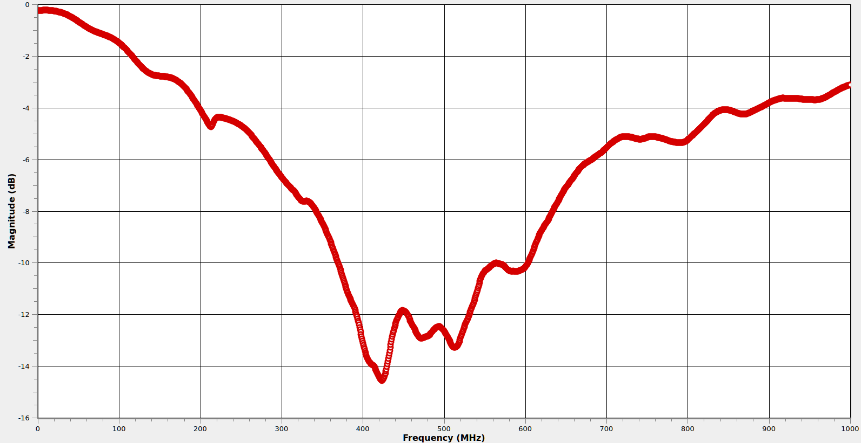
R-C Divider Probe: S11 (across open)

Slide 33
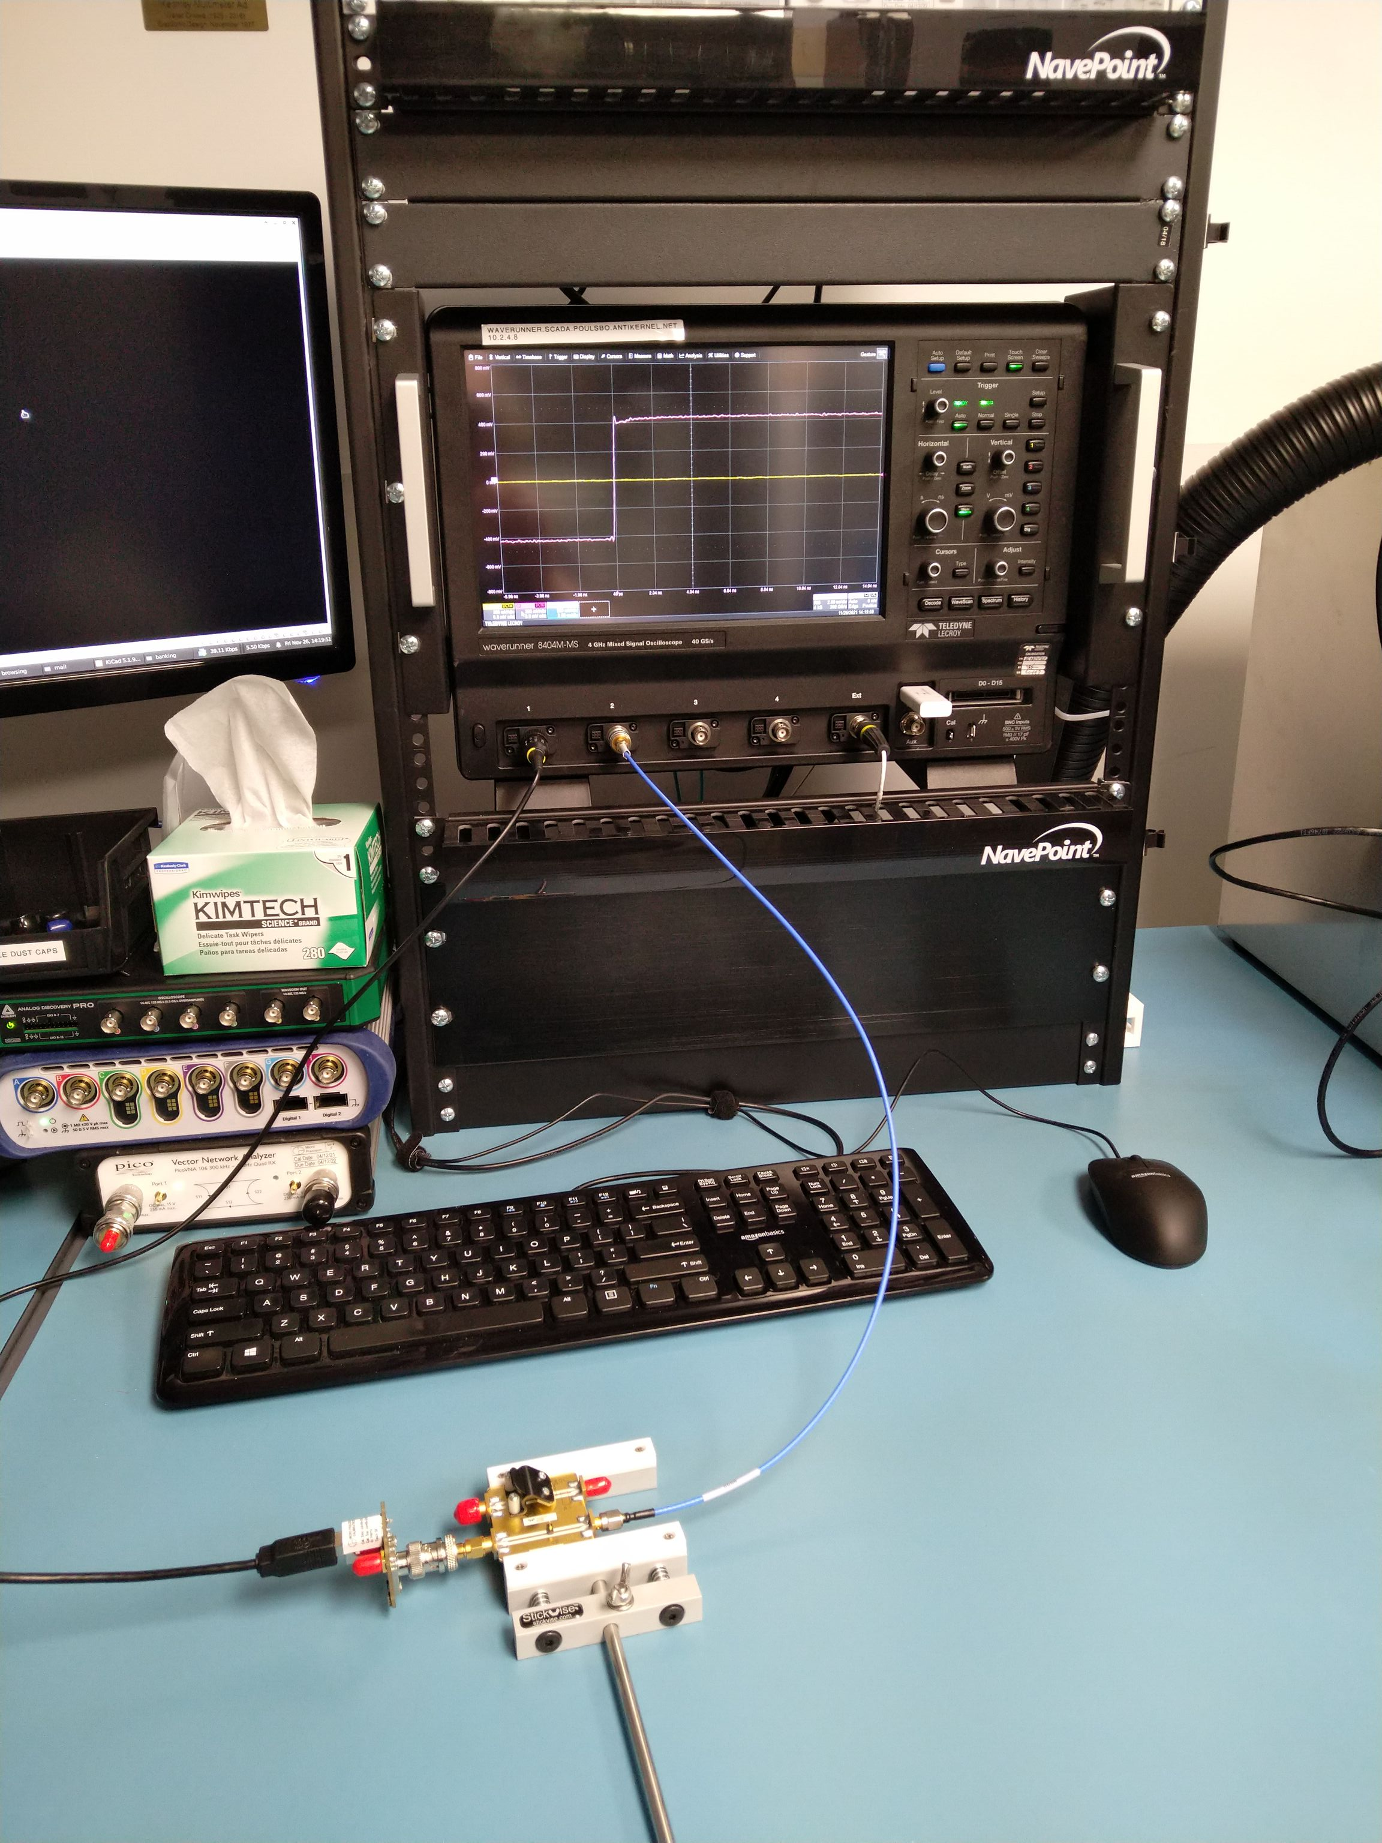
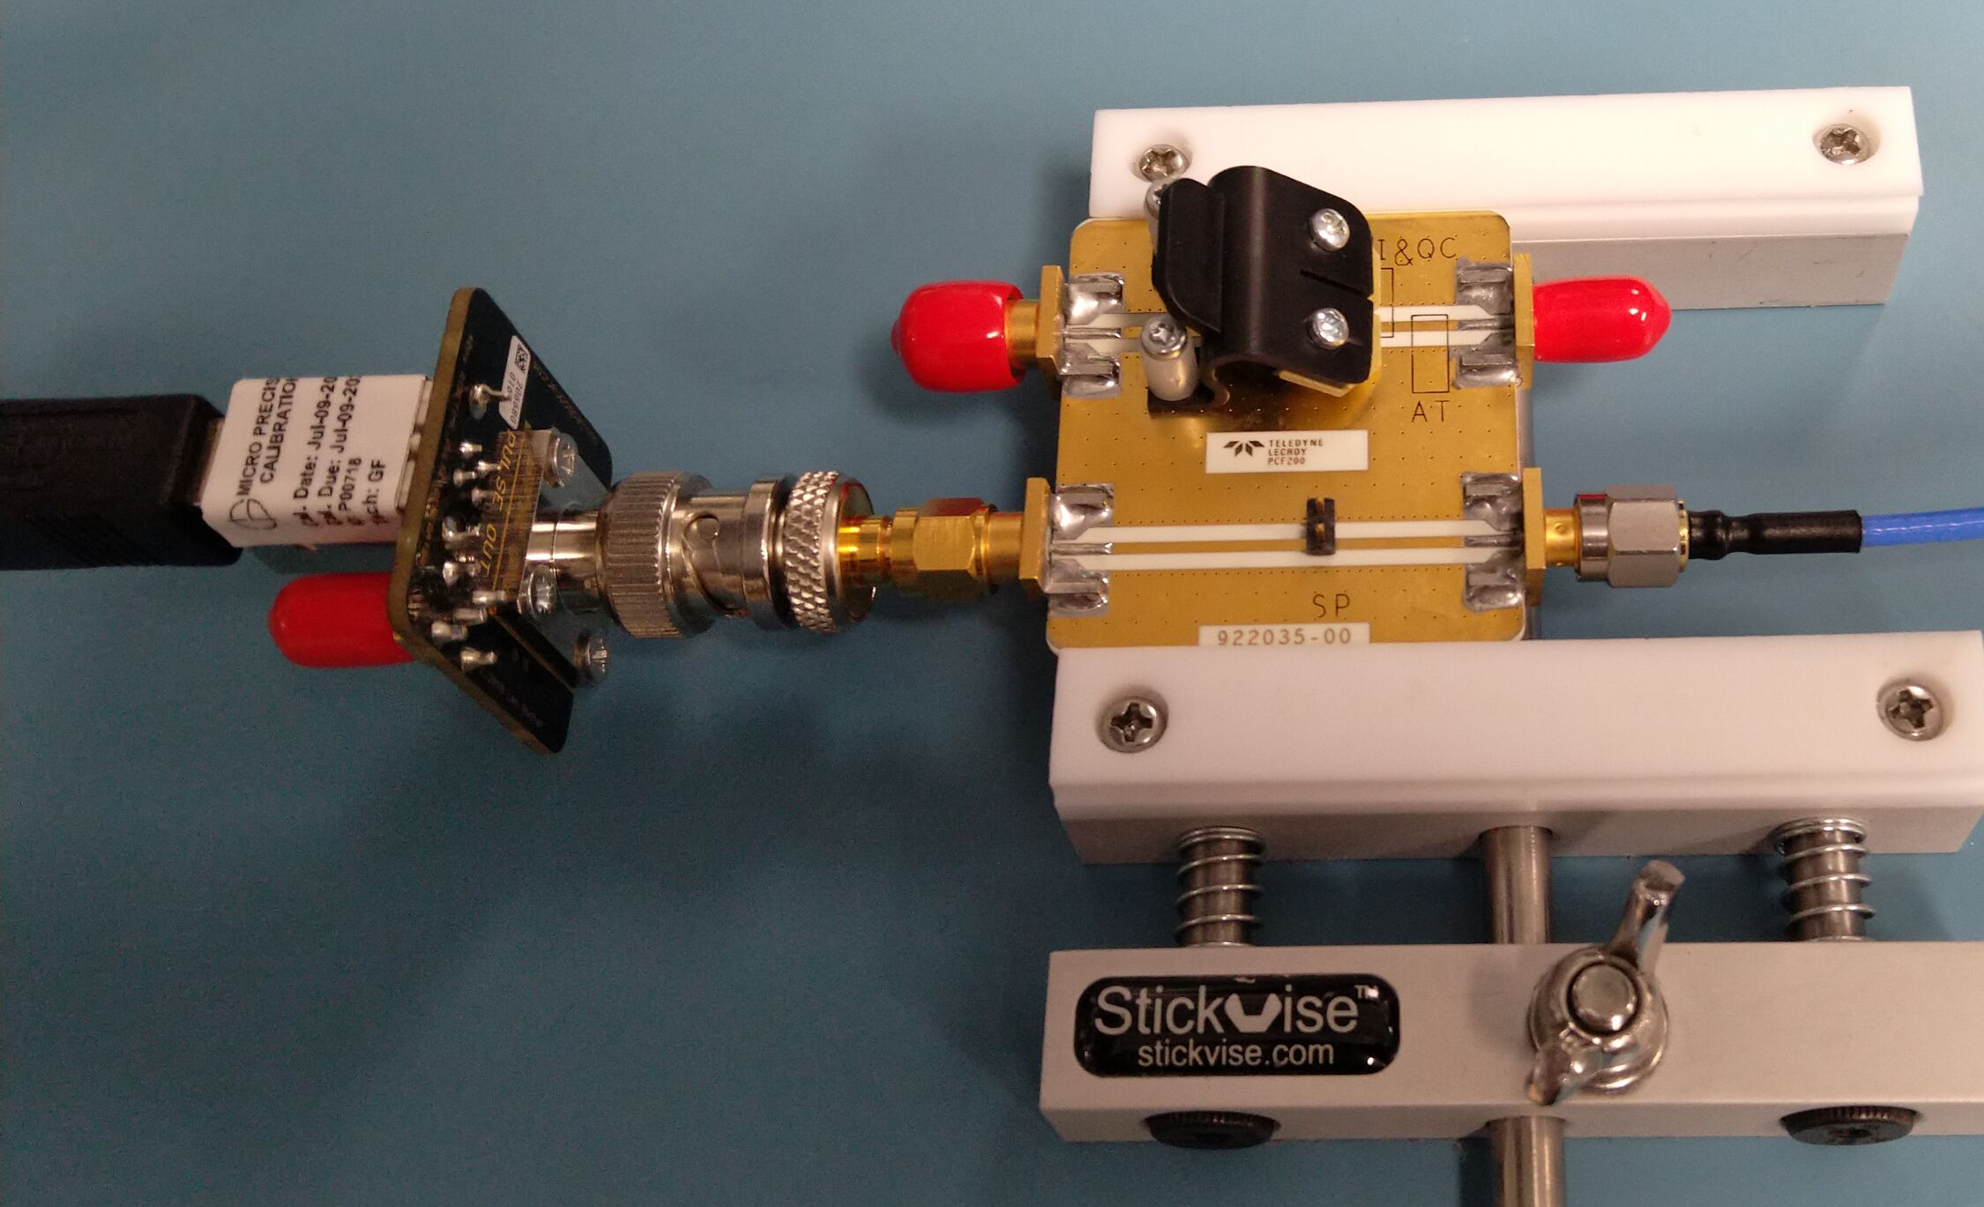
Time Domain Loading Measurement Setup
Fast edge
To scope C2
50Ω thru line

Slide 34
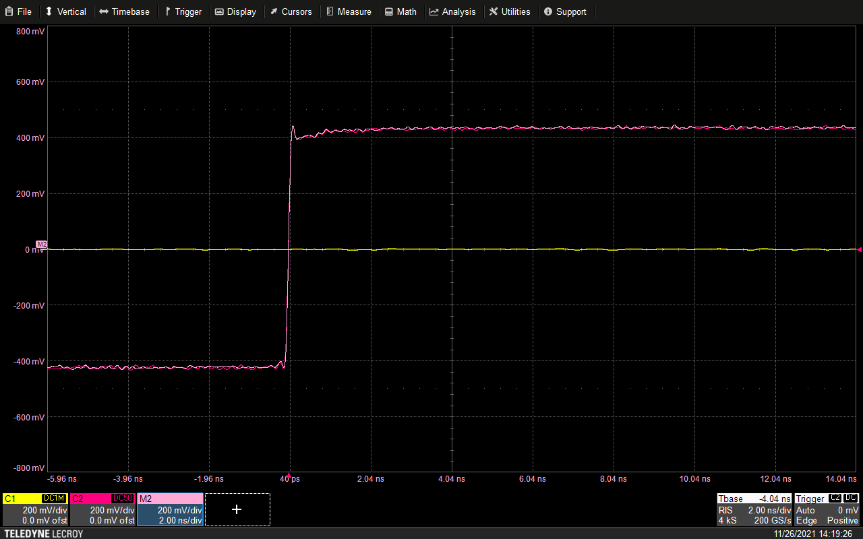
Baseline Measurement
Probe is
off the DUT
Fast edge
seen by DUT
Copy of DUT signal
without probe

Slide 35
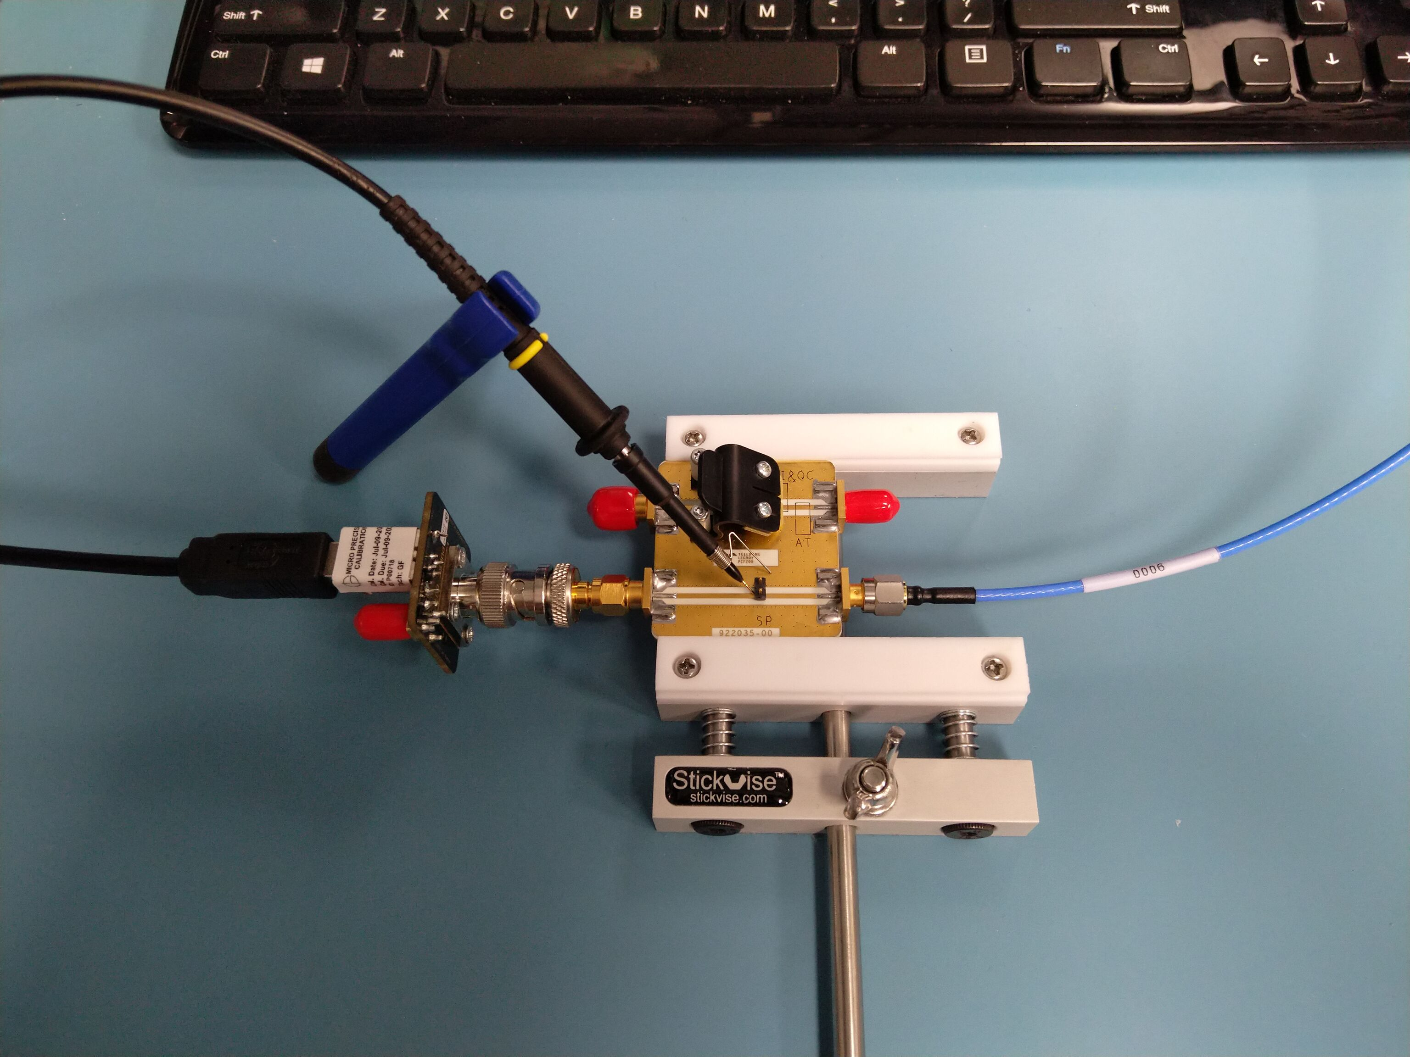
Now let’s add the probe...
What happens to the signal on the DUT?

Slide 36
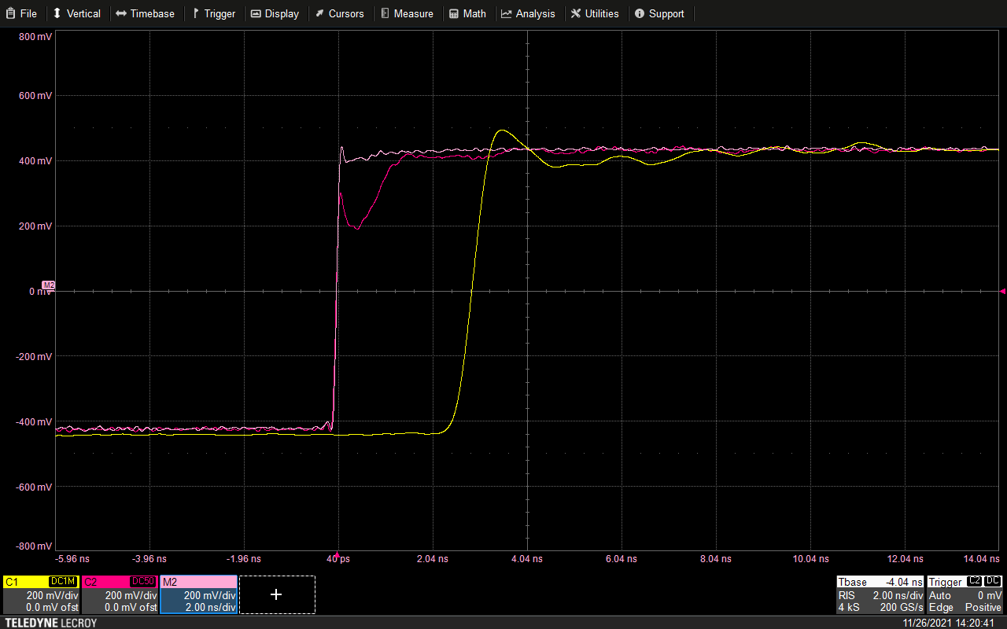
With Probe On DUT
Probe loading
Probe sees this
Non-monotonic edge
Potential glitch!

Slide 37
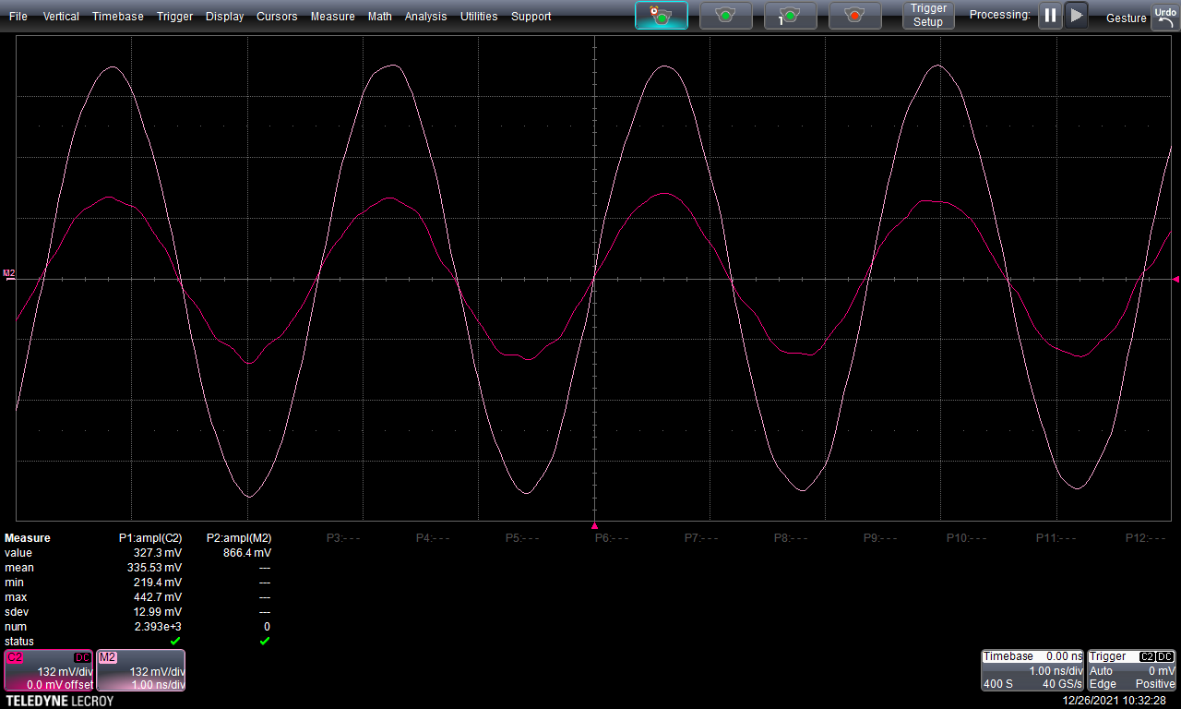
Pure-Tone Loading Example (High-Z Line)

Slide 38
R-C Divider Probe: Ground Inductance
Input is very capacitive
  Any extra L will cause ringing
Forget that alligator clip ground for anything fast
  How fast is “fast”? Let’s find out…
Generally, tradeoff of convenience vs performance
  Alligator wire: super convenient, huge L
  Z-ground: trickier to use, moderate L
  Spring: hard to use, small L

Slide 39
Challenges of measuring probe S21
Measuring S11 of a probe is straightforward
  Same way you’d use a VNA to measure anything else
We don’t care much about S22 or S12
  Scope doesn’t drive its end of the probe
But S21 path is tricky!
  Active probes – proprietary power/signal interface
  R-C divider probes: 1MΩ ideal Z0, not 50Ω

Slide 40
Scope based “mixed signal VNA”
Use scope as direct sampling RX for S21 path!
  Port 1: Tone applied to probe tip
  Port 2: Digitized scope waveform
Split tone to provide phase-locked reference
  Scope CH2 = RF reference port
  Scope CH1 = DUT port 2
Digital downconversion of both ports
  Then calculate ratiometric I/Q phase/amplitude

Slide 41
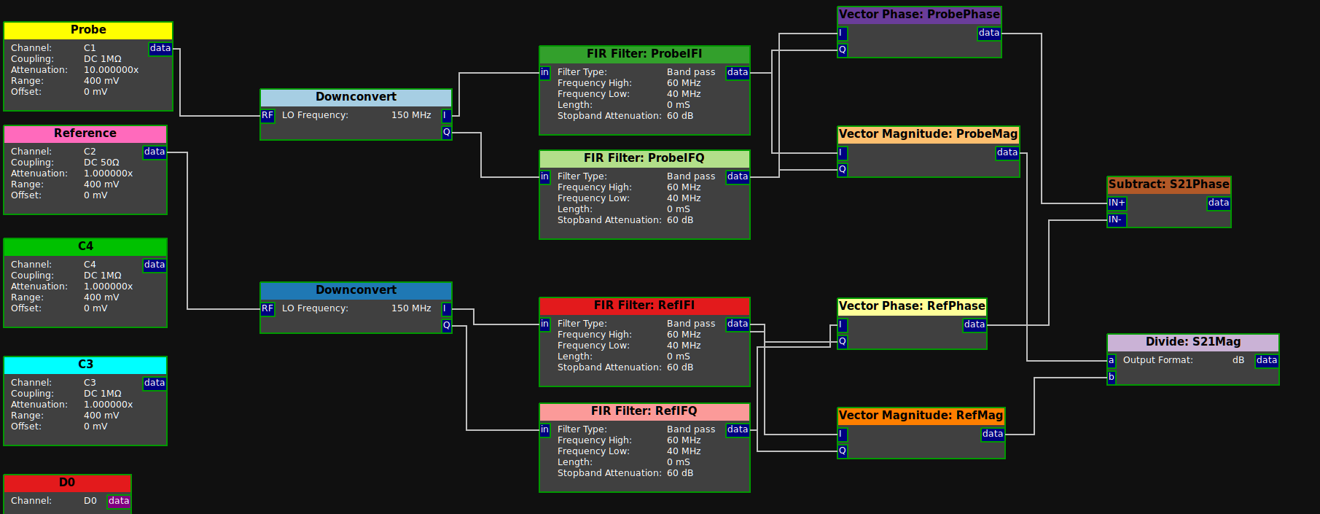
RX Filter Pipeline (example for 200 MHz Fin)

Slide 42
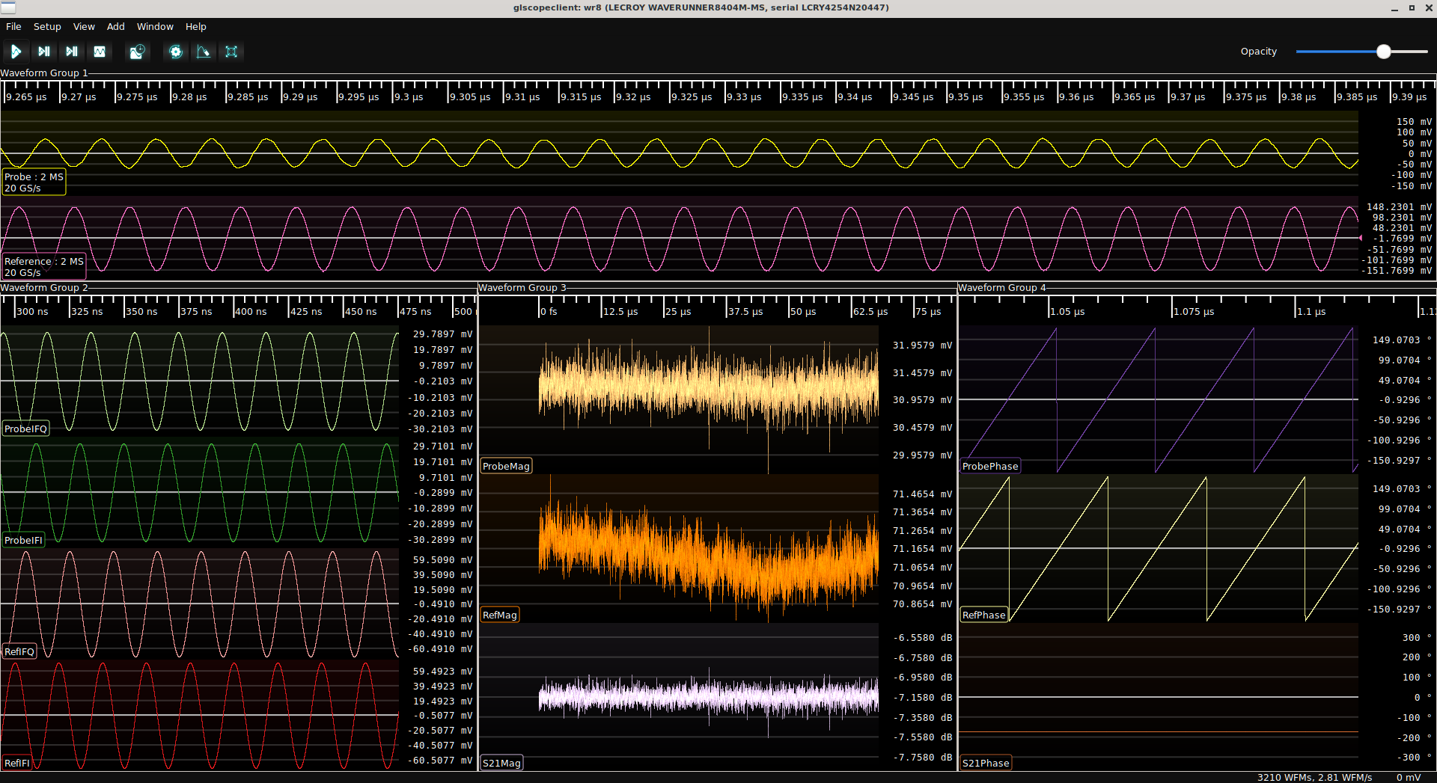
Raw / Processed Data

Slide 43
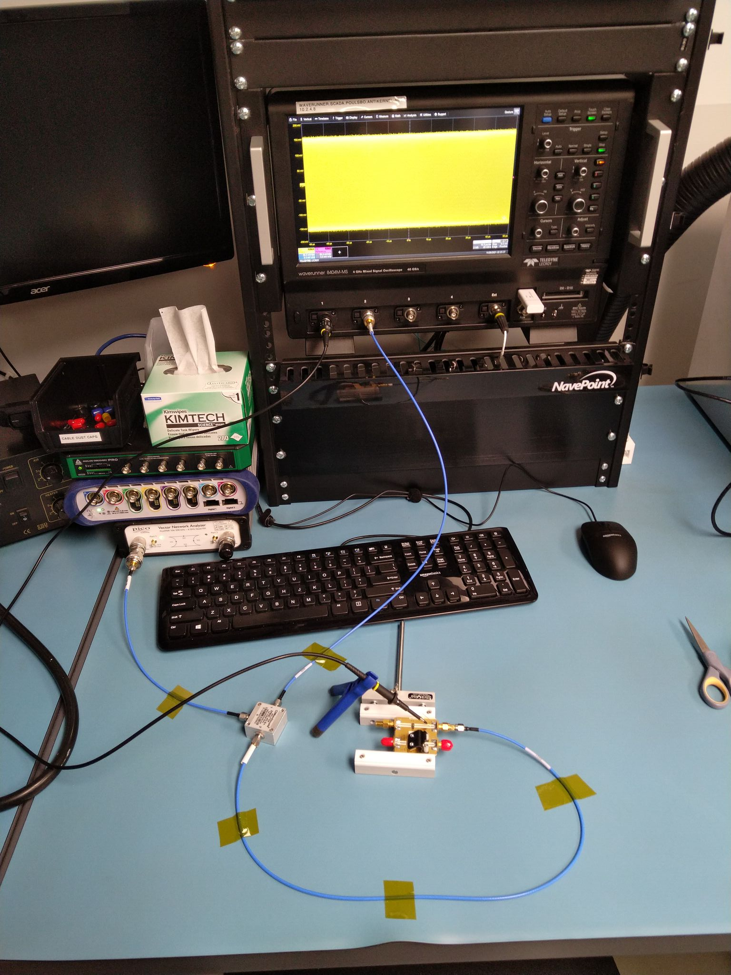
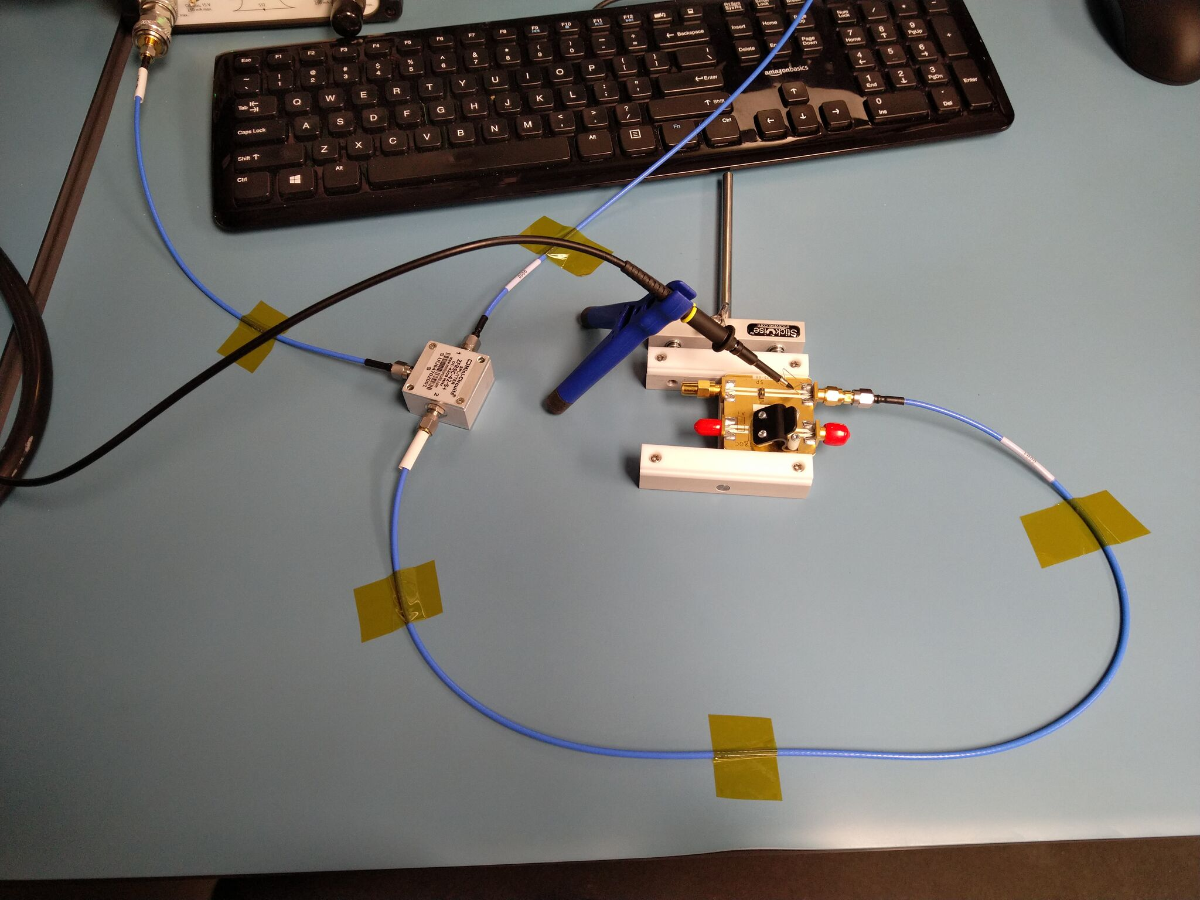
S21 Measurement Setup
Equal length cables to scope and DUT
Can calibrate out remaining skew/loss

Slide 44
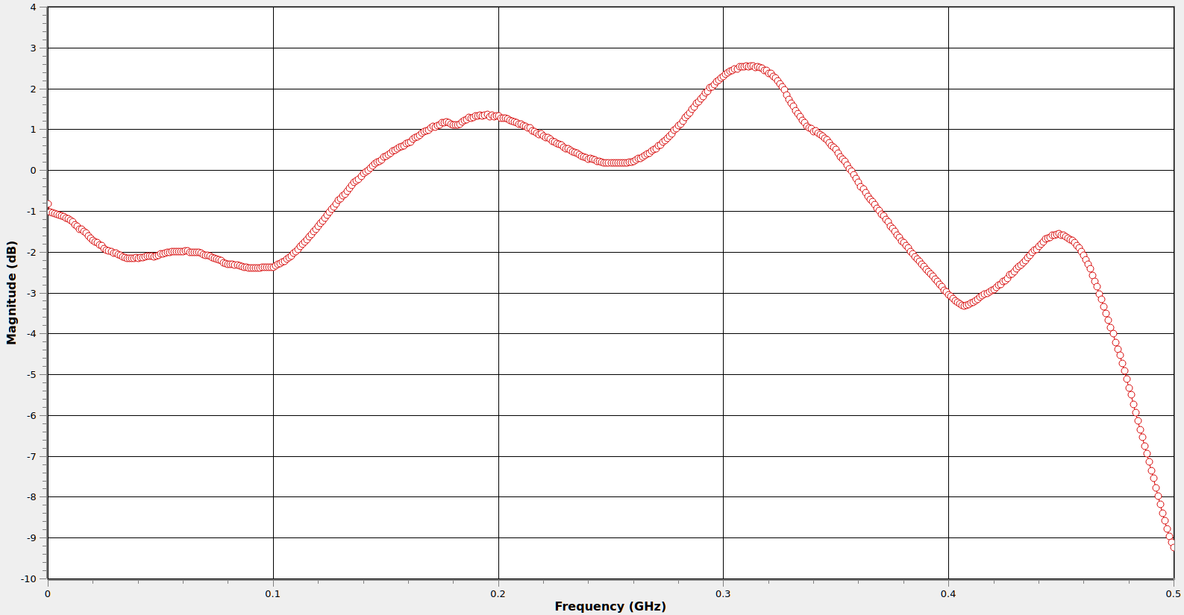
R-C Divider Probe: S21 w/ Spring Ground
-3 dB at 400 MHz
On a 500 MHz probe
Difficult to hit rated BW!
Usually need coaxial socket
Teledyne LeCroy PP022
SDA 816Zi
Spring ground

Slide 45
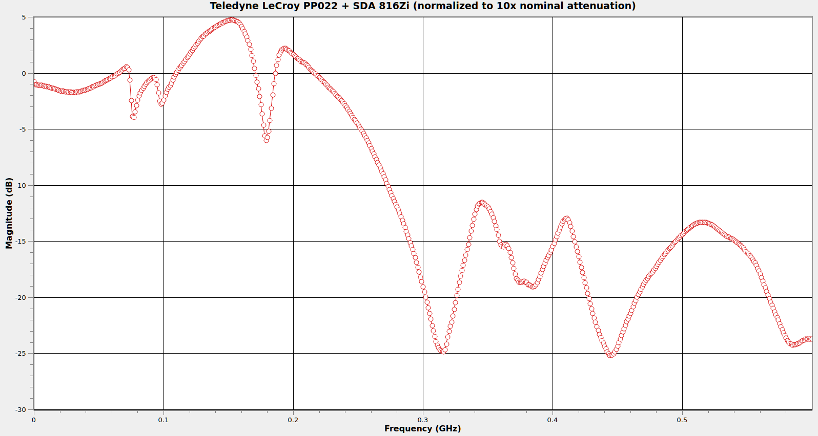
R-C Divider Probe: S21 w/ Alligator Ground
-3 dB at
76 MHz
-25 dB at 315 MHz
… on a “500 MHz” probe
5 dB peaking at 150 MHz!
+78% amplitude error

Slide 46
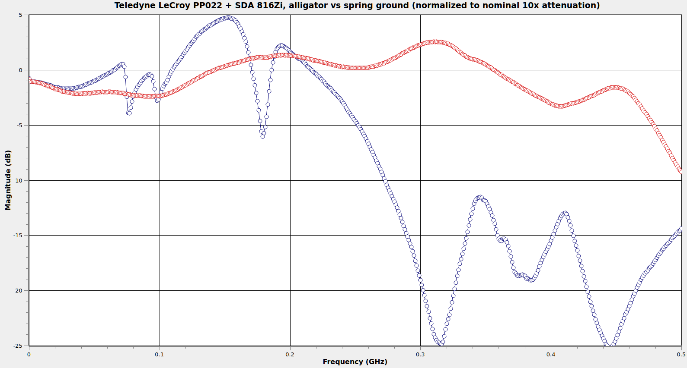
R-C Divider: Spring vs Alligator Ground

Slide 47
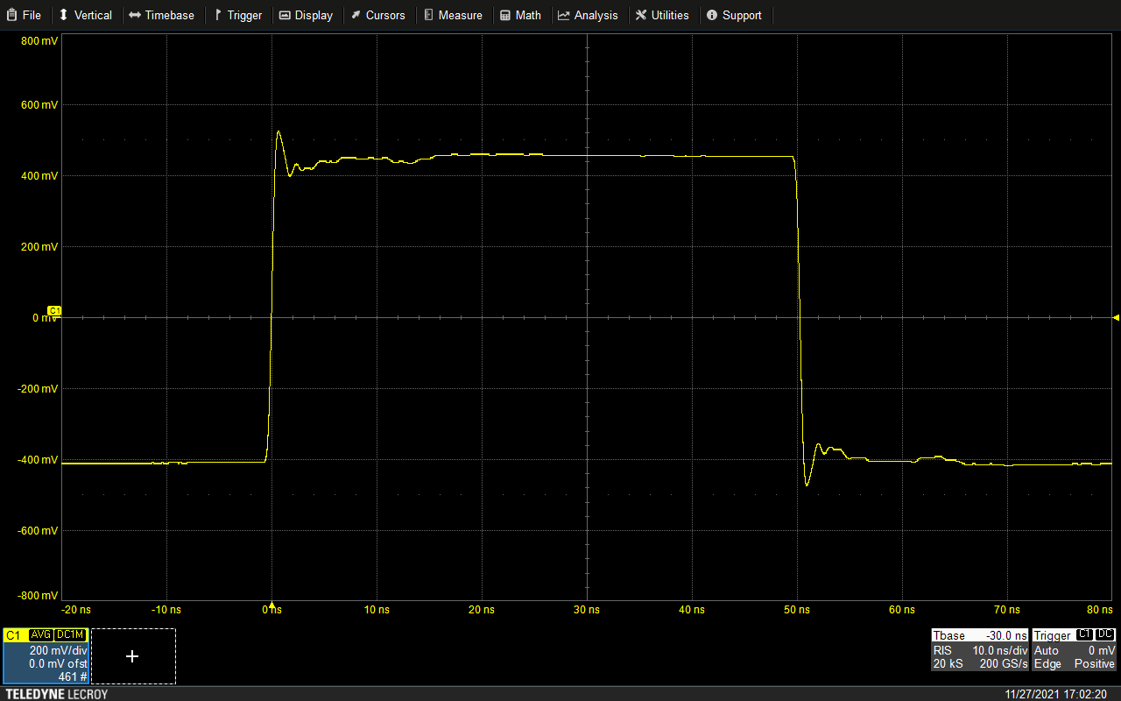
Step Response w/ Spring Ground
Reflection at 13 ns
(propagation delay of cable)
Lossy cable helps with this
but can’t entirely eliminate
L-C ringing
from ground

Slide 48
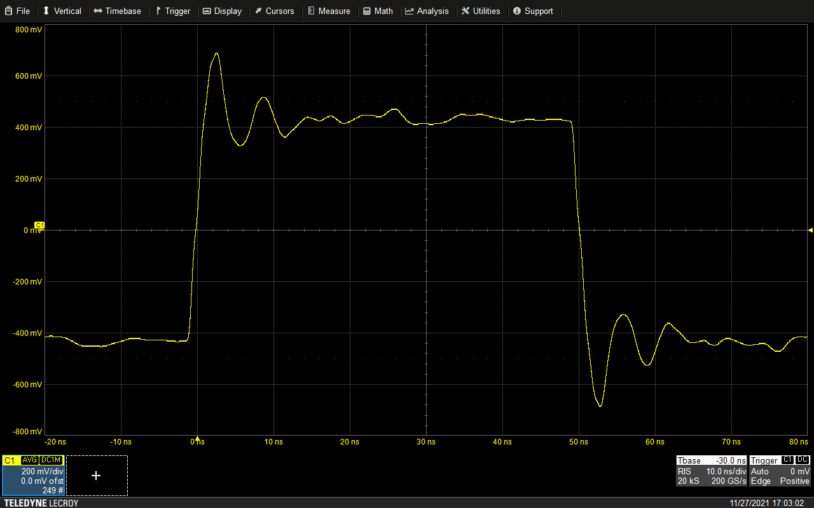
Step Response w/ Alligator Ground
~160 MHz ringing
L-C resonance
Ground lead L +
probe input C

Slide 49
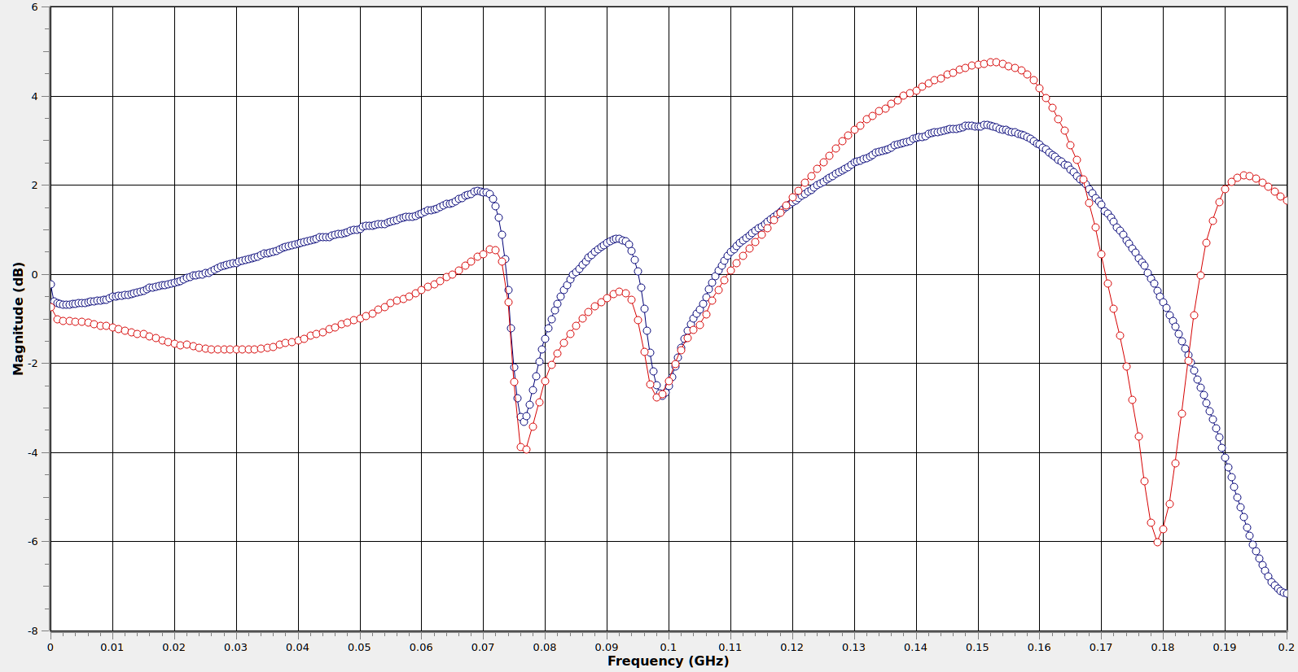
Cheap Vs Expensive Probe, Alligator Ground
Matrix IP1120
$10, “200 MHz”
34x difference in price
Same bandwidth
$$ can’t fix bad ground
Teledyne LeCroy PP022
$345, “500 MHz”

Slide 50
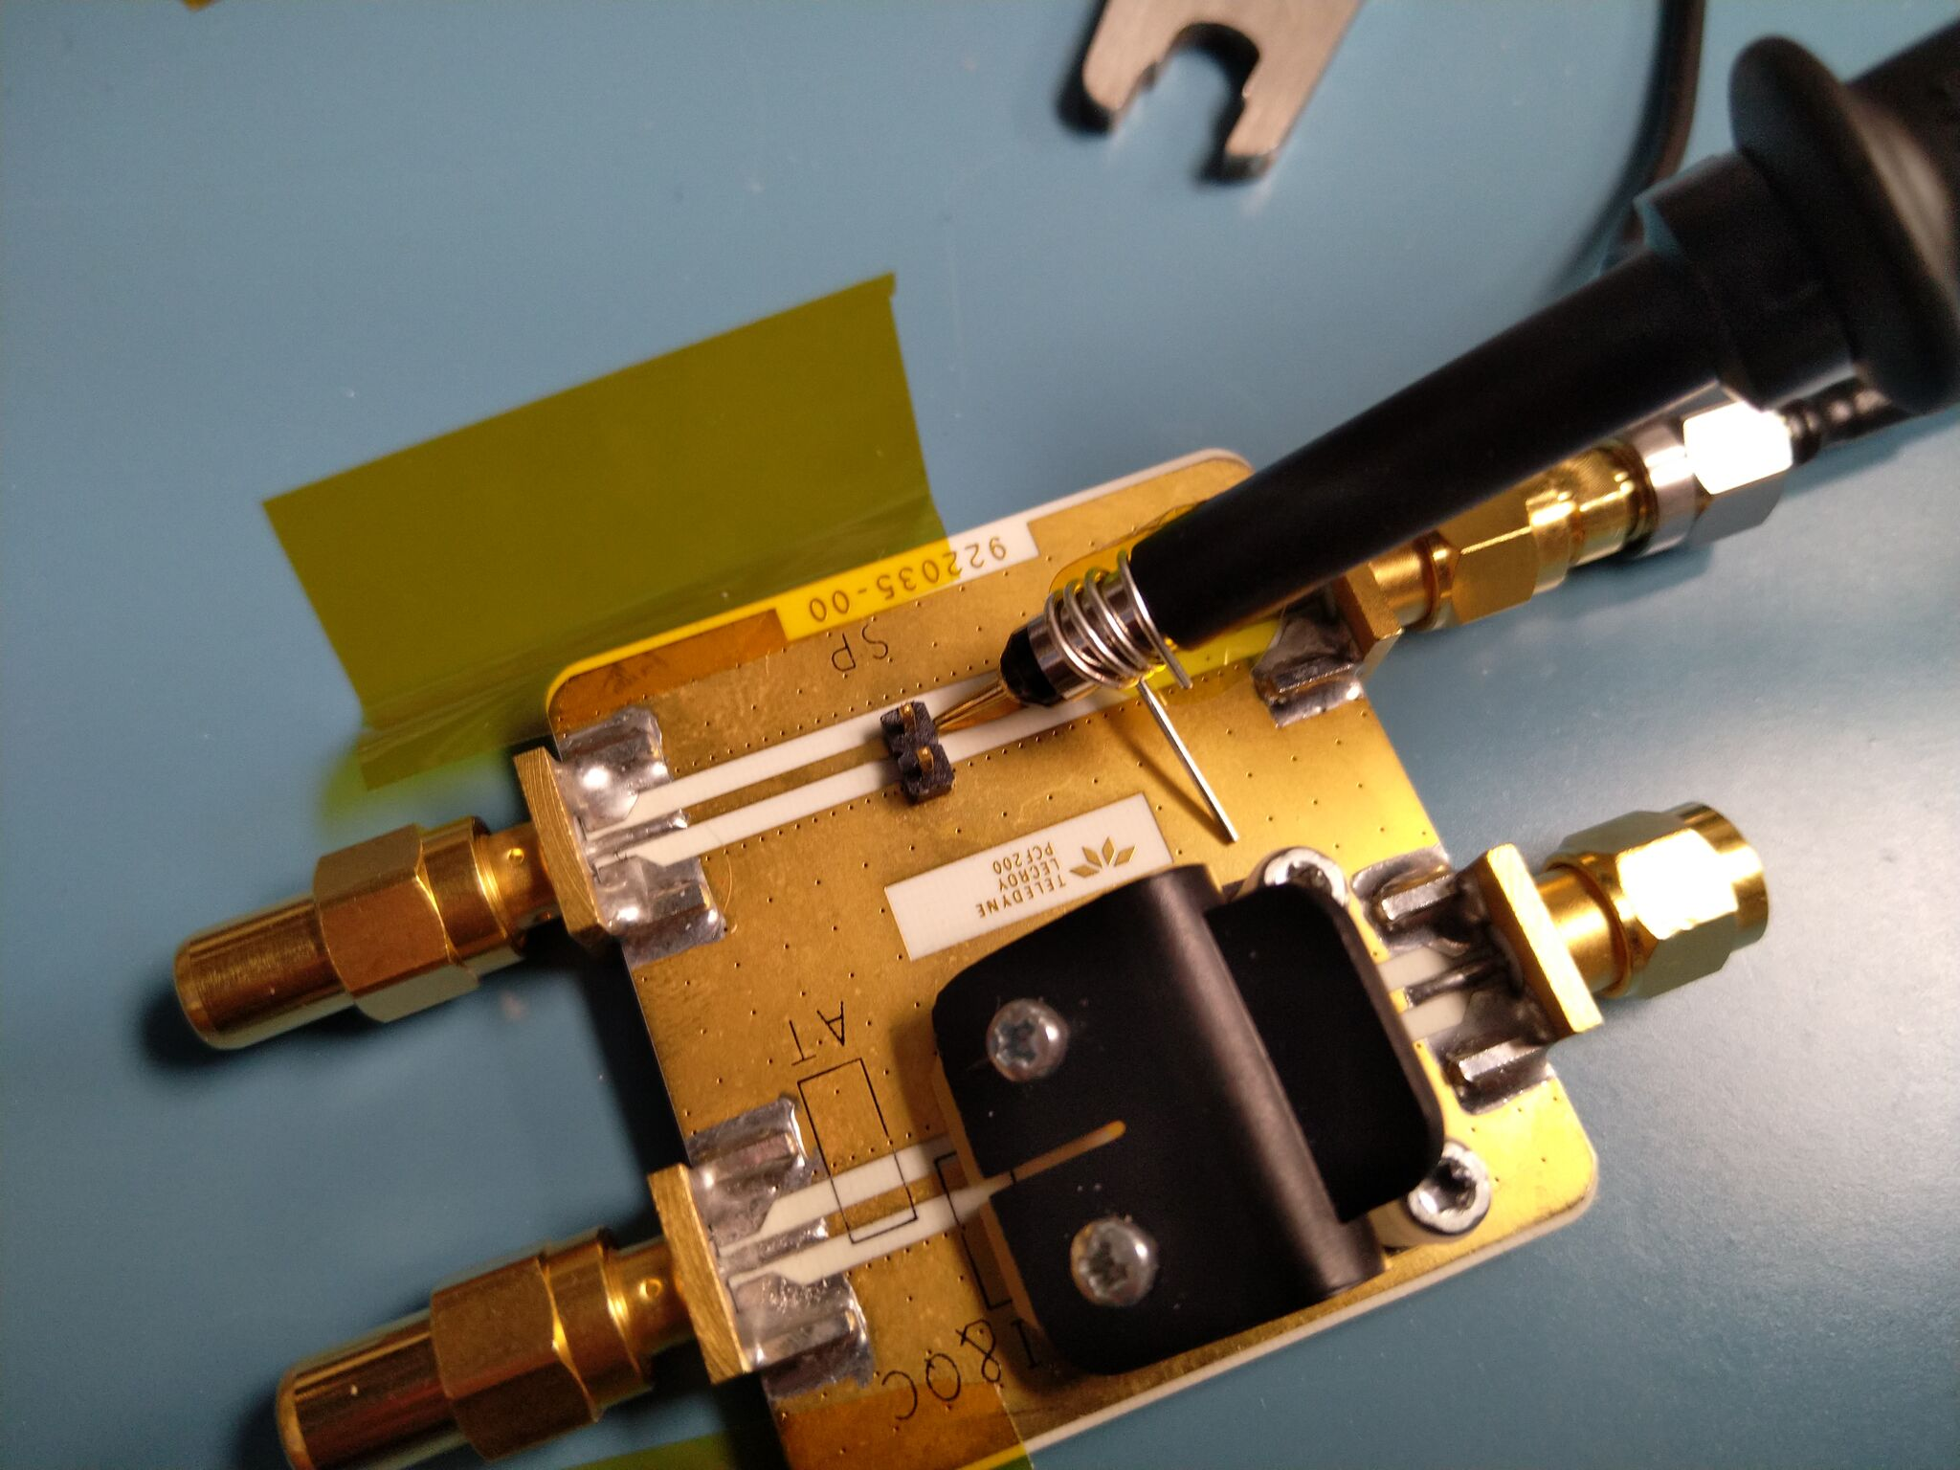
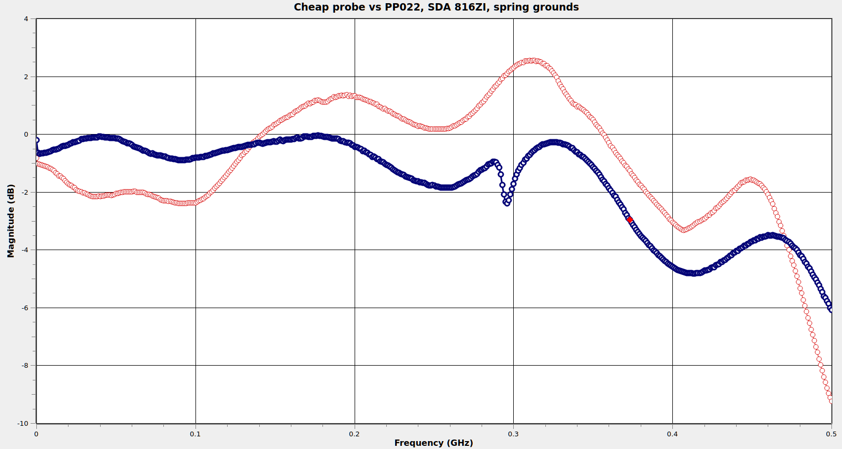
Cheap Vs Expensive Probe, (DIY) Spring Ground
Matrix IP1120
$10, “200 MHz”
Only ~30 MHz
difference in -3 dB BW
Teledyne LeCroy PP022
$345, “500 MHz”

Slide 51
So what did that $335 buy you?
Better ergonomics
Better accessories
More compensation adjustments
Gain autodetection resistor
No need to DIY a spring ground
Worth it? Depends on your needs and budget

Slide 52
R-C Divider Probe: Strengths
Very low resistive loading at DC
Low cost
  Low 3 digits USD for a nice one
  Cheap ones down to single digits
Hard to damage with overload/ESD
Generic design, no vendor lock-in

Slide 53
R-C Divider Probe: Weaknesses
High input capacitance
  Heavy loading on DUT
  Extremely sensitive to L in ground path
  Running in 1x mode makes this waaaay worse (~95 pF)!
Requires compensation adjustment
High attenuation (typically 10:1)
  Not great for really weak signals
  Worse SNR due to higher frontend gain

Slide 54
R-C Divider Probe: When to use
Highish voltage, low frequency analog
  (As used in vacuum tube systems!)
  Most active probes don’t go past 5-10V
  Resistive probes have similar limits
Beginners you don’t trust with $$$ gear
If you have nothing better

Slide 55
Resistive Probes

Slide 56
Resistive Probe
The other passive probe design
  Aka Transmission line probe, Low-Z probe, Z0 probe
Conceptually super simple
  Resistor and a piece of coax
Doesn’t get as much love as it deserves

Slide 57
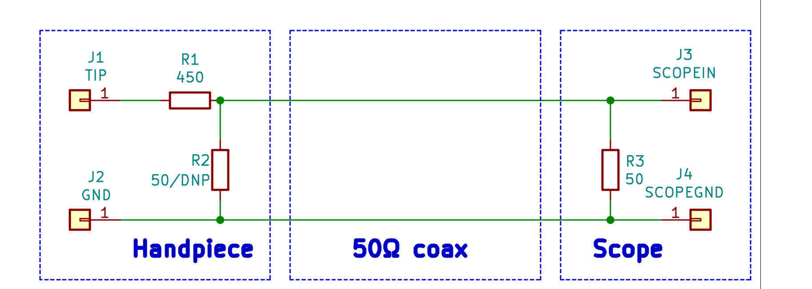
Resistive Probe
Linear tradeoff between insertion
loss and loading on DUT.
450Ω for 10x, 950Ω for 20x
Optional terminator
Doubles probe attenuation
but damps out reflections
if scope input is mismatched

Slide 58
Resistive Probe
Much higher DC loading than an R-C divider
But response can be much flatter!
  Ideal resistive probe has C=0 and constant S21 / S11
  Of course, parasitics ruin our fun like always...

Slide 59
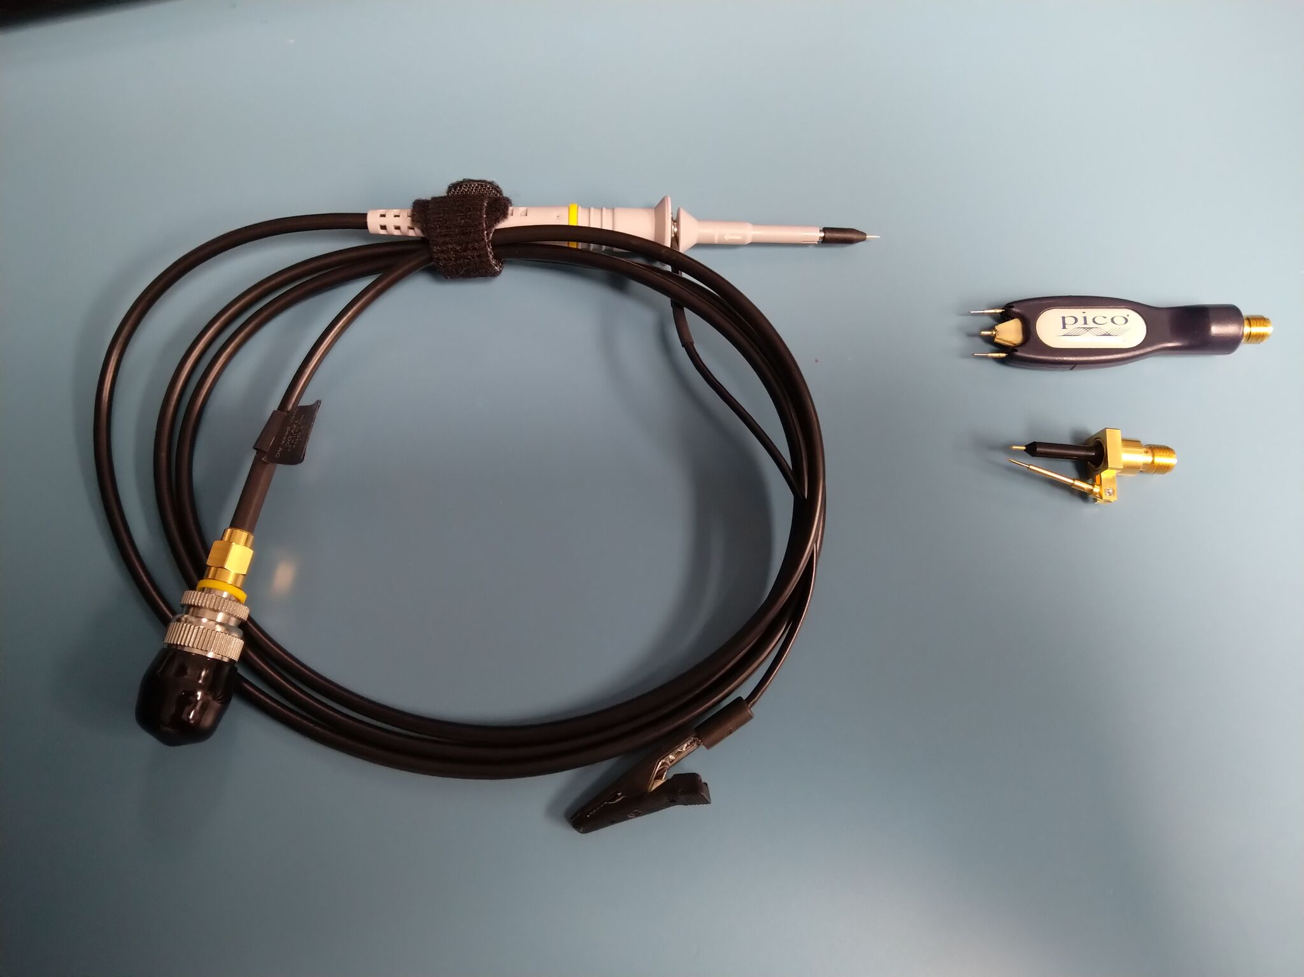
Typical Resistive Probes
PicoConnect 921
20:1, AC coupled
Source terminated
$1055, 6 GHz
Pico TA061
10:1
$419, 1.5 GHz
Teledyne LeCroy
PP066
1:1 / 10:1 / 20:1
$1860, 7.5 GHz

Slide 60
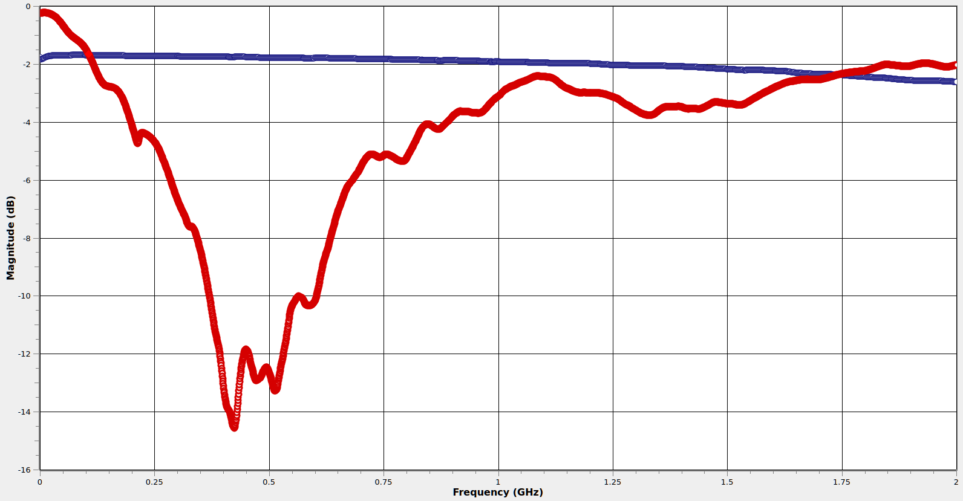
Resistive Probe: S11 vs R-C Divider
R-C divider probe wins
Lower loading
PicoConnect 921
Resistive
Crossover
~100 MHz
Teledyne LeCroy
PP023
R-C divider
Resistive probe wins
-14 dB S11 @ 420 MHz
Signal on DUT is loaded down
to 20% of original amplitude!

Slide 61
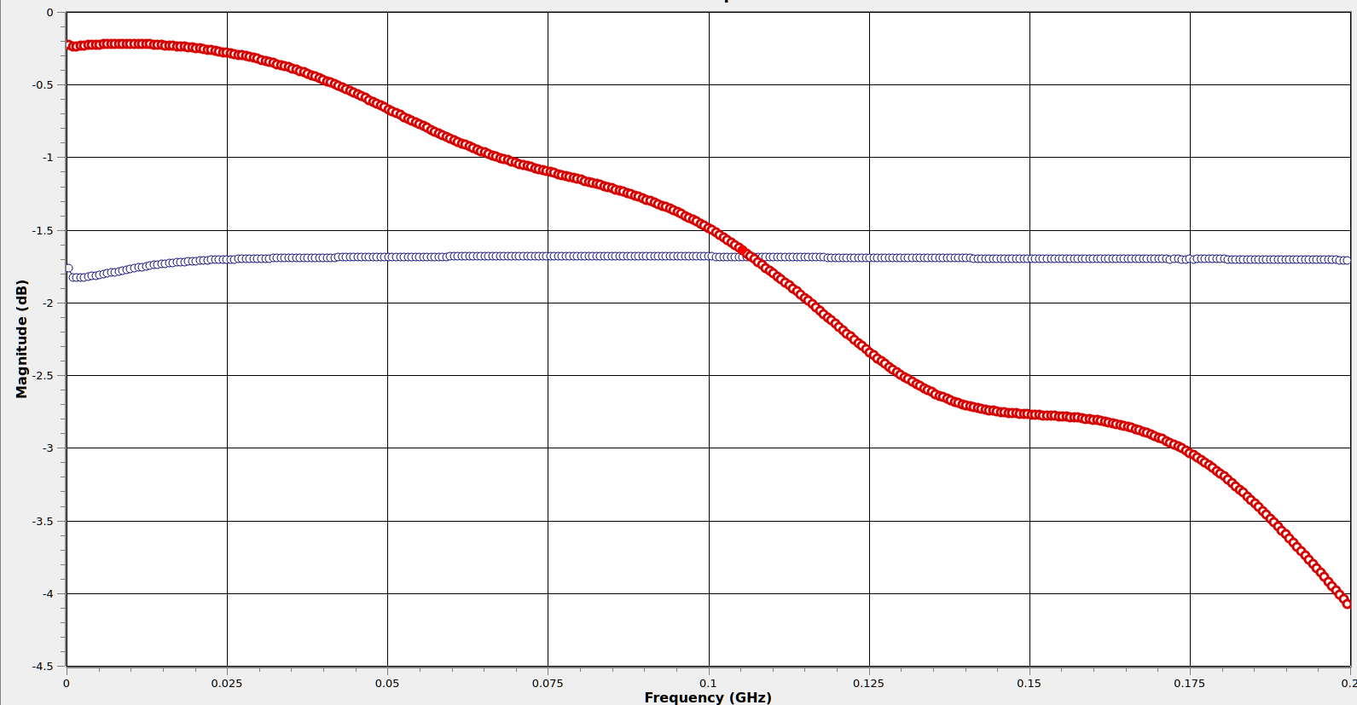
Resistive Probe: S11 Crossover
Crossover is at around 100 MHz!
“500Ω” probe has lower loading
than “10MΩ” probe after here!

Slide 62
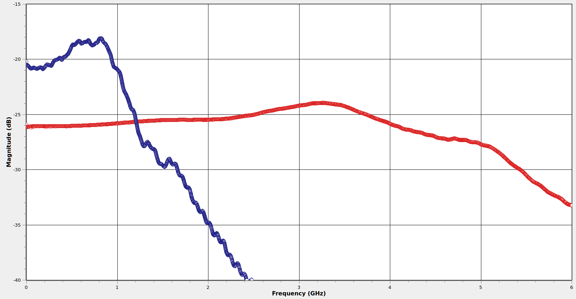
Resistive Probe: S21 Flatness Across Models
+2.7 dB peaking
PicoConnect 921
20:1, $1055
Pico TA061
10:1, $419

Slide 63
Resistive Probe: S21 Flatness Across Models
Lower cost probe has much worse flatness
But why?
Let’s look at some of the effects in play

Slide 64
Chip Resistor Cross Section
NiCr film
Al2O3 brick
Solder terminals

Slide 65
But from a different perspective...
Leakage path
Dielectric
Parallel plates of conductor

Slide 66
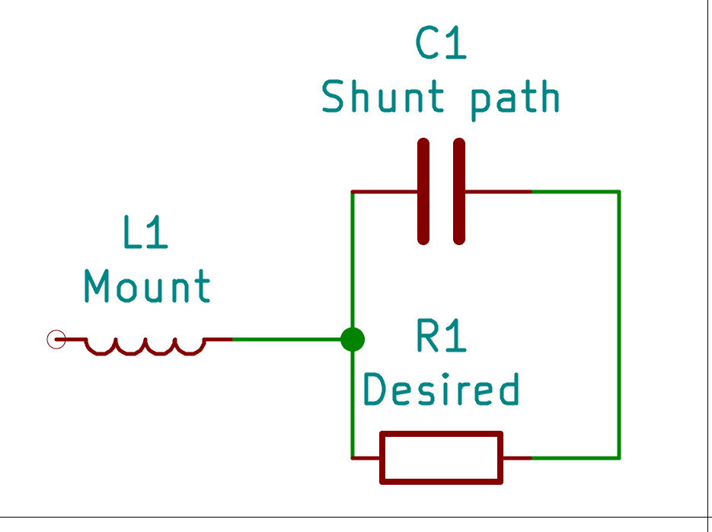
Yep, it’s a capacitor!
Here’s a better model of a real resistor

Slide 67
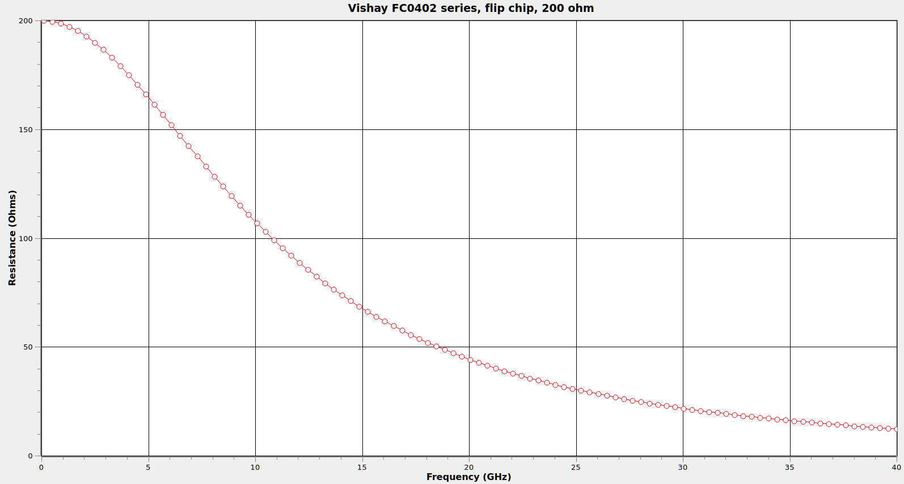
Real Resistor Behavior

Slide 68
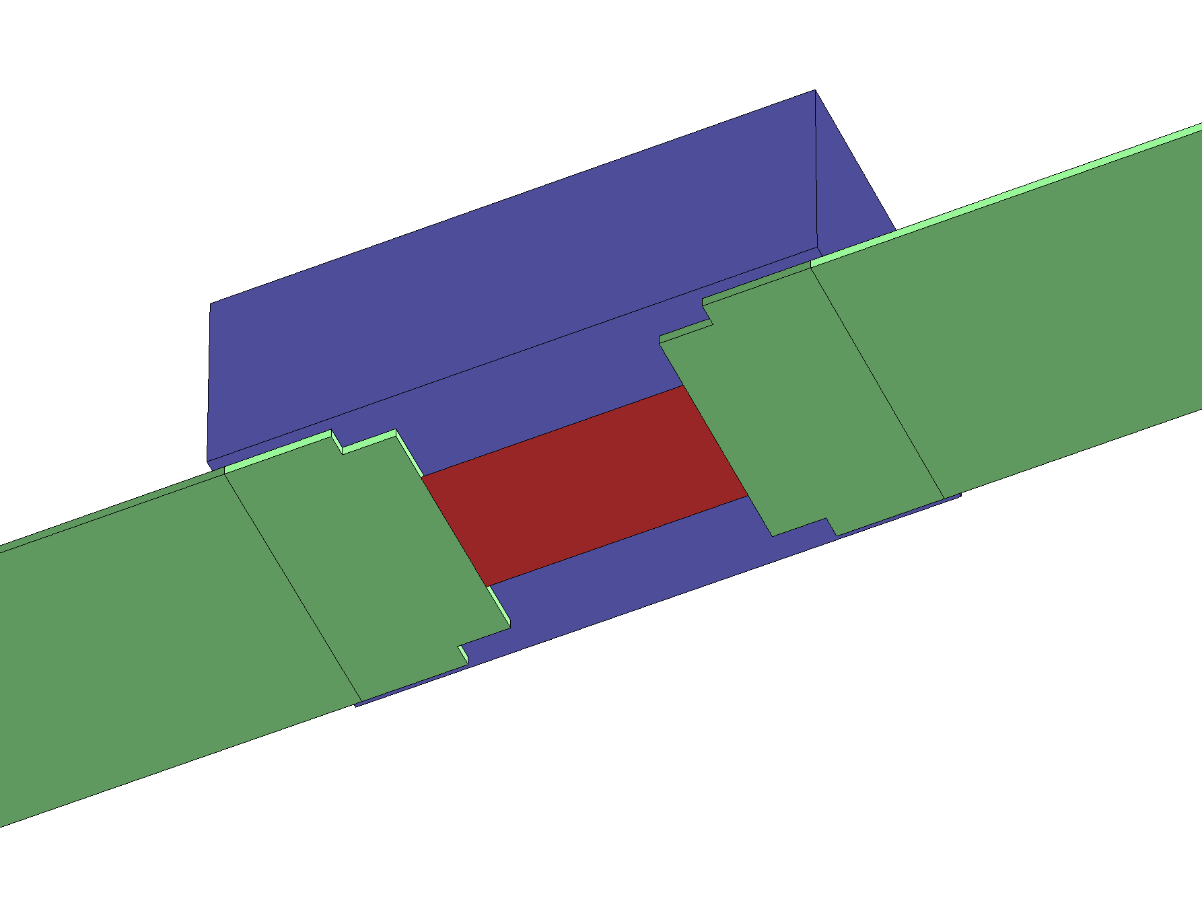
Flip-Chip Resistors

Slide 69
Resistive Probe: Ground L Sensitivity
Much less input C than an R-C divider
  Low end ones (Pico TA061) can be as high as 2 pF
  Better ones (PicoConnect) are hundreds of fF
Less C means less ringing for same L
  You can often get away with worse grounding vs R-C divider

Slide 70
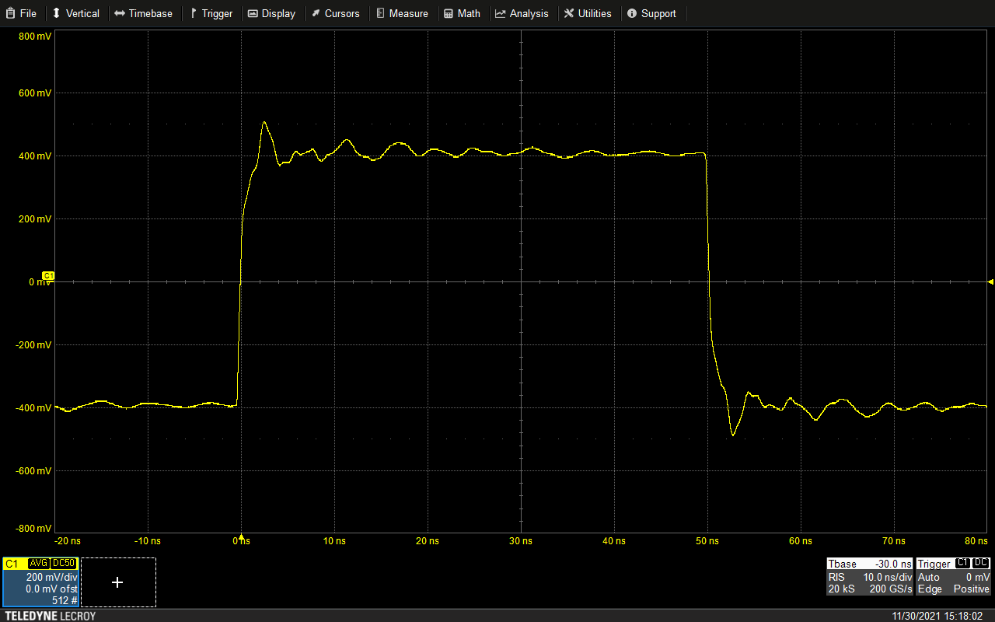
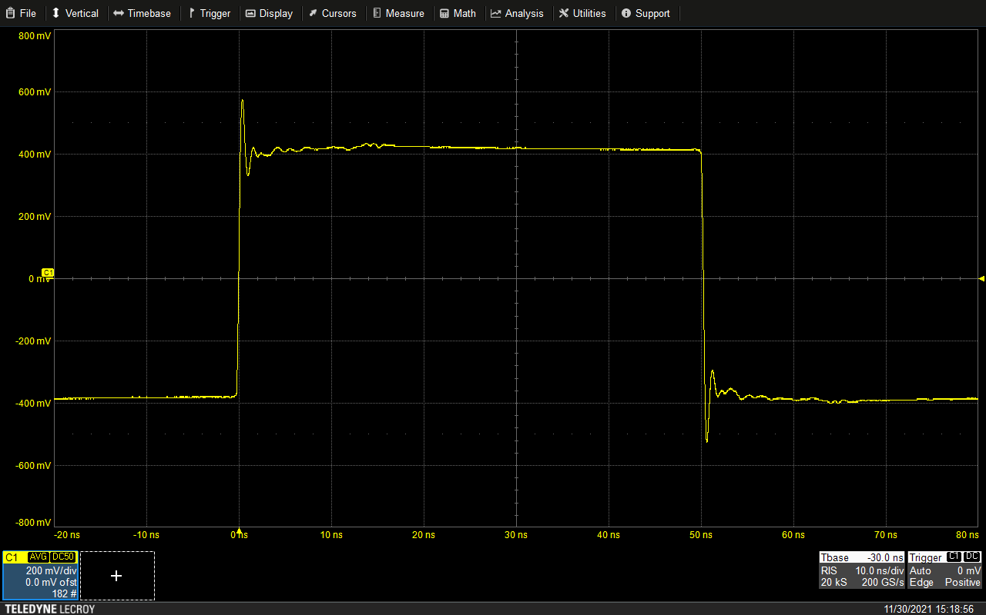
Resistive Probe: Ground L Sensitivity
Pico TA061
Alligator ground
Pico TA061
Spring ground

Slide 71
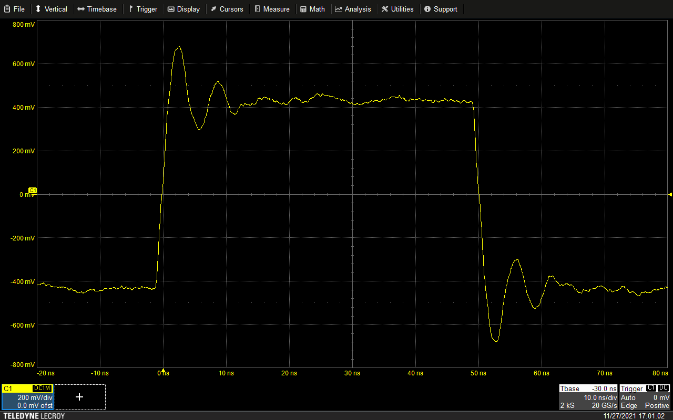
Resistive Probe: Ground L Sensitivity vs R-C
Pico TA061
Alligator ground
Teledyne LeCroy PP023
Alligator ground

Slide 72
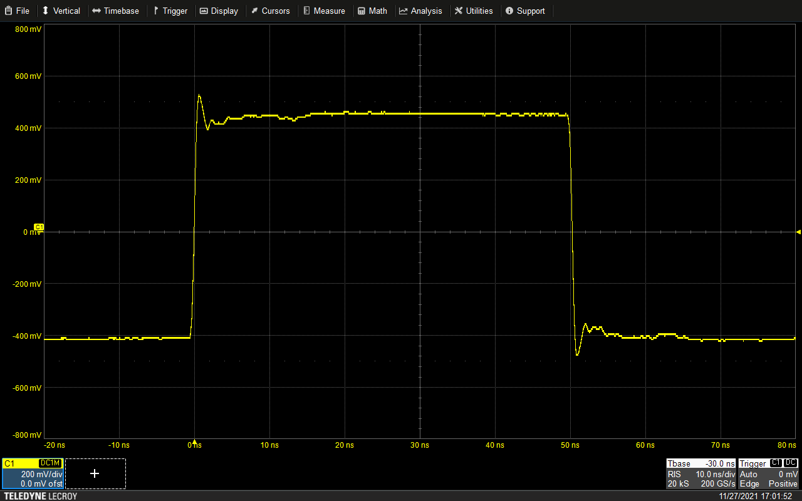
Resistive Probe: Ground L Sensitivity vs R-C
Pico TA061
Spring ground
Teledyne LeCroy PP023
Spring ground

Slide 73
Resistive Probe: Ground L Sensitivity vs R-C
Pico TA061
Alligator ground
Teledyne LeCroy PP023
Spring ground

Slide 74
Resistive Probe: Input Stub
Distance from probe tip to resistor is critical
  This is an unterminated low-Z stub!
  Reflection off resistor causes ¼ wave null in response
Longer tip needle makes this effect worse

Slide 75
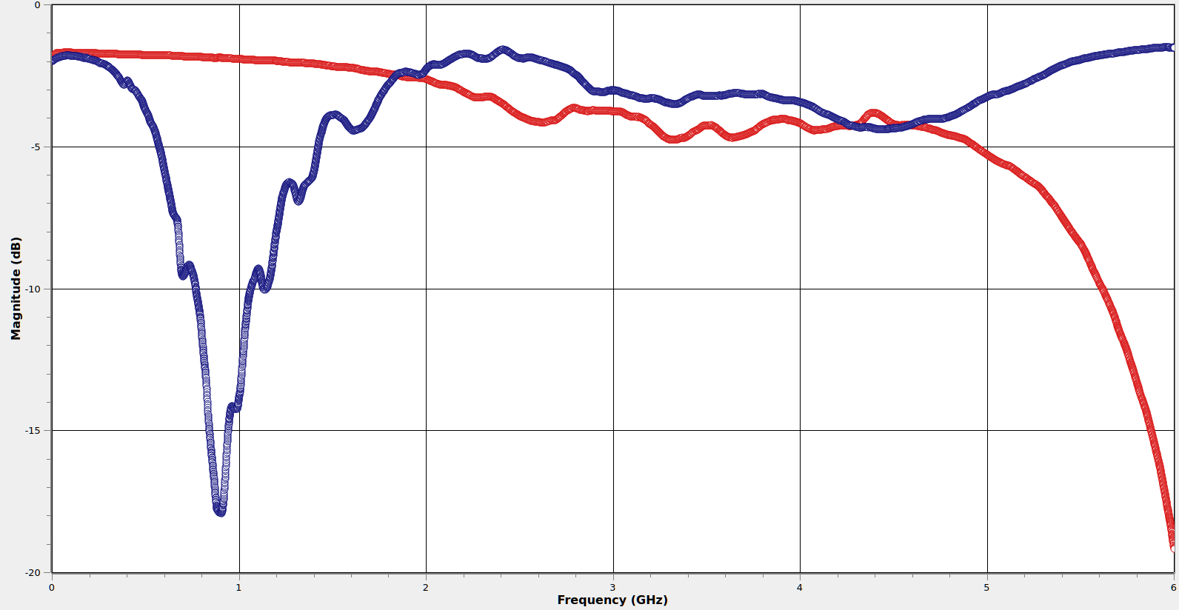
Resistive Probe: Input S11 vs Needle Length
PicoConnect 921
~6 mm tip
Pico TA061
~17 mm tip

Slide 76
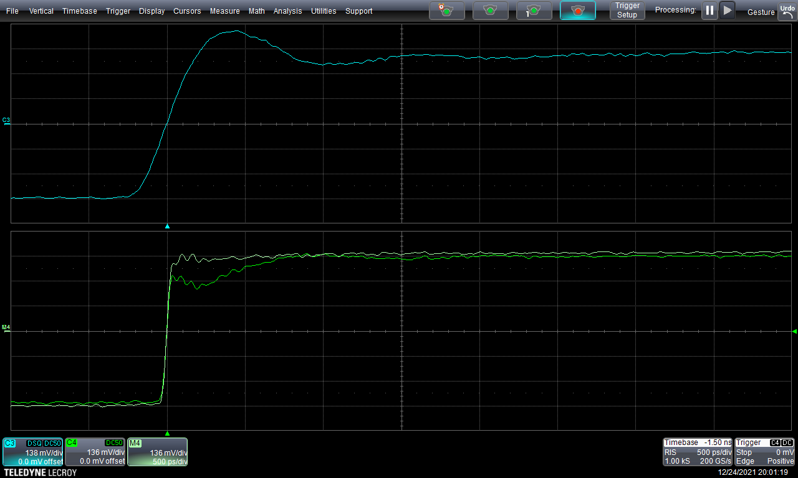
Resistive Probe – Time Domain Loading (TA061)
Capacitive / stub loading from probe tip
Long needle = long reflection period
DC loading from
500Ω input resistance

Slide 77
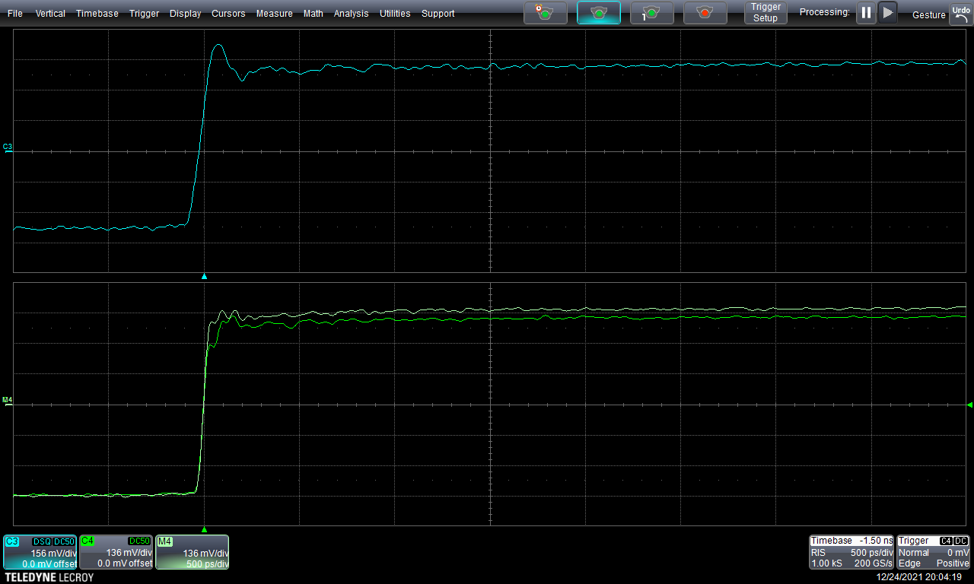
Resistive Probe – Time Domain Loading (921)
Much smaller capacitive load!
Can still see tiny ~50ps reflection
from probe tip to resistor
DC loading comparable
to TA061

Slide 78
Resistive Probe – Input Stub
Ideally we want no reflection at all!
  But how can we get that?
  Need to eliminate the mismatched stub somehow...

Slide 79
Resistive Probe – Reducing Reflections
What if we match tip Z0 to probe resistance?
  For example, 500Ω Z0 for a 500Ω 10:1 probe
This eliminates mismatch at tip-to-R junction
  All power we don’t sample is instantly reflected back to DUT

Slide 80
Resistive Probe – Reducing Reflections
There’s just one problem…
  The impedance of free space is ~377Ω
  Matched tip is impossible with a 10:1 or 20:1 probe
  Doable (maybe) with a 5:1, but mechanically tricky

Slide 81
Resistive Probe – Reducing Reflections
Alternative: Make the stub really short
  Move the null past the band of interest
Lots of fun ways to do this
  Castellated probe tips
  Solder-in damping resistors
  Carbon fiber tip needles
Any of these sound familiar?
  We’ll return to this in a later section...

Slide 82
Resistive Probe: Strengths
Excellent price / performance ratio
  Nothing else gives you GHz of BW for $1K!
  Prices typically mid 3 to low 4 digits USD
No active components – fairly ESD resistant
Generic design – no vendor lock-in

Slide 83
Resistive Probe: Weaknesses
Relatively high DC loading
  Not suitable for use on lines with pullups
May disturb DC bias on DUT
  Can mitigate this w/ coaxial DC block
  Some probes include AC coupling cap
High attenuation (typically 10:1 or 20:1)
  Can reduce attenuation at the cost of worse DC loading

Slide 84
Resistive Probe: When to Use
Fast digital signals with push-pull drivers
  Excellent general purpose embedded debug probe
  Easily usable out to several Gbps
Low impedance analog
  Great for 50Ω RF

Slide 85
High Impedance Active Probes

Slide 86
High-Z Active Probe
FET amplifier in probe head
Typically fixed HW gain
  Some (not all) provide offset capability
High DC input resistance (MΩ range)
Relatively low input C (usually sub-pF)

Slide 87
High-Z Active Probe
Most are made by scope vendors
  Proprietary interface, not portable across makes
Some third party ones exist
  Tetris by PMK (1 to 4 GHz models)
  External power supply, 50Ω BNC to scope

Slide 88
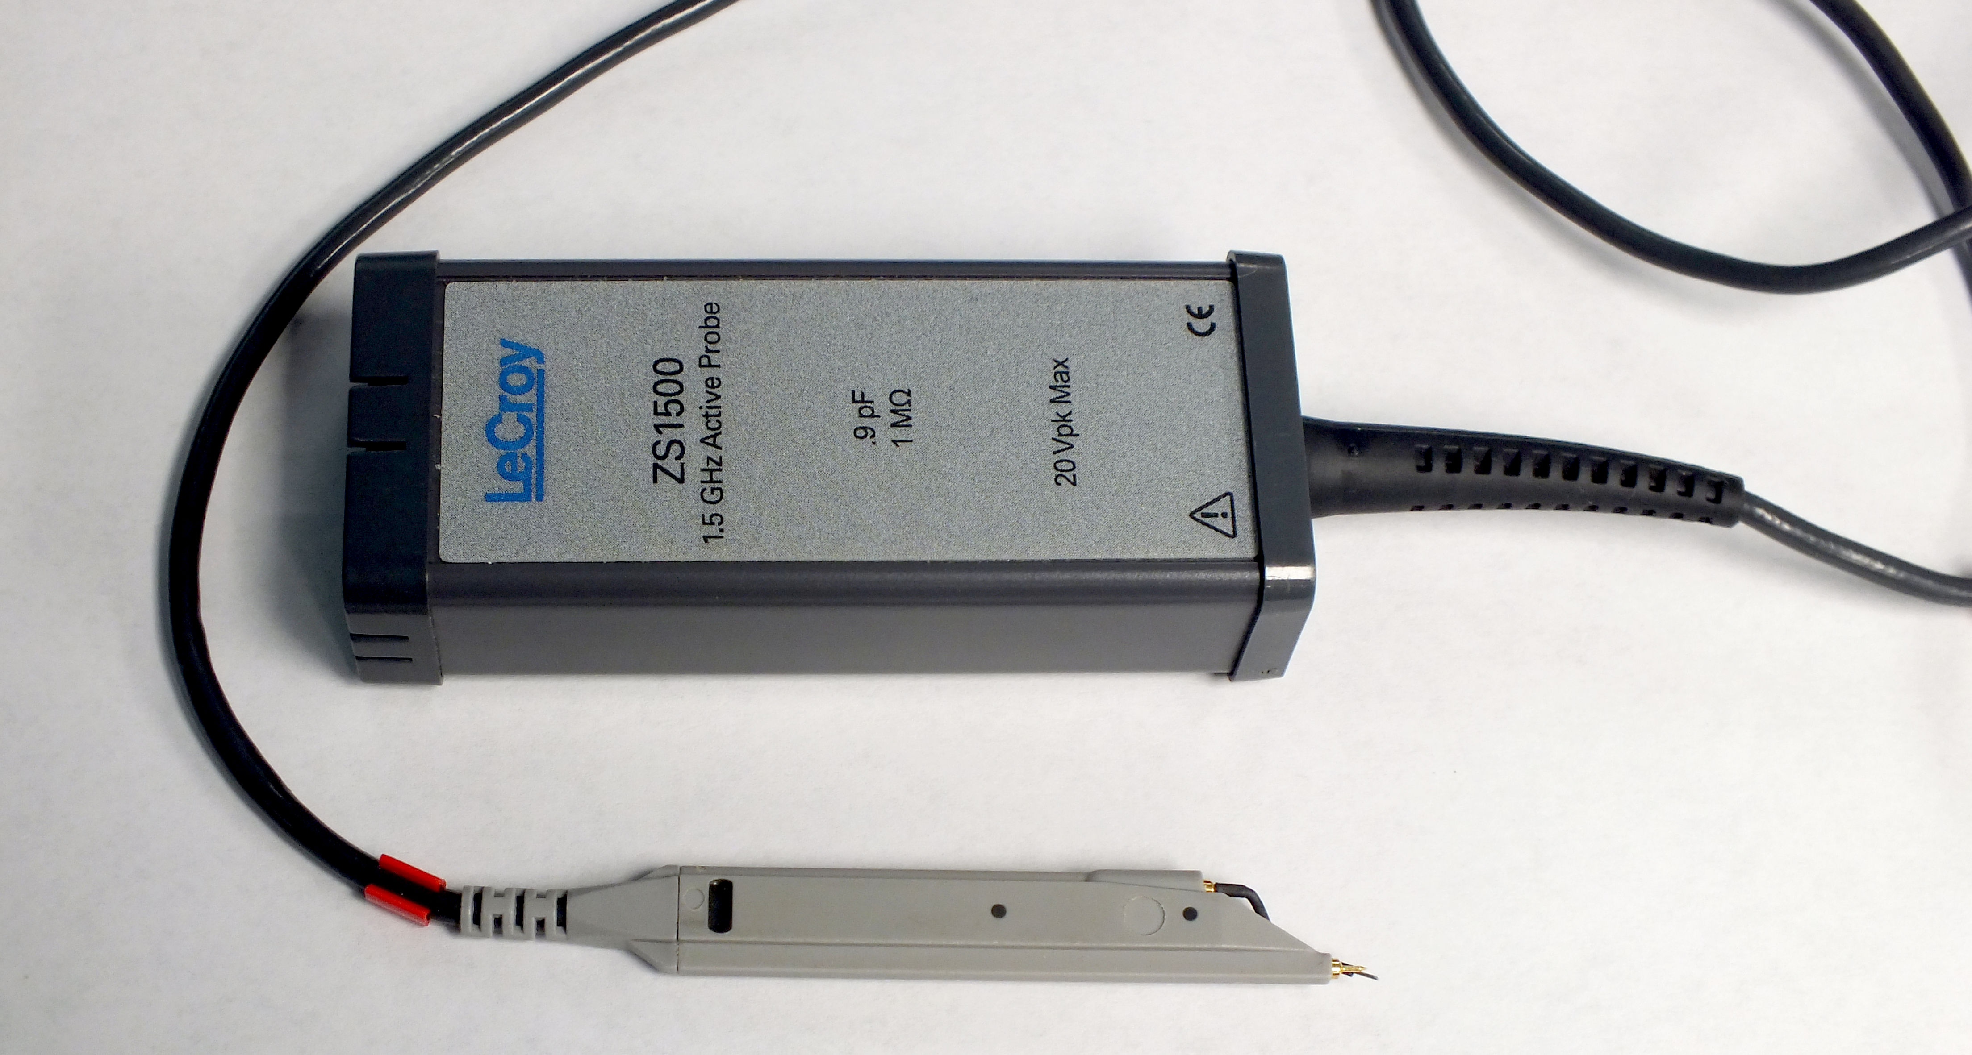
Teledyne LeCroy ZS1500
Probe head based on PMK Tetris 1500
  1.5 GHz, 1MΩ || 900 fF
ProBus control pod
  Adds ± 12V offset capability
  (PMK version has no offset DAC)

Slide 89

ZS1500 – S11 w/ Leaf Ground

Slide 90

ZS1500 – S21 w/ Leaf Ground

Slide 91

ZS1500 – Step Response w/ Leaf Ground

Slide 92

ZS1500: Step Response w/ 7cm Wire Ground
Worse performance due to higher L
But not actually too horrible

Slide 93

ZS1500 – S11 Across Open
PicoConnect 921
Resistive
Crossover w/ 921 at
632 MHz
Teledyne LeCroy ZS1500
Active FET
Teledyne
LeCroy PP023
R-C Divider

Slide 94

ZS1500: Time Domain Loading w/ Leaf Ground

Slide 95
High-Z Active Probe: Strengths
Lowest DC loading of any common probe
  Maintains high input Z much longer than R-C divider
Relatively low capacitance
Somewhat tolerant of poor grounding
  Resistive probes are usually better at this, though

Slide 96
High-Z Active Probe: Weaknesses
ESD sensitive
Expensive (low-mid 4 digits USD)
High attenuation (typically 10:1)
Small but non-negligible input capacitance

Slide 97
High-Z Active Probe: When to use
Loading-sensitive low to mid speed signals
  The ZS1500 is my probe of choice for crystal oscillators
Excellent general purpose embedded debug probe
  But you can buy 4+ resistive probes for cost of one FET probe!
  Don’t go out and buy a case of them unless you really need to

Slide 98
Active Differential Probes

Slide 99
Differential Probe
Differential amplifier fed by probe tip
Typically used for low swing, high BW signals
  HV diff probes exist, will be covered separately

Slide 100
Differential Probe: Input Considerations
Loading
Common mode range
Differential dynamic range
Damage levels
Overload recovery

Slide 101
Differential Probe: Grounding
Input signal isn’t measured WRT ground, but...
Very limited common mode range
  ± 5V for Teledyne LeCroy DH series
  ± 2.4V for Teledyne LeCroy D400A-AT
Board needs to share same DC ground as probe
  No need for a low-L RF ground path!

Slide 102

Differential Probe: Grounding Methods
Ground from another probe
Grounded power supply
Ground input on amplifier
  Only need to use one per DUT
USB / UART / JTAG cable
Coax shield

Slide 103
Differential Probe: Simplified Schematic

Slide 104

Loading (Teledyne LeCroy D420-A, SI tip)
Shift is almost invisible!
Good diff probes have
extremely low loading

Slide 105

Differential Probe: Tips/Accessories (D1330)
Mounting jigs, tape,
tip clips, etc.
Yes, they’re Legos!
Handheld browser
Solder-in
Pin header

Slide 106

Solder-In Tip (D1330-SI)
950Ω
100Ω
Tip is just two
resistive probes!

Slide 107


Differential Probe: Securing Tips
Solder-in probe tips are fragile!
  Cannot handle significant shear forces
Secure them with tape or dedicated probe clips

Slide 108

Differential Probe: Securing Probe Body
Amplifier is large and heavy compared to tip
If it moves, it will damage the tip
Use provided holders
Taping wires down helps too

Slide 109

Overload Recovery (LeCroy D1605)
Overshoot and slow recovery
in response to sharp edge

Slide 110



Eye Pattern Comparison: 2.5 Gbps PRBS-9
LeCroy D420-A
(Active differential)
Strong overshoot
Low noise
Direct coaxial input
Best performance
High loading
Antikernel Labs
AKL-PT5
(Resistive)
Slight overshoot
Worse noise

Slide 111
Differential Probe: Strengths
Relatively low DC loading
  Often not as low as high-Z active probe
Very low capacitance
Very tolerant of poor grounding
  Ground is only used to keep common mode in range

Slide 112
Differential Probe: Strengths
Rejection of common mode noise
Saves scope channels when probing a diff pair
  Psuedo-differential input uses 2 channels + math function
Low net attenuation (typ range /1 to /5)
  Probe head has significant attenuation = low loading
  Amplifier means scope sees strong signal anyway

Slide 113
Differential Probe: Weaknesses
Very ESD sensitive
Extremely expensive (4-5 digits USD)
Limited range
Overload recovery issues

Slide 114
Differential Probe: When to use
High speed low-swing differential signals
High speed low-swing single-ended signals (DDRx)
  Need to make it differential somehow
  Most common is to measure WRT ground
  Can also measure WRT SSTL Vref etc

Slide 115
Active Power Rail Probes

Slide 116
Challenges of Power Rail Measurement
Looking for weak ripple on large offset
DC coupled measurements are hard
  Most active probes can’t work with 5 / 12 / 24V rails
  Even at lower voltages, often limited offset at low V/div
AC coupled measurements lose LF content

Slide 117
Challenges of Power Rail Measurement
We want low attenuation to see weak signal
But also need low loading
  Heavy DC load will alter DUT PSU behavior

Slide 118
Power Rail Probe: Architecture
Split the signal into two paths
High(ish) impedance DC path
  Around 50KΩ is common
  Active amplifier with large offset range (± 24-60V)
Capacitively coupled 50Ω AC path
  Minimal attenuation, close to 1:1
  Entirely passive, no additive noise

Slide 119
Power Rail Probe: Simplified Schematic

Slide 120
Power Measurement Scenario
Zynq-7000 series SoC (Digilent Zybo)
Looking at 1.0V core power rail
Time domain and spectral analysis in glscopeclient
Compare two 4 GHz probes on same 4 GHz scope
Teledyne LeCroy WaveRunner 8404M-MS
  D400-AT: 4 GHz /2.5 differential
  RP4030: 4 GHz /1.2 power rail

Slide 121


Power Measurement Scenario
D400A-AT
RP4030

Slide 122

Results using D400A-AT
Activity spike
Voltage dips
On-die activity
Ethernet frame
arrives
SMPS ripple + harmonic

Slide 123

Results using RP4030
Overshoot as control
loop recovers from transient
SMPS ripple
On-die clocks
108, 125 MHz
Additional switching
activity visible
Much lower
noise floor

Slide 124

Better view of spectrogram

Slide 125
Power Rail Probe: Strengths
Extremely low noise
Very low attenuation (close to 1:1)
  Can detect extremely weak signals

Slide 126
Power Rail Probe: Weaknesses
Expensive (RP4030 $3016, TPR4000 $7380)
Limited dynamic range (± 1V or less)
Not much good for anything but power rails

Slide 127
Power Rail Probe: When to use
Power integrity measurements
Millivolt signals on large DC bias

Slide 128
Nearfield Loop Probes

Slide 129
Nearfield Loop Probe
Variants available for both H- and E-fields
Short range RF pickup
Typically used for EMC testing
  Precompliance
  Tracking down source of a failure

Slide 130

Nearfield Loop Probe (Tekbox TBPS01)
20mm H-field
10mm H-field
5mm H-field
5mm E-field

Slide 131
Nearfield Loop Probe
Coupling varies with distance from DUT
  Not useful for quantitative intensity measurements
  But allows precise physical location of emitter to be found
Often used for ratiometric EMC measurements
  Place probe a fixed distance from DUT
  Compare field strength before / after some change
Ratio doesn’t scale 1:1 with far field strength
  But usually close enough if you add some safety margin

Slide 132
Nearfield Loop Probe
Start with sensitive probe for long range scanning
Move to smaller one to pin down exact source
May need external LNA for weak signals

Slide 133
Nearfield Loop Probe: Strengths
Very broadband (most go to several GHz)
Only real option for benchtop EMC testing
  Calibrated antenna in anechoic chamber is definitive
  But they’re big and expensive!
Allows spatial location of emitter to be found

Slide 134
Nearfield Loop Probe: Weaknesses
Very sensitive to exact position
  Not useful for quantitative measurements
Ultra specialized
  Not useful for much besides EMC testing

Slide 135
Nearfield Loop Probe: When to use
Identifying the source of an EMC problem

Slide 136
Current Probes

Slide 137
Current Probe: Types
Current transformer
Hall effect
Rogowski coil
Flux gate
Anisotropic magnetoresistive (AMR)
Shunt resistor and differential probe

Slide 138

AMR Positional B-Field Probe (Little Bee)
Photo courtesy
of Weston Braun
(Stanford)

Slide 139
Current Probe: Strengths
Doesn’t require breaking circuit to add shunt

Slide 140
Current Probe: Weaknesses
Some can only see AC
Most are mechanically fragile
  Hall sensor on ferrite core is extremely impact sensitive
Most have to clamp around a wire
  Difficult to measure signals on PCB
  Provide wire loop test points if planning to measure current
Typically designed for 10s or 100s of amps
  Hard to measure really small currents

Slide 141
Current Probe: When to use
Power supply design
Motor control applications

Slide 142
High Voltage Probes

Slide 143
High Voltage Probes
Many different designs for different applications
  HV passive
  Fiber isolated
  HV differential

Slide 144
High Voltage Passive Probes
Classic R-C divider architecture
Much higher attenuation
  Teledyne LeCroy PPE5KV is 100:1, 5 kV max

Slide 145
High Voltage Fiber Isolated Probe
Measuring small signal on huge DC offset
  Teledyne LeCroy HVFO108 has 35 kV common mode range
  Amplitude ranges from ±1V to ±40V
Isolated front end driving optical fiber TOSA
ROSA feeds scope input
Often not a simple linear system
  Fiber transceivers have poor linearity
  HVFO108 uses FM over the fiber

Slide 146
High Voltage Differential Probe
Active differential probe for HV applications
Pico TA044 ($1075)
  70 MHz B/W
  Switchable 100:1 / 1000:1 attenuation
  700 V RMS / 5 kV RMS differential range
  2.5 kV RMS common mode range

Slide 147
HV Probe: Strengths
Extends range of scope to several kV

Slide 148
HV Probe: Weaknesses
Active probes often need batteries for remote head
  Can’t be powered directly by scope
  Some fancier ones include isolated DC-DC supplies
Passive probes have frequency derating
  Often can’t hit rated BW and voltage at once
Low bandwidth (tens to low hundreds of MHz)

Slide 149
HV Probe: When to use
Measuring high voltages
If DC isolation is required for any other reason

Slide 150
Effects of Limited Bandwidth

Slide 151


5 GHz probe, 2.5 Gbps signal
Separate rise / stable / fall regions
Bits are equal amplitude

Slide 152


5 GHz probe, 5 Gbps signal
Bits look more sinusoidal
Still roughly equal amplitude

Slide 153


5 GHz probe, 10.3125 Gbps signal
Fast toggles do not reach full amplitude
This leads to ISI

Slide 154
Miscellaneous Tips

Slide 155

Passive Probe Holders

Slide 156

Securing Cabling with Kapton Tape

Slide 157
Concluding Remarks

Slide 158
Conclusions
Huge range of options, prices, features
  Some general purpose, some very specialized
Easy to get garbage results with poor technique
Understanding your probe helps you use it well

Slide 159
Questions?

