Slide 1
Current Probes

Slide 2
Current Probe: Types
Current transformer
Hall effect
Rogowski coil
Flux gate
Anisotropic magnetoresistive (AMR)
Shunt resistor and differential probe

Slide 3
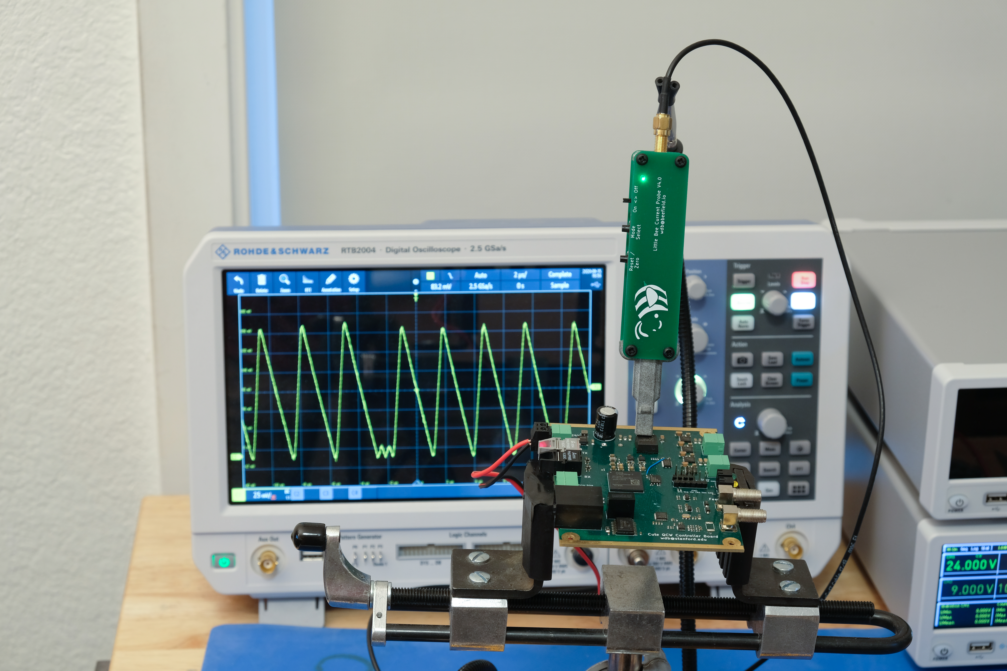
AMR Positional B-Field Probe (Little Bee)
Photo courtesy
of Weston Braun
(Stanford)

Slide 4
Current Probe: Strengths
Doesn’t require breaking circuit to add shunt

Slide 5
Current Probe: Weaknesses
Some can only see AC
Most are mechanically fragile
  Hall sensor on ferrite core is extremely impact sensitive
Most have to clamp around a wire
  Difficult to measure signals on PCB
  Provide wire loop test points if planning to measure current
Typically designed for 10s or 100s of amps
  Hard to measure really small currents

Slide 6
Current Probe: When to use
Power supply design
Motor control applications

Slide 7
High Voltage Probes

Slide 8
High Voltage Probes
Many different designs for different applications
  HV passive
  Fiber isolated
  HV differential

Slide 9
High Voltage Passive Probes
Classic R-C divider architecture
Much higher attenuation
  Teledyne LeCroy PPE5KV is 100:1, 5 kV max

Slide 10
High Voltage Fiber Isolated Probe
Measuring small signal on huge DC offset
  Teledyne LeCroy HVFO108 has 35 kV common mode range
  Amplitude ranges from ±1V to ±40V
Isolated front end driving optical fiber TOSA
ROSA feeds scope input
Often not a simple linear system
  Fiber transceivers have poor linearity
  HVFO108 uses FM over the fiber

Slide 11
High Voltage Differential Probe
Active differential probe for HV applications
Pico TA044 ($1075)
  70 MHz B/W
  Switchable 100:1 / 1000:1 attenuation
  700 V RMS / 5 kV RMS differential range
  2.5 kV RMS common mode range

Slide 12
HV Probe: Strengths
Extends range of scope to several kV

Slide 13
HV Probe: Weaknesses
Active probes often need batteries for remote head
  Can’t be powered directly by scope
  Some fancier ones include isolated DC-DC supplies
Passive probes have frequency derating
  Often can’t hit rated BW and voltage at once
Low bandwidth (tens to low hundreds of MHz)

Slide 14
HV Probe: When to use
Measuring high voltages
If DC isolation is required for any other reason

Slide 15
Effects of Limited Bandwidth

Slide 16
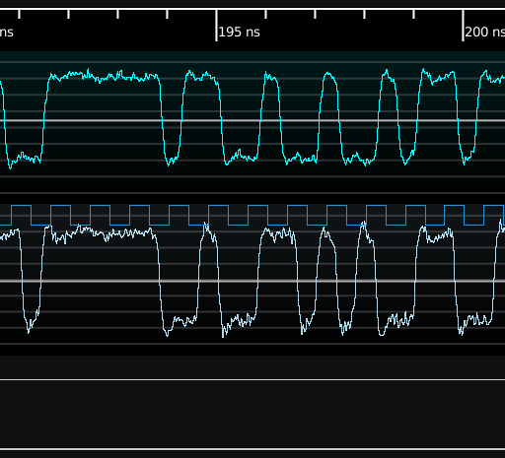
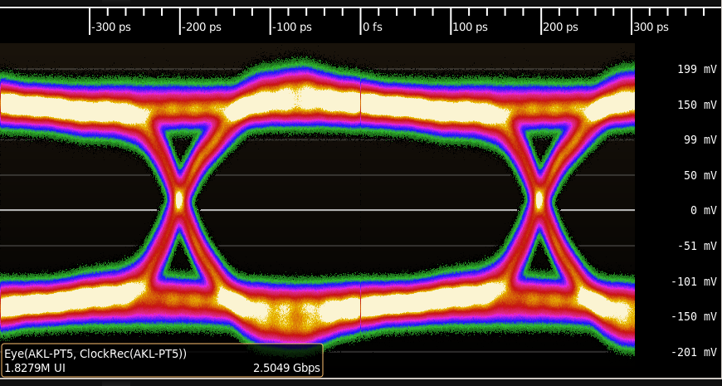
5 GHz probe, 2.5 Gbps signal
Separate rise / stable / fall regions
Bits are equal amplitude

Slide 17
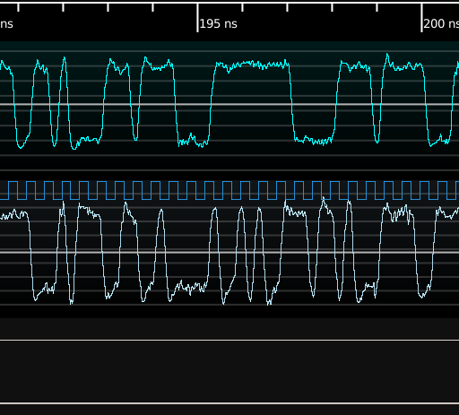
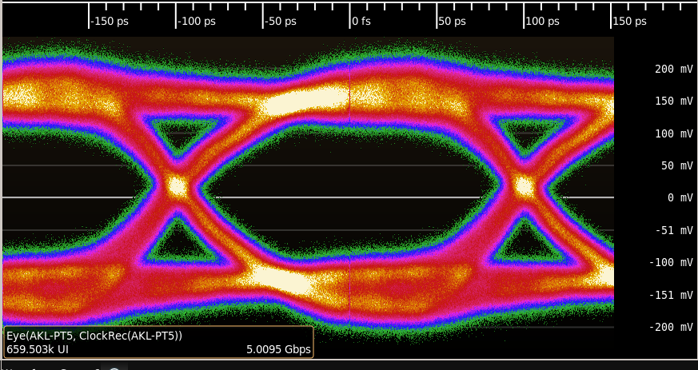
5 GHz probe, 5 Gbps signal
Bits look more sinusoidal
Still roughly equal amplitude

Slide 18
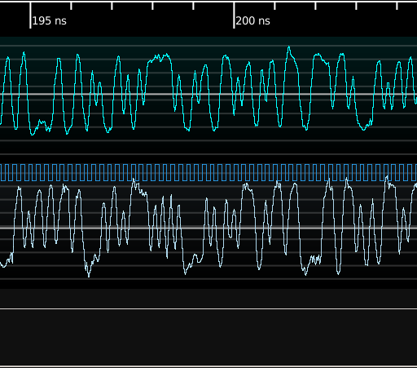
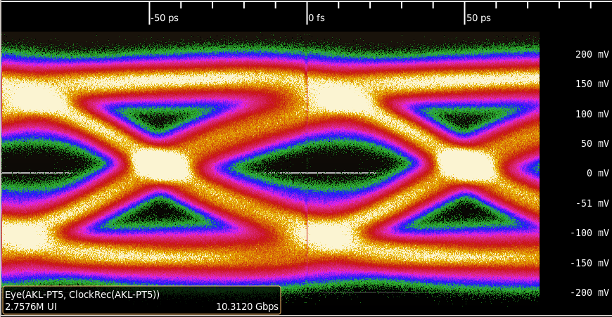
5 GHz probe, 10.3125 Gbps signal
Fast toggles do not reach full amplitude
This leads to ISI

Slide 19
Miscellaneous Tips

Slide 20
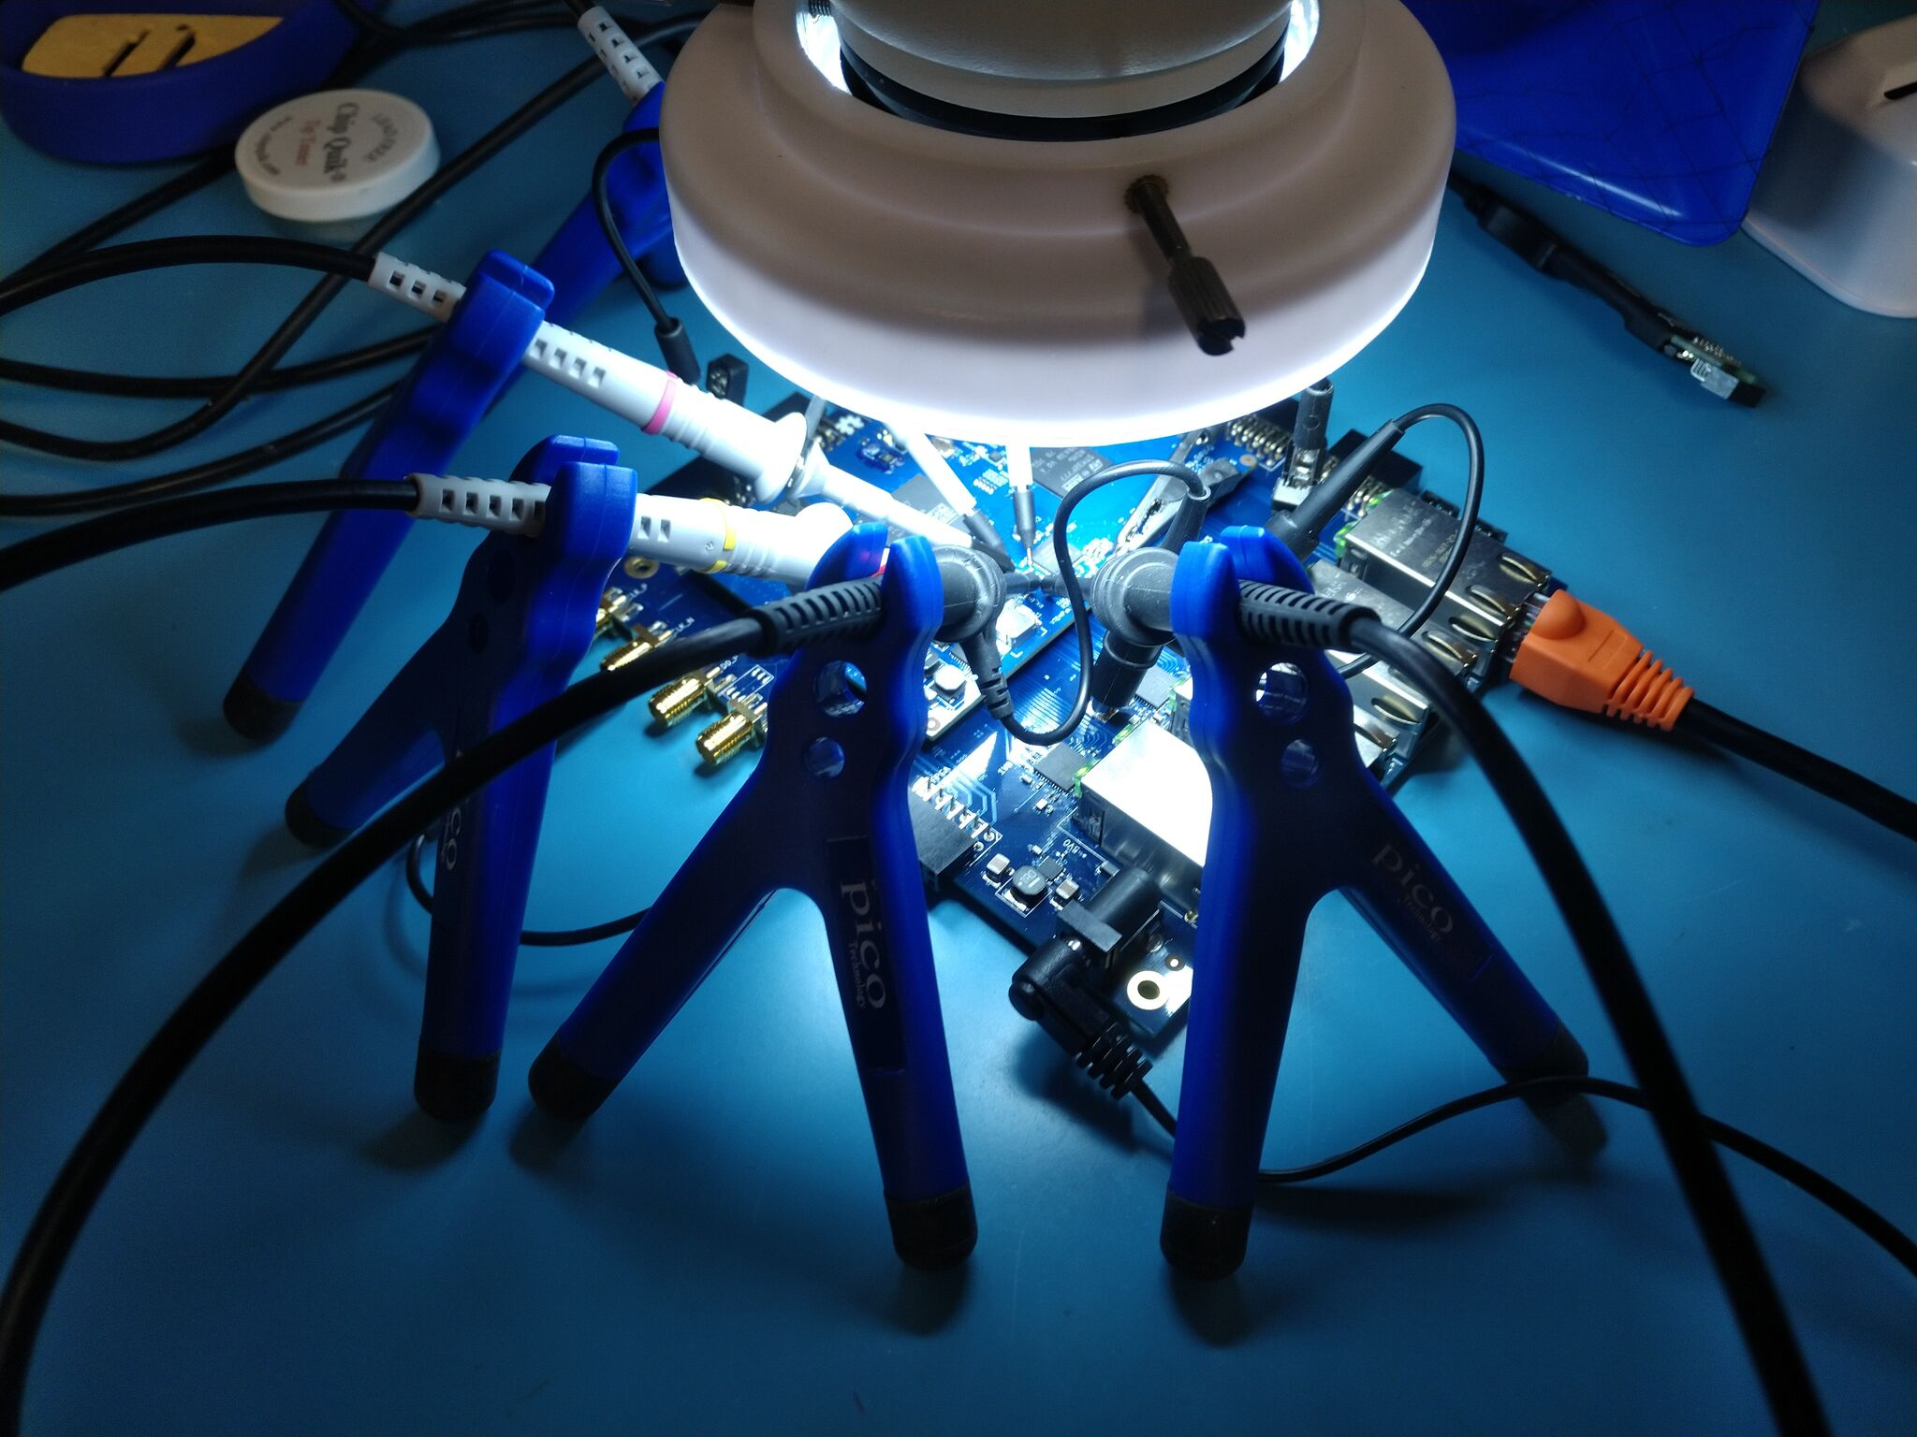
Passive Probe Holders

Slide 21
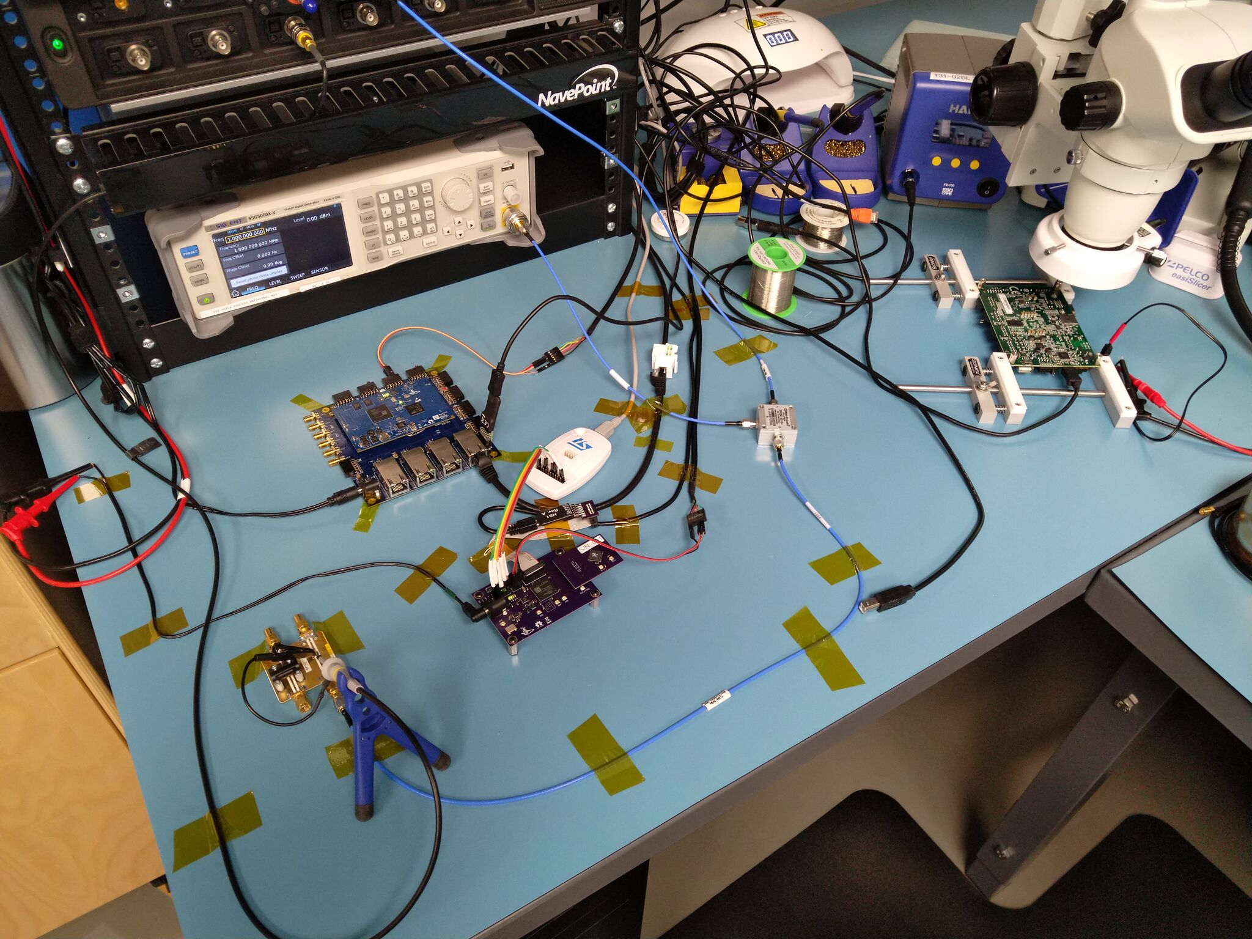
Securing Cabling with Kapton Tape

Slide 22
Concluding Remarks

Slide 23
Conclusions
Huge range of options, prices, features
  Some general purpose, some very specialized
Easy to get garbage results with poor technique
Understanding your probe helps you use it well

Slide 24
Questions?

