Slide 1
Nearfield Loop Probes

Slide 2
Nearfield Loop Probe
Variants available for both H- and E-fields
Short range RF pickup
Typically used for EMC testing
  Precompliance
  Tracking down source of a failure

Slide 3
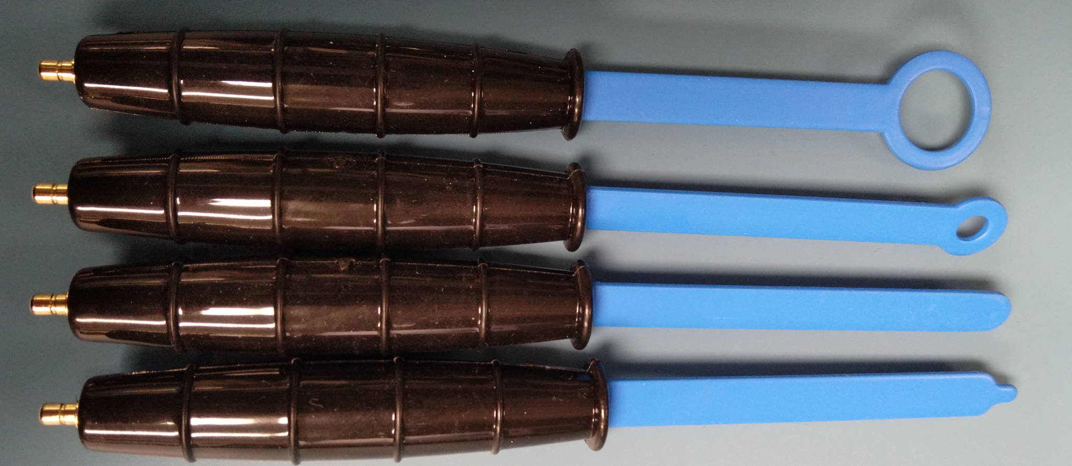
Nearfield Loop Probe (Tekbox TBPS01)
20mm H-field
10mm H-field
5mm H-field
5mm E-field

Slide 4
Nearfield Loop Probe
Coupling varies with distance from DUT
  Not useful for quantitative intensity measurements
  But allows precise physical location of emitter to be found
Often used for ratiometric EMC measurements
  Place probe a fixed distance from DUT
  Compare field strength before / after some change
Ratio doesn’t scale 1:1 with far field strength
  But usually close enough if you add some safety margin

Slide 5
Nearfield Loop Probe
Start with sensitive probe for long range scanning
Move to smaller one to pin down exact source
May need external LNA for weak signals

Slide 6
Nearfield Loop Probe: Strengths
Very broadband (most go to several GHz)
Only real option for benchtop EMC testing
  Calibrated antenna in anechoic chamber is definitive
  But they’re big and expensive!
Allows spatial location of emitter to be found

Slide 7
Nearfield Loop Probe: Weaknesses
Very sensitive to exact position
  Not useful for quantitative measurements
Ultra specialized
  Not useful for much besides EMC testing

Slide 8
Nearfield Loop Probe: When to use
Identifying the source of an EMC problem

Slide 9
Questions?

