Slide 1
High Voltage Probes

Slide 2
High Voltage Probes
Many different designs for different applications
  HV passive
  Fiber isolated
  HV differential

Slide 3
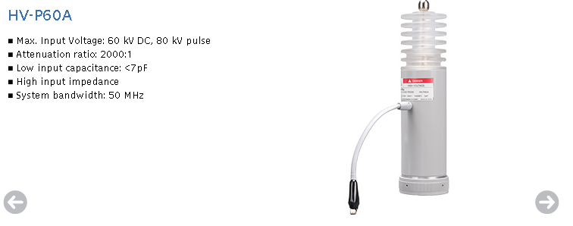
High Voltage Passive Probes
Classic R-C divider architecture
Much higher attenuation
  Teledyne LeCroy PPE5KV is 100:1, 400 MHz, 5 kV max
  Iwatsu HV-P60A is 2000:1, 50 MHz, 60 kV

Slide 4
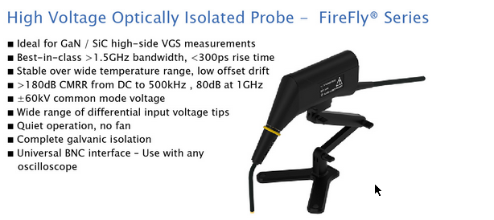
High Voltage Fiber Isolated Probe
Measuring small signal on huge DC offset
  PMK FireFly has ±60 kV common mode range
  Variable tips for ±1V to ±2.5 kV input range
Isolated front end driving optical fiber TOSA
ROSA feeds scope input
Often not a simple linear system
  Fiber transceivers have poor linearity
  Teledyne LeCroy HVFO108 uses FM over the fiber

Slide 5
High Voltage Differential Probe
Active differential probe for HV applications
Pico TA044 ($1075)
  70 MHz B/W
  Switchable 100:1 / 1000:1 attenuation
  700 V RMS / 5 kV RMS differential range
  2.5 kV RMS common mode range

Slide 6
HV Probe: Strengths
Extends range of scope to several kV

Slide 7
HV Probe: Weaknesses
Active probes often need batteries for remote head
  Can’t be powered directly by scope
  Some fancier ones include isolated DC-DC supplies
Passive probes have frequency derating
  Often can’t hit rated BW and voltage at once
Low bandwidth (tens to low hundreds of MHz)

Slide 8
HV Probe: When to use
Measuring high voltages
If DC isolation is required for any other reason

Slide 9
Questions?

Slide 10
No lab for this section

