Slide 1
Effects of Limited Bandwidth

Slide 2
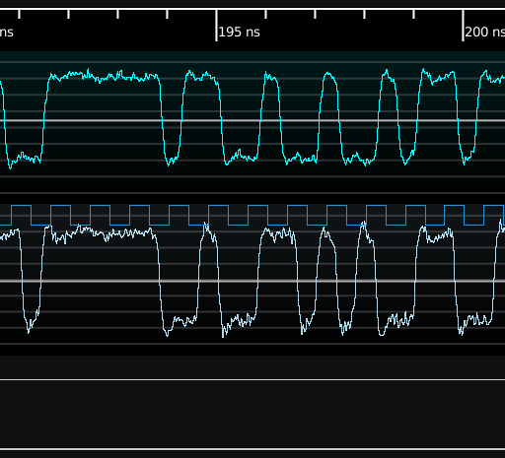
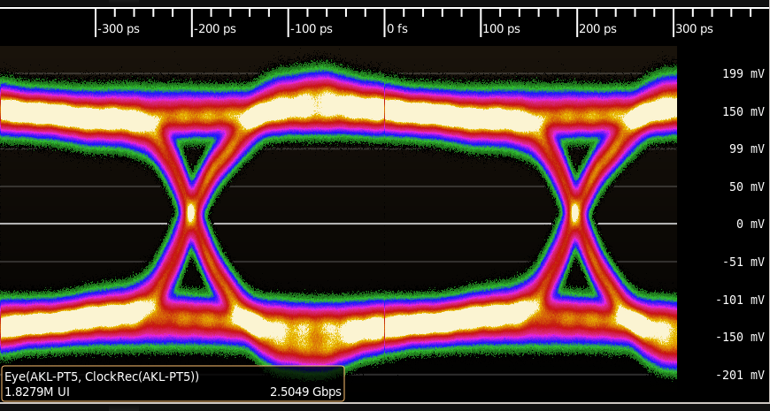
5 GHz probe, 2.5 Gbps signal
FIXME REDO
Separate rise / stable / fall regions
Bits are equal amplitude

Slide 3
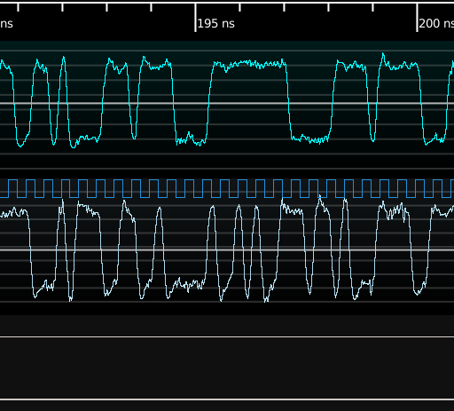
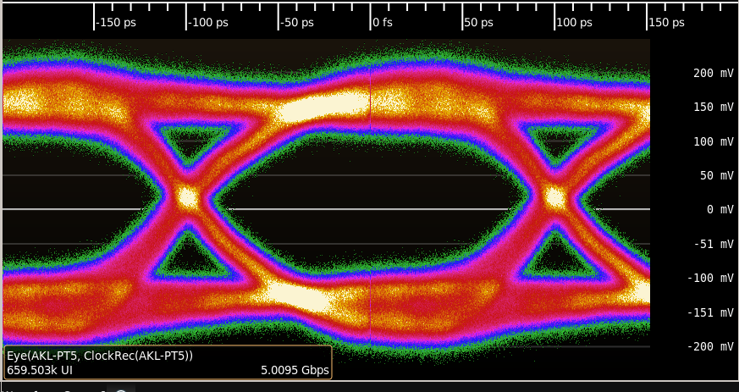
5 GHz probe, 5 Gbps signal
FIXME REDO
Bits look more sinusoidal
Still roughly equal amplitude

Slide 4
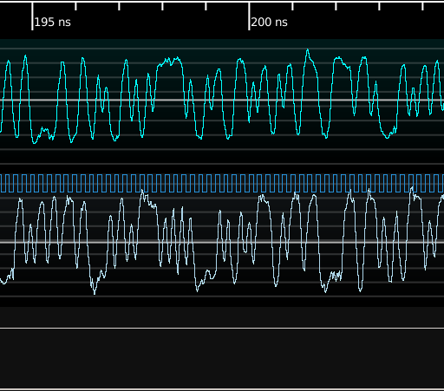
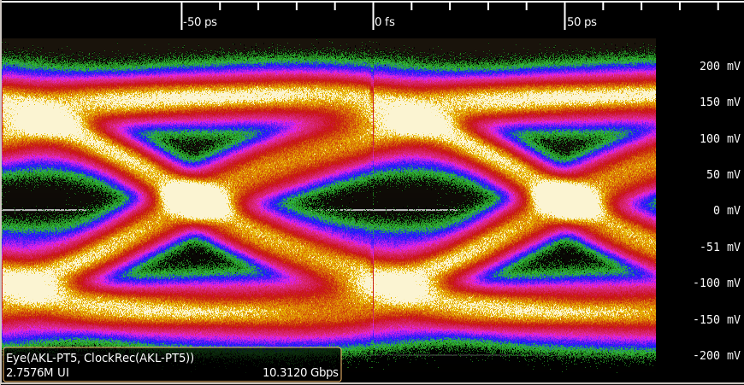
5 GHz probe, 10.3125 Gbps signal
FIXME REDO
Fast toggles do not reach full amplitude
This leads to ISI

Slide 5
Miscellaneous Tips

Slide 6
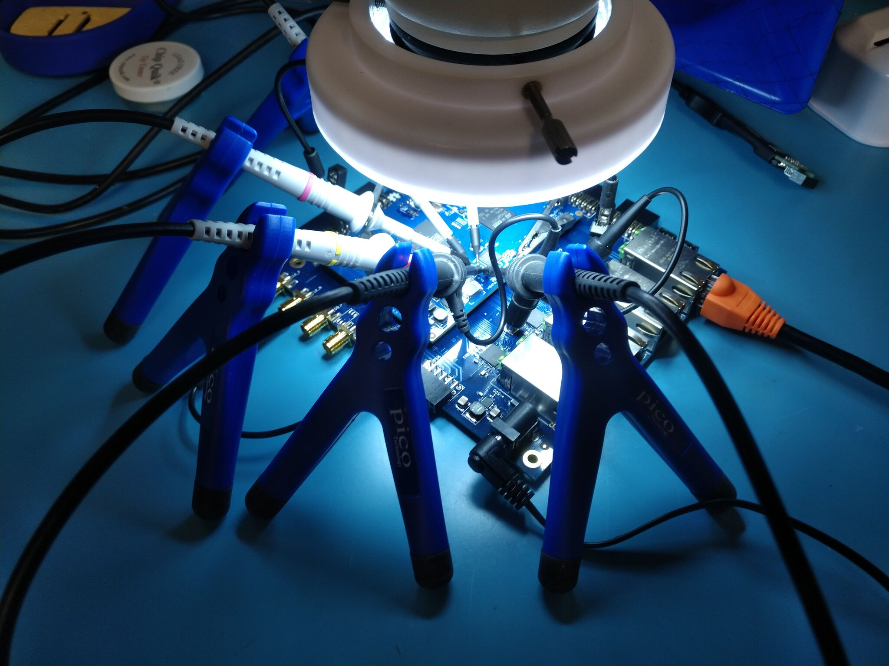
Passive Probe Holders

Slide 7
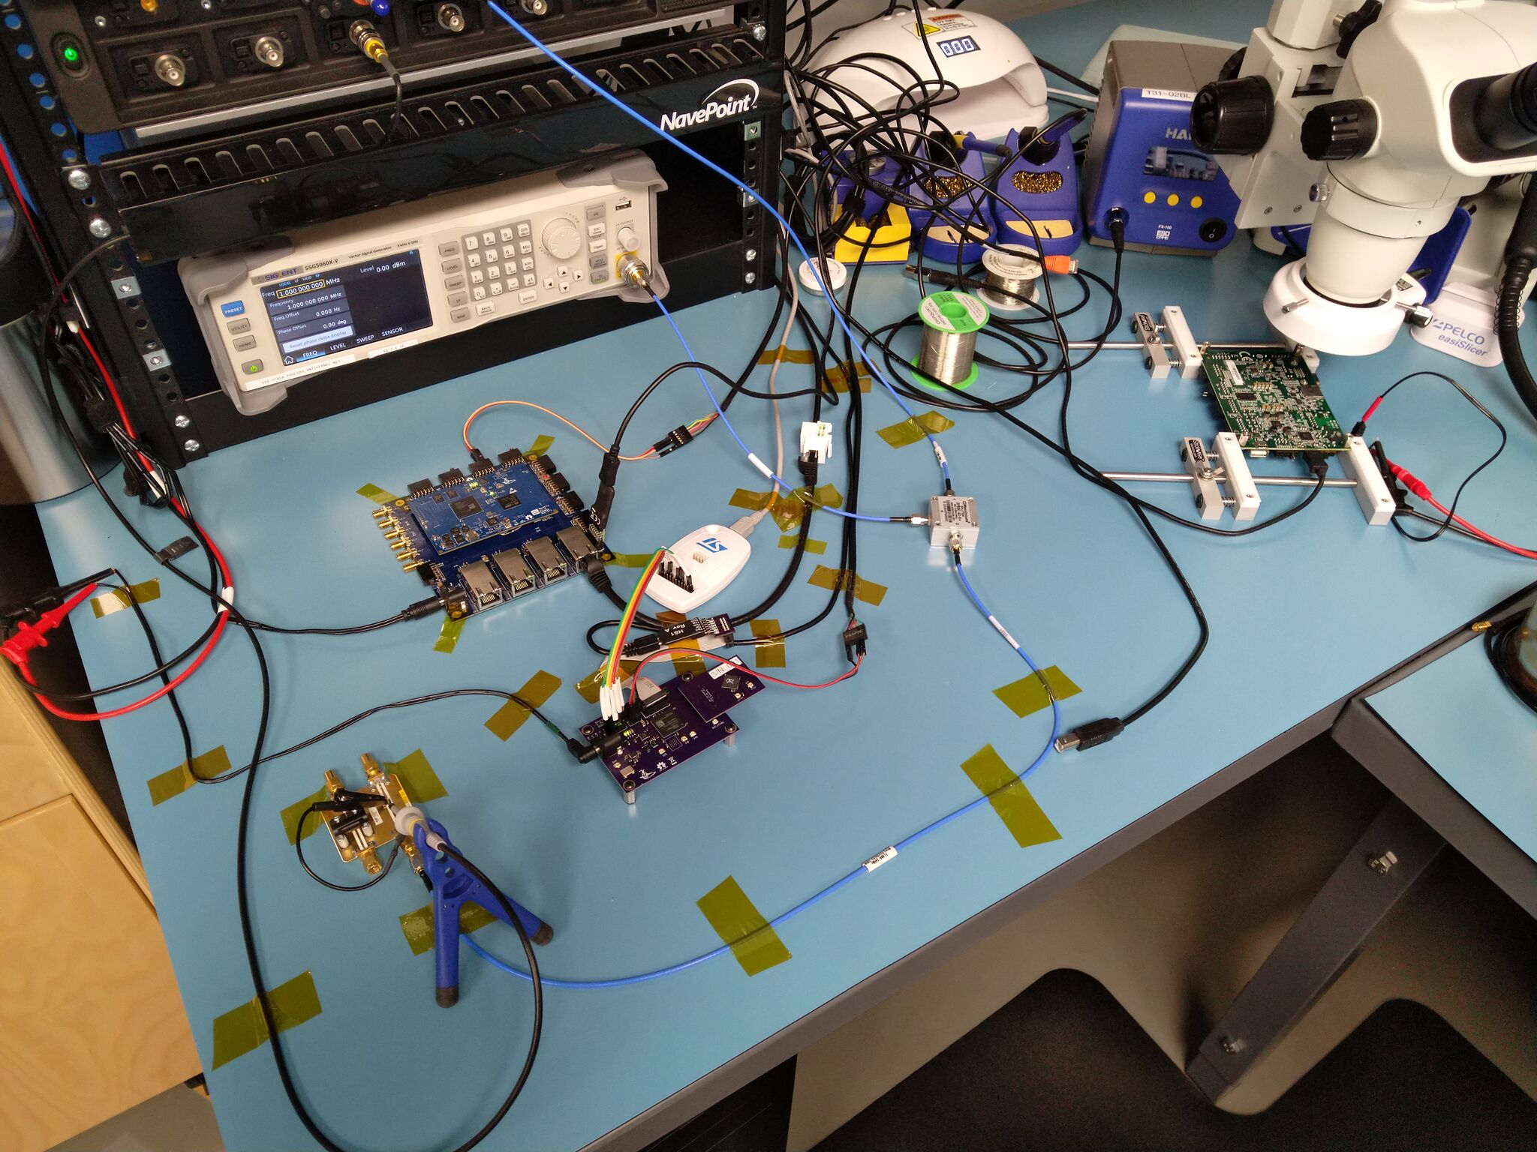
Securing Cabling with Kapton Tape

Slide 8
Concluding Remarks

Slide 9
Conclusions
Huge range of options, prices, features
  Some general purpose, some very specialized
  Most expensive isn’t always best for a given use case
Easy to get garbage results with poor technique
Understanding your probe helps you use it well

Slide 10
Questions?

