Slide 1
R-C Divider Probe

Slide 2
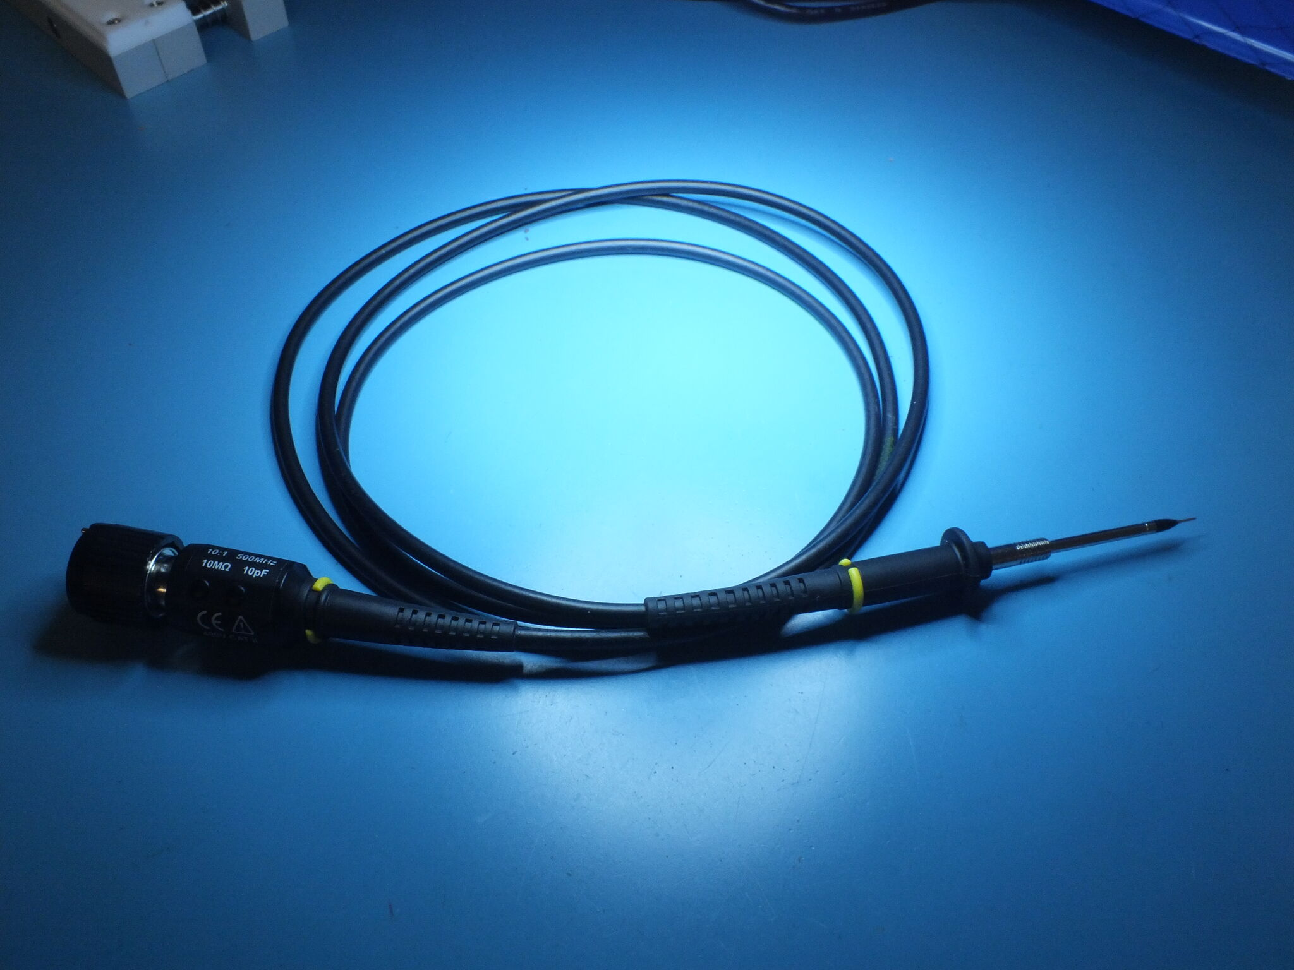
R-C Divider Probe
You’ve all used this one
Dates to the vacuum tube era!

Slide 3
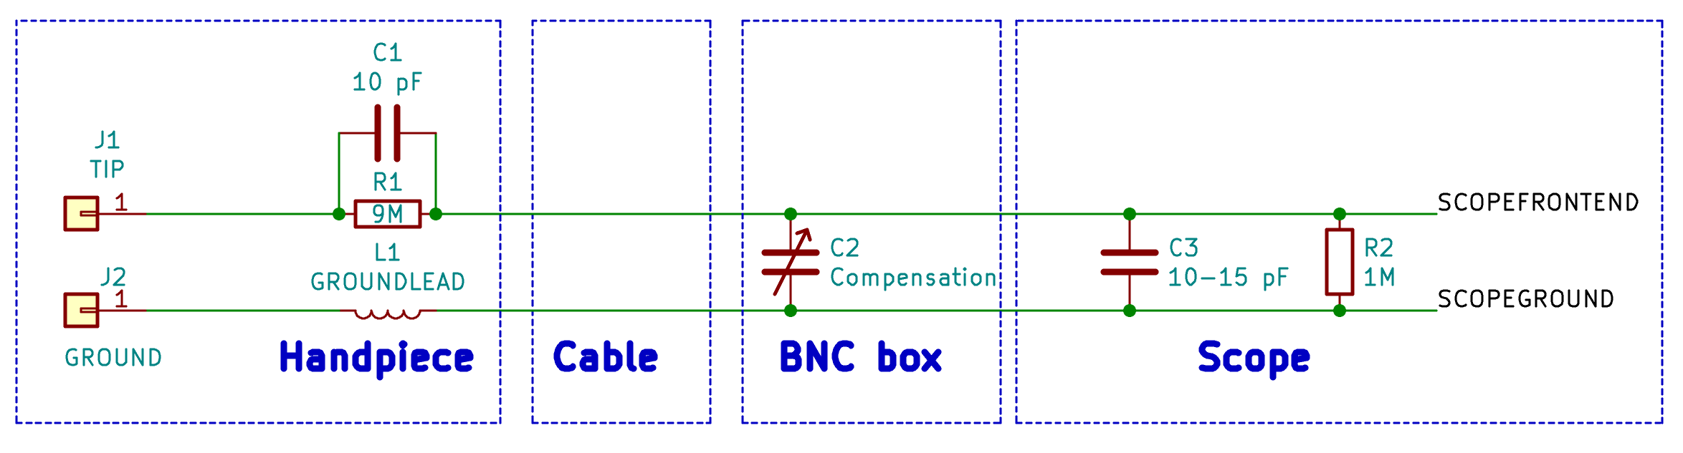
R-C Divider Probe
Lossy cable (often thin Ni-Cr core)
to damp out reflections
Ground wire has
nontrivial inductance

Slide 4
R-C Divider Probe: Compensation
Trimpots / caps near BNC
  Simple design is a single C
  Higher end probes may have multiple trimmers for fine tuning
Adjust for desired frequency response
  Usually target is broadband flatness
  For narrowband measurements, optimize for that region
Generally not portable across scopes
  If moving probe to another instrument, re-compensate

Slide 5
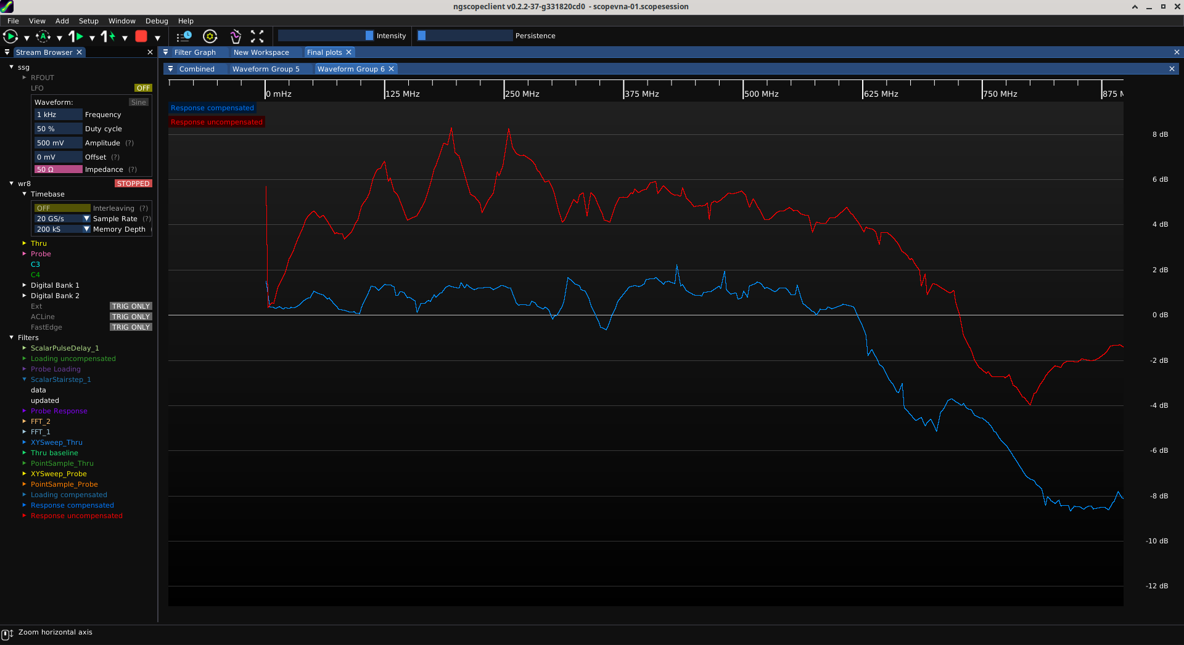
R-C Divider Probe: Compensation
+8 dB peaking at 250 MHz
2.5x amplitude error!
+2 / -0.5 dB
DC to 625 MHz

Slide 6
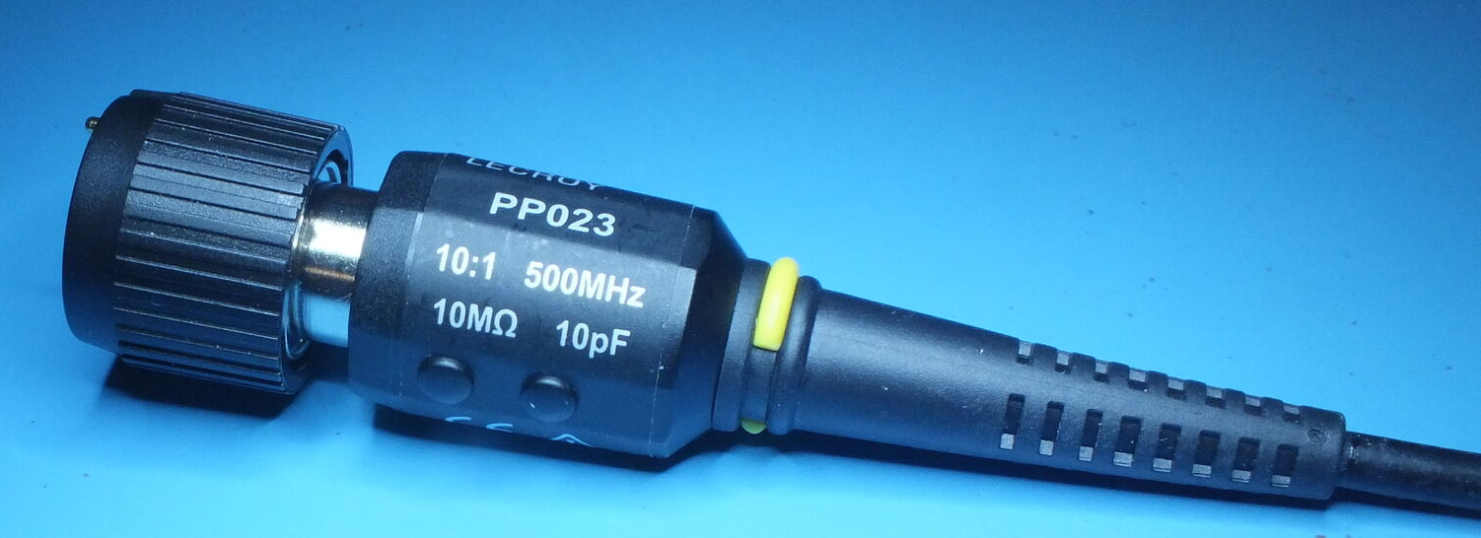
R-C Divider Probe: Loading
10MΩ input impedance is great!
  ...right?
We might have forgot something :(

Slide 7
Probe Loading
Placing probe on a circuit changes its behavior
This can manifest as a “heisenbug”
  DUT stops working when you probe it, or (worse)...
  DUT only works when you probe it!
  New, unrelated failure introduced by probing
Persistent data corruption is possible!

Slide 8
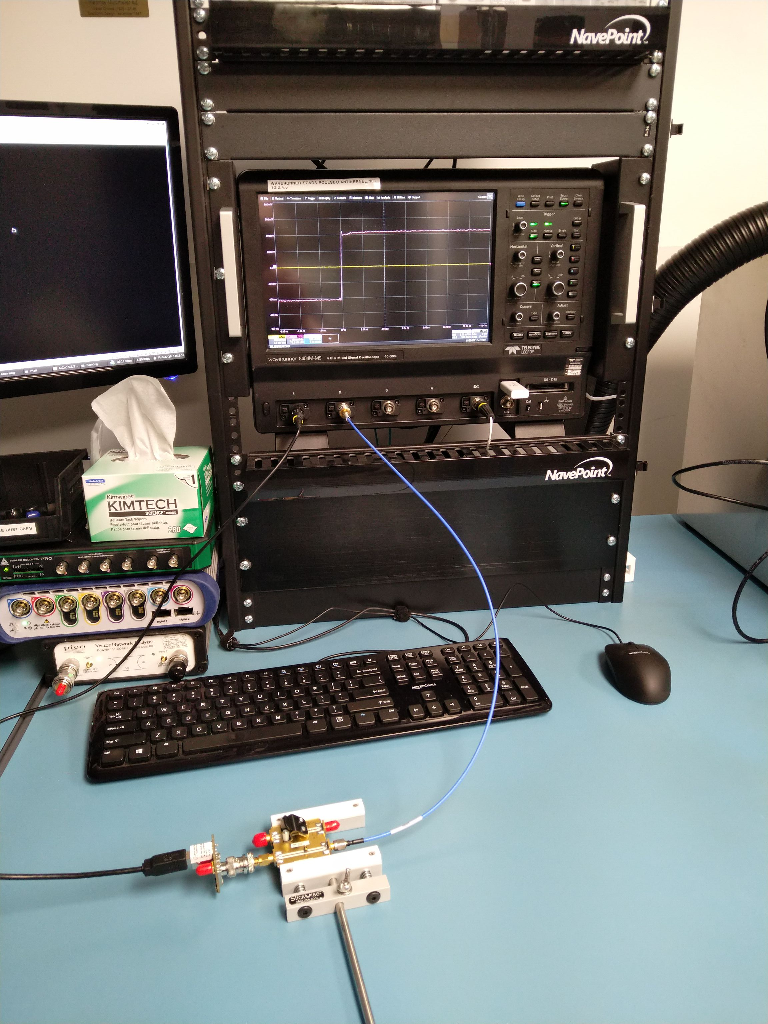
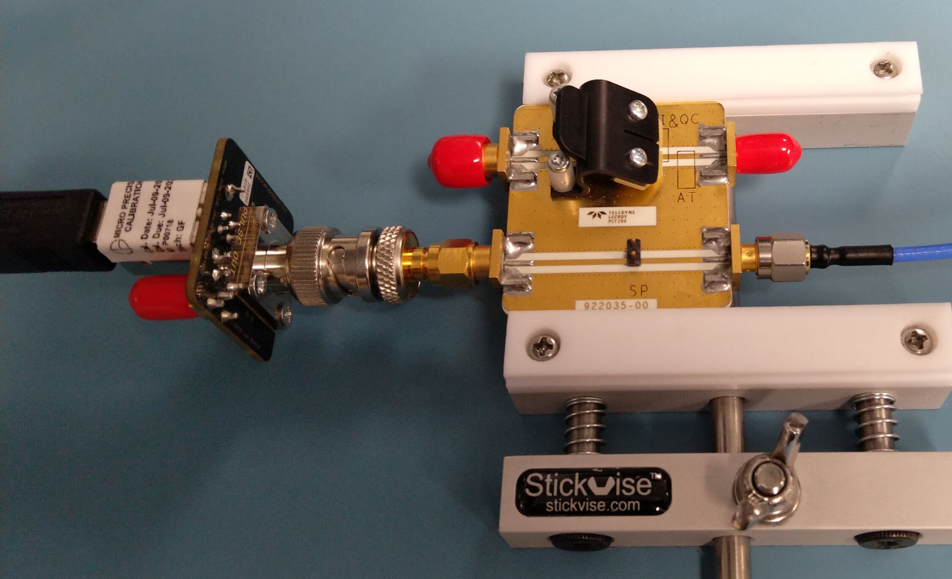
Time Domain Loading Measurement Setup
Fast edge
To scope C2
50Ω thru line

Slide 9
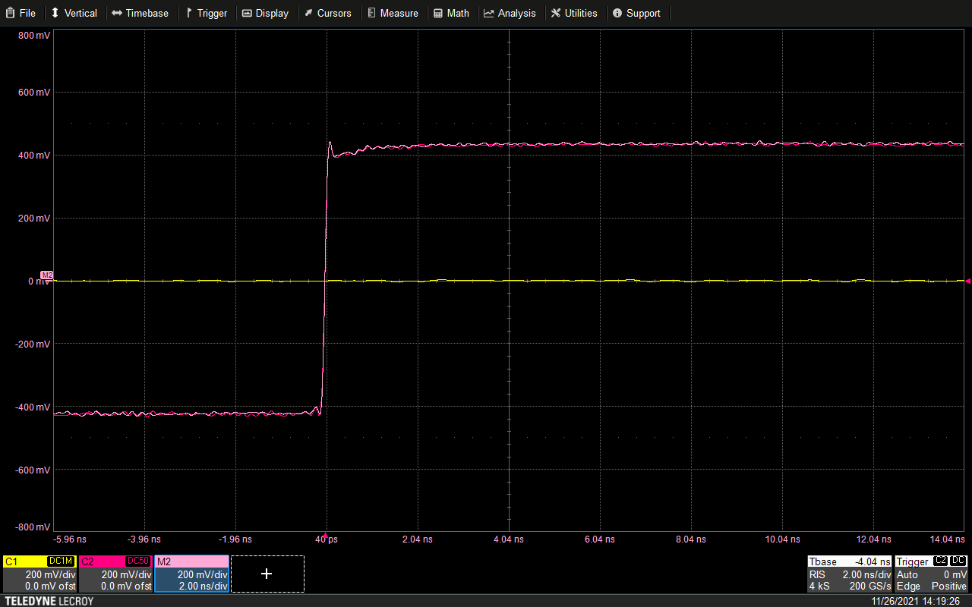
Baseline Measurement
Probe is
off the DUT
Fast edge
seen by DUT
Copy of DUT signal
without probe

Slide 10
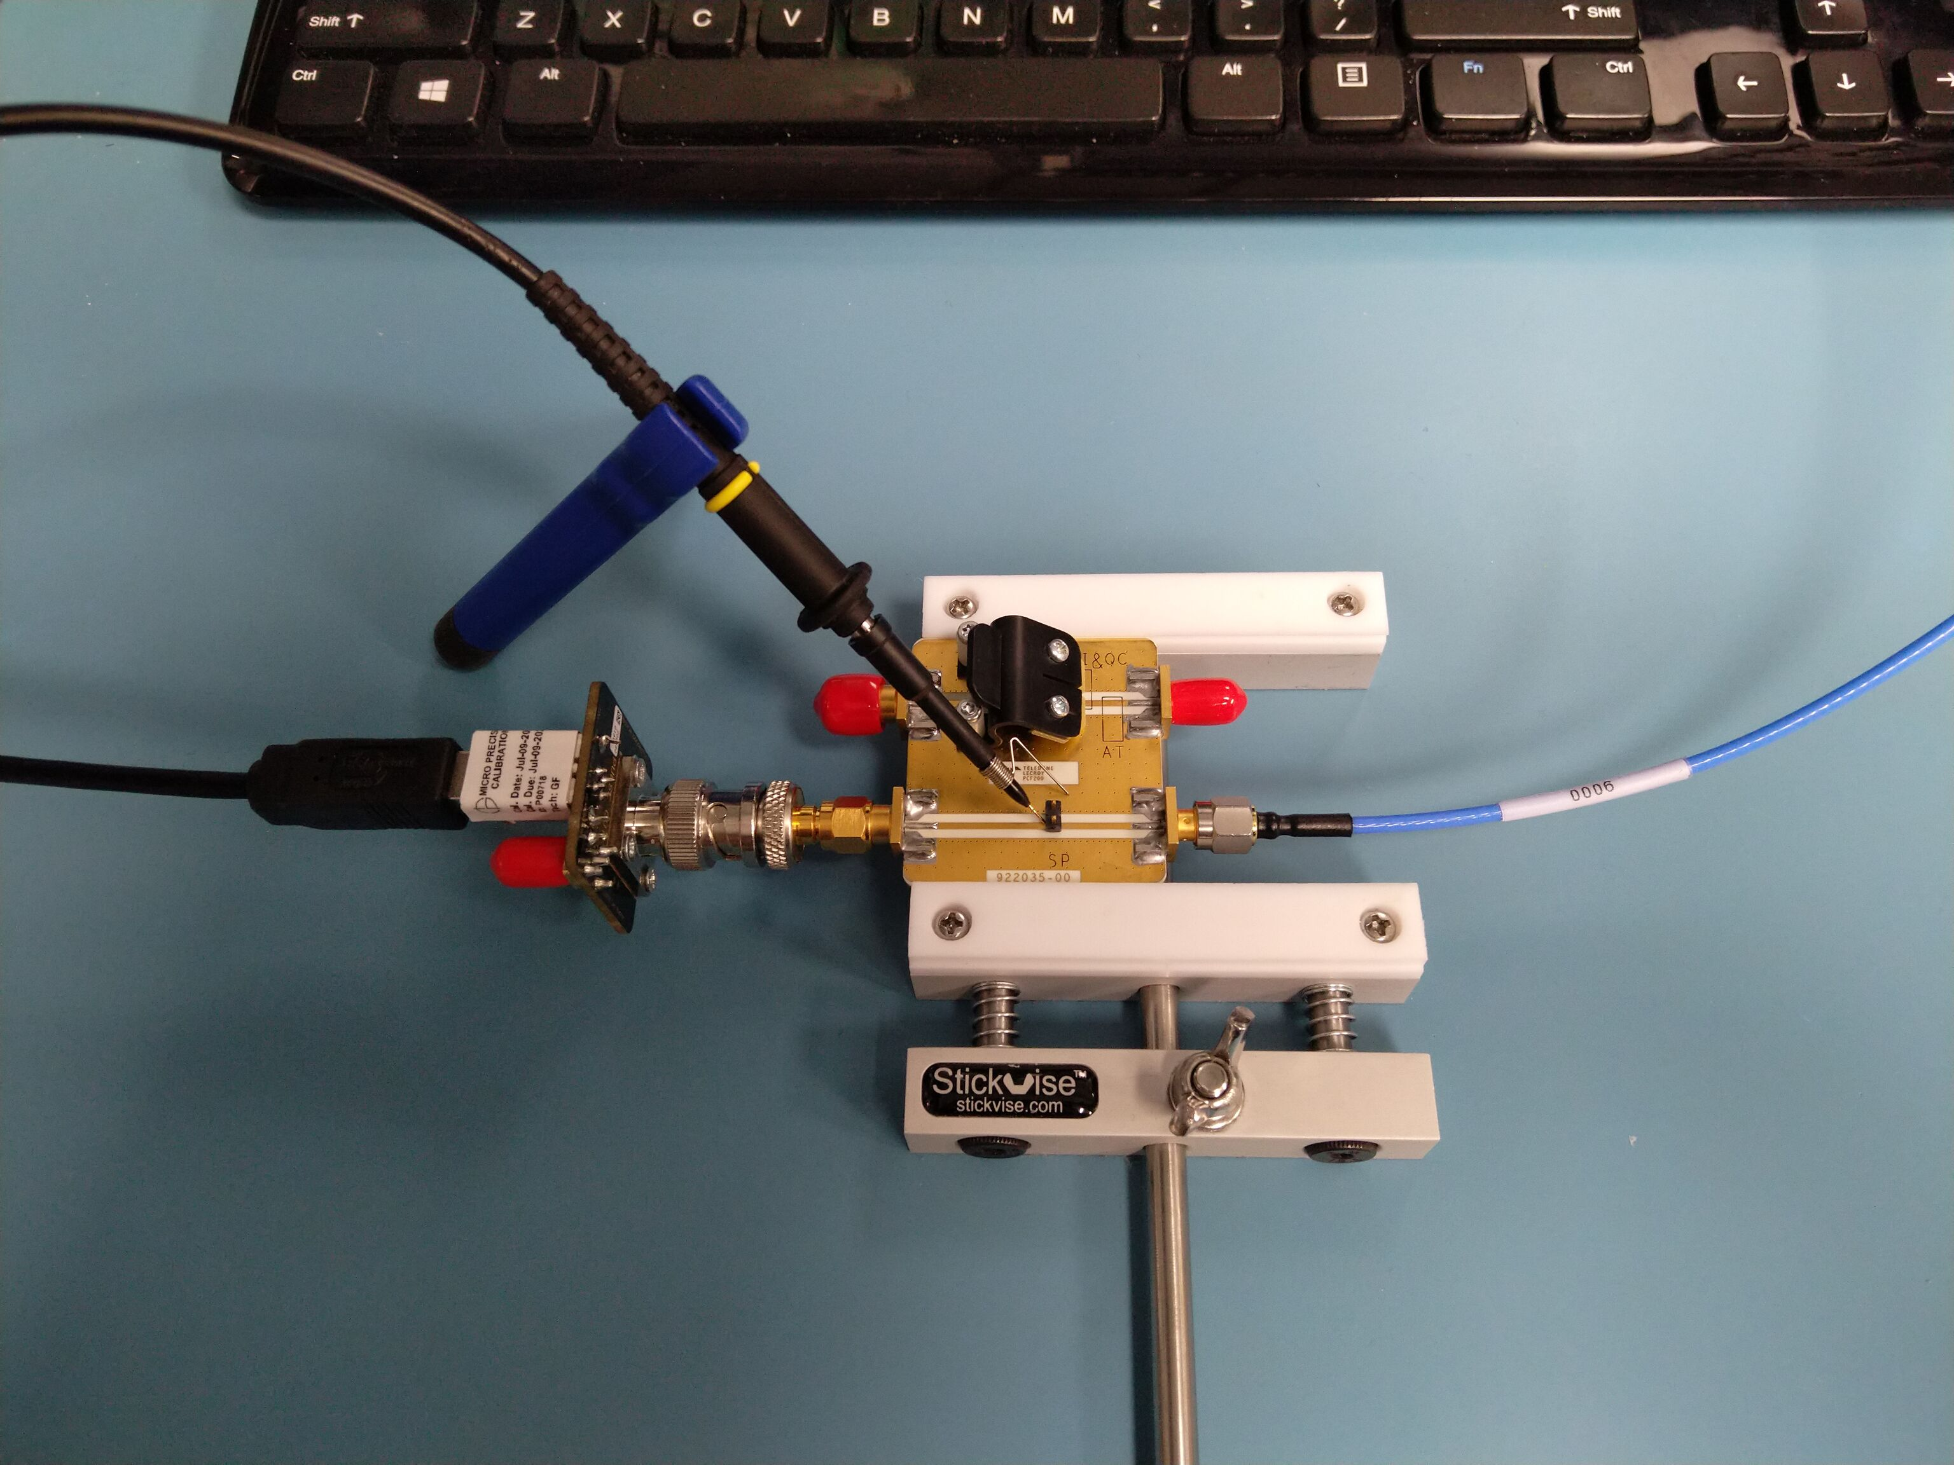
Now let’s add the probe...
What happens to the signal on the DUT?

Slide 11
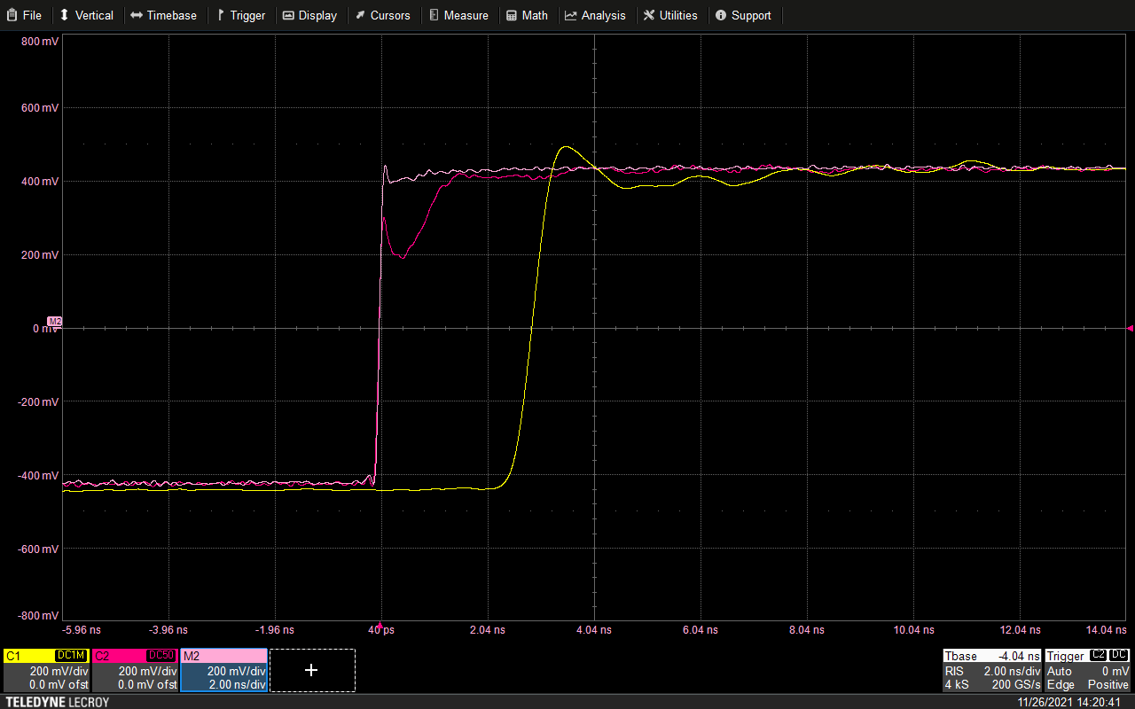
With Probe On DUT
Probe loading
Probe sees this
Non-monotonic edge
Potential glitch!

Slide 12
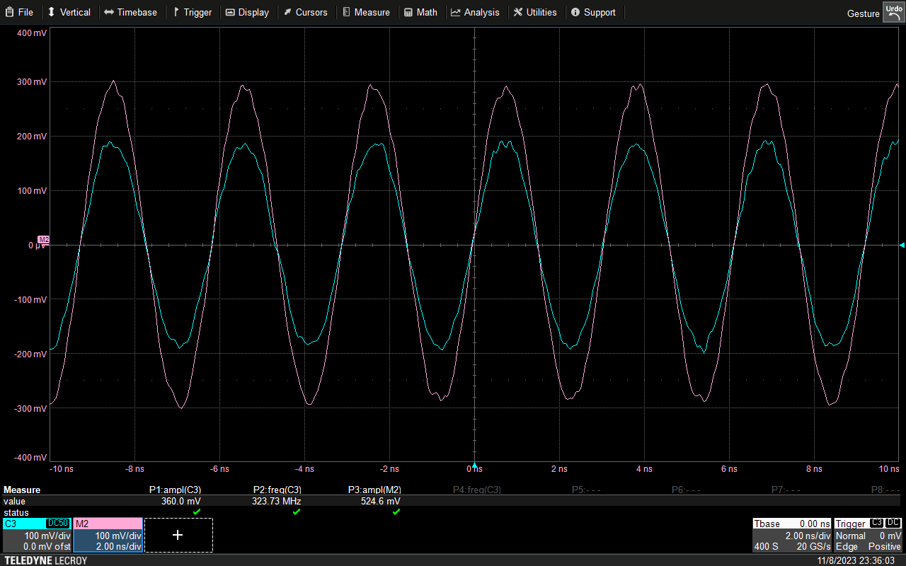
Pure-Tone Loading Example (50Ω Line)
Signal is loaded to 68%
of original amplitude

Slide 13
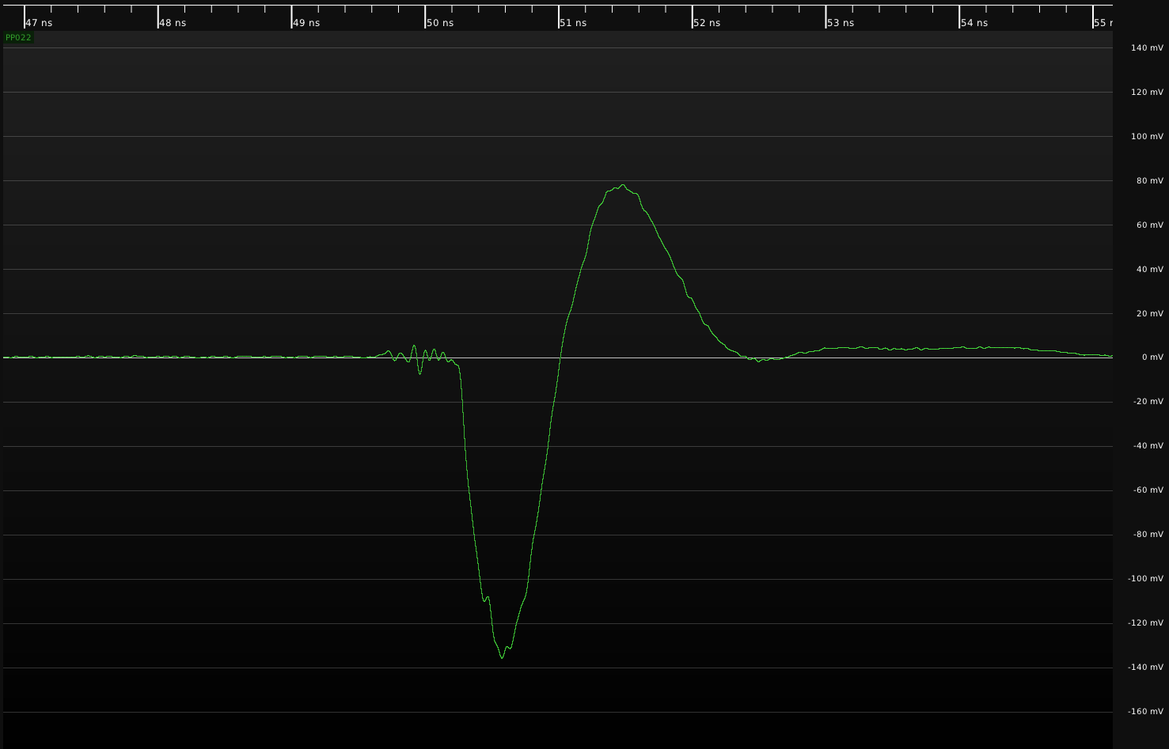
TDR response of R-C divider probe
Massive low freq dip
Coupler BW starts @ 500 MHz
So probably underestimate!

Slide 14
R-C Divider Probe: Ground Inductance
Probe input is very capacitive
  Any extra L will cause ringing
Forget that alligator clip ground for anything fast
  How fast is “fast”? Let’s find out…
Generally, tradeoff of convenience vs performance
  Alligator wire: super convenient, huge L
  Z-ground: trickier to use, moderate L
  Spring: hard to use, small L

Slide 15
Challenges of measuring probe S21
Measuring S11 of a probe is straightforward
  Same way you’d use a VNA to measure anything else
We don’t care much about S22 or S12
  Scope doesn’t drive its end of the probe
But S21 path is tricky!
  Active probes – proprietary power/signal interface
  R-C divider probes: 1MΩ ideal Z0, not 50Ω

Slide 16
Scope based “mixed signal VNA”
Use scope as direct sampling RX for S21 path!
  Port 1: Tone applied to probe tip
  Port 2: Digitized scope waveform
  Port 3: Thru line (loading path)
FFT measure amplitude on thru / probe path
  Calculate amplitude normalized to no-probe case
  Can do phase too but let’s keep today’s demo simple

Slide 17
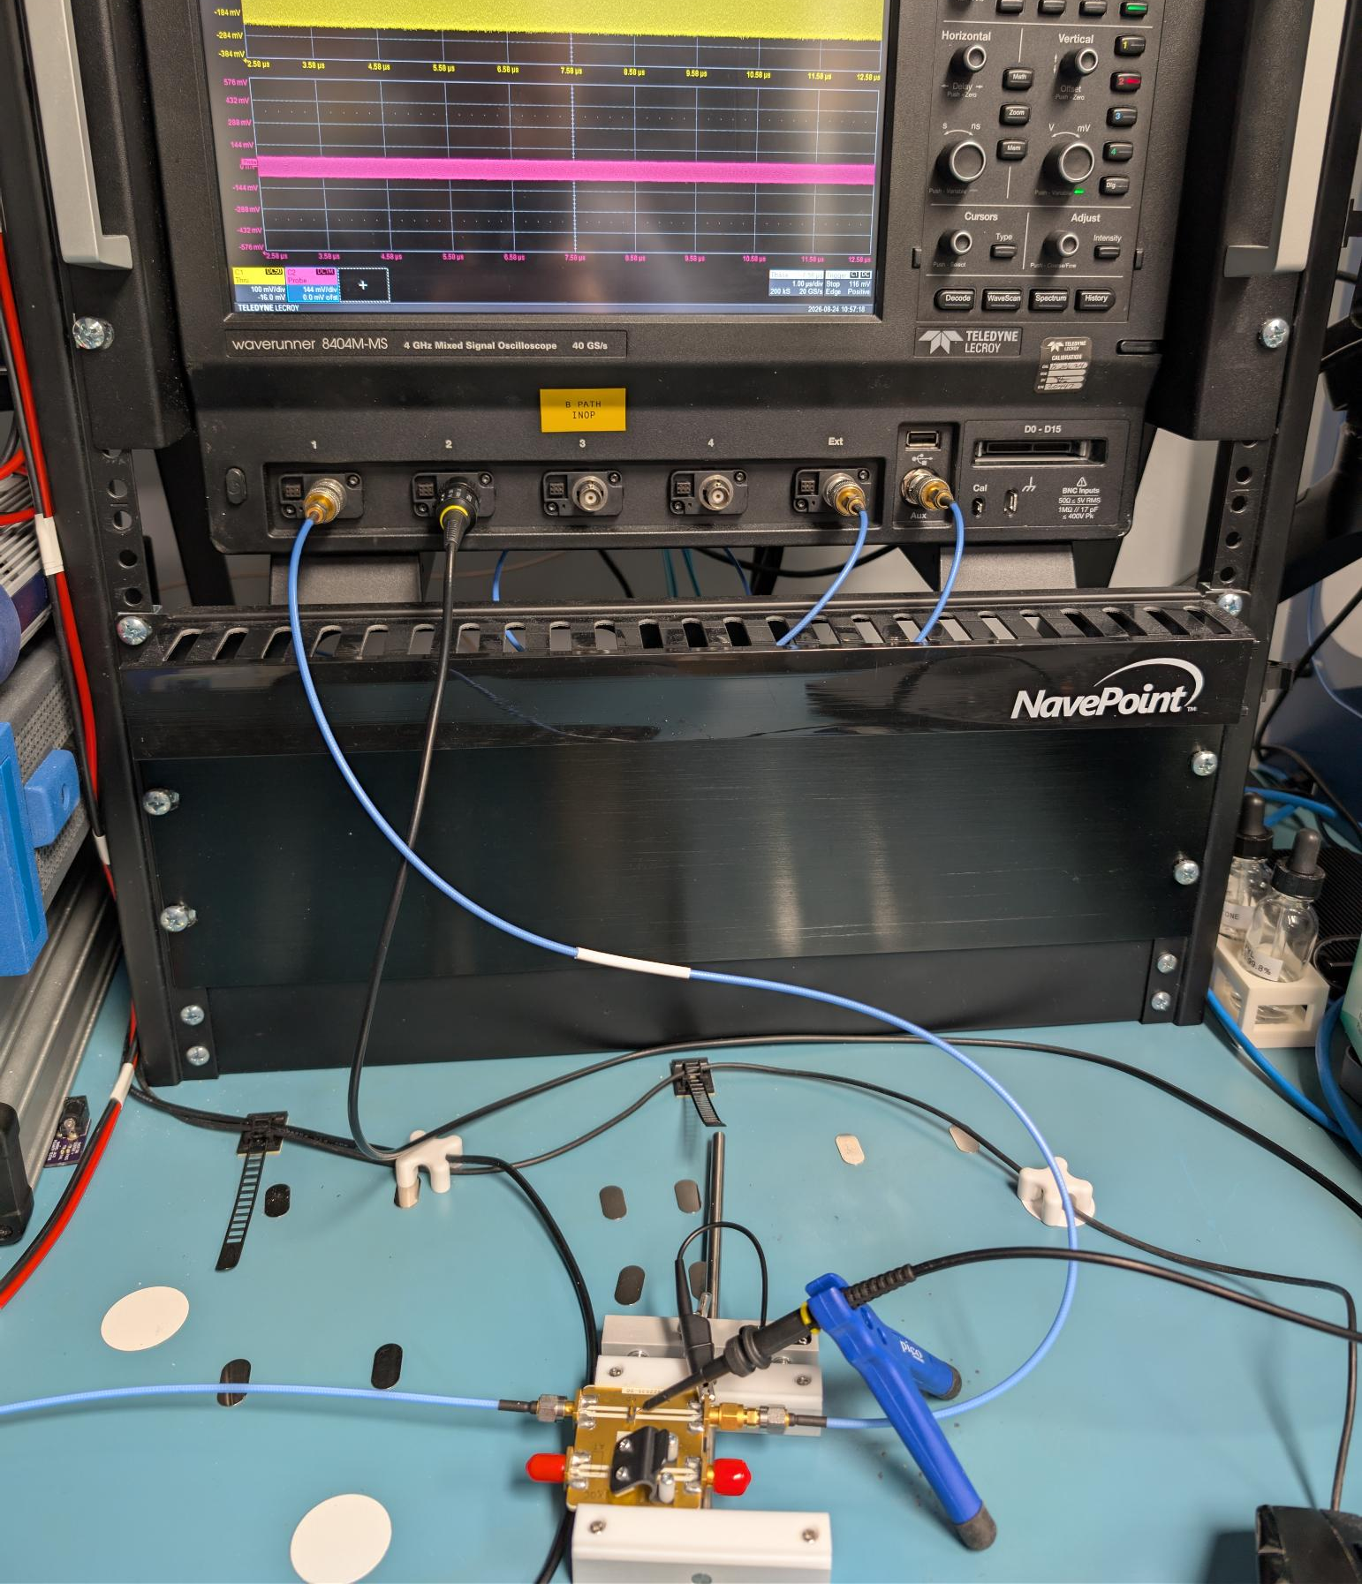
S21 Measurement Setup
Thru path
To signal generator

Slide 18
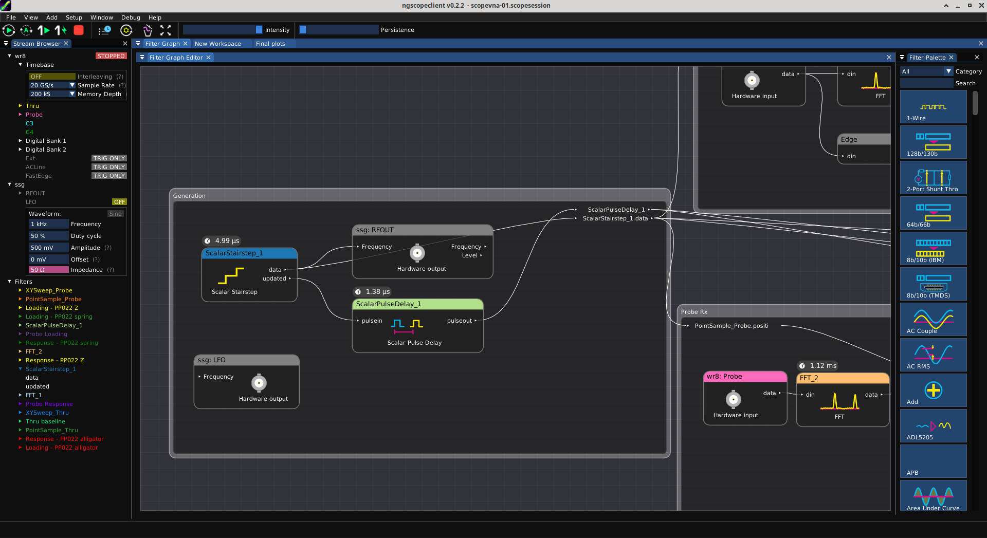
Filter graph design

Slide 19
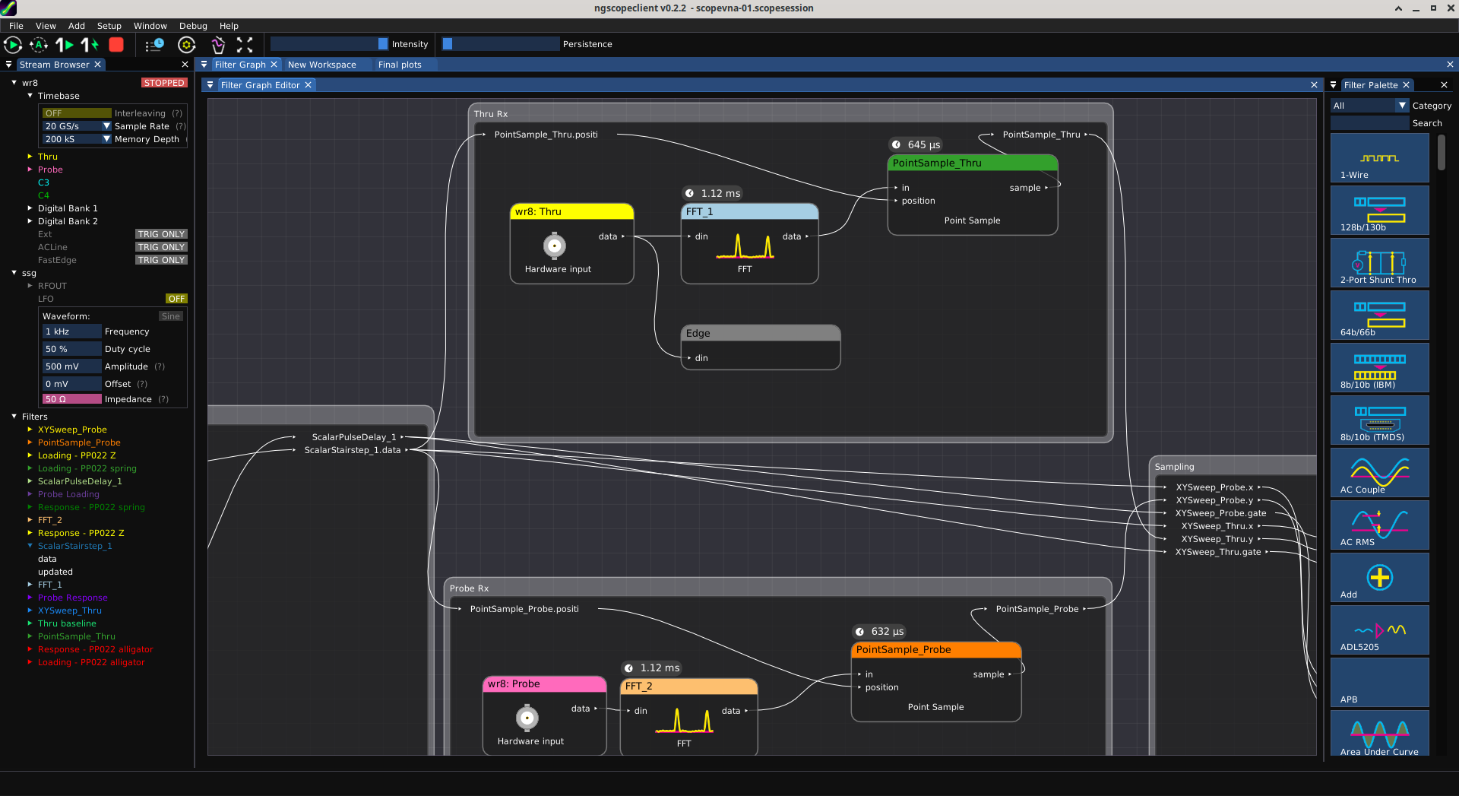
Filter graph design

Slide 20
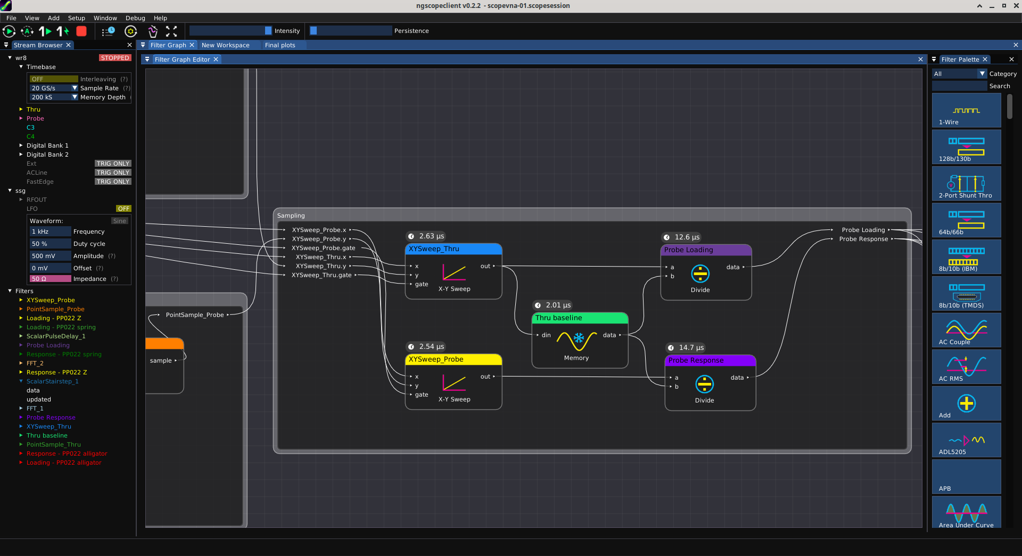
Filter graph design

Slide 21
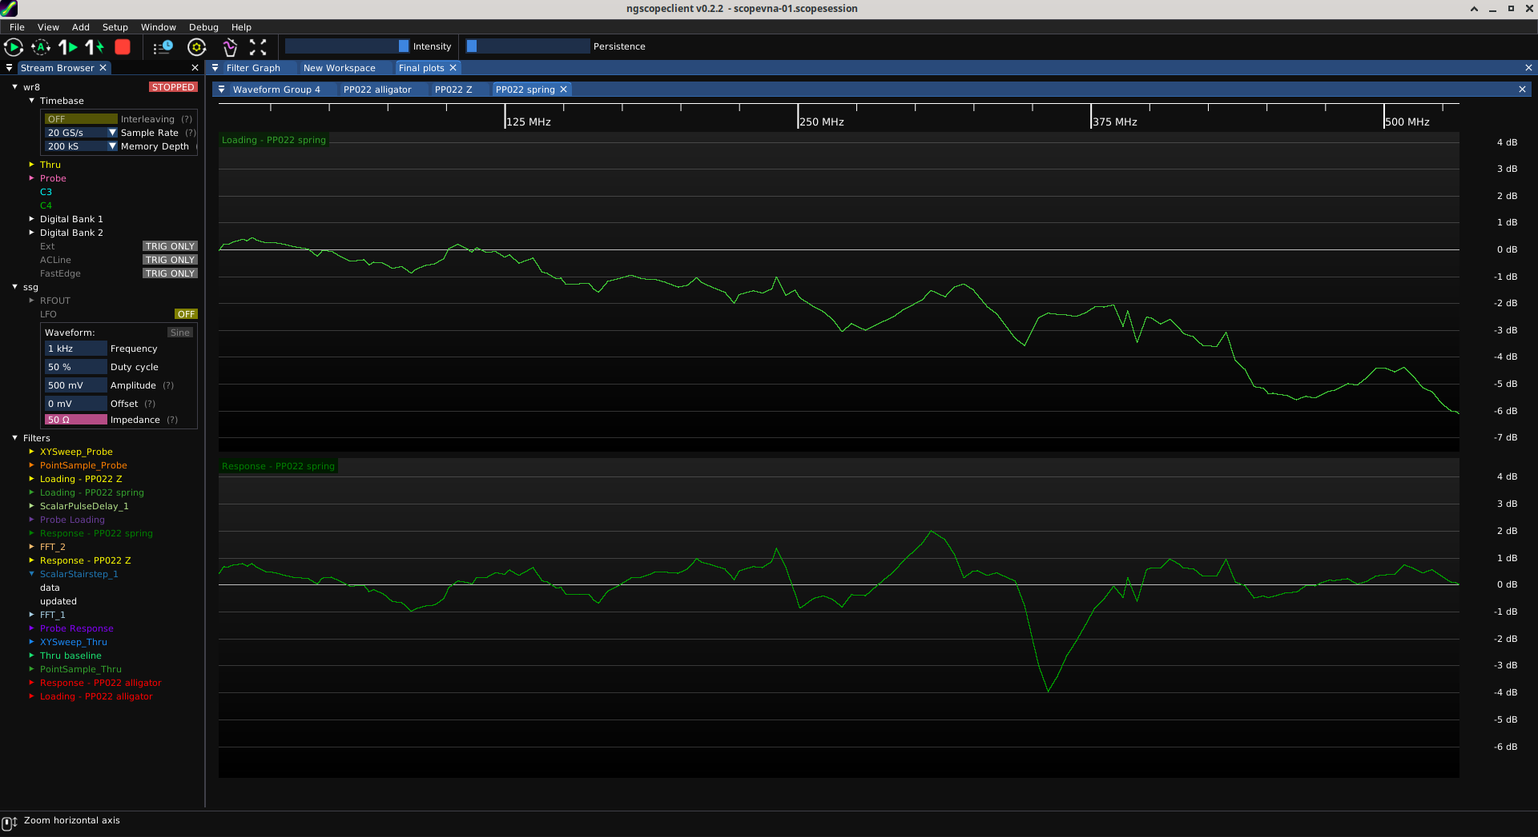
R-C Divider Probe: S21 Plot Setup
Thru path loss
from probe loading
Probe S21 normalized to
nominal 10x (-20 dB)
attenuation

Slide 22
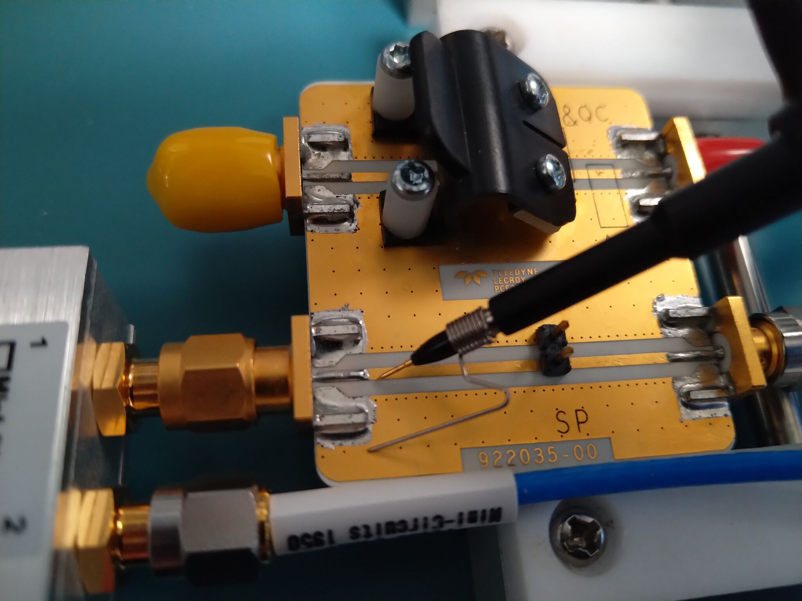
R-C Divider Probe: S21 w/ Spring Ground
-5.2 dB loading at 470 MHz
Signal reduced to 55%
of original amplitude
+/- 1 dB to 240 MHz
Teledyne LeCroy PP022
WaveRunner 8404M-MS
Spring ground
-3.9 dB at 356 MHz

Slide 23
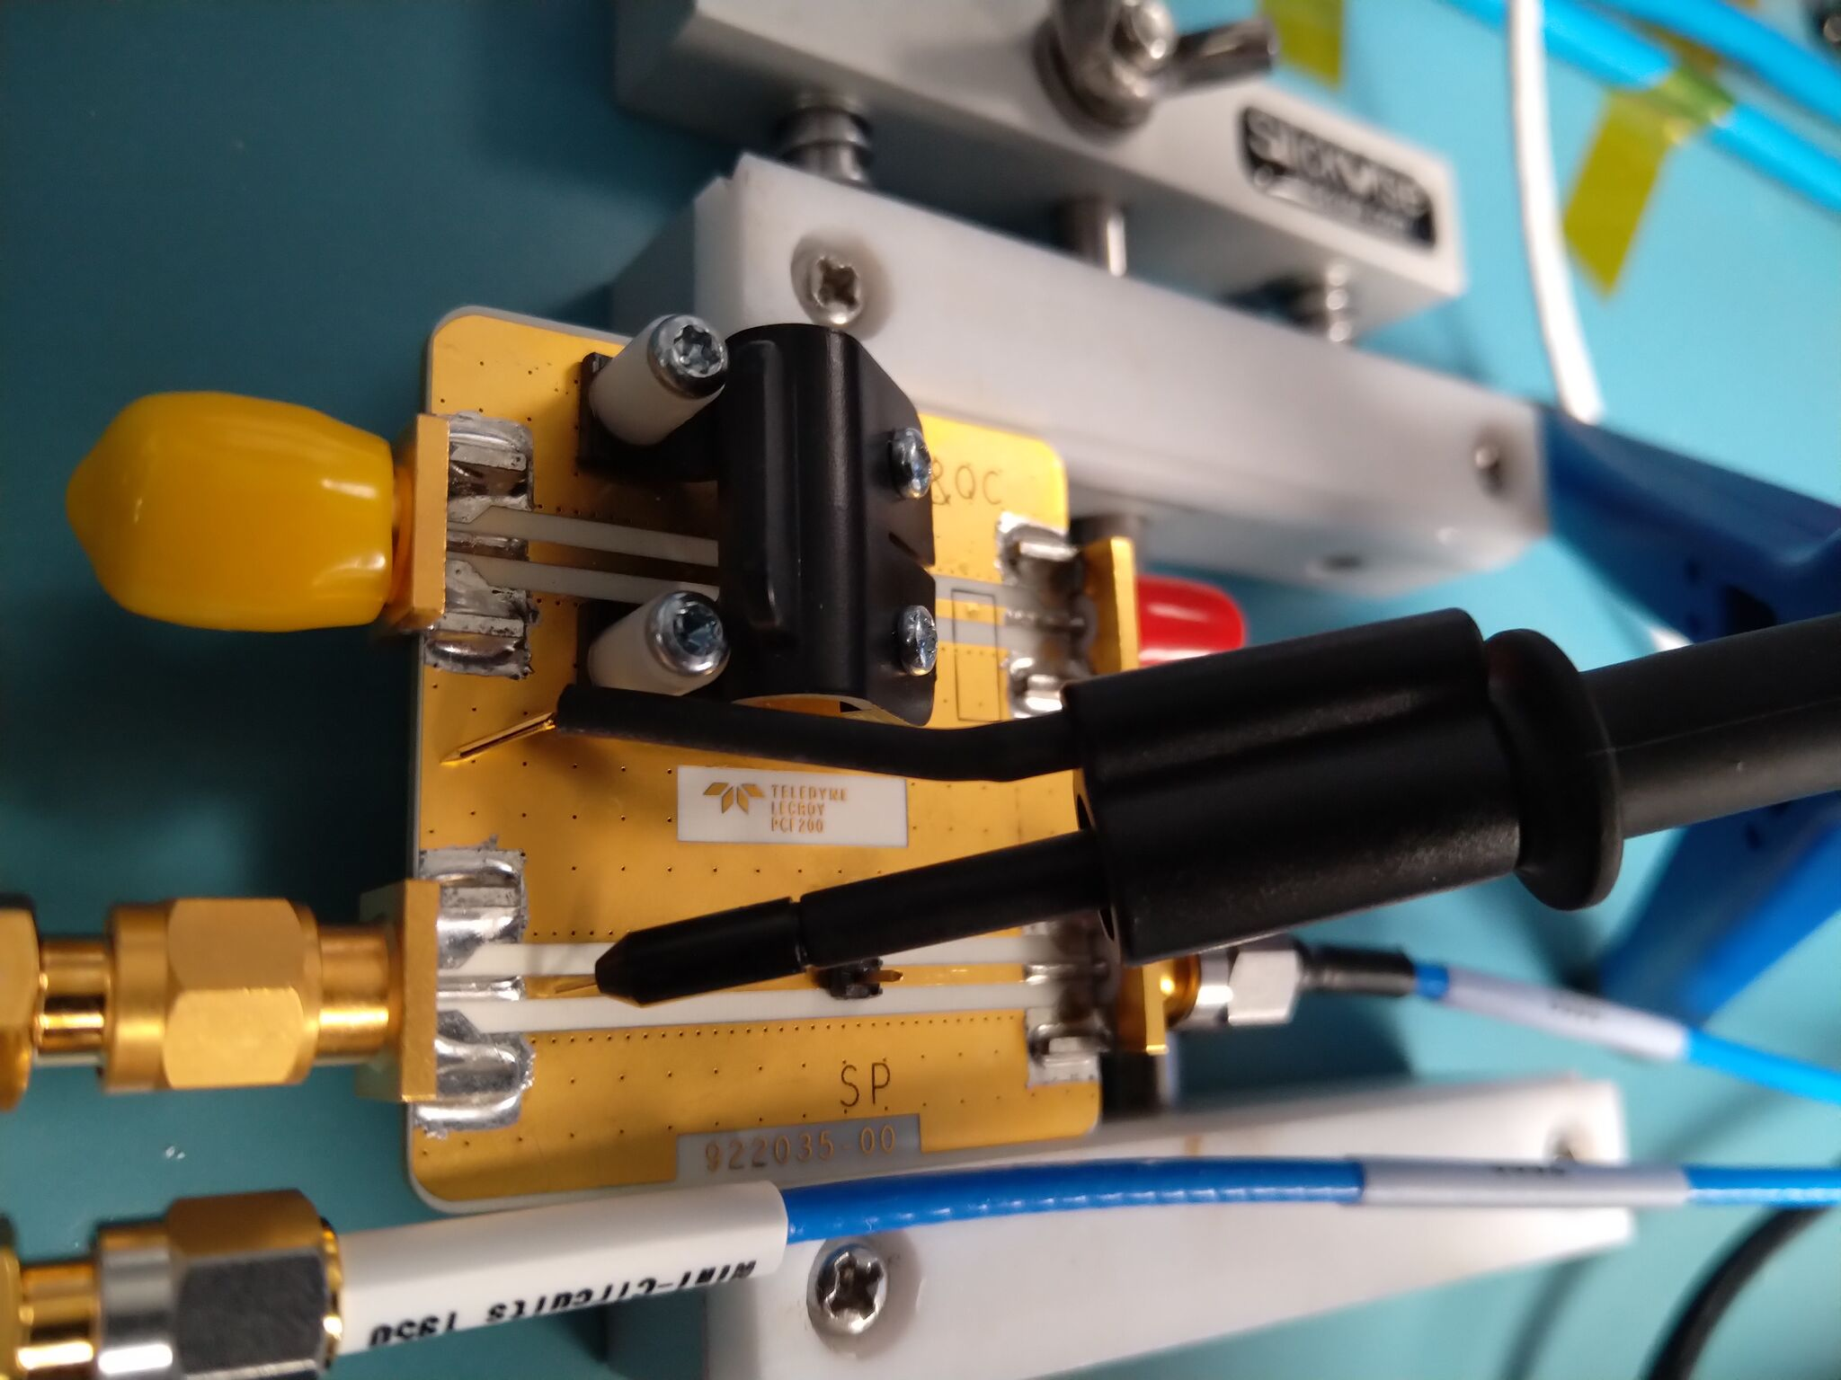
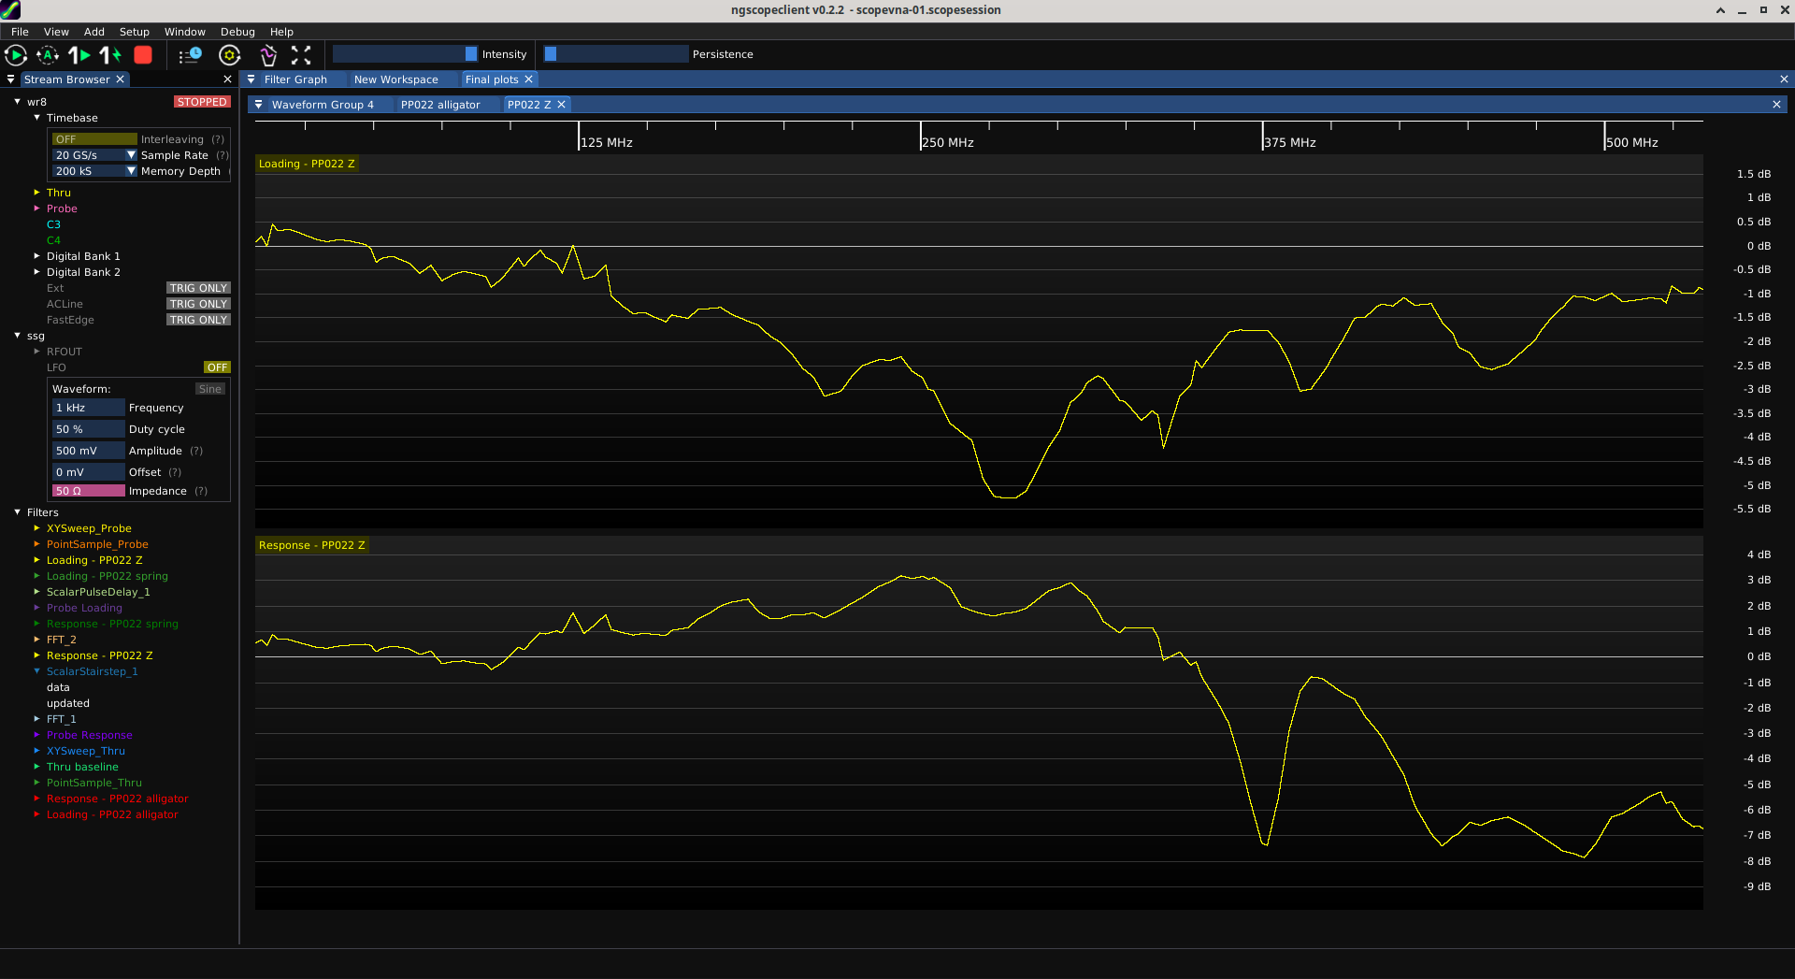
R-C Divider Probe: S21 w/ Z-Ground
-5.2 dB loading at 280 MHz
Signal reduced to 55%
of original amplitude
+/- 1 dB to
125 MHz
-7 dB at
375 MHz
Teledyne LeCroy PP022
WaveRunner 8404M-MS
Z ground
+3.1 dB at
242 MHz

Slide 24
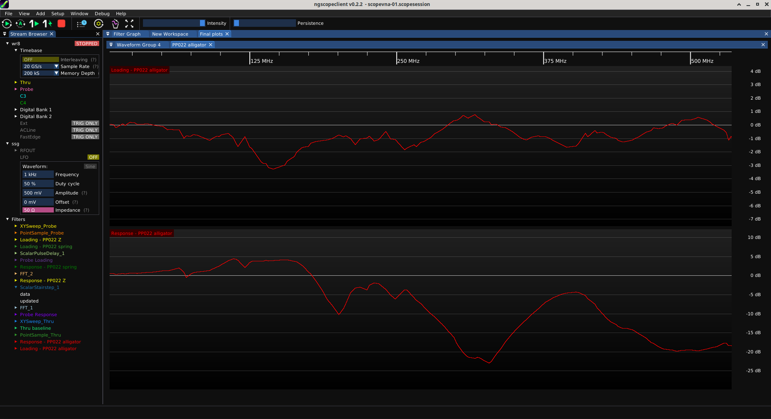
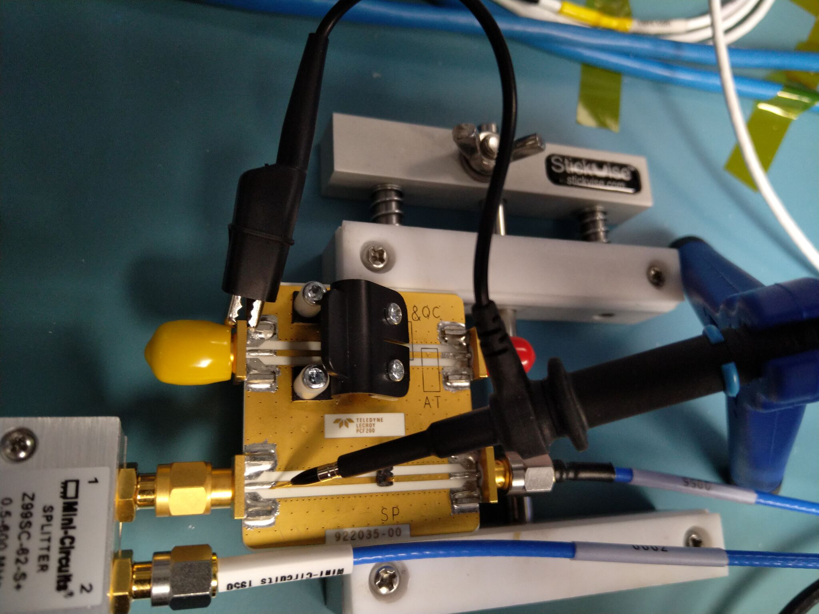
R-C Divider Probe: S21 w/ Alligator Ground
-3 dB loading at
144 MHz
+4.3 dB at 111 MHz
+64% amplitude error!
-10 dB at
200 MHz
-23 dB at
328 MHz
Teledyne LeCroy PP022
WaveRunner 8404M-MS
Alligator ground

Slide 25
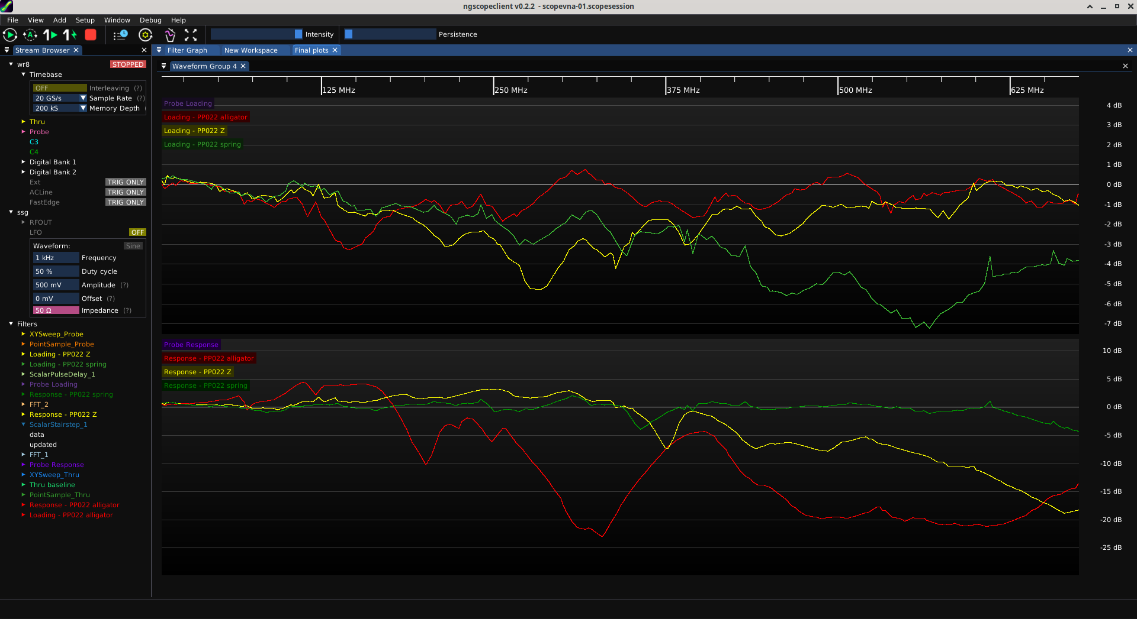
R-C Divider: All grounds
Spring
Z
Alligator

Slide 26
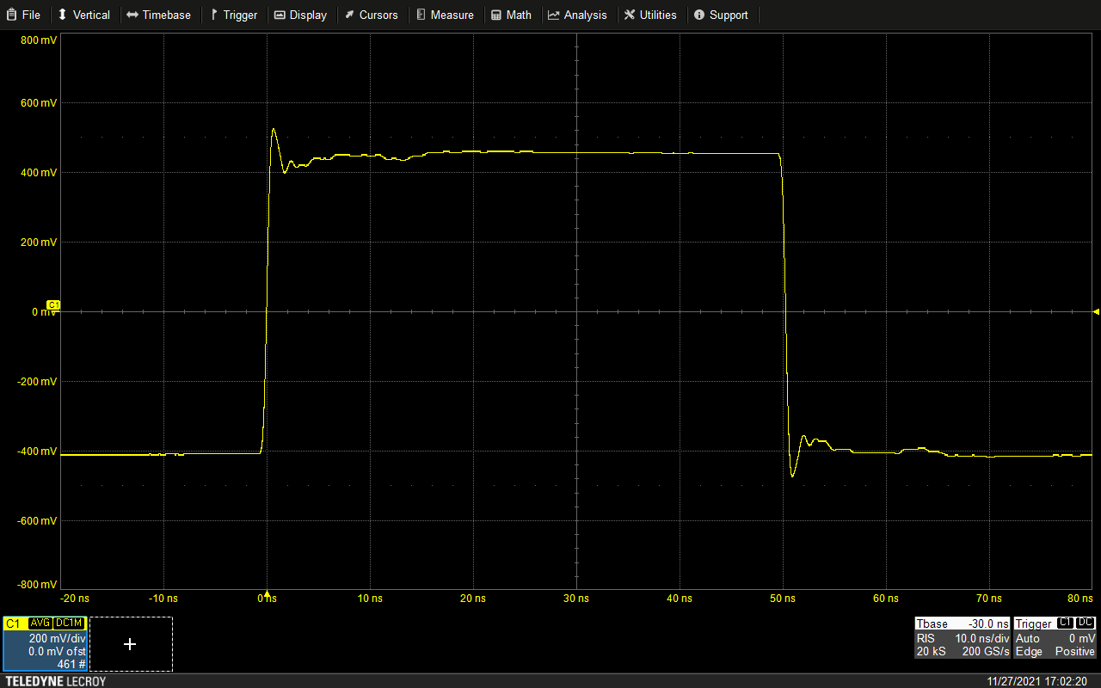
Step Response w/ Spring Ground
Reflection at 13 ns
(propagation delay of cable)
Lossy cable helps with this
but can’t entirely eliminate
L-C ringing
from ground

Slide 27
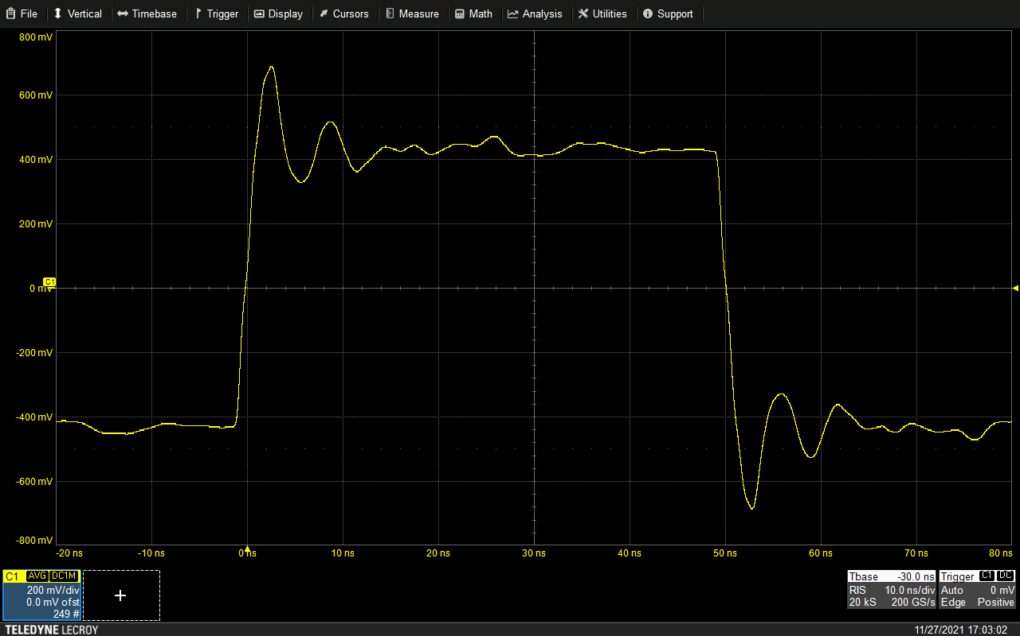
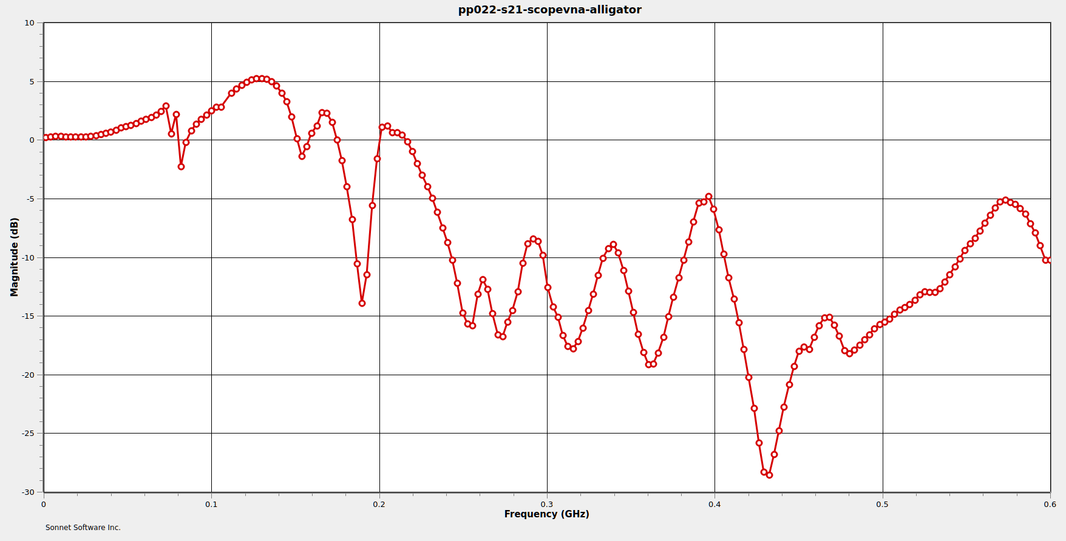
Step Response w/ Alligator Ground
~160 MHz ringing
L-C resonance
Ground lead L +
probe input C

Slide 28
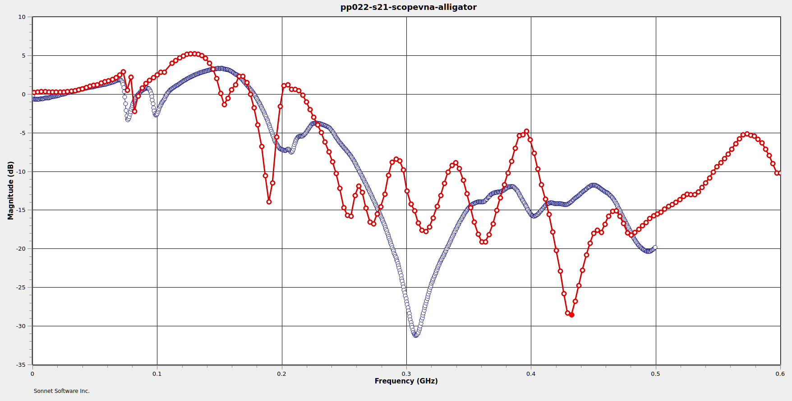
Cheap Vs Expensive Probe, Alligator Ground
Matrix IP1120
$10, “200 MHz”
34x difference in price
Similar response
$$ can’t fix bad ground
Teledyne LeCroy PP022
$345, “500 MHz”

Slide 29
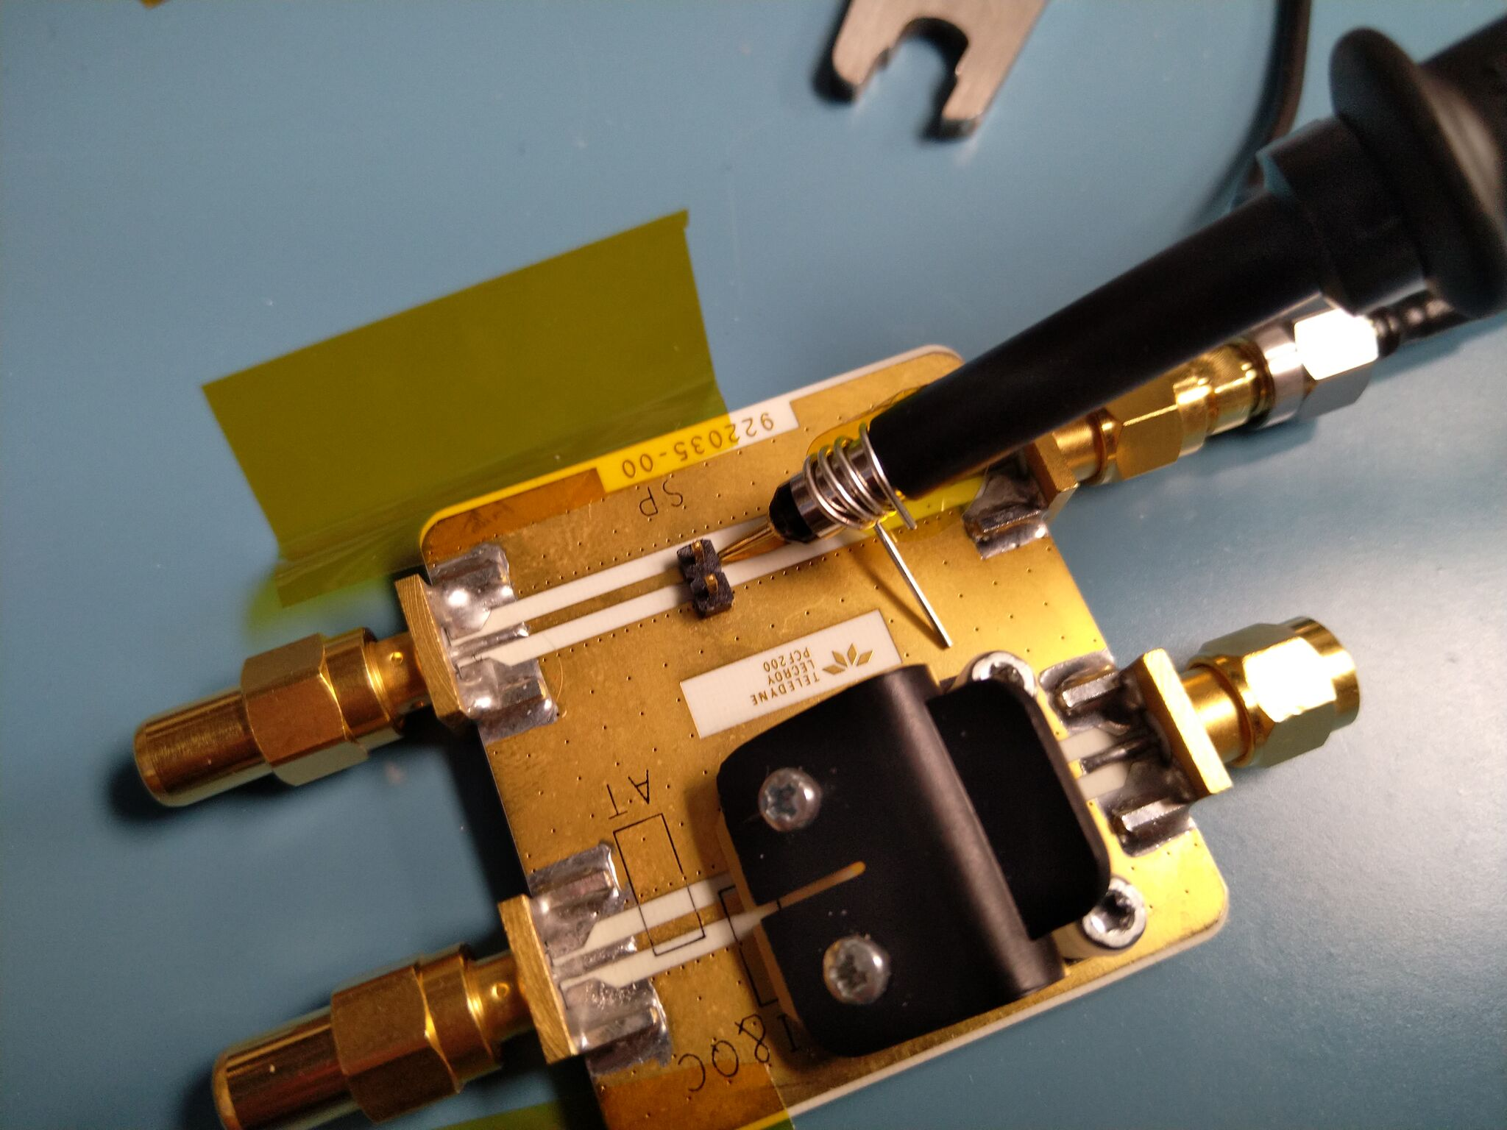
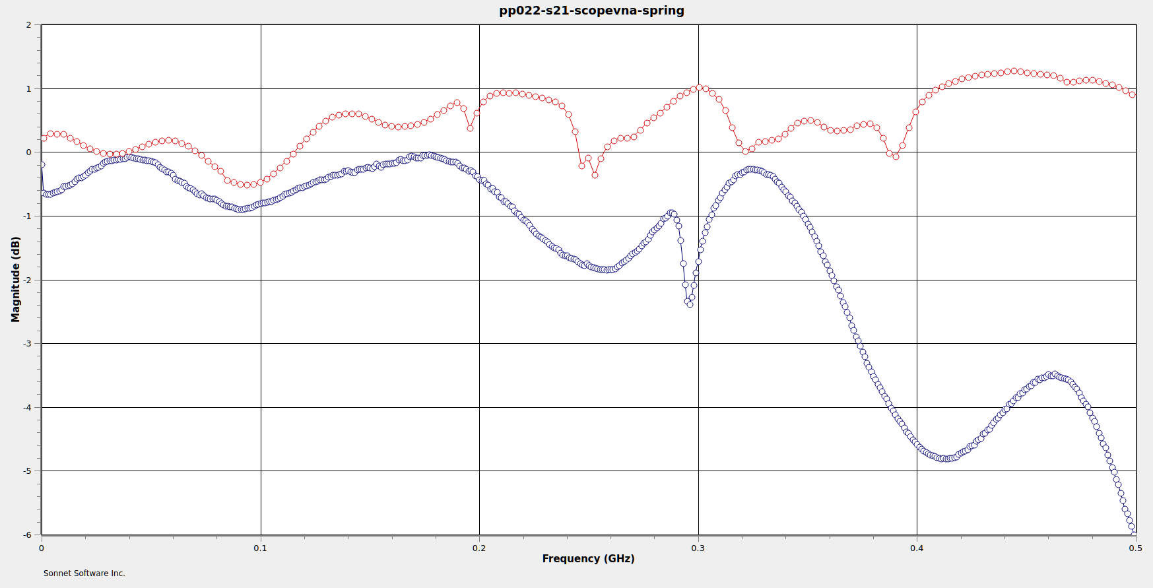
Cheap Vs Expensive Probe, (DIY) Spring Ground
Teledyne LeCroy PP022
$345, “500 MHz”
Matrix IP1120
$10, “200 MHz”
375 MHz BW
Beats 200 MHz spec!

Slide 30
So what did that $335 buy you?
Flatter… but only if you use spring ground
Better ergonomics
More accessories
More compensation adjustments
Gain autodetection resistor
No need to DIY a spring ground
Worth it? Depends on your needs and budget

Slide 31
R-C Divider Probe: Strengths
Very low resistive loading at DC
Low cost
  Low to mid 3 digits USD for a nice one
  Cheap ones down to single digits
Hard to damage with overload/ESD
Generic design, no vendor lock-in

Slide 32
R-C Divider Probe: Weaknesses
High input capacitance
  Heavy loading on DUT
  Extremely sensitive to L in ground path
  Running in 1x mode makes this waaaay worse (~95 pF)!
Requires compensation adjustment
High attenuation (typically 10:1)
  Not great for really weak signals
  Worse SNR due to higher frontend gain

Slide 33
R-C Divider Probe: When to use
Highish voltage, low frequency analog
  (As used in vacuum tube systems!)
  Most active probes don’t go past 5-10V
  Resistive probes have similar limits
Beginners you don’t trust with $$$ gear
If you have nothing better

Slide 34
Questions?

Slide 35
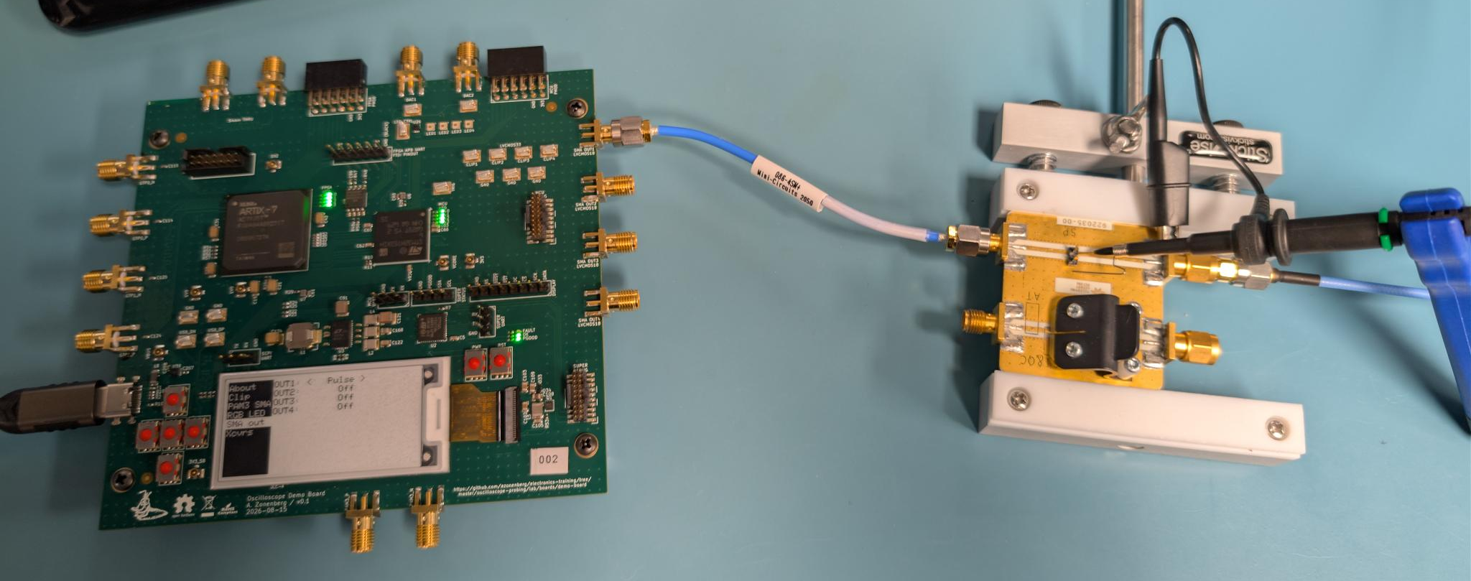
LAB OPTION A: Demo board + scope
Thru path
To scope
Pulse out
on SMA1

Slide 36
Scope setup
1M passive probe on one channel
Thru path to another channel
Adjust X/Y settings as needed

Slide 37
Baseline
Grab memory trace of thru signal (w/ no probe)
Ideally:
  Probe will see exactly the same waveform
  Thru path signal won’t change when we probe it

Slide 38
Experiment
Try different ground accessories
Compare loading and thru path response

Slide 39
LAB OPTION B: Antikernel Labs facility

Slide 40
Lab 1: R-C Divider Probes
Oscilloscope
  Teledyne LeCroy WaveRunner 8404M-MS
Probe
  Teledyne LeCroy PP022
Signal sources
  Siglent SSG5060X-V
  Leo Bodnar fast edge generator

Slide 41
Lab 1A: Compensate probes
Mess up compensation trimmers
LF compensation (1 kHz squarewave)
  Single trimmer
HF compensation (1 MHz squarewave)
  BNC side trimmer first, then cable side trimmer

Slide 42
Lab 1B: Compare step response of grounds
10 MHz squarewave w/ sharp rising edge
Probe with different ground accessories
  Compare waveform shapes
  Note magnitude and frequency of ringing

Slide 43
Lab 1C: Compare frequency response
Sine stimulus at 129, 189, 275, 432 MHz
Probe with different ground accessories
  Compare measured amplitude with each
  Direct coaxial input for reference

Slide 44
Lab 1D: Time domain probe loading
10 MHz sharp squarewave
Compare thru path performance
  No probe
  Each ground accessory

Slide 45
Lab 1E: Frequency domain probe loading
Tones at 50, 323, 465 MHz
Use spring ground only
Compare thru path performance
  No probe
  Each ground accessory

