Slide 1
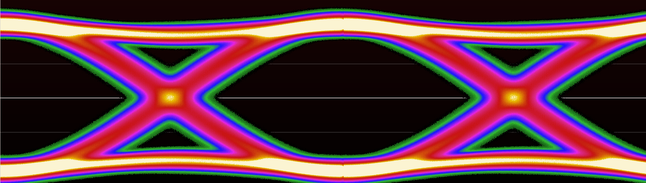
Oscilloscope Probing
Andrew D. Zonenberg, Ph. D

Slide 2
Introduction

Slide 3
Today’s Class
Lecture mixed with hands-on lab
Stop me at any time with questions
Bathroom / emergency procedures
Slides are on my GitHub (CC BY-SA 4.0)
  https://github.com/azonenberg/electronics-training/tree/master/oscilloscope-probing

Slide 4
Learning Goals
Pros and cons of various probe designs
How to select the best probe for a measurement
  Not always the most expensive!
How to get the most out of each probe
Understand non-idealities of real world probes

Slide 5
Lecture Outline
Introduction
What is a probe?
Types of probes
  R-C divider probes
  Resistive probes
  Active voltage probes
  Active differential probes
  Power rail probes
  Nearfield loop probes
  Current probes
  High voltage probes

Slide 6
About Me
Ph.D Computer Science (RPI 2015)
Embedded systems security by day
High speed digital and F/OSS T&M by night
Founder and lead developer of ngscopeclient

Slide 7
Disclaimer re Example Hardware
Not an endorsement or criticism
  I’m mostly a Teledyne LeCroy and Pico shop
  Most probes shown in the slides are made by them
  This just means I have their products handy
  Analysis of data should not be taken as a recommendation to buy or not
Product names are trademarks of owners

Slide 8
Disclaimer re Example Hardware
Pricing discussed for rough comparison only
  May not be current
  Intended to illustrate broad $$/performance ratios

Slide 9
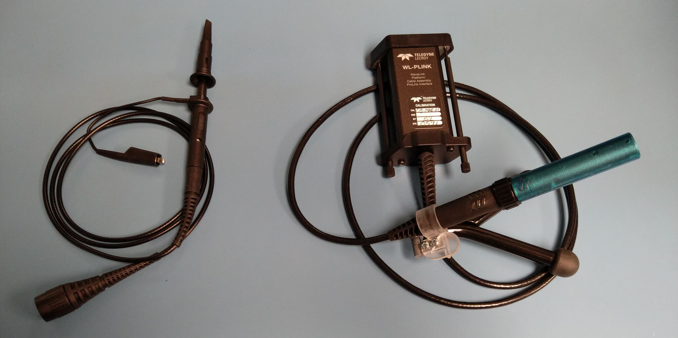
Why Use One Probe Over Another?
Matrix IP1120
200 MHz
$10 on Amazon
Teledyne LeCroy D1330
13 GHz
Over $10000

Slide 10
What is a Probe?
Both electrical and mechanical components
Takes signal from board and puts into instrument

Slide 11
The Ideal Probe
No influence on DUT behavior
No noise
No loss
Low cost
Unlimited frequency / voltage range
Doesn’t exist!
  All real probes are compromises

Slide 12
Attributes of a Probe
What distinguishes one probe from another?
Let’s think of as many as we can

Slide 13
Attributes of a Probe
Bandwidth
Attenuation
Noise
Flatness
Loading
Voltage range
Linearity
Cost
Durability
Ergonomics

Slide 14
Crash Course in S-Parameters
We have a circuit with N ports
  Typical probes are 2-port networks
RF energy is applied to one port
Some signal comes out each port
  Outputs / reflections have amplitude and phase shift
Model this as a NxN “scattering matrix”

Slide 15
Crash Course in S-Parameters
Notation: Sxy is path to X from Y
S21
Port 1
DUT
Port 2
S11
S22
S12

Slide 16
Crash Course in S-Parameters
Each S-matrix element is a complex number
  Real and imaginary
  Or (often easier to think about) magnitude and phase angle
Value is frequency dependent
Nonlinear effects can create harmonics
  S-parameters only model linear behavior
  X-Parameters etc for modeling nonlinearities exist.
  This is beyond the scope of today’s discussion.

Slide 17
Crash Course in S-Parameters
Typically measured with a VNA
  Can also simulate, etc
Port numbering is arbitrary
  For examples in today’s class, convention is:
  1 = DUT end
  2 = scope end
  S11 = power reflected to DUT
  S21 = power seen by scope

Slide 18
Time-Domain Reflectometry (TDR)
Conceptually 1D radar
Send impulse or step down transmission line
Look at what comes back
  Positive reflection = impedance increase
  Negative reflection = impedance decrease
Probe loading shows as a dip
  Probe is in parallel with DUT
  Can’t increase impedance, only decrease (but can time-shift)

Slide 19
Don’t have a TDR? Build one!
Fast pulse generator
  Leo Bodnar, $75
Wide band directional coupler
  0.5 - 18 GHz units listed for $65-$250 on ebay
  Way cheaper than buying new ($1.8K for similar specs)
Your fastest scope
We’ll do this in the lab

Slide 20
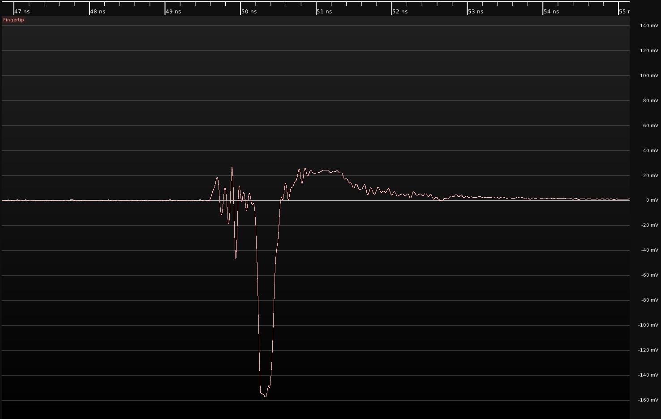
TDR for probe characterization
Compare fixture response with / without probe
Observe width/depth of dip
  Smaller dip is better!
  Good gut feeling for
  broadband response
  More intuitive IMO than
  looking at S11 vs freq

Slide 21
Direct Coaxial Connection

Slide 22
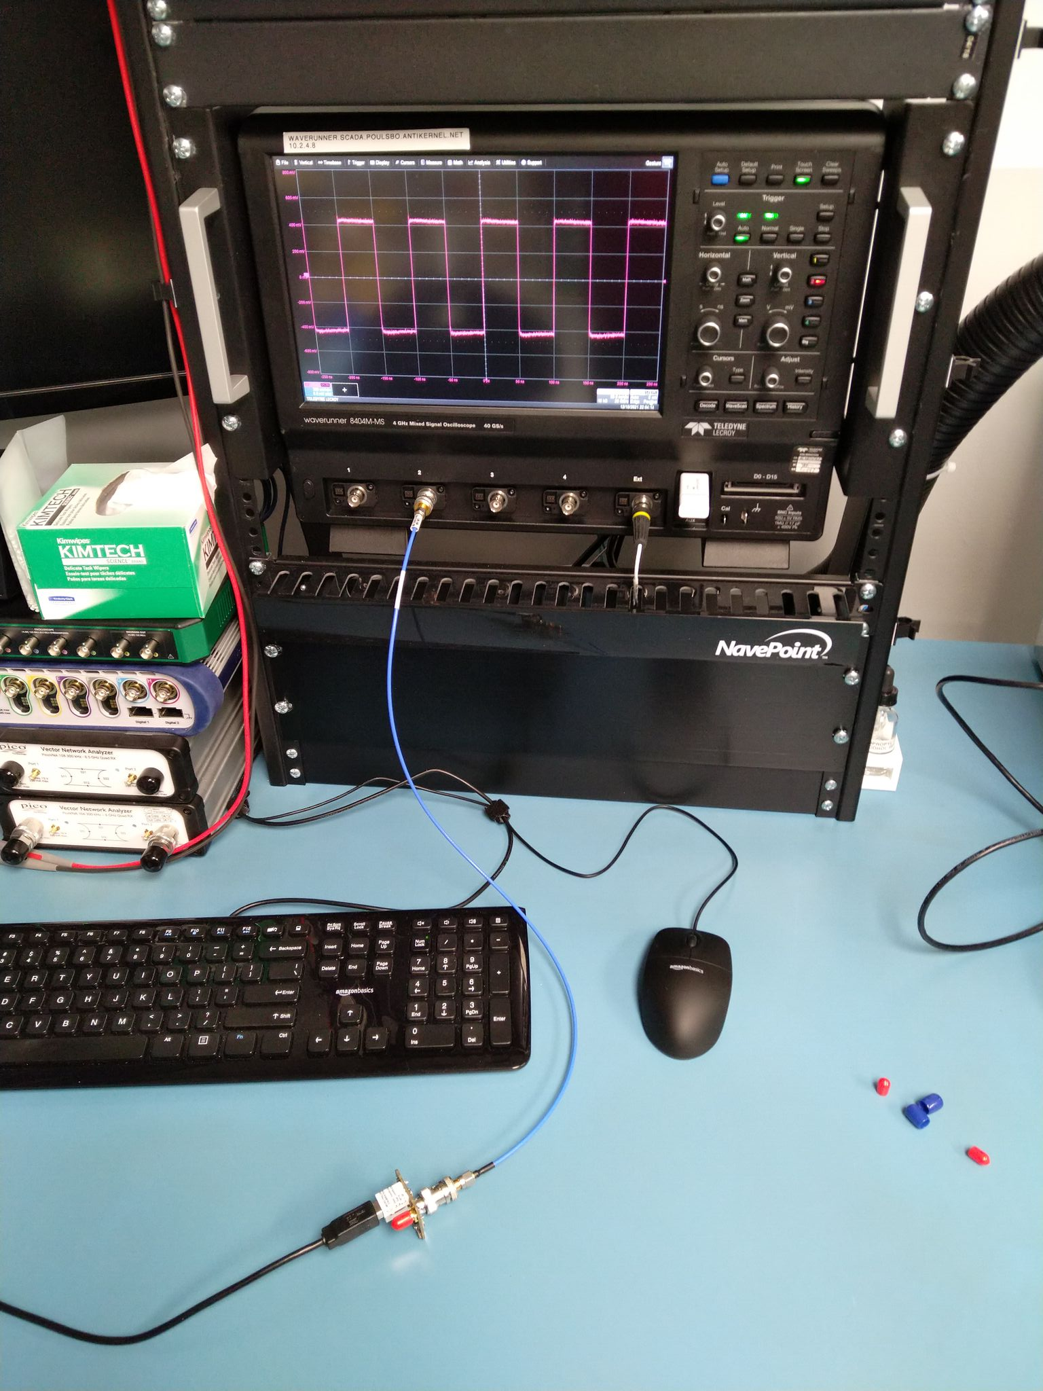
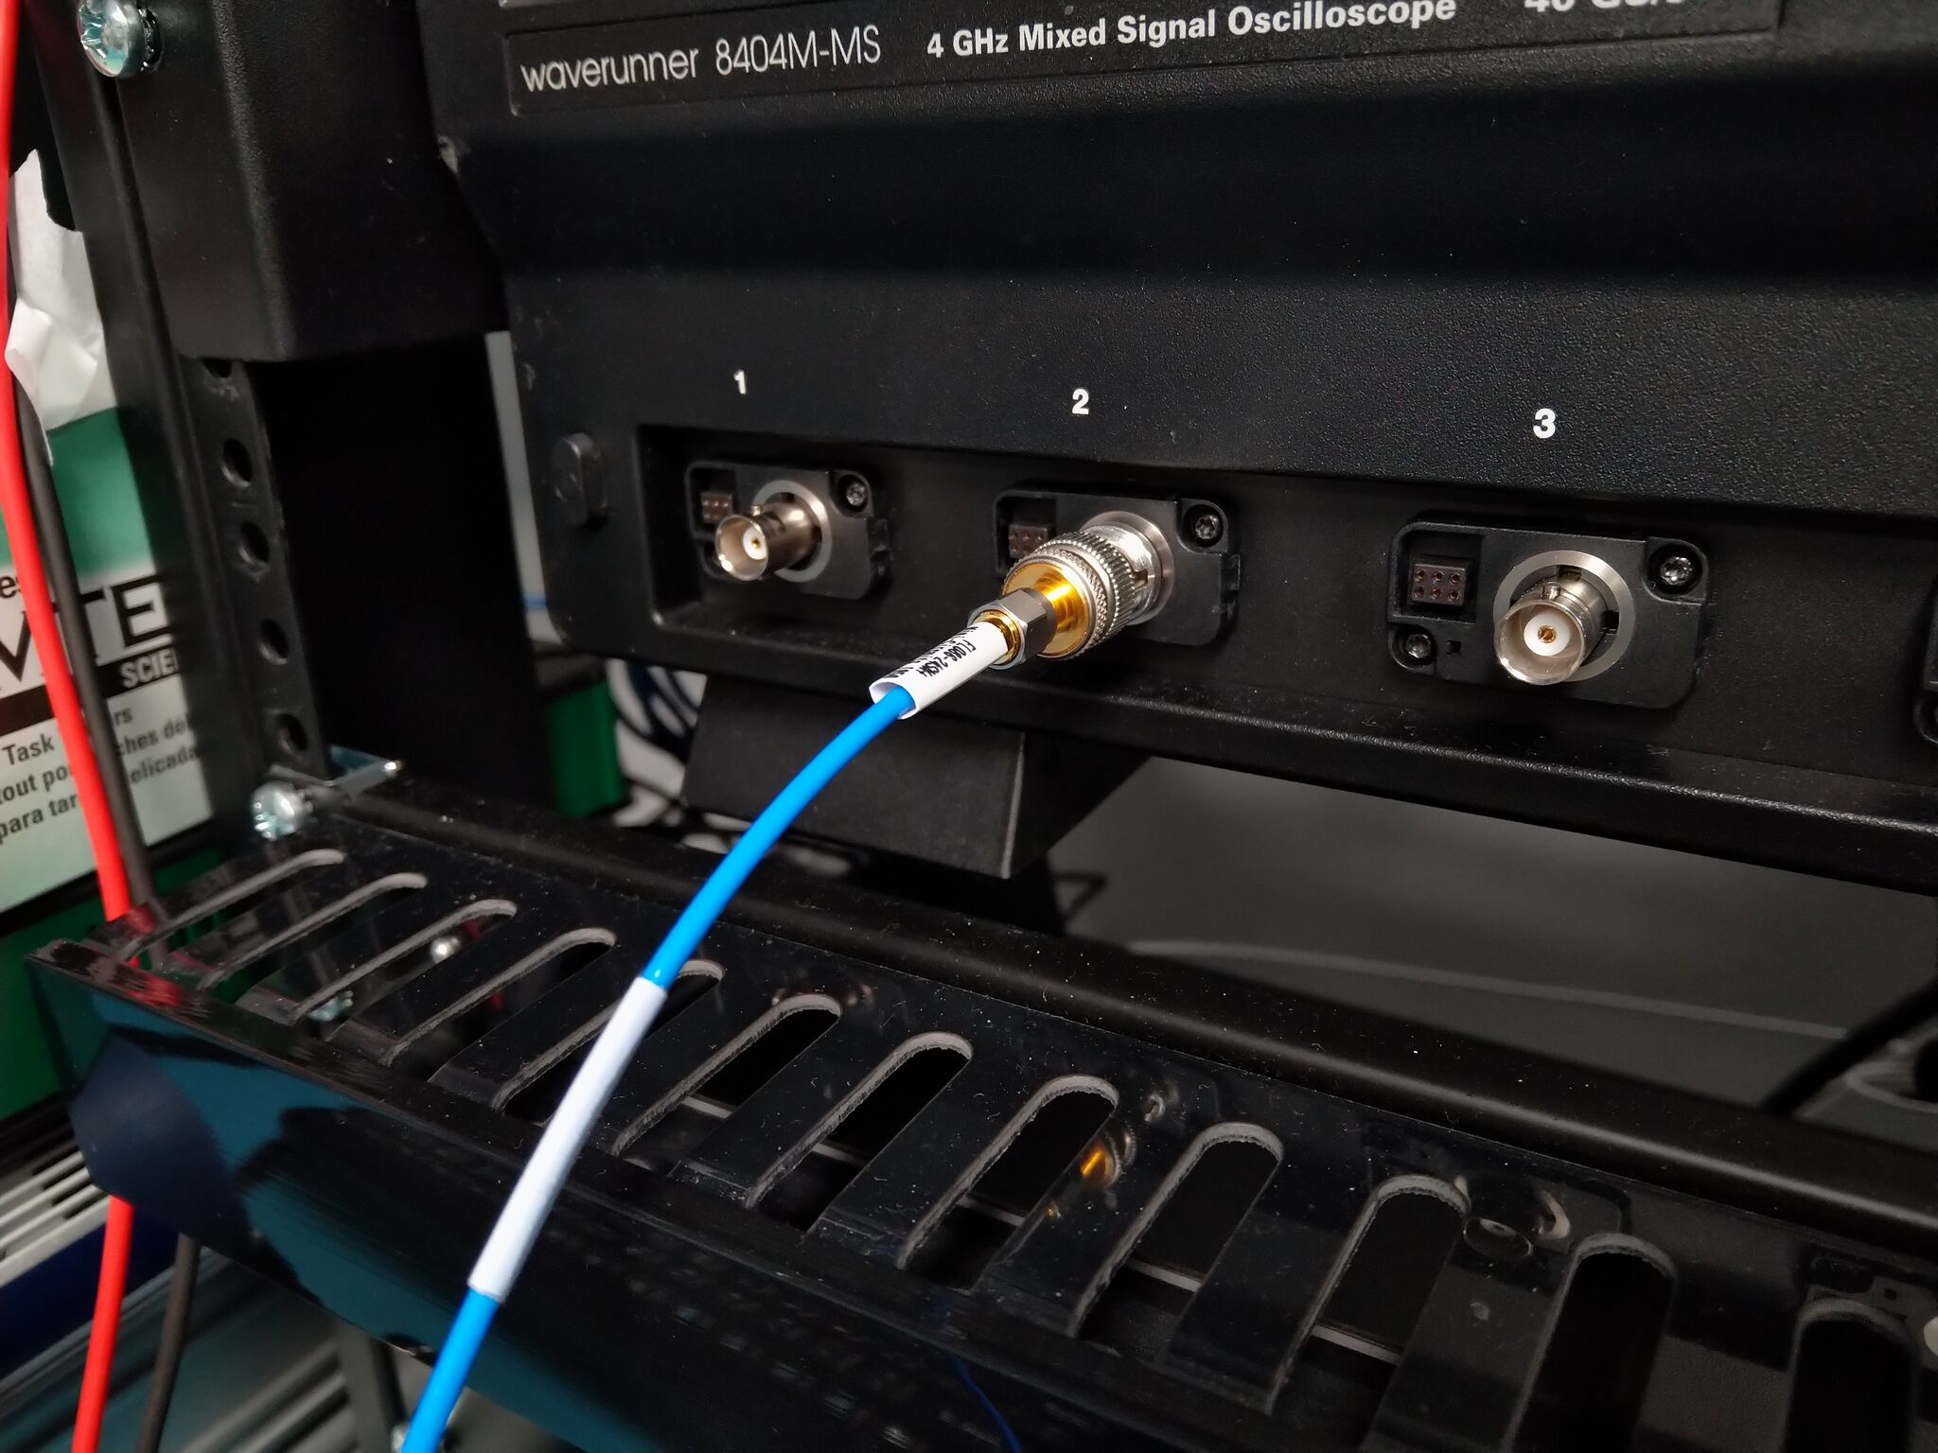
When Is A Probe Not A Probe?
When it’s just a cable!

Slide 23
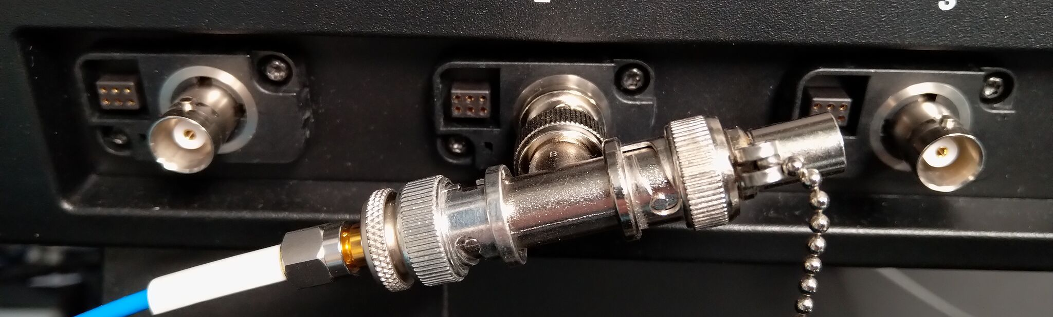
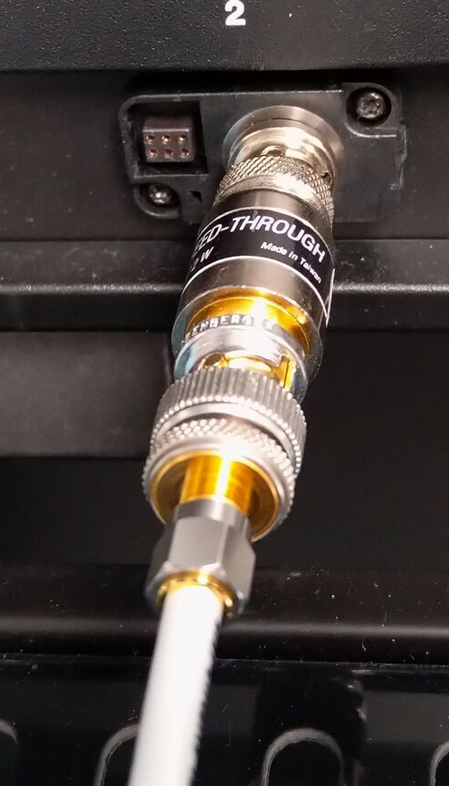
External 50Ω Termination
Lower end scopes lack native 50Ω terminations
Can use in-line or T terminations at lower freqs

Slide 24
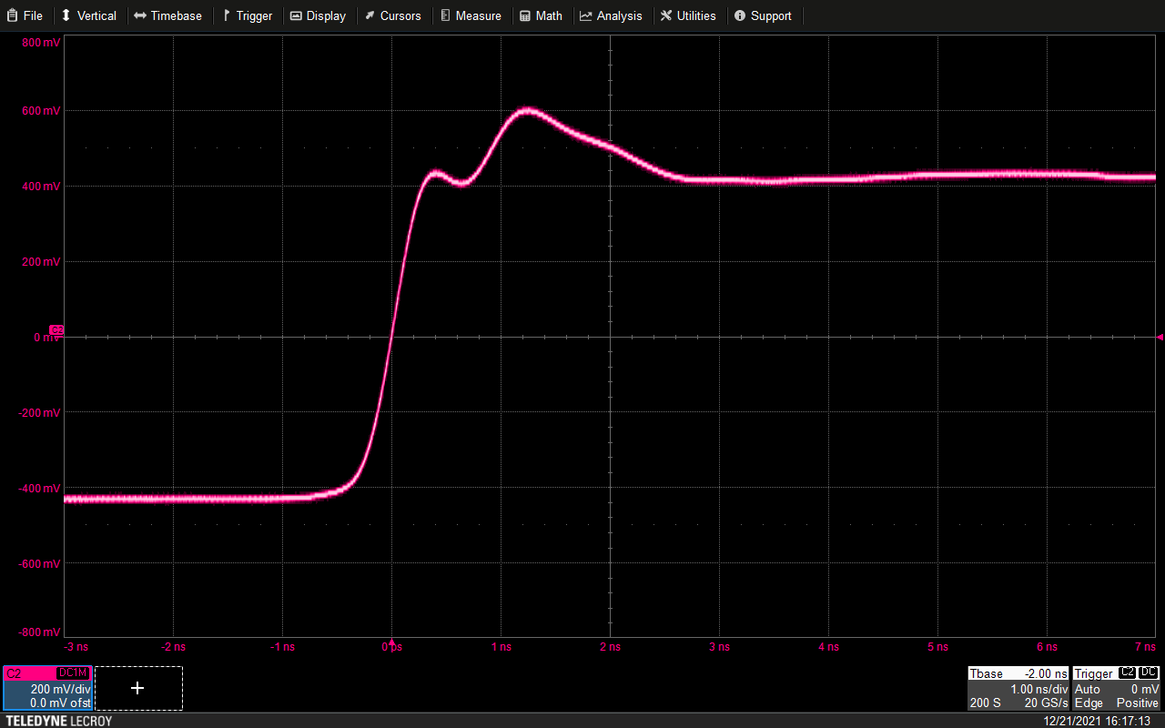
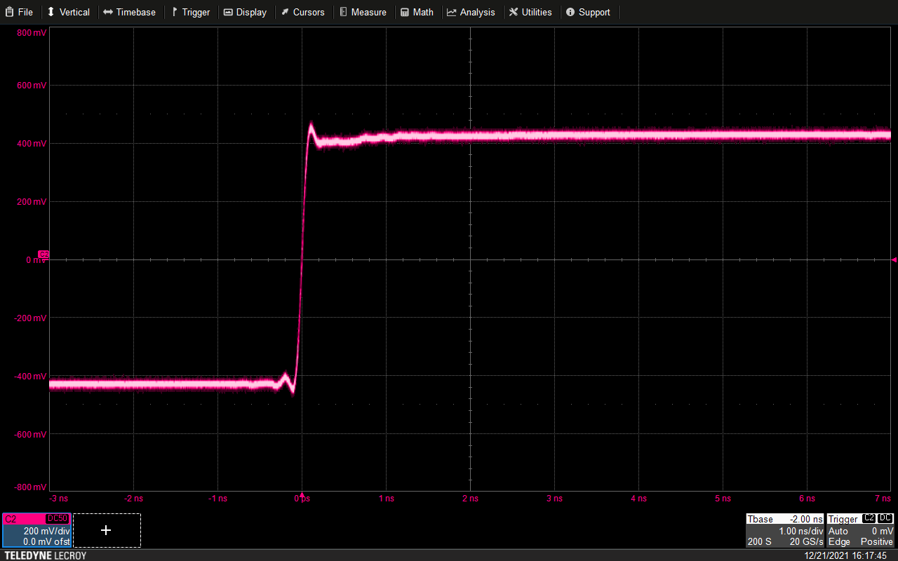
In-Line Terminator vs Native 50Ω Input
Reflection off stub between
terminator and scope frontend
Matched input
No reflection
Note rise time difference:
This scope is 4 GHz BW in 50Ω mode, 500 MHz in 1MΩ mode

Slide 25
Direct Coaxial Connection: Advantages
Lowest possible noise
  No external amplifiers
  No attenuation so need less frontend gain
Low cost – no expensive probe needed
Flattest possible response
  Only source of error is cable loss
  Can de-embed this if cable is characterized

Slide 26
Direct Coaxial Connection: Disadvantages
Requires 50Ω scope input
  Inline termination works OK at lower freqs
  Reflection issues at higher speeds
High loading on DUT
  Probe presents a 50Ω load
Limited range
  Most 50Ω scope inputs are ±5V max range
  Many higher BW inputs are even less (±2V is common)

Slide 27
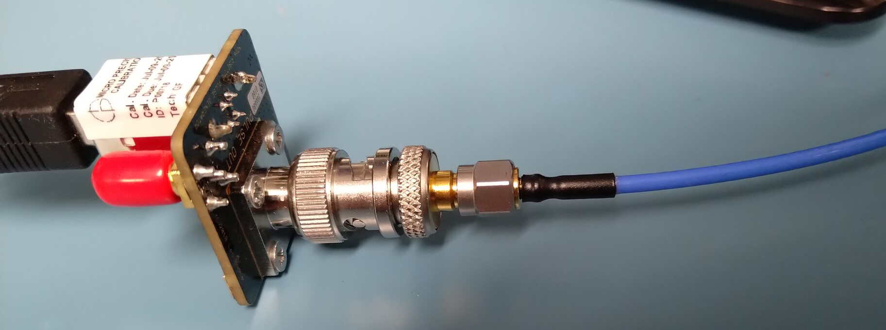
Direct Coaxial Connection: When to Use
If your DUT already has coaxial test points
Measuring end of unterminated 50Ω line
  Empty DIMM or PCIe socket
  Card edge connector
  Unpopulated footprint
Ideal reference signal to compare probe against
  It’s hard to get flatter response than a short cable

Slide 28
Questions?

Slide 29
No lab for this section
Break if needed, then resume

