Slide 1
High Impedance Active Probes

Slide 2
High-Z Active Probe
FET amplifier in probe head
Typically fixed HW gain
  Some (not all) provide offset capability
High DC input resistance (MΩ range)
Tiny input C (usually sub pF) vs passive R-C

Slide 3
High-Z Active Probe
Most are made by scope vendors
  Proprietary interface, not portable across makes
Some third party ones exist
  Tetris by PMK (1 to 4 GHz models)
  External power supply, 50Ω BNC to scope

Slide 4
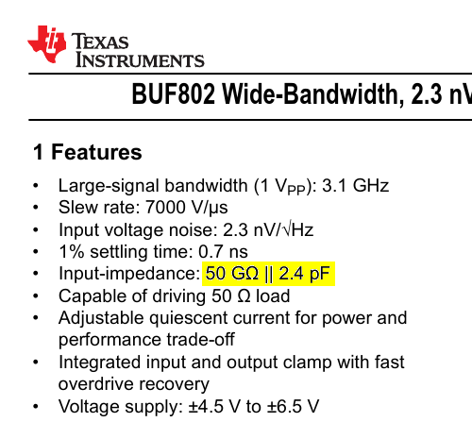
Why put an amplifier in the probe?
Typical scope input: 10MΩ || 17 pF
Compare to a modern JFET buffer IC
  Older probes usually used discretes
  Same general architecture

Slide 5
Not so fast...
50GΩ || 2.4 pF sounds great at first
  But that’s still more capacitance than we’d like
  And 50GΩ is overkill for almost all real world circuits

Slide 6
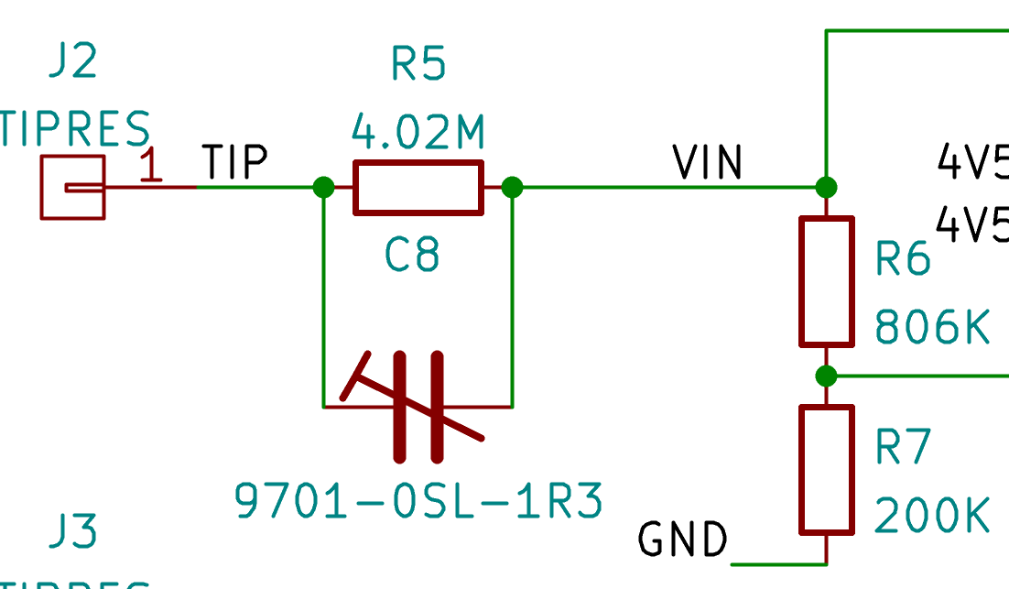
Can we hide some of this capacitance?
Capacitors in series divide
  But we still need a DC path :(
  What about a parallel R?
R || C between input and amplifier
~1MΩ termination R across amplifier input
Trim C for flat response

Slide 7
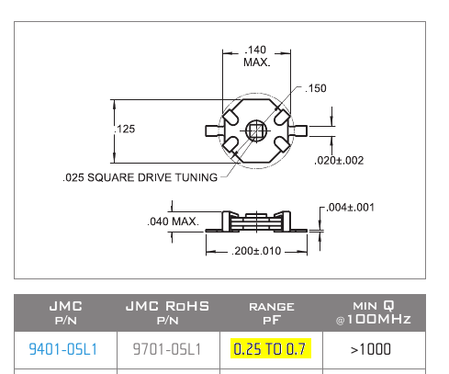
That looks familiar...
Yep, it’s our old friend the R-C divider probe!
But matched to 2.4 pF amplifier, not 17 pF scope
  This means we need much less series C
  AKL-AV1: 5MΩ || 350 fF equivalent

Slide 8
Other design considerations
High BW JFET amplifiers often come w/ large offset
May need to combine two
  High BW amplifier for AC path
  Precision amplifier for DC path
Distance from probe tip to amplifier
  Small damping resistor (100Ω) to reduce reflection

Slide 9
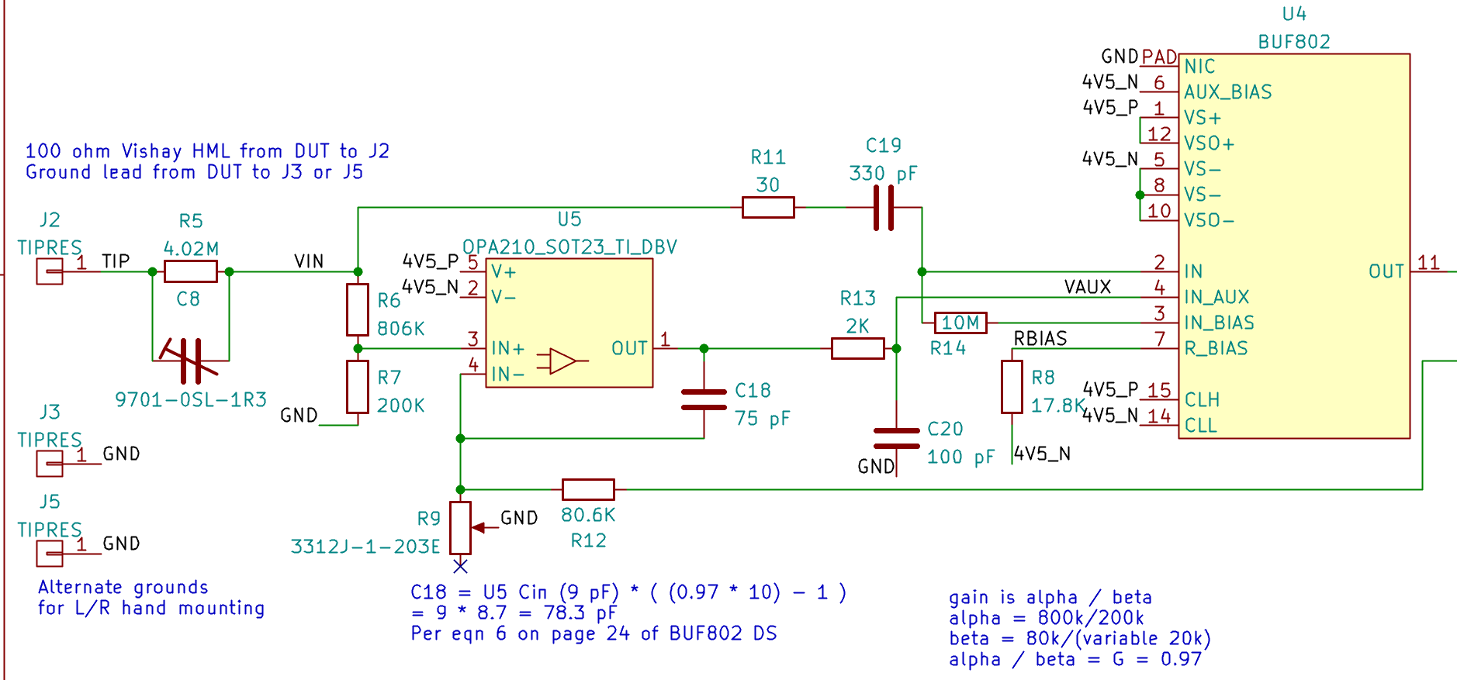
Putting it all together: AKL-AV1 schematic 1/2
AC path amplifier
DC path amplifier
R-C divider

Slide 10
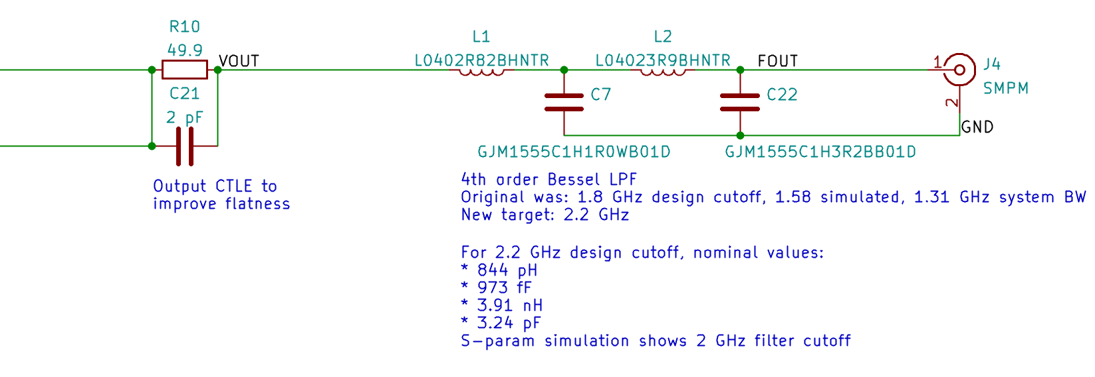
Putting it all together: AKL-AV1 schematic 2/2

Slide 11
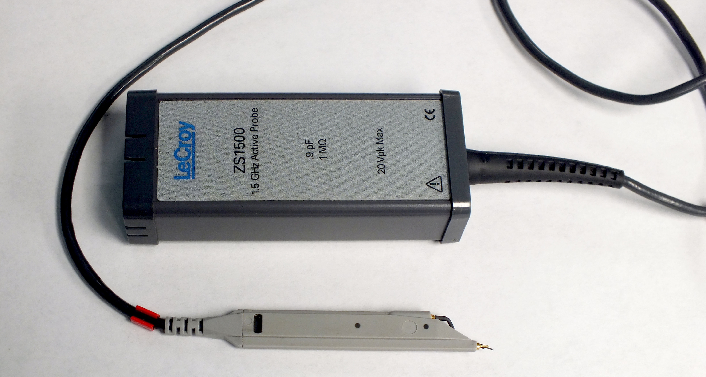
Teledyne LeCroy ZS1500
Probe head based on PMK Tetris 1500
  1.5 GHz, 1MΩ || 900 fF
ProBus control pod
  Adds ± 12V offset capability
  (PMK version has no offset DAC)

Slide 12
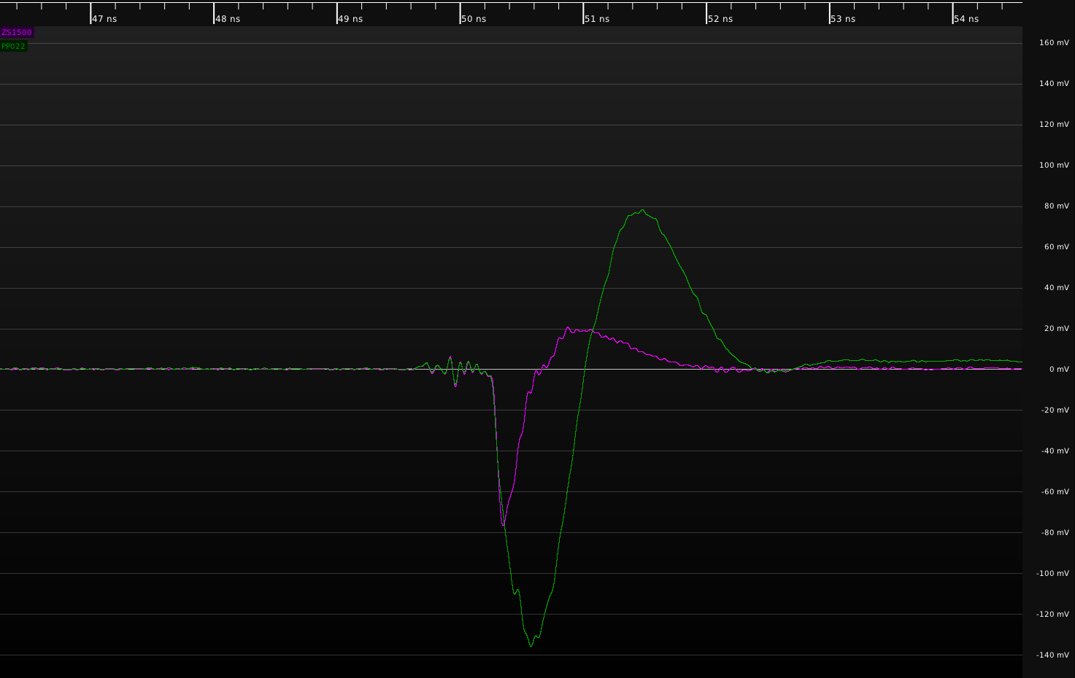
ZS1500 – TDR response vs R-C divider

Slide 13
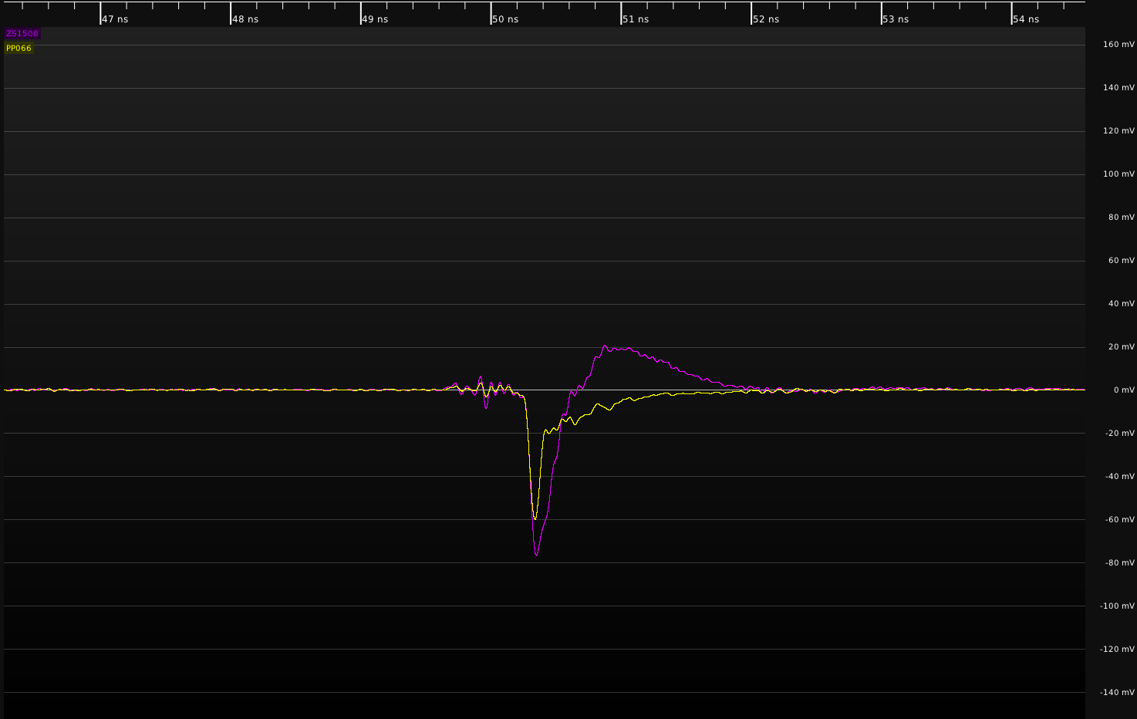
ZS1500 – TDR response vs resistive

Slide 14
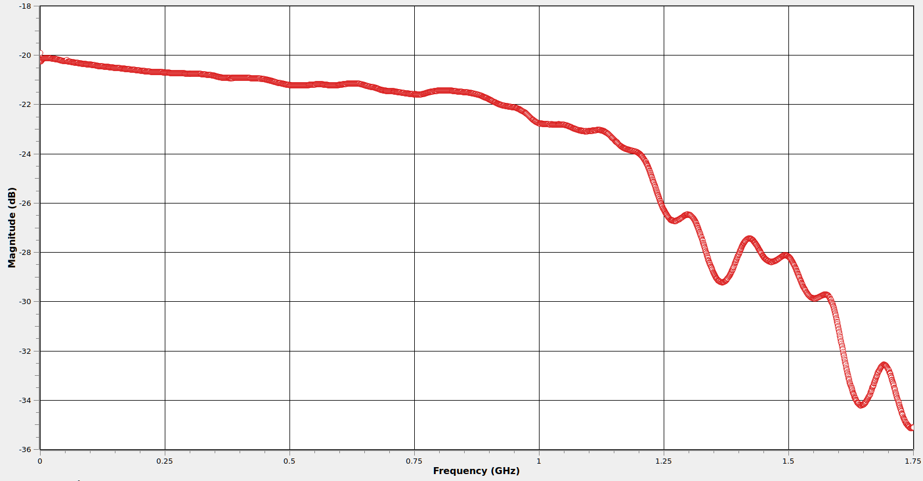
ZS1500 – S21 w/ Leaf Ground

Slide 15
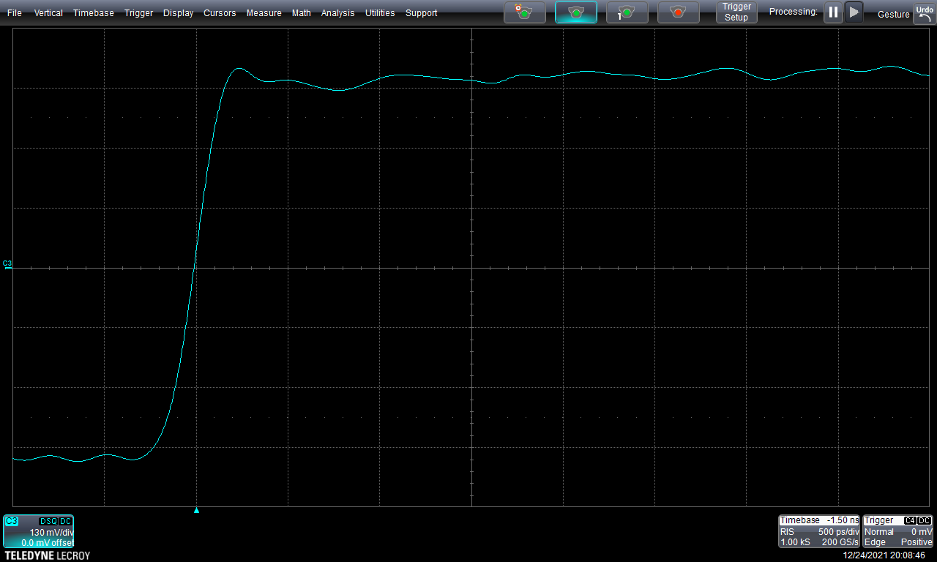
ZS1500 – Step Response w/ Leaf Ground

Slide 16

ZS1500: Step Response w/ 7cm Wire Ground
Worse performance due to higher L
But not actually too horrible

Slide 17
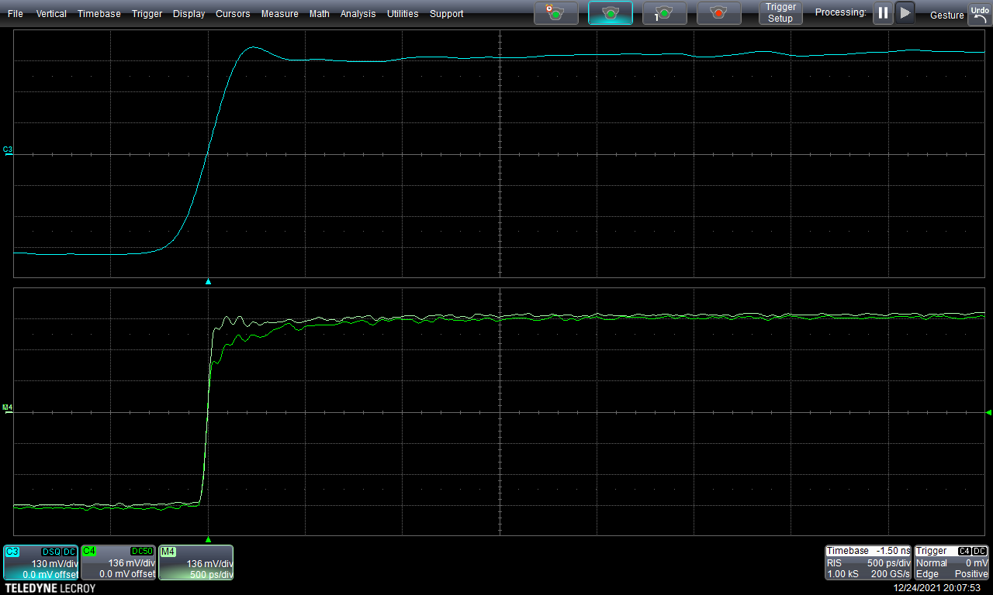
ZS1500: Time Domain Loading w/ Leaf Ground

Slide 18
High-Z Active Probe: Strengths
Lowest DC loading of any common probe
  Maintains high input Z much longer than R-C divider
Relatively low capacitance
  But can’t beat a high end resistive probe
Somewhat tolerant of poor grounding
  Resistive probes are usually competitive

Slide 19
High-Z Active Probe: Weaknesses
ESD sensitive
Expensive (low-mid 4 digits USD)
High attenuation (typically 10:1)
Small but non-negligible input capacitance

Slide 20
High-Z Active Probe: When to use
Loading-sensitive low to mid speed signals
  The ZS1500 is my probe of choice for crystal oscillators
Excellent general purpose embedded debug probe
  But you can buy 4+ resistive probes for cost of one FET probe!
  Don’t go out and buy a case of them unless you really need to

Slide 21
Questions?

Slide 22
LAB OPTION A: Demo board + scope
Same setup as the last two
Compare DC shift vs resistive probe
Compare loading on rising edge

Slide 23
LAB OPTION B: Antikernel Labs facility
Oscilloscope
  Teledyne LeCroy
  WaveRunner 8404M-MS
Probes
  ZS1500
  TA061
Signal sources
  Leo Bodnar pulse generator
  DS125DF111 PRBS board

Slide 24
Lab 3A: Resistive loading example
Probe I2C bus on PRBS board
Observe bus behavior w/ resistive vs active

Slide 25
Lab 3B: Capacitive loading example

