Slide 1
Nickel Wire Test Board Model For Andrew Zonenberg - Proprietary
Greg Kinnetz
Application Engineer
support@sonnetsoftware.com
November 1, 2022

Slide 2
Introduction

Slide 3
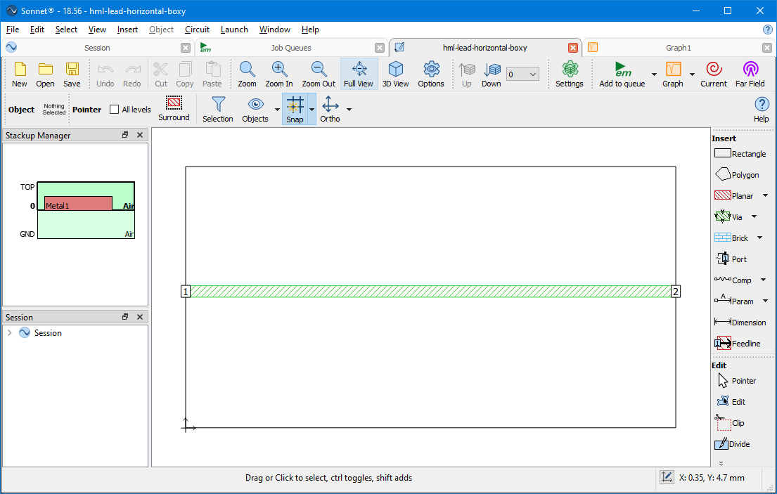
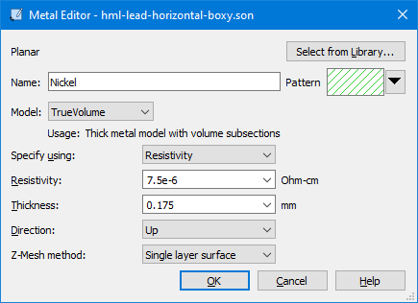
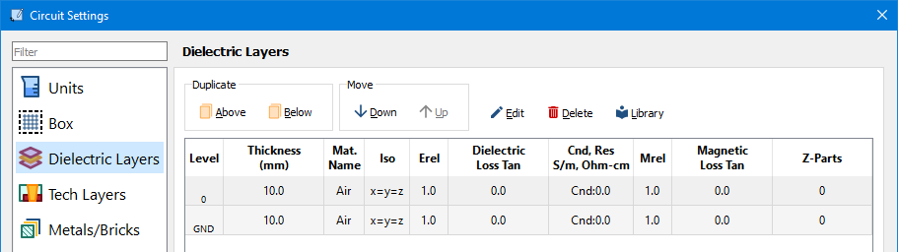
Initial Wire Model
The 0.188 mm diameter circular wire is modeled as a 0.175 mm wide trace.
A True Volume metal type, with 0.175 mm thickness, is used to represent the wire.
The wire is placed in 20 mm air dielectric.

Slide 4
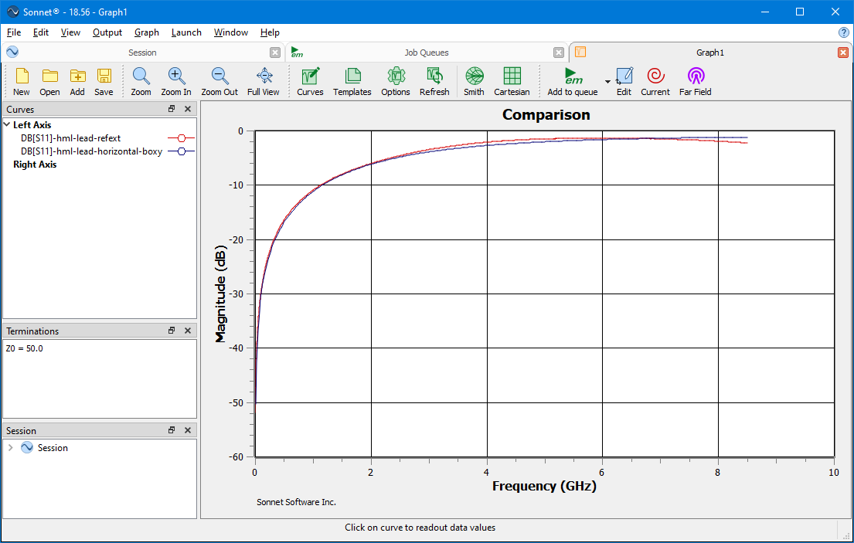
Initial Model vs Measured Comparison
The dB[S11] curves are relatively similar, whether measured or modeled.

Slide 5
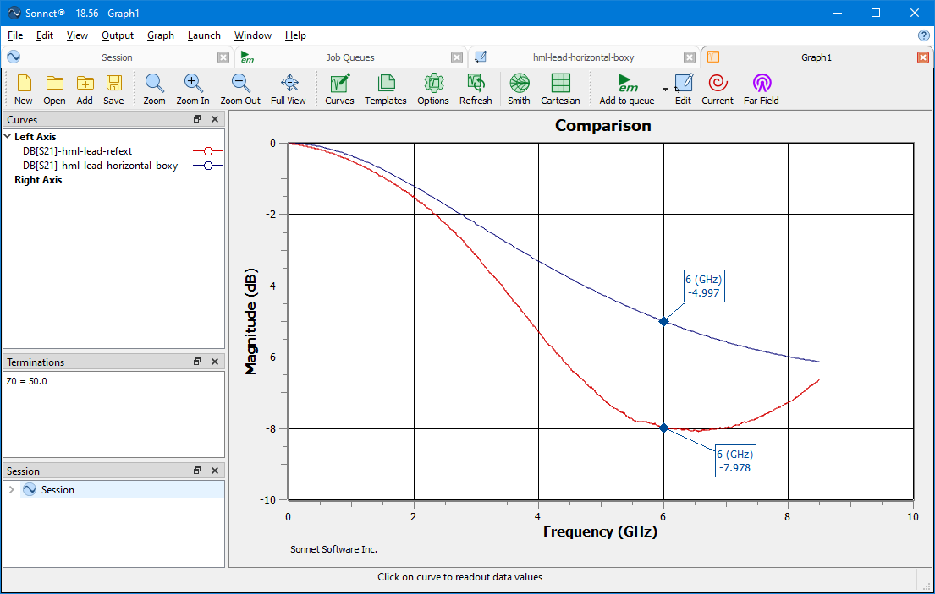
Initial Model vs Measured Comparison
There is a significant difference in the insertion loss above 2 GHz. The maximum difference reaches approximately 3 dB at 6 GHz.

Slide 6
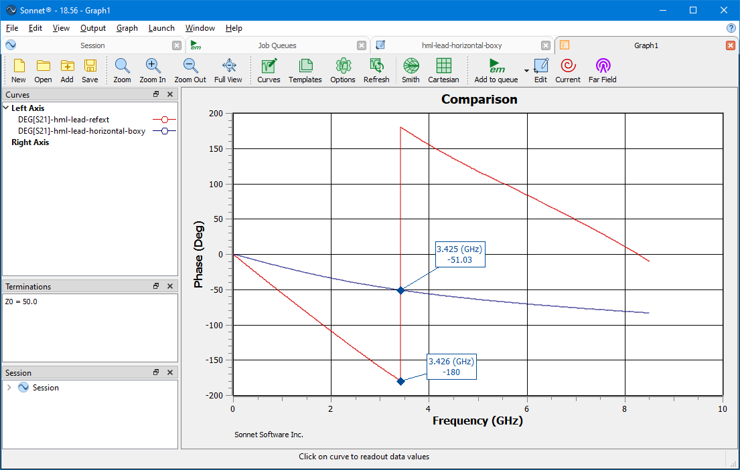
Initial Model vs Measured Comparison
There is a large difference in insertion phase.

Slide 7
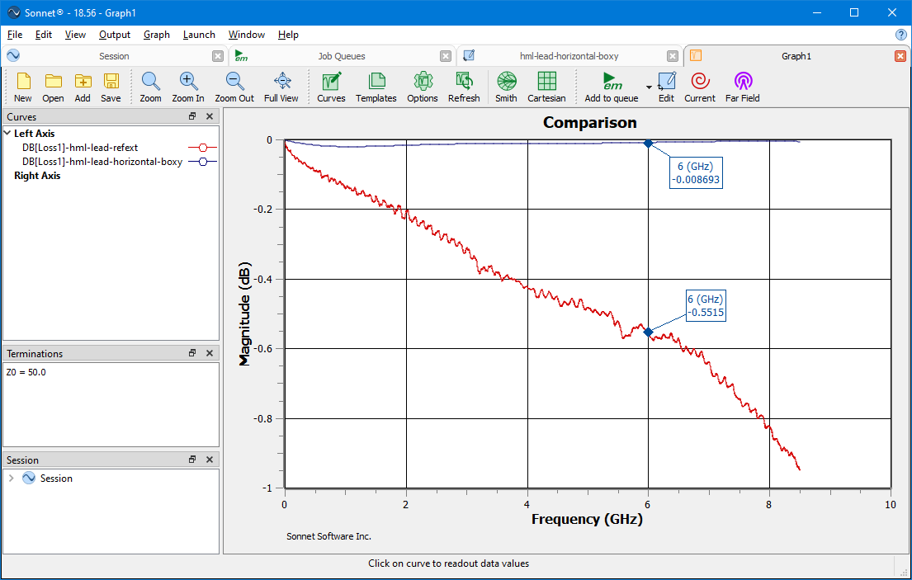
Initial Model vs Measured Comparison
The Loss Factor is the insertion loss with the mismatch loss removed. The plot indicates much higher loss in the measured device and very little in the model.

Slide 8
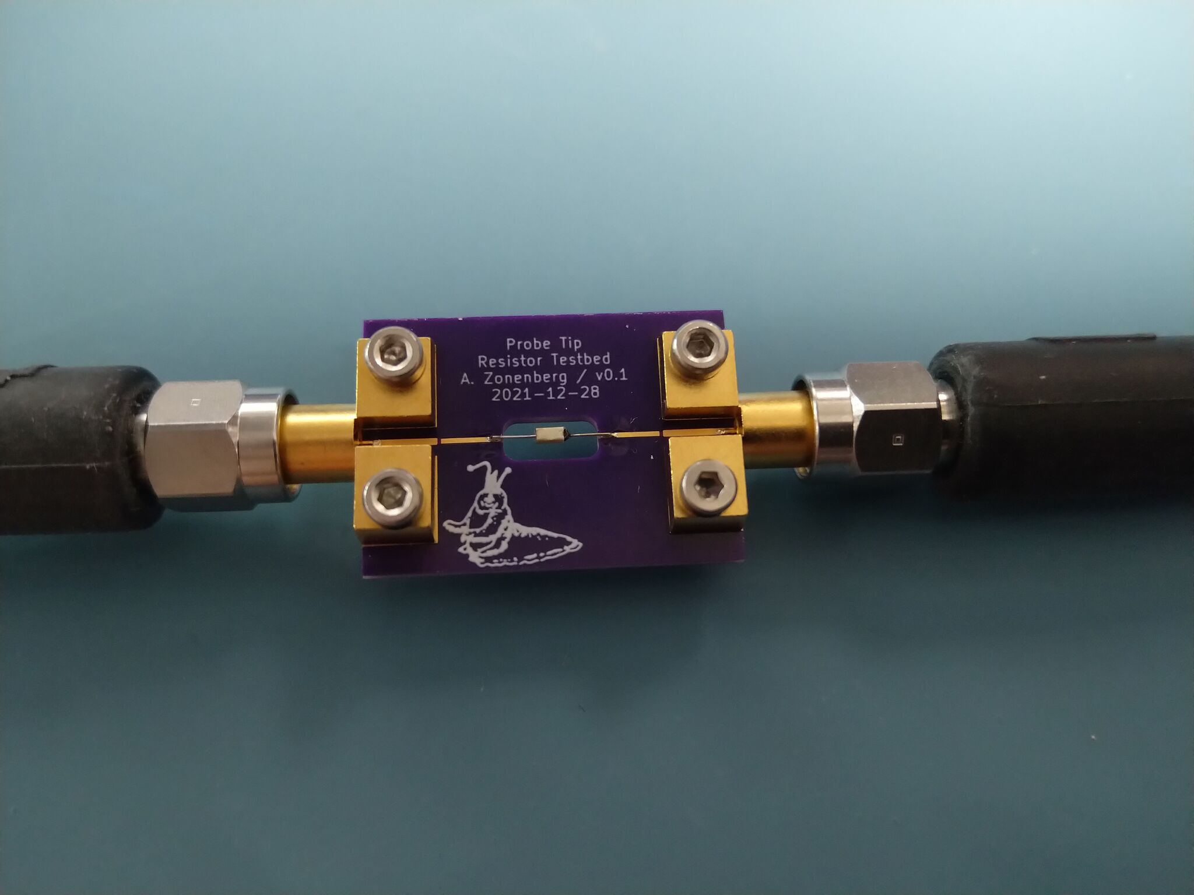
Photo of Wired Resistor Under Test
For the wire measurement the resistor was replaced with a wire.

Slide 9
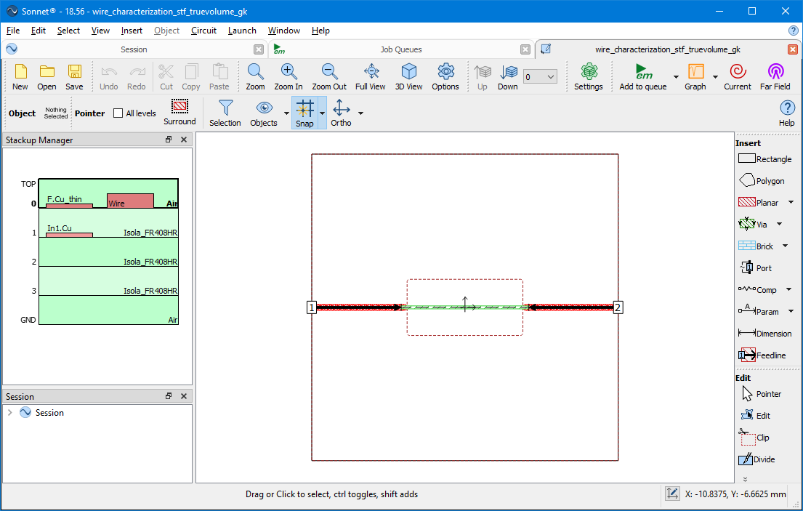
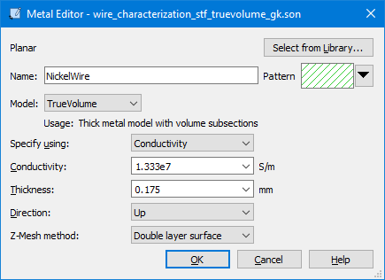
Wire on Test Board – True Volume
The wire was measured on a test board.
A new model was created using the front copper Gerber “resistor-characterization-F_Cu.gbr” and the internal groundplane Gerber “resistor-characterization-In1_Cu.gbr”. The stackup from the “oshpark-4l-soldermask.stf” technology files was used.
This model captures the actual signal trace, groundplane, and PCB materials, found in the physical device. It does not include the air cutout within the groundplane opening.
This model uses a True Volume metal to represent the wire. The resistivity of 7.5e-6 Ohms-cm was converted to a conductivity of 1.333e7 S/m.

Slide 10
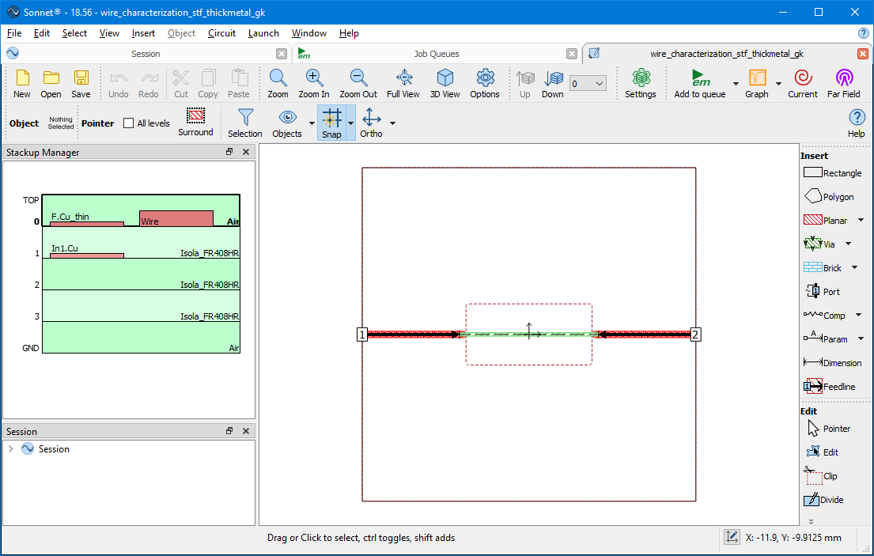
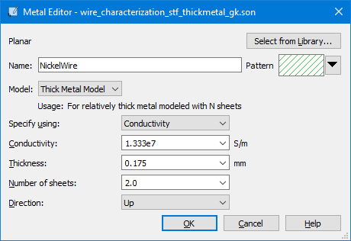
Wire on Test Board – Thick Metal
This model uses a Thick Metal type.

Slide 11
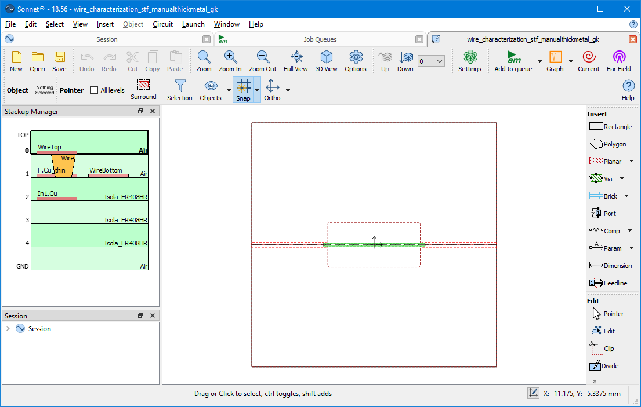
Wire on Test Board – Manual Thick Metal
This model uses a Manual Thick Metal technique.
The technique includes creating 2 sheets of Normal or General Metal polygons, one to represent the upper half of the trace and the other the lower half. These are the WireTop and WireBottom tech layers.
Vias also must be added to connect the 2 sheets together. This is the Wire tech layer.
The sheets are placed at the vertical planes where the trace top and bottom surfaces exist.

Slide 12
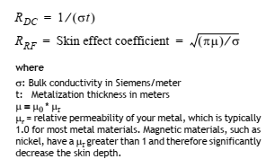

Rdc and Rrf Equation Reference
This is an excerpt from the Sonnet 16 documentation defining Rdc and Rrf. Mur is included in the Rrf equation.
The General Metal type has Rdc and Rrf settings and will be used in the manual thick metal model, of the Nickel wire.
As described in the paragraph , there is some judgement involved relating to the current flow assumption.

Slide 13
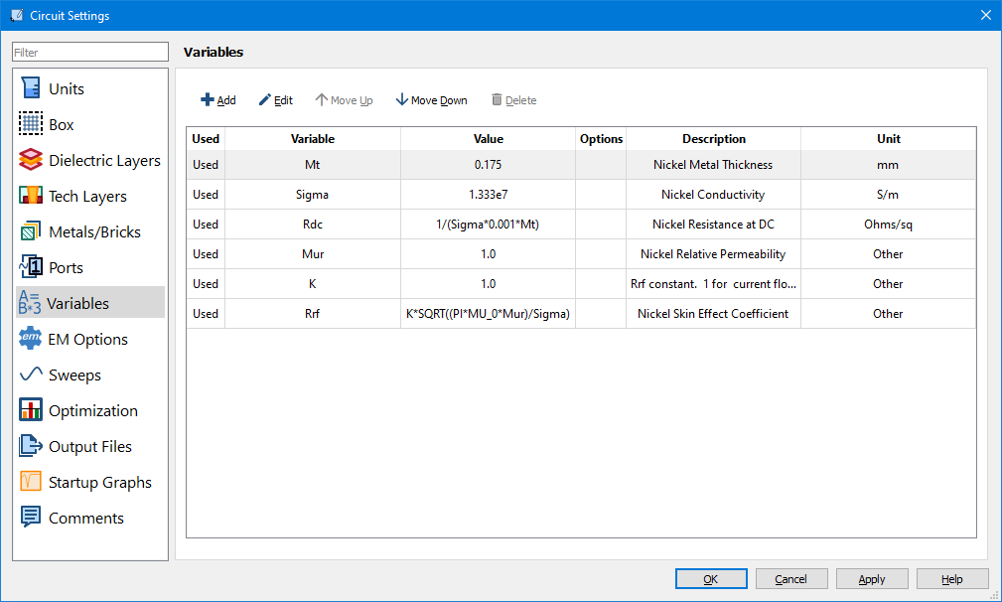
Wire on Test Board – Manual Thick Metal
Variables were defined for the Nickel metal thickness, Conductivity, and Mur.
A “K” variable was defined for the current flow assumption. Note with manual thick metal that the current is modeled as flowing on one surface, so K is set to 1.
Variables with equations for Rdc and Rrf were defined.

Slide 14
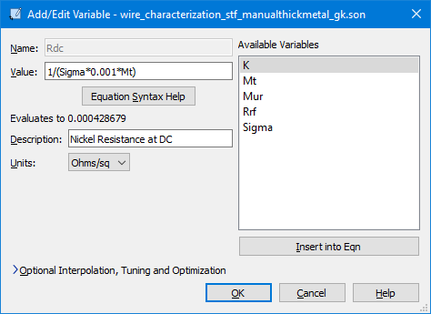
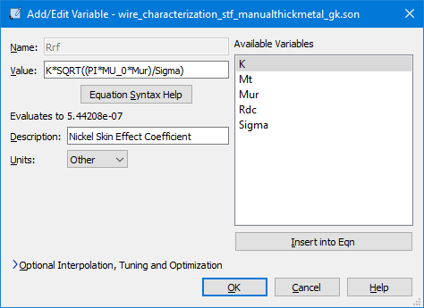
Rdc and Rrf Equation Definitions
Also shown is the resulting value at the sweep set maximum frequency (8.5 GHz).

Slide 15
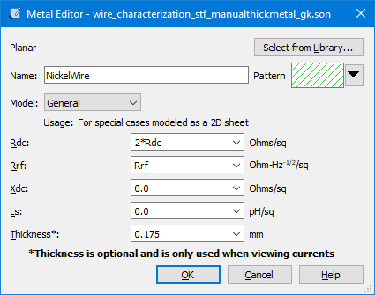
NickelWire Metal Definition
Each sheet in manual thick metal represents half of the overall metal thickness. As such, Rdc is multiplied by 2.

Slide 16
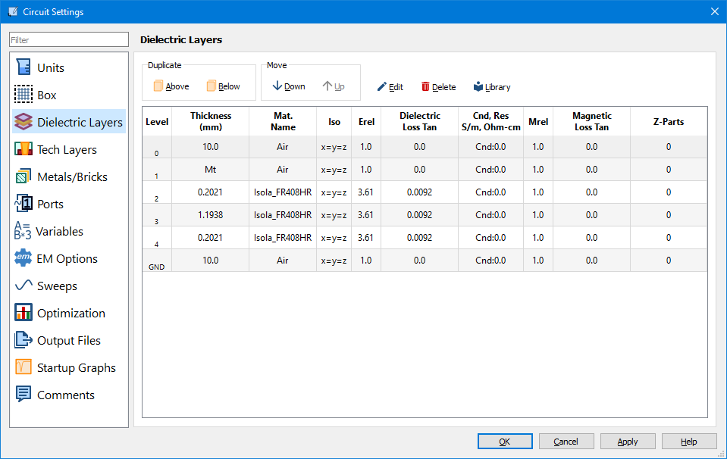
Dielectric Layers
In order to have a Metal Level for the upper sheet, a new Air layer must be added with the thickness set to the metal thickness.

Slide 17
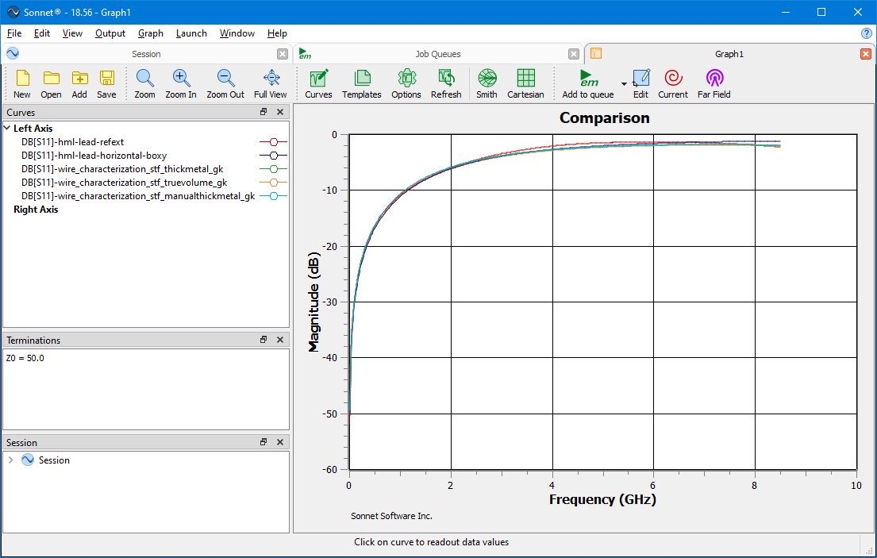
Wire on Test Board Model vs Measured Comparison
The dB[S11] curves are all relatively similar.
The manual thick metal model uses Mur=1.

Slide 18
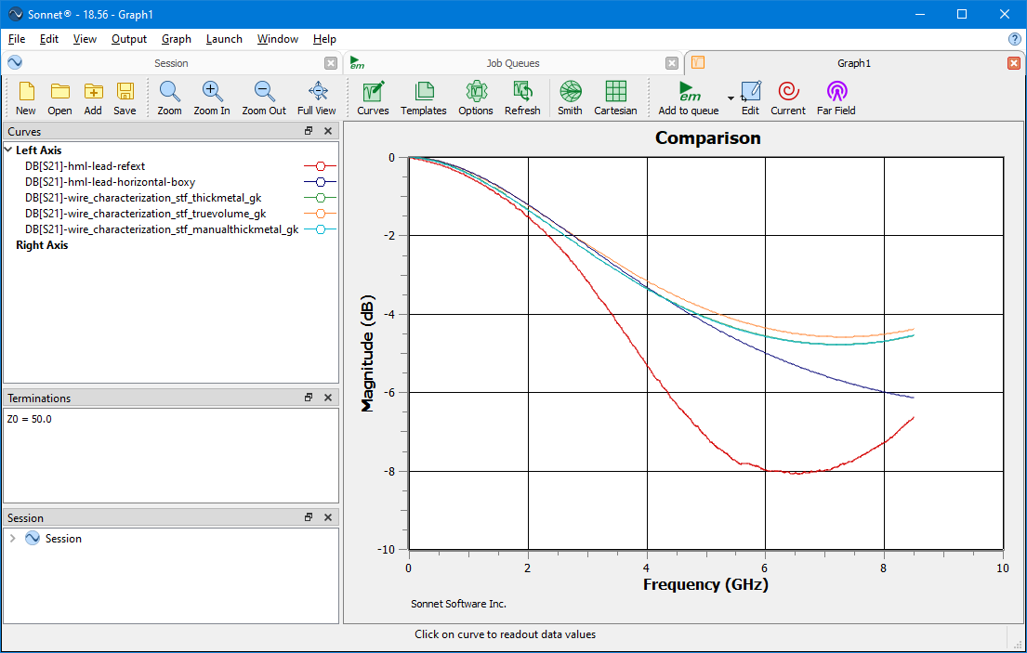
Wire on Test Board Model vs Measured Comparison
The dB[S21] difference slightly grew with the Wire on Test Board models.
The True Volume curve (orange) is very close to the thick metal and manual thick metal models. True Volume will be dropped after this comparison.
The thick metal and manual thick metal models are right on top of one another, verifying the latter model’s setup.

Slide 19
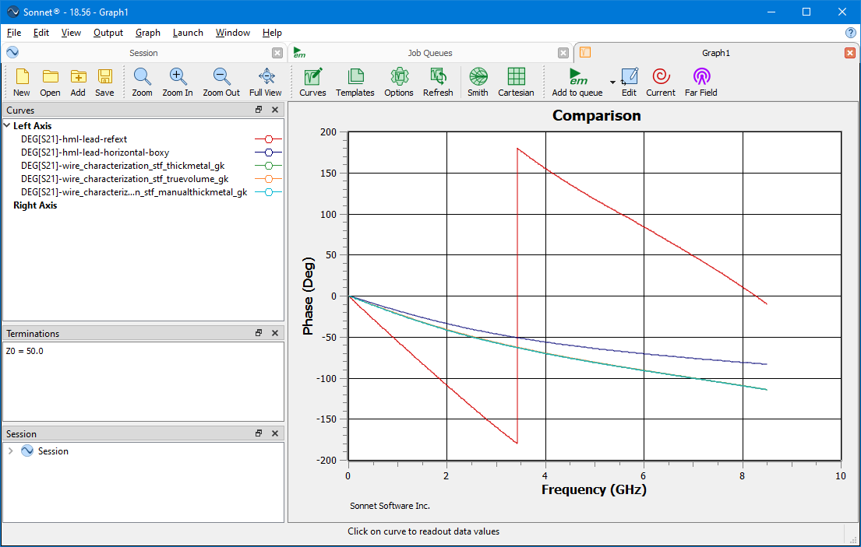
Wire on Test Board Model vs Measured Comparison
The latest Wire on Test Board models have nearly identical insertion phase and the value is a small step closer to measured.

Slide 20
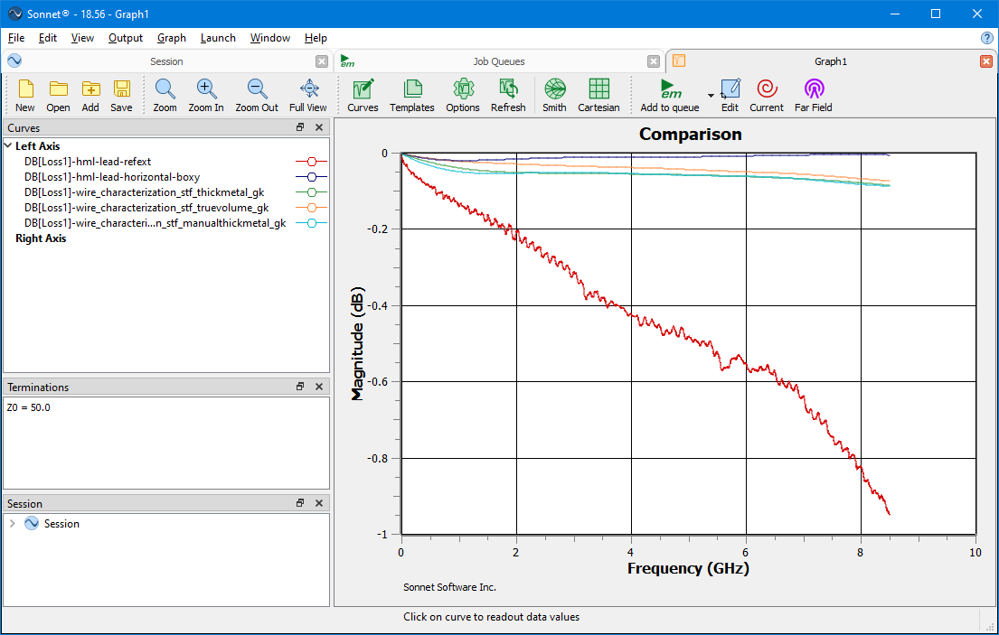
Wire on Test Board Model vs Measured Comparison
The latest Wire on Test Board models have nearly identical Loss Factor and the curves are a small step closer to measured.

Slide 21
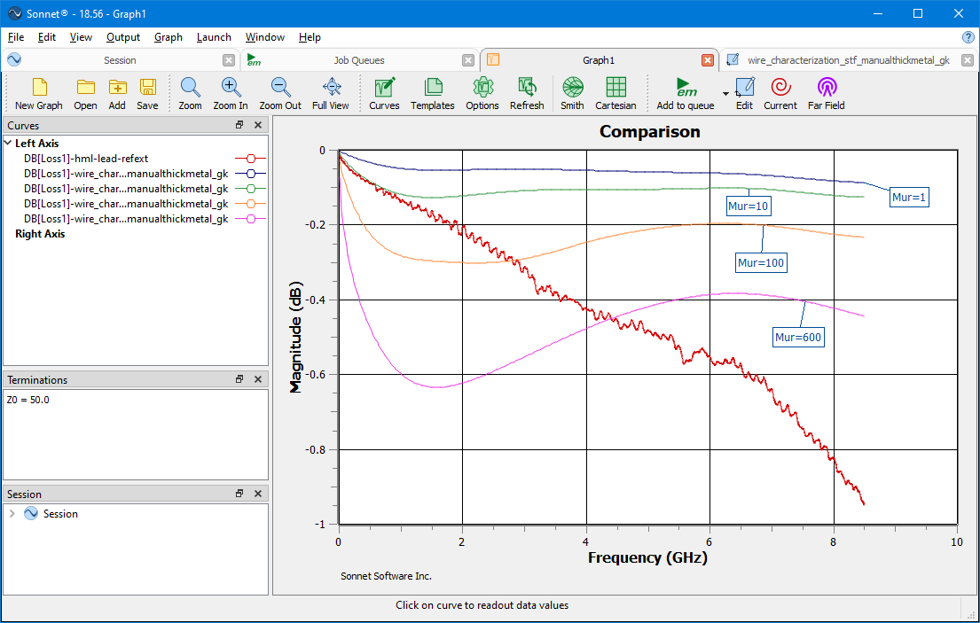
Wire on Test Board Model vs Measured Comparison
In this Loss Factor plot, the manual thick metal model is compared with measured data. Four Mur values are plotted: 1, 10, 100, 600.
The effect of Mur on Loss Factor starts at low frequency, even below 1 GHz. Mur values of 100 and 600 push the low frequency Loss Factor below measurement. The shape of the high Mur Loss factor curves is significantly different than measured.
Mur likely plays a role in the modeled vs measured difference, but there appears to be other factors.

Slide 22
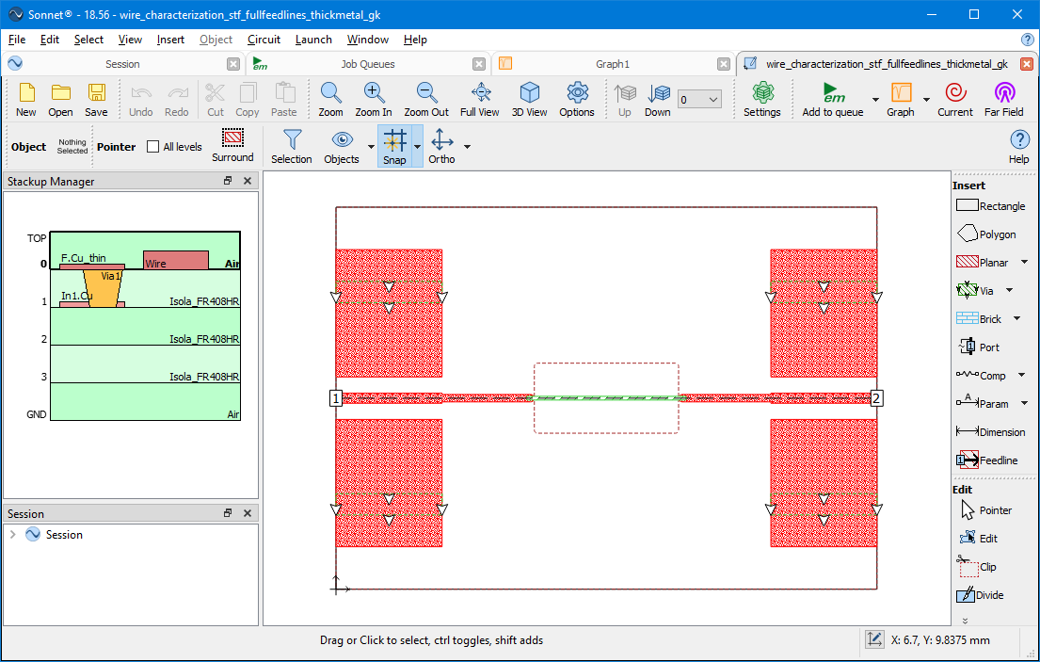
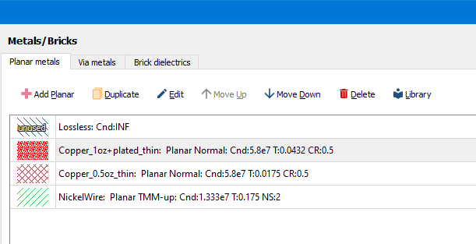
Whole Test Board Model – Normal Board Metal
The comparisons so far indicate a key feature or features are missing from the model. In these next series of models, the whole test board F.Cu and In1.Cu layers are included.
This model continues to use Normal Metal for the test board metal and Thick Metal for the wire.

Slide 23

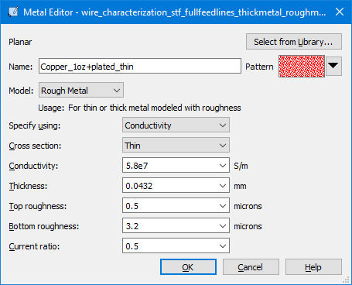
Whole Test Board Model – Rough Board Metal
This model uses Rough Metal with a Thin cross-section, on the test board. The wire metal is still Thick Metal.
The surface roughness values were taken from Rogers Corp 1oz copper foil. Isola copper foil likely is similar, but we should verify.

Slide 24
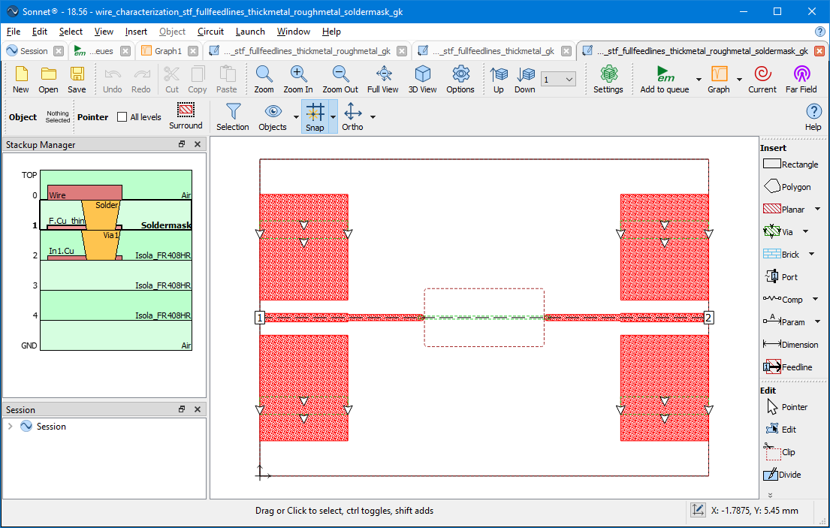
Whole Test Board Model – Rough Board Metal with Soldermask
This model builds on the preceding rough metal model and adds a soldermask layer over the test board traces. A via with Solder properties was added, to connect the trace to the wire through the soldermask.

Slide 25
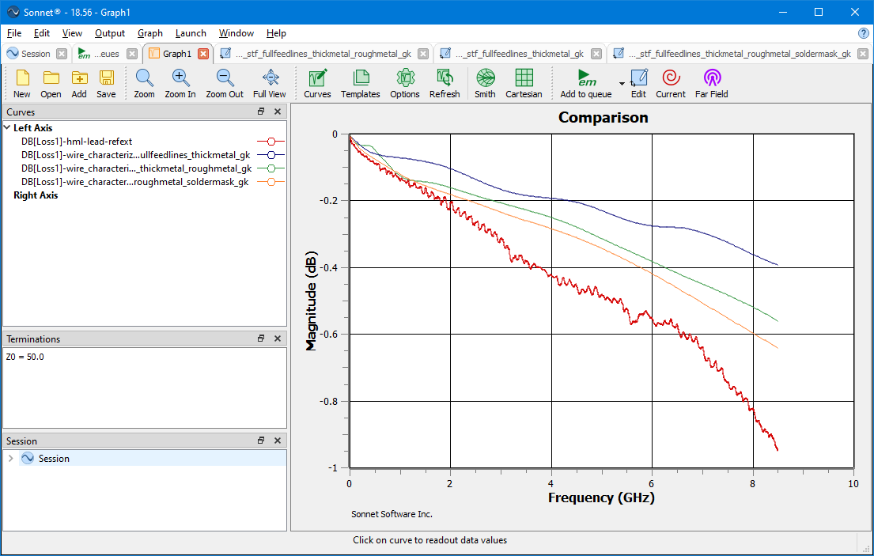
Whole Test Board Model vs Measured Comparison
Modeling the wire on the whole test board, moved the Loss Factor curves much closer to measured.
The added loss due to metal roughness and the soldermask layer were steps in the right direction. The rough metal with soldermask model accurately predicts the metal loss up approximately 2 GHz. The maximum difference is 0.25 dB at 8.5 GHz

Slide 26
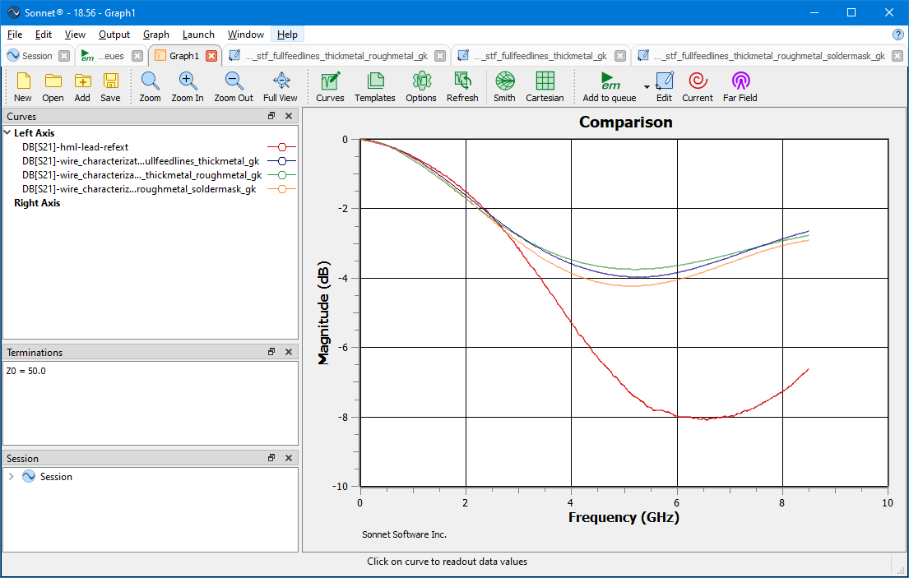
Whole Test Board Model vs Measured Comparison
The dB[S21] difference is approximately 4 dB at 6 GHz, with the Whole Test Board models.

Slide 27
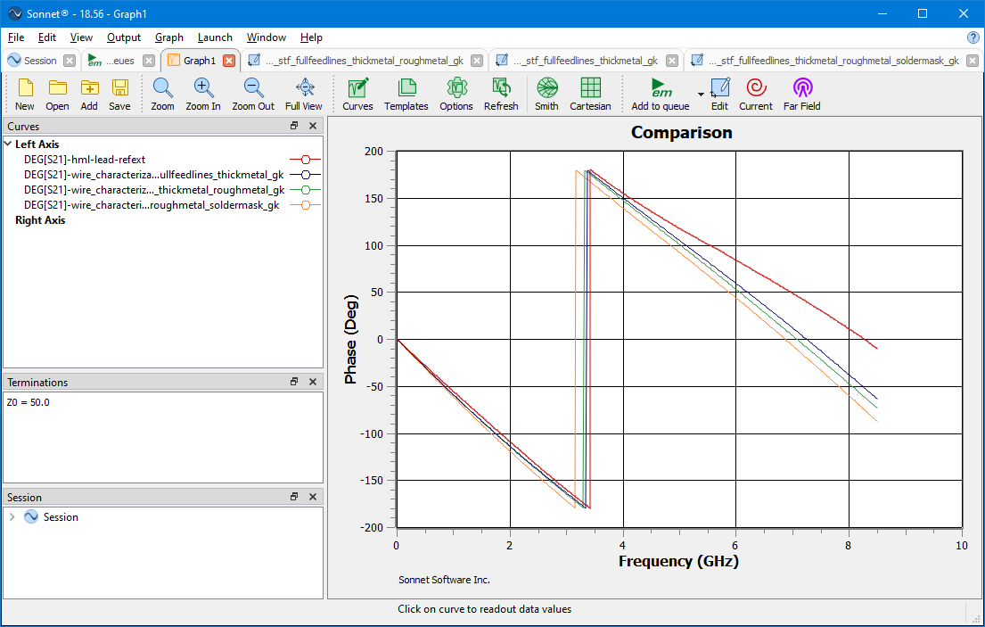
Whole Test Board Model vs Measured Comparison
The Whole Test Board models Deg[S21] curves are all relatively close to measured. The small additional phase in the models could be caused by the lack of air underneath the wire.

Slide 28
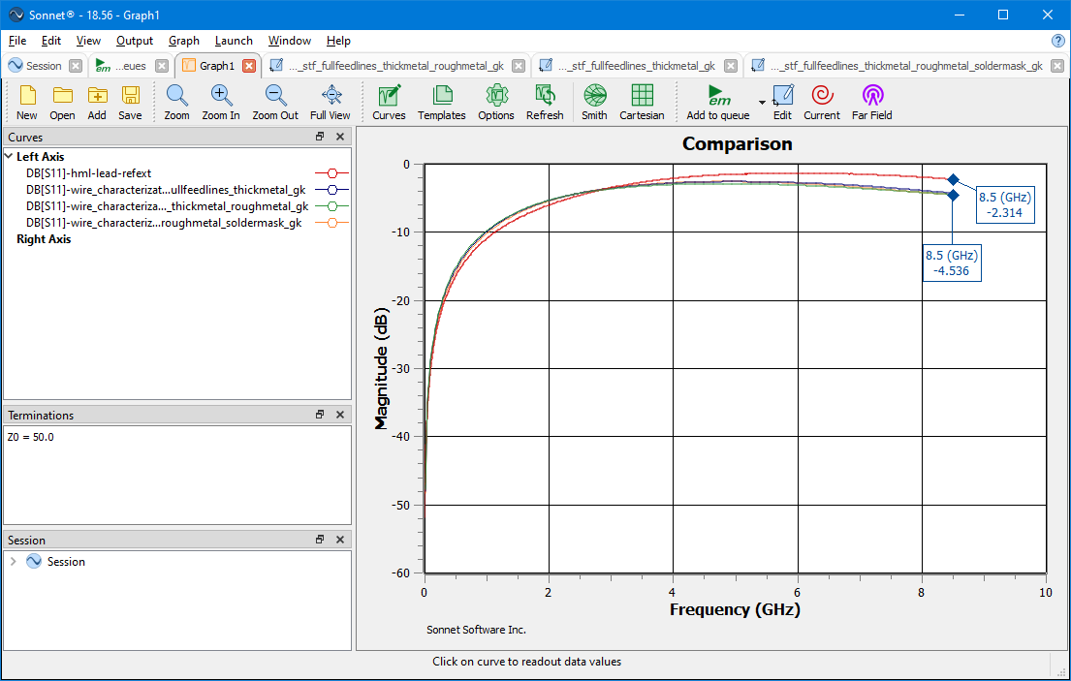
Whole Test Board Model vs Measured Comparison
The Whole Test Board models dB[S11] curves are all relatively close to measured, below approximately 3 GHz. This aligns with the dB[S21] behavior as well.
The dB[S11] differences at 8.5 GHz are 2.2 dB, which is a large magnitude change in reflection.

Slide 29
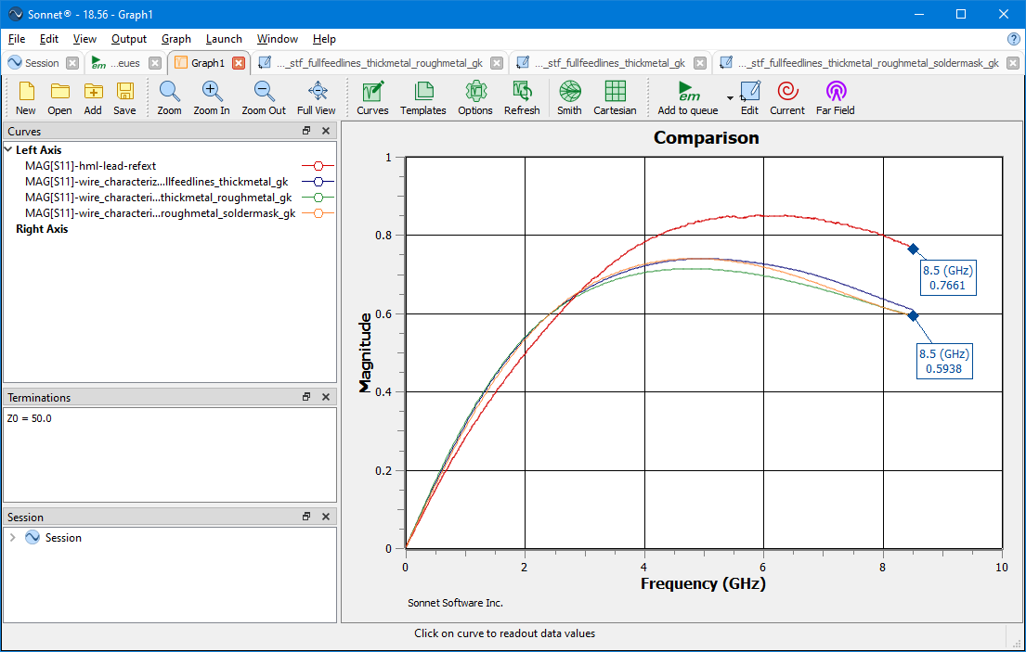
Whole Test Board Model vs Measured Comparison
The Mag[S11] curves are revealing. There is a significant difference in magnitude above 3 GHz.

Slide 30
Comments
The results so far indicate the whole test board must be modeled with the wire, in order to approach the measured results.
The Loss Factor curve indicates that there a small amount of material loss missing in the model. It could be related to the nickel wire Mur. It could also be related to another factor not studied yet such as surface roughness on the wire.
One challenge is that in order to include the Nickel wire Mur in the model the manual thick metal technique and General or Normal Metal type must be used. Unfortunately, there is no way to incorporate the copper foil metal roughness with these metal types.
The largest factor in the difference between modeled and measured is mismatch loss. The connectors are well matched to 50 Ohms. There could be an important feature in the connector transition region, such as the block walls, that need to be added to the model. The missing air below the wire could also be a contributing factor.
In the next section, Nickel wire roughness and vertical position will be studied.

