Slide 1
SEJIRE
Investor deck · 2026
SEJIRE
Free first.
Forever later.
Shezhire for the whole family.
Arweave when you need it — not because you must.
Kazakhstan → the world

Slide 2
SEJIRE
Investor deck · 2026
00 · THE BET
A stranger’s company
should not own
your ancestors.
Ancestry and MyHeritage keep family history on their servers — for as long as you pay. SEJIRE gives memory back to the family: 12 words, encryption on the device, Arweave for centuries.

Slide 3
SEJIRE
Investor deck · 2026
01 · PROBLEM
The lineage is scattered
across chats, Excel, and other people’s clouds
01
Hard to start
Genealogy is overloaded. People need to begin with themselves — not a dissertation.
02
Nothing to share
A PDF for the wall, a letter to relatives, a print for a toi — without a subscription.
03
The data is not yours
The history lives only as long as the company and your plan do.
04
Forever is locked
Permaweb can keep records for centuries. An ordinary family does not buy tokens.

Slide 4
SEJIRE
Investor deck · 2026
02 · INSIGHT
Zheti ata —
a ready wedge
into the market.
In Kazakhstan, knowing seven generations is the norm, not a “why would I?” pitch. One PDF in the family chat brings the next people in. A cultural product beats a generic family tree.

Slide 5
SEJIRE
Investor deck · 2026
03 · SOLUTION
SEJIRE — shezhire
for the whole family
01
02
03
Start with yourself
Download a PDF
Forever, if you want
Mother, father, children — “+” cards. The draft lives in the browser on its own.
A tree or an ornamental shezhire — mail, print, toi.
12 words + about $3. No crypto to buy. Ciphertext → Arweave.
0 ₸
~$3
200+
12
create · PDF · share
eternal option
years, Arweave model
words = the family key

Slide 6
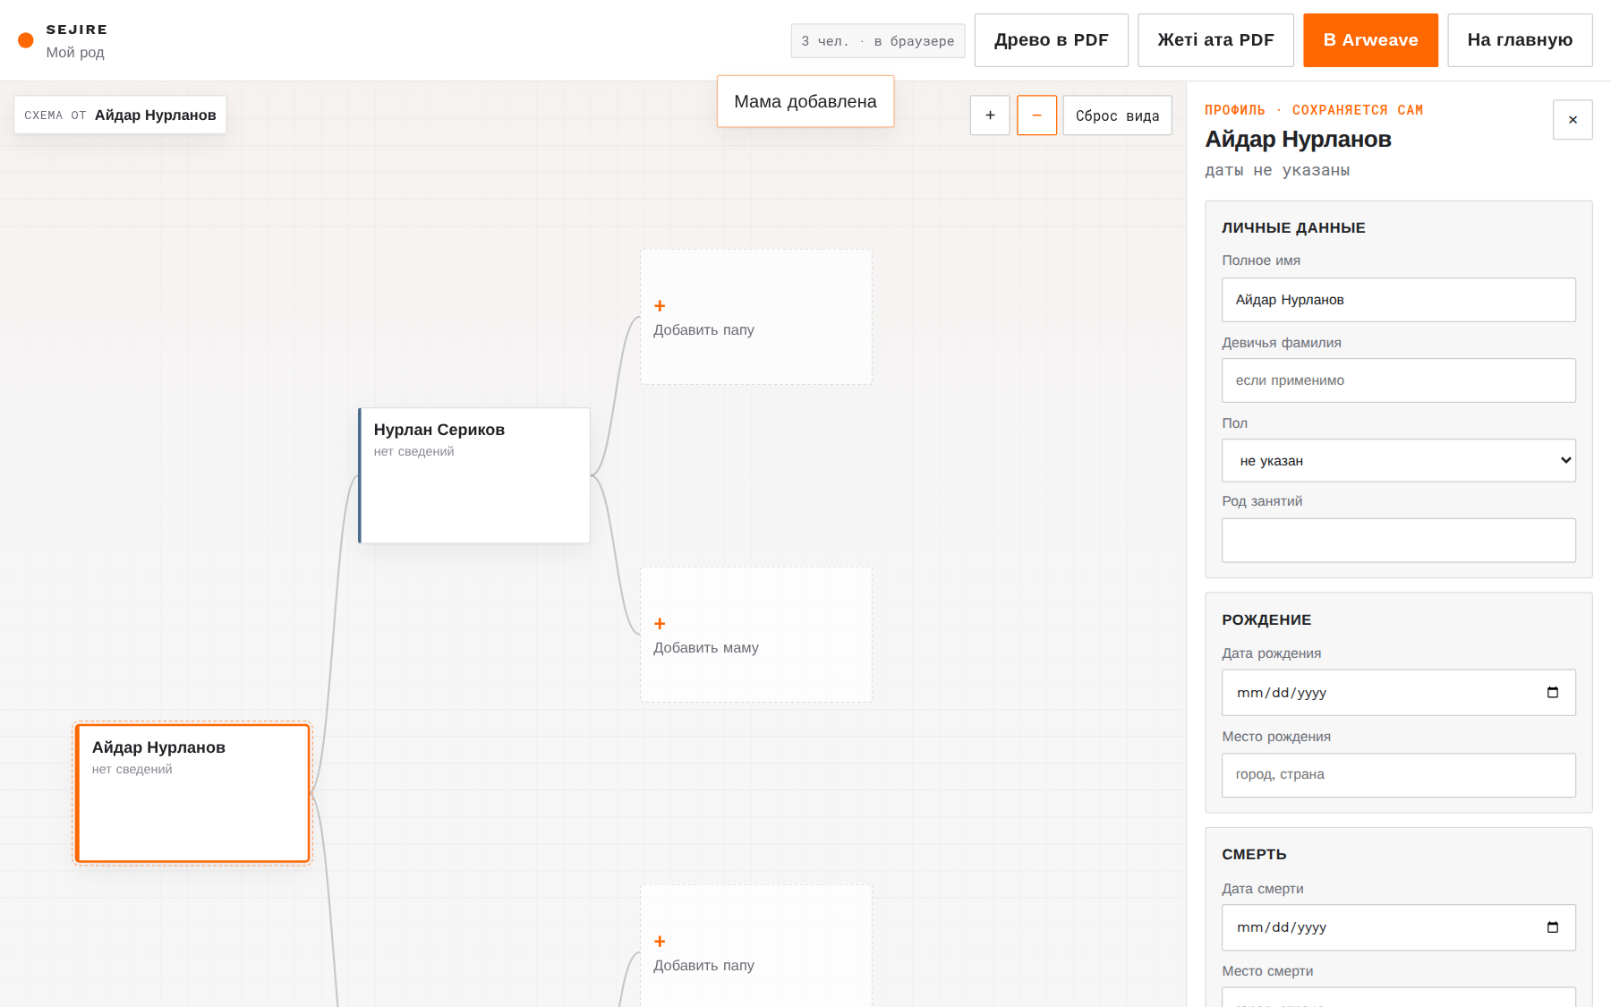

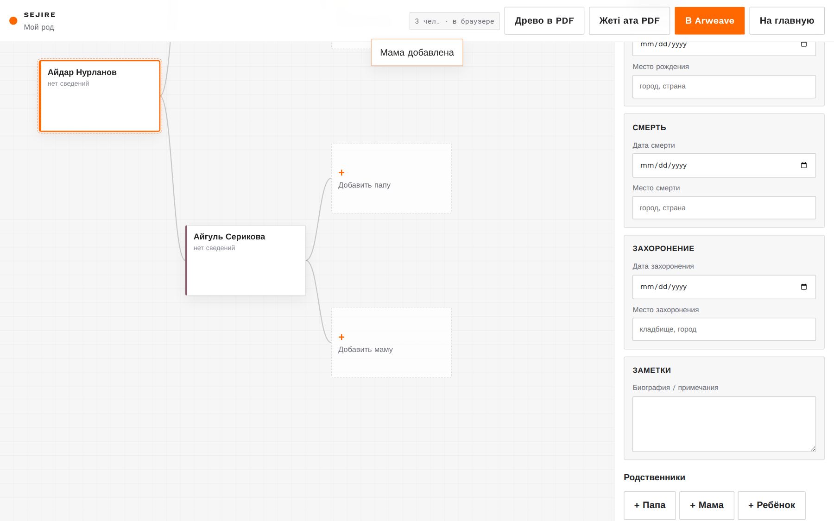
SEJIRE
Investor deck · 2026
04 · PRODUCT
This is what
family memory looks like
Quiet, Apple-like UX. Cultural fields are optional. The brand leads the features.
Tree · live draft
Entry — only SEJIRE
Profile · autosave

Slide 7
SEJIRE
Investor deck · 2026
05 · FREE LAYER
You do not pay
to use it
Card and crypto only if you want an eternal copy. Everyday family use stays free in this layer, for good.
Create
Save
PDF
Share
Open the site — build the tree.
Draft in the browser. No account.
Tree and zheti ata / shezhire.
Mail, file, print for the wall.

Slide 8
SEJIRE
Investor deck · 2026
06 · THE FOREVER OPTION
Lock the lineage
for 200+ years
Key
Payment
Storage
12 words
~$3 in fiat
Arweave
BIP-39. The seed never hits a server. Only the family can open the vault.
Kaspi / card. The user does not buy AR. The SEJIRE treasury pays the network.
AES-GCM ciphertext. Endowment model. An immutable snapshot of the family.
Required? No. · Crypto for the user? Zero. · SEJIRE account? Not needed.

Slide 9
SEJIRE
Investor deck · 2026
07 · WHY US
Not Ancestry.
Not DeepFamily.
SEJIRE.
Ancestry
DeepFamily
SEJIRE
— Subscription lock-in
— Needs an EVM wallet
— Free to start
— Data sits with the company
— Not permaweb
— 12 words with the family
— No forever
— Crypto-native UX
— Arweave · $3 option
— West + DNA
— Not shezhire
— Shezhire / zheti ata
There is no live shezhire analogue on Arweave. The niche is almost empty.

Slide 10
SEJIRE
Investor deck · 2026
08 · BEACHHEAD
Kazakhstan is not a pivot.
It is a weapon.
The culture is already bought
Kinship virality
Zheti ata is the norm. No need to sell “why know your ancestors.”
One PDF in the family chat = organic growth without a CAC lecture.
Web3 without the pain
The name is already ours
The free layer removes fear. Forever is a quiet upsell.
sejire on ArNS. Canon: sejire.ar.io.

Slide 11
SEJIRE
Investor deck · 2026
09 · GO-TO-MARKET
KZ → the belt → the world
I
Kazakhstan
Zheti ata, PDF for a toi, Kazakh/Russian, lineage communities, Kaspi.
II
CIS / Turkic belt
The same seven-generation tradition — Kyrgyzstan, Uzbekistan, and neighbours.
III
The world
An eternal family vault for diasporas and anyone tired of subscriptions.

Slide 12
SEJIRE
Investor deck · 2026
10 · TRACTION
The MVP is already live.
Not a slide — a product.
Live
Stack
Next
Tree, autosave, PDF, ornamental shezhire, JSON, encryption pipeline.
React · Vite · BIP-39 · AES-GCM · Arweave/Turbo · jsPDF · ArNS
Kaspi $3 · Turbo treasury · site on permaweb · sejire.ar.io
azovskaya.github.io/Sejire_arweave

Slide 13
SEJIRE
Investor deck · 2026
11 · ASK
We accelerate
three strikes.
01
~$3 payment
Kaspi / merchant + Turbo treasury — forever without tokens for the family.
02
Permaweb + ArNS
SEJIRE on Arweave. Canon: sejire.ar.io.
03
Growth in KZ
Content, lineage pilots, the first thousands of trees and the first vaults.

Slide 14
SEJIRE
Investor deck · 2026
SEJIRE
Free
first.
Forever
later.
Create. Save. Send. Print.
And when you need it — lock the lineage on Arweave.
Live MVP · azovskaya.github.io/Sejire_arweave · sejire.ar.io

