Slide 1
HUMOROUS ITEMS AND TOYS Analyses and machine learning prepared by: petya mutafchieva - galabova

Slide 2
📌PROJECT’S SCOPE
Unique order count ;
Average order amount in £;
YTD internet sales in £ ;
YTD shop sales in £
Online sales as a percentage of overall sales, excluding customer collections
Each KPI should also be predicted until May 2016 (3 months), using regression machine learning.

Slide 3
📌GENERAL STEPS:
Cleaning and preparing data
Designing dimensional model
Creating measures
Machine learning for predicting sales
Creating measures
Drawing reports and dashboard
.

Slide 4
📌 preparing data & IMPORTANT questions
How to distinguish Online Sales from Shop Sales?
How to distinguish the collections of those that were distributed?
Later on I will need:
The sum of picked items;
The sum of online sales without collections
How to use it so the measures to work properly?

Slide 5
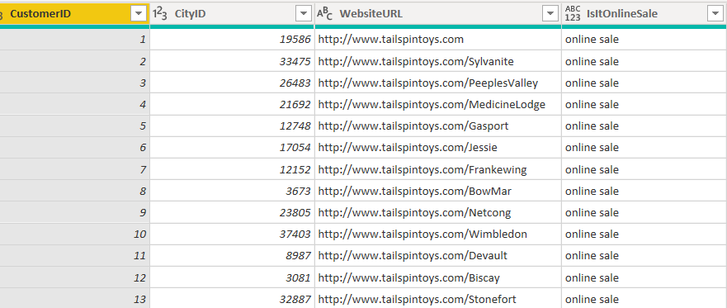
🔨 Preparing data
Joining columns related with the sales fact in fact table.
Calculating total price and adding a new column with it in the fact table and convert it in pounds. Tax rate of 15% included.
Distinguishing online sales from shop sales by adding a new conditional column and using the website URL written in the Customer table as a condition;

Slide 6
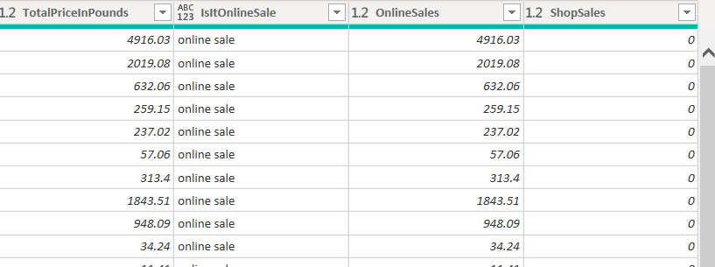
🔨 Preparing data
Next, adding new conditional columns in which the prices of online sales and shops sales are extracted and distinguished from one another.

Slide 7
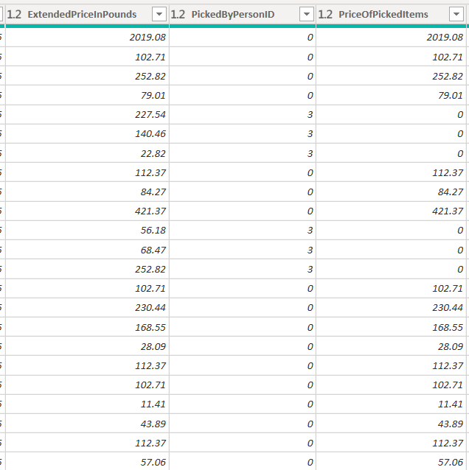
🔨identifying collections
Using the column “Picked by person ID” in Sales Payment Statement Lines
Using the option for adding a conditional column to extract prices for the collected items.
All items with pointed ID are considered as distributed and the rest as collected.

Slide 8
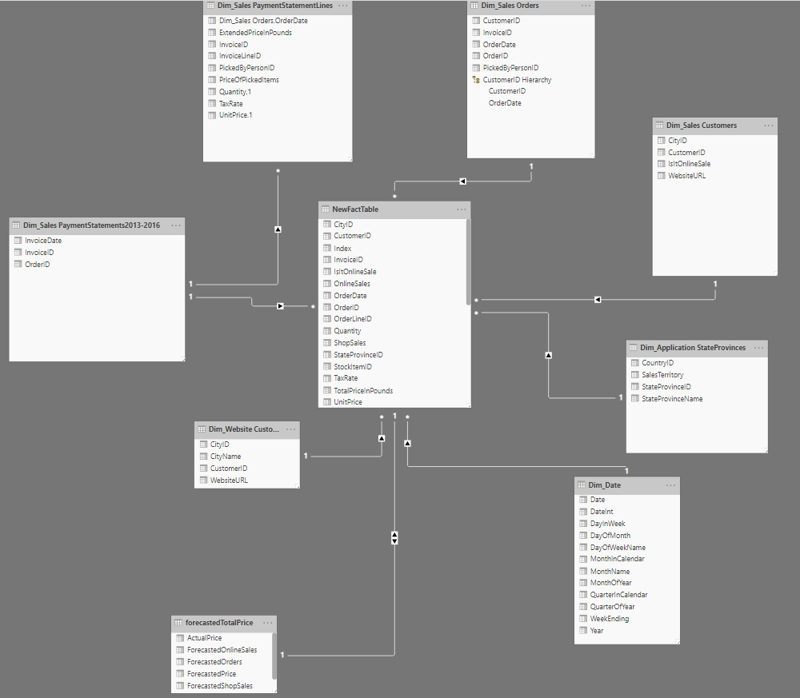
STAR SCHEMA Fact table – SALES FACTS • index • City id • Customer id • Invoice id • Is it online sale • Online sales • Shop sales • Order id • Order date • Quantity • Unit price • Tax Rate & ALL MEASURES

Slide 9

MEASURES
AverageOrderAmount1 = AVERAGE('Dim_Sales PaymentStatementLines'[ExtendedPriceInPounds])
DistinctOrders = DISTINCTCOUNT(NewFactTable[OrderID])
YTDSales = SUM(NewFactTable[TotalPriceInPounds])
YTDTotalOnlineSales = SUM(NewFactTable[OnlineSales])
YTDTotalShopSales = SUM(NewFactTable[ShopSales])
SumOfPIckedItems = SUM('Dim_Sales PaymentStatementLines'[PriceOfPickedItems])
WithoutCollSales = NewFactTable[YTDTotalOnlineSales]-[SumOfPIckedItems]
%OnlineSales = ([WithoutCollSales]/[YTDSales]
%OfPickedItems = ([SumOfPIckedItems]/[YTDTotalOnlineSales])

Slide 10
146,257,132.30
ONLINE SALES 2013-2016
138,974,520.50
SHOP SALES 2013-2016
7,282,611.80

Slide 11
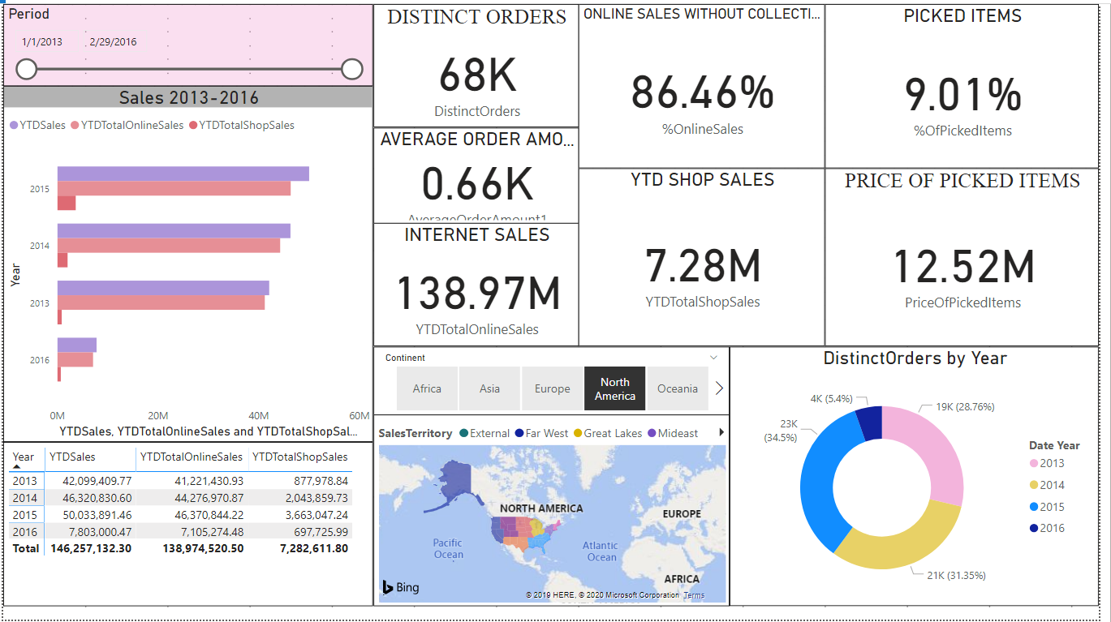

Slide 12
Machine learning

Slide 13
PREDICTIONS IN R
ARIMA – AUGOREGRESSIVE INTEGRATED MOVING AVERAGE.
forecast a time series using the series past values.
time series should be stationary – with no seasonality or trends
logarithms can help to stabilise the variance of a time series.

Slide 14
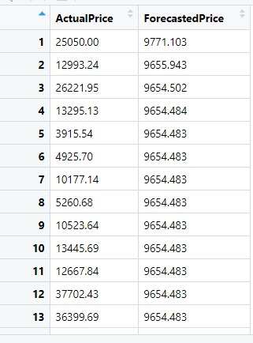
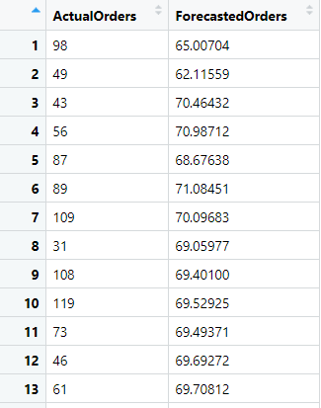
GENERAL STEPS
Extracting 4 tables for predictions:
Order Date + Total Sales
Order Date + Online Sales
Order Date + Order ID
Order Date + Shop Sales
Modeling data in R
Fitting auto.arima on each table separately.
Making a data frame with the actual and forecasted price

Slide 15
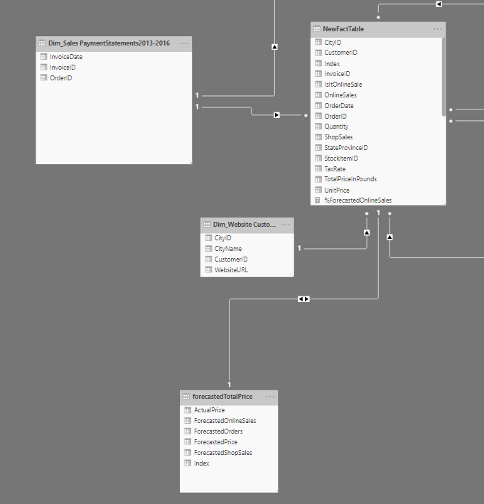
GENERAL STEPS
Next:
Calculating the error.
Loading the forecasted tables in Power BI
Joining all forecasted columns in one table
Adding an index column of the new table and making a relationship with the fact table

Slide 16
MEASURES
YTDForecastedDistinctOrders = SUM(forecastedTotalPrice[ForecastedOrders])
YTDForecastedOnlineSales = SUM(forecastedTotalPrice[ForecastedOnlineSales])
YTDForecastedShopSales = SUM(forecastedTotalPrice[ForecastedShopSales])
YTDForecastedTotalSales = SUM(forecastedTotalPrice[ForecastedPrice])
ForecastedAverageOrders = AVERAGE(forecastedTotalPrice[ForecastedOrders])
ForecastedPriceOfPickedItems = ([YTDForecastedOnlineSales]*9.01)/100
Forec.SalesWithoutCollect. = [YTDForecastedOnlineSales]-[ForecastedPriceOfPickedItems]
ForecastedPriceOfPickedItems = ([YTDForecastedOnlineSales]*9.01)/100
%ForecastedOnlineSales = ([Forec.SalesWithoutCollect.]/[YTDForecastedOnlineSales])

Slide 17
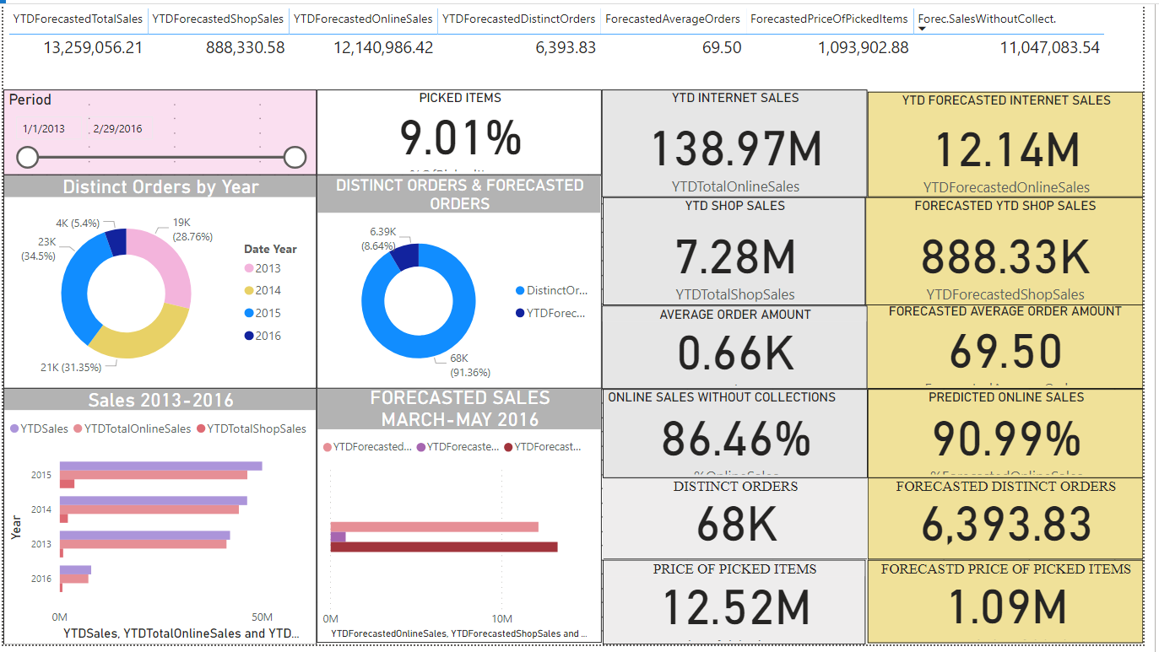

Slide 18
THANKS!
Any questions?
You can find me at:
https://github.com/azpetia/Adatis-task
petya.mutafchieva@gmail.com

