Slide 1
HUMOROUS ITEMS AND TOYS Analyses and machine learning prepared by: petya mutafchieva - galabova

Slide 2
📌PROJECT’S SCOPE
Unique order count ;
Average order amount in £;
YTD internet sales in £ ;
YTD shop sales in £
Online sales as a percentage of overall sales, excluding customer collections
Each KPI should also be predicted until May 2016 (3 months), using regression machine learning.

Slide 3
📌GENERAL STEPS:
Cleaning and preparing data
Designing dimensional model
Creating measures
Machine learning for predicting sales
Creating measures
Drawing reports and dashboard
.

Slide 4
📌 preparing data & IMPORTANT questions
How to distinguish Online Sales from Shop Sales?
How to distinguish the collections of those that were distributed?
Later on I will need:
The sum of picked items;
The sum of online sales without collections
How to use it so the measures to work properly?

Slide 5
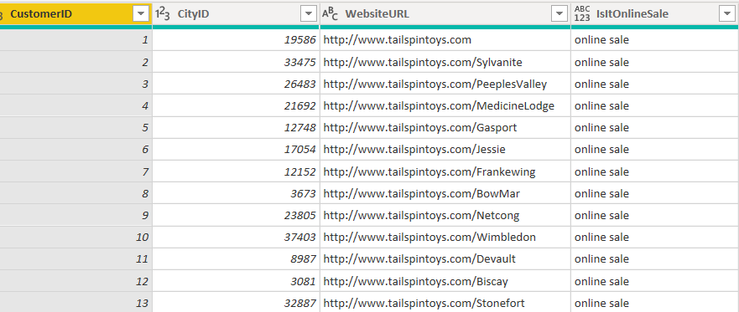
🔨 Preparing data
Joining columns related with the sales fact in fact table.
Calculating total price and adding a new column with it in the fact table and convert it in pounds. Tax rate of 15% included.
Distinguishing online sales from shop sales by adding a new conditional column and using the website URL written in the Customer table as a condition;

Slide 6
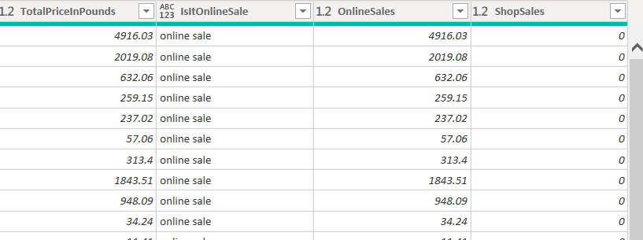
🔨 Preparing data
Next, adding new conditional columns in which the prices of online sales and shops sales are extracted and distinguished from one another.

Slide 7
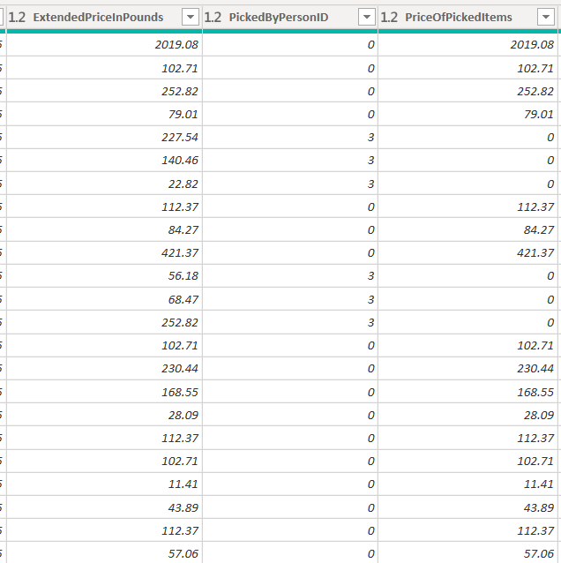
🔨identifying collections
Using the column “Picked by person ID” in Sales Payment Statement Lines
Using the option for adding a conditional column to extract prices for the collected items.
All items with pointed ID are considered as distributed and the rest as collected.

Slide 8
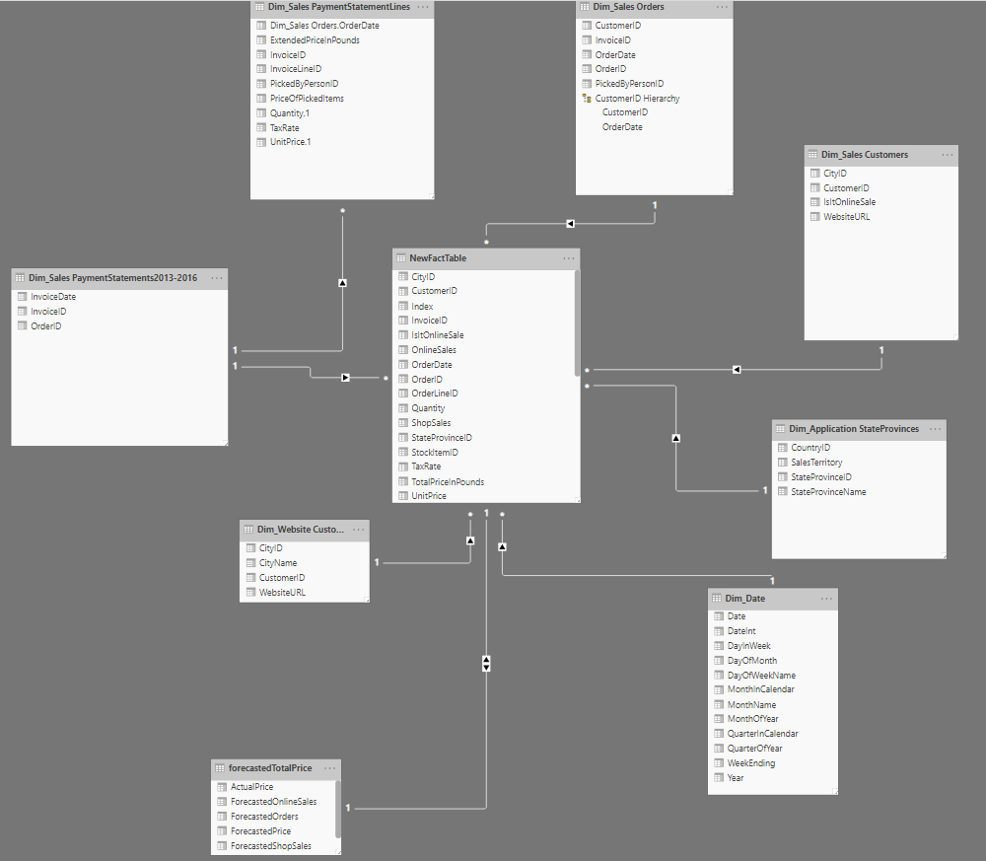
STAR SCHEMA Fact table – SALES FACTS • index • City id • Customer id • Invoice id • Is it online sale • Online sales • Shop sales • Order id • Order date • Quantity • Unit price • Tax Rate & ALL MEASURES

Slide 9

MEASURES
AverageOrderAmount1 = AVERAGE('Dim_Sales PaymentStatementLines'[ExtendedPriceInPounds])
DistinctOrders = DISTINCTCOUNT(NewFactTable[OrderID])
YTDSales = SUM(NewFactTable[TotalPriceInPounds])
YTDTotalOnlineSales = SUM(NewFactTable[OnlineSales])
YTDTotalShopSales = SUM(NewFactTable[ShopSales])
SumOfPIckedItems = SUM('Dim_Sales PaymentStatementLines'[PriceOfPickedItems])
WithoutCollSales = NewFactTable[YTDTotalOnlineSales]-[SumOfPIckedItems]
%OnlineSales = ([WithoutCollSales]/[YTDSales]
%OfPickedItems = ([SumOfPIckedItems]/[YTDTotalOnlineSales])

Slide 10
146,257,132.30
ONLINE SALES 2013-2016
138,974,520.50
SHOP SALES 2013-2016
7,282,611.80

Slide 11
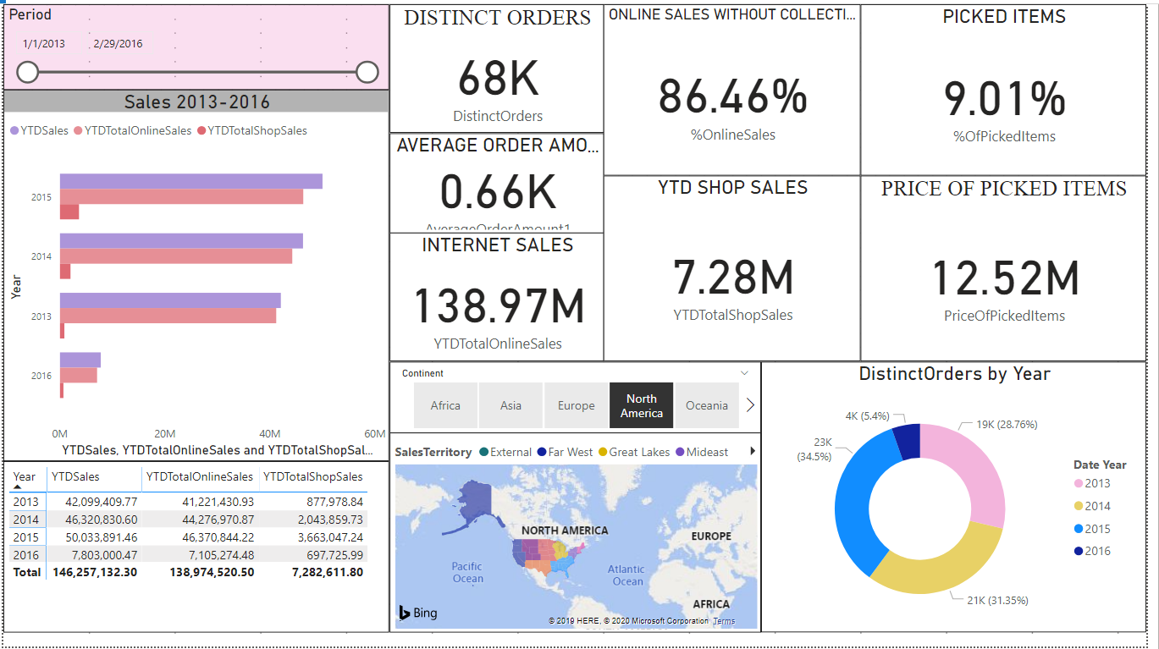

Slide 12
Machine learning

Slide 13
PREDICTIONS IN R
ARIMA – AUGOREGRESSIVE INTEGRATED MOVING AVERAGE.
forecast a time series using the series past values.
time series should be stationary – with no seasonality or trends
logarithms can help to stabilise the variance of a time series.

Slide 14
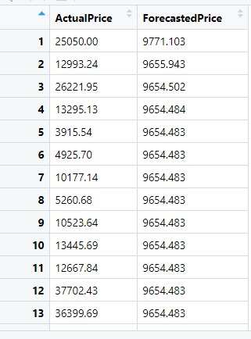
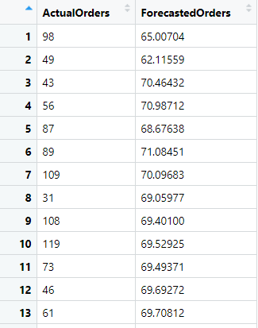
GENERAL STEPS
Extracting 4 tables for predictions:
Order Date + Total Sales
Order Date + Online Sales
Order Date + Order ID
Order Date + Shop Sales
Modeling data in R
Fitting auto.arima on each table separately.
Making a data frame with the actual and forecasted price

Slide 15
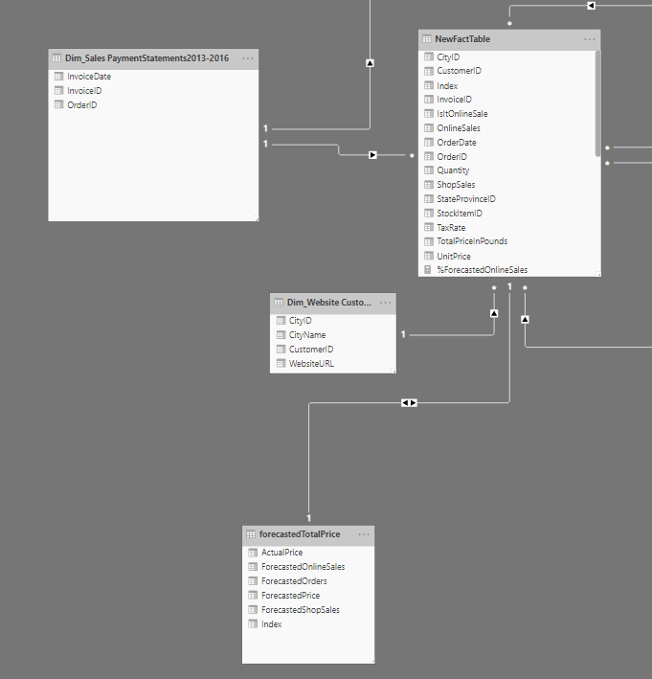
GENERAL STEPS
Next:
Calculating the error.
Loading the forecasted tables in Power BI
Joining all forecasted columns in one table
Adding an index column of the new table and making a relationship with the fact table

Slide 16
MEASURES
YTDForecastedDistinctOrders = SUM(forecastedTotalPrice[ForecastedOrders])
YTDForecastedOnlineSales = SUM(forecastedTotalPrice[ForecastedOnlineSales])
YTDForecastedShopSales = SUM(forecastedTotalPrice[ForecastedShopSales])
YTDForecastedTotalSales = SUM(forecastedTotalPrice[ForecastedPrice])
ForecastedAverageOrders = AVERAGE(forecastedTotalPrice[ForecastedOrders])
ForecastedPriceOfPickedItems = ([YTDForecastedOnlineSales]*9.01)/100
Forec.SalesWithoutCollect. = [YTDForecastedOnlineSales]-[ForecastedPriceOfPickedItems]
ForecastedPriceOfPickedItems = ([YTDForecastedOnlineSales]*9.01)/100
%ForecastedOnlineSales = ([Forec.SalesWithoutCollect.]/[YTDForecastedOnlineSales])

Slide 17
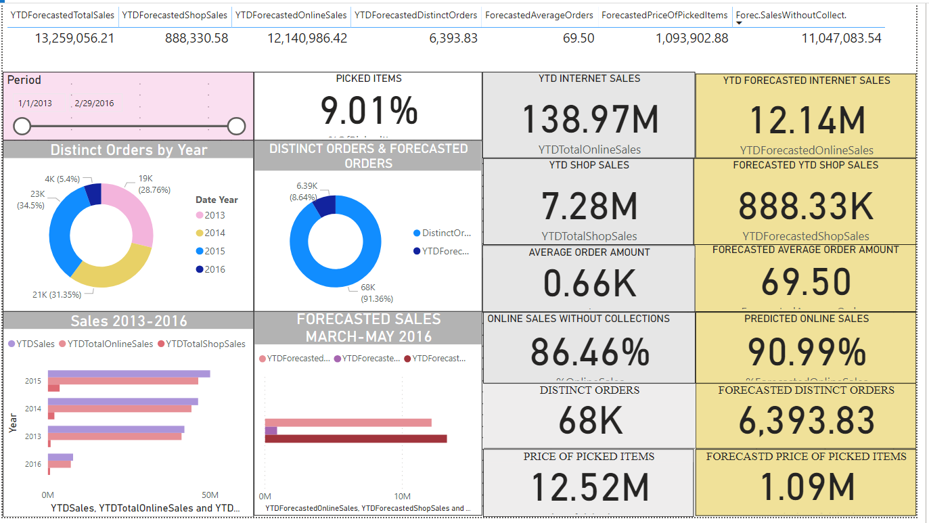

Slide 18
THANKS!
Any questions?
You can find me at:
https://github.com/azpetia/Adatis-task
petya.mutafchieva@gmail.com

Slide 19
Place your screenshot here
Desktop project
Show and explain your web, app or software projects using these gadget templates.

Slide 20
Presentation design
This presentation uses the following typographies:
Titles: Raleway
Body copy: Barlow
Download for free at:
https://www.fontsquirrel.com/fonts/raleway
https://www.fontsquirrel.com/fonts/barlow
You don’t need to keep this slide in your presentation. It’s only here to serve you as a design guide if you need to create new slides or download the fonts to edit the presentation in PowerPoint®

Slide 21
Extra resources
Illustrations created by Sergei Tikhonov.
Free illustrations published under the MIT License. You can use them for personal and commercial projects, without the need to include attribution.
See license.

Slide 22
SlidesCarnival icons are editable shapes. This means that you can:
Resize them without losing quality.
Change fill color and opacity.
Change line color, width and style.
Isn’t that nice? :) Examples:
Find more icons at slidescarnival.com/extra-free-resources-icons-and-maps

Slide 23
😉
You can also use any emoji as an icon! And of course it resizes without losing quality.
How? Follow Google instructions https://twitter.com/googledocs/status/730087240156643328
✋👆👉👍👤👦👧👨👩👪💃🏃💑❤😂😉😋😒😭👶😸🐟🍒🍔💣📌📖🔨🎃🎈🎨🏈🏰🌏🔌🔑 and many more...

