Slide 1

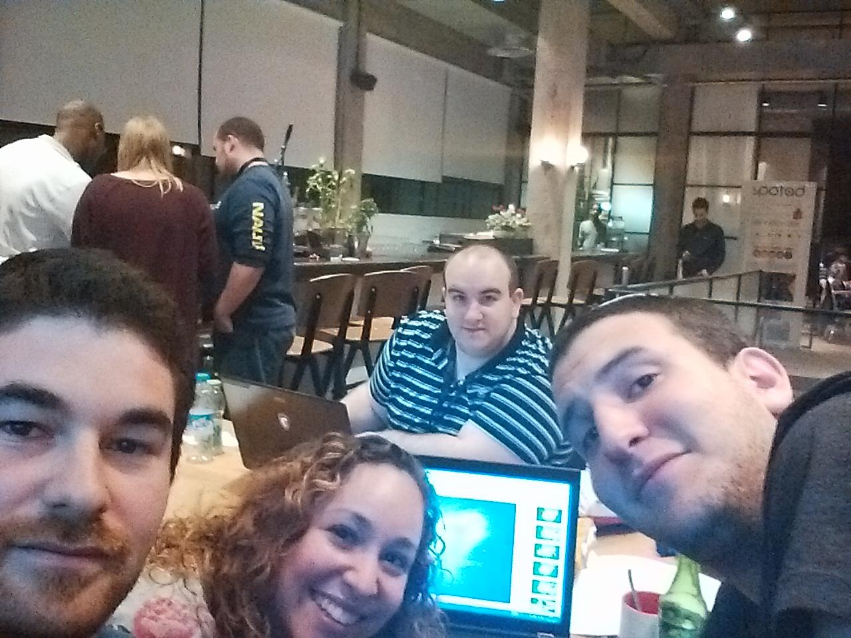
Best ad game ever!!!11
Star wars matrioshka game

Slide 2
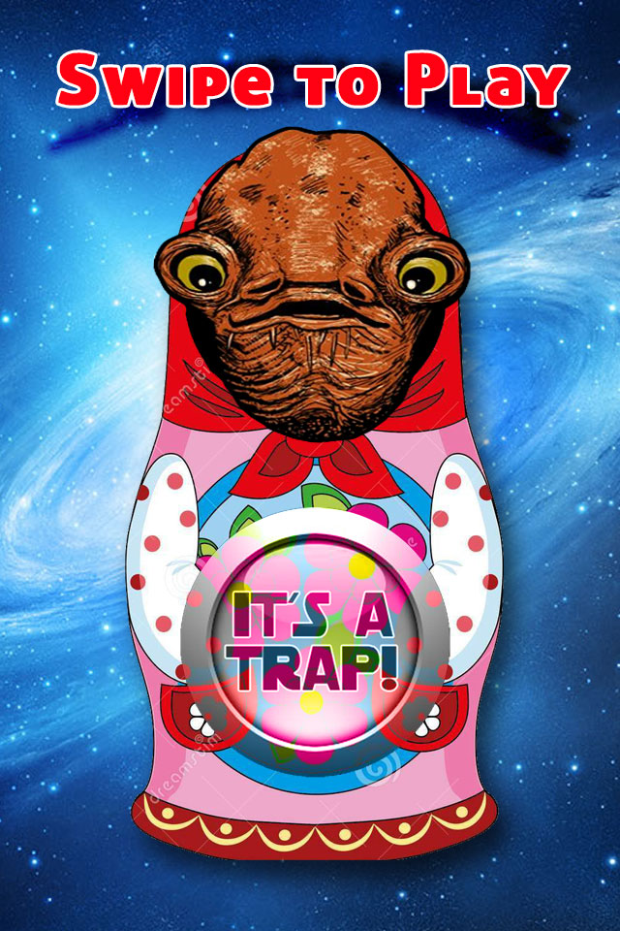
Start Frame:

Slide 3
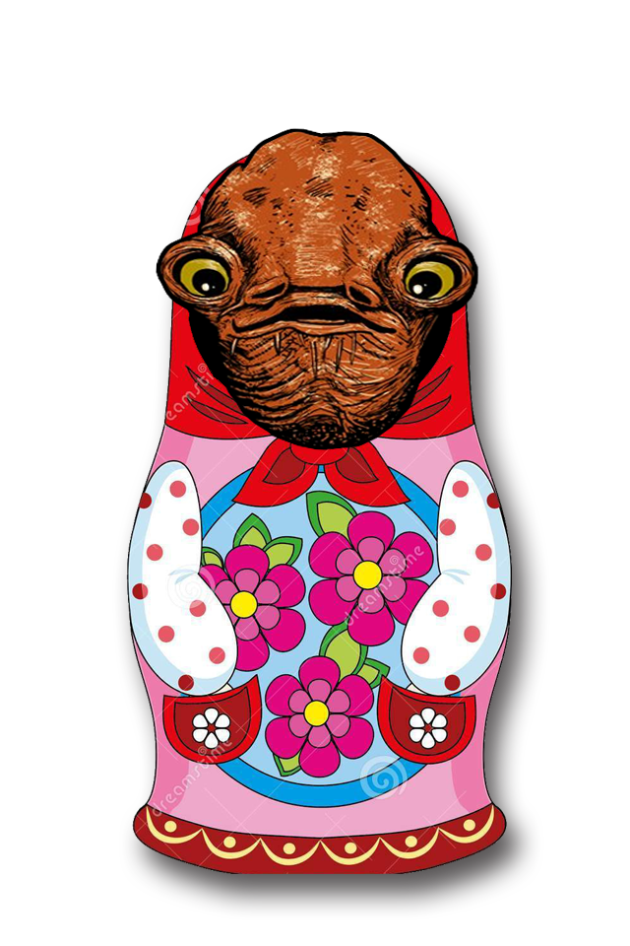
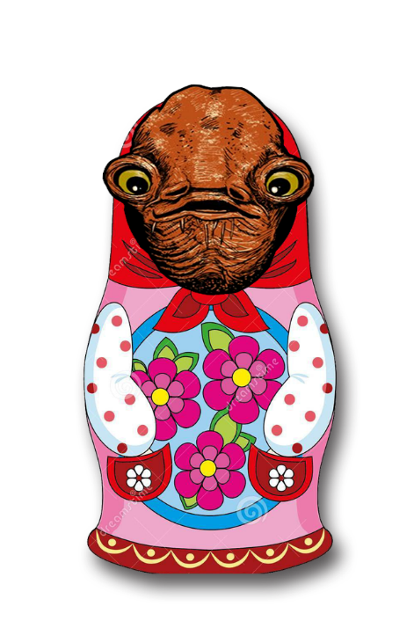

Play frame:

Slide 4
Goes on forever!!!

Slide 5
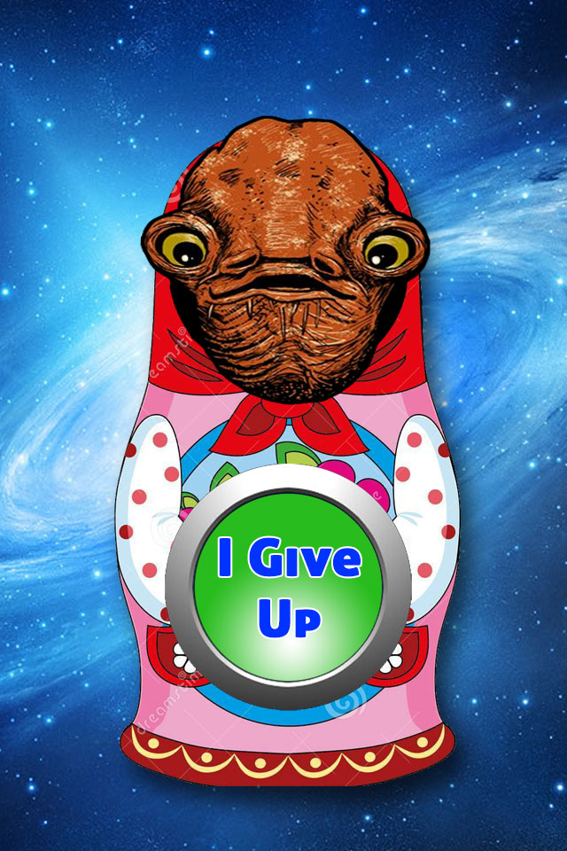
Or until you give up

Slide 6


If you did enough effort you win:
* Your equity stake is measured by your persistence.

Slide 7
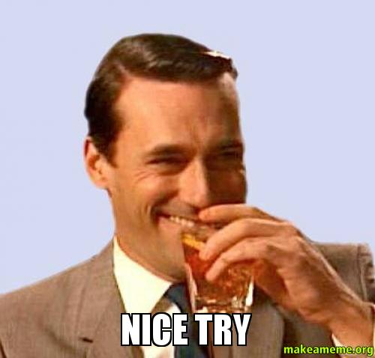
If you lack determination you lose:

Slide 8
Get it now on your neighborhood’s app store

Slide 9
Objectives accomplished:
Have FUN!!!!
~2000 calories
Get hired by spotad
Beat Taglit
Endless glory forever!!!!111@#$%

