Slide 1
CS231. Nhập môn Thị giác máy tính
Object segmentation
Mai Tiến Dũng

Slide 2
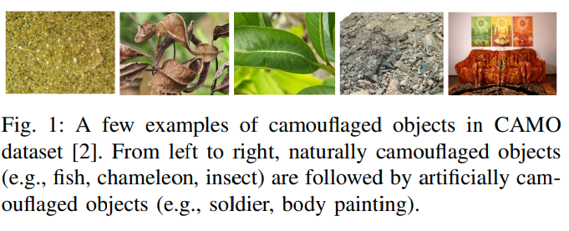
MirrorNet: Bio-Inspired Camouflaged Object Segmentation
https://arxiv.org/abs/2007.12881

Slide 3
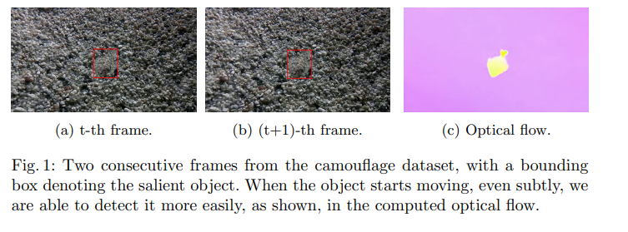
Betrayed by Motion: Camouflaged Object Discovery via Motion Segmentation
https://www.robots.ox.ac.uk/~vgg/data/MoCA/

Slide 4
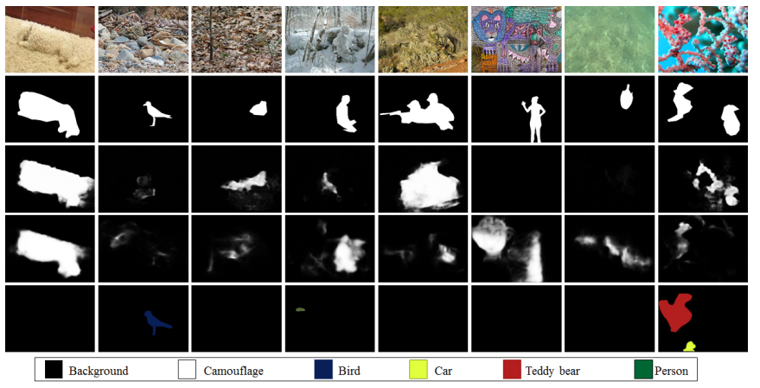
MirrorNet: Bio-Inspired Camouflaged Object Segmentation

Slide 5
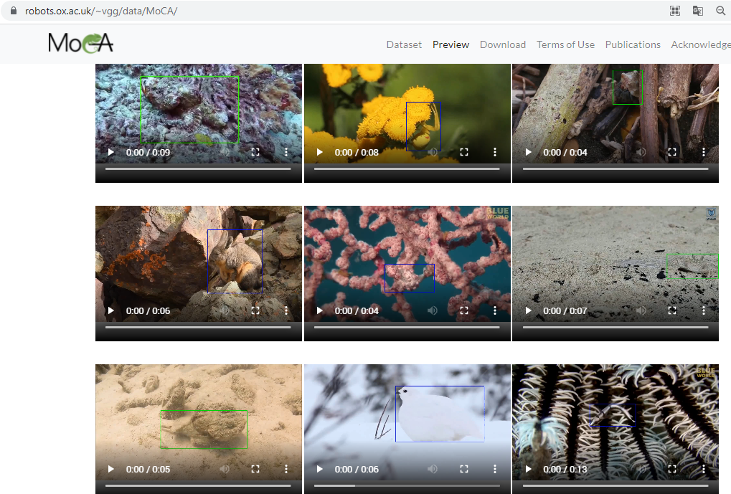
Betrayed by Motion: Camouflaged Object Discovery via Motion Segmentation
https://www.robots.ox.ac.uk/~vgg/data/MoCA/

