Slide 1







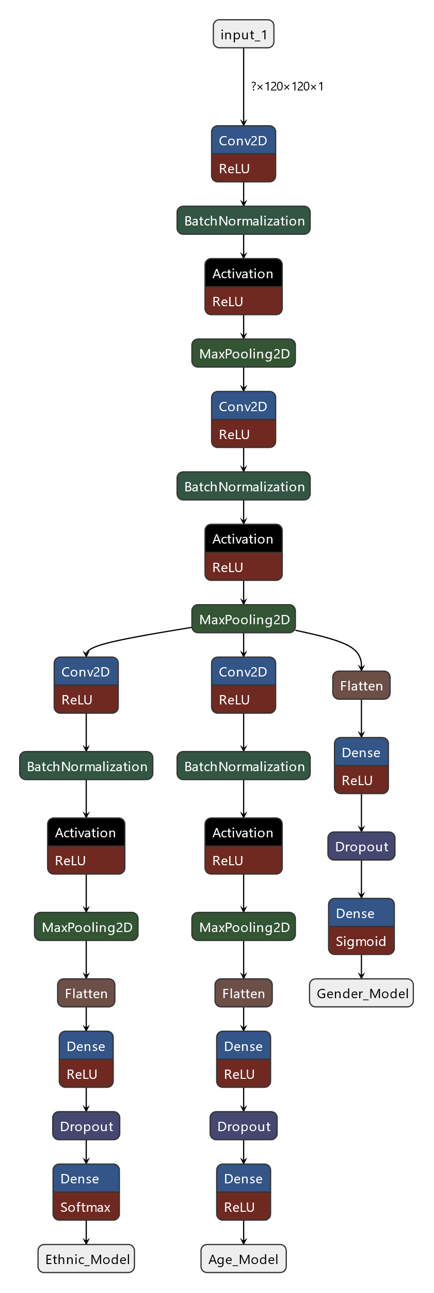

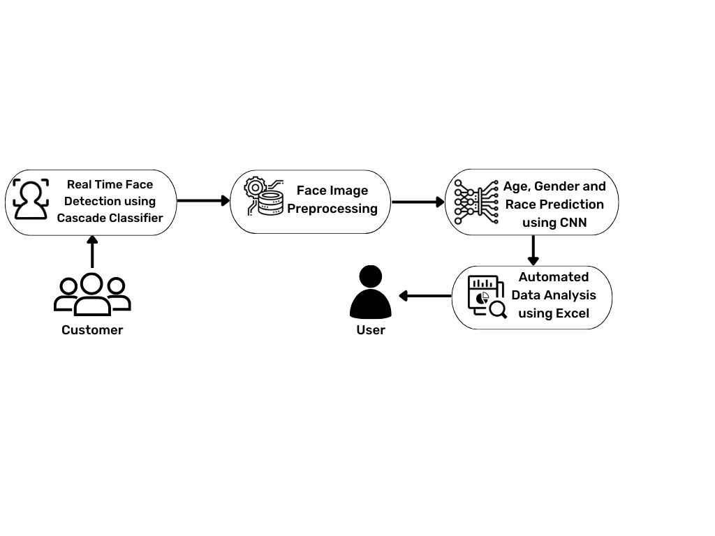
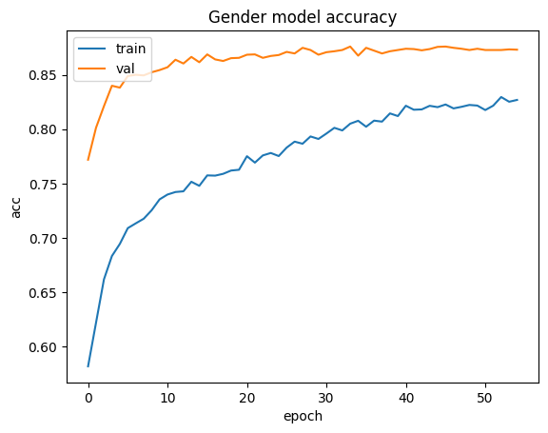
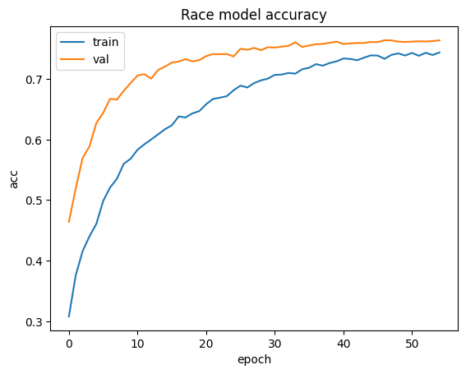
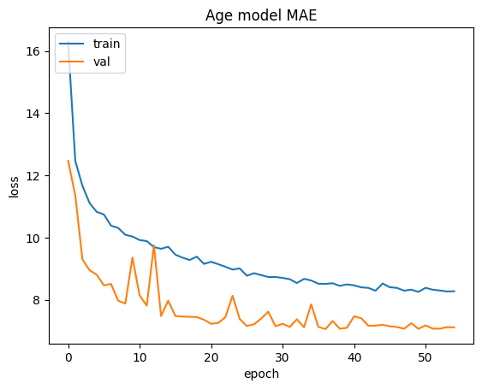
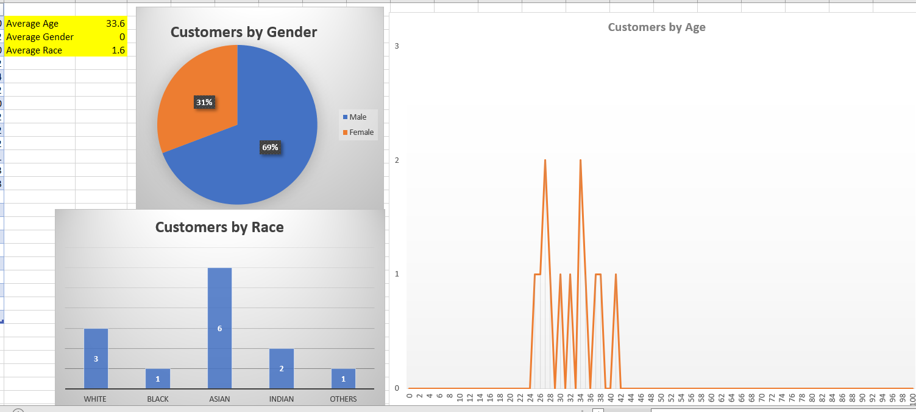
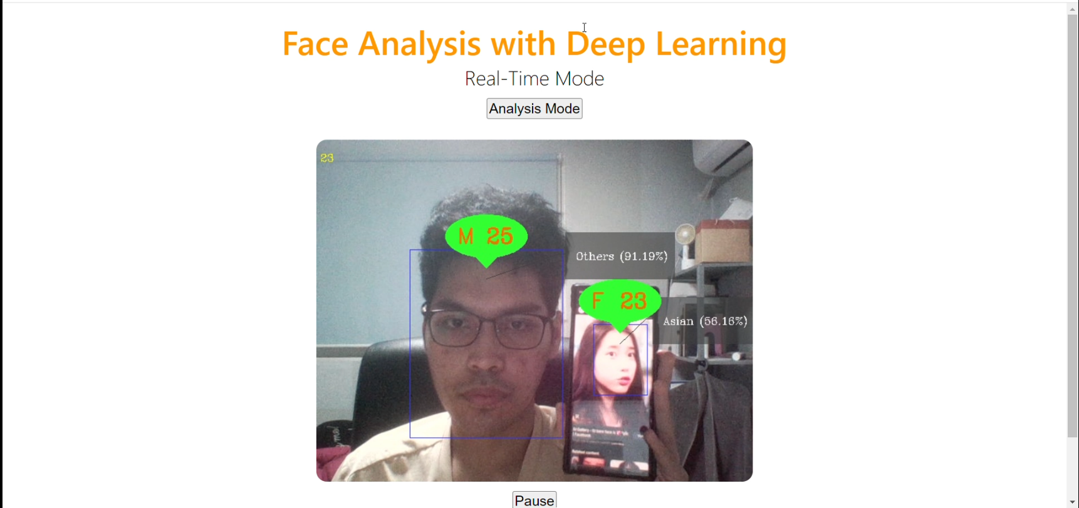
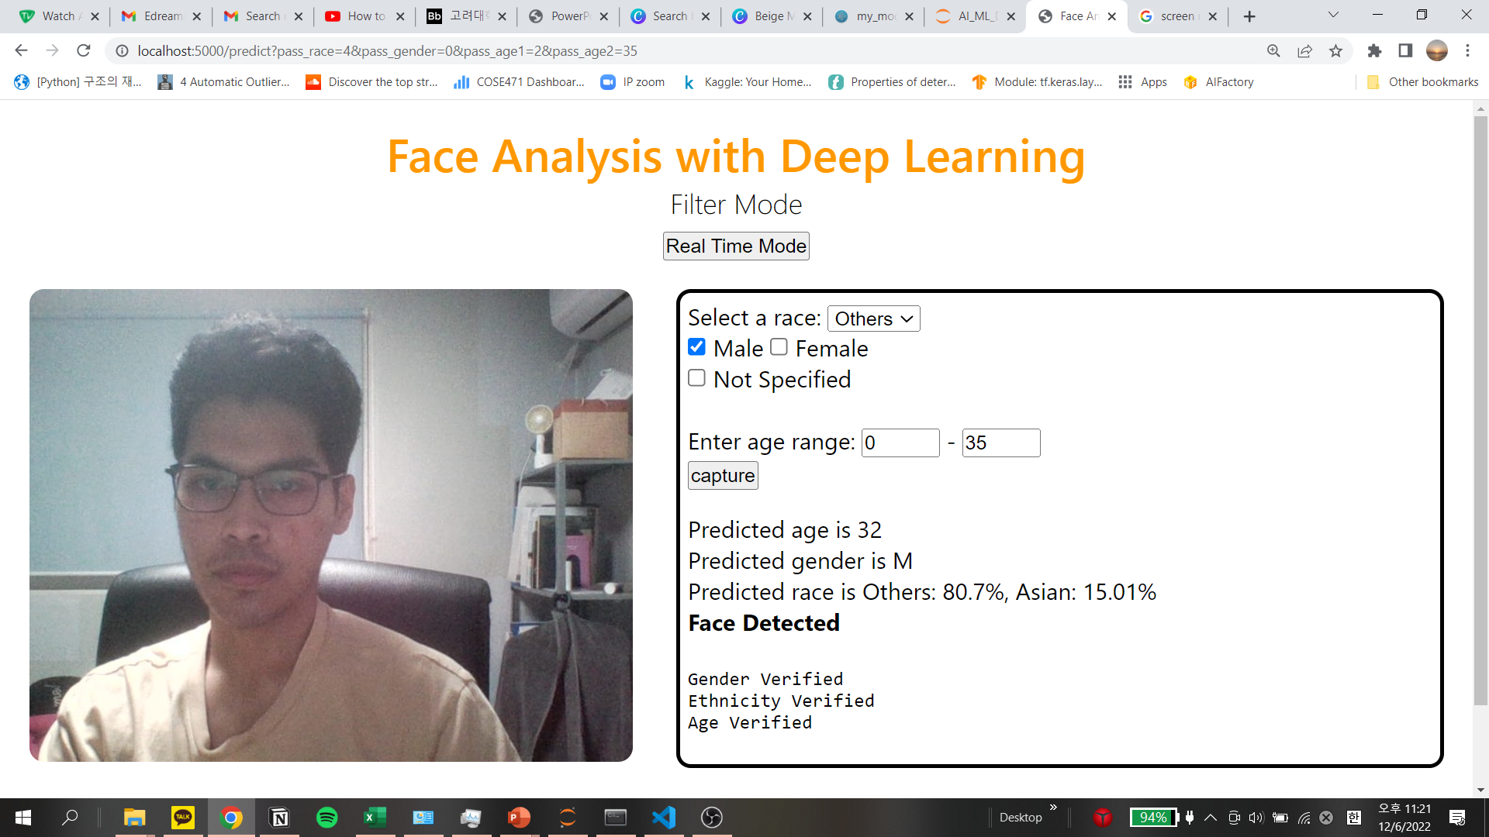
2022 Fall Semester
Capstone Design Project
Face Analysis for Customer Segmentation using Deep Learning
Affiliation : Department of Computer Science & Engineering
Name : Mohamad Azrai bin Mahadan
Introduction
Methods
Background
Customer segmentation is important and a trend in marketing industry.
A lot of data can be analyzed from the customers that come to a shop.
By understanding the pattern of customer, user can increase business profits.
There is a need to utilize the data to provide meaningful insights for the user.
Objective
Build web application that helps predicting and automatically analyzing the demographic information like age, gender and race of the customers in real-time.
Development Tools
Figure 3 Core tools used during deep learning model development and deployment
Model Development
Model is trained using UTK Face dataset.
Due to limited computation capability, shallow CNN with Functional API is designed.
Optimization methods
Adam optimizer
Early stopping
Learning rate reduction.
Core Function
System Design
Figure 4 Model architecture of Shallow CNN (3 Convolutional blocks)
Web Browser
Results/Evaluation
Gender and race prediction achieve 87.6% and 76.1% accuracy on test set respectively. Age model is evaluated using mean absolute error(MAE) achieves 7.2 age error.
Figure 1 End-to-end face detection, prediction and deployment.
Figure 5 Model accuracy of each demographic attributes
Figure 2 Collected data are automatically visualized using Excel
Figure 6 Example of the application in real-time mode(left) and filter mode(right).
Notes:
There are different methodologies for customer segmentation, which includes geographic, demographic, behavioural and psychological based segmentation.
Early stopping and lr scheduler based on ethnic model metrics because the hardest to optimize.

