Slide 1





AI SMART STUDY RISK &
PERFORMANCE PREDICTOR
Team Members
Dilay Tarhan (63750626)
Azra Özdaş (47786847)
Eylül Özekinci (42088852)
Müslüm Selim Akşahin (28841832)

Slide 2

TEAM STORY & RESPONSIBILITIES
How We Became a Team
We decided to form our team during the 2nd semester for our Computer Science Project.
Since then, we have worked together on multiple university projects.
Through previous collaborations, we learned each other's strengths, communication styles, and work habits.
This experience helped us divide responsibilities efficiently and work as a coordinated team throughout the project.
Azra Özdaş – Frontend Development, Streamlit Dashboard, User Interface, Authentication System
Eylül Özekinci – Machine Learning Model, Prediction Logic, Model Evaluation
Müslüm Selim Akşahin – Dataset Generation, Data Preprocessing, Backend Development
Dilay Tarhan – Testing, Documentation, Reports, Daily Logs

Slide 3
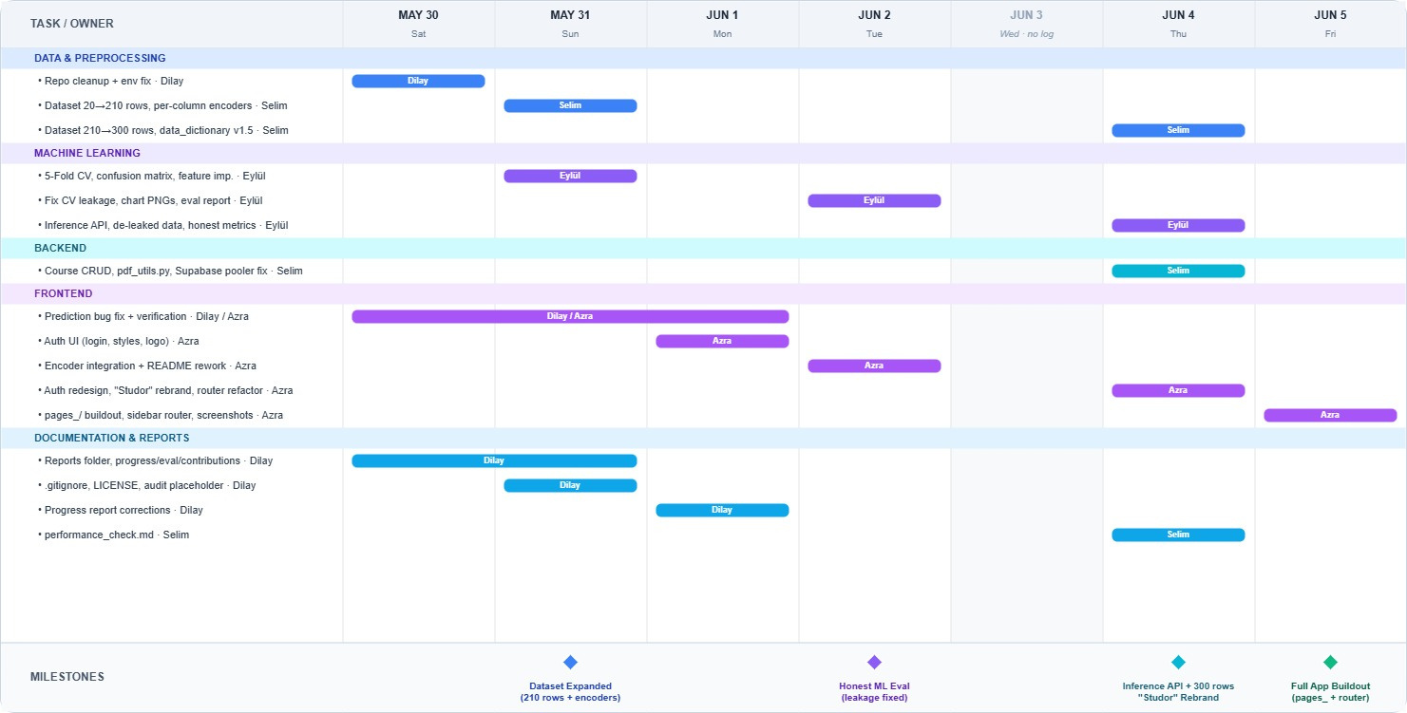
GANTT CHART & TIMELINE

Slide 4

THE PROBLEM
WE WANTED TO SOLVE
Many students struggle with academic pressure, overloaded schedules, and poor study planning. In many cases, students realize academic problems too late, after deadlines accumulate and performance begins to decrease.
As university students ourselves, we recognized this problem firsthand and wanted to explore how artificial intelligence could help students spot academic risk earlier. Our team turned that idea into Studor (AI Smart Study Risk & Performance Predictor): a prototype that analyzes study habits, attendance, deadlines, and grades to flag Low / Medium / High risk before problems escalate.

Slide 5

PROJECT OBJECTIVE
This project develops Studor, an AI-supported academic assistant that helps students understand study performance and workload. By analyzing attendance, study hours, assignment deadlines, pass grade, assignment difficulty, and workload level, the system predicts academic risk (Low / Medium / High) and presents results through an interactive Streamlit dashboard with study recommendations and model evaluation charts.
Main Features & Technologies
Academic risk prediction (Random Forest Classifier)
Workload and study behavior analysis
Rule-based study recommendations & weekly schedule
Interactive dashboard with Plotly visualizations
User authentication (Supabase PostgreSQL)
Python · Pandas & NumPy · Scikit-learn · Streamlit · Plotly · Joblib
GitHub & Microsoft Teams (version control & collaboration)

Slide 6
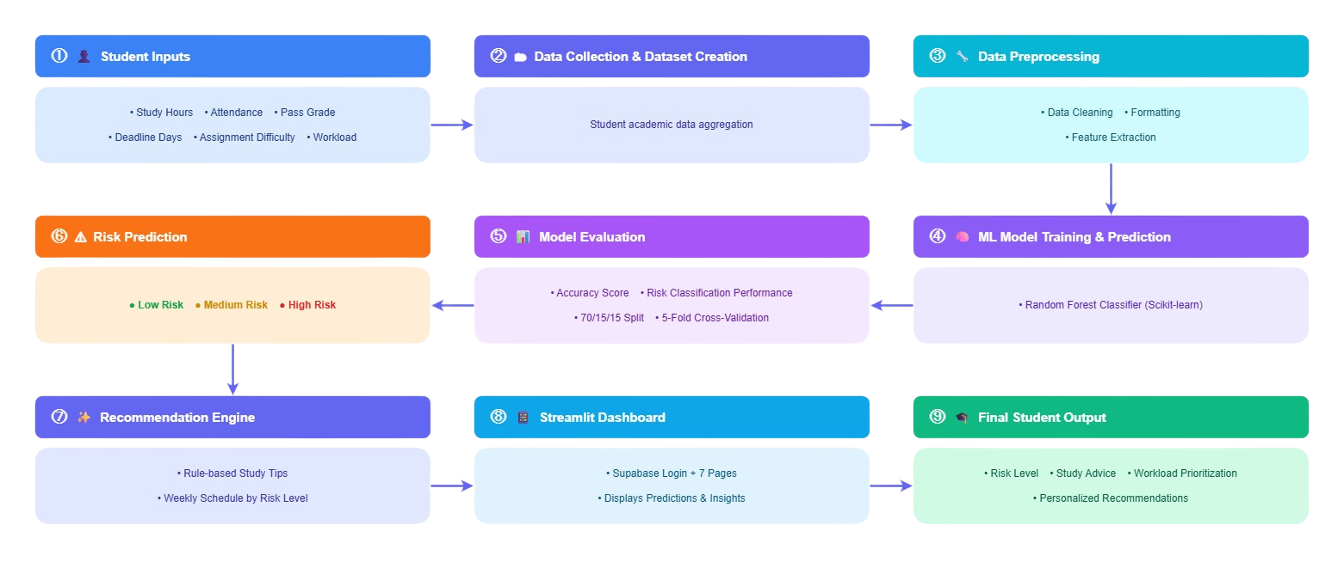
SYSTEM WORKFLOW

Slide 7

DATASET PREPROCESSING
A simulated academic dataset (300 rows) was created because real student data is private and hard to access. Profiles for Low / Medium / High risk use overlapping value ranges plus ~12% injected label noise, so the classes are not perfectly separable — this keeps the model's results realistic instead of artificially perfect.
The dataset has 7 features — course, study hours, attendance, deadline days, pass grade, assignment difficulty, and workload level — and the target, academic risk level. These reflect realistic study behavior and workload conditions.
During preprocessing, missing values are imputed (median for numeric features, mode for categorical features), duplicate rows are removed, values are standardized, and categorical variables are label-encoded. Although the current dataset contains no missing values, imputation is included as a safeguard because Random Forest cannot process missing values directly.

Slide 8

FRONTEND DASHBOARD
The frontend is a Streamlit application (Studor) with a Supabase-backed login (sign in / register / password reset). After authentication, a custom sidebar routes to seven pages: Dashboard (KPIs, risk distribution, deadlines), Course Analytics, Risk Prediction (model form with confidence, probabilities, and recommendations), Study Schedule, Recommendations, Model Results (confusion matrix, feature importance, test predictions), and Profile. The dark-theme UI focuses on readability, clear visualization (Plotly charts), and a realistic scope for a university AI MVP.

Slide 9


MACHINE LEARNING MODEL
Model Selection
A Random Forest Classifier was selected because it provides reliable predictions, works well with different types of features, and offers interpretable feature importance scores. It is a robust model that is widely used for classification tasks.
Training Process
The dataset was cleaned, preprocessed, and encoded before training. A stratified train-validation-test split was applied to ensure balanced class distribution, and 5-Fold Cross Validation was used to evaluate the model's performance and reliability.
Prediction Output
The model predicts whether a student is at Low, Medium, or High academic risk. It also provides confidence scores and supports the generation of personalized study recommendations to help students manage their workload more effectively.

Slide 10
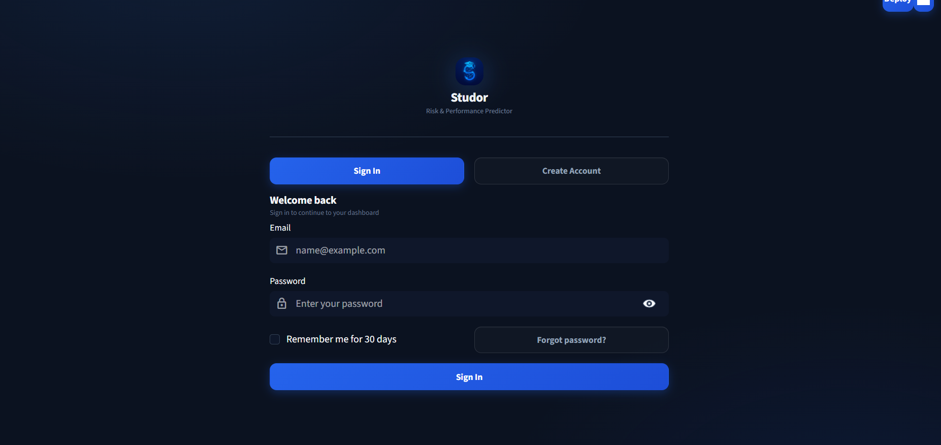
LOGIN PAGE

Slide 11
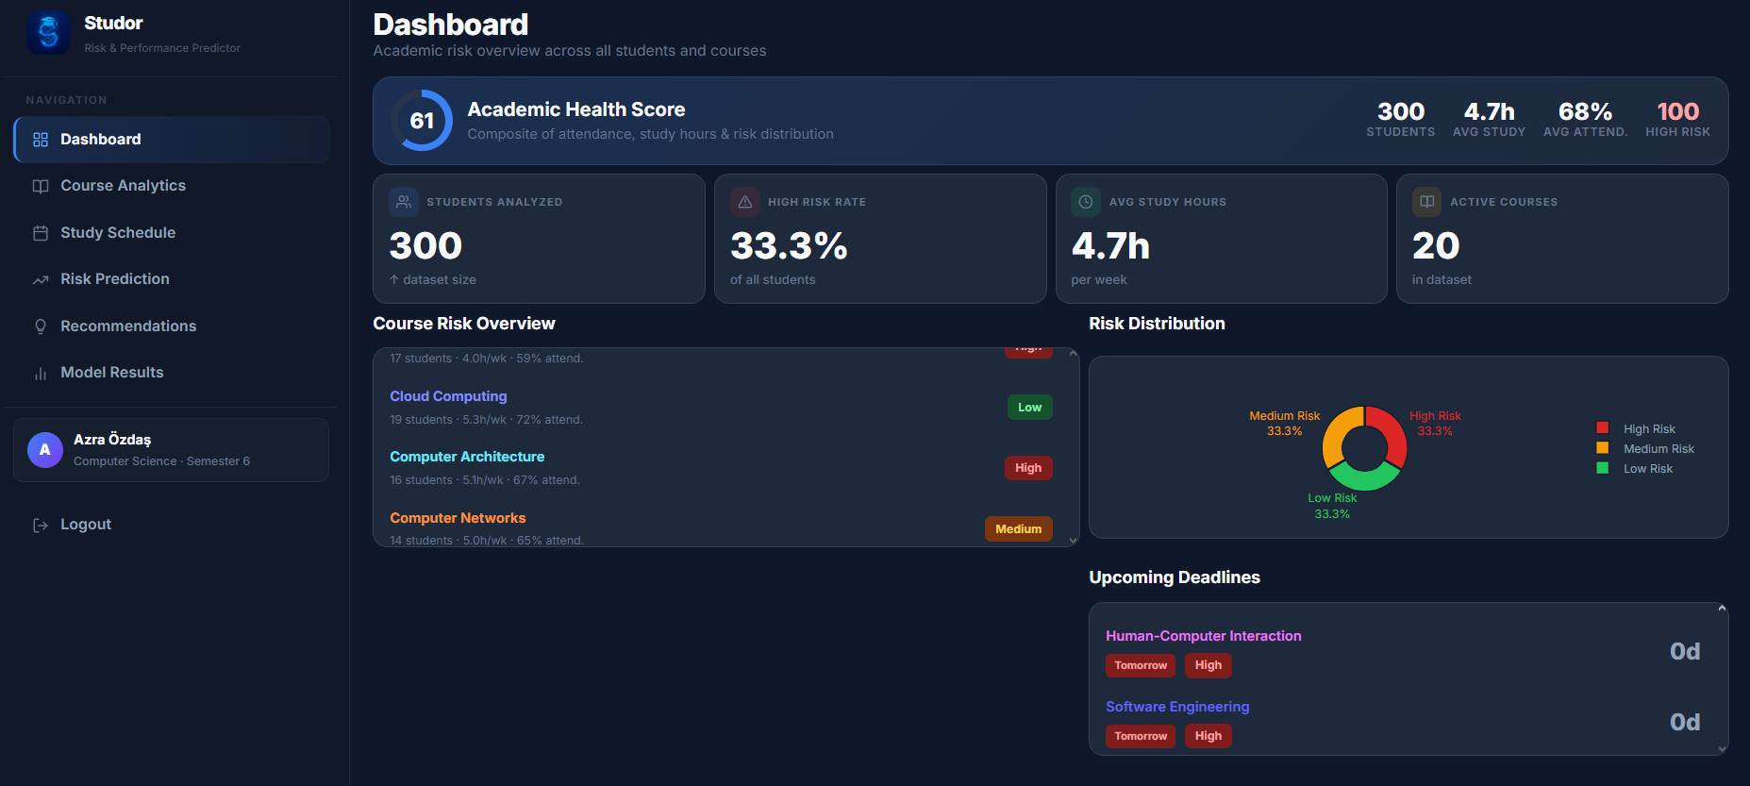
DASHBOARD

Slide 12
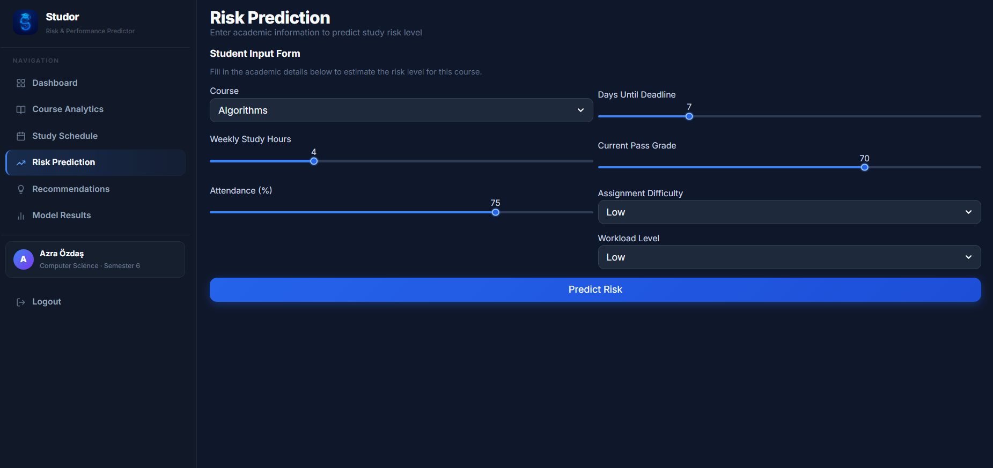
RISK PREDICTION

Slide 13
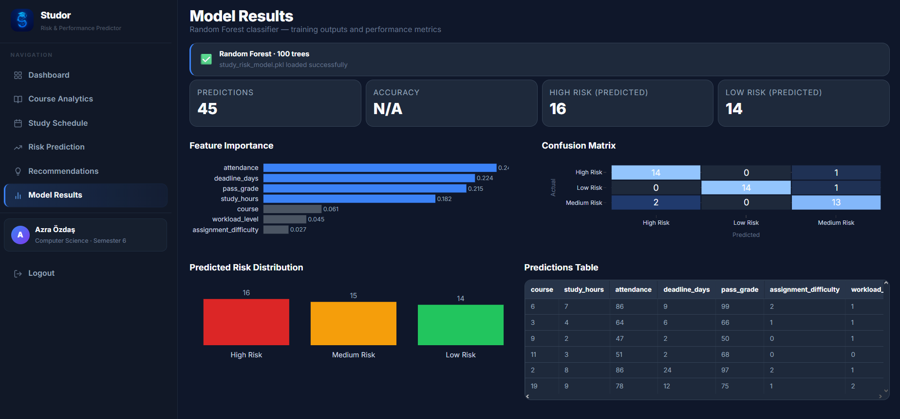
MODEL RESULTS

Slide 14

CHALLENGES
• Our initial dataset achieved 100% accuracy due to data leakage caused by fixed labeling rules.
• We redesigned the dataset with overlapping feature ranges, label noise, and increased it to 300 samples.
• We implemented a 70/15/15 stratified split and 5-Fold Cross Validation for more reliable evaluation.
• Final results were 86.67% CV Accuracy, 88.89% Validation Accuracy, and 91.11% Test Accuracy.
• We also resolved frontend-model integration issues, encoding inconsistencies, and Git/Supabase connectivity problems.
• Finally, we resolved Git synchronization issues and Supabase connectivity problems during development.

Slide 15

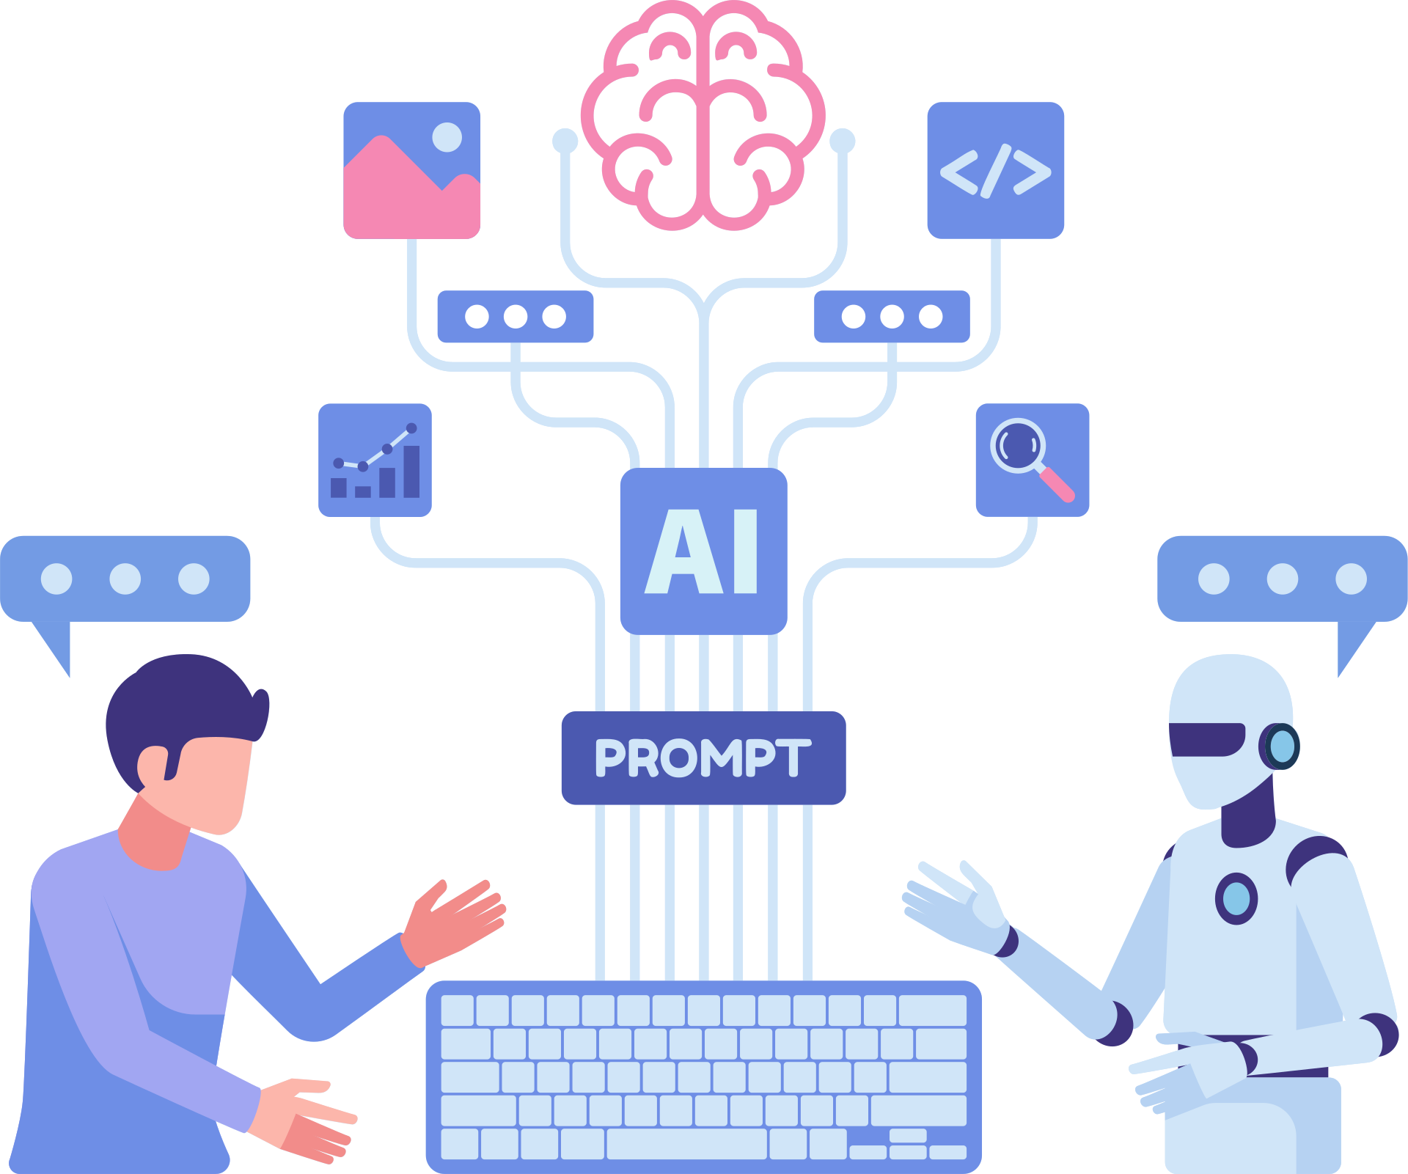
FUTURE IMPROVEMENTS
AI PDF & Document Analysis
Students could upload lecture PDFs, assignments, or course materials directly into the system. The AI model could then analyze the documents and detect workload difficulty, deadlines, and important topics automatically.
Real-Time Analytics & Notifications
The system could later include real-time analytics, smart notifications, and deadline reminders to help students manage academic workload more effectively throughout the semester.
Personalized Student Profiles
During registration, students will provide information such as their university, degree program, and current semester. The system will start with a personalized profile and gradually become more accurate as students add more information over time.
Course Management System
Students will be able to add, manage, and view their courses in a dedicated section.After adding a course, they will be able to select it directly in the Risk Prediction page and receive course-specific risk assessments.

Slide 16

THANK YOU
QUESTIONS?

