Slide 1
Paypal Node Infra
Development Environment

Slide 2
Agenda
Understand the configuration used in the development mode
Laptop for dev machine
Laptop runs the application
Laptop seeks PayPal services (on service machine)
Configure the application to run in the laptop
Exercise
Get the application from github
Configure the app to run on the laptop
Configure the resources the application needs
Test the app

Slide 3
Developer Configuration
Browser
App
services
db
laptop

Slide 4
Developer Use Case
Get the sample app from github
OR
Get your app from github
Increase the network timeouts in /config/development.json as shown on the next page.
Start the app on the local machine in the browser using:
Name is ‘buttonmill@paypal.com’, password is ‘45454545’
http://localhost.paypal.com:8000/sampleapp
Or use the port number and application name configured in /config/config.json
Test the app using your browser
Repeat as needed

Slide 5
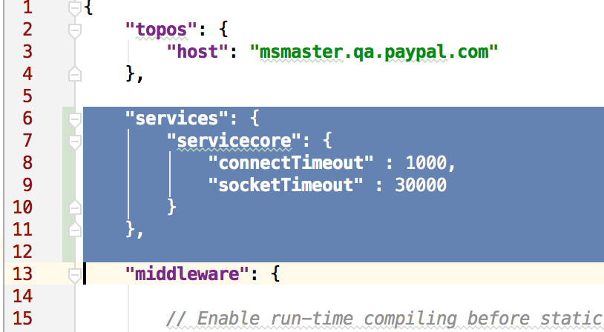
Increase Network Timeouts
Increase the network timeouts in /config/development.json.
Add the lines in blue to the configuration file.
This allows the development machine to have longer connect times and socket timeouts. Useful if overseas or using a VPN.

Slide 6
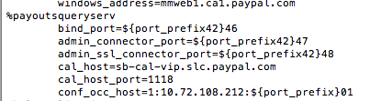
Services Layer
Defined in topo file
Service name
Location
Transport
http
ASF
RESTful
Sparta Proxy (deprecated)
Only allows the app to connect to certain services for security

Slide 7
Start Server on Laptop
Change to the folder
Use git clone <url>
Configure npm to use PayPal’s internal registry
Use npm config set registry http://npm.paypal.com
Use npm to build and start the application
Use npm install
This compiles some of the modules
Use npm start
NOTE: the CAL messages now go to the console
Open the browser to:
Use http://localhost.paypal.com:8000/sampleapp

Slide 8
Resources
Node.js Cookbook – http://go/nodecookbook
Watson – http://watson
PayMon – https://paymon.paypal.com
CAL – http://ppcal
Monitor - http://monitor.vip.paypal.com/ (Big Brother / Big Mother)
AnswerHub – https://ahpaypal.corp.ebay.com/spaces/190/nidejswebcore.html
SystemInternals, NetSecTools etc requires special privileges and could be accessed through SiteView
Monitoring URLs: https://dev.paypal.com/wiki/General/MonitoringURL

