Slide 1
Node Infra – brogan

Slide 2
brogan – Paypal Bootstrap
Takes most of the configuration work out of using the paypal infrastructure
Adds default middleware
Makes it much easier to access internal resources
services
security
protected packages
Look at the README on github
https://github.paypal.com/NodeInfra

Slide 3
What is brogan
brogan adds support for the following
topos
vault protocol in configs
servicecore configuration
provide standard Infra configuration
enforces these Infra dependencies
cal
commons-paypal
pplogger
express-meta
ecv-paypal
analytics-paypal
keebler-paypal
monitor-paypal
connect-mayfly
device-detection-paypal

Slide 4
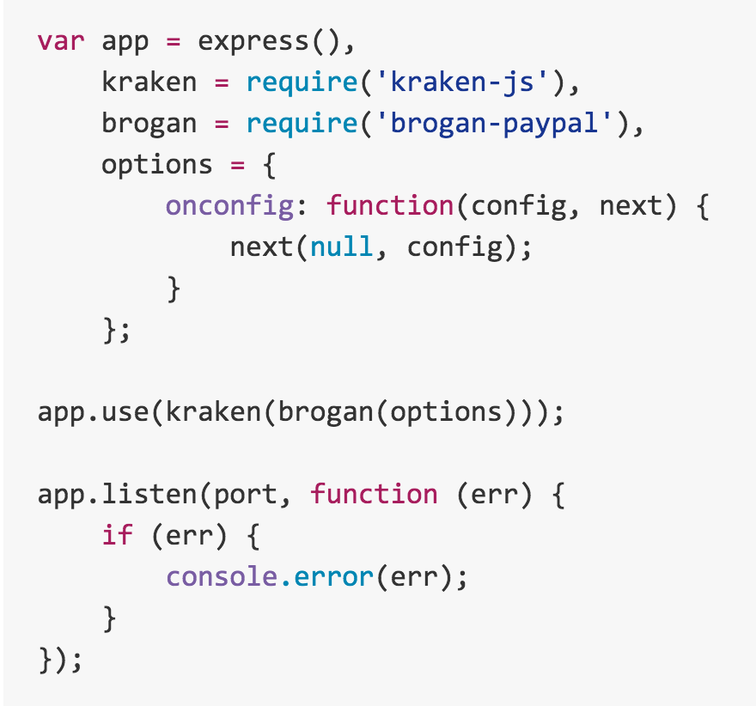
brogan
Works as a wrapper for kraken’s onconfig function

Slide 5
brogan
Most of the support requires no programmer intervention
Unless you want to access another service
CAL instrumentation
Requires insertion of CAL messages
See next section
Mayfly
Requires no configuration to use as a session store
In development mode, usually use local file store

Slide 6
connect-mayfly
connect-mayfly is a Mayfly session store backed by node_mayfly
Kraken configuration
"session" : {
"module": "connect-mayfly",
"secret": "santa",
"config": {
"crypto": true,
"noRetries": 5
},
}

Slide 7
MAYFLY OPTIONS
Options
appName App name, for logging purpose
noRetries number of retries for connection
timeout timeout for connection to mayfly directory server
crypto Boolean value (true|false) to use data encryption
algorithm If crypto is true and you want to use algorithm other than aes-256-cbc . Refer node-mayfly for details
prefix Key prefix defaulting to "sess:"

Slide 8
New session??
This module will add
_isNewSession: true | false
property on the session object
determines if new session or old one
_sessionLen
property on the session object
Length of the session

Slide 9
node-vault
This library is a wrapper for what is traditionally known as Protected Packages.
Provides a simplified API for accessing protected values based on a known key.
Can get server credentials to build a HTTPS server
Can get client credentials to make an HTTPS client request.
Can get values for key string.
Best Practices:
Use the “Vault:keyString” protocol in config/config.json

Slide 10
Example of Vault
Vault resolver – handler for shortstop – extracts information from the Vault using the “Vault:keyString” protocol in ‘config/config.json’
Provide the mayfly configuration which uses vault protocols – Next page.
If someone needs a value from the vault, then use the vault protocols…
Extract from the config file.

Slide 11
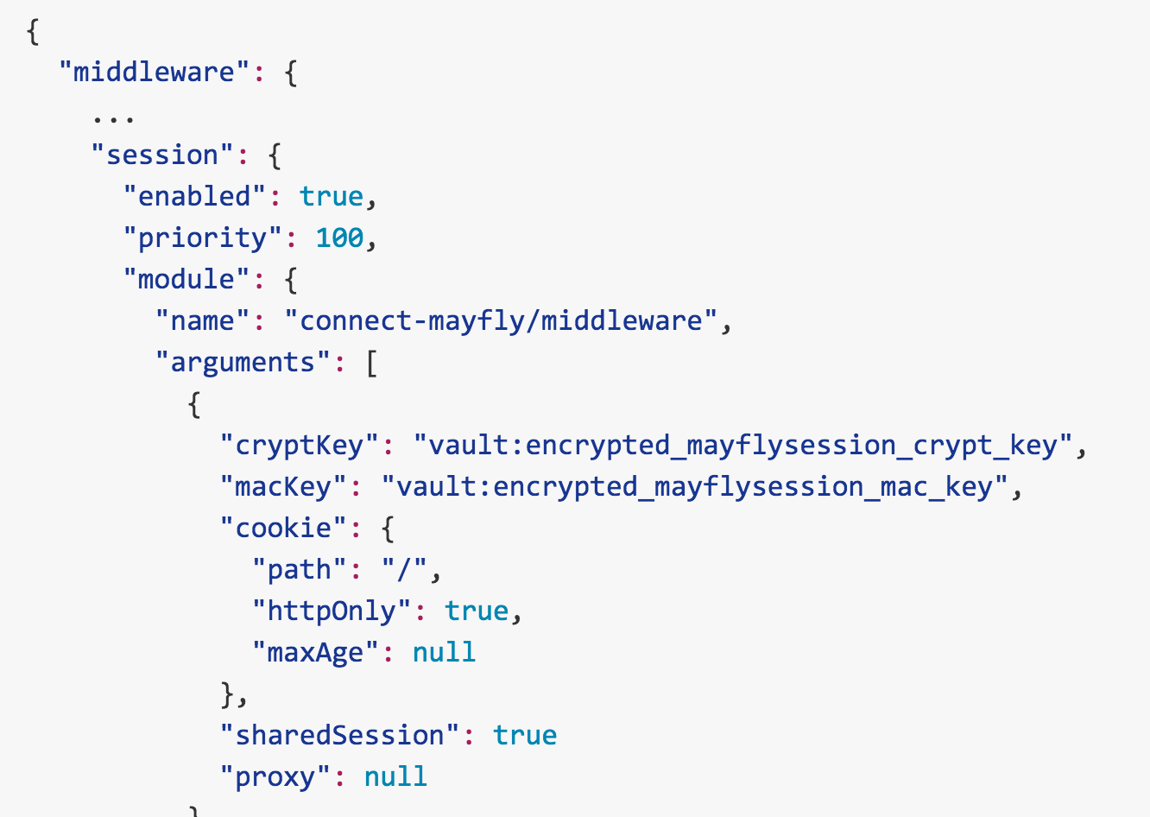
Example of Mayfly Vault Params

Slide 12
servicecore
Transport wrapper for service calls.
Makes communicating with PayPal services easier
Default servicecore configuration done by Brogan
Examples in the next section

Slide 13
ppcommons
This module adds PayPal Common request data pieces for express middleware
Decorates the req object with:
application name
isInternalRequest – originates from internal IP
rlogId – format urlencoded, etc.
correlationId – unique id for CAL – 12 bit
encryptedHostName
uuid – 32 bit
pageStartTime – page load start time
ts – decoded tracking service (analytics) cookie

Slide 14
topos
This module will add topos for node.js
Resolves the connection end points for PayPal internal services.
Different configuration for
Production
Staging
Development

Slide 15
Auth-paypal
Passport.js based security
Provides PayPal token validation and authorization
Configured by brogan

Slide 16
demo
Open github to the NodeInfra site
https://github.paypal.com/NodeInfra
Examine the github site for the source of the NodeInfra middleware components
Resources:
https://engineering.paypalcorp.com/confluence/display/DemoPortal/Useful+Links%3A+Node%2CSSO%2CGit%2CMongo%2CDust%2C+Bootstrap%2CNode-Infra%2CHME

