Slide 1
Node Infra – CAL

Slide 2
CAL – Centralized Application Logging
Node CAL page
http://cal-web-stage-vip.qa.paypal.com/cgi/logview?p_cmd=list
http://mscal.qa.paypal.com/cgi/logview
Then search for you application name
Used for CAL messages for Altus deployed applications
CAL Confluence page
https://engineering.paypalcorp.com/confluence/display/CAL/CAL+Cookbook

Slide 3
Agenda
What is CAL?
CAL Best Practices
CAL Report View and Log View
CAL API, Demo / Example
Resources and Summary

Slide 4
Who uses CAL ?
Site Ops/SWAT
To run the live site. To know the health of Paypal site, its performance
Dev Engineers
Add their CAL logs in the application code
When analyzing/triaging live site issues
QA Engineers
To test new features or existing bugs in stage and live environments
Business
To analyze the usage of new features or get business metrics

Slide 5
CAL Purpose
To understand the run time systems’ holistically
To enable system health monitoring
To enable business monitoring
To manage capacity
Notes:
To enable system health monitoring
e.g. cal logs to indicate service connection failures or timeouts, abnormal process terminations, tracking duration of an activity
To enable business monitoring
e.g. cal logs to indicate credit card authorization declined, insufficient fund in source account
To manage capacity
e.g. cal logs to indicate volume of transactions handled by a service
To understand the run time system in large.
To understand how exceptions were handled by an application
Failure detection and reporting - Provide data to allow OPS and SWAT teams to perform site monitoring and diagnostic.
Site performance and usage - Provide service feature quality and usage statistics to business for planning. Provide data to allow OPS on understand system utilization and for capacity planning.

Slide 6
CAL Principles
All CAL messages must be aligned with the CAL purpose
CAL messages must be concise, consistent, and should minimize information redundancy
CAL messages are not for debugging applications or for tracing code execution paths
Host resource monitoring (like cpu, memory) should not be done with CAL
Framework code should be doing CAL logging whenever possible

Slide 7
CAL Protocol
CAL Transaction
CAL Event
CAL Message format
<Class><Timestamp>\t<Type>\t<Name>[\t<Status>][\t<Duration>][\t<Data>]
CAL Message size is 4096 Bytes

Slide 8
What is CAL ?
Central Application Logging
98% of PayPal applications instrumented
All site activity tracked in real time
Data collection centralized
Variety of real-time and historical reporting
What was CAL built for ?
Extensive monitoring solution
High Level Site metrics
Highly efficient and scalable
Minimal impact to applications
What CAL has evolved into ?
Business metrics solution - User Behavior Intelligence
QoS and TnS solution
Site Capacity Modeling metrics
Revenue impacting, mission critical functionality

Slide 9
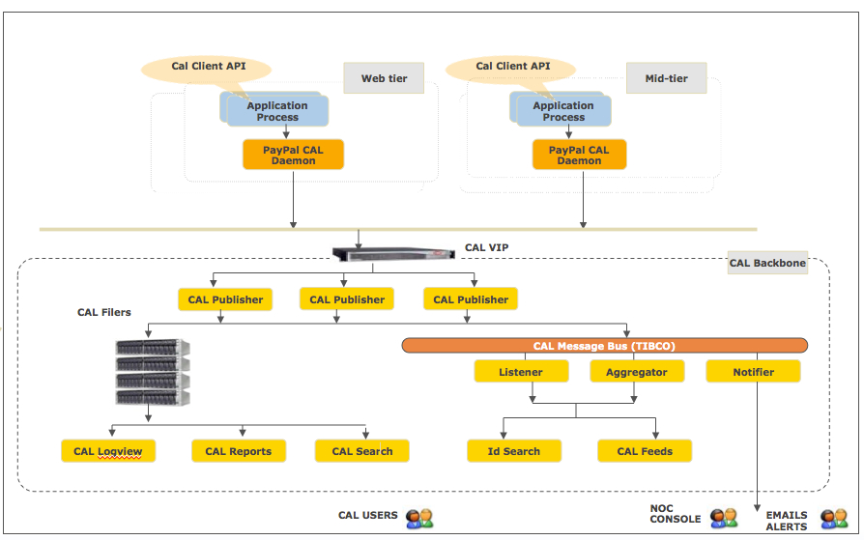
CAL Architecture
Notes:
How does CAL work? The application code is instrumented by CAL API calls.
The CAL Client Library implements this API.
The CAL Client Library sends a CAL message via TCP/IP to the CAL Daemon.
The CAL Daemon handles all CAL messages from the same system (machine).
The CAL messages are forwarded to the CAL Publisher (publisherd).
The Publisher archives the CAL message in log files and publishes them on a message bus in the CAL backend.
Several different consumers can subscribe to these CAL messages

Slide 10
CAL Messages
All CAL messages are abstracted in these three kinds of activities / Classes:
CAL Transaction: a unit of work (code) that takes certain amount of time and may fail
Can be nested Transactions
If there are no other messages between the transaction start and end, an atomic transaction message
CAL Event: a statistical message that occurs at the associated time
We can use this for raising warnings, errors, as well as informational messages.
CAL Heartbeat: a periodic message conveying status or statistics, normally related to the "health" of an application
Notes:
The SuperCAL API reduces all CAL logging to three kinds of messages: CalTransaction – an interesting unit of work that takes time to complete and may fail. If there are no other messages between the transaction start and end, an atomic transaction message is written that contains the start and end messages combined. CalEvent – A notification type of message. We can use this for raising warnings, errors, as well as informational messages. CalHeartbeat – a periodic message conveying status or statistics, normally related to the "health" of an application - Application statistics that are computed internally and logged at regular intervals, such as CPU%, MEM%, Tibco stats, Connection Pooling stats, and Oracle performance stats.
All three types of messages also have a Status, which is reserved to indicate success/failure.
Success is always indicated with a "0" string (the digit 0 as a string).
Failure is anything else but should not be the empty string. Failure status strings should follow the same general guidelines given above for Type and Name strings. We encourage you to go to the effort to log short, meaningful character strings. Please do not simply stringify an error code. The Status strings will be displayed in reports and in logview pages. Don't make your colleagues (or yourself, two months from now) have to go look up the meaning of a numeric error code.
The maximum size of a CAL log (Heartbeat/Event/Transaction) must not exceed 4096 bytes including header.

Slide 11
CAL Instrumentation – Message Data Protocol
https://engineering.paypalcorp.com/confluence/display/CAL/CAL+Message+Specification
Spec:
<Class><Timestamp>\t<Type>\t<Name>[\t<Status>][\t<Duration>][\t<Data>]
Example:
T11:14:12.53 API GetBidderList 3.PIMP.INTERNAL.INVALID_PASSWORD 527ms port=1252
Message CLASS
TRANSACTION – t, T, A [t => start, T => end, A => atomic]
EVENT – E
Heartbeat – H
Message TYPE – What kind of thing happened
Message NAME - Where it happened? or what type of error happened?
Message STATUS – Success [status code is 0] or Failure
Message DATA - Message payload; name=value pairs separated by '&'
Notes:
Class: there are five defined CAL message classes; each class is represented as a single character:
T, T, A, E & H
Transaction: Transactions may be nested. Most transactions may fail and therefore have a completion status code. If there are no other messages between the transaction start and end, an atomic transaction message is written that contains the start and end messages combined.
Heartbeat: application statistics that are computed internally and logged at regular intervals, such as CPU%, MEM%, Tibco stats, Connection Pooling stats, and Oracle performance stats.
Event: catch all for all other types of messages that are not transactions or heartbeats. It includes Warnings and Errors, as well as Informational messages and CAL internal messages.
Timestamp: records when the logging occurred, in the format of "HH:MM:SS.mm", and has precision of centiseconds.
Type: a case sensitive character string. Common transaction types are "URL", "Exec", "Fetch", etc. For events, types should be one of the following: "Info", "Warn", "Error", and "CAL", where "CAL" is used for CAL internal messages.
2.4 Name: a case sensitive character string whose namespace is within a type. Only alpha-numeric,'.','-', and '_' are allowed.
2.5 Status: a case sensitive character string whose namespace may be global. When a status is set repeatedly, the first non-"0" is used. Transaction Start messages don't have status.
2.6 Duration: tells how long a transaction takes. It's the time elapsed between the Transaction Start and the Transaction End. It's a floating point number that's in unit of milliseconds. It only appears in the Transaction End or Atomic Transaction messages. Event and heartbeat classes don't have duration field.
2.7 Data: a list of name=value pairs separated by '&'. The Transaction Start messages don't have data fields.

Slide 12
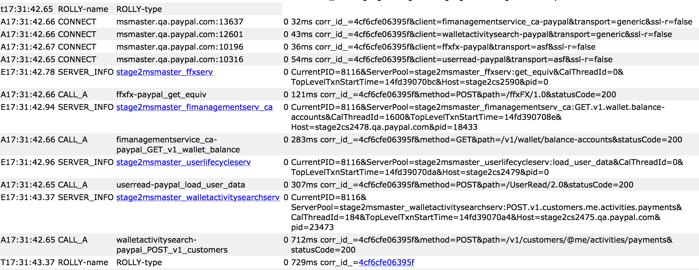
Example of CAL output

Slide 13
CAL Message details
Type: A case sensitive character string defined by app developer
Common transaction types are "URL", ”EXEC", ”API", etc.
For Events, types could be: ”FATAL", ”ERROR", ”WARNING", ”BIZ”, etc.
Should be 8 characters or less (best practice)
Name: A case sensitive character string whose namespace is within a type. Only alpha-numeric,'.','-', and '_' are allowed. Defined by the app developer
Should be 32 characters or less (best practice)
Status: 0 is ok. Transaction Start messages don't have status.
PayPal CAL Transaction and Event Error Status Code Scheme
Data: A list of name=value pairs separated by '&'. The Transaction Start messages don't have data fields.
Notes:
The above types of CAL Transactions have already been defined in the framework layer (ServerChild?.cpp, DaemonChild?.cpp, etc).
Make sure that “URL” and “API” are used only with root transactions.
Don't create your own business logic transaction using the above reserved TYPE’s.
Do not have nested transactions with same TYPE, this confuses the CAL report processing.
Do not use dynamically generated values for the CAL type and name fields, such as connection IP address and port number. This will cause huge number of CAL report files, as the CAL reports are created for each unique transaction name.
‘TYPE’ and ‘NAME’ should not be empty. If it is empty, the corresponding CAL transaction is set as ‘UNSET’. This might impact the CAL reports and hence not advised.

Slide 14
CAL Message TYPES
There few reserved keywords for TYPE, usage and keywords and usage are as follows:
TYPE Usage
URL - Used for outer-most transactions on Front-tire applications [web, admin, other HTTP protocol]
API - Used for Mid-tire applications getting requests from web or api tiers
EXEC - Used for all SQL’s Query. ”FETCH” Used for multi row fetch of SQL data
FETCHB - fetch batch
‘TYPE’ and ‘NAME’ should not be empty. If it is empty, the corresponding CAL transaction is set as ‘UNSET’.
Notes:
The above types of CAL Transactions have already been defined in the framework layer (ServerChild?.cpp, DaemonChild?.cpp, etc).
Make sure that “URL” and “API” are used only with root transactions.
Don't create your own business logic transaction using the above reserved TYPE’s.
Do not have nested transactions with same TYPE, this confuses the CAL report processing.
Do not use dynamically generated values for the CAL type and name fields, such as connection IP address and port number. This will cause huge number of CAL report files, as the CAL reports are created for each unique transaction name.
‘TYPE’ and ‘NAME’ should not be empty. If it is empty, the corresponding CAL transaction is set as ‘UNSET’. This might impact the CAL reports and hence not advised.

Slide 15
TYPE, NAME examples
TYPE Name
URL webapps_checkout_name
CALL_A Service Name
MAYFLY CONNECT, CREATE, GET,CONDITIONAL_UPDATE
KEEBLER Cookie handler
SERVER_INFO occ-risk 0 CurrentPID=7827
EXEC 47075185 0 27 HOST=RISK_POST
Notes:
The above types of CAL Transactions have already been defined in the framework layer (ServerChild?.cpp, DaemonChild?.cpp, etc).
Make sure that “URL” and “API” are used only with root transactions.
Don't create your own business logic transaction using the above reserved TYPE’s.
Do not have nested transactions with same TYPE, this confuses the CAL report processing.
Do not use dynamically generated values for the CAL type and name fields, such as connection IP address and port number. This will cause huge number of CAL report files, as the CAL reports are created for each unique transaction name.
‘TYPE’ and ‘NAME’ should not be empty. If it is empty, the corresponding CAL transaction is set as ‘UNSET’. This might impact the CAL reports and hence not advised.

Slide 16
CAL Status codes
A successful transaction should have a zero status code
For failure, use the error status code scheme:
Any non-zero status code will be flagged by CAL as an error
It can also trigger CAL Notifier to send alert of the error for investigation
Error Scheme:
<Severity>.<Calling Module Name>.<Error Category>.<Error Return Code>
Severity: 1- fatal, 2 - error, 3 - warning
Fatal: a critical part of the system is not working, and needs to be looked at by Ops/SWAT ASAP.
Error: a part of the system is not working, but does not need immediate service.
Warning: a condition which might soon result in an error - Heads-up

Slide 17
Agenda
What is CAL?
CAL Best Practices
CAL API, Demo / Example
CAL Report View and Log View
Summary and Resources

Slide 18
Where to Add CAL logging?
Application Failures
Log cases where your application fails
The performance of interesting units of work:
High Impact or Highly Variable Processing
Client/Server Relationship (Usually done by the framework)
outgoing client requests to a new server
incoming requests inside the new server
The maximum size of a CAL log (Heartbeat/ Event/ Transaction) must not exceed 4096 bytes including header.
Notes:
High Impact or Highly Variable Processing - Ops and the Business is generally interested in how much it costs—capacity-wise—to run a particular application. Log units of work in your application that are expected (or predicted) to have a high processing impact. Similarly, for application processes that have highly variable processing times, increased user activities that use your application may cause spikes in processing demand, impacting other applications, whole pools or the whole site. Best practice is to log these highly variable units of work to allow Ops to monitor the impact of these processes on site capacity
Guideline 1: When to Use CAL instrumentation?
If the application contains a try {} block which communicates with external services then instrument CAL.
If the application contains significant units of work that can fail or the application can fail but attempts to recover when it does so.
If application is impacting on processing capacity. In other words, application processing time is highly variable, than instrument CAL.
If the application is either a client or server for a new client/server relationship or service, you are strongly advised to add CAL instrumentation to log outgoing client requests to a new server as well as incoming requests inside the new server as CAL transaction messages.
If application has reporting requirements for Business Units, Product Management, Ops or Development to measure business transactions that require specific execution details beyond URL transactions or SQL queries, then Instrument CAL.

Slide 19
Guidelines: When to not use CAL
Do not use CAL Transactions for
Logging Sub-Millisecond, High Volume Transactions
Not interested in timing statistics – use CAL Events and not Transactions
Do not use CAL for
Printf()-style debugging
Size Matters
PayPal CAL productions generates > 1 TB* amount of log data each day
The maximum size of a CAL log (Heartbeat/Event/Transaction) must not exceed 4096 bytes (4KB) including header.
*
Notes:
*Logging transactions that execute in less that 1 millisecond and execute in high volumes will create undue overhead in your application from CAL logging operations.
Size Matters
In addition to the number of messages your application generates per day, also consider the size of your messages. CAL has been designed to accommodate the high volume of traffic on the sites. However, logging all of these transactions does have an impact on the CAL infrastructure and a specific impact on the hardware storage requirements for the CAL clusters. As now (September 2008), PayPal CAL productions generates > 140GB amount of log data each day.
The maximum length of a CAL message is 4KB, which includes the total length of all fields in the message. Data included beyond that 4K limit gets truncated.

Slide 20
Agenda
What is CAL?
CAL Best Practices
CAL Report View and Log View
CAL API, Demo / Example
Resources and Summary

Slide 21
CAL Reporting Tools
All under http://cal.vip.paypal.com
PayPal CAL ErrorView
Search production errors by keywords
Production access: http://cal-dev02.ca1.paypal.com:8080/cgi-bin/error_view/index.php?start=error
Correlation ID Search
locate the specific mid tier instances
Production access: http://cal.vip.paypal.com/idsearch.html
CAL Logview:
Provides: Detail CAL message logging information for all pools.
Usage: high level glance, detail diagnostic
Stage2 access: http://cal.vip.ca1.paypal.com/cgi/logview
Production access: http://cal.vip.paypal.com/cgi/logview
See next page.

Slide 22
CAL Reporting Tools – CONT.
All under http://cal.vip.paypal.com
DEN and PHX CAL Hourly and Daily Reports:
Provides: PayPal application statistics aggregated from CAL message log
Production access: http://cal.vip.paypal.com/24x7/2005/06-June/06/16:00:00/report/

Slide 23
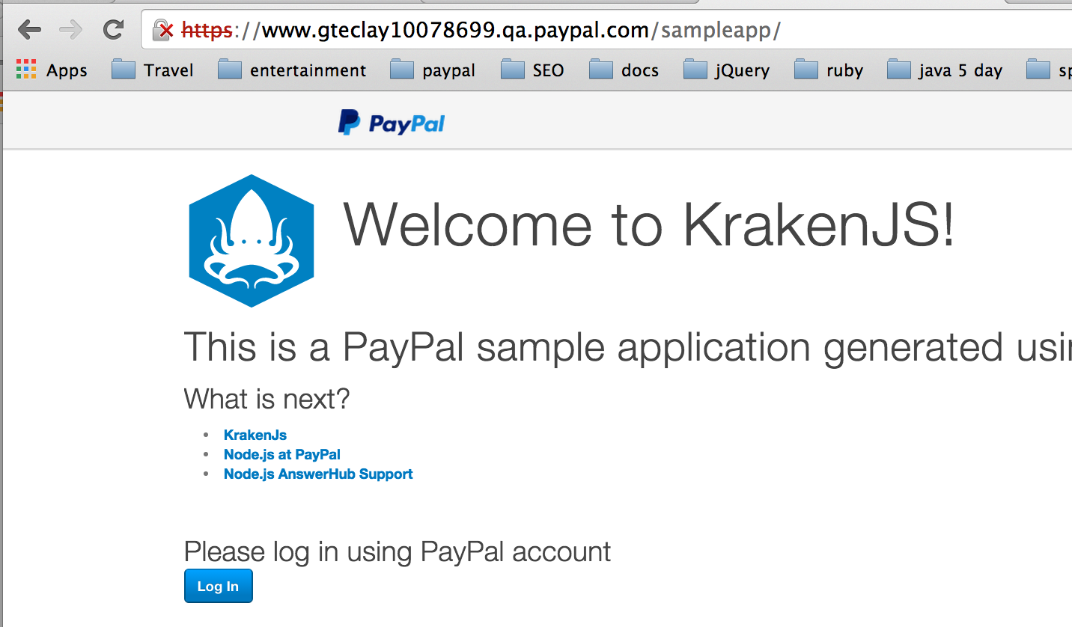
Open the Application

Slide 24
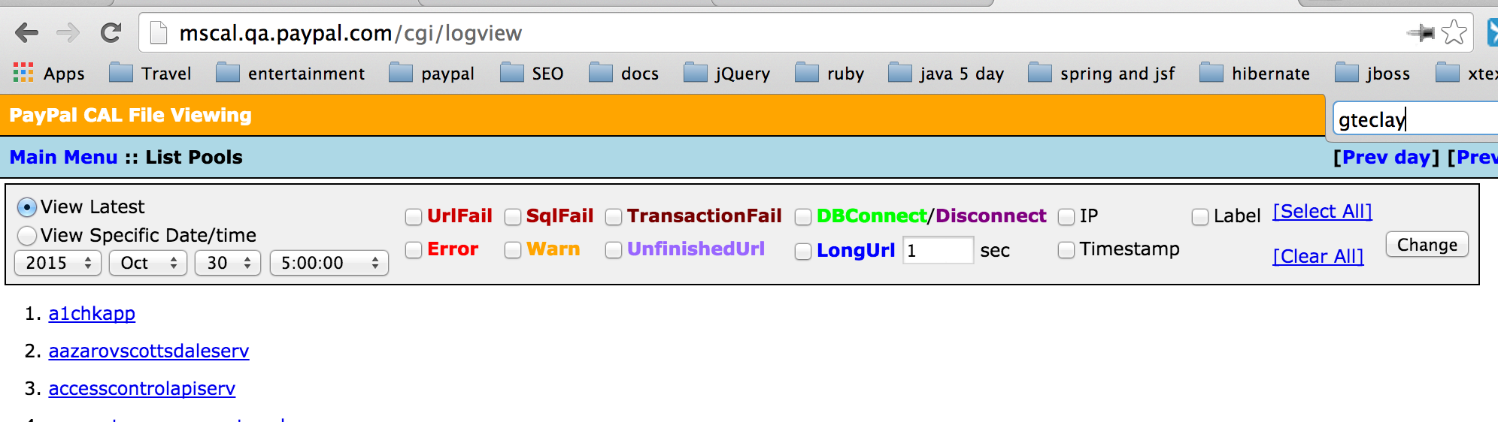
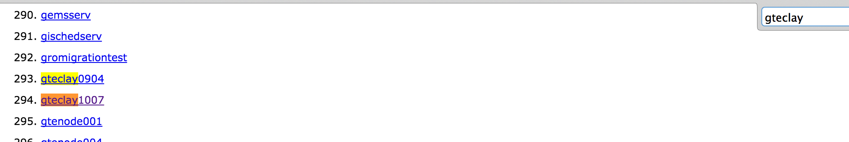
CAL LogView
Search the browser page for your project name

Slide 25
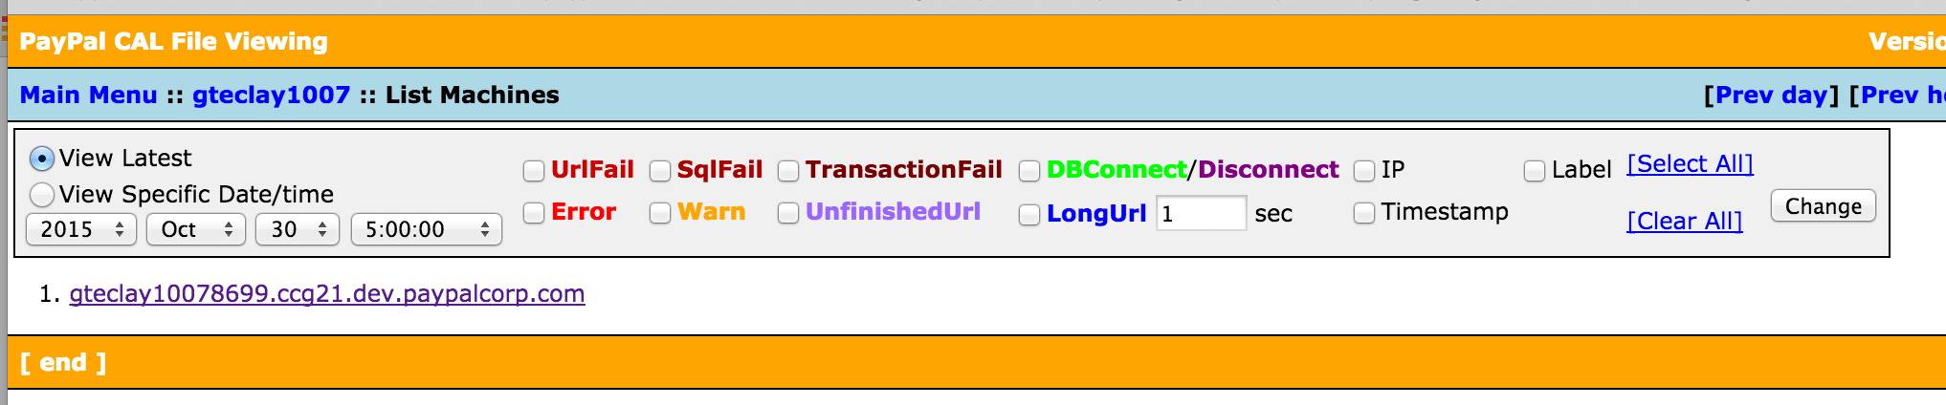
CAL LogView
Select the machine whose messages you care about

Slide 26
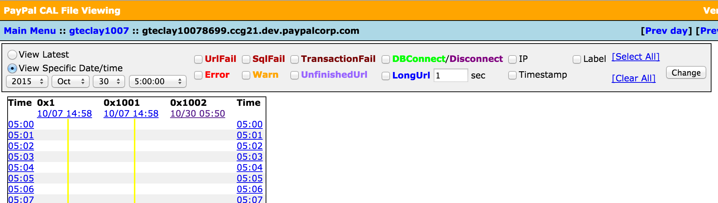
CAL LogView
Select the Date / Time for the messages

Slide 27
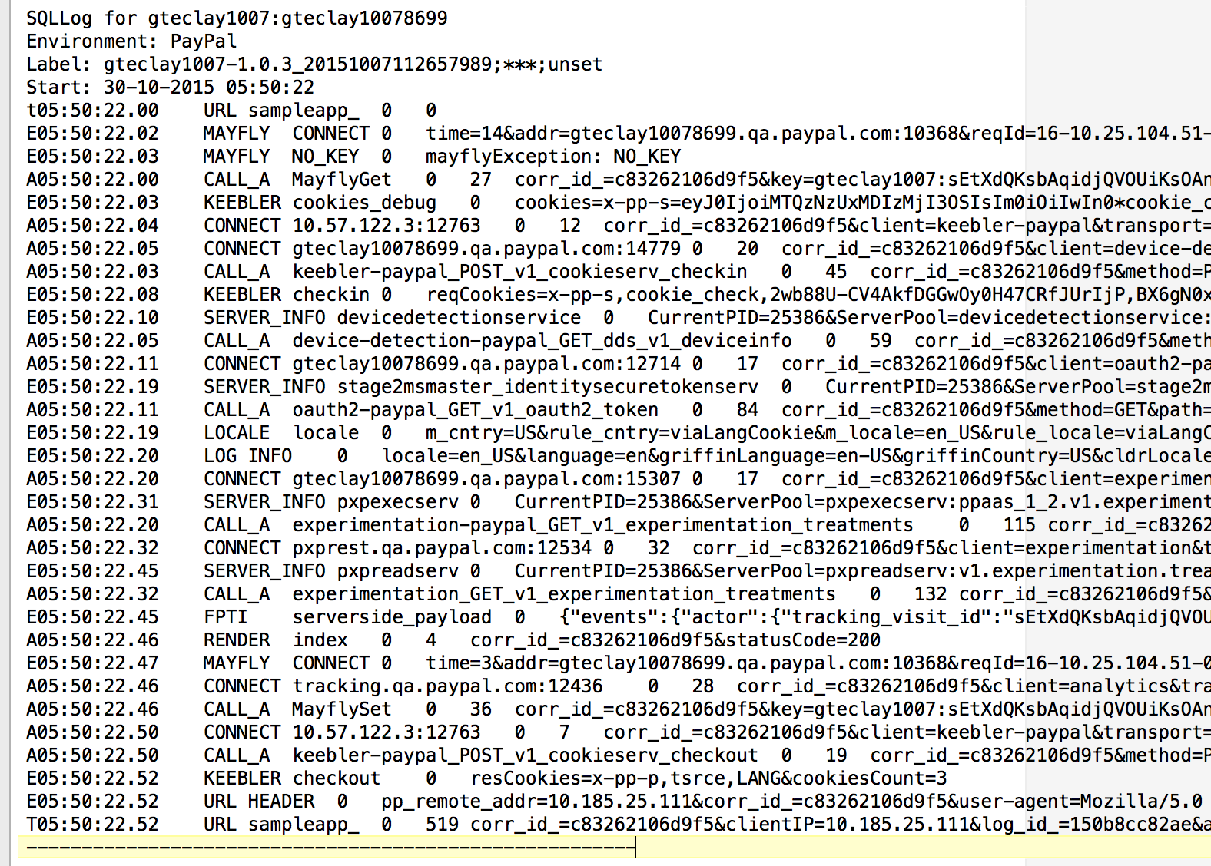
CAL LogView

Slide 28
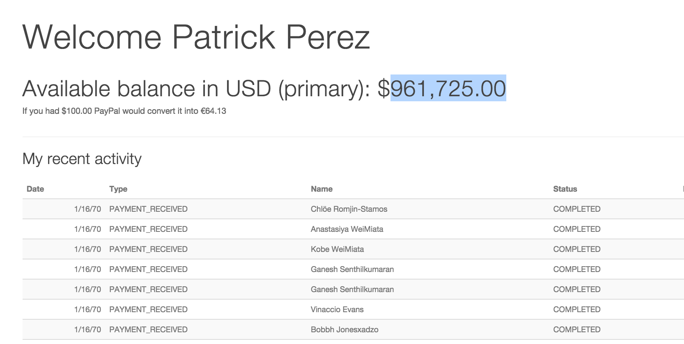
CAL LogView

Slide 29
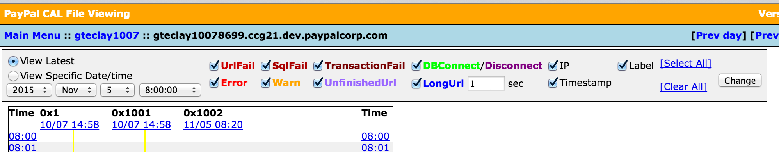
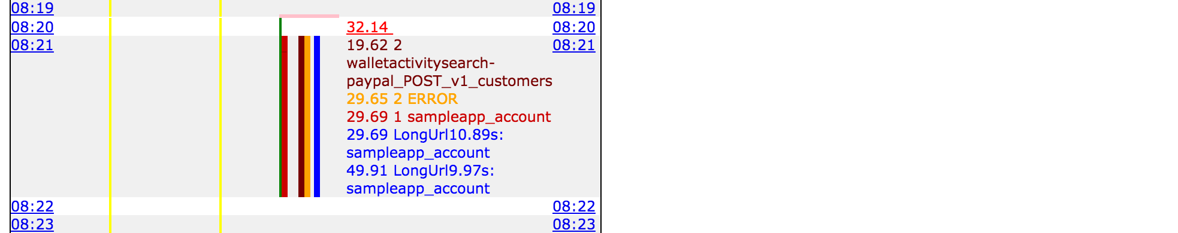
CAL LogView

Slide 30
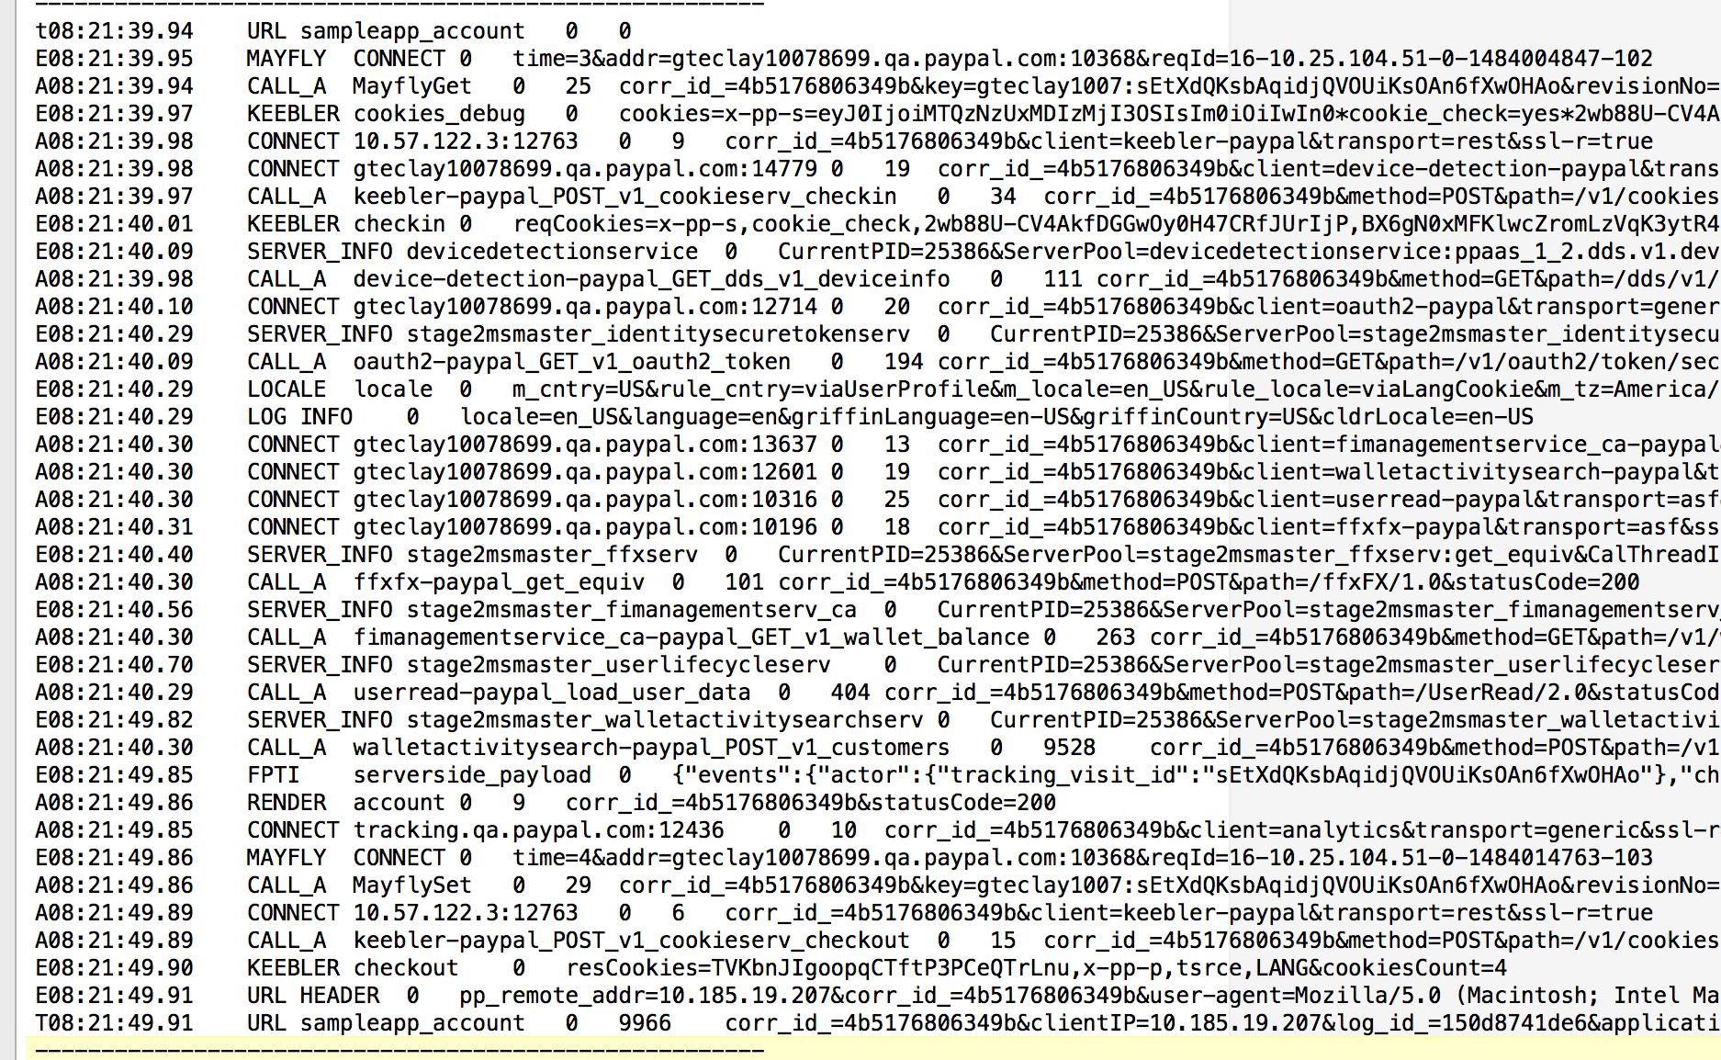
CAL LogView

Slide 31
Agenda
What is CAL?
CAL Best Practices
CAL Report View and Log View
CAL Node Installation
Resources and Summary

Slide 32
Installation and importing
From: https://github.paypal.com/NodeInfra/node-cal#a-nodejs-cal-client
First, install the module
npm install --save cal --registry http://npm.paypal.com
Next, import it in our application
var cal = require('cal');

Slide 33
Configuration
Tell app to buffer CAL Transactions:
In Kraken, this is in “config/config.json”
"cal": {
"enableBuffering“ : false|true
}

Slide 34
CAL API
Four basic API methods, three for the CAL message types and one to create a custom logger.
createEvent(type, name, [status], [data]);
Create a single event message to CAL
createHeartbeat(type, name, [status], [data]);
Create a heatrbeat, usually only done by the CAL dev team.
createTransaction(type, name, [status], [data], [parent])
Create a transaction message.
createLogger([options]);
Create a custom logger with other formatters and / or write streams

Slide 35
CAL status
Status values in the following CAL objects have an enum value
Values are
SUCCESS, FATAL, ERROR, EXCEPTION, and WARNING
Used in the following pages.
If not set, the CAL status is UNDEFINED
var event = cal.createEvent(…)
event.status = cal.status.SUCCESS;

Slide 36
createevent
createEvent(type, name, [status], [data])
Creates a CAL Event object initialized with the provided options.
var cal = require('cal');
var event = cal.createEvent('my_type', 'my_name');
event.addData('key', 'value');
event.addData({ foo: 'bar' });
event.complete();

Slide 37
event object
Properties:
type – The message type as specified in CAL protocol
name – The message name as specified in the CAL protocol
status – The message status as specified in the CAL protocol
“0” – if no errors
“some message string” – if errors
Methods
addData(key, value)
addData(encodedString)
addData(object)
complete(status) – Finalizes and commits the event.

Slide 38
createheartbeat
createHeartbeat(type, name, [status], [data])
Creates a CAL Heartbeat object initialized with the provided options
var cal = require('cal');
var hb = cal.createHeartbeat('my type', 'my name');
hb.addData('key', 'value');
hb.addData({ foo: 'bar' });
hb.complete();

Slide 39
Heartbeat object
Same as CAL Heartbeat object
Properties:
type – The message type as specified in CAL protocol
name – The message name as specified in the CAL protocol
status – The message status as specified in the CAL protocol
Methods
addData(key, value)
addData(encodedString)
addData(object)
complete(status) – Finalizes and commits the event.

Slide 40
createtransaction
createTransaction(type, name, [status], [data], callback)
Creates a CAL Transaction object initialized with the provided options.
var cal = require('cal');
cal.createTransaction('my type', 'my name', function(err, transaction) {
transaction.addData('key', 'value');
transaction.addData({ foo: 'bar' });
// optional transaction.flush();
transaction.complete();
});

Slide 41
Transaction object
Properties:
type – The message type as specified in CAL protocol
name – The message name as specified in the CAL protocol
status – The message status as specified in the CAL protocol
duration – Manually set/overrides the duration of the transaction
correlationId – Marks this transaction with the id
parent – Creates a relationship with the provided transaction, allowing nested profile information to be captured.

Slide 42
Transaction object - cont
Methods
addData(key, value)
addData(encodedString)
addData(object)
flush()
Flushes the data and start time of the transaction. Without flush(), transactions are marked as ATOMIC. flush() marks them with START and STOP events.
complete(status) – Finalizes and commits the transaction.

Slide 43
Summary
CAL is an common logger for Paypal and eBay
CAL has three types of messages
Event
Heartbeat
Transaction

