Slide 1
Node Infra – servicecore

Slide 2
Agenda
What is the servicecore?
How do I configure it?
Example code
Resources and Summary

Slide 3
What is the servicecore?
Servicecore is a Node wrapper around Paypal services
Hides the Paypal technology
ASF Client / Server
SOAP
RESTful
WSDL
Allows decoupling between the Kraken app and the Paypal services layer

Slide 4
Agenda
Examine the servicecore API
Examine the Node interface to servicecore
Examine the internals of the sample-app

Slide 5
PPaaS
Paypal as a Service
Browser url: ppaas/
Demo
Examine the APIs
Look at invoices

Slide 6
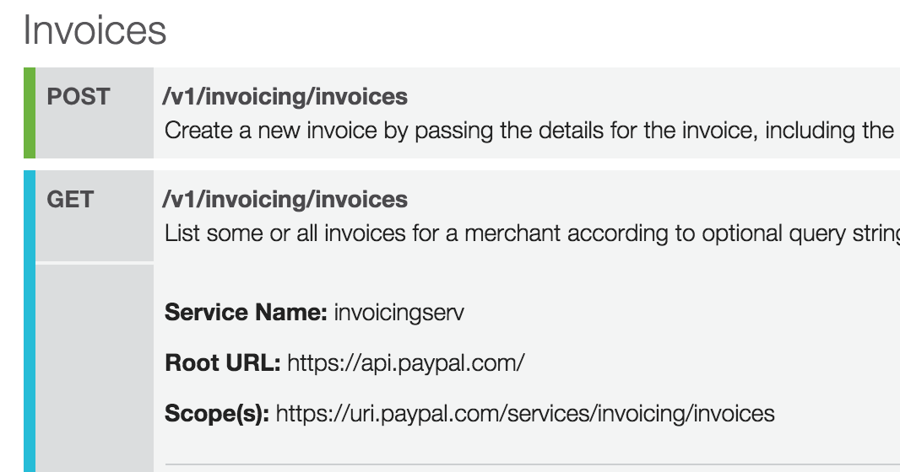
PPaaS Description

Slide 7
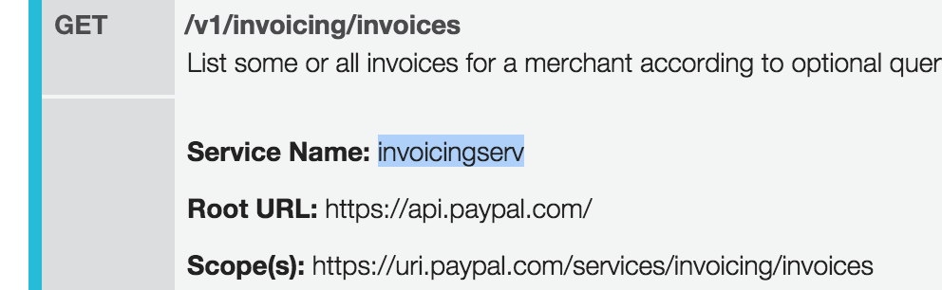
Javascript Interface
var servicecore = require('servicecore'), invoices = servicecore.create('invoicingserv’);
On the command line:
npm install –save invoicingserv

Slide 8
Javascript Interface
invoices.request({ method: 'GET', path: '/v1/invoicing/invoices', qs: 'page=' + (options.page ? options.page : '0') + '&page_size=' + (options.page_size ? options.page_size : '10') +'&total_count_required=' + (options.total_count_required ? options.total_count_required : true) }, function (err, response) { callback(err, response.body); }); },

Slide 9
Resources
Look at the PPaaS website ‘ppaas/’
Select an API,
look at the programming interface
use it in an application

