Slide 1

Juraj Dzifcak
November 13th 2008

Slide 2

Introduction and motivation
Quick Background
  λ - calculus
  Combinatorial categorial grammars
Overview of the approach
Current and Future work

Slide 3

Recent non-monotonic approaches to translate and represent the semantics of NL sentences have run into problems
  NL -> ASP, existential quantification
The inability to completely deal with existential quantification asks for new target language
  New ASP
  There is an electric powered car.
    To properly represent this sentence, we need a form of existential quantification
    FOL is monotonic
    ASP is non-monotonic, but cannot handle existential quantification
      Thus the new approach combining those should help us solve the problematic issues

Slide 4

A λ–expression is either a variable v in V (set of identifiers); or an abstraction where v is a variable and e is a -expression; or an application e₁e₂ , where e₁ and e₂ are two λ -expressions.
  Examples: λx.plane(x), λx.x,y
Operations:
  A β-reduction could be viewed as a function application, which will be denoted by the symbol @
  Example:
  λ x.plane(x) @ boeing767
  results to
  plane(boeing767)

Slide 5

CCG can be characterized by
  A set of basic categories
  A set of derived categories, each constructed from the basic categories
  A set of syntactical (combinatorial) rules describing the concatenation and determining the category of the result of the concatenation
  Every lexical element is assigned to a category.

Slide 6

John takes a plane
(Noun) (Trans. verb) (Determiner) (Noun)
N (S[dcl]\NP)/NP NP[nb]/N N
NP
NP[nb]
S[dcl]\NP
S[dcl]
lex
>
>
<
<: backward functional application
X Y\X Y
>: forward functional application
X/Y Y X
dcl – sentence is declarative
nb – non-bare noun, e.g. includes
a determiner

Slide 7

Assign a syntactic category and semantic category to each word
  Syntax: CCG categories
  Semantics: λ–expressions
The parse will produce the final representations
  The combinatorial rules specify how syntax AND semantics is combined
  The root gives the final formula that represents the semantics of a sentence

Slide 8

There is non-dividing cell
We can represent as
  Exists x –divides(x) :- cell(x).
Advantages
  We keep the non monotonic aspect of the natural language
  We properly capture existential quantification

Slide 9

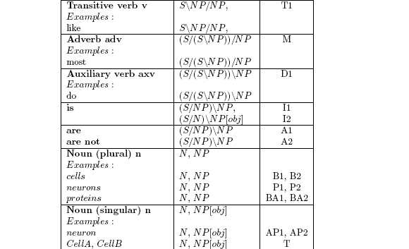
The syntactic part of the grammar
Example:
Adapted the basic implementation

Slide 10

Develop the semantic part of the grammar so that we obtain proper representations
  Both safe and unsafe rules
    E.g. both computable and non-computable examples
Show simple reasoning tasks with the specific subset of sentences

Slide 11

Questions and discussion

Slide 12
Thank you for your attention.

