Slide 1
Formalizing and Solving Peg Solitaire using ASP
Michael Casolary
Dr. Joohyung Lee
CSE 598
11/13/08

Slide 2
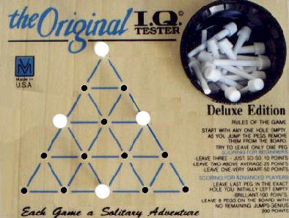
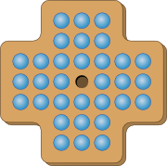
Peg Solitaire: A Brief Intro
Remember this?
Here's its grand-daddy:

Slide 3
Why Bother? (Practical)
Unless you know "the algorithm", Peg Solitaire is very hard (esp. playing by the "strict" rules)
Computers can help us stupid humans (read: me) solve these blasted things
ASP lets us easily change the rules and still compute solutions (e.g., where the starting hole is, how many holes, the board size/layout, etc.)

Slide 4
Why Bother? (Theoretical)
Possibility of comparing ASP performance to other systems (raw speed & elaboration tolerance)
Examining ASP's ability (or lack thereof) to represent this puzzle in multiple forms
(Hopefully) be able to comment on ASP's general suitability as a puzzle solver for this class of puzzle

Slide 5
Progress So Far
Puzzle formalized in ASP as a planning problem
  Basic rules set up, can "attach" a given board, extra victory conditions
Formalism is an effective representation of the problem
  Solves simple problems with ease, accuracy
Can use both smodels and cmodels (with its assortment of SAT solvers) to solve

Slide 6
Problems So Far
Can't get triangle solved
  My rules assumed a "grid" board with orthogonal moves, need to figure out how to adapt
Can't get English board solved
  31-move solution, and at some steps there are over 3 million ways the board could be arranged
  I think I need an incomplete solver, but past experience suggests they won't cut the mustard either
cmodels sucks
Problem not really representable in alternate forms
  Board state changes, can't solve Sudoku-style
  Glimmer of hope for a "yes/no" solve, but not in ASP

Slide 7
To-Do List
Re-tool rules to support triangle puzzle
  Try not to clobber orthogonal case
Try to find functioning incomplete ASP solver, see if it can tackle the problem
Try configuring formalism to...
  Determine minimum number of "peg touches"
  Quickly give a "yes/no" answer for a solution
  Find only "unique" solutions (whatever that means)
Give up, cry, eat a bowl of ice cream, then compare what I can get ASP to solve against other systems (Java, CCalc, etc.)
(Maybe) write a wrapper program to quickly, easily set up a board & rules

Slide 8
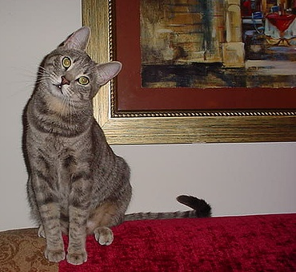
Questions...
...bring 'em on!
(please?)
?

