Slide 1


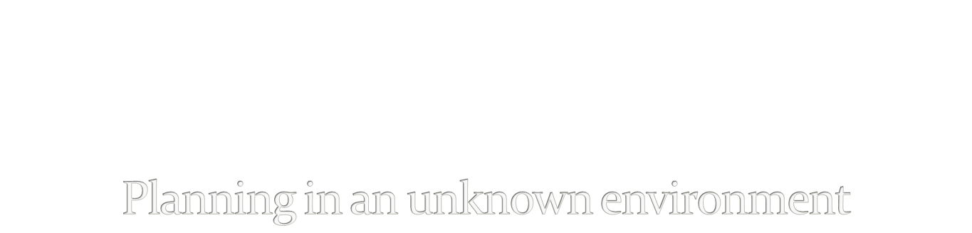
Tylar Hoag

Slide 2
Introduction
Wumpus World: a famous AI toy problem
  Plan generation
Significance: dealing with an unknown environment
  Learning
  Reasoning
  Uncertainty
  Risk?

Slide 3
Problem Specification
There is a dungeon (a grid), a hero, treasure (goal), and a wumpus(es).
The hero only has knowledge of visited positions
The wumpus must be avoided
  How? Positions near the wumpus smell
Actions: move(direction, time)
Fluents: hero’s position: at(x,y,t), danger(x,y,t)
Knowledge base:
  Static: safe(x,y), nearDanger(x,y)
  Dynamic: danger(x,y,t)
Precondition: at(x,y,0), safe(x,y).

Slide 4

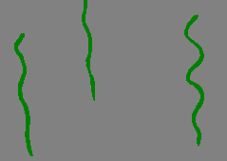
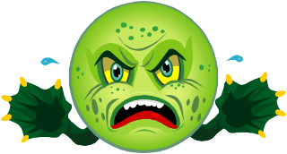
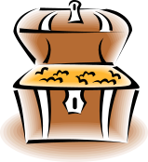
Example Environment

Slide 5
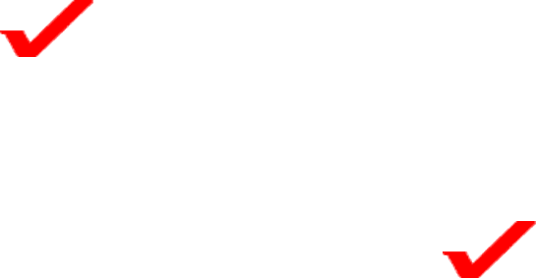
Progress
Three phases
  Board generation
    Generate grid and initial positions
    Define adjacency
    Define unknown environment and “smell”
  Plan generation in known environment
    Define actions and frame control
    Define goals and failure tag (moved onto wumpus)
    Define constraints:
      Must only move onto valid positions
      Must not move onto squares deemed dangerous
  Plan generation in unknown environment
    Knowledge and reasoning

Slide 6
Walkthrough
S

Slide 7
First move
S
ND

Slide 8
Reasoning
S
ND
D
D
D
D
D

Slide 9
Reasoning
S
ND
D
D
ND
D
D
D
D

Slide 10
Reasoning
S
ND
D
S
ND
D
S
S
D

Slide 11
Goal!
S
ND
D
S
ND
S
S
S
Answer set: move(right,0), move(down,1), move(left,2), move(down,3), move(right,4), move(right,5).

Slide 12
Questions?

Slide 13
Expandability (If time)
Risk and probabilistic reasoning
  Current design doesn’t handle risk
    If sure path isn’t found program returns false
      Example: a “smell” square with no adjacent safe squares
Dynamic environment
  A wumpus that moves
  Requires risk handling
Non-deterministic environment?
  A wumpus that moves randomly

