Slide 1
PAINT BY NUMBER
Jake Griffin

Slide 2
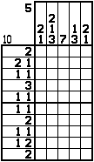
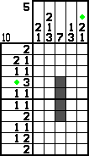

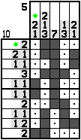
PROJECT DESCRIPTION
Row and Column Clues
Can be multi-colored
Finished puzzle makes a picture (usually)
May or may not be uniquely solvable

Slide 3



PROJECT DESCRIPTION
Take completed puzzle
Generate clues
Determine if unique

Slide 4
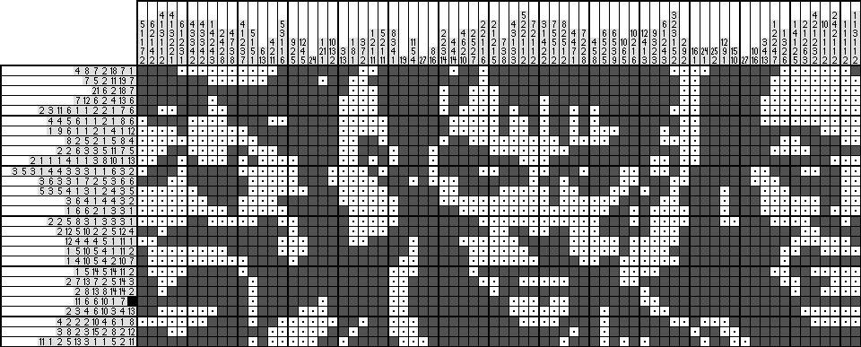
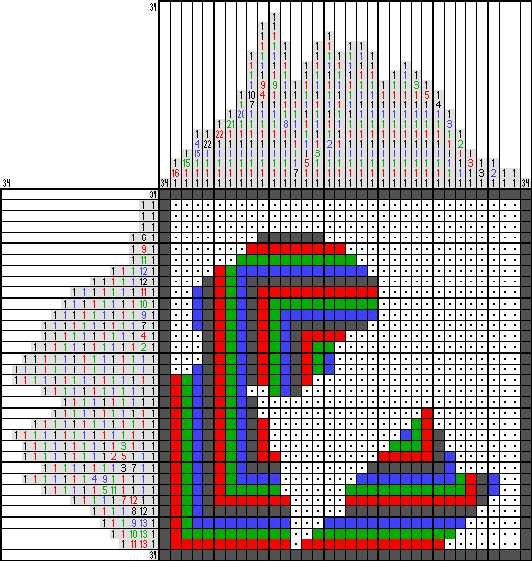
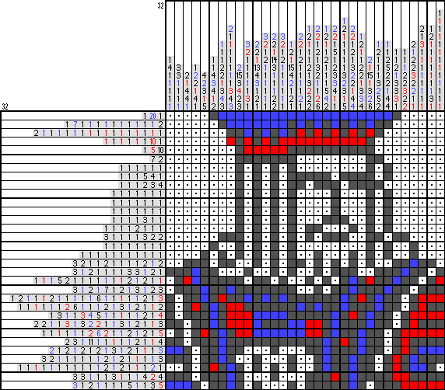
OTHER PUZZLE EXAMPLES

Slide 5
CURRENT/FUTURE WORK
Completed So Far
To Be Completed
Black and white puzzles only
Doesn’t seem to be efficient
Color Puzzles
Improve timing?
Easier method of entering puzzle to be solved (GUI)?

Slide 6
ANY QUESTIONS?
Thanks!

