Slide 1
Tutoring System for
Korean Honorifics
Tae-Won Kim
Arizona State University
11. 13. 2008

Slide 2
Agenda
Korean Honorifics
Formalizing in Answer set Programming (ASP)
Tutoring System
Future Works
Q & A

Slide 3
Korean Honorifics
Korean language reflects the important observance of a speaker’s relationships with the subject of the sentence, a third person of the sentence, or the audience (listener).
Korean honorifics mirror social factors such as age, intimacy, formality, social rank, or kinship.
There are three ways of honorification. It is expressed by nouns, honorific case particles, verb suffixes, or special honorific forms of verbs.

Slide 4
Korean Honorifics
Example:
[English]
Did you eat lunch?
[Korean]
Guess………
How many different representations would be
in Korean?

Slide 5
Korean Honorifics
Example:
[English]
Did you eat lunch?
[Korean]
점심 (lunch) 먹었니? (Did you eat?)
점심 (lunch) 먹었어요? ➔ by verb suffix
점심 (lunch) 드셨어요? ➔ by special honorific
form of verb

Slide 6
Korean Honorifics
Focus on the relationship between Speaker and Listener in order to know social factors between them.
There are speech levels to reflect the relationship between Speaker and Listener by different representation of verb suffixes.

Slide 7
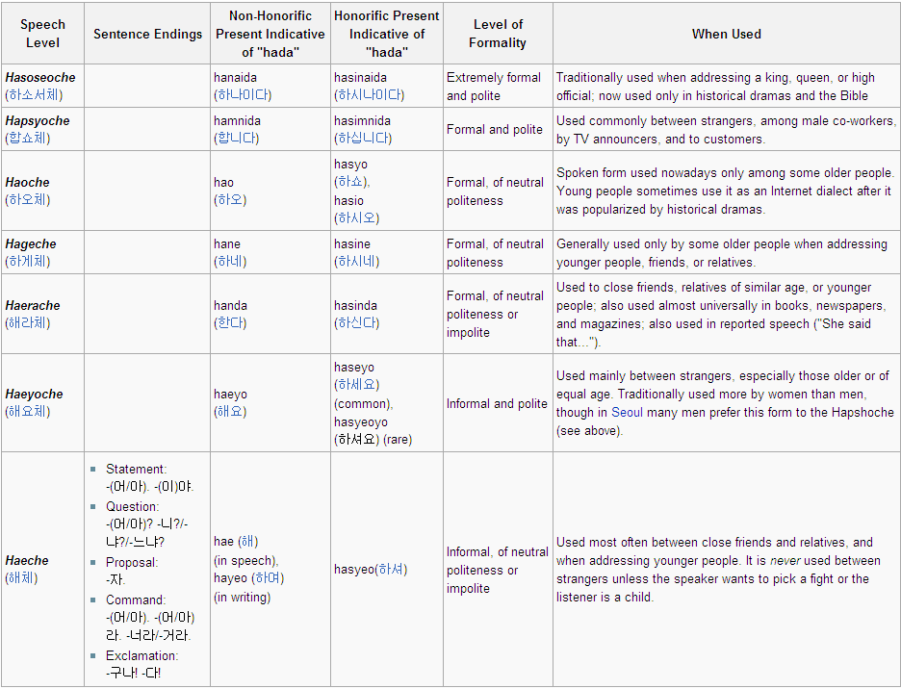
Korean Honorifics

Slide 8
Formalizing in ASP
[Level of Social Factors]
% S: Speaker, L: Listener
formality(S,L,F) % F= formal or informal
intimacy(S,L,I) % I=close or distant
position(S,L,P) % P= p_higher, p_equal, or p_lower
kindred(S,L,K) % K=k_higher, k_equal, k_lower
older(S,L,G) % G=much_older, older, equal, younger,
much_younger
age(S,L,V) % V=elder(60~ years), adult(40~60 years),
young_adult(20~40 years), teenager(10~20 years),
child(0~10 years)

Slide 9
Formalizing in ASP
[Constraints for some social factors]
% constraints for relationship between older and age
:- older(S,L,much_older), age(S,V), age(L,V2), V-V2<2.
:- older(S,L,older), age(S,V), age(L,V2), V-V2!=1, V-V2!=0.
:- older(S,L,equal), age(S,V), age(L,V2), V!=V2.
:- older(S,L,younger), age(S,V), age(L,V2), V2-V!=1, V2-V!=0.
:- older(S,L,much_younger), age(S,V), age(L,V2), V2-V<2.
% constraints for relationship between age and position
:- position(S,L,P), age(S,V), V<=teenager, age(L,V2), V2>=young_adult,
P!=p_lower.
:- position(S,L,P), age(S,V), V>=young_adult, age(L,V2), V2<=teenager,
P!=p_higher.

Slide 10
Formalizing in ASP
[Speech level]
hapSho(S,L) :- formality(S,L,formal).
haeRa(S,L) :- intimacy(S,L,close), older(S,L,equal).
haeRa(S,L) :- older(S,L,much_older), not ab1_haeRa(S,L).
ab1_haeRa(S,L) :- position(S,L,p_lower).
haeRa(S,L) :- older(S,L,much_older), not ab2_haeRa(S,L).
ab2_haeRa(S,L) :- kindred(S,L,k_lower)
[By user choice]
older(speaker,listener,much_older).
position(speaker,listener,p_lower).
formality(speaker,listener,formal).
kindred(speaker,listener,k_higher). intimacy(speaker,listener,close).

Slide 11

Tutoring System

Slide 12
Formalizing in ASP
[Answer sets]
ab1_haeRa(speaker,listener)
kindred(speaker,listener,1)
position(speaker,listener,-1)
formality(speaker,listener,1)
intimacy(speaker,listener,1)
older(speaker,listener,2)
haeRa(speaker,listener) hapSho(speaker,listener)

Slide 13
Future Works
Complete the Knowledge Base in ASP
Use abduction approach to explain more precisely why the speaker should choose particular speech levels.
Make preference between speech levels after computing answer sets.

Slide 14
Q / A

