Slide 1
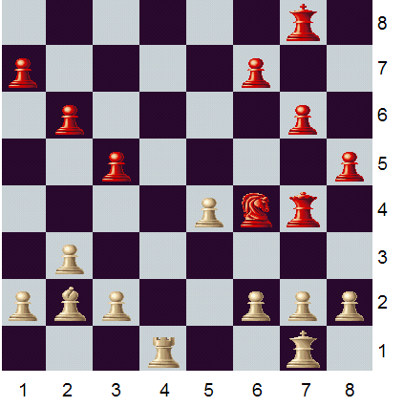
Chess End Game Puzzles
3
2
White to play and win in 2 moves.
1

Slide 2
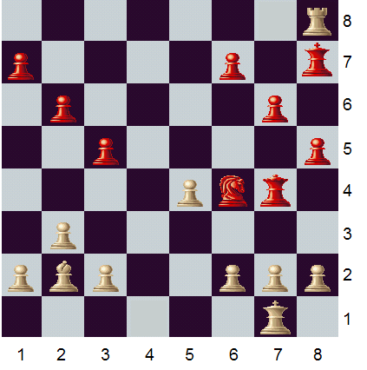
Chess End Game Puzzles

Slide 3
Problem modelisation
White piece have number from 1 to NbWhite
Black piece have number from NbWhite+1 to NbWhite+NbBlack
piece(n,c,l,t)‏
queen(n),king(n)....
play(n,c,l,t)‏
alive(n,t)‏

Slide 4
Play generation and constraint
An unique play by turn and play a white piece if the turn is even or black piece if the turn is odd
When play don't stay at the same place
The only piece allowed to jump over an other piece is the knight

Slide 5
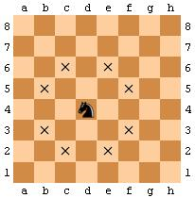
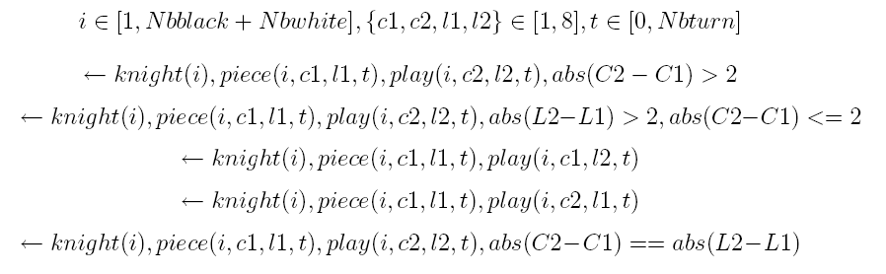
Piece Movement
Exemple : the knight

Slide 6
Piece alive and piece dead
Utilisation of true negation
When not affected stay the same
When there is a piece at the destination of the play, the piece become dead
If a piece is dead we don't put it back on the board for the next turn
Goal : the black king is dead during the last turn.

Slide 7
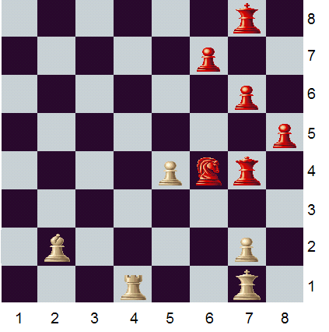
Future work: Problem simplification
preprocessing

Slide 8
Future Work : Restraint solution
We want not any solution where the king is dead
Detect check
...
2
3
1

