Slide 1
Using ASP to Solve Binary-Determination Logic Puzzles
MATT ROBERSON

Slide 2
Kuromasu
played on rectangular grid
cells are either white or black
some white cells contain numbers and must remain white
each numbered cell represents the number of white cells that can be seen from that cell, including itself
a cell is seen if it is contained in the same row or column and there is no black cell between them in that row or column
no two black cells may be horizontally or vertically adjacent
all white cells must be connected horizontally or vertically
GOAL: to determine which cells are white and which are black

Slide 3
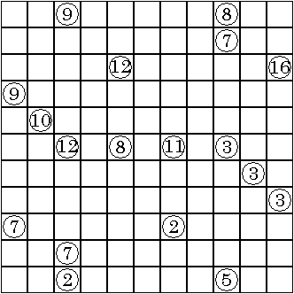
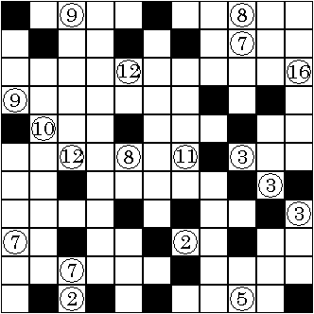
Kuromasu
Solution

Slide 4
Kuromasu
Input: num(X,Y,Z)
Output: black(X,Y)
Variables: row(X)
col(Y)
color(b;w)
cell(C,X,Y)
adj(X,Y,R,S)
connect_cell(C,X,Y,R,S)
seen(X,Y)
black(X,Y)

Slide 5
Kuromasu
Psuedocode:
  generate: white cells are subset of all grid cells
  constraint: numbered cells are white cells
  define: black cell is any cell that is not white
  define: cell adjacency
  define: cells are connected if adjacent and of same color
  define: each numbered cell should be connected to the same number of white
  cells as the number contained in that cell
  constraint: all white cells must be connected horizontally or vertically
  constraint: every numbered cell should be seen
  constraint: no two black cells can be horizontally or vertically adjacent

Slide 6
Light Up
played on rectangular grid
cells are either white or black
light bulbs are placed in white cells such that no two bulbs shine on each other
each bulb sends rays of light both vertically and horizontally
each bulb illuminates its entire row/column unless its light is blocked by a black cell
a black cell may contain a number from 0-4 which indicates the number of bulbs that must be placed adjacent to it
an unnumbered black cell may have any number of bulbs around it
bulbs placed diagonally adjacent to any black cell do not contribute to its bulb count
GOAL: to light up the entire grid

Slide 7
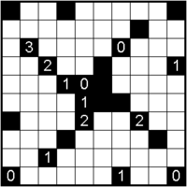
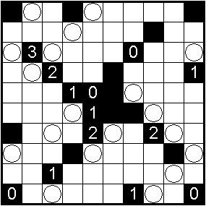
Light Up
Solution

Slide 8
Light Up
Input: black(X,Y,N)
Output: lightbulb(X,Y)
Variables: row(X)
col(Y)
color(b;w)
black(X,Y,N)
adj(X,Y,R,S)
connect_cell(C,X,Y,R,S)
lightbult(X,Y)
lit(X,Y)
(in progress…)

Slide 9
Light Up
Psuedocode:
  define: black cell
  define: white cell
  define: adjacency
  define: connect_cell
  generate: lightbulbs are subset of white cells
  constraint: no two lightbulbs are connected
  (in progress…)
  constraint: each black cell must have the same number of lightbulbs placed adjacent to it as the number it contains
  constraint: unnumbered black cells may have any number of lightbulbs placed adjacent to it
  define: every white cell must be shone on, i.e. connected to a light bulb

Slide 10
Work
Completed:
Kuromasu
  list of variables
  description of rules (both explicit and implied)
  translation of rules into ASP
Light Up
  description of rules (both explicit and implied)
In Progress:
Light Up
  list of variables
  translation of rules into ASP

Slide 11
Milestones
Week #1
  complete list of variables for Light Up
  translate rule descriptions into ASP
Week #2
  testing
  begin final report
Week#3
  finish report
  prepare slides for final presentation

