Slide 1
BUILDABILITY MODELING WITH GEOMETRIC CONSTRAINTS
By
Saleel Kudchadker
Arizona State University

Slide 2
In Brief
Portal
Simple structure of column and beam
Column
Formwork Covers Reinforcement
Reinforcement precedes Formwork
Beam
Formwork Supports Reinforcement
Formwork precedes Reinforcement
Buildability Modeling with Geometric Constraints

Slide 3


Development of a Project Model
Portal
16
21
22
7
14
18
20
B
2
4
11
9
6
13
A
C
Ps= Process, Pd= product, F=Formwork, R= Reinforcement, C= Concrete
A=Column A, B=Beam B, C= Column C, P=Portal
Buildability Modeling with Geometric Constraints

Slide 4


Development of a Project Model
Relations in Portal
Part_Of
Covers
Supports
Needs_Access
Buildability Modeling with Geometric Constraints

Slide 5
Development of a Project Model
Direct
Rules
Facts
New
Facts
New
Facts
Production
Rules
Precedence
Network
Precedence
Network
Precedence
Network
Action of Production Rules on Facts
Buildability Modeling with Geometric Constraints

Slide 6
Development of a Project Model
Facts in Portal
FApd SUPPORTSxy CApd
RCps NEEDS_ACCESSxy
FBpd SUPPORTSxy-z CBpd
FApd PART_OF Apd
FCpd SUPPORTSxy CCpd
FCpd PART_OF Cpd
Apd SUPPORTS-z Bpd
FBpd PART_OF Bpd
Cpd SUPPORTS-z Bpd
CApd PART_OF Apd
CApd COVERSxyz RApd
CBpd PART_OF Bpd
CBpd COVERSxyz RBpd
CCpd PART_OF Cpd
CCpd COVERSxyz RCpd
RApd PART_OF Apd
RAps NEEDS_ACCESSxy
RBpd PART_OF Bpd
RBps NEEDS_ACCESS+z
RCpd PART_OF Cpd
Buildability Modeling with Geometric Constraints

Slide 7
Development of a Project Model
Rules for Portal
DIRECT RULES
Xpd SUPPORTS Ypd → Xpd PRECEDES Yps
Xpd COVERSm Ypd ∧ Yps NEEDS_ACCESSm → Ypd PRECEDES Xps
Xpd PART_OF Ypd → Xpd PRECEDES Ypd
Xps → Xps PRECEDES Xpd (*)
PRODUCTION RULES
Xpd SUPPORTS Ypd ∧ Ypd COVERSm Zpd ∧ Zps NEEDS_ACCESSm →Xpd COVERSm Zpd (**)
Xpd SUPPORTS Ypd ∧ Zpd PART_OF Ypd → Xpd SUPPORTS Zpd
Buildability Modeling with Geometric Constraints

Slide 8
Development of a Project Model
Rules for Portal
Direct Rule
Xpd SUPPORTS Ypd → Xpd PRECEDES Yps
1{pd_supports_pd(U,V):input(U,V)}1.
pd_preceeds_ps(U,V):-pd_supports_pd(U,V),fact(U;V).
hide.
show pd_supports_pd(_,_).
show pd_preceeds_ps(_,_).
Buildability Modeling with Geometric Constraints

Slide 9
Development of a Project Model
Inference
FApd PRECEDES CAps
FBpd PRECEDES CBps
FCpd PRECEDES CCps
Inference from Direct Rule
These are the Answer sets of the rule
Buildability Modeling with Geometric Constraints

Slide 10
Development of a Project Model
Inference
Production Rule
Xpd SUPPORTS Ypd ∧ Ypd COVERSm Zpd ∧ Zps NEEDS_ACCESSm → Xpd COVERSm Zpd
{pd_supports_pd(U,V):input(U,V)}.
{pd_covers_pd(U,V):cvr(U,V)}.
{ps_needsAcs(V):nacs(V)}.
pd_covers_pd(U,W):-pd_supports_pd(U,V),pd_covers_pd(V,W),ps_needsAcs(W),fact(U;V;W).
Buildability Modeling with Geometric Constraints

Slide 11
Development of a Project Model
New Facts in Portal
FApd COVERSxy RApd
FCpd COVERSxy RCpd
FBpd COVERSz RBpd
Generation of New Facts by Production Rule
These are the Answer sets of the rule
Buildability Modeling with Geometric Constraints

Slide 12
Development of a Project Model
Direct Rules
Rest of the Rules
Xpd SUPPORTS Ypd → Xpd PRECEDES Yps
Xpd COVERSm Ypd ∧ Yps NEEDS_ACCESSm → Ypd PRECEDES Xps
Xpd PART_OF Ypd → Xpd PRECEDES Ypd
Xps → Xps PRECEDES Xpd (*)
Buildability Modeling with Geometric Constraints

Slide 13
Development of a Project Model
Final Inference
FApd precedes CAps
CCps precedes CCpd
FBps precedes FBpd
FBpd precedes CBps
RAps precedes RApd
CBps precedes CBpd
FCpd precedes CCps
FAps precedes FApd
RCps precedes RCpd
RApd precedes CAps
CAps precedes CApd
FCps precedes FCpd
RBpd precedes CBps
RBps precedes RBpd
CCps precedes CCpd
RCpd precedes CCps
FBps precedes FBpd
RApd precedes FAps
Apd precedes Ppd
CBps precedes CBpd
RCpd precedes FCps
Bpd precedes Ppd
RCps precedes RCpd
FBpd precedes RBps
Cpd precedes Ppd
FCps precedes FCpd
Apd precedes CBps
CApd precedes Apd
CCps precedes CCpd
Apd precedes FBps
FApd precedes Apd
RAps precedes RApd
Apd precedes RBps
RApd precedes Apd
FAps precedes FApd
Cpd precedes CBps
CBps precedes CBpd
CAps precedes CApd
Cpd precedes FBps
RCps precedes RCpd
RBps precedes RBpd
Cpd precedes RBps
FCps precedes FCpd

Slide 14
Development of a Project Model
Final Inference
☺ Milestone!!! Final Graph Obtained from Answer sets.
1
3
5
2
4
6
7
15
16
19
20
21
22
18
17
9
11
13
14
8
10
12

Slide 15
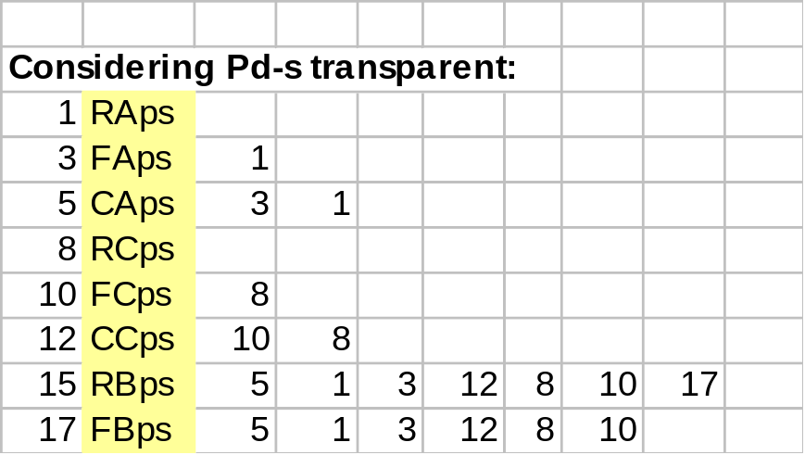
Development of a Project Model
Next Step!
Reducing Redundancy
Buildability Modeling with Geometric Constraints

Slide 16
Development of a Project Model
Next Step!
1
3
5
17
15
19
8
10
12
Final Precedence Network
Buildability Modeling with Geometric Constraints

Slide 17

Buildability Modeling with Geometric Constraints
QUESTIONS??

