Slide 1

Paper Presentation – Delay Scheduled impulsive Control for networked control system – chengzhi yuan
Muhammad Azriel r – 6022221047

Slide 2
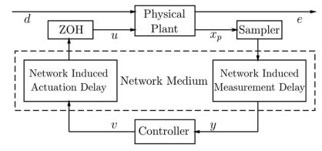
Background
NCS analysis and synthesis with two control method.
The linear impulsive control technique and dynamics integral quadratic constraints (IQCs) based robust control technique.
Two class of NCSs with time-varying delay
From the continuous-time plant to the discrete-time controller (measurement delay) and from the discrete-time controller back to the continuous-time plant (actuation delay).
Network system constructed delay scheduled impulsive (DSI) for controller.
Robust $ℒ_{2}$ stability analysis and controller synthesis investigated utilizing the IQC mechanism and clock-dependent storage functions.
Notes:
the associated delay behavior will be modeled as an impulsive effect acting on the nominal NCS dynamics.
for actuation delay, the considered NCS is first transformed to an equivalent linear fractional transformation (LFT) model, so that dynamic IQCs can be used to fully capture the nonlinear behavior of the time-varying delay.
DSI controller is constructed in a full-information feedback manner, that is, both plant states and the IQC dynamic states are used for feedback control, while real-time measurements of the network induced time-varying delays (measurement delay and actuation delay) are also used for controller gain scheduling.

Slide 3



Problem Formulation
- Networked control and control objective
Mathematical model for physical plant as continuous-time linear time-invariant (LTI) system
Controller design for linear model with input output delays
Notes:
objective is to design a control law using the IQC mechanism such that the overall networked control system is robustly stabilized against the network-induced delays τ1(t) and τ2(t) and achieves an L2-gain performance from the disturbance d(t) to the error output e(t), that is, e(t)2 < γd(t)2 for some positive number γ under zero initial conditions.
tujuannya adalah untuk merancang undang-undang kontrol menggunakan mekanisme IQC sedemikian rupa sehingga keseluruhan sistem kontrol jaringan distabilkan dengan kuat terhadap penundaan yang diinduksi jaringan τ1(t) dan τ2(t) dan mencapai kinerja penguatan L2 dari gangguan d(t) ke output kesalahan e(t), yaitu, e(t)2 < γd(t)2 untuk beberapa angka positif γ dalam kondisi awal nol.

Slide 4
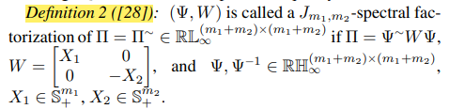
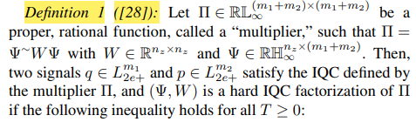
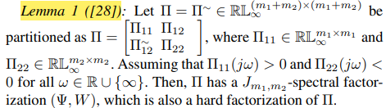

Problem Formulation
- Basic Definitions

Slide 5
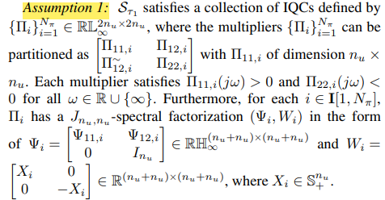
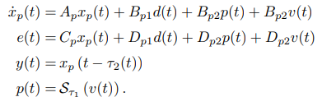
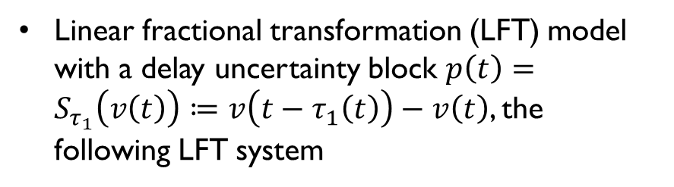
Problem Formulation
- Delay Scheduled Impulsive Controller Structure
Linear fractional transformation (LFT) model with a delay uncertainty block $p\left(t\right)=S_{τ_{1}}\left(v\left(t\right)\right)≔v\left(t−τ_{1}\left(t\right)\right)−v\left(t\right)$, the following LFT system
This assumption does not any loss generality.
Notes:
Under this formulation, the nonlinear behavior of the time-varying delay τ1(t) can thus be captured using dynamic IQCs as defined in Section II-B.

Slide 6


Problem Formulation
- Delay Scheduled Impulsive Controller Structure
Under assumption 1, the IQC-inducted LTI system ${\left\{Ψ_{i}\right\}}_{k=1}^{N_{π}}$ for delay nonlinearity $S_{τ_{1}}\left(v\right)$
Assumption 1 renders the associated output matrices with the following structure for all $i∈Ι\left[1,N_{π}\right]$
To fulfill control objective, propose a new IQC based control synthesis with full-information feedback.
The proposed control law designed by following delay-scheduled impulsive (DSI) controller structure

Slide 7
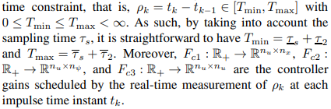
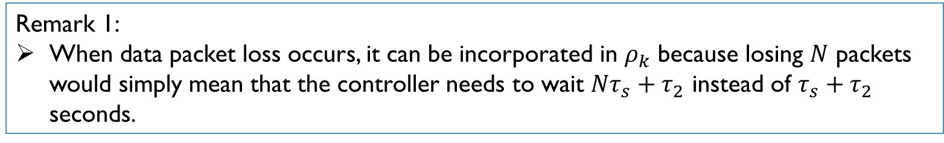
Problem Formulation
- Delay Scheduled Impulsive Controller Structure
Assumed that the impulse sequence ${\left\{t_{k}\right\}}_{k∈N_{+}}$obeys a ranged dwell-time constant,
Remark 1:
When data packet loss occurs, it can be incorporated in $ρ_{k}$ because losing $N$ packets would simply mean that the controller needs to wait $Nτ_{s}+τ_{2}$ instead of $τ_{s}+τ_{2}$ seconds.
Notes:
The actuation delay τ1(t) is treated as a nonlinear perturbation interconnecting to a nominal linear system [see (7)] and dynamic IQCs are used to characterize its input–output behavior, while the measurement delay information τ2(t) is hidden in the impulsive dynamics as mentioned before

Slide 8

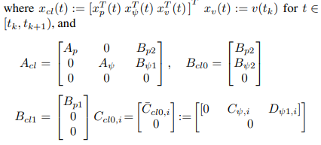
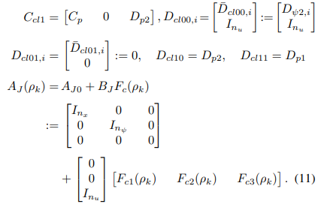
Problem Formulation
- Delay Scheduled Impulsive Controller Structure
Connecting the controller (9) to the controlled plant (7) and absorbing the IQC-inducted dynamics (8). Result closed-loop system can be equivalently formulated.

Slide 9
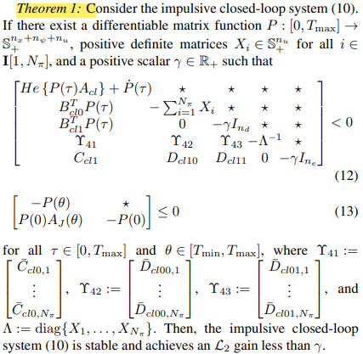
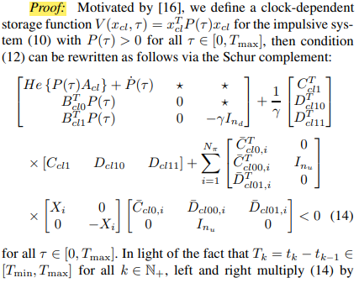

Problem Formulation
- $ℒ_{2}$ stability analysis
$ℒ_{2}$ stability condition for impulsive closed-loop system (10) by using the IQCs

Slide 10
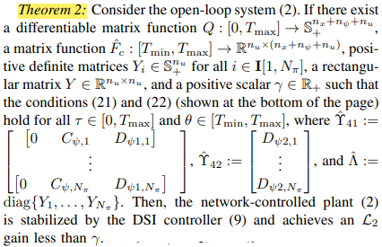

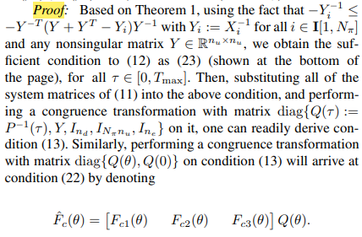
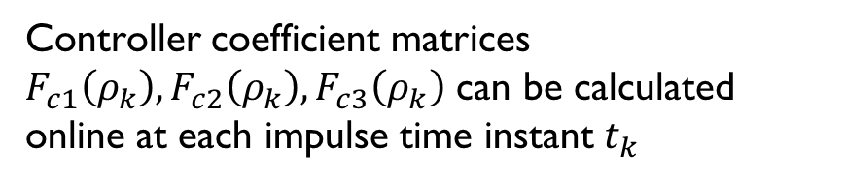
Controller synthesis
Based on the IQC analysis result established in theorem 1
Controller coefficient matrices $F_{c1}\left(ρ_{k}\right),F_{c2}\left(ρ_{k}\right),F_{c3}\left(ρ_{k}\right)$ can be calculated online at each impulse time instant $t_{k}$

Slide 11
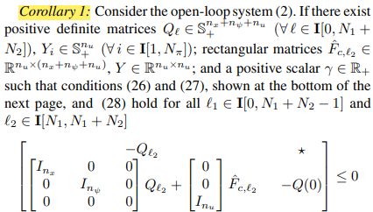
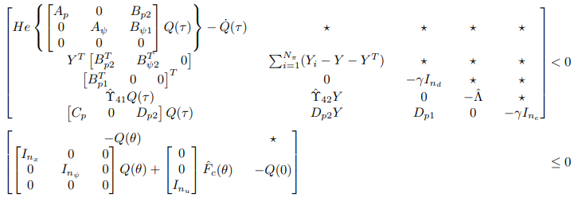
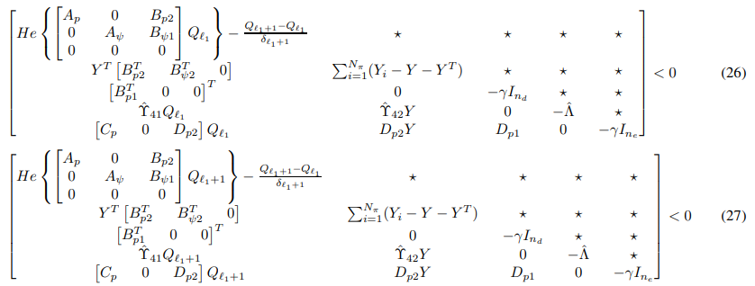
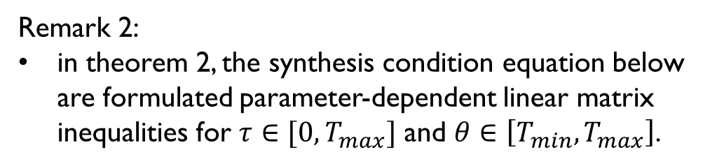
Controller synthesis
Remark 2:
in theorem 2, the synthesis condition equation below are formulated parameter-dependent linear matrix inequalities for $τ∈[0,T_{max}]$ and $θ∈\left[T_{min},T_{max}\right]$.
Notes:
Untuk mengatasi dua kemungkinan kekurangan ini dan menyediakan pengontrol yang lebih mudah diterapkan dan andal, kami akan mengusulkan metode berikut menggunakan tipe khusus dari fungsi penyimpanan yang bergantung pada jam (yaitu, fungsi linear sepotong-sepotong)

Slide 12



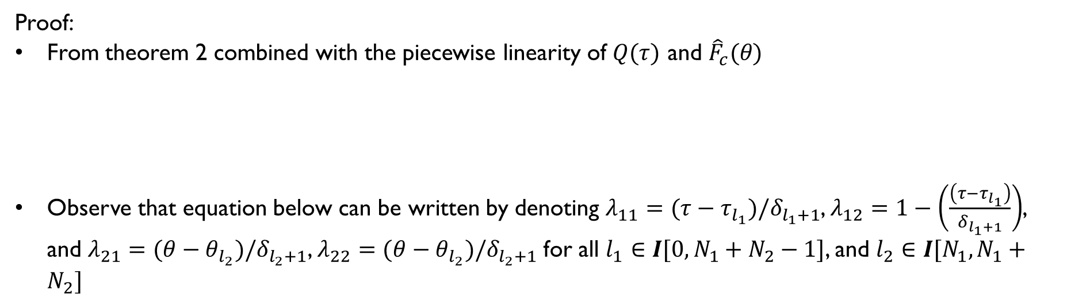
Controller synthesis
Proof:
From theorem 2 combined with the piecewise linearity of $Q(τ)$ and ${\hat{F}}_{c}(θ)$
Observe that equation below can be written by denoting $λ_{11}=(τ−τ_{l_{1}})/δ_{l_{1}+1}$, $λ_{12}=1−\left(\frac{\left(τ−τ_{l_{1}}\right)}{δ_{l_{1}+1}}\right)$, and $λ_{21}=(θ−θ_{l_{2}})/δ_{l_{2}+1}$, $λ_{22}=(θ−θ_{l_{2}})/δ_{l_{2}+1}$ for all $l_{1}∈I[0,N_{1}+N_{2}−1]$, and $l_{2}∈I[N_{1},N_{1}+N_{2}]$

Slide 13
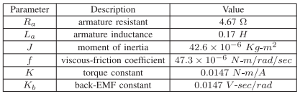
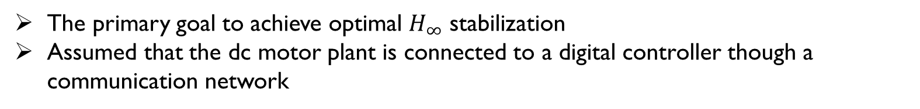
Example
An application to a simple dc motor
Demonstrating the IQC-based design procedure and the effectiveness of DSI control
Dc motor parameter
The primary goal to achieve optimal $H_{∞}$ stabilization
Assumed that the dc motor plant is connected to a digital controller though a communication network

Slide 14
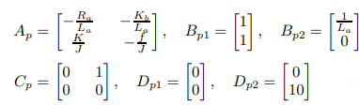

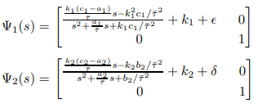
Example
The continuous-time linear model
Characterize the associated delay operator $S_{τ1}\left(v\left(t\right)\right)$

Slide 15
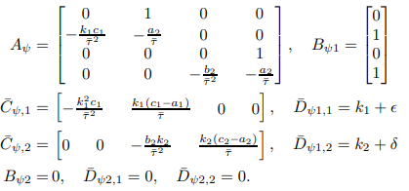
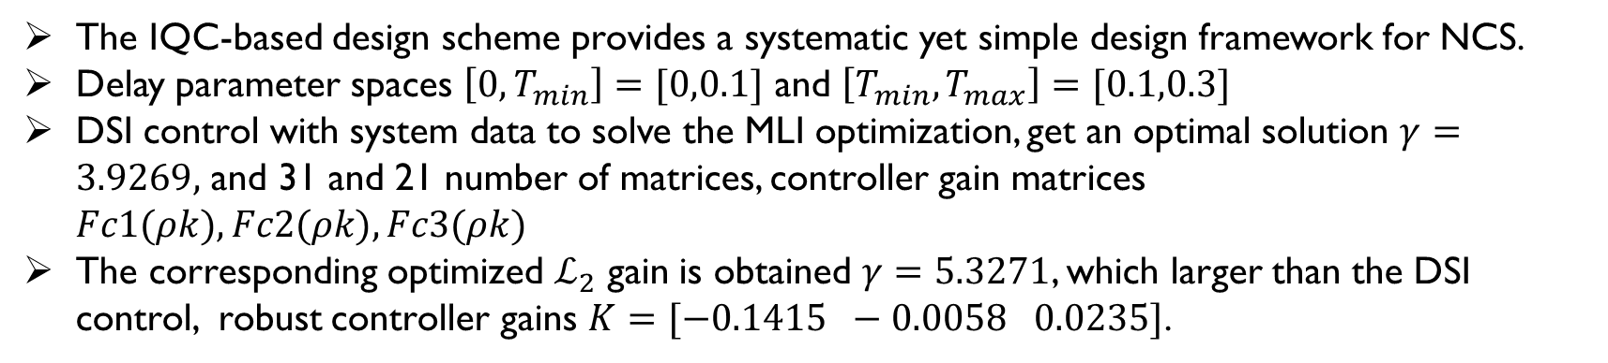
Example
The IQC-induced dynamics can be expressed in state-space (8), with the system matrices
The IQC-based design scheme provides a systematic yet simple design framework for NCS.
Delay parameter spaces $\left[0, T_{min}\right]=[0,0.1]$ and $\left[T_{min},T_{max}\right]=[0.1,0.3]$
DSI control with system data to solve the MLI optimization, get an optimal solution $γ=3.9269,$ and 31 and 21 number of matrices, controller gain matrices $Fc1(ρk), Fc2(ρk), Fc3(ρk)$
The corresponding optimized $ℒ_{2}$ gain is obtained $γ=5.3271$, which larger than the DSI control, robust controller gains $K=[−0.1415 −0.0058 0.0235]$.

Slide 16
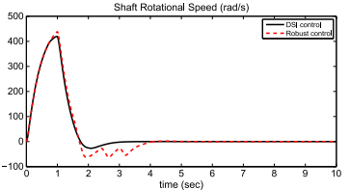
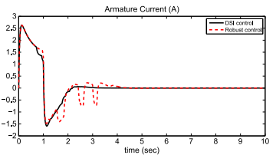


Example
Dc motor states $x_{p2}=w$
Dc motor states $x_{p1}=i_{a}$
Notes:
Gambar 3(a) dan (b) bahwa kedua pengontrol memang mampu menstabilkan sistem loop tertutup dengan kuat di bawah lingkungan kontrol jaringan, dan kedua kondisi plant menyatu dengan cepat ke nol ketika sinyal gangguan menghilang.

Slide 17
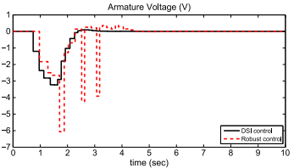
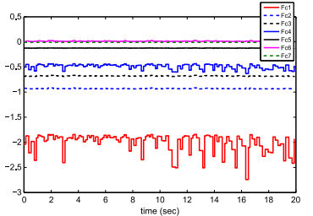


Example
Control input $u$
Controller gains $F_{c}$
Notes:
Selain itu, dibandingkan dengan metode roboust kontrol, skema kontrol DSI yang diusulkan memberikan scheme renders better disturbance rejection performance dengan tidak hanya respons keadaan plant yang lebih kecil tetapi juga upaya kontrol yang lebih sedikit [Gambar. 3(c)]. Keuntungan kinerja ini dapat dikaitkan dengan penggabungan informasi penundaan yang diinduksi jaringan ke struktur pengontrol DSI Fig. 3(d).

Slide 18
Conclusion
The proposed method combines IQC framework and linear impulsive control techniques to effectively manage these delays.
Delay Scheduled Impulsive (DSI) controller, uses full-information feedback and real-time measurement of network-induced actuation and measurement delays for controller gain scheduling. This approach offers a systematic framework for NCS analysis and synthesis.
The robustness and effectiveness of the proposed design scheme was demonstrated through successful application to a dc motor system, thereby validating its potential for practical implementations. This method enables a finite number of LMIs for synthesis conditions, solvable using existing convex optimization algorithms.
Notes:
This paper introduced an innovative control design approach for networked control systems (NCS) that addresses network-induced delays in both directions - from the continuous-time plant to the discrete-time controller (measurement delay) and vice versa (actuation delay). The proposed method combines IQC framework and linear impulsive control techniques to effectively manage these delays.

Slide 19

Thank you

